Slide 1






PUTTING CLIMATE CHANGE ON THE MAP: DEVELOPING SPECIFIC, SPATIAL MANAGEMENT STRATEGIES FOR WHITEBARK PINE IN THE Greater Yellowstone Ecosystem
Kathryn Ireland, Andrew Hansen, Robert Keane, Kristin Legg, & Rob Gump

Slide 2
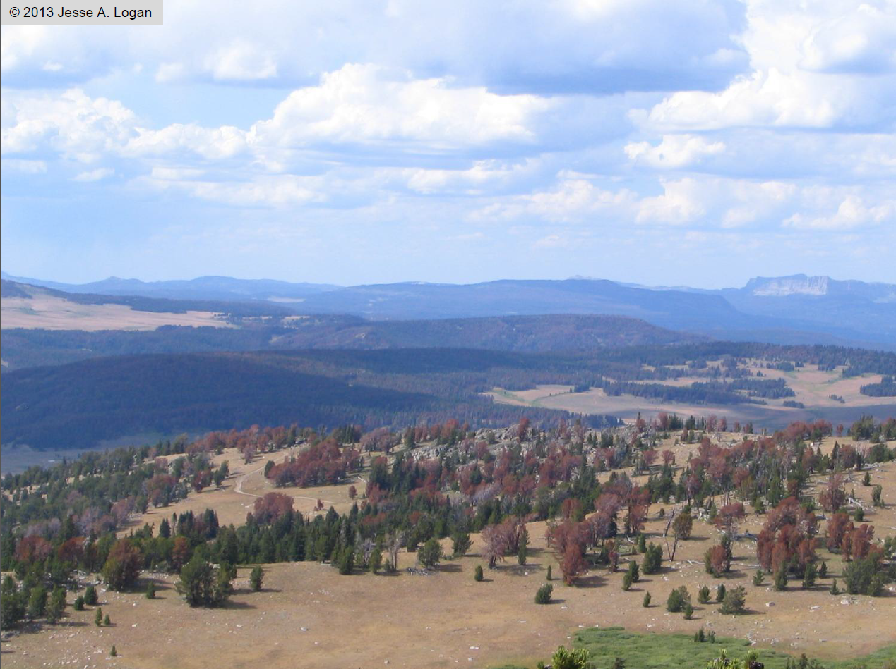
Whitebark pine mortality
Keystone species
80% mortality rate within the adult population (MacFarlane et al. 2013)
Listed candidate species
Notes:
Like Yellow Cedar in Alaska, WBP is a tree species that has experienced high levels of recent mortality, throughout most of its range. It also appears to be an early responder to changing climatic conditions.
Whitebark pine (Pinus albicaulis) (WBP) is a native conifer of the Western U.S. that is considered a keystone species in the sub-alpine environment, whose nuts provide a food source for Clark’s nutcracker, red squirrels, and grizzley bears. It also serves the ecosystem funcitons of stabilizing soil, moderating snow melt and runoff, and facilitating establishment for other species.
Whitebark pine has experienced a notable decline in the past two decades within the U.S. Northern Rockies (especially the GYE) due to high rates of infestation from the mountain pine beetle (Dendroctonus ponderosae) and white pine blister rust, whose activity is linked to increased temperatures and precipitation, resulting in an 80% mortality rate within the adult population.

Slide 3
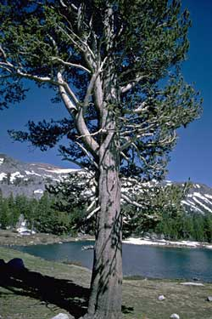
Whitebark pine management
Interagency committee has worked since 1999 to develop a region-wide strategy to protect WBP
Little information on climate change impacts to WBP available to the committee when developing strategy
Notes:
In light of these threats, since 1999 an interagency committee, the GYCC, with members from the FS, NPS, BLM has worked to develop a region-wide strategy to protect & restore WBP. However, little information on climate change impacts were available at the time they were developing their strategy. Recognizing this, the GYCC wrote into their plan the need to incorporate climate science and adapt their management as information became available.

Slide 4
Managers implement whitebark pine protection/restoration
2011
Greater Yellowstone Area
Whitebark Pine Strategy
Candidate listing
2015
Update Adaptation Strategy &
Incorporate climate science research
2007
Climate Change discussed
2004
Long-term monitoring initiated
2010
Real discussions underway
Climate Change Workshops
2013
USGS Climate Science Center
WBP Management Project
2015
GN LCC WBP Management
Project
2017
Spatial Maps of
WBP Management Complete
Modeling of WBP management completed
Climate science related to WBP: paleo (Iglesias & Whitlock), beetles (Buotte, Logan),
modeling, range-wide restoration strategy (Keane), mortality & water balance (Thoma), genetics (Mahalovich)
Managers learning the basics of climate change; lots of science information becoming available for specific topics such as whitebark pine; many other meetings, trainings, etc., underway

Slide 5
Where to prioritize adaptation actions?
Zones of Climate Suitability – Yellow Cedar in Alaska
  Migration
    Favor dispersal to newly suitable habitats
  Persistent
    Conservation and active management in occupied suitable habitat
  Maladapted
    Facilitate species transitions
    No active conservation/restoration of yellow cedar
Hennon et al. (2012). Bioscience.
Notes:
However, one difficulty of implemenation is often determining where exactly management options might be most effective. Relatively few examples exist of large-scale planning of climate adaptation efforts to prioritize the effectiveness of adaptation efforts at the regional scale.
One example is planning for management of Yellow Cedar in SE AK. Hennon and others reviewed the climate and other drivers of Yellow Cedar declined and divided Y Cedar habitat into migration, persisten, and maladapted zones with different management priorities based on these different climate suitability zones.

Slide 6
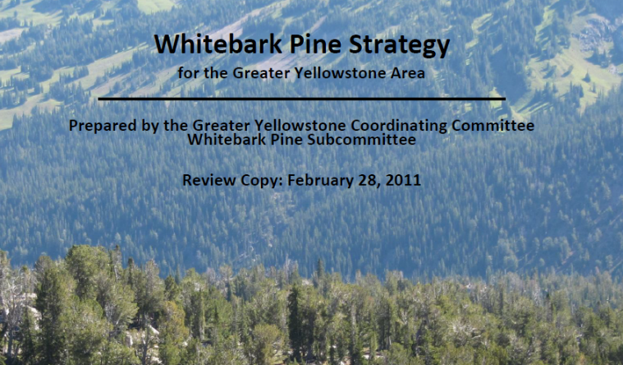
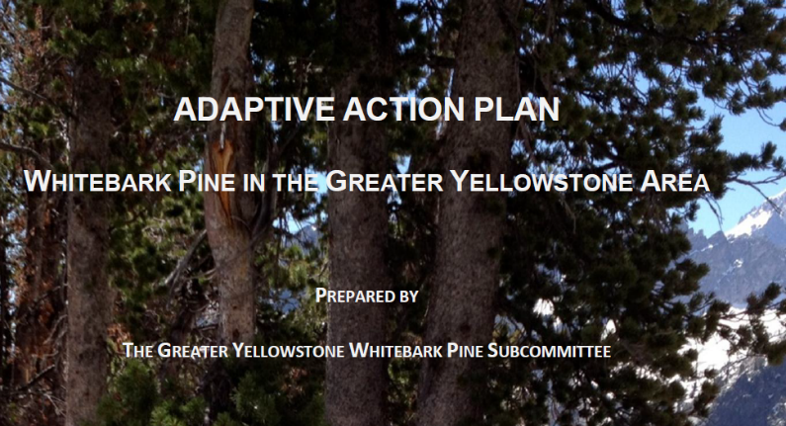
Our goal is to provide information back to the subcommittee for adaptive management under climate change
Modeling WBP Management Alternatives
Ireland, Hansen, Keane

Slide 7
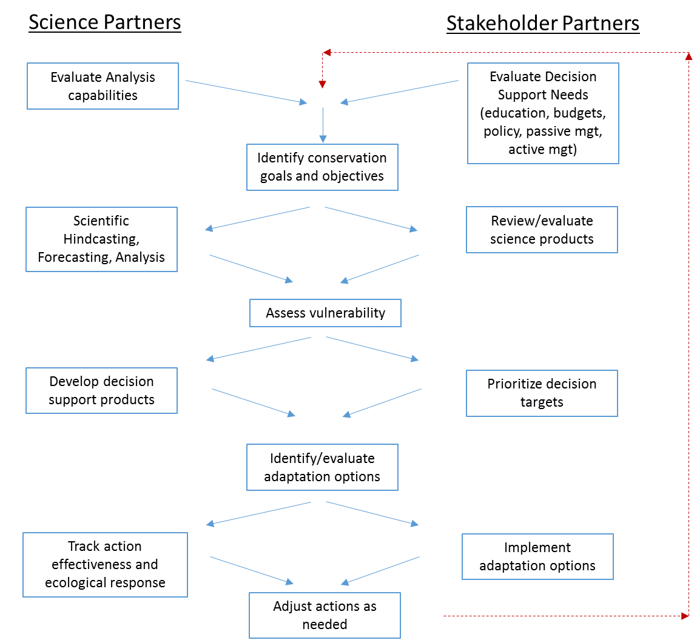
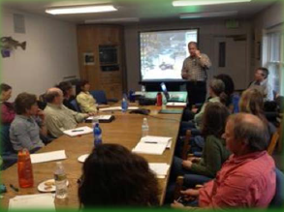
collaborative approach
Which restoration strategies will be most effective at maintaining resilient WBP forests in the GYA under future climate conditions?
  Develop & compare spatial management alternatives for WBP in the GYA
  Strategies designed through workshops/discussions with agency partners
Notes:
I want to take a moment to stress that this has been a collaborative effort from the start. The GYCC had already identified the threats/management strategies for WBP as well as the need to incorporate new climate information into their strategy. We have worked closely with the agency representative through workshops/discussions to develop, map, and evaluate both their original strategy & a “climate-informed” strategy based on new climate science.

Slide 8
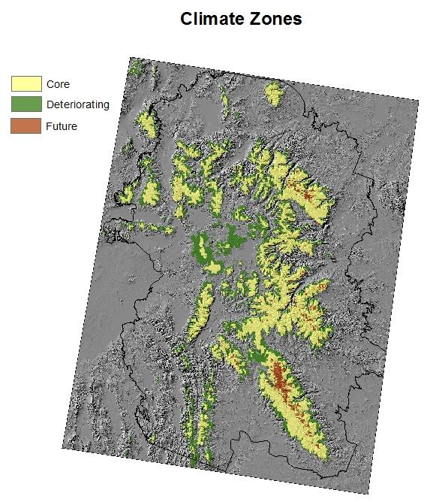
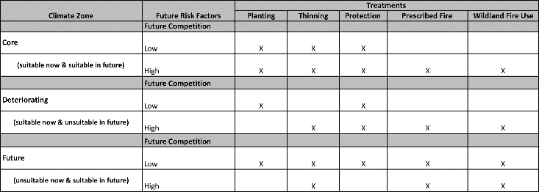
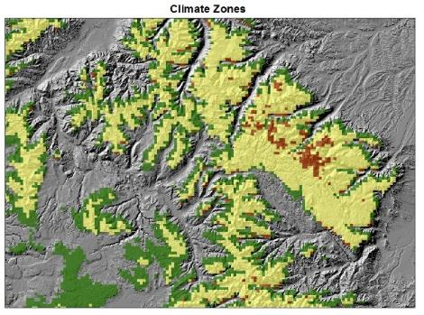
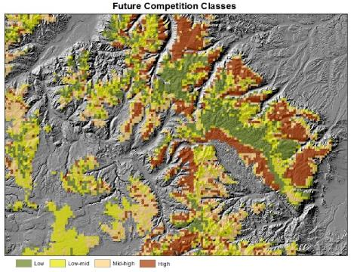
Spatially Prioritize Management Actions
Climate Zones
Core
Deteriorating
Future
Competition
Probabilities of future habitat for:
  Engelmann spruce
  Subalpine fir
  Lodgepole pine
  Douglas-fir
Notes:
Although treatments will need to implemented based on stand-level criteria, our approach was then to map management “zones” where different combinations of the specific treatments would be available and implemented based on the local stand conditions.
First, we prioratized management by “climate suitability zones”. Similar to the example for Yellow cedar, we took the approach of dividing the study area into Core, Deteriorating, Future habitat. These were based on comparing climate suitability from SDM models under historical climate and under 3 scenarios of future CC at different time periods.
We then overlaid our climate zones for WBP with similar projections of future climate suitability for all of WBP’s competitors. We took the table of future WBP climate suitability and future projections of competitor’s presence to the managers and determined which management tools they would want available within the different zones to spatially map the treatment options available.

Slide 9
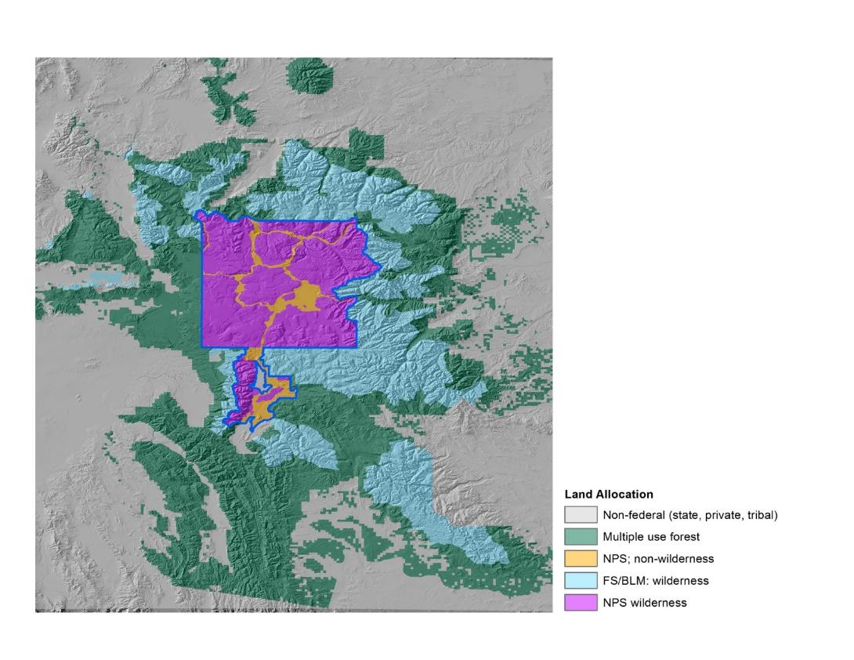
Spatial implementation of current strategy
Land Allocation | Distance from Roads/trails | Plant | Thin | WFU | Protect
Multiple Use Forest; NPS non-wilderness | > 1 mile |  | X | X | X
Multiple Use Forest; NPS non-wilderness | <= 1 mile | X | X | X | X
Wilderness | N/A |  |  | X
Nonfederal lands (private, tribal, state, etc) | N/A
Notes:
To spatially implement both strategies, we mapped “zones” where the different suites of management tools would be available. These tools include planting blister-rust resistant WBP seedling to promote regen/establishment, thinning to remove competing conifer species, WFU and Rx fire to both promote regen and remove competitors, and protection from MPB (pesticides and pheromones to prevent MPB attack).
For the current strategy, we largely relied on differences in land allocation classes to determine where treatments would occur. The types of treatments that can be implemented in the current strategy are constrained by access, logistics, and management constraints among different jurisdictions (ie multiple use forest v wilderness)

Slide 10
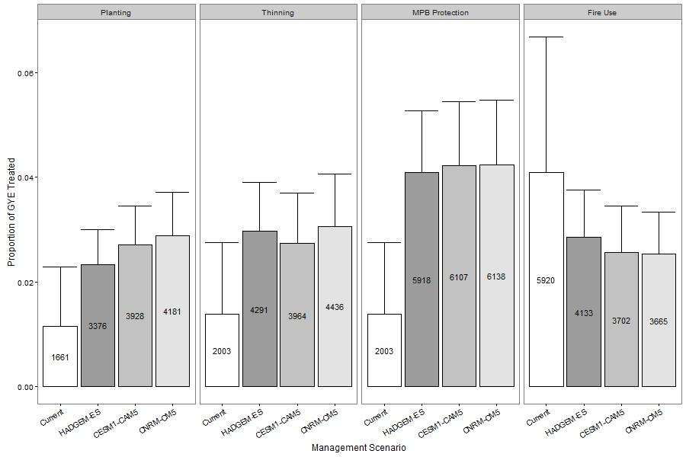
Planting
Thinning
MPB Protection
Fire Use
More area treated under climate-informed management

Slide 11
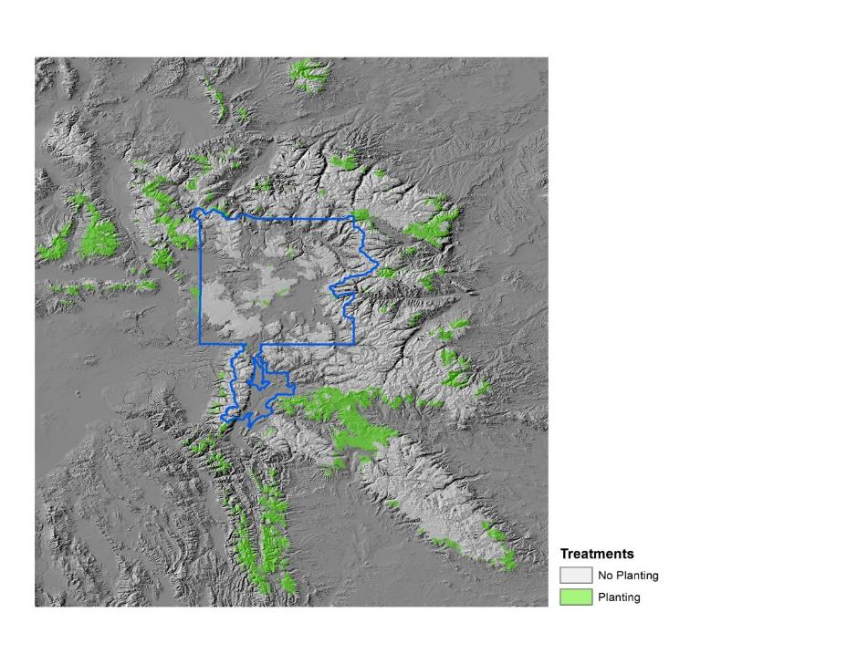
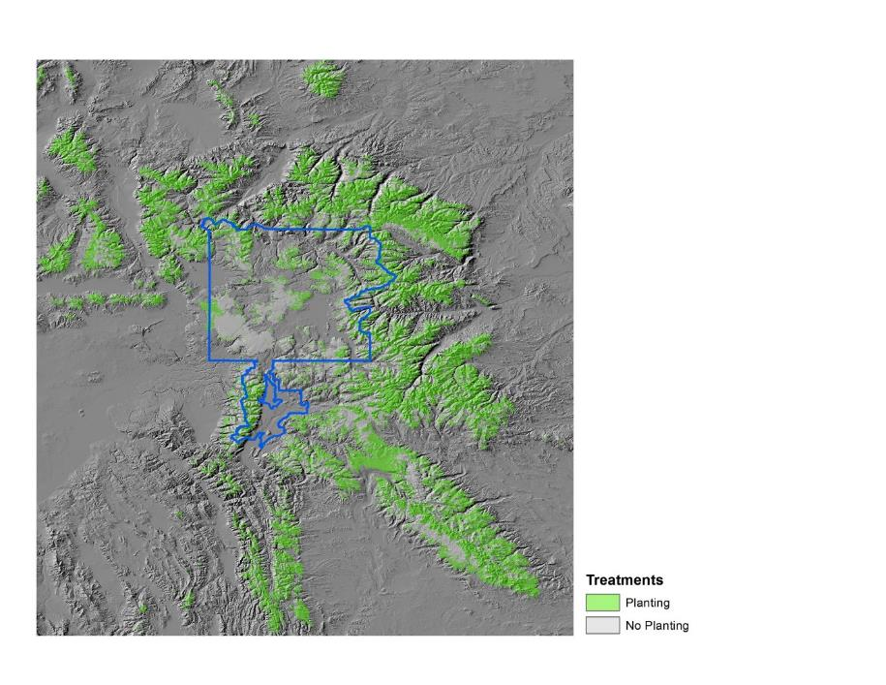
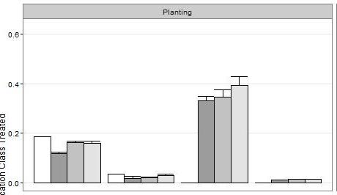
treatment comparisons - planting
GYCC STRATEGY
CLIMATE-INFORMED STRATEGY
Proportion of Land Class Treated
Multiple
Use Forest
NPS
Wilderness
Non-federal
Notes:
As an example, here are the differences between the current strategy and the “climate-informed” strategy for areas where planting would be available as a treatment option. As you can see, much more area would be considered for treatment in the climate-informed strategy. The difference is largely due to planting being a viable option in Wilderness zones in the climate-informed scenario than in the current strategy.

Slide 12
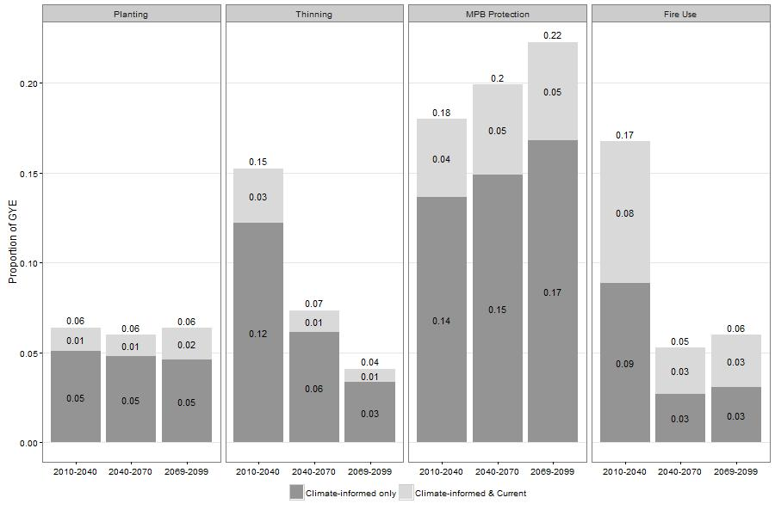
Management Recommendations
Areas of agreement between current/climate-informed management = first priorities for treatment/monitoring
Areas of agreement between multiple climate scenarios = experimental treatments/monitoring

Slide 13
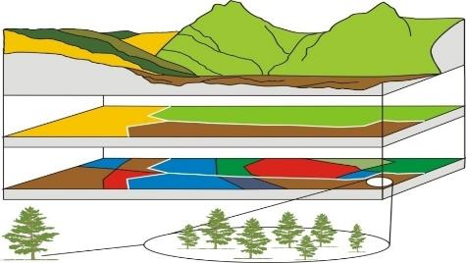
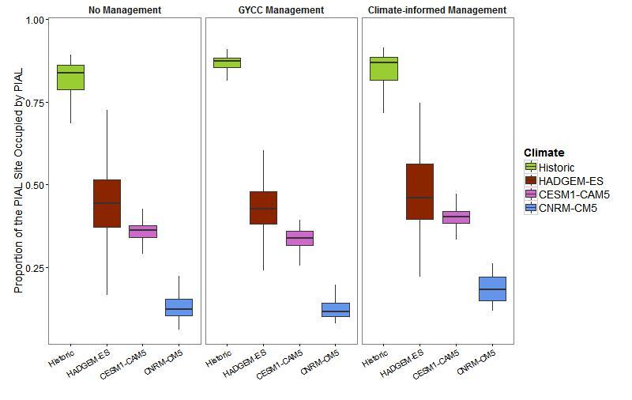
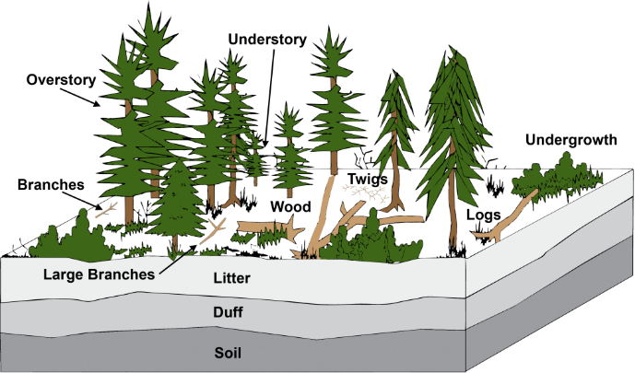
Evaluating Management Alternatives: Simulation Modeling with FireBGCv2
Landscape
Site
Stand
Tree
Species
Area occupied by WBP declines in all future climate scenarios. In some cases, climate-informed management may help maintain WBP in particular locations.
Keane, R.E., R.A. Loehman, and L. M. Holsinger. 2010.
Notes:
So, our maps show important difference, in terms of area treated and spatial distribution of those treatments between the 2 management strategies. But, we still don’t know how much those differences would actually effect the viability of WBP populations under CC. Perhaps the current strategy will be enough to maintain pockets of WBP populations, with a lot less cost and less challenge to current management guidelines than the “pie in the sky” strategy. We are currently working on a simulation model to implement these two scenarios under 3 different CC scenarios to evaluate their efficacy in maintaining viable WBP populations.

Slide 14
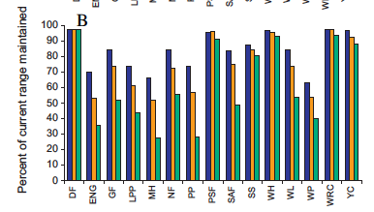
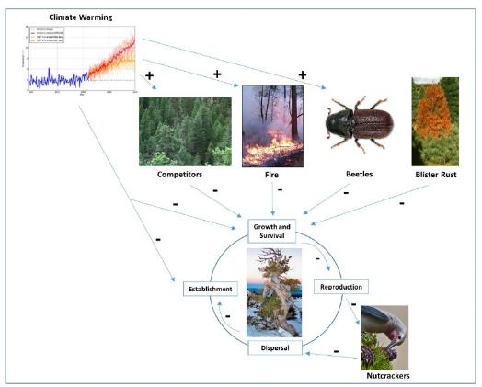
APPLICATIONS TO OTHER CLIMATE-VULNERABLE SPECIES
Require:
Conceptual model of direct/indirect climate impacts on conservation target
Spatial information on
  Target climate vulnerability
  Projected climate change influences on indirect drivers (competition, disturbance, pests, disease, etc.)
Coops and Waring (2011). Ecological Modelling.
Notes:
Many other tree species are likely to be vulnerable to climate change. Coops & Waring assessed vulnerability for 15 different tree species in the XXX region. As you can see, at least 9 of these 15 species are expected to decrease in suitable range.
With a conceptual model of the direct/indirect impacts on your conservation target and some spatial information on CC effects on the species and at least some of those drivers, this approach can be adapted to any climate vuln species.

Slide 15
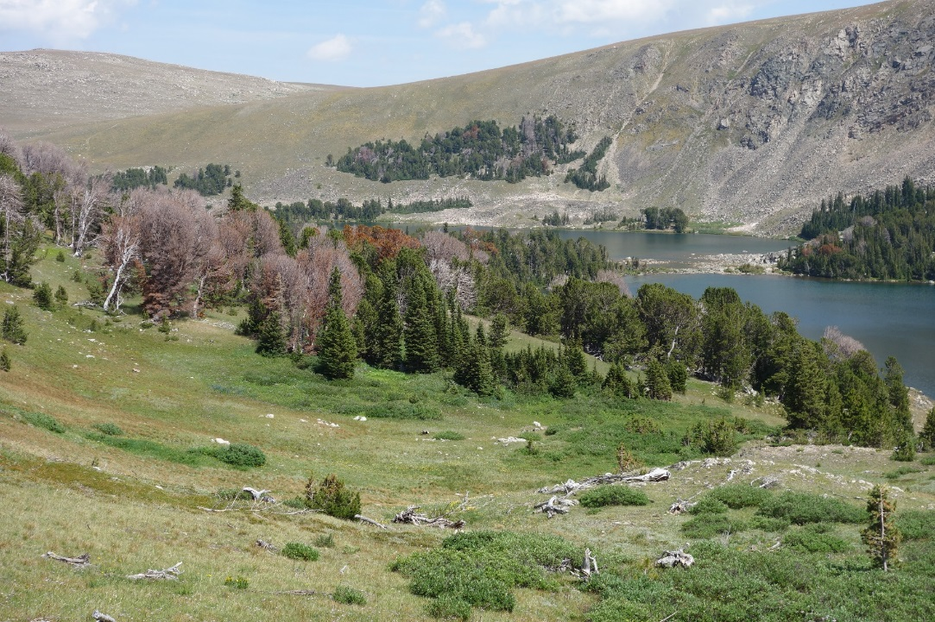

Acknowledgements
Funding Sources
  Montana Institute on Ecosystems
  North Central Climate Sciences Center
  Great Northern Landscape Conservation Cooperative
Whitebark Pine Subcommittee of the GYCC
  Ellen Jungck, Shoshone National Forest
  Nancy Bokino, Grand Teton National Park
  Mary Frances Mahalovich, Moscow Forestry Sciences Laboratory
Tony Chang, Montana State University
Nate Piekieliek, Pennsylvania State University
Karl Buermeyer, Helena National Forest

