Slide 1
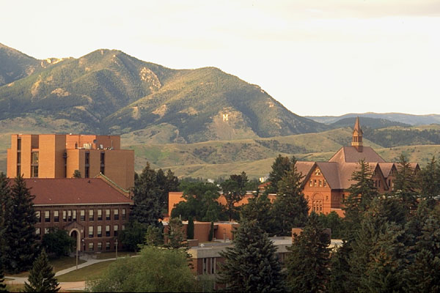
Climate Change in Montana: A Community Development Perspective
Paul Lachapelle
Community Development Specialist
Associate Professor
Montana State University

Slide 2
1. What is extension’s role in climate science outreach? 2. How can we best address vulnerable populations? 3. What is extension’s role to engage citizens in discussions about prospective policy changes?

Slide 3
It is now more certain than ever, based on many lines of evidence, that humans are changing Earth’s climate… The present level of atmospheric CO2 concentration is almost certainly unprecedented in the past million years… Adding more CO2 to the atmosphere will cause surface temperatures to continue to increase… Global warming of just a few degrees will be associated with widespread changes in regional and local temperature and precipitation as well as with increases in some types of extreme weather events. These and other changes will have serious impacts on human societies and the natural world.
US National Academy of Sciences and Royal Society. 2014. Climate Change: Evidence & Causes. Wash. DC: National Academy of Sciences.

Slide 4
Position Statements from ~200 Academies, Professional Associations and Organizations
American Association for the Advancement of Science
"The scientific evidence is clear: global climate change caused by human activities is occurring now, and it is a growing threat to society." (2006)
American Medical Association
“Supports the findings of the Intergovernmental Panel on Climate Change’s fourth assessment report and concurs with the scientific consensus that the Earth is undergoing adverse global climate change and that anthropogenic contributions are significant." (2013)
American Meteorological Society
"It is clear from extensive scientific evidence that the dominant cause of the rapid change in climate of the past half century is human-induced increases in the amount of atmospheric greenhouse gases, including carbon dioxide (CO2), chlorofluorocarbons, methane, and nitrous oxide." (2012)
The Geological Society of America
"The Geological Society of America (GSA) concurs with assessments by the National Academies of Science (2005), the National Research Council (2006), and the Intergovernmental Panel on Climate Change (IPCC, 2007) that global climate has warmed and that human activities (mainly greenhouse‐gas emissions) account for most of the warming since the middle 1900s." (2006; revised 2010)
U.S. National Academy of Sciences
"The scientific understanding of climate change is now sufficiently clear to justify taking steps to reduce the amount of greenhouse gases in the atmosphere." (2005)
source: opr.ca.gov/s_listoforganizations.php; climate.nasa.gov/scientific-consensus/

Slide 5
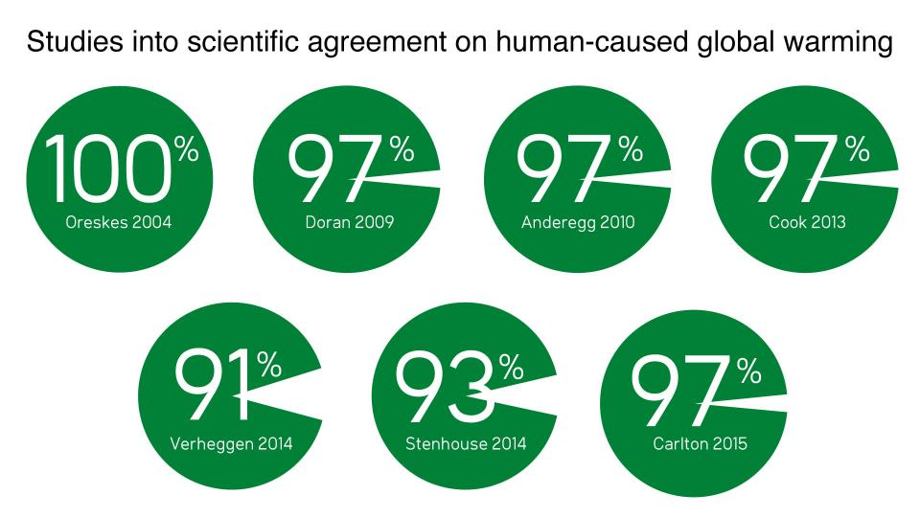
Source: https://www.skepticalscience.com/global-warming-scientific-consensus-intermediate.htm

Slide 6
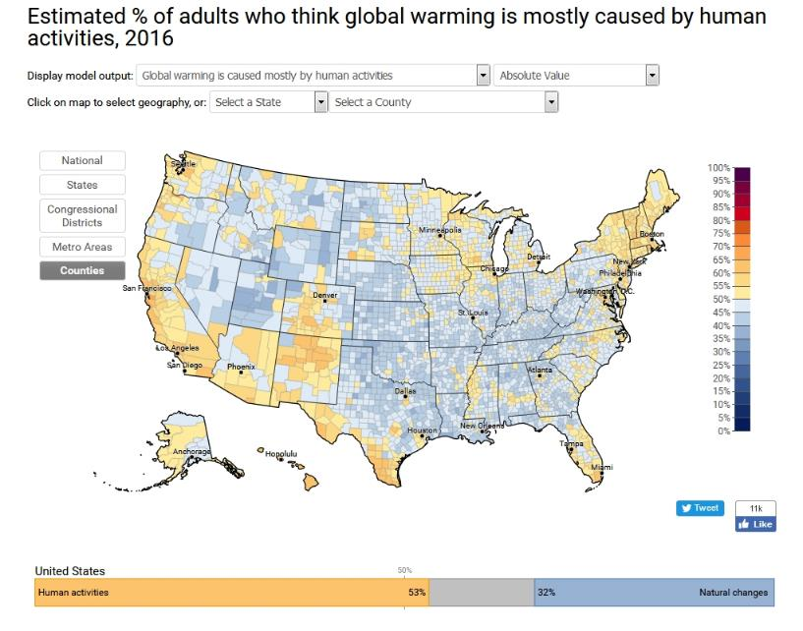
Source: Yale Project on Climate Change Communication: www.environment.yale.edu/climate-communication/

Slide 7
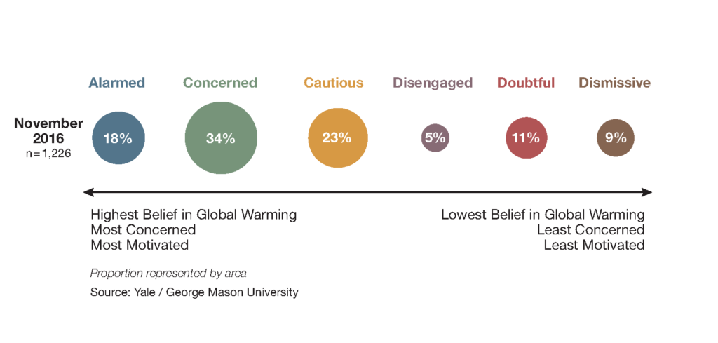
6 Americans
source: http://climatecommunication.yale.edu/visualizations-data/global-warmings-six-americas-november-2016/

Slide 8
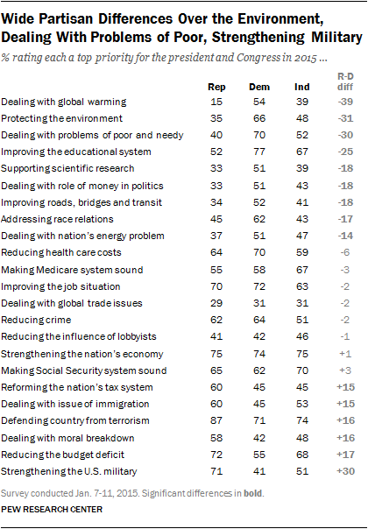

Slide 9
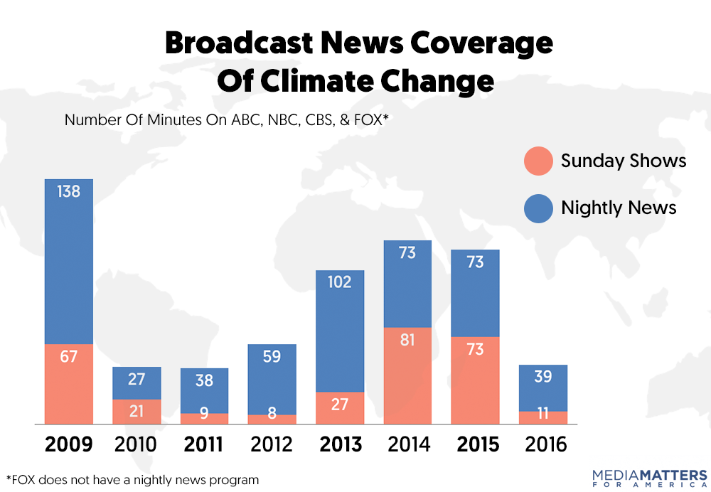
https://mediamatters.org/research/2017/03/23/how-broadcast-networks-covered-climate-change-2016/215718

Slide 10
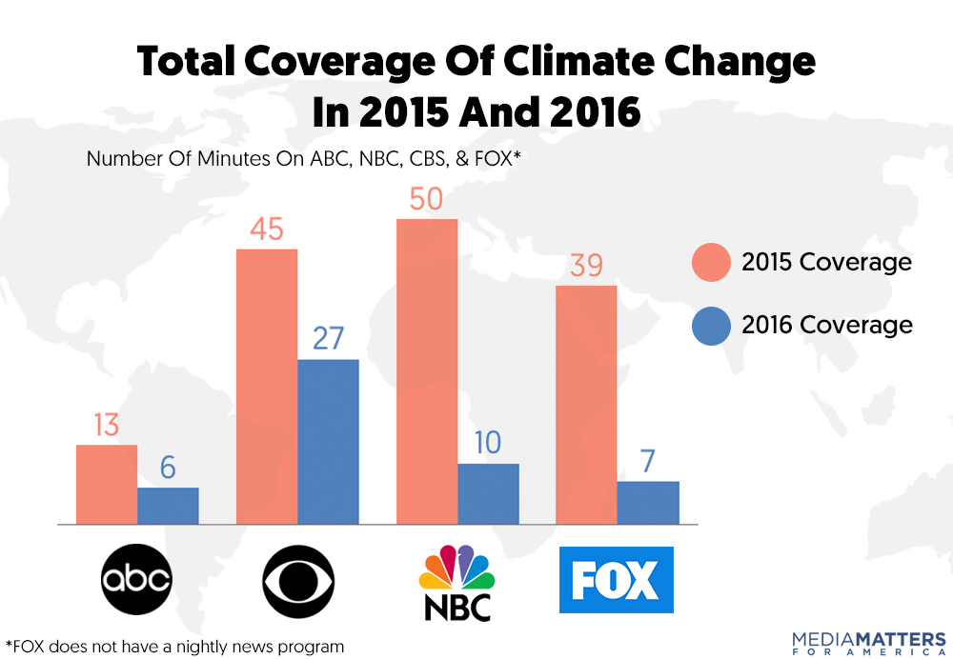
https://mediamatters.org/research/2017/03/23/how-broadcast-networks-covered-climate-change-2016/215718

Slide 11
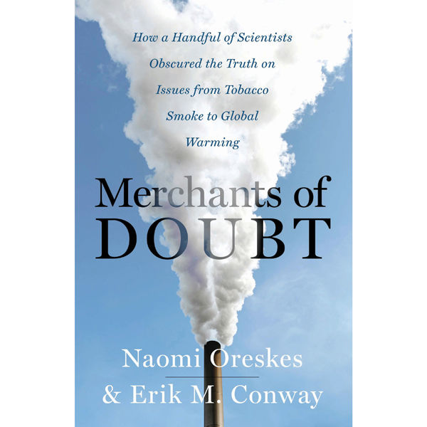

Slide 12
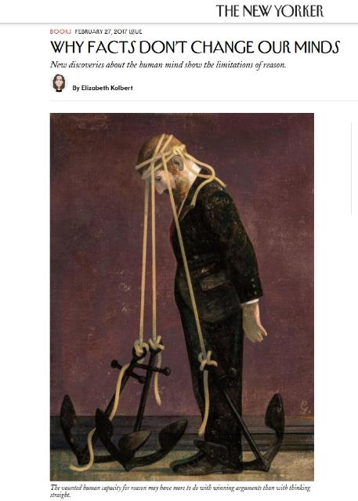
http://www.newyorker.com/magazine/2017/02/27/why-facts-dont-change-our-minds

Slide 13
Impacts on Communities
The projected rapid rate and large amount of climate change over this century will challenge the ability of society and natural systems to adapt.
--US Global Change Research Program
Climate change makes many existing diseases and conditions worse, but it may also help introduce new pests and pathogens into new regions or communities.
--National Institutes of Health
Climate change will affect certain groups more than others, particularly groups located in vulnerable areas and the poor, young, old, or sick.
--US Environmental Protection Agency
Current and future impacts of climate change on human society are and will continue to be overwhelmingly negative.
--Oxfam
Climate change threatens the basic elements of life for people around the world. The impacts of climate change are not evenly distributed – the poorest countries and people will suffer earliest and most.
-- Stern Review on the Economics of Climate Change
Sources:
www.niehs.nih.gov/research/programs/geh/climatechange/
www.epa.gov/climatechange/impacts-adaptation/society.html
www.globalchange.gov/usimpacts
www.oxfam.org.uk/what-we-do/issues-we-work-on/climate-change
www.hm-treasury.gov.uk/d/closed_short_executive_summary.pdf

Slide 14
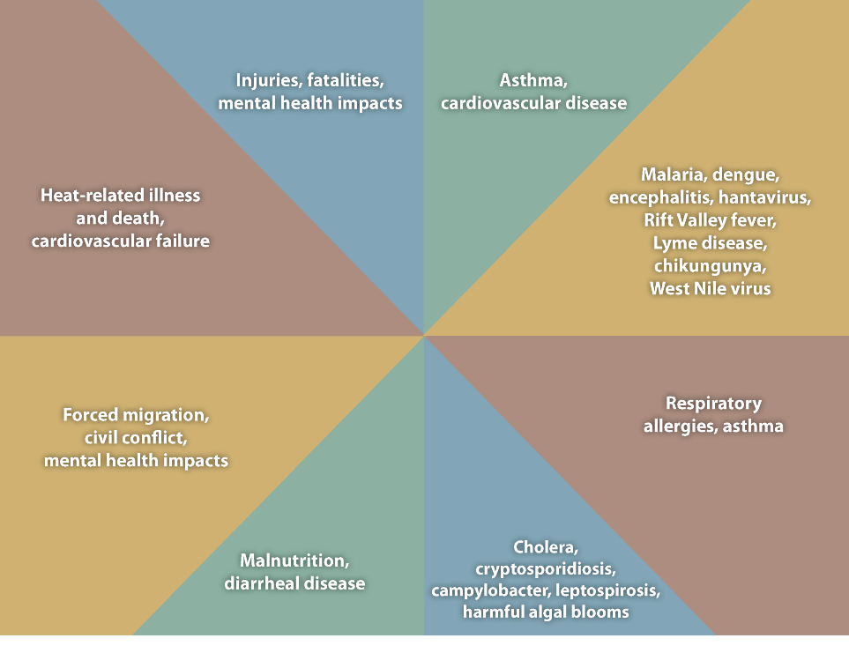
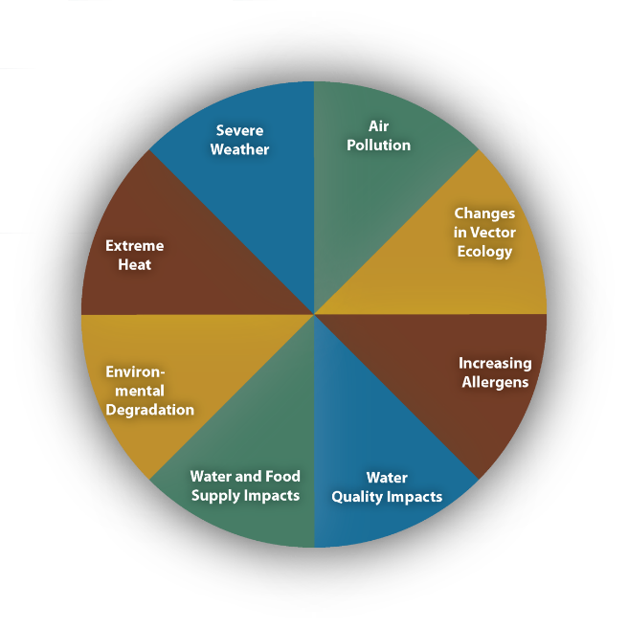
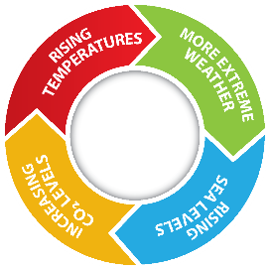
https://www.cdc.gov/climateandhealth/effects

Slide 15
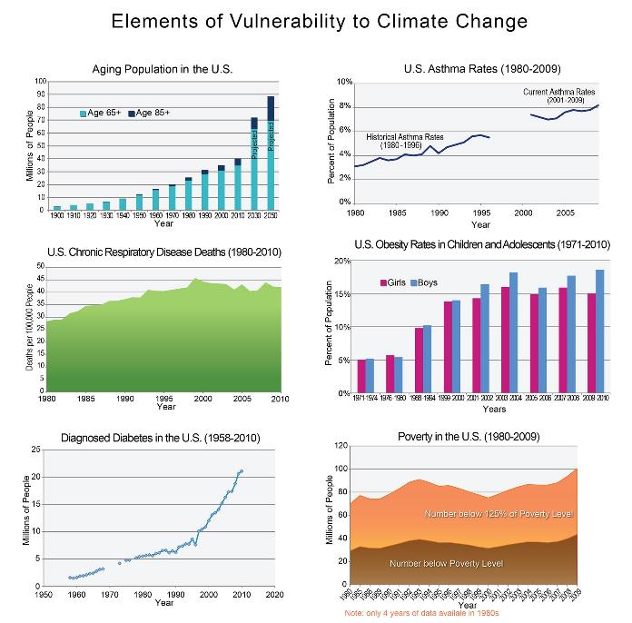

Slide 16
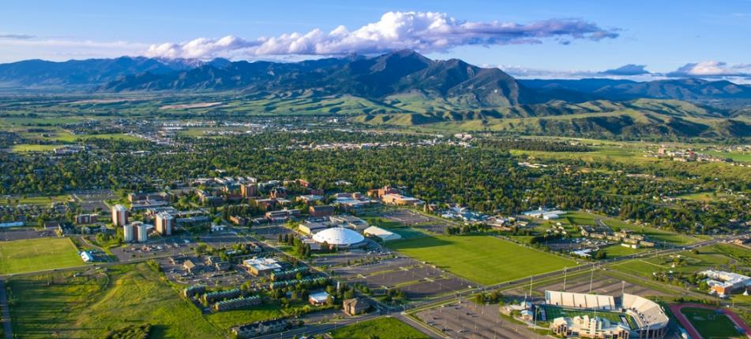
THANK YOU!
Paul Lachapelle
406.994.3620
paul.lachapelle@montana.edu
www.msucommunitydevelopment.org

Slide 17
1. What is extension’s role in climate science outreach? 2. How can we best address vulnerable populations? 3. What is extension’s role to engage citizens in discussions about prospective policy changes?

