Slide 1
A Brief History of the MSU Extension Climate Science Team
Jane Mangold
Associate Professor, Extension Invasive Plant Specialist
Dept. of Land Resources and Environmental Sciences

Slide 2
MSU-Extension Mission
MSU Extension improves the lives of Montana citizens by providing unbiased research-based education and information that integrates learning, discovery and engagement to strengthen the social, economic and environmental well-being of individuals, families, and communities.

Slide 3
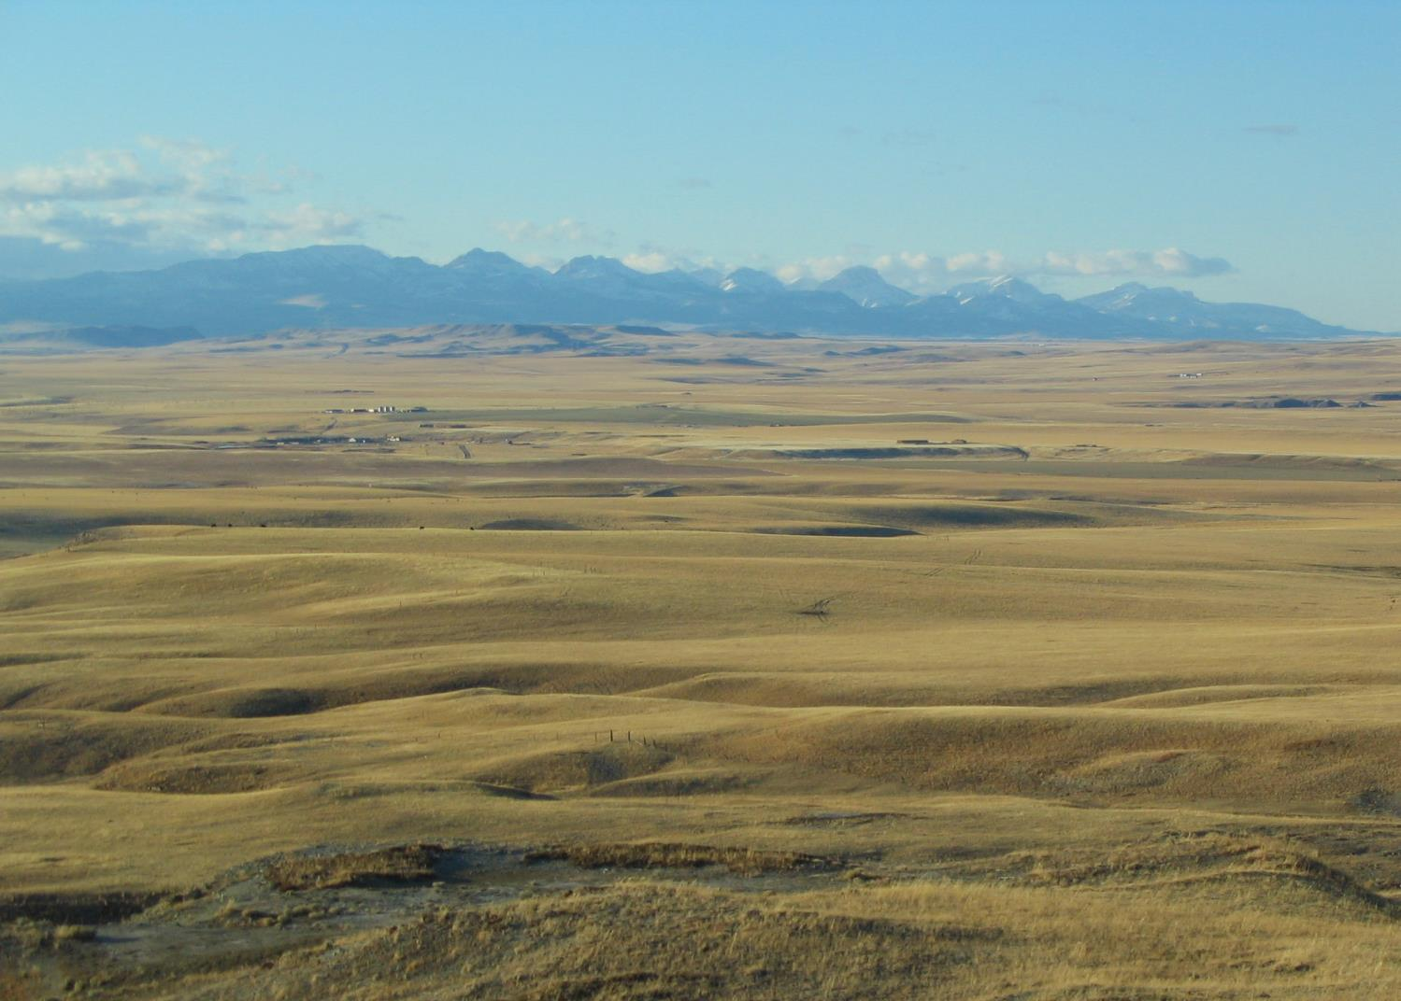
MSU-E Program Areas
Agriculture and natural resources
Family and consumer sciences
Community and business development
Youth development

Slide 4
MSU-E Climate Science Working Group spring/summer 2014
1. Inventory current climate programming
2. Design and implement a survey of Extension faculty to determine demand for future climate programming
3. Identify opportunities and develop recommendations
Working group members: Fabian Menalled, Virginia Knerr, Larry Brence, Jane Mangold, Rachel Endecott, Bobbie Roos, Rose Malisani, Myla Kelly, Kent McVay, Dan Lucas, Paul Lachapelle, Cody Stone

Slide 5
Survey Overview
Modeled after similar effort at North Carolina Cooperative Extension
Direct request from Extension Director to respond
24% response rate
62% of respondents were county agents

Slide 6
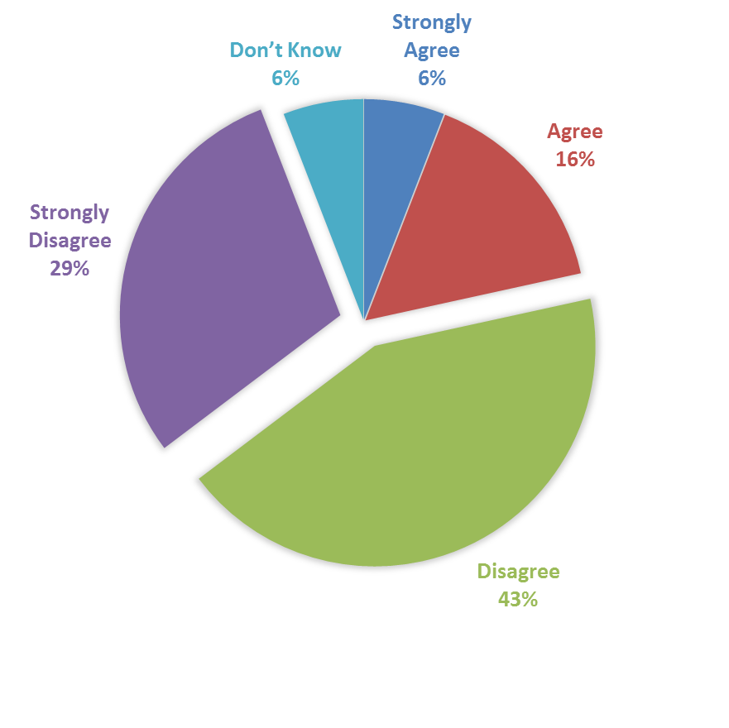
Current or potential climate change programming in Extension is not relevant to my program area
72% disagrees or strongly disagrees that climate change programming is not relevant to their program area

Slide 7
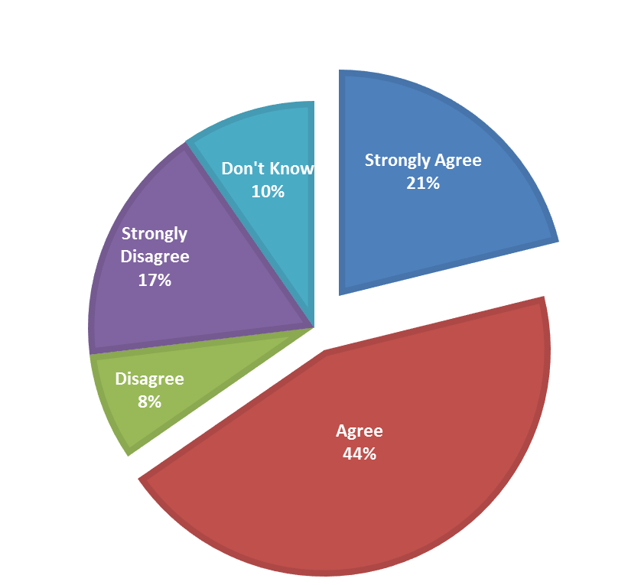
There is not enough applied information available regarding current or potential climate change programming in Extension
65% agree or strongly agree there is not enough applied information available

Slide 8
Top 5 Topic Areas
Weed and invasive plant management
Cropping systems modeling and decision-making
Cover crops management
Hydrologic systems and water quality
Soil fertility

Slide 9
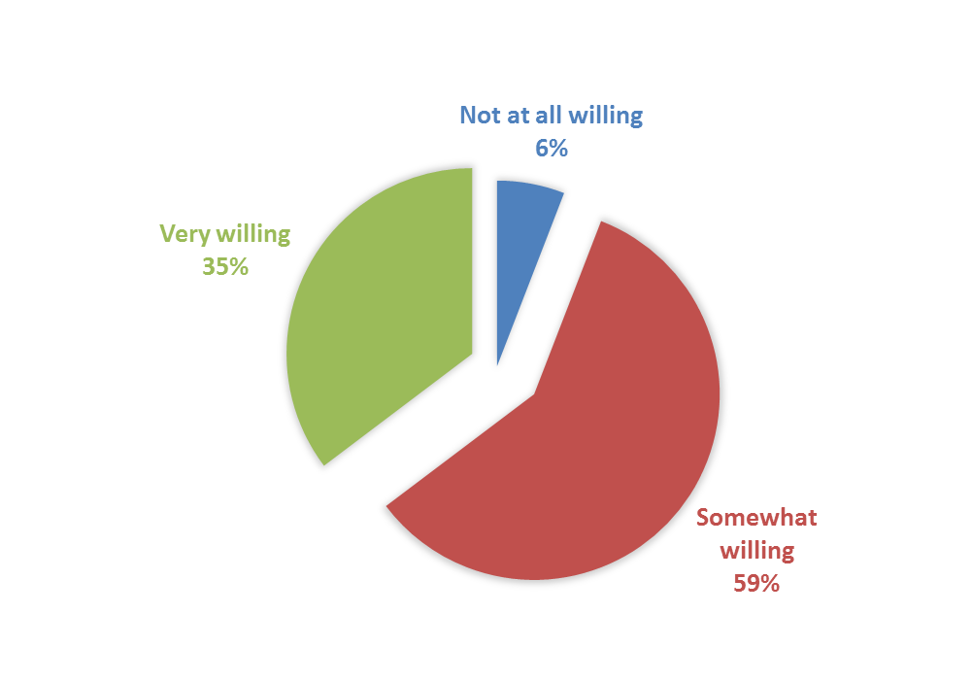
How willing are you to participate in professional development opportunities?
94% are somewhat or very willing to participate in professional development opportunities

Slide 10
Working Group Recommendations
Establish MSU-E Climate Science team
Hold 1-2 day climate science training for MSU-E specialists and agents
Support continued professional development and programming in the area of climate science
Promote cross county, regional, and interdisciplinary climate science programs
Adopt MSU-E Climate Science Program Framework as a means to define program areas related to climate science and outline goals of MSU-E Climate Science Team

Slide 11
MSU-E Climate Science Program Framework
Increase the number of MSU-E faculty with skills and knowledge necessary to effectively address climate variability and its impacts.
Create opportunities to engage in, discuss, plan and implement educational programs about climate science, climate change, impacts, adaptation, and mitigation.
Design and deliver science-based research, relevant educational resources, and engaged leadership programs on climate science, climate change, impacts, adaptation, and mitigation to the people and communities of Montana.

Slide 12
MSU-E Climate Science Team
Formed October 2015
Chair
Jane Mangold, October 2015—June 2016
Brad Bauer, January 2016—current
20+ members
Campus and county-based faculty
Provide leadership for programming efforts, training, resource development, grant opportunities, interdisciplinary programs, and communication
Cooperate with USDA Northern Plains Regional Climate Hub

Slide 13
Extension Climate Science Conference
December 8-10, 2015
Climate science basics
Stakeholder panels
Agriculture
Natural Resources
Families, youth and community
Tools and resources for discussing climate science
Program area group discussions
Strategizing and team-building

Slide 14
MSU Extension Activities
Today’s forum
Forums on agricultural resiliency
Topic-specific presentations at workshops across state and region
Partnering with others on climate-related activities

Slide 15
Personal Reflections
Breaking the ice can be cold and uncomfortable
Start the conversation on common ground
Listen
Return to common ground
Make it relevant
Stick to the science
Focus on adaptation and resilience
Discuss mitigation as opportunity present itself
Avoid being overly negative

Slide 16
More Reflections
Large issue which often seems insurmountable
Small but earnest audience
Slow but meaningful progress
How can we increase size of audience and progress faster?

