Slide 1
Economic Analysis of Climate Change
Richard Ready
Montana State University and
Montana Institute on Ecosystems
Climate Science and Outreach Forum
April 5, 2017
Notes:
Today want to give an example of how we can use economic methods to value changes in ecosystem services
Ecosystem service in this case is outdoor recreation (sport fishing)
Want to know how value of sport fishing is affected by an invasive species – the asian carp
Going to discuss two different approaches to measuring impact of asian carp on value of fishing

Slide 2
Research on Economics of Climate Change
How much will climate change cost us?
How much would it cost us to reduce GHG emissions?
How much are citizens willing to pay to reduce GHG emissions?
If we are going to reduce GHG emissions, what is the least-cost way to do so?

Slide 3
Cost of Climate Change
Bottom-up approach
Coastal flooding – structural damage + cost to defend
Impact of increased heat and drought on ag yields
Control costs and damages from wildfire
Productivity
Health impacts
Lost recreation opportunities
Impact on rare and endangered species
Damages caused by severe storms
Etc.

Slide 4
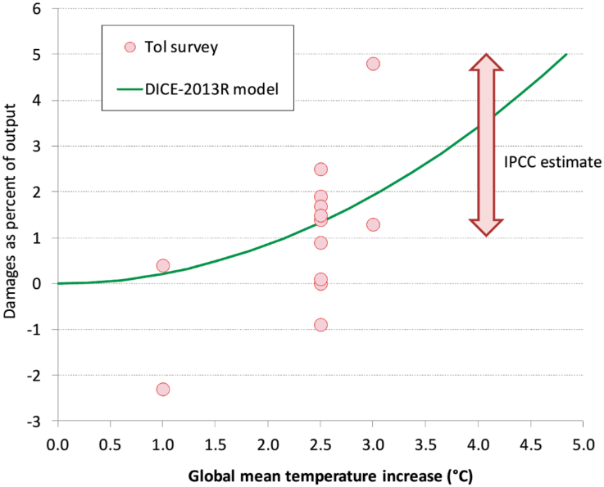
Cost of Climate Change
Top-down approach
Macroeconomic effect of increased temp on GDP

Slide 5
Cost of Climate Change
US Cost of BAU vs 2˚C
Median estimate: 1-2.5% of GDP
$1300-$3300 per household per year
Higher for more warming
New Research:
Asymmetry in uncertainty
Worst case scenarios are pretty bad, but best case scenarios aren’t that great
Warming leads to slower economic growth rates
Compounding effect could lead to much larger damages over time
Notes:
Sources:
Ackerman, Frank, and Elizabeth A. Stanton. 2008. The Cost of Climate Change: What We’ll Pay if Global Warming Continues Unchecked. NRDC. New York, NY
Total damages are 1.36% of GDP in 2025 rising to 1.84% of GDP in 2100
Figure 10-1 in IPCC Fifth Assessment Report: Most studies estimating cost of 2.5-3 degree warming cluster between 1 and 2.5% decrease in GDP
Burke, Hsiang, and Miguel (2015) Global non-linear effect of temperature on economic production. Nature 527:235-239. Project that US GDP will decrease by 36% by 2100 due to CC

Slide 6
Cost of Reducing GHG Emissions
Simple Analysis:
Compare levelized cost of carbon-free technologies to current lowest-cost technology (i.e. wind/solar with storage vs coal)
Cost of renewables declining fast, while cost of coal has been steady or increasing slightly
Look at cost to sequester carbon

Slide 7
Cost of Reducing GHG Emissions
More Complete Analysis
Incorporate co-benefits from GHG reductions
Example: Wind/Gas combination vs Coal
Electric bills vs hospital bills – who pays?

Slide 8
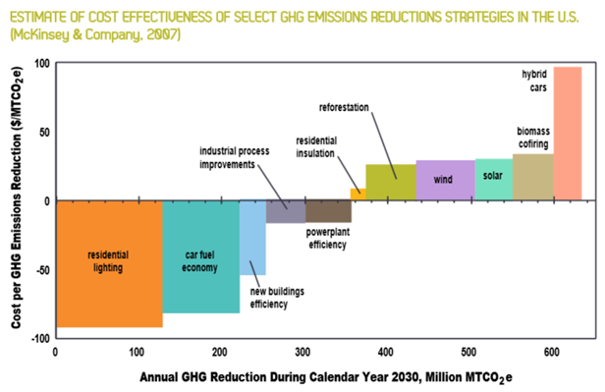
Cost of Reducing GHG Emissions
Marginal Abatement Cost Curves

Slide 9
Cost of Reducing GHG Emissions
Cost to meet Paris Accord (US)
$37-$135B per year
$300 - $1100 per household per year
A little less than what we currently pay for water and sewer
Notes:
Source:
Heal, Geoffrey. 2016. What would it take to reduce US greenhouse gas emissions by 80% by 2050? NBER Working Paper No. 22525

Slide 10
Cost of Reducing GHG Emissions
Some points about costs:
Cost estimates vary widely
cost of CC more uncertain than cost of emission reductions
Be careful of one-time cost estimates vs annual cost estimates
Creating or saving a job: is it a benefit or a cost?

Slide 11
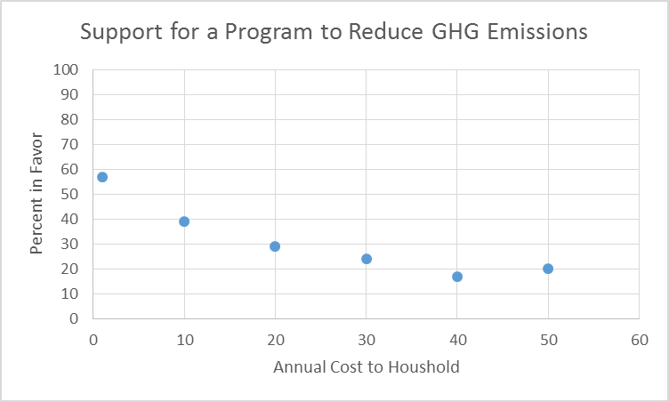
Citizen Preferences for GHG Policies
80% believe CC is happening
70% believe govt should do something
60% WTP something to address CC
Notes:
Source: Associated Press-NORC Center Poll, conducted August, 2016

Slide 12
Summary
Cost of BAU: $1300-$3300
But it could be much higher
Cost to limit warming: $300 - $1100
Total social cost could be negative if you count co-benefits
Average household WTP: $60-$90
40% not willing to pay anything
Average driven by a minority with high WTP

Slide 13
Cost-Effectiveness Analysis
What is least-cost way to reduce GHG emissions?
Want to encourage lower-cost approaches first
Want to encourage innovation that reduces costs
Want a system that is easy to administer
Want a system that is fair
Want a system that preserves as much individual freedom as possible

Slide 14
Cost-Effectiveness Analysis
Technology Standards
All emitters in an industry treated the same
No incentive to innovate
Need standards for each type of emitter
Market-based Approaches
Incentives to reduce emissions at lowest cost
Need less information about technology in each industry
Carbon Fee/Tax
What do you do with the revenues?
How do you know the right tax?
Cap and Trade
How do you hand out the credits?
How do you know the right cap?
Who bears the costs? How do impacts ripple out through economy?

Slide 15
Related Research Topics
Impact of fracking on energy markets
What drives coal mining employment?
Natural gas prices
Mechanization
Regulation

Slide 16
Trump Executive Order
Review/reconsider Obama regulations
Clean Power Plan
Emission standards for new power plants
Methane emissions from oil and gas
Revise how “Social Cost of Carbon” is calculated
Remove GHG emissions from NEPA reviews
Lift moratorium on federal coal leasing

Slide 17
Trump Executive Order
Some Background History – GHG regulation
Clean Air Act: EPA must regulate pollutants that endanger health or welfare
2007: Supreme Court says EPA can regulate GHG under CAA if it determines that CC endangers health or welfare
2009: Endangerment Finding
Since 2009
Light Duty Vehicle Rule (CAFE Standards)
GHG regulated under New Source Review
Clean Power Plan
Methane emissions from oil and gas

Slide 18
Trump Executive Order
Some Background History - SCC
Federal requirements for environmental reviews
NEPA: Environmental Impact Statements
Executive Order 12291: Regulatory Impact Assessments
2008: US Court of Appeals finds that government must include climate change impacts in EIS
2009: Interagency Working Group develops estimates of Social Cost of Carbon
Currently $36 per ton carbon dioxide

Slide 19
Trump Executive Order
Implications:
Unless the Endangerment Finding is rescinded, federal govt is required to
Regulate greenhouse gas emissions
Include projected CC impacts (SCC) in EIS, RIA

Slide 20
GHG Emission Regulations
Clean Power Plan – existing power plants
Current CPP under judicial injunction
Court may decide EPA can’t regulate emissions from existing power plants
Will take at least a year or two to rewrite regs
Current CPP assumes fuel switching
New regs might only regulate individual source emissions

Slide 21
GHG Emission Regulations
New Source Review – new power plants
Current CPP essentially requires new coal plants to use CCS
New regs might require a less aggressive technology
But no one’s building new coal power plants anyway

Slide 22
GHG Emission Regulations
Methane emissions from oil and gas
Not yet in effect
Have to have some regulation, but could be weaker
Any regulation rewrite will take a long time and has to be justifiable in court

Slide 23
Social Cost of Carbon
Current:
One value used by all agencies
Includes global damages
New:
Each agency decides its own value
Only include US damages?
Remember:
SCC is an accounting tool, not a tax

Slide 24
GHG Accounting in NEPA Analyses
Revokes guidance documents for how to incorporate GHG emissions into NEPA reviews
Impact not clear
Courts have already found that CC impacts must be included in NEPA reviews
Included in a more fossil-fuel friendly way?

Slide 25
Federal Coal Moratorium
Put in place in 2016
Is govt getting fair price for leased resources?
Lease payments
Royalties
How to account for resulting GHG emissions
Not much demand right now for new leases
Buy and hold?

