Slide 1

Wheat streak mosaic virus:
A threat to wheat production enhanced by warming climate
Tim Seipel, Nar B. Ranabhat, Erik A. Lehnhoff, Zach J. Miller, Fabian D. Menalled, and Mary E. Burrows
Research Scientist
Montana State University Bozeman, MT

Slide 2
Wheat is the most important crop in Montana
2017 – Expect 5.2 million acres of planted wheat
2016 – Wheat value of 1 billion dollars

Slide 3
The most common viral disease in Montana wheat
Wheat Streak Mosaic Virus (WSMV)
Yield loss of up to 100% in field and trials.
2% yield loss in central Great Plains annually
In MT - 1964, 1981, 1993, 1994 and 2016 with losses >10%

Slide 4
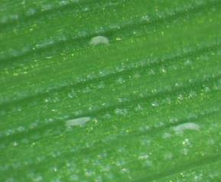
Wheat curl mite
(WCM, Aceria tosichella Keifer)
Virus vector
  WSMV, Wheat mosaic virus
  Microscopic eriophyid mite
Reproduces rapidly
Limited damage on its own
Slide c. Carmen Murphy

Slide 5
WSMV: Disease pyramid
Grasses
Host
Vector
Wheat curl mite
WSMV
Weather
Pathogen
Environment

Slide 6
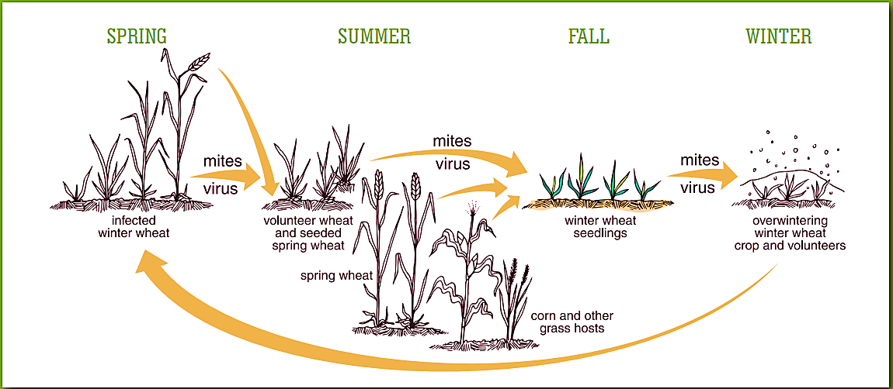
The cycle

Slide 7
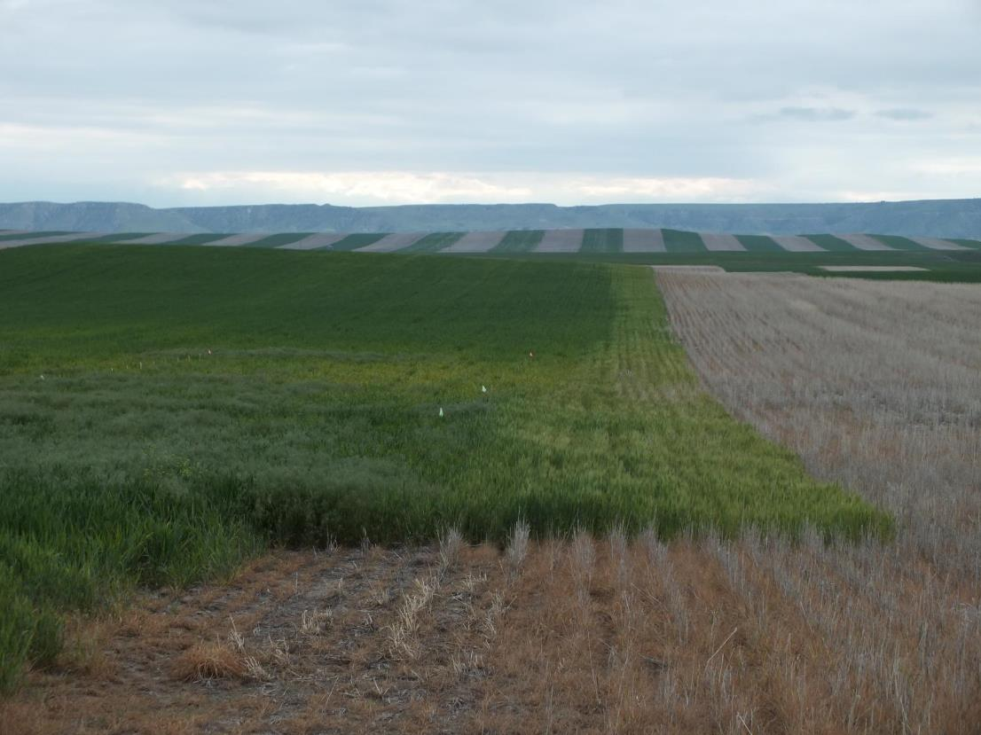
Notes:
Edge obvious, but symptoms are moving into the field

Slide 8
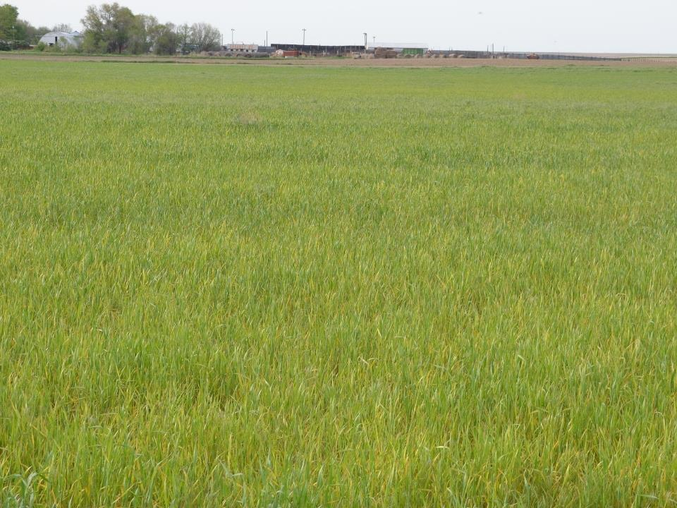
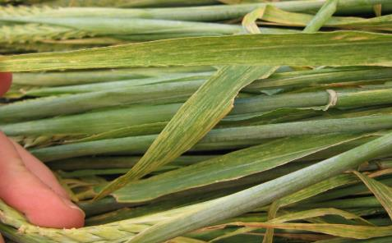
WSMV
Huntley, MT
July 9, 2010

Slide 9
Wheat streak mosaic virus samples into the Schutter Diagnostic Laboratory (Montana), 2008-2015
Year | WSMV samples*
2008 | 6
2009 | 36
2010 | 45
2011 | 52
2012 | 18
2013 | 3
2014 | 42
2015 | 89
Confirmed and suspected 2015 samples through 9/1/15 2008-2011 active surveys of MT

Slide 10
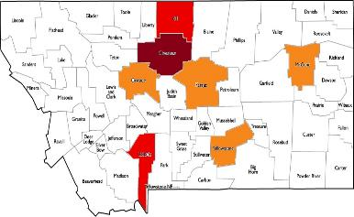
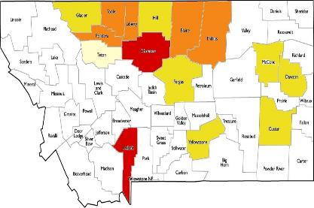
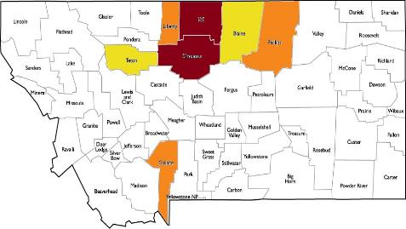
Occurrence of WSMV
2014: 42 positive samples from 19 counties
2015:89 positive samples from 24 counties
Hill
14%
Hill
14%
Chouteau
21%
Chouteau
21%
McCone
9%
Toole 5%
Hill
3%
Cascade
7%
Fergus
5%
Glacier 3%
Liberty
7%
Blaine
5%
Pondera 8%
Phillips
9%
Teton 7%
Chouteau
12%
McCone
3%
Gallatin
12%
Yellowstone
5%
Fergus
3%
Dawson
3%
2016: 316 positive samples from 21 counties
Custer
3%
Gallatin
13%
Yellowstone
4%
Hill
32 %
Liberty
8%
Blaine
4%
Phillips
5%
Teton
4%
Chouteau 21%
Gallatin
8%
Status end of October 2016

Slide 11
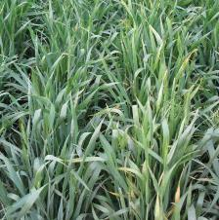
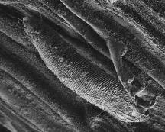

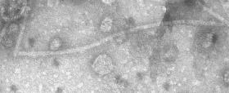
Increase in regional virus incidence?
Host
Vector
（New York Times)
Pathogen
Environment
Notes:
Why?
→ change in virus
- new virus strains?
→ change in variety susceptibility
→ change in vector
- new species
- distribution
→ change in environment
(i.e. global warming)
Infected plant with BYDV makes more biomass under elevated CO2. → increasing survival of plant over winter → more reservoirs for virus
BYDV (potyvirus) → more severe in mild winter
Global warming → if infection cycle increases, more chance for pathogen to make severe races (strains)
Breeding for resistance to wheat streak mosaic virus and its mite vectorAuteur(s) / Author(s)
CONNER Robert L. (1) ; QIN CHEN (2) ; Affiliation(s) du ou des auteurs / Author(s) Affiliation(s)
(1) Agriculture & Agri-Food Canada, Morden Research Centre, Unit 100-101, Route 100, Morden, Manitoba, R6M 1Y5, CANADA
(2) Agriculture & Agri-Food Canada, Research Centre PO Box 3000, Lethbridge, Alberta, CANADA
Résumé / Abstract
Wheat streak mosaic (WSM) is an important viral disease of wheat and other cereal crops in the Great Plains region of North America. Outbreaks of WSM can result in severe yield losses in both winter and spring wheat. The wheat curl mite (WCM) is the only known vector of wheat streak mosaic virus (WSMV). Cultural controls can limit the survival and spread of the WCM, but are not always effective in preventing epidemics of WSM. Resistance to WSM and the WCM has been identified and transferred into wheat from rye and several grass species. The development of WSM- and WCM-resistant wheat may be the most cost effective and environmentally sound means of control for WSM. However, new biotypes of the WCM that can overcome certain sources of mite-resistance have recently been detected under greenhouse conditions. Molecular cytogenetic and biotechnology methods have been applied to characterize new sources of WCM and WSM resistance and to create more efficient strategies for the development of resistant wheat cultivars. This chapter contains a review of research on WSM disease, the WCM and innovative control measures that have shown promise against WSMV.

Slide 12
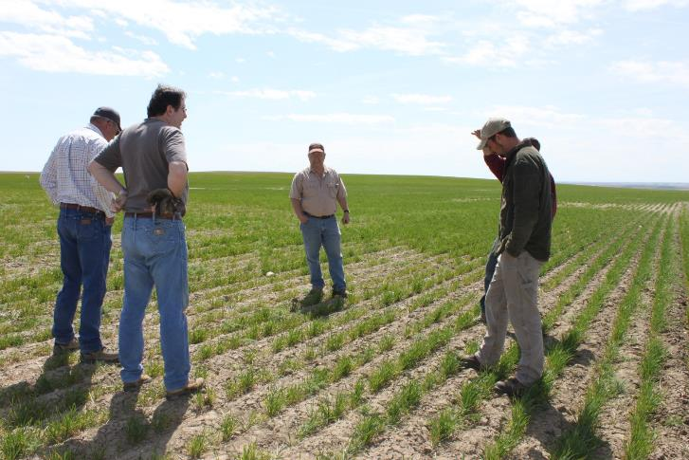
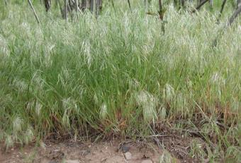
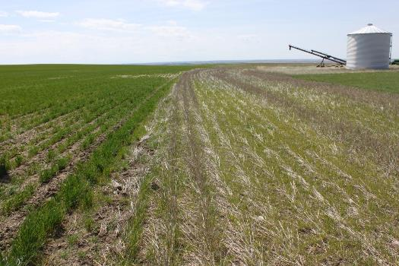

Slide 13
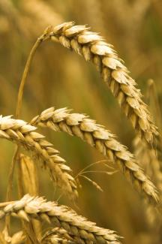
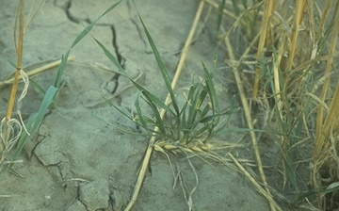
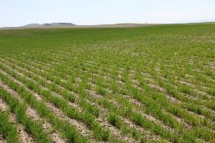
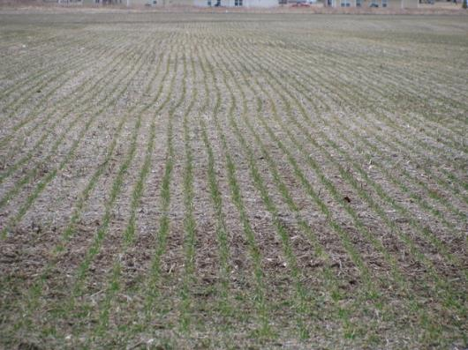
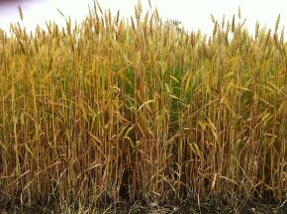
The ‘green bridge’
Volunteer wheat/
grassy weeds
WW
Next year’s crop
Newly planted WW
Late-maturing SW
Notes:
Particularly important in states with continuous wheat

Slide 14
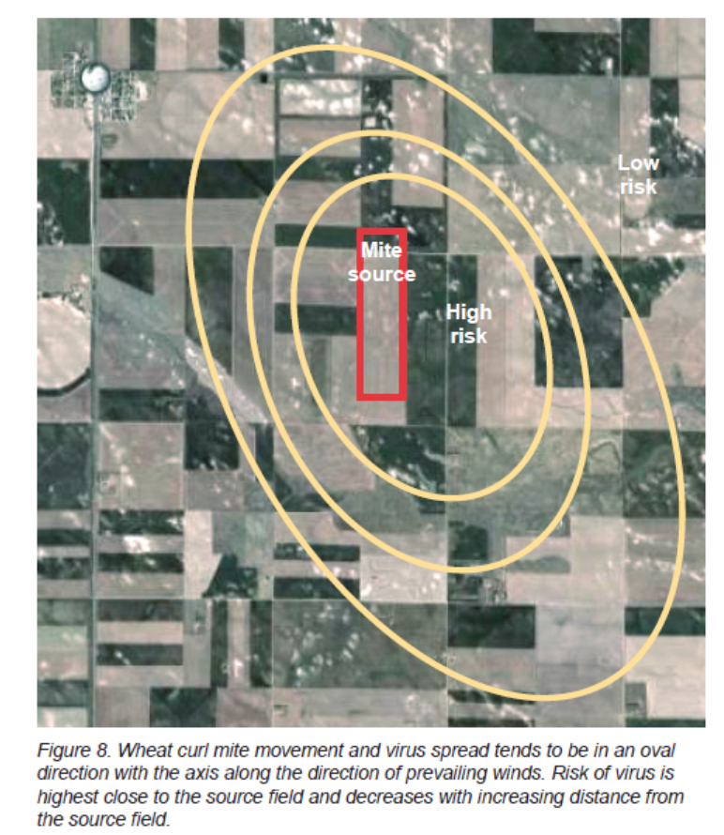
Wegulo et al. NE Extn Bull. EC1871

Slide 15
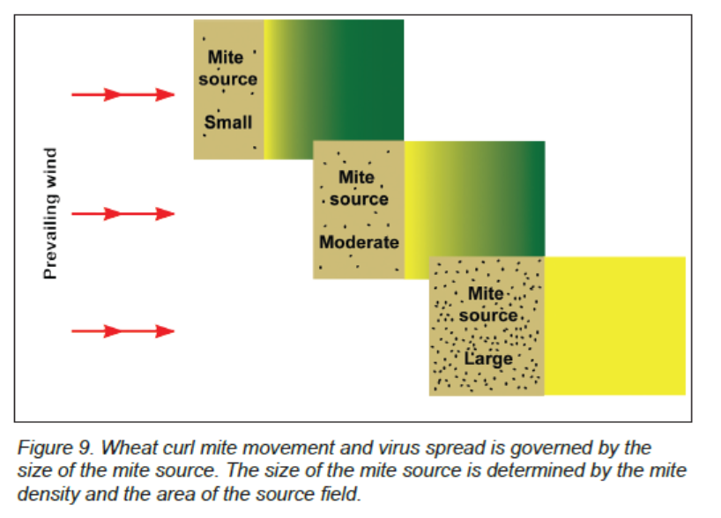
Wegulo et al. NE Extn Bull. EC1871

Slide 16

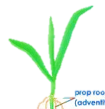

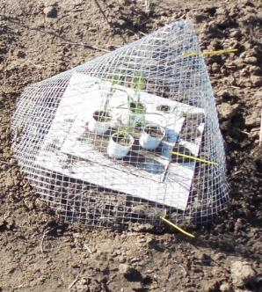

Methods
Randomized complete block design with six replicates.
Pre-harvest volunteer wheat
Post-harvest volunteer wheat
Corn
Green foxtail
Spring emerged downy brome
Fall emerged downy brome
Control: bare ground
-
Trap plant (winter wheat)

Slide 17
Daily temperatures in autumn a big predictor of WSMV risk
10 °C threshold?
50 ° F

Slide 18
Daily temperatures in autumn a big predictor of WSMV risk
10 °C threshold?
50 ° F

Slide 19
Weather in autumn a big predictor

Slide 20
Weather in fall a big predictor

Slide 22
Cold less WSMV
Warm more WSMV

Slide 23
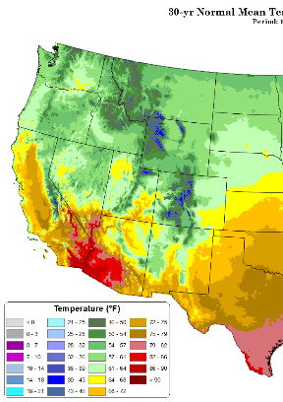
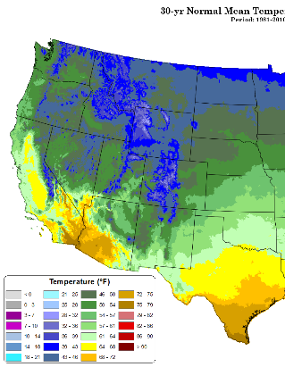
Warmer autumns greater risk of WSMV
Between Sept and Oct cross the threshold (10°C) of WCM movement, population growth; limit spread
Havre
57°F in Sept
46°F in Oct
Prism data http://prism.oregonstate.edu/normals/

Slide 24
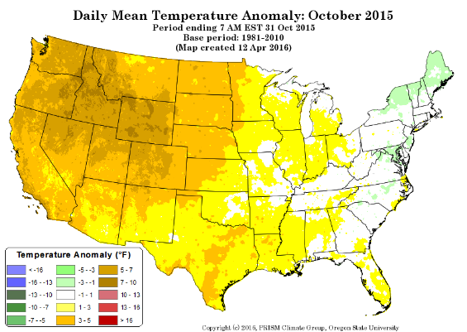
Warmer autumns
Greater risk of WSMV
5 to 7 °F warmer
47+7=54°F
Crosses a threshold
More WCMs

Slide 25
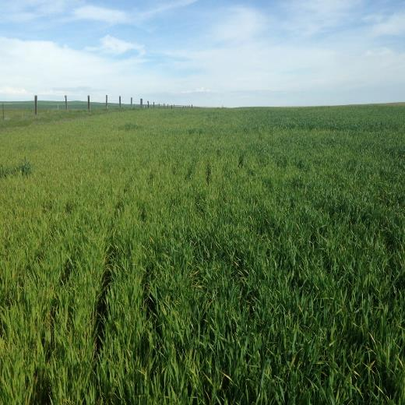
Thank you - Questions?

