Slide 1
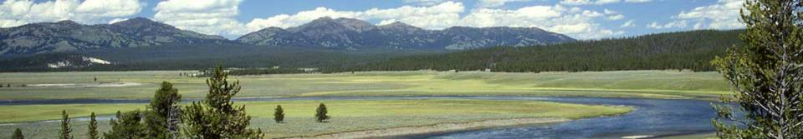
Montana Climate Assessment stakeholder driven, science informed
Cathy Whitlock
MSU Director, Montana Institute on Ecosystems
whitlock@montana.edu

Slide 2









MCA Partners

Slide 3
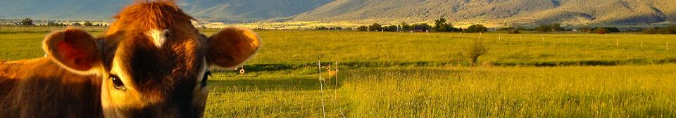
Understanding Montana’s
Stakeholder needs
  MCA driven by outreach to ~900 citizens of Montana to determine:
  Critical decisions and issues impacted by climate
  What type of information they need
  How to disseminate useful information
  Stakeholder responses informed the MCA strategy
Notes:
53 respondents (62% extension agents)

Slide 4

Montana Climate Assessment
Approach for Montana:
  Build on national efforts
  Build on university science, engagement & partnerships
  Sector-relevant assessments:
    User relevant
    Stakeholder driven
  Useful, updatable products
  Sustainable enterprise
Notes:
60+ watershed groups
58 conservation districts – elected supervisors

Slide 5
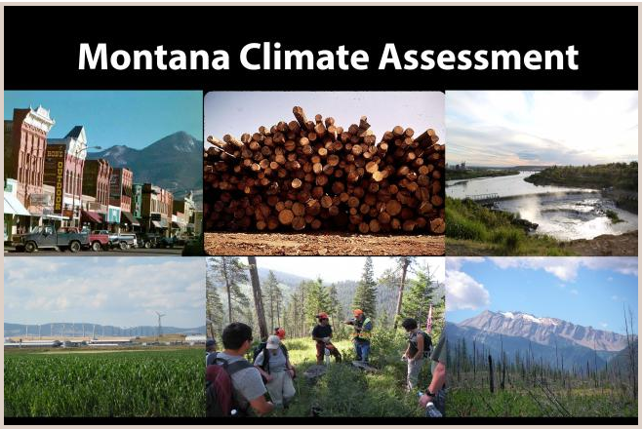
Key MCA Topics
Climate
Water
Agriculture
Forests

Slide 6
How is Montana’s Climate Changing?
Between 1950-2015:
Average temperatures have risen 2-3ºF. Winter and springs have warmed the most.
Montana’s growing seasons are 11 days longer.
No changes in average seasonal precipitation.
Future:
Additional warming of 4-6ºF by 2050 and 10ºF by 2100
Precipitation will increase slightly in winter, spring and fall, and decrease in summer.

Slide 7
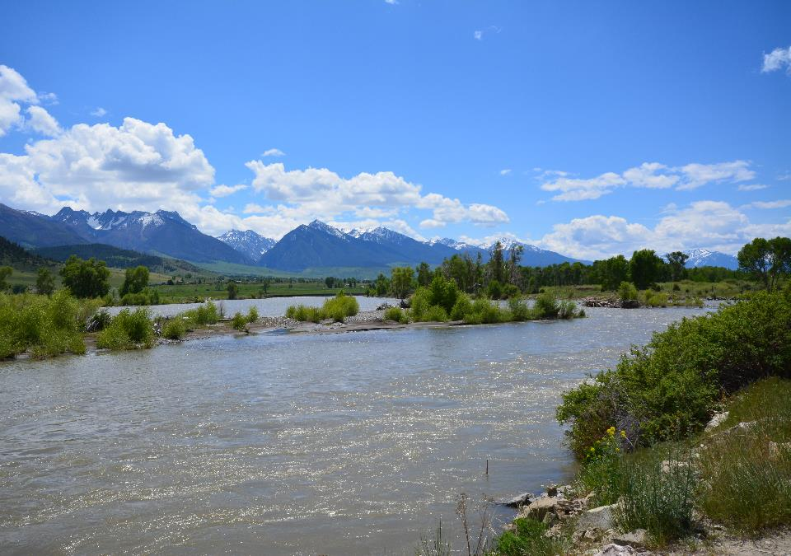
What does it mean for water?
Notes:
Example ‘lead-in’ slide to each issue – we should have a similar one for forests and agriculture

Slide 8
Montana Water Trends & Projections
Between 1950-2015:
Snowpack has declined, especially since 1980s.
Earlier spring runoff.
Streamflow is influenced by warming & climate variability (e.g., El Nino).
Future:
Snowpack will continue to decline with earlier snowmelt.
Late-summer water supplies will decrease.
Droughts will more severe with warming.
Demands for groundwater will increase.

Slide 9
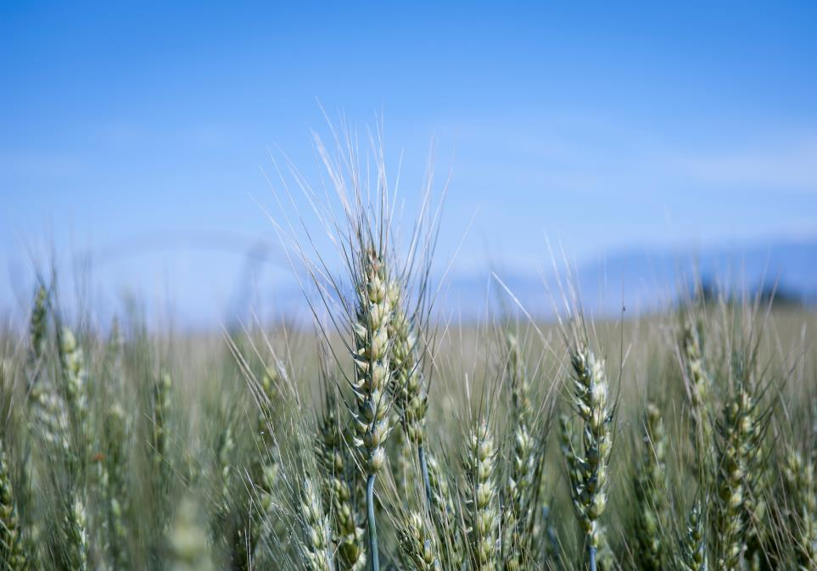
What does it mean for agriculture?
Notes:
http://www.lakecountycdc.org/content/images/MMFEC/Beignet_wants_fresh_grass.jpg

Slide 10
Montana Agriculture projections
Future:
Decreasing snowpack will reduce late-season irrigation capacity (affect hay, sugar beet, malt barley, garden/potato production).
Longer growing season could enable crop diversity but with greater vulnerability.
More days >90ºF will impact wheat & stress livestock.
Winter annual weeds will increase.
There are multiple drivers in Ag decision making; climate will become more important as warming increases.

Slide 11
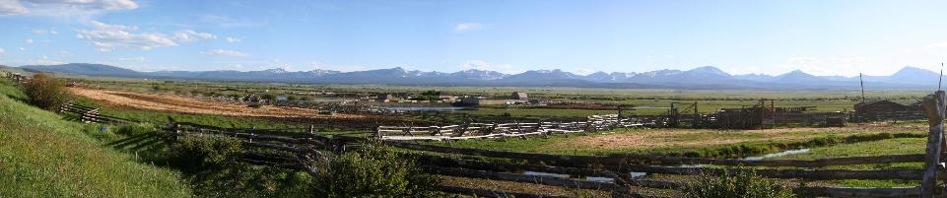
Future of the MCA
Public Comment Period April 10-May 5:
  Check the MCA website: http://montanaioe.org/mca
MCA 1 will be released in August 2017
  Cathy Whitlock (whitlock@montana.edu)
  Bruce Maxwell (bmax@montana.edu)
MCA “road show events” in Fall (working with Extension, Extended Univ. to reach MT communities)
Notes:
not a lone wolf… Montana is ready to work together like these wolf pups.

Slide 12

MAKE is a partnership of the state’s universities, extension service, state and Federal agencies, businesses, and non-profits.
MAKE is a non-political collaborative program that facilitates the exchange of knowledge between scientists and stakeholders of Montana.
MAKE’s first priority is climate change adaptation, building on the success of the first Montana Climate Assessment.

