Slide 1
Project Learning Tree
Carbon & Climate:
Workshop Title
Presenter 1 Name, Presenter 1 Title
Presenter 2 Name, Presenter 2 Title
Notes:
Remember to update the red text with your workshop-specific information.

Slide 2


Lexi Brown
MSU Extension Forestry
32 Campus Drive MS0606
Missoula MT 59812-0606
(406) 243-4706
alexios.brown@montana.edu
www.montana.edu/extension.forestry/projectlearningtree

Slide 3
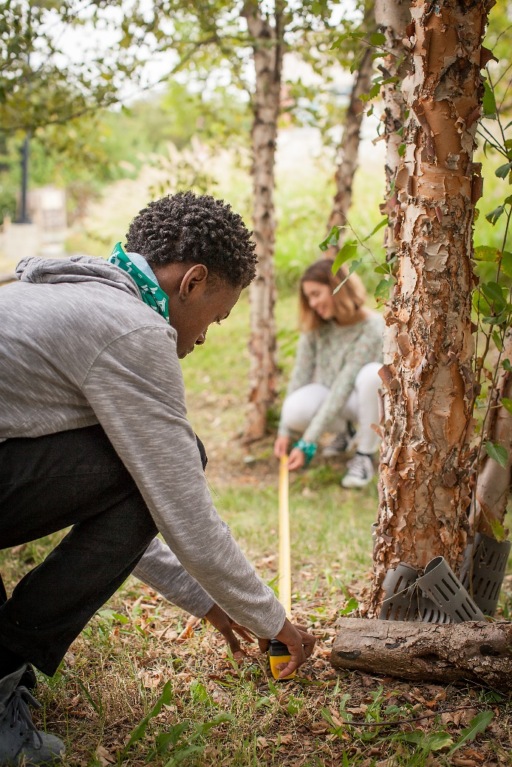
Project Learning Tree
A Comprehensive
Environmental Education
Program
  High quality, preK-12 curriculum materials
  Professional development for educators
  International network of partners

Slide 4

PLT uses forests as “windows on the world” to help students:
  Understand ecological systems
  Think critically and creatively
  Make informed decisions on environmental issues
  Take responsible action

Slide 5
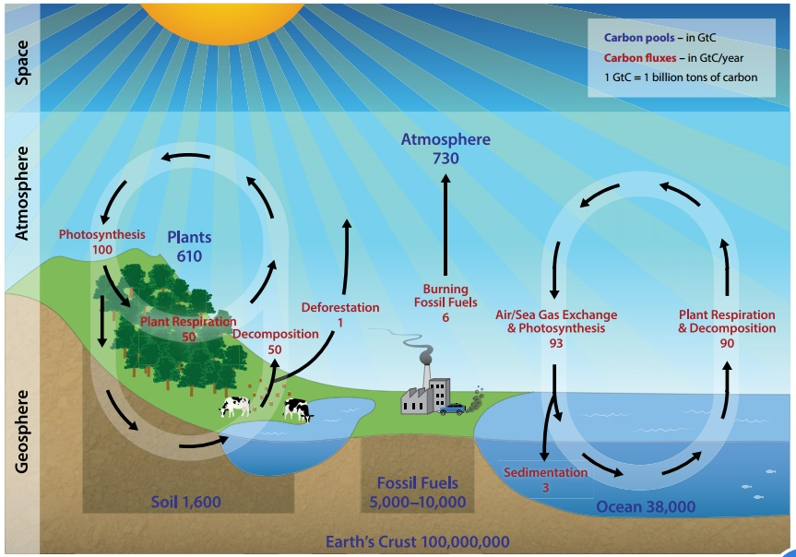
The Carbon Cycle
Notes:
Use this slide to introduce the Carbon Cycle, which is Activity 2 in the Carbon & Climate E-Unit. Take 10-15 minutes to conduct a sampling of this lesson, using the Carbon Cycle Station Cards, Carbon Pathway student pages, and dice.
The purpose of the activity is to teach students that carbon may be found in a variety of places and that it moves from location to location. The primary focus is the biological portion of the carbon cycle that happens on a much shorter timeframe than the geological portion.
Learner Objectives (from Overview)
Students will participate in an active simulation of the carbon cycle.
Students will create a model of the carbon cycle.
Students will calculate the amount of carbon a tree can sequester.

Slide 6
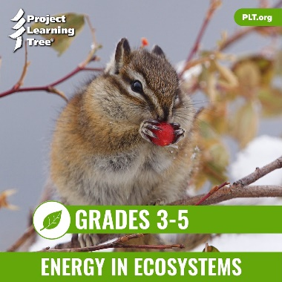

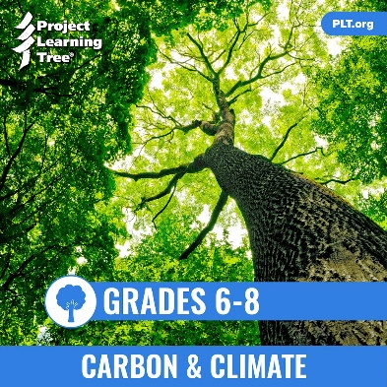
PLT’s E-Units
Designed by teachers
Housed entirely online for access anywhere
Constructed around targeted performance expectations in NGSS
Aligned with Common Core and C3 Framework
Notes:
Use this slide to introduce the PLT E-Units in general, pointing out that PLT began with the standards and NGSS’s three-dimensional approach in the initial design of the unit.
In addition, the e-units are aligned with two other academic benchmarks: Common Core (ELA and Math), and The College, Career, and Civic Life (C3) Framework for Social Studies.

Slide 7
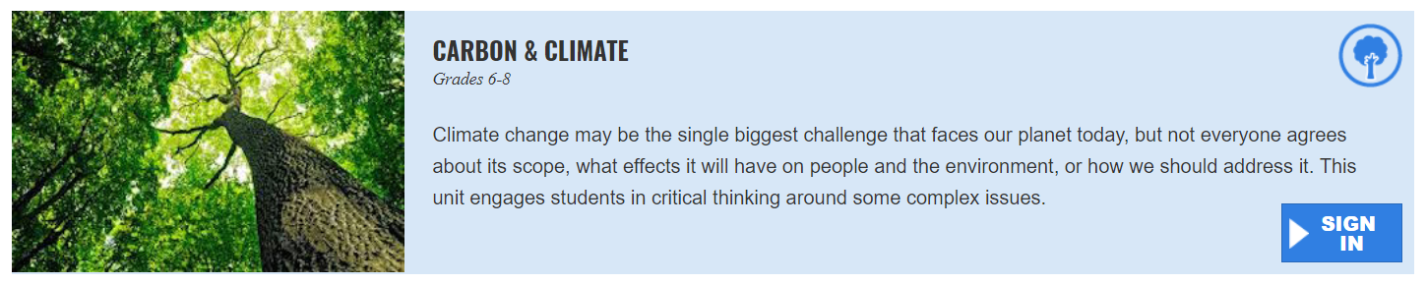
Explore the Carbon & Climate E-Unit
  Carbon and Clumate E-Unit
Notes:
This slide contains links to the live e-unit website. You must be logged into your e-unit account in advance to access the embedded links.
Subsequent slides provide screen shot images if wifi is not available or reliable.

Slide 8
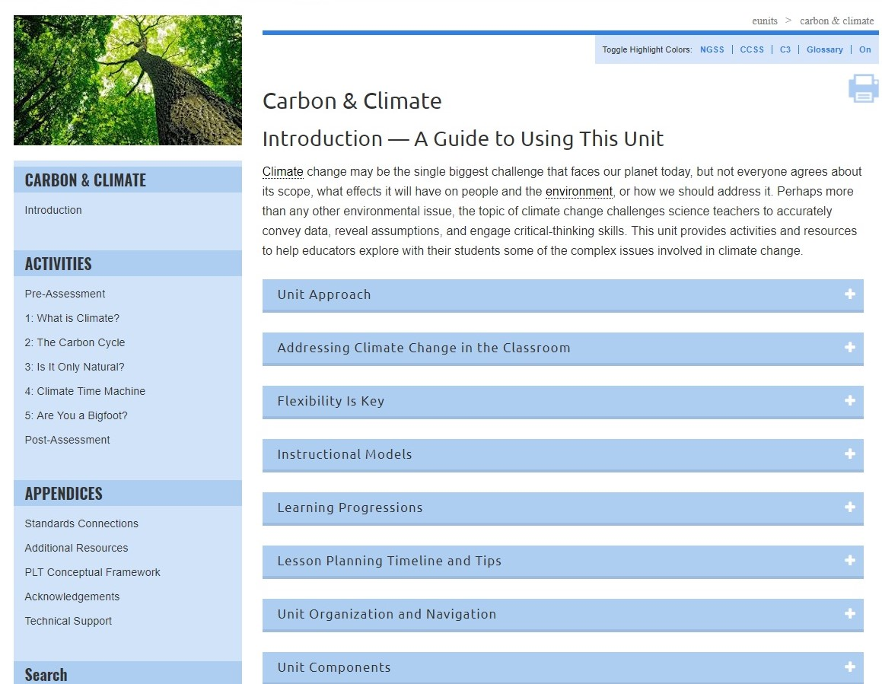
Notes:
The Carbon and Climate E-Unit is designed for grades 6-8. Use this slide to highlight the many useful sections of the Introduction. Pick one or two to highlight, such as the Learning Progressions or Lesson Planning Timeline and Tips.
The unit introduces students to climate science and its associated social, political, and environmental challenges.
It explores several essential questions:
What is climate?
How does climate affect living systems?
What role does carbon play in climate?
What can we learn from past changes in the global climate?
What can individuals do about climate change?

Slide 9
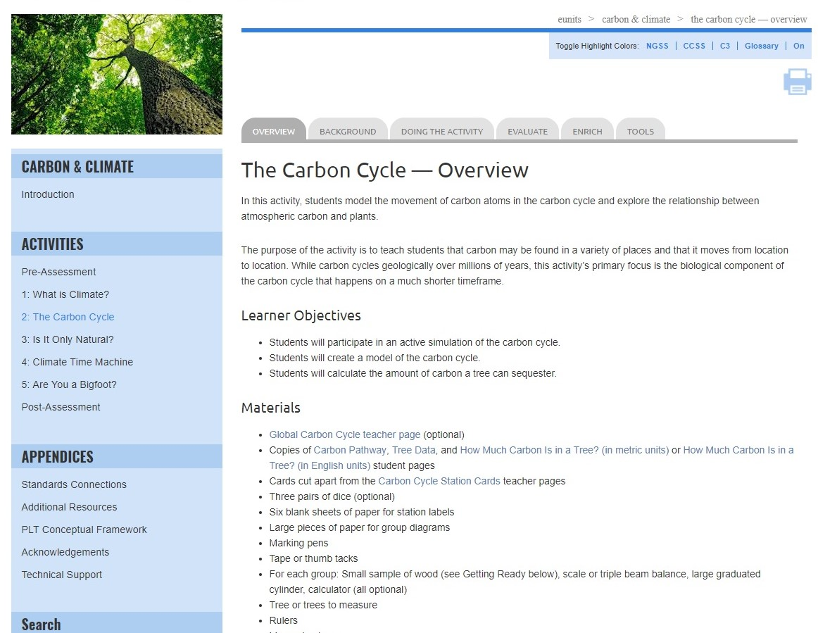
Notes:
Use this slide and those that follow to explain the e-unit navigation and layout.
Be sure to review the unit-level blue left-hand navigation bar, as well as the gray tabs across the top for individual activities.

Slide 10
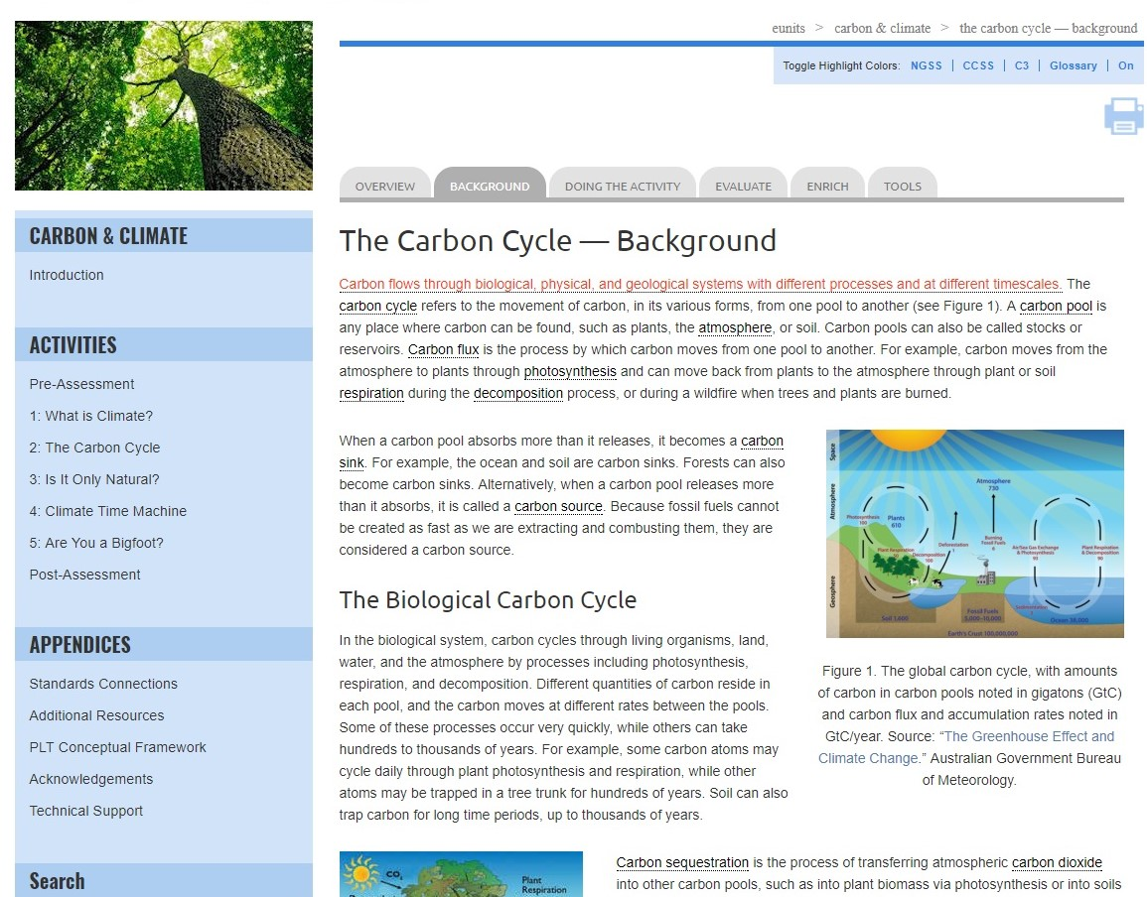
Notes:
Use this slide to point out that in-depth background information is provided for each activity. Note that this section may include helpful photos, charts, or diagrams.

Slide 11
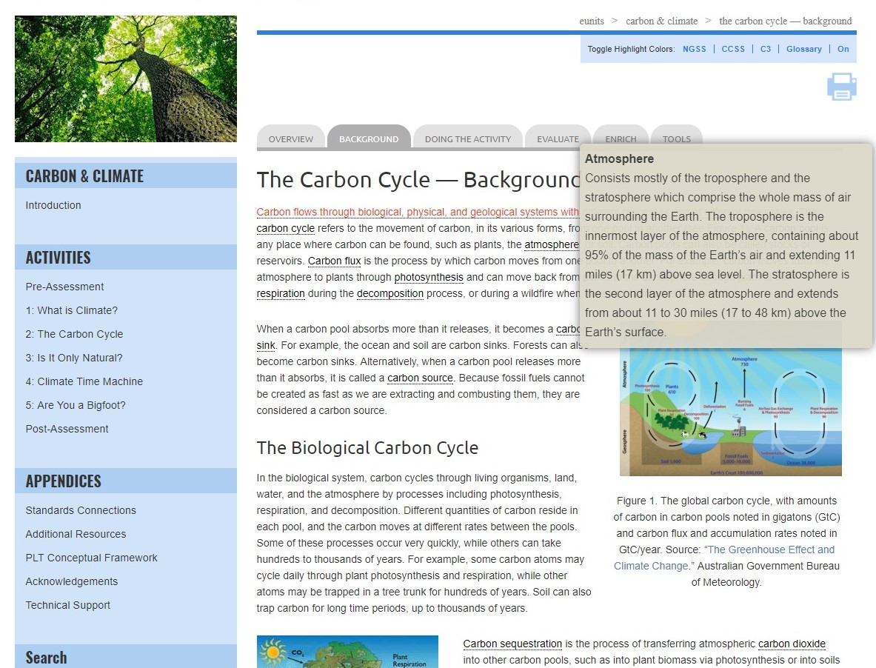
Notes:
Also note that the background and other activity sections include pop-up definitions for key vocabulary.

Slide 12
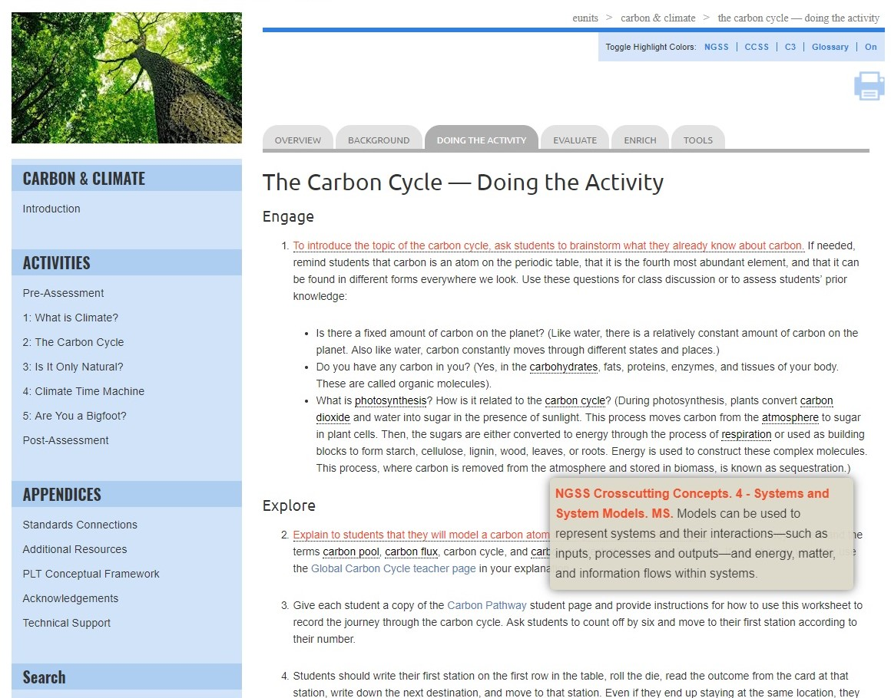
Notes:
Use this slide and the one that follows to show the interactive standards pop-ups.
The Carbon & Climate e-unit is built around two middle-school standards from the Next Generation Science Standards (NGSS):
MS-ESS2: Earth’s Systems
MS-ESS3: Earth and Human Activity
While the e-unit is based on these two NGSS standards, it will also help meet relevant state science standards for middle schools. (Almost all states address the topics of climate, climate science, or climate change in one or more middle school grades.)

Slide 13
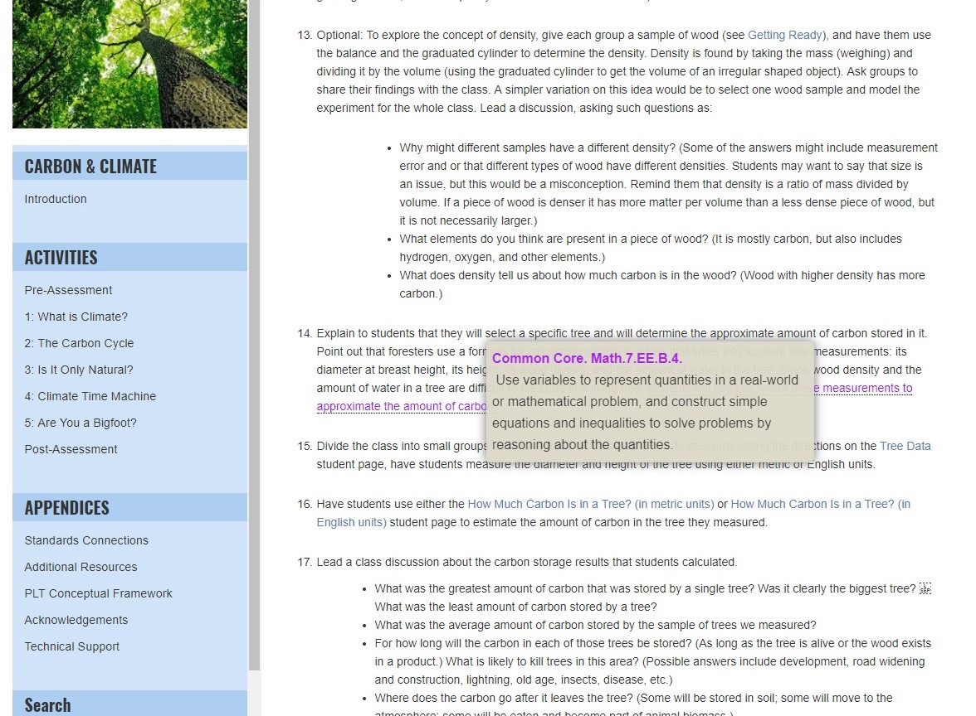
Notes:
The unit also integrates math, language arts, and other discipline areas in fun and creative ways, drawing on both mathematics and English language arts benchmarks from the Common Core State Standards.
Remember to mention that red pop ups signify NGSS connections, purple are Common Core (English language arts and mathematics), and green are the C3 Framework (social studies).

Slide 14
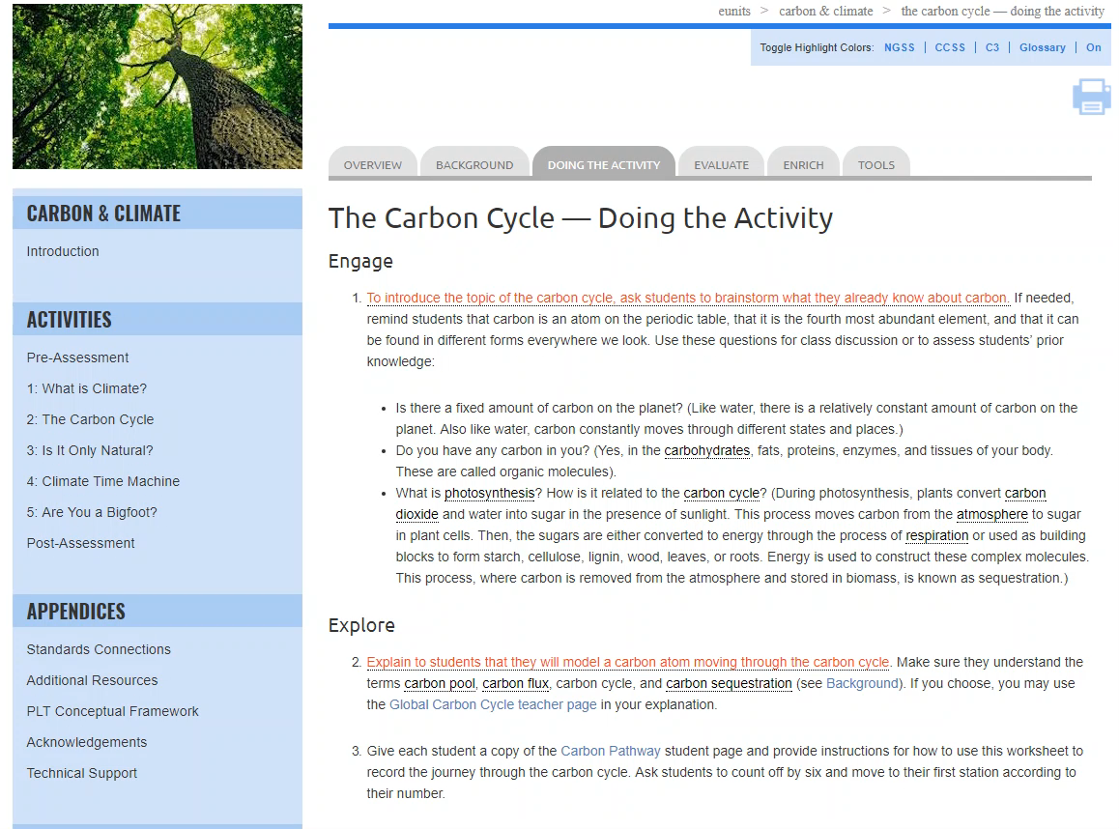
Notes:
Use this slide to point out that the unit is designed around the 5E Instructional Model:
Engage
Explore
Explain
Elaborate
Evaluate
It includes an imbedded screen video showing the headers that indicate the relevant parts of the model: Engage, Explore, Explain, and Elaborate with Doing the Activity. Note that Evaluate is listed in a separate tab.

Slide 15
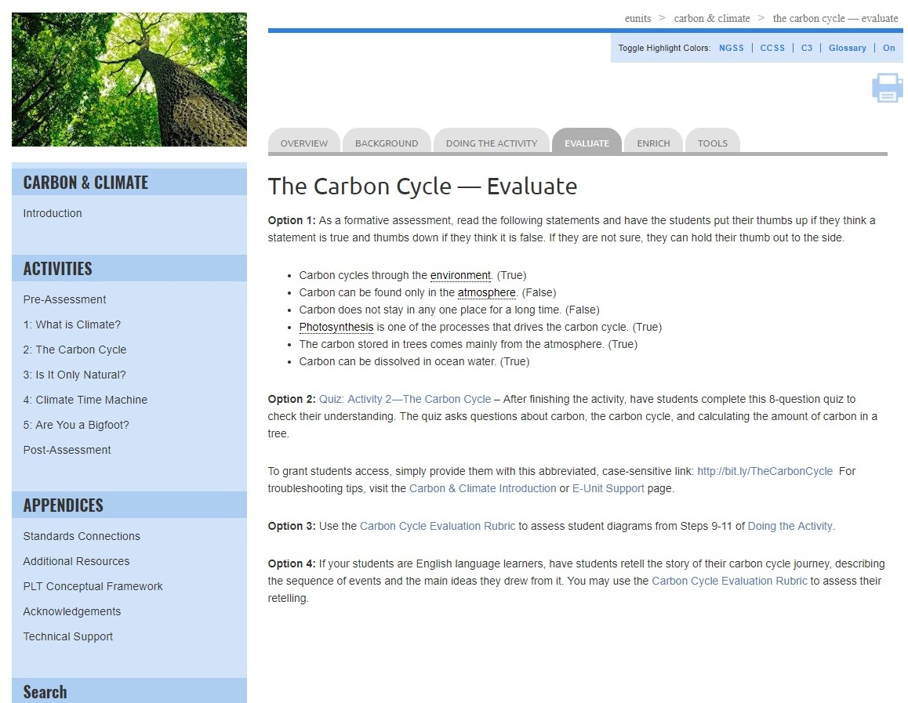
Notes:
Each activity includes multiple assessment options. Including
Online quizzes for students
Rubrics to assess student learning
And additional evaluation options

Slide 16
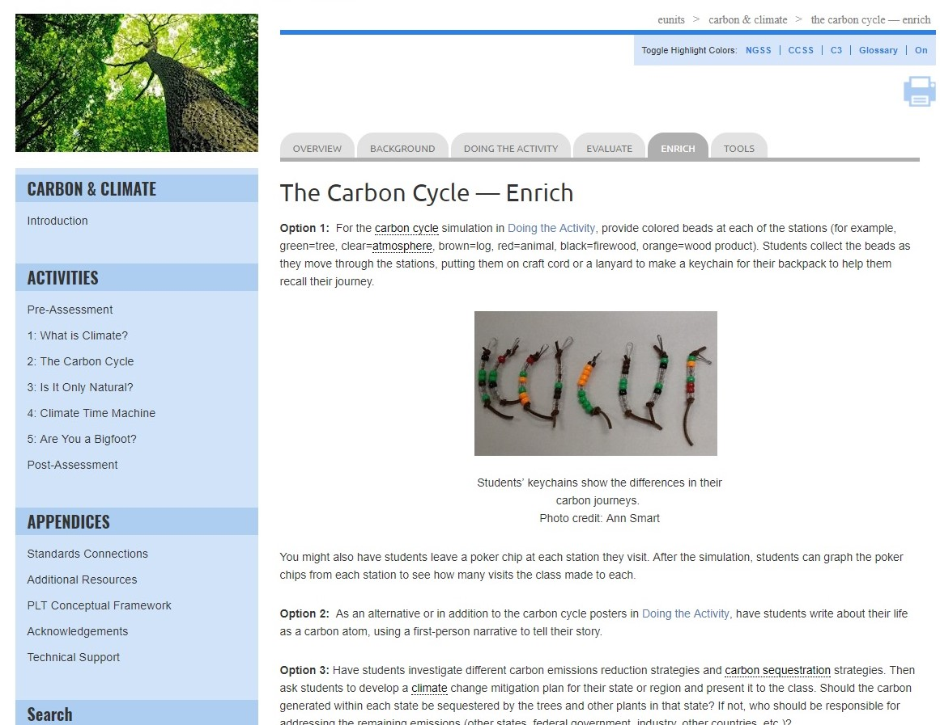
Notes:
Each activity provides suggested enrich options to extend learning

Slide 17
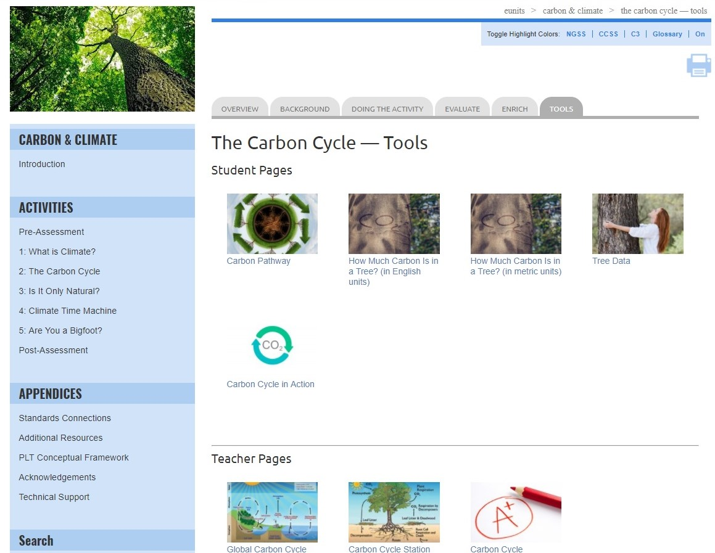
Notes:
Tools include:
Student pages
Teacher pages
Links to Additional Resources

Slide 18

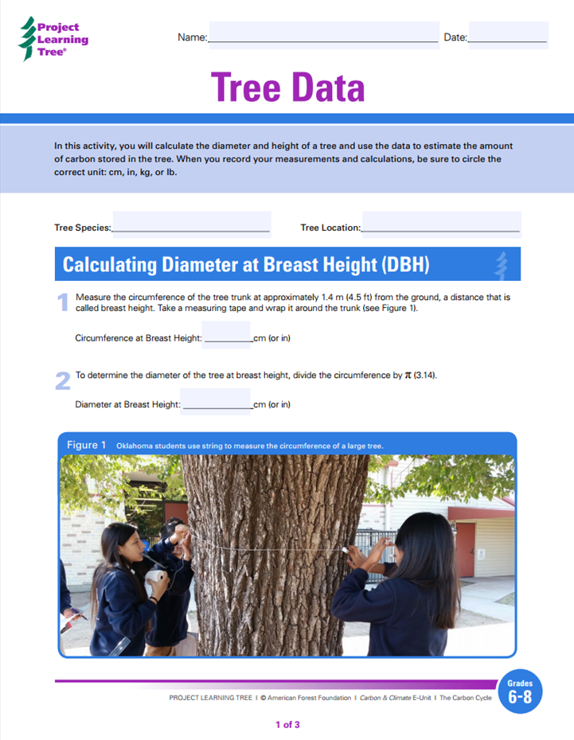
Notes:
Example student page
One of the exciting features of the e-units are that student pages are both printable and fillable. These pages can also be downloaded and saved to your computer.

Slide 19
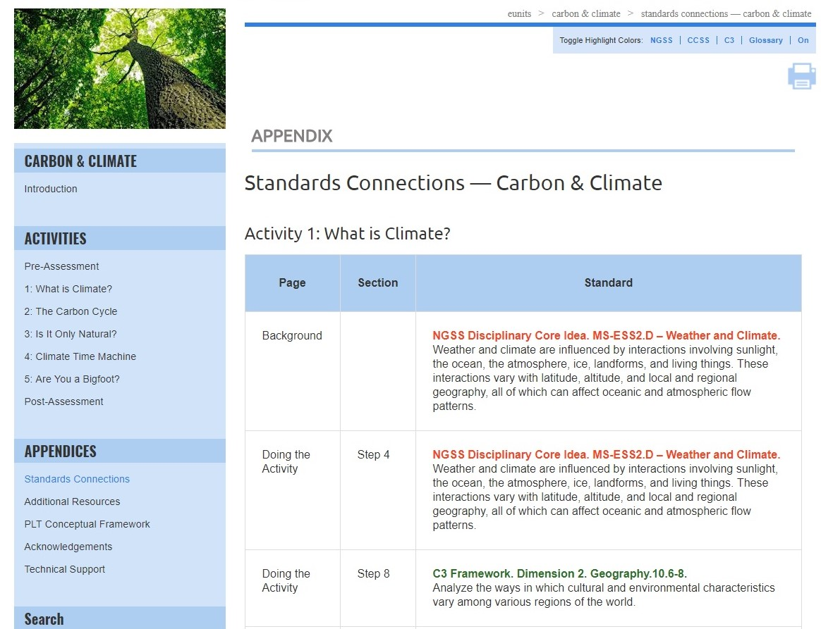
Notes:
Use this slide (and/or the others) to highlight relevant appendices for your audience; they include:
Standards Connections
Additional Resources
PLT Conceptual Framework
Acknowledgements
Technical Support
Standards Connections in the appendices is a listing of all of the connections for the entire unit that are identified by the pop-up feature.

Slide 20
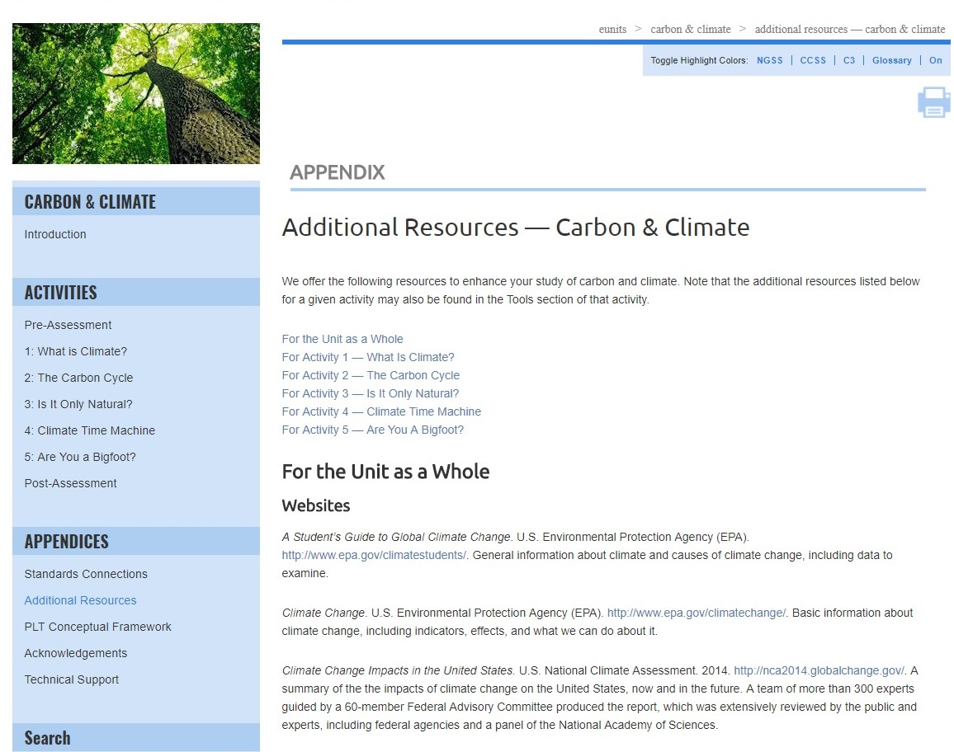
Notes:
Use this slide (and/or the others) to highlight relevant appendices for your audience; they include:
Standards Connections
Additional Resources
PLT Conceptual Framework
Acknowledgements
Technical Support
Additional Resources in the appendices is a listing of all websites, books, and videos for the unit as a whole as well as activity-by-activity resources to support teaching of the unit.

Slide 21
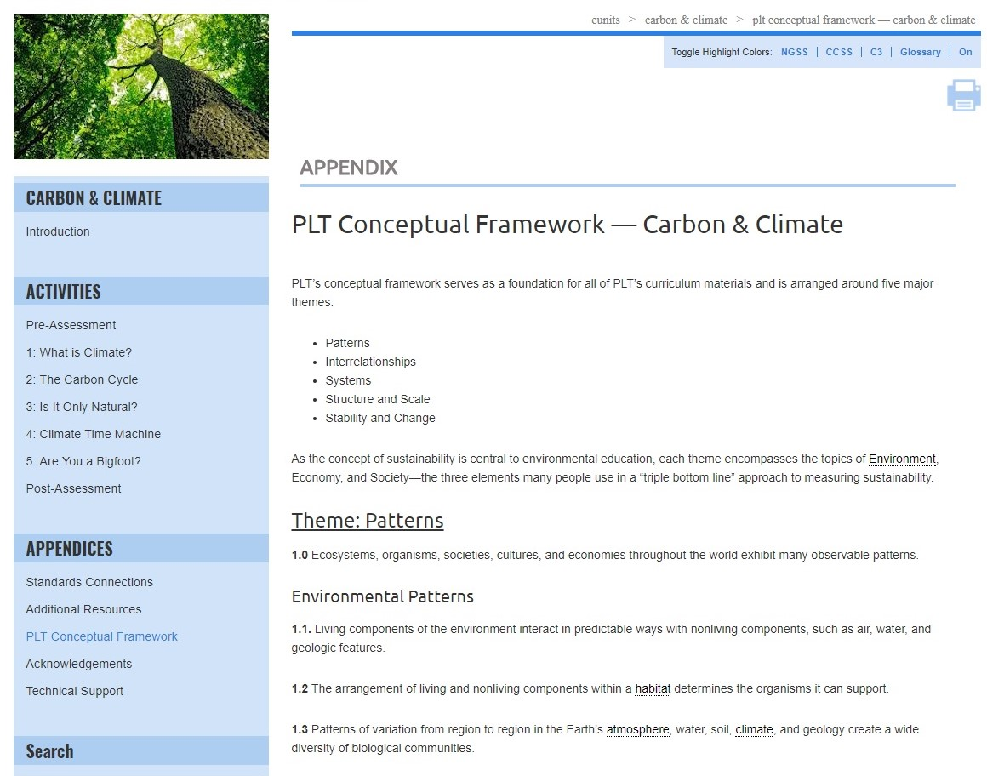
Notes:
Use this slide (and/or the others) to highlight relevant appendices for your audience; they include:
Standards Connections
Additional Resources
PLT Conceptual Framework
Acknowledgements
Technical Support
The PLT Conceptual Framework serves as a foundation for all of PLT’s curriculum materials.

Slide 22
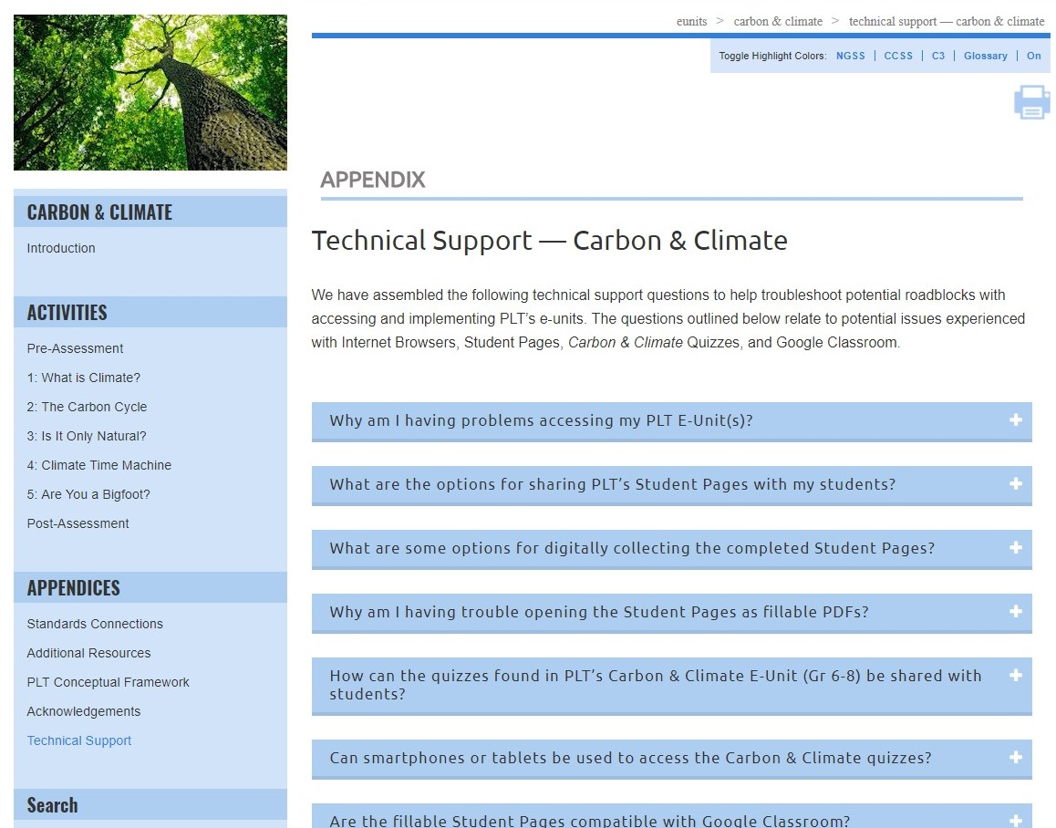
Notes:
Use this slide (and/or the others) to highlight relevant appendices for your audience; they include:
Standards Connections
Additional Resources
PLT Conceptual Framework
Acknowledgements
Technical Support
Technical Support answers common technical questions to help troubleshoot potential problems with accessing and using the e-units. Questions relate to potential issues experienced with internet browsers, student pages, quizzes and Google Classroom.

Slide 23
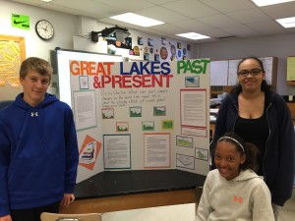
Climate Time Machine
Notes:
To elaborate, give participants a taste of another activity, Activity 4: Climate Time Machine.

Slide 24
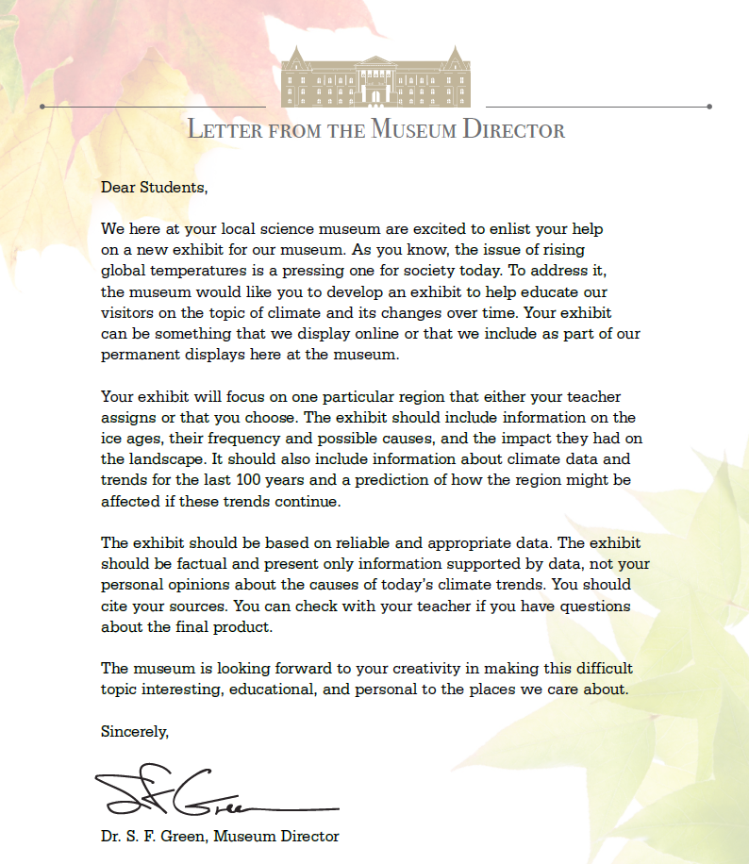
Notes:
Explain that the teacher introduces the project by sharing a letter from a Museum Director (found in Tools), inviting students to create an exhibit for the museum on the effects of past and future climate changes on the landscape.
The letter encourages students to be creative, and points out the importance of educating others about what they have learned, but leaves the form and specific content of the exhibit up to the students.
Students work in teams and contribute to their team’s project based on different roles they choose or are assigned.

Slide 25

Opportunities to Localize Learning
Consider compiling geologic history from your local area to meet state standards and to personalize student learning.
Notes:
PLT provides links to a variety of resources on the Great Lakes, which were formed at the end of the last ice age, when miles-thick glaciers began to melt, filling the large basins they had carved with melt water. (In Resources).
But, teachers may choose to have students focus on their own state or other region. Example geologic histories exist for NY (Adirondacks) and Kentucky.
This is just one of the ways that you can take PLT’s “national” e-unit curriculum and customize it for the regional, state, and local levels.

Slide 26
Exhibits Should Aim to Answer:
What effects have past climate changes had on the area selected?
What can we learn from studying climate history that will help us understand current global temperature trends?
Notes:
If time allows, work in groups of 4-5 to design an exhibit. You can use the Great Lakes example (provided in Tools tab), or another area of your choosing. Consider using copies of the “Climate Science Project Planner” student page, and providing poster paper and pens.
Exhibits should answer:
What effects have past climate changes had on the area selected?
What can we learn from studying climate history that will help us understand current global temperature trends?

Slide 27
Carbon & Climate Activities
1: What is Climate?
  Explore the concept of climate
2: The Carbon Cycle
Active simulation of carbon cycle
3: Is It Only Natural?
Explore the geologic history of a region
4: Climate Time Machine
  Explore factors that cause climate change
5: Are you a Bigfoot?
Experiment with a carbon footprint calculator
Notes:
The e-unit includes 5 activities that help students understand some of the complex issues involved in climate science.

Slide 28
Supports for Teaching Activities
Step-by-step instructions
Extensive background sections
Online quizzes
Vocabulary exercises
Links to videos, websites, and other resources
Assessment rubrics
Printable and fillable student pages
Notes:
The Carbon & Climate e-unit contains lots of resources and materials to support teaching the activities.

Slide 29
Obtaining PLT E-Units
In-Person Professional Development
  Contact your PLT State Coordinator
  www.plt.org/your-state-project-learning-tree-program
Online Professional Development
  Self-paced online workshop included with e-unit
  $40 per e-unit at shop.plt.org
Notes:
If desired, insert your state specific contact information or upcoming workshop details.

Slide 30
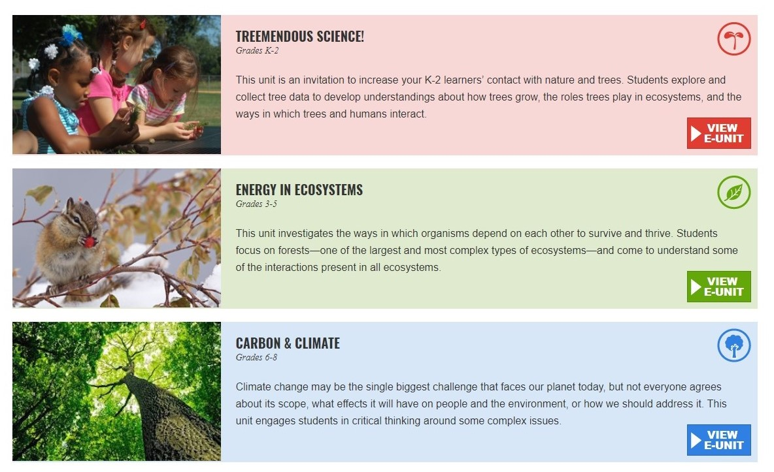
Available E-Units
Notes:
PLT has 3 e-units available at this time, each for a different grade level band.

Slide 31
Questions, Comments?
Presenter 1 Name
Presenter 1 Title, State
Presenter1email@xxxx.org
Presenter 2 Name
Presenter 2 Title, State
Presenter2email@xxxx.org
Thank you!
Notes:
Remember to update the red text with your workshop-specific information.
Distribute any evaluation forms at this time, tying survey questions to the intended workshop outcome, as appropriate.

Slide 32


Project Learning Tree Montana
These workshops are funded in part from a federal award of the U.S. Forest Service, Department of Agriculture, subawarded by the Montana Department of Natural Resources and Conservation, Forestry Division to Montana State University Extension.
The Montana State University Extension Service is an ADA/EO/AA/ Veteran’s Preference Employer and Provider of Educational Outreach.

