Slide 1
Project Learning Tree
Energy in Ecosystems:
Workshop Title
Presenter 1 Name, Presenter 1 Title
Presenter 2 Name, Presenter 2 Title
Notes:
Remember to update the red text with your workshop-specific information.

Slide 2


Lexi Brown
MSU Extension Forestry
32 Campus Drive MS0606
Missoula MT 59812-0606
(406) 243-4706
alexios.brown@montana.edu
www.montana.edu/extension/forestry/projectlearningtree

Slide 3
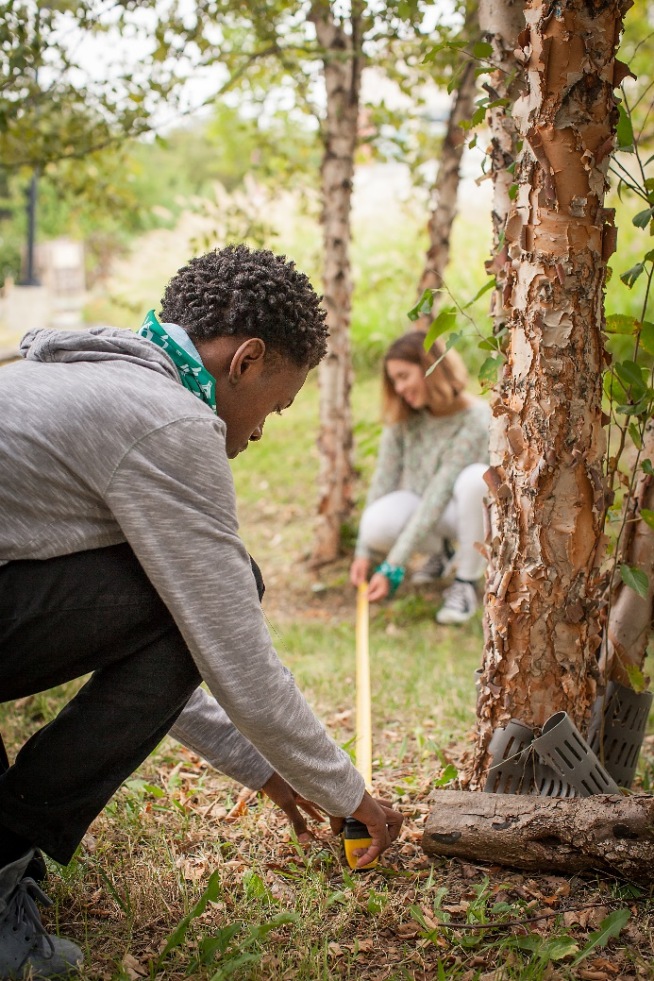
Project Learning Tree
A Comprehensive
Environmental Education
Program
  High quality, preK-12 curriculum materials
  Professional development for educators
  International network of partners

Slide 4

PLT uses forests as “windows on the world” to help students:
  Understand ecological systems
  Think critically and creatively
  Make informed decisions on environmental issues
  Take responsible action

Slide 5
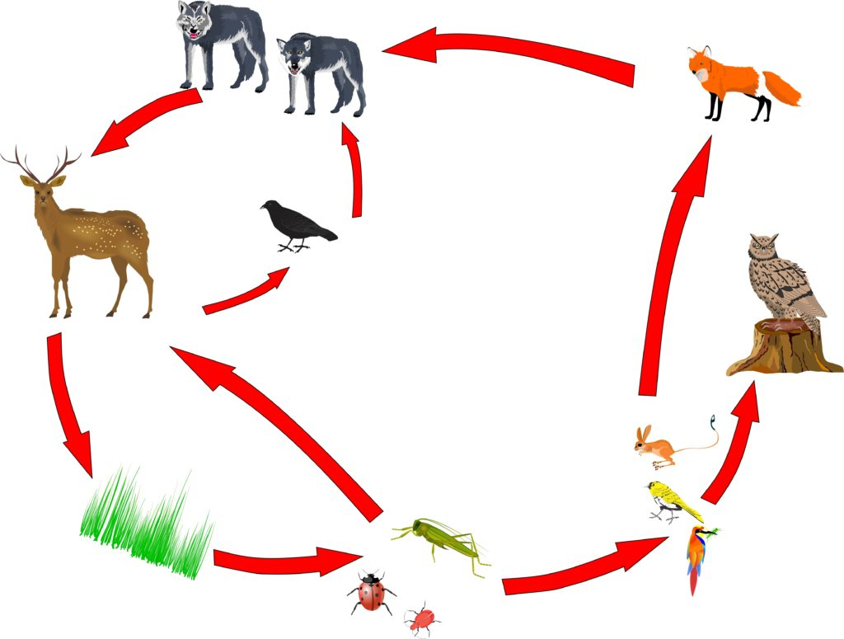
Web of Life
Notes:
Use this slide to introduce Web of Life, which is Activity 3 in the Energy in Ecosystems E-Unit. Take 10-15 minutes to conduct a sampling of this lesson, using the Food Web Research student page to have workshop participants conduct their own species research, if reliable wifi and personal devices are available.
Have participants model a food web using string and assigned species cards; your own local species cards you’ve prepared in advance; or, if you’re short on time, models created by PLT state programs in Wyoming, Arkansas, and Washington (PLT website account required).
The aim of the activity is for students to take a close look at a forest ecosystem and discover ways that plants and animals are connected to each other.
Learner Objectives
Identify a food chain or food web that contains a particular forest organism.
Create a model of the forest food web.
Explore what happens to the food web if one of the components is no longer present.

Slide 6
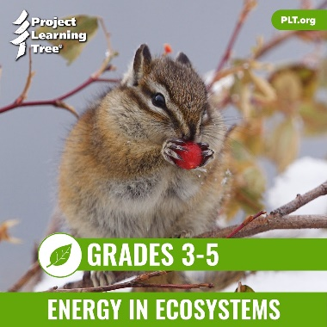

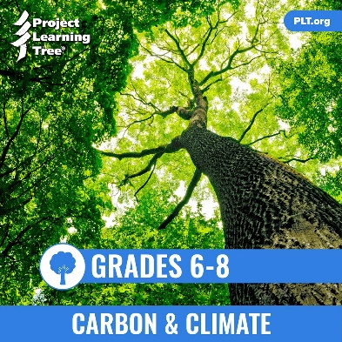
PLT’s E-Units
Designed by teachers
Housed entirely online for access anywhere
Constructed around targeted performance expectations in NGSS
Aligned with Common Core and C3 Framework
Notes:
Use this slide to introduce the PLT E-Units in general, pointing out that PLT began with the standards and NGSS’s three-dimensional approach in the initial design of the unit.
In addition, the e-units are aligned with two other academic benchmarks: Common Core (ELA and Math), and The College, Career, and Civic Life (C3) Framework for Social Studies.

Slide 7

Explore the Energy in Ecosystems
E-Unit
  Energy in Ecosystems E-Unit
Notes:
This slide contains links to the live e-unit website. You must be logged into your e-unit account in advance to access the embedded links.
Subsequent slides provide screen shot images if wifi is not available or reliable.

Slide 8
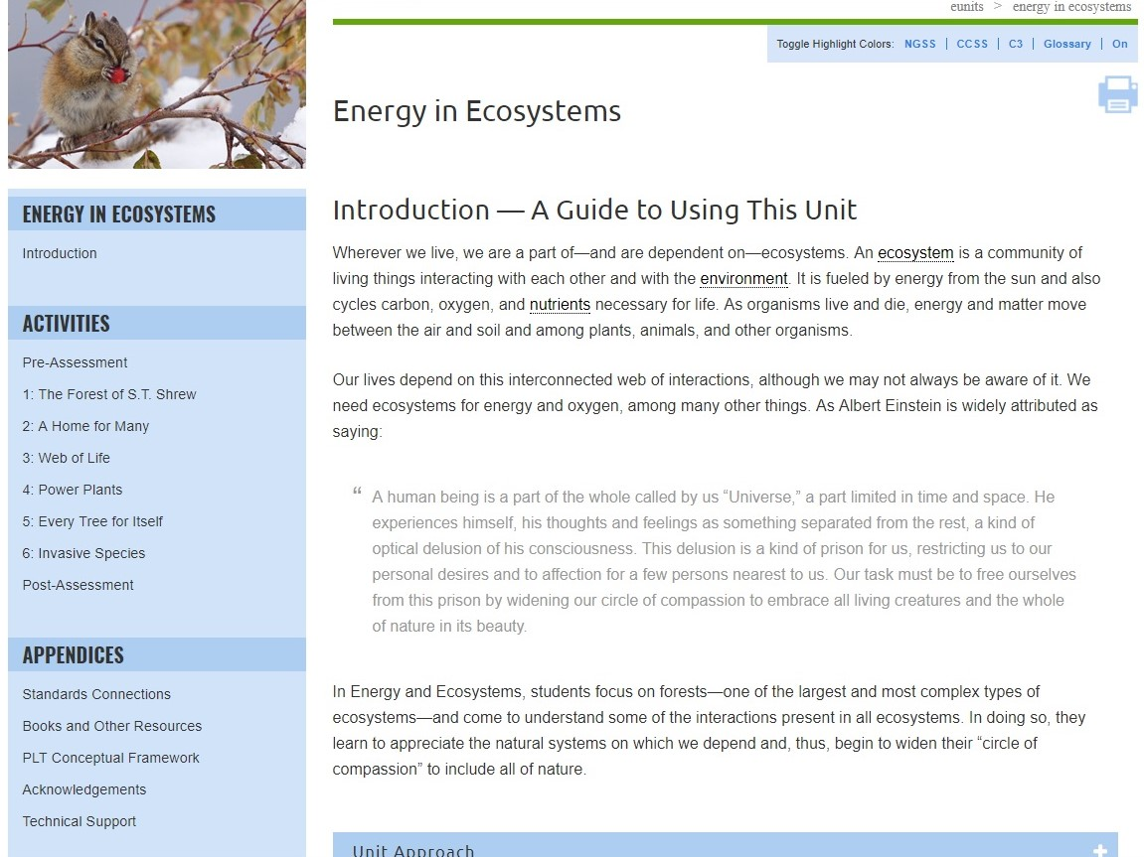
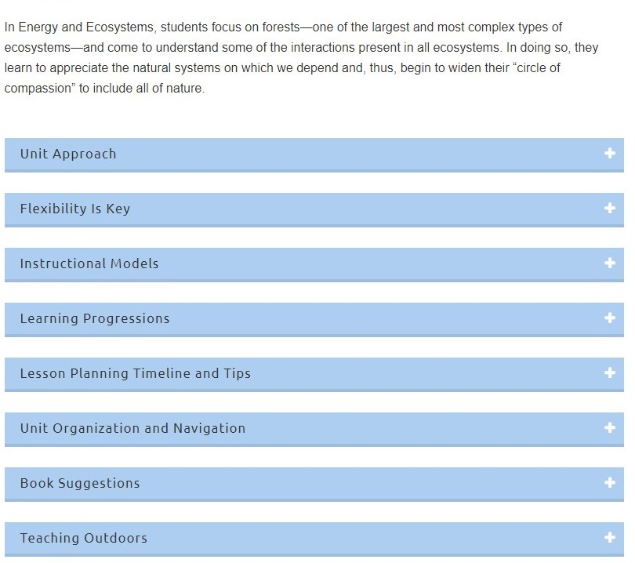
Notes:
The Energy in Ecosystems E-Unit is designed for grades 3-5. Use this slide to highlight the many useful sections of the Introduction. Pick one or two to highlight, such as the Learning Progressions or Lesson Planning Timeline and Tips.
In this unit, students focus on forests—one of the largest and most complex types of ecosystems—and come to understand some of the interactions present in all ecosystems. In doing so, they learn to appreciate the natural systems on which we depend.
It explores several essential questions:
What is an ecosystem?
In what ways do living things interact in an ecosystem?
How does energy flow through an ecosystem?
What can individuals do to sustain ecosystems?

Slide 9
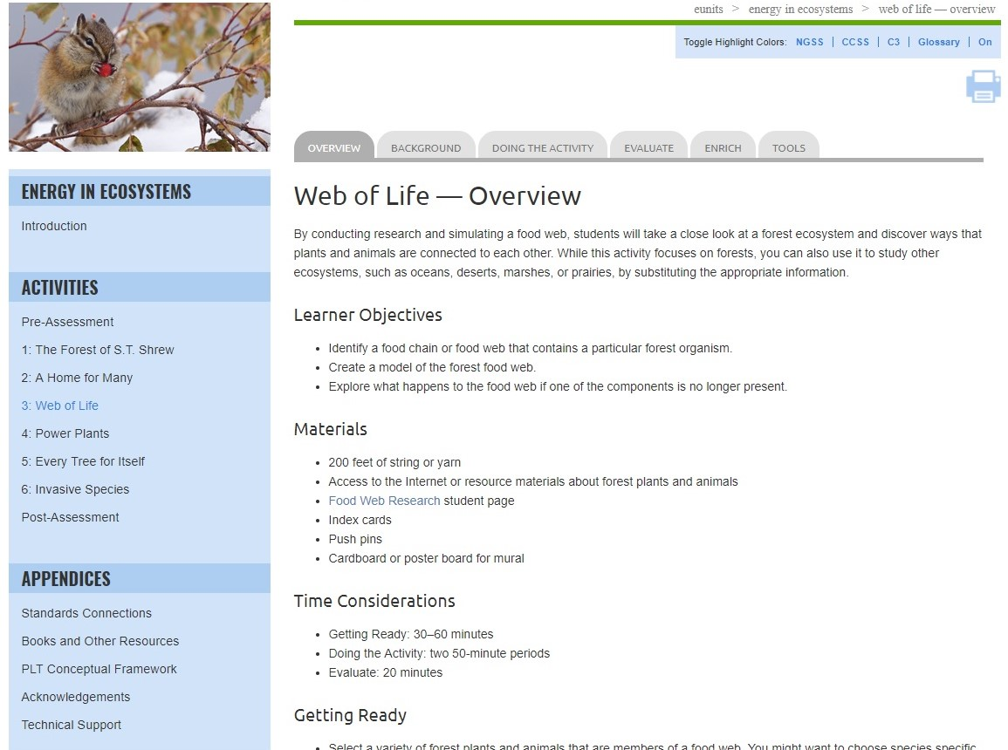
Notes:
Use this slide and those that follow to explain the e-unit navigation and layout.
Be sure to review the unit-level blue left-hand navigation bar, as well as the gray tabs across the top for individual activities.

Slide 10
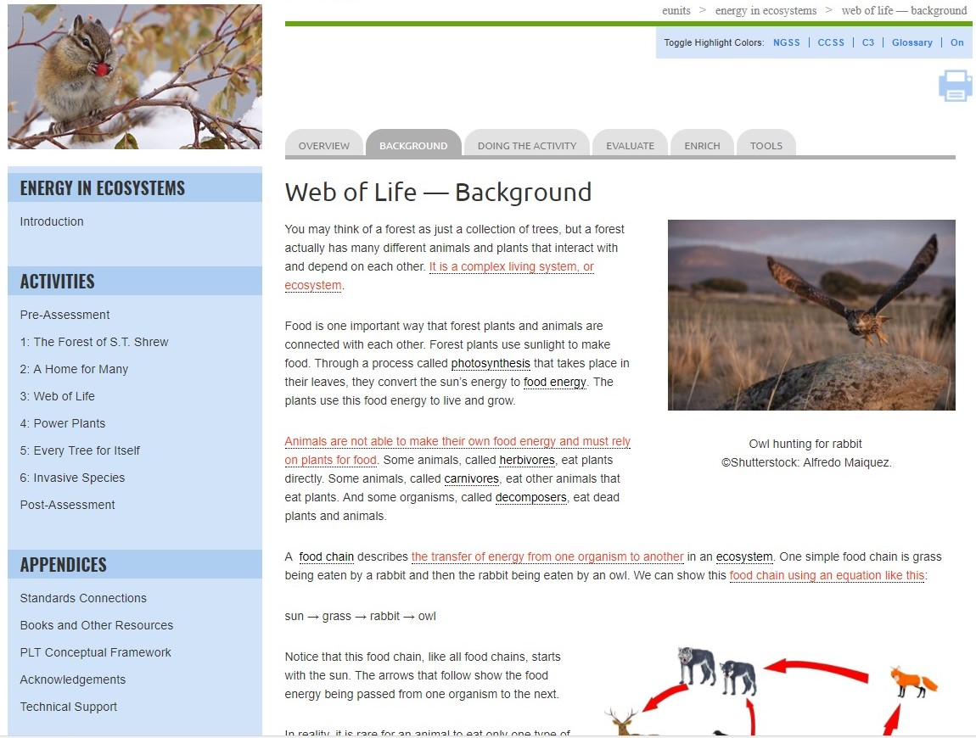
Notes:
Use this slide to point out that in-depth background information is provided for each activity. Note that this section may include helpful photos, charts, or diagrams.

Slide 11
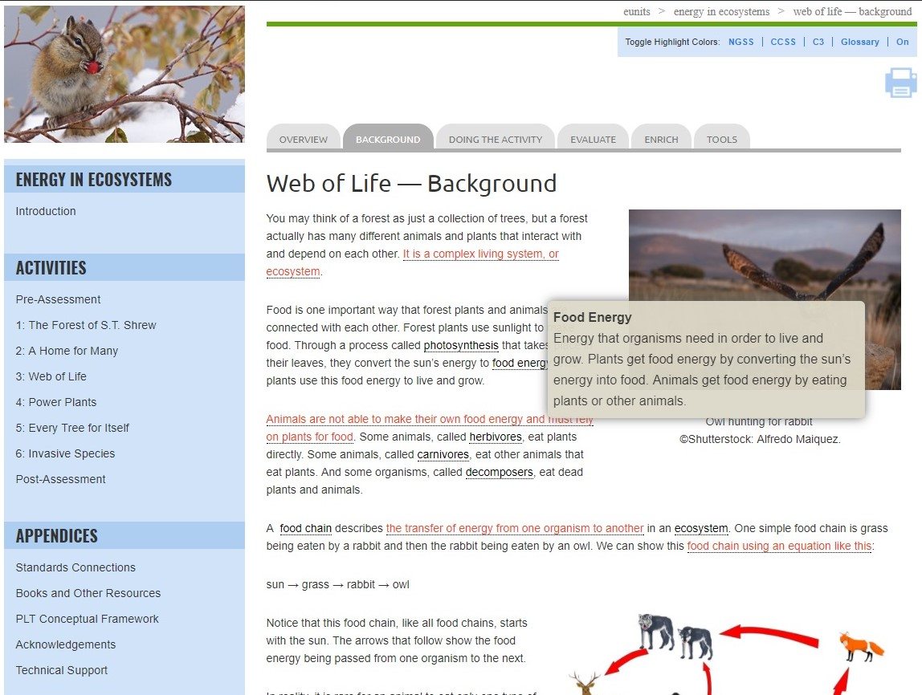
Notes:
Also note that the background and other activity sections include pop-up definitions for key vocabulary.

Slide 12
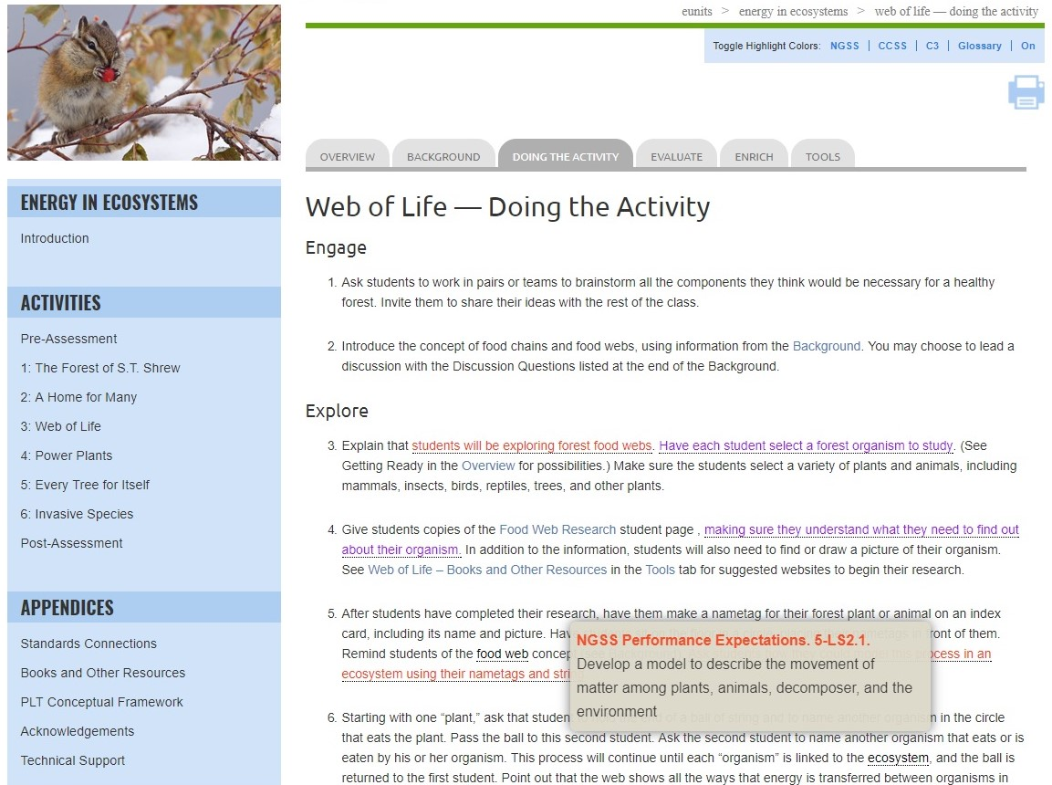
Notes:
Use this slide and the one that follows to show the interactive standards pop-ups.
The Energy in Ecosystems e-unit is built around the following performance expectations from the Next Generation Science Standards (NGSS):
3-LS4-3 – Biological Evolution: Unity and Diversity. Construct an argument with evidence that in a particular habitat some organisms can survive well, some survive less well, and some cannot survive at all.
4-LS1-1 – From Molecules to Organisms: Structures and Processes. Construct an argument that plants and animals have internal and external structures that function to support survival, growth, behavior and reproduction.
5-PS3-1 – Energy. Use models to describe that energy in animals’ food (used for body repair, growth, and motion and to maintain body warmth) was once energy from the sun.
5-LS2-1 – Ecosystems: Interactions, Energy, and Dynamics. Develop a model to describe the movement of matter among plants, animals, decomposers, and the environment.
While the e-unit is based on these NGSS standards, it will also help meet relevant state science standards.

Slide 13
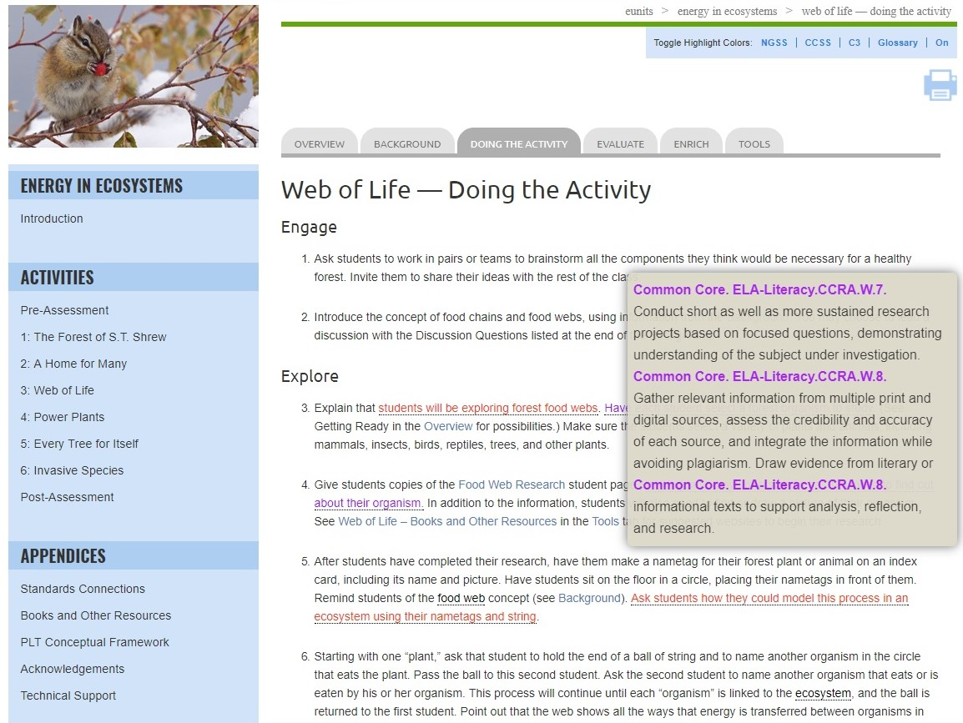
Notes:
The unit also integrates math, language arts, and other discipline areas in fun and creative ways, drawing on both mathematics and English language arts benchmarks from the Common Core State Standards.
Remember to mention that red pop ups signify NGSS connections, purple are Common Core (English language arts and mathematics), and green are the C3 Framework (social studies).

Slide 14
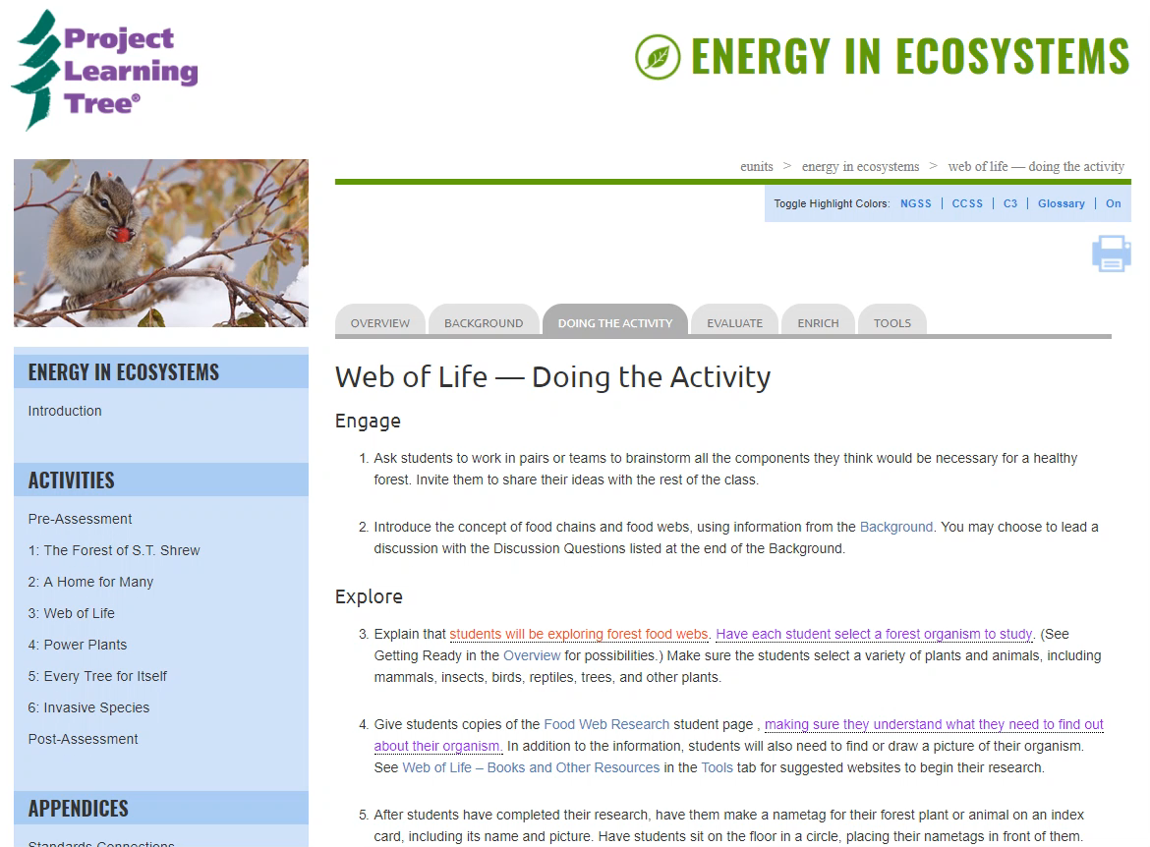
Notes:
Use this slide to point out that the unit is designed around the 5E Instructional Model:
Engage
Explore
Explain
Elaborate
Evaluate
It includes an imbedded screen video showing the headers that indicate the relevant parts of the model: Engage, Explore, Explain, and Elaborate with Doing the Activity. Note that Evaluate is listed in a separate tab.

Slide 15
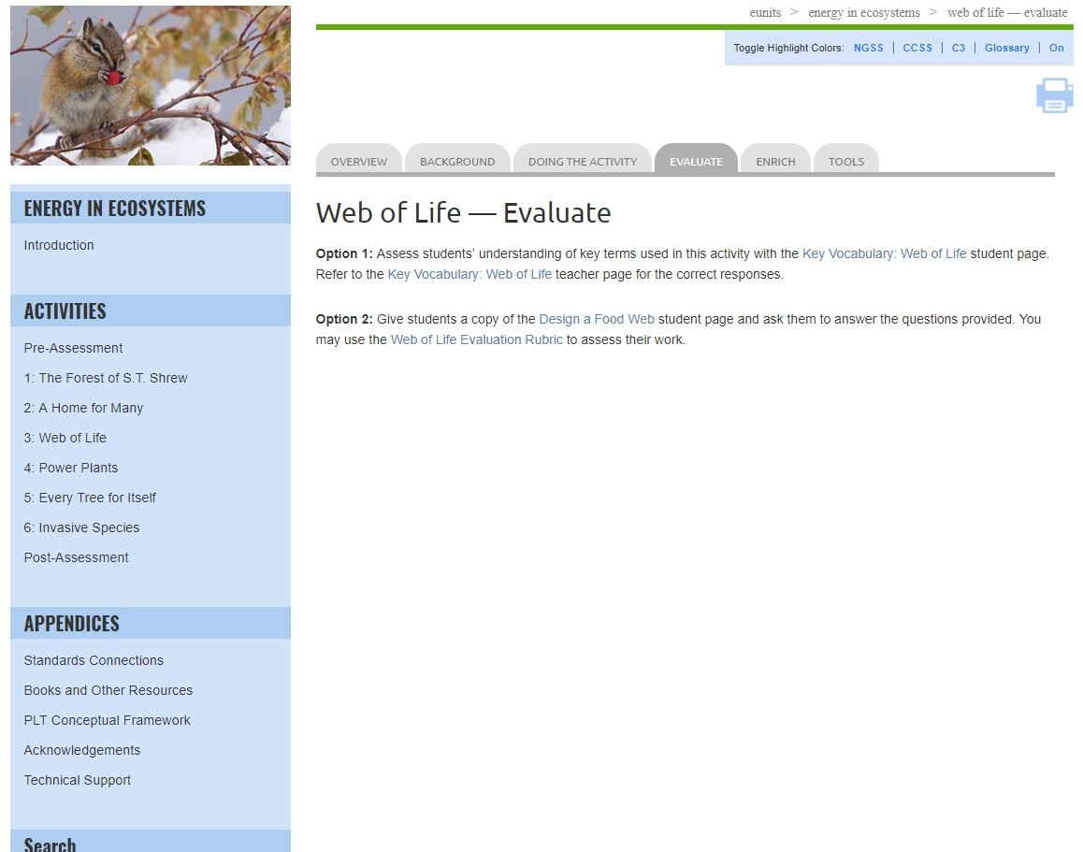
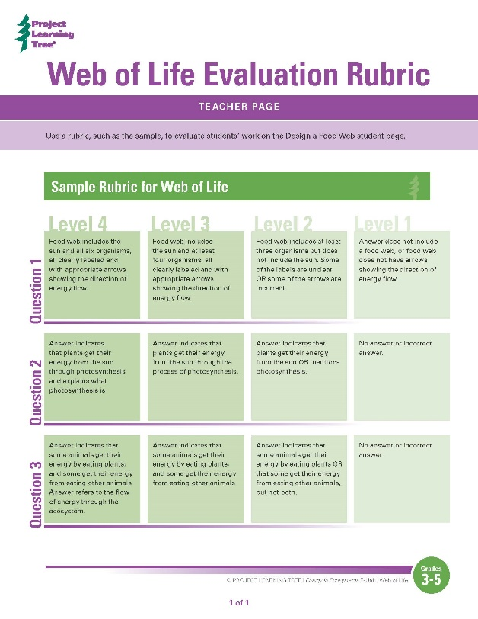
Notes:
Each activity includes multiple assessment options. Including:
Vocabulary worksheets
Rubrics to assess student learning
And additional evaluation options

Slide 16
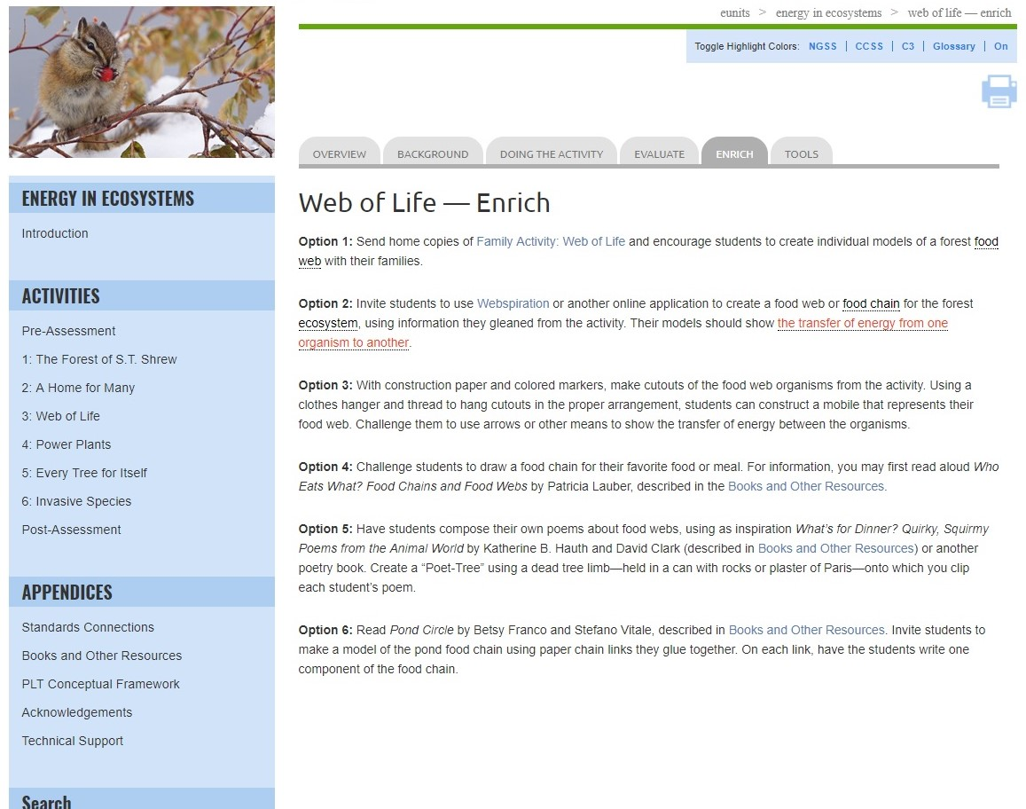
Notes:
Each activity provides suggested enrich options to extend learning

Slide 17
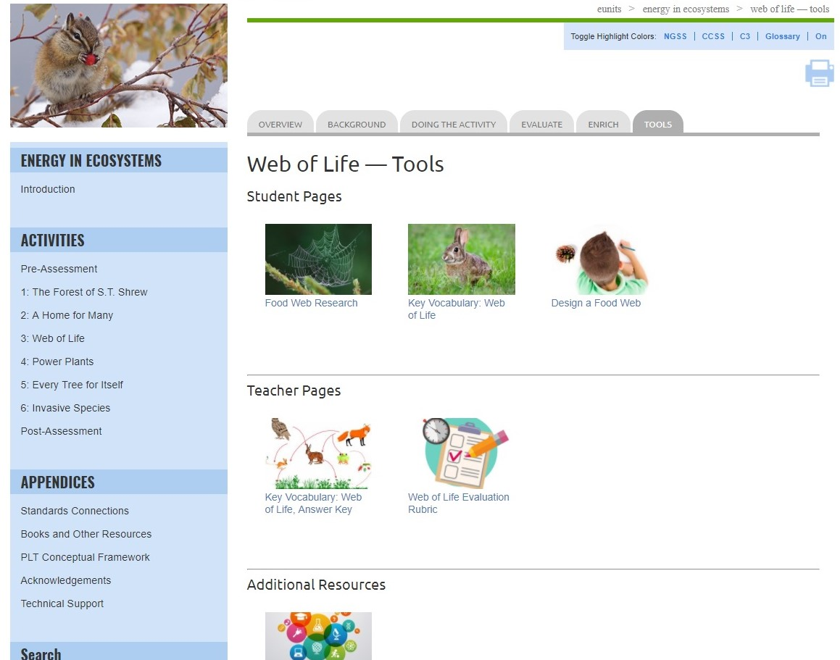
Notes:
Tools include:
Student pages
Teacher pages
Links to Additional Resources

Slide 18

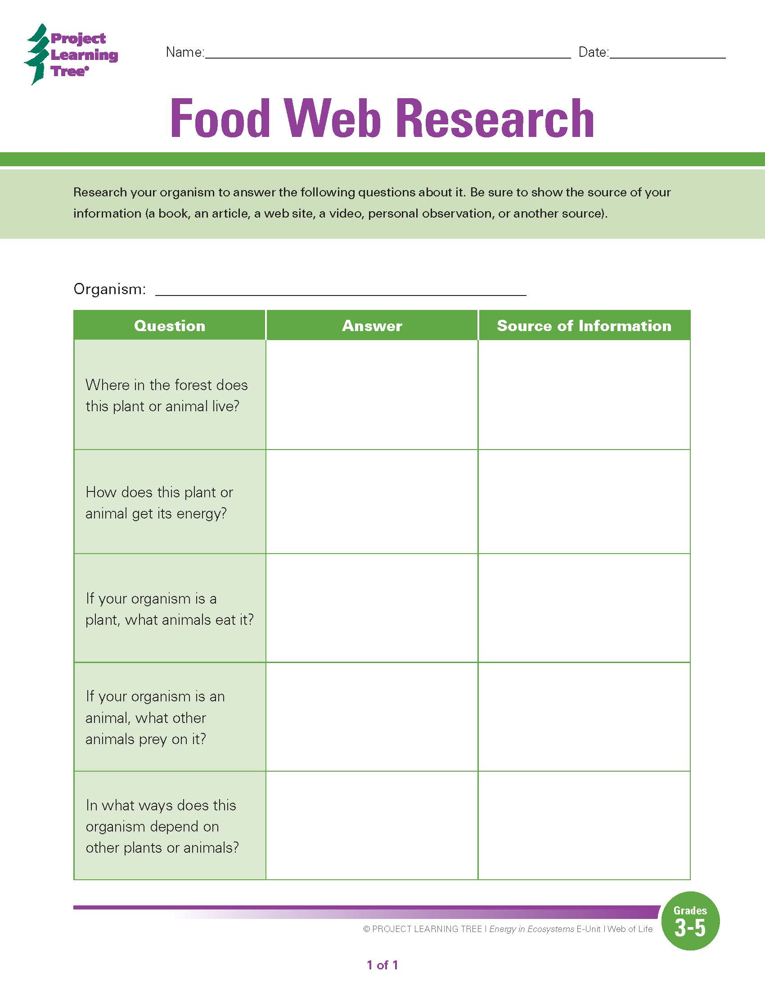
Notes:
Example student page
One of the exciting features of the e-units are that student pages are both printable and fillable. These pages can also be downloaded and saved to your computer.

Slide 19
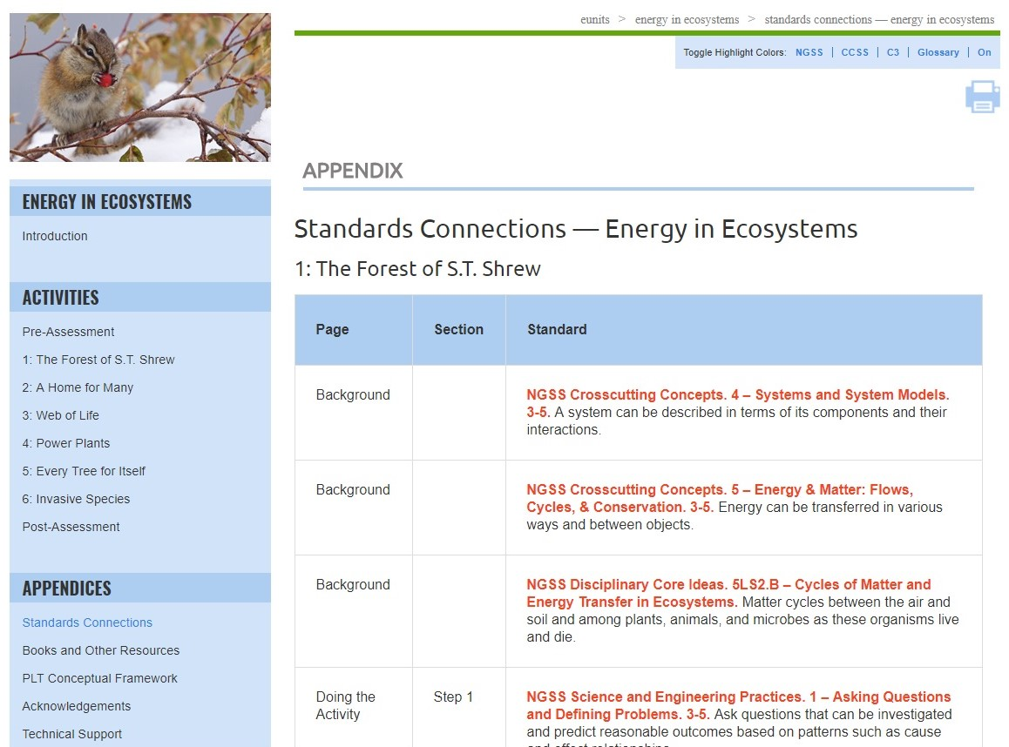
Notes:
Use this slide (and/or the others) to highlight relevant appendices for your audience; they include:
Standards Connections
Books and Other Resources
PLT Conceptual Framework
Acknowledgements
Technical Support
Standards Connections in the appendices is a listing of all of the connections for the entire unit that are identified by the pop-up feature.

Slide 20
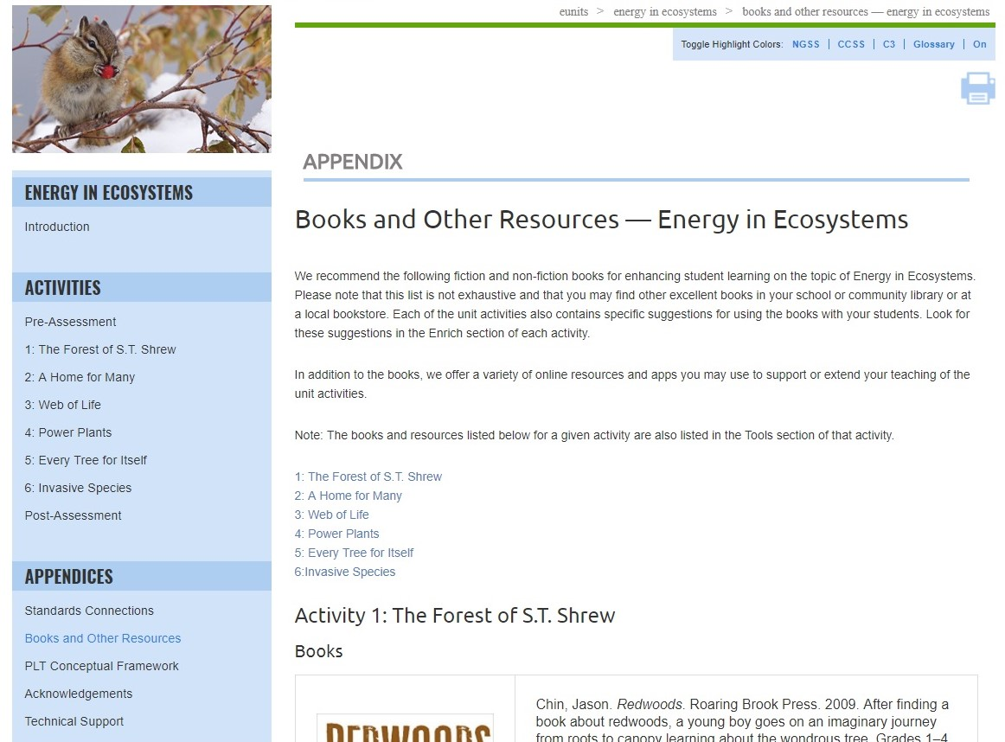
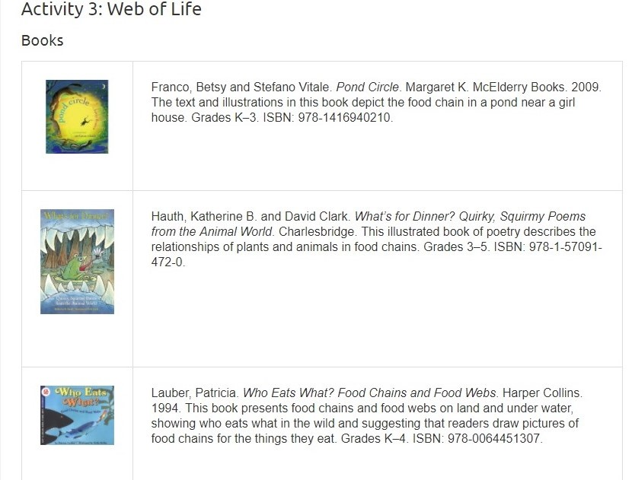
Notes:
Use this slide (and/or the others) to highlight relevant appendices for your audience; they include:
Standards Connections
Books and Other Resources
PLT Conceptual Framework
Acknowledgements
Technical Support
Books and Other Resources in the appendices is a listing of all websites, books, and other resources for the unit as a whole as well as activity-by-activity resources to support teaching of the unit.

Slide 21
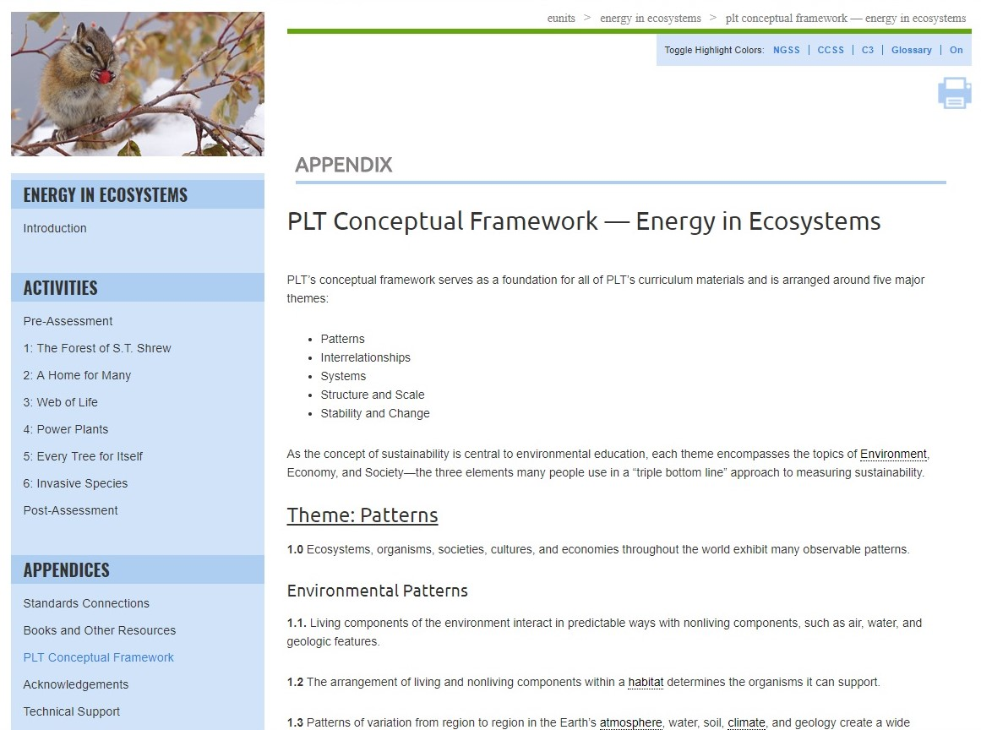
Notes:
Use this slide (and/or the others) to highlight relevant appendices for your audience; they include:
Standards Connections
Books and Other Resources
PLT Conceptual Framework
Acknowledgements
Technical Support
The PLT Conceptual Framework serves as a foundation for all of PLT’s curriculum materials.

Slide 22
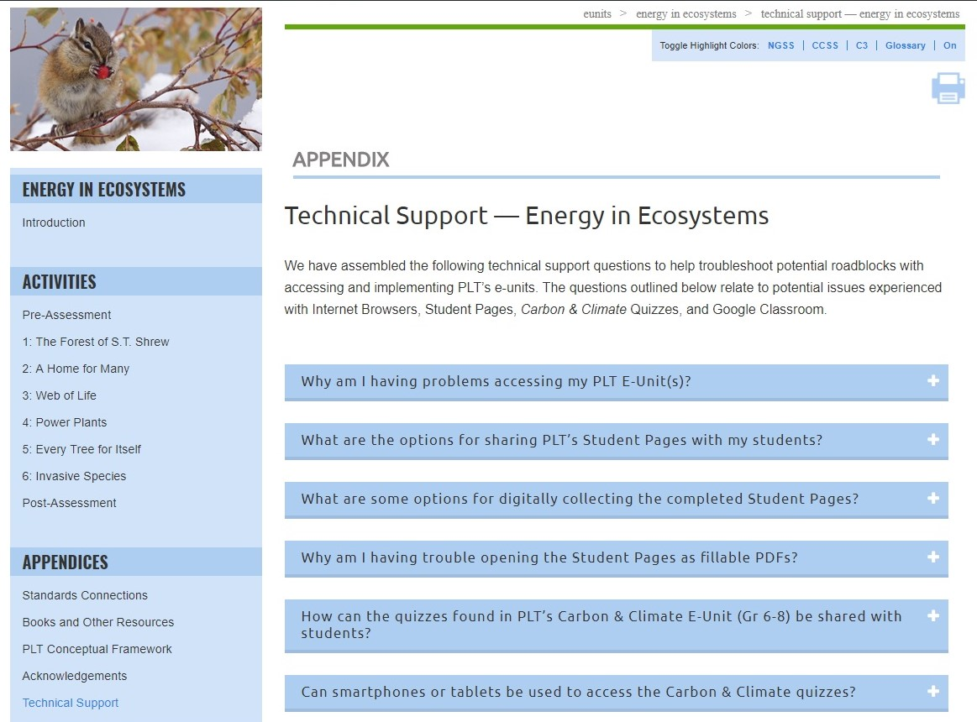
Notes:
Use this slide (and/or the others) to highlight relevant appendices for your audience; they include:
Standards Connections
Books and Other Resources
PLT Conceptual Framework
Acknowledgements
Technical Support
Technical Support answers common technical questions to help troubleshoot potential problems with accessing and using the e-units. Questions relate to potential issues experienced with internet browsers, student pages, quizzes and Google Classroom.

Slide 23
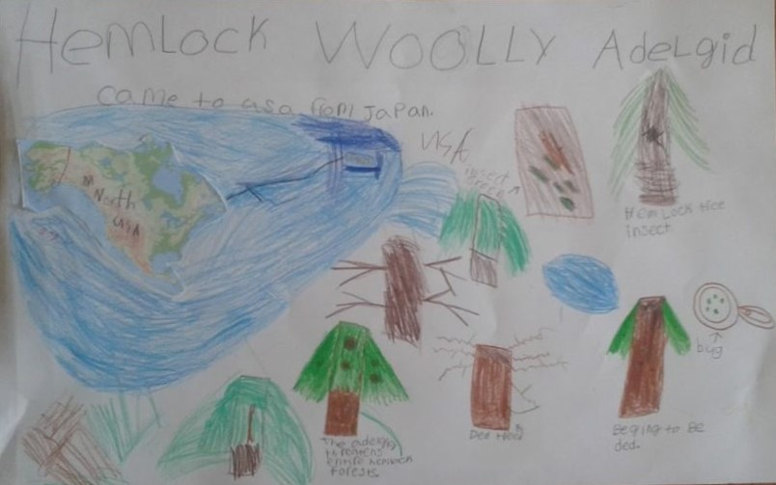
Invasive Species
Notes:
To elaborate, give participants a taste of another activity, Activity 6: Invasive Species.

Slide 24
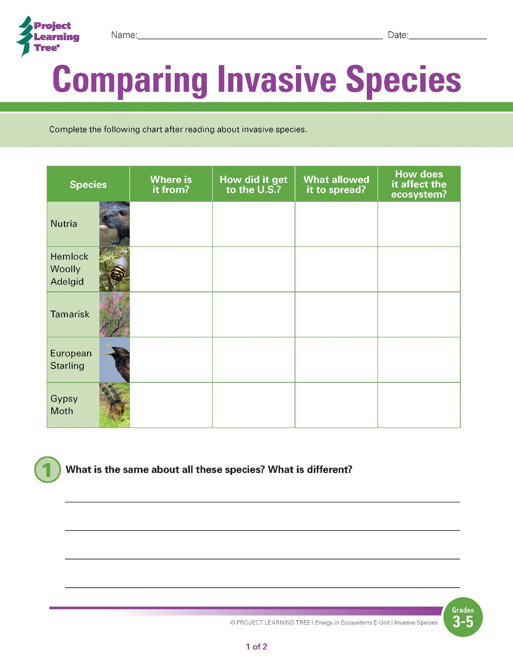
Notes:
Explain that in this activity, students read about different invasive species and then analyze the characteristics of invasive species to determine the attributes they share.
They then research an invasive species more in depth, and create a group presentation about that species.

Slide 25
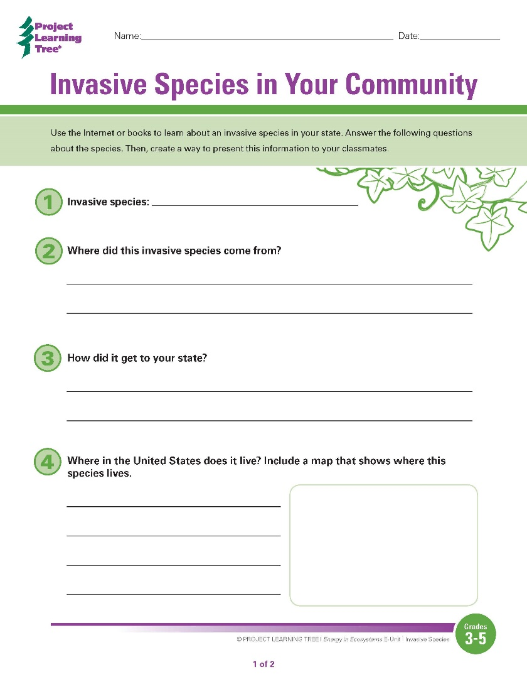
Opportunities to Localize Learning
Notes:
In this activity, teachers may use the species provided with the unit materials, or they may choose to have students focus on their own state or other region.
This is just one of the ways that you can take PLT’s “national” e-unit curriculum and customize it for the regional, state, and local levels.

Slide 26
Energy in Ecosystems Activities
1: The Forest of S.T. Shrew
  Examine how forest organisms get their food energy.
2: A Home for Many
Observe organisms living in and around a tree.
3: Web of Life
Create a model showing energy transfer between organisms.
4: Power Plants
  Conduct an experiment to learn what plants need to grow.
  5: Every Tree for Itself
Simulate what happens when trees do or don’t get their needs met.
6: Invasive Species
Explore how invasive species affect the flow of energy in ecosystems.
Notes:
The e-unit includes 6 activities that help students understand the flow of energy in ecosystems, with a focus on forest ecosystems.

Slide 27
Supports for Teaching Activities
Step-by-step instructions
Extensive background sections
Vocabulary exercises
Suggested book, websites, and other resources
Assessment rubrics
Printable and fillable student pages
Notes:
The Energy in Ecosystems e-unit contains lots of resources and materials to support teaching the activities.

Slide 28
Obtaining PLT E-Units
In-Person Professional Development
  Contact your PLT State Coordinator
  www.plt.org/your-state-project-learning-tree-program
Online Professional Development
  Self-paced online workshop included with e-unit
  $40 per e-unit at shop.plt.org
Notes:
If desired, insert your state specific contact information or upcoming workshop details.

Slide 29
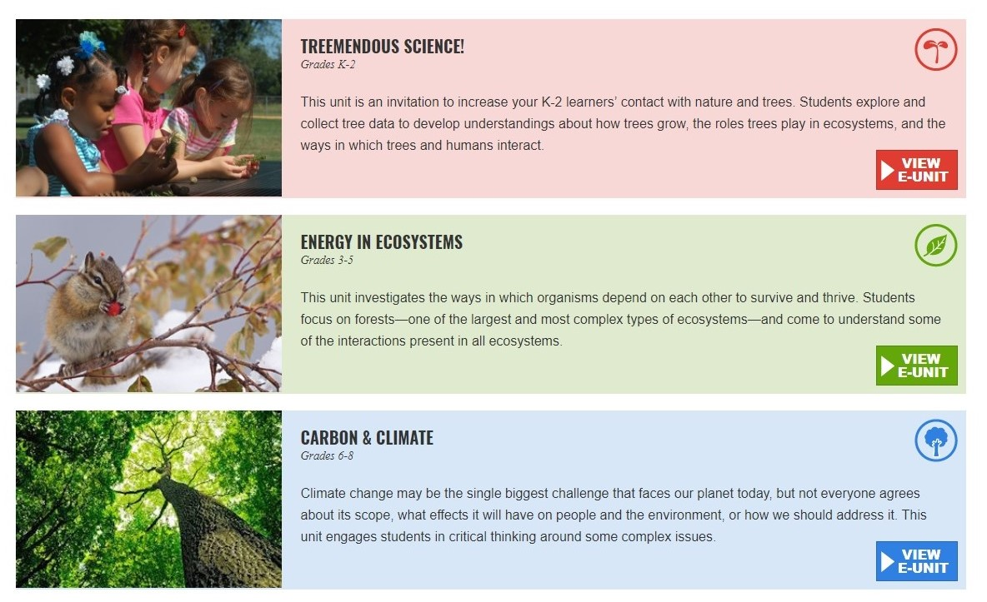
Available E-Units
Notes:
PLT has 3 e-units available at this time, each for a different grade level band.

Slide 30
Questions, Comments?
Presenter 1 Name
Presenter 1 Title, State
Presenter1email@xxxx.org
Presenter 2 Name
Presenter 2 Title, State
Presenter2email@xxxx.org
Thank you!
Notes:
Remember to update the red text with your workshop-specific information.
Distribute any evaluation forms at this time, tying survey questions to the intended workshop outcome, as appropriate.

Slide 31


Project Learning Tree Montana
These workshops are funded in part from a federal award of the U.S. Forest Service, Department of Agriculture, subawarded by the Montana Department of Natural Resources and Conservation, Forestry Division to Montana State University Extension.
The Montana State University Extension Service is an ADA/EO/AA/ Veteran’s Preference Employer and Provider of Educational Outreach.

