Slide 1
Montana PLT Coordinator
April 2020
Cindy Peterson
MSU Extension Forestry
Associate Forestry Specialist 2
32 Campus Drive MS0606
Missoula MT 59812-0606
(406) 243-4706
cindy.peterson@umontana.edu
www.forestry.msuextension.org

Slide 2
Project Learning Tree
PLT is a program of the Sustainable Forestry Initiative SFI is a solutions-oriented sustainability organization that collaborates on forest-based conservation and community initiatives that demonstrate and enhance our shared quality of life while providing supply chain assurances through standards, data, and authentic stories.
Montana PLT is sponsored by:
MSU Extension Forestry

Slide 3
What is Project Learning Tree? A Comprehensive Environmental Ed. (EE) Program
High quality, PreK-12 EE curriculum materials
Diverse, international network of partners
Implementation via a successful delivery system of professional development

Slide 4
PLT’s Mission
PLT uses the forest as a "window on the world" to:
Increase students' understanding of our complex environment
Stimulate critical and creative thinking
Develop the ability to make informed decisions on environmental issues
Instill the confidence and commitment to take responsible action

Slide 5
Project Learning Tree History
Early 1970’s: Partnership between education, resource agencies, and businesses
→ started Project Learning Tree to teach young people about the environment
1976: PLT materials first implemented in 13 western states
→PreK-6 and 7-12 Environmental Education Guides
1990: PLT materials revamped into PreK-8 and Secondary Modules
2006: Major revisions to the PLT PreK-8 Guide and continued development of Secondary Modules
2017: Introduction of on-line modules for EC, preK-8 Guides, GreenSchools Grants, Energy in Ecosystems E-Unit for grades 3-5 and Carbon & Climate E-Unit for grades 6-8.
PLT was so effective it inspired other EE programs based on the PLT model
Project WILD in 1983
Project WET in 1992

Slide 6
PLT’s Environmental Education Goals
Awareness
Knowledge
Challenge
Responsible
Action
“Teaching students how to think, not what to think about complex environmental issues.”
~Rudy Schafer, Founder PLT

Slide 7
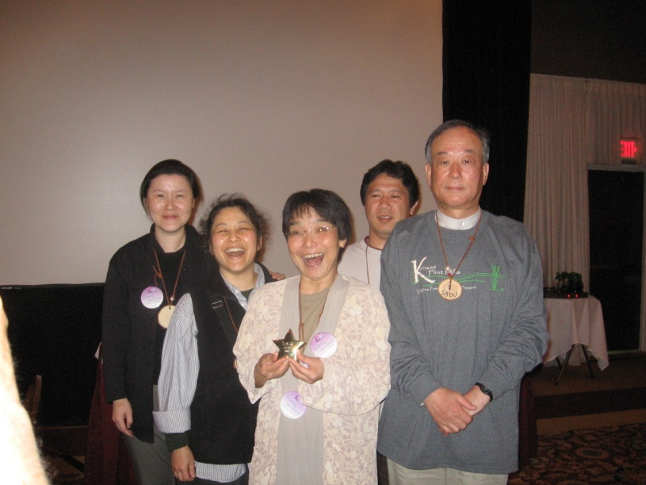
PLT’s International Network
All 50 states and the District of Columbia
Brazil, Canada, Chile, Finland, Japan, Mexico, Philippines, Slovakia, Sweden, U.S. Trust Territories, The Peace Corps
AFF’s Center for Environmental Learning office (“National PLT”)
CEL Operating Committee
State Sponsors
State Steering Committees
State Coordinators
Facilitators
Teachers
Students

Slide 8
National, State, and Local Partnerships
American Forest Foundation

Slide 9
Implementation
50 State Network
“Train the Trainer Model”
Professional Development
Inservice
Preservice
Nonformal
30,000 Educators Trained Each Year Across the Country
You are the first Educators Trained Each Year in Montana
During the average business day,
a PLT workshop begins every hour.
More than half the teachers who
attend use PLT in their classes
at least six times a year.

Slide 10
PLT Curriculum
PLT for PreK-8
Early Childhood
PreK-8 Environmental Education Activity Guide
Energy and Society
Treemendous Science (K-2)
Energy in Ecosystems (3-5) online
Carbon & Climate (6-8) online
PLT for Secondary
5 printed modules
3 online modules

Slide 11
PLT’s PreK-8 Environmental Education Activity Guide
New Features
Reading Connections
Technology Connections
Differentiated Instruction
New Design
Aligned to National and State Standards
Classroom Friendly
96 hands-on, interdisciplinary activities
Indoor and outdoor activities

Slide 12
Energy & Society Kit
Activity Guide
Music & Dance by Billy B
Energy & Me CD
Energy & Me music and dance DVD
Poster Set
Where is the energy?
What powers the move?

Slide 13
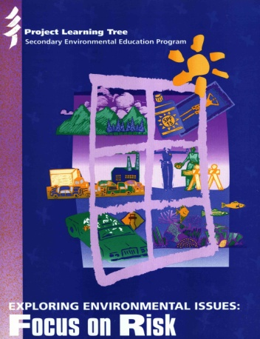
Secondary Modules (Grades 9-12)
- Focus on Forests
- Municipal Solid Waste
- Focus on Risk
Biotechnology Supplement (In Development)
- Places We Live
- Biodiversity (Online)
- Forests of the World

Slide 14
Curriculum Development Process
Advisory Committee
2. Focus Groups
First Draft of Activities
Teachers Pilot-test Activities
5. Activities reviewed by Education and Resource Professionals
6. Activities Revised/Edited
7. Activities Reviewed
8. Final Editing
9. Design and Publishing
10. Implementation through workshops
11.Teachers Field-Test Module

Slide 15
PLT Curriculum Evaluation
Evaluations confirm increased knowledge and positive attitudinal growth among students
PreK-8 Guide:
Evaluation by NAAEE Research Commission in 1994
Secondary Modules:
Focus on Forests, Forest Ecology, and Municipal Solid Waste modules evaluated by Dr. Louis Iozzi at Rutgers University-Cook College
Focus on Risk module evaluated by Dr. Michaela Zint and Christina Gomez-Schmidt at the University of Michigan
Places We Live module evaluated by Dr. Sarah Haines at Towson University
Please visit Project Learning Tree website for more details.

Slide 16
Standards Correlations and No Child Left Behind (NCLB)
Most states have aligned PLT materials to their state academic standards
visit PLT website for national and state correlations
(Common Core, next Generation Science, Girls Scouts, Boy Scouts and more)
No Child Left Inside Act (NCLI) (H.R. 882/2015)
AFF/PLT a member of the NCLI coalition
Legislation would:
authorize Environmental Education in NCLB
provide new funding to states for teacher training and state environmental literacy plans

Slide 17
Every Student Learns Outside
Teaching with PLT is fun and hands-on video
Learn how to make outdoor experiences part of everyday lesson plans
Find a series of kids activity pages for “non-educators” based upon PLT activities

Slide 18
Urban Forestry Website
link to PLT urban forest page
Annotated bibliography and links to websites of urban and community forestry organizations
Enhances the teaching of PLT activities related to urban and community forestry
Funding provided by National Urban and Community Forestry Advisory Council

Slide 19
Educator Support Materials
The Branch, PLT’s quarterly online newsletter
Information on PLT’s programs and resources
Latest in environmental education news
The PLT website, PLT website
Resources by Activity Pages
Download student pages
Find additional resources for each activity
Calendar of PLT events
Standards correlations
and more!

Slide 20
Recognizing Excellence
PLT’s National Outstanding Educator Program
Recognizes educators for their commitment to EE, teaching skills, and use of PLT
Five winners chosen each year from state nominations

Slide 21
Green Works
Grants up to $5,000 for students to complete environmental service-learning projects.
Integrates community service with the academic curriculum.
Combines the environmental knowledge and resources of PLT with community action initiatives.
Grant Cycles
Round 1: Applications Due April 30
Round 2: Applications Due October 31

Slide 22
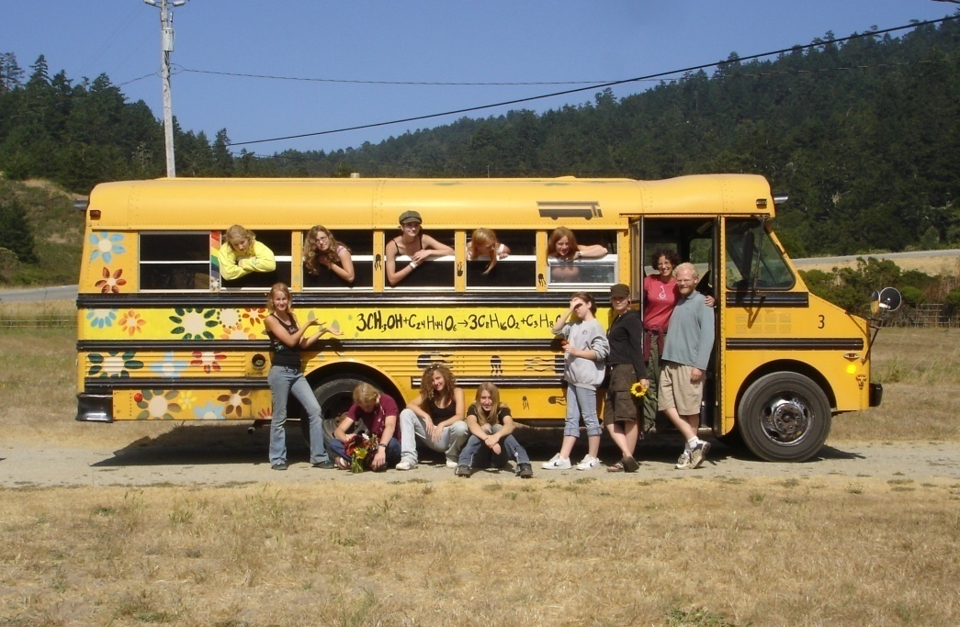
GreenWorks! In Action: Biodiesel ReEnergizes Us!
11th Grade Science Students in Utah created biodiesel…
…then powered a van with it for field trips!

Slide 23
PLT’s GreenSchools! Program
It combines:
environmental education
service-learning
leadership opportunities
It engages:
teachers, faculty, maintenance staff
students
school board members
parents and community members
Students
reduce the ecological footprint of their school
create a more green and healthy learning environment
save their school money!

Slide 24
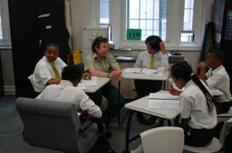
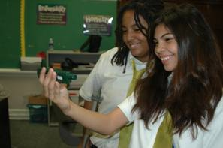
How can schools participate?
1. Attend a PLT Workshop
2. Register Online – PLT GreenSchools website
3. Obtain GreenSchools! Investigations
4. Form a GreenSchools! Team
5. Complete 5 GreenSchools! Investigations
6. Conduct Environmental
Action Projects
7. Collect Data to
Support Change

Slide 25
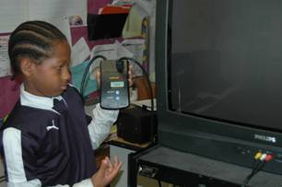
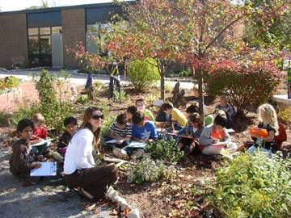
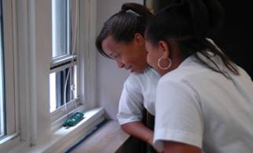
GreenSchools! Investigations
Energy Use
Waste and Recycling
Water Consumption
School Site
Environmental Quality

Slide 26
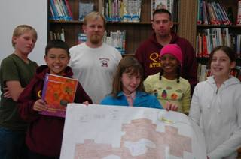
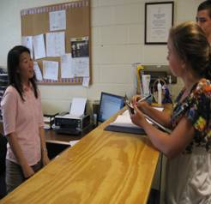
PLT GreenSchools! and GreenWorks!
Based on service-learning practices:
Investigation
Preparation
Action
Reflection
Demonstration
Celebration
All about Youth Voice!!

Slide 27
Project Learning Tree Works
25,000 educators trained a year
Half of users report using PLT at least
once a month
Recipient of national awards
60% of workshop participants are
referred to PLT by another educator

