Slide 1



Project Learning Tree in Action!

Slide 2
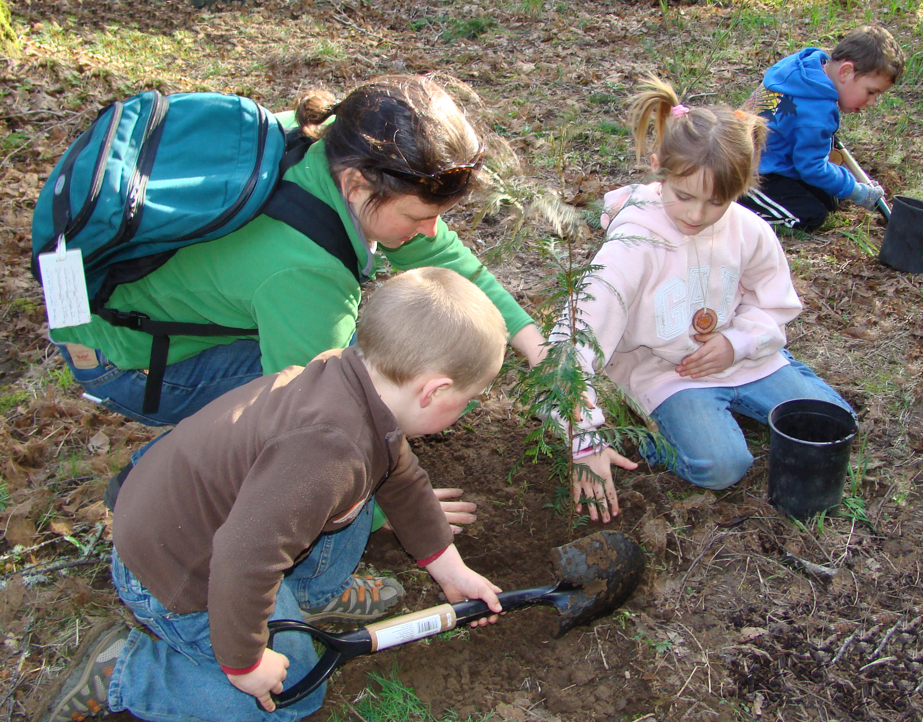

Slide 3
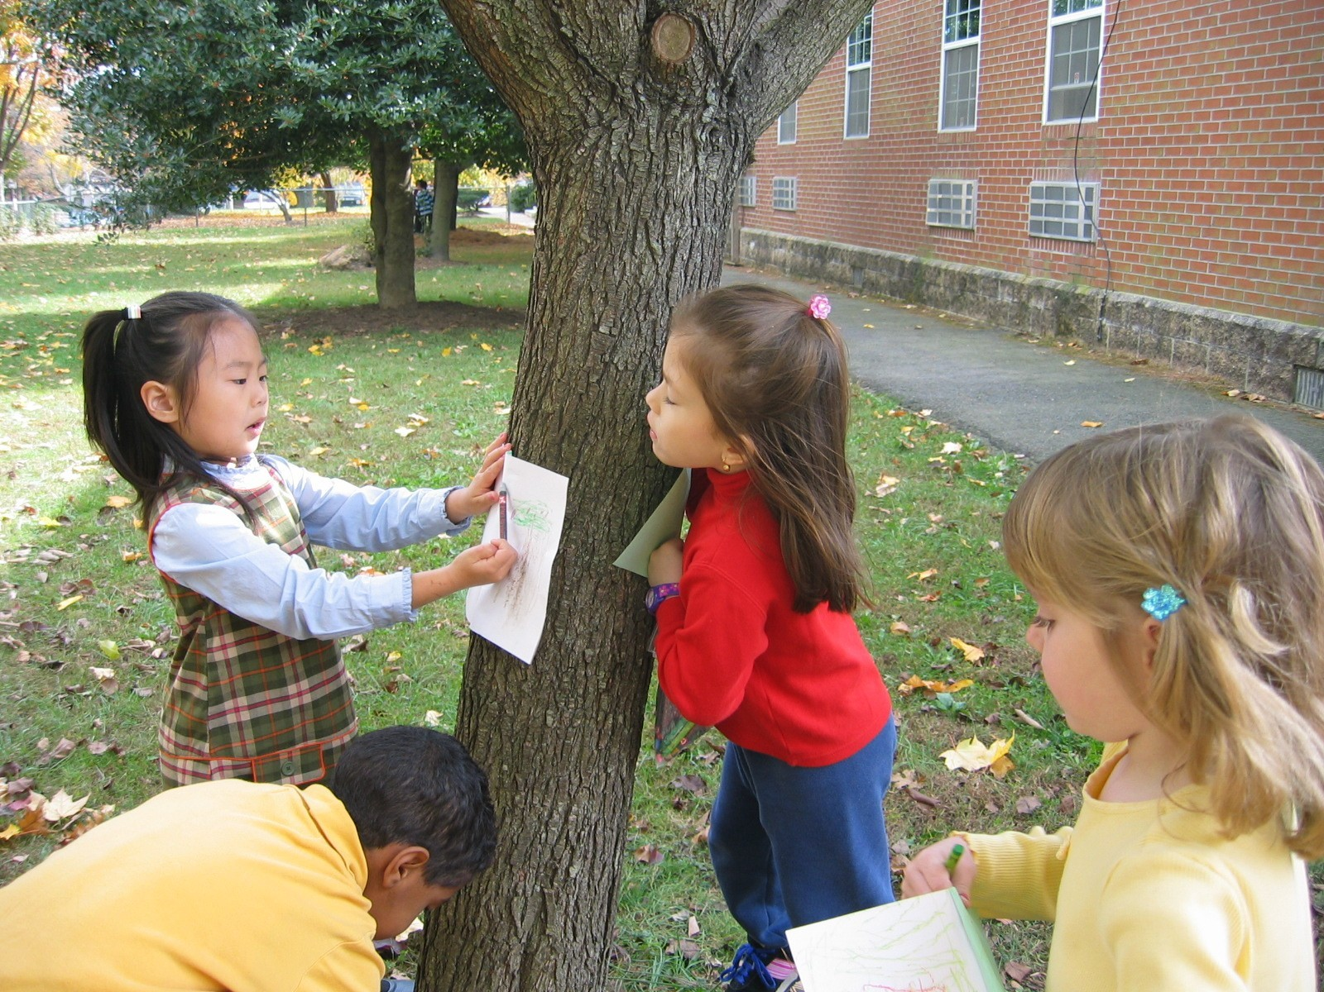

Slide 4
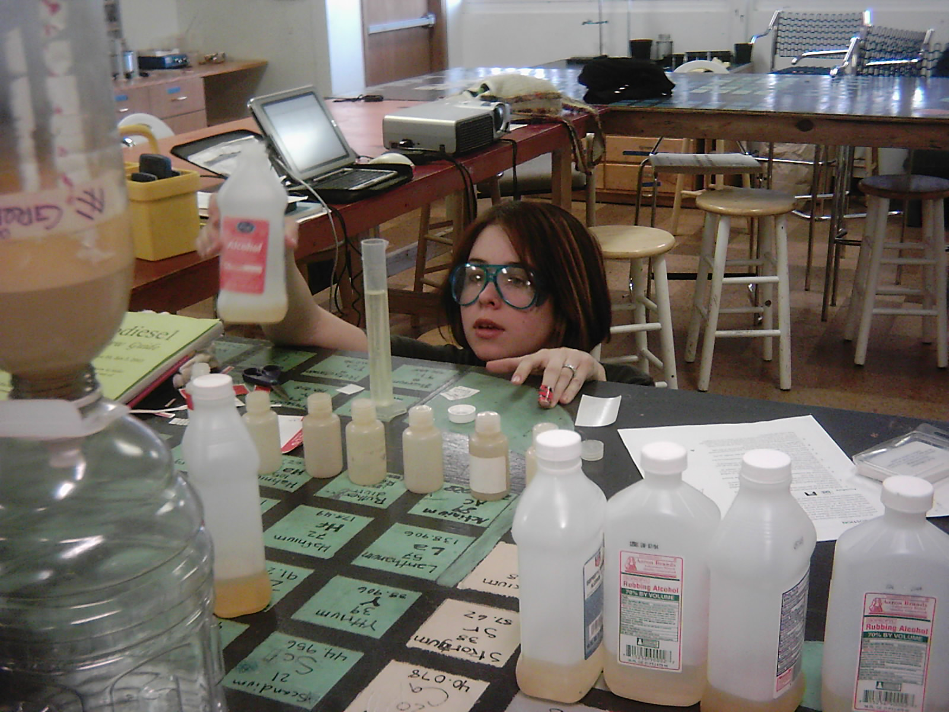

Slide 5
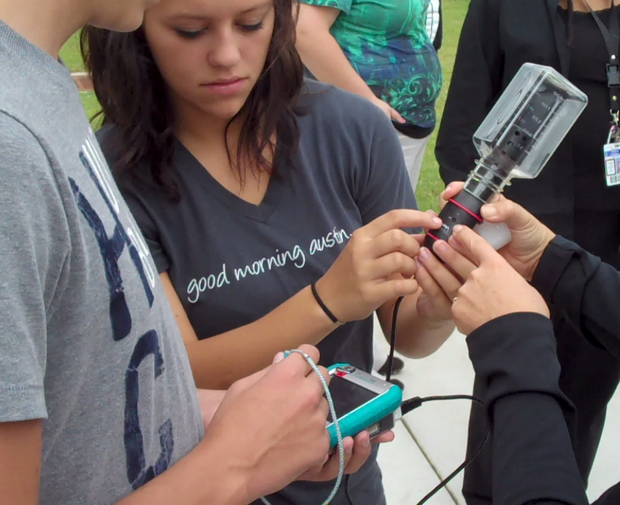

Slide 6
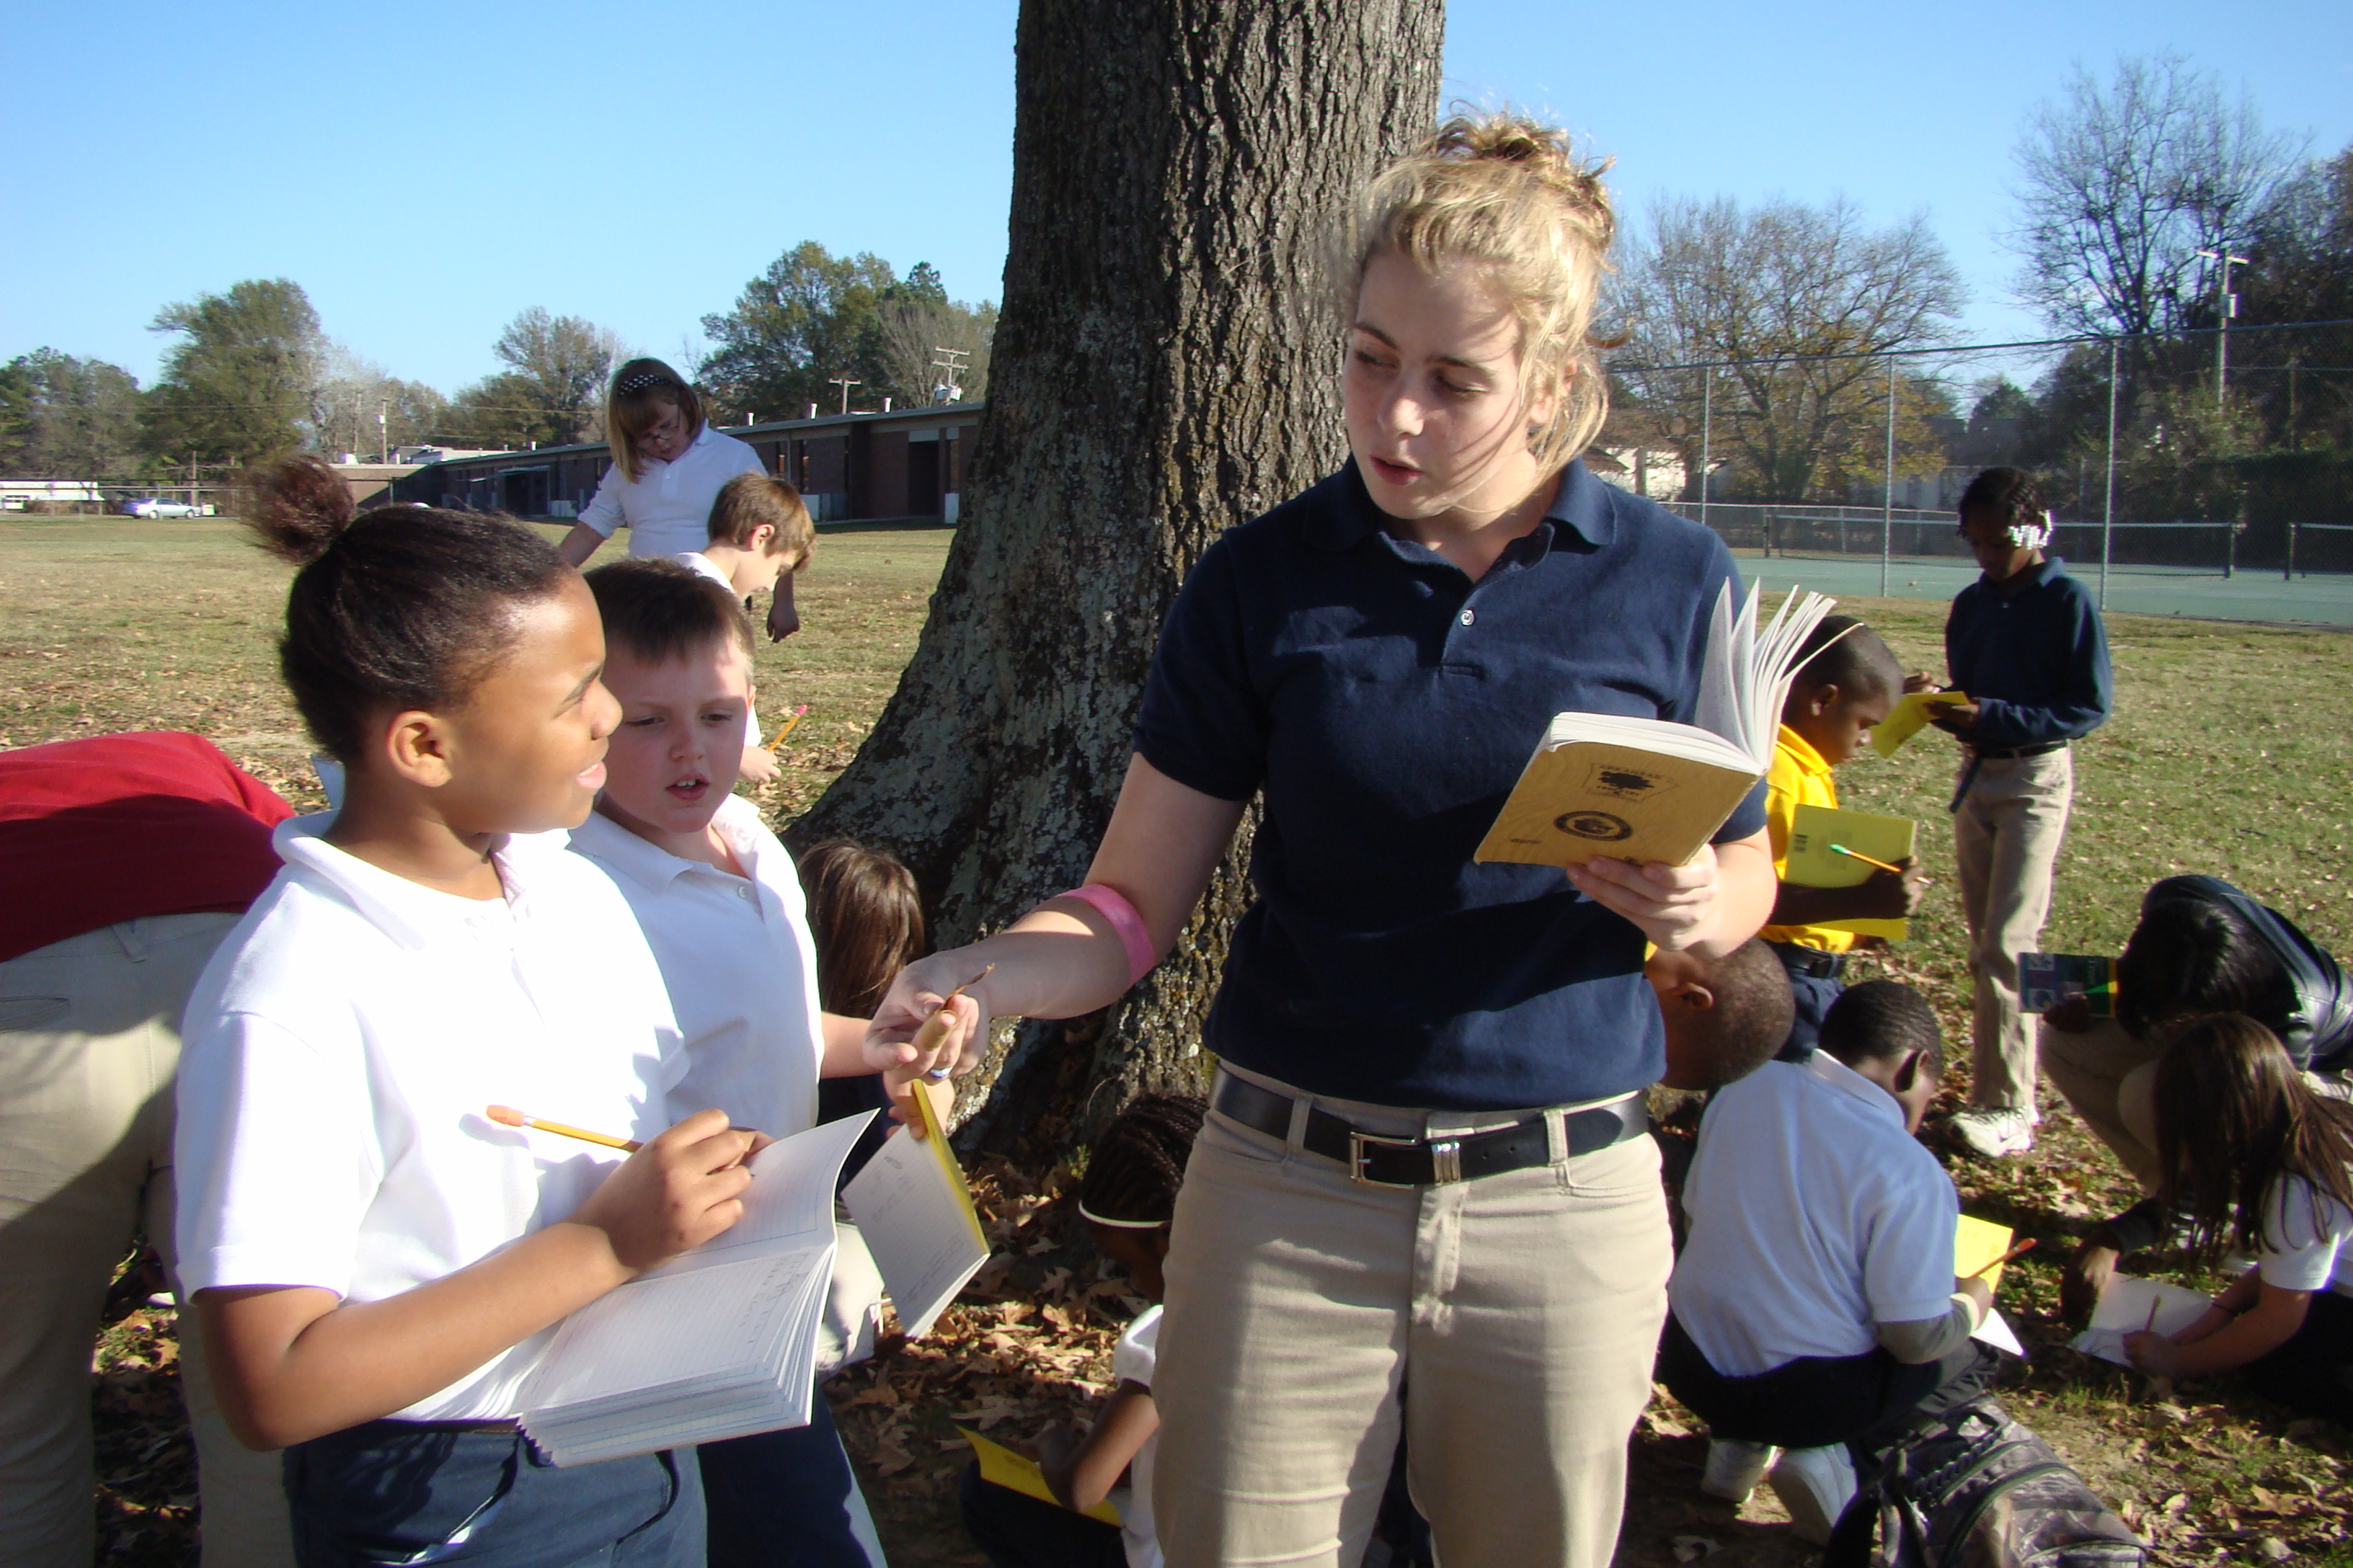

Slide 7
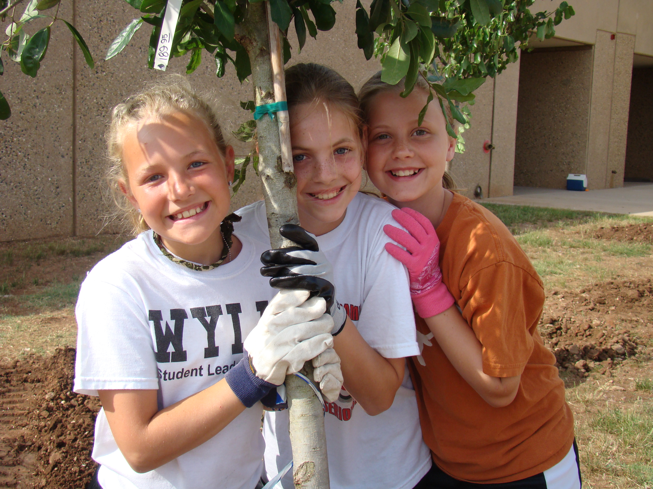

Slide 8
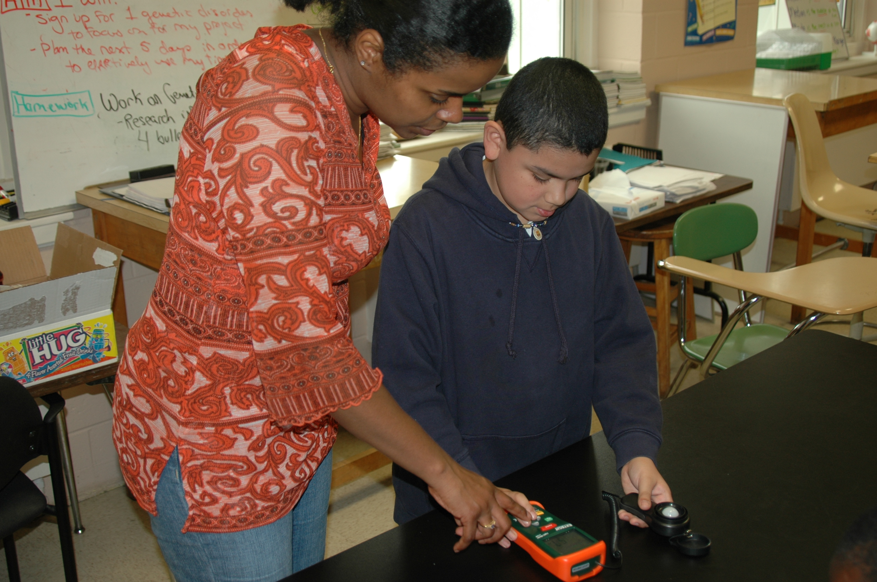

Slide 9
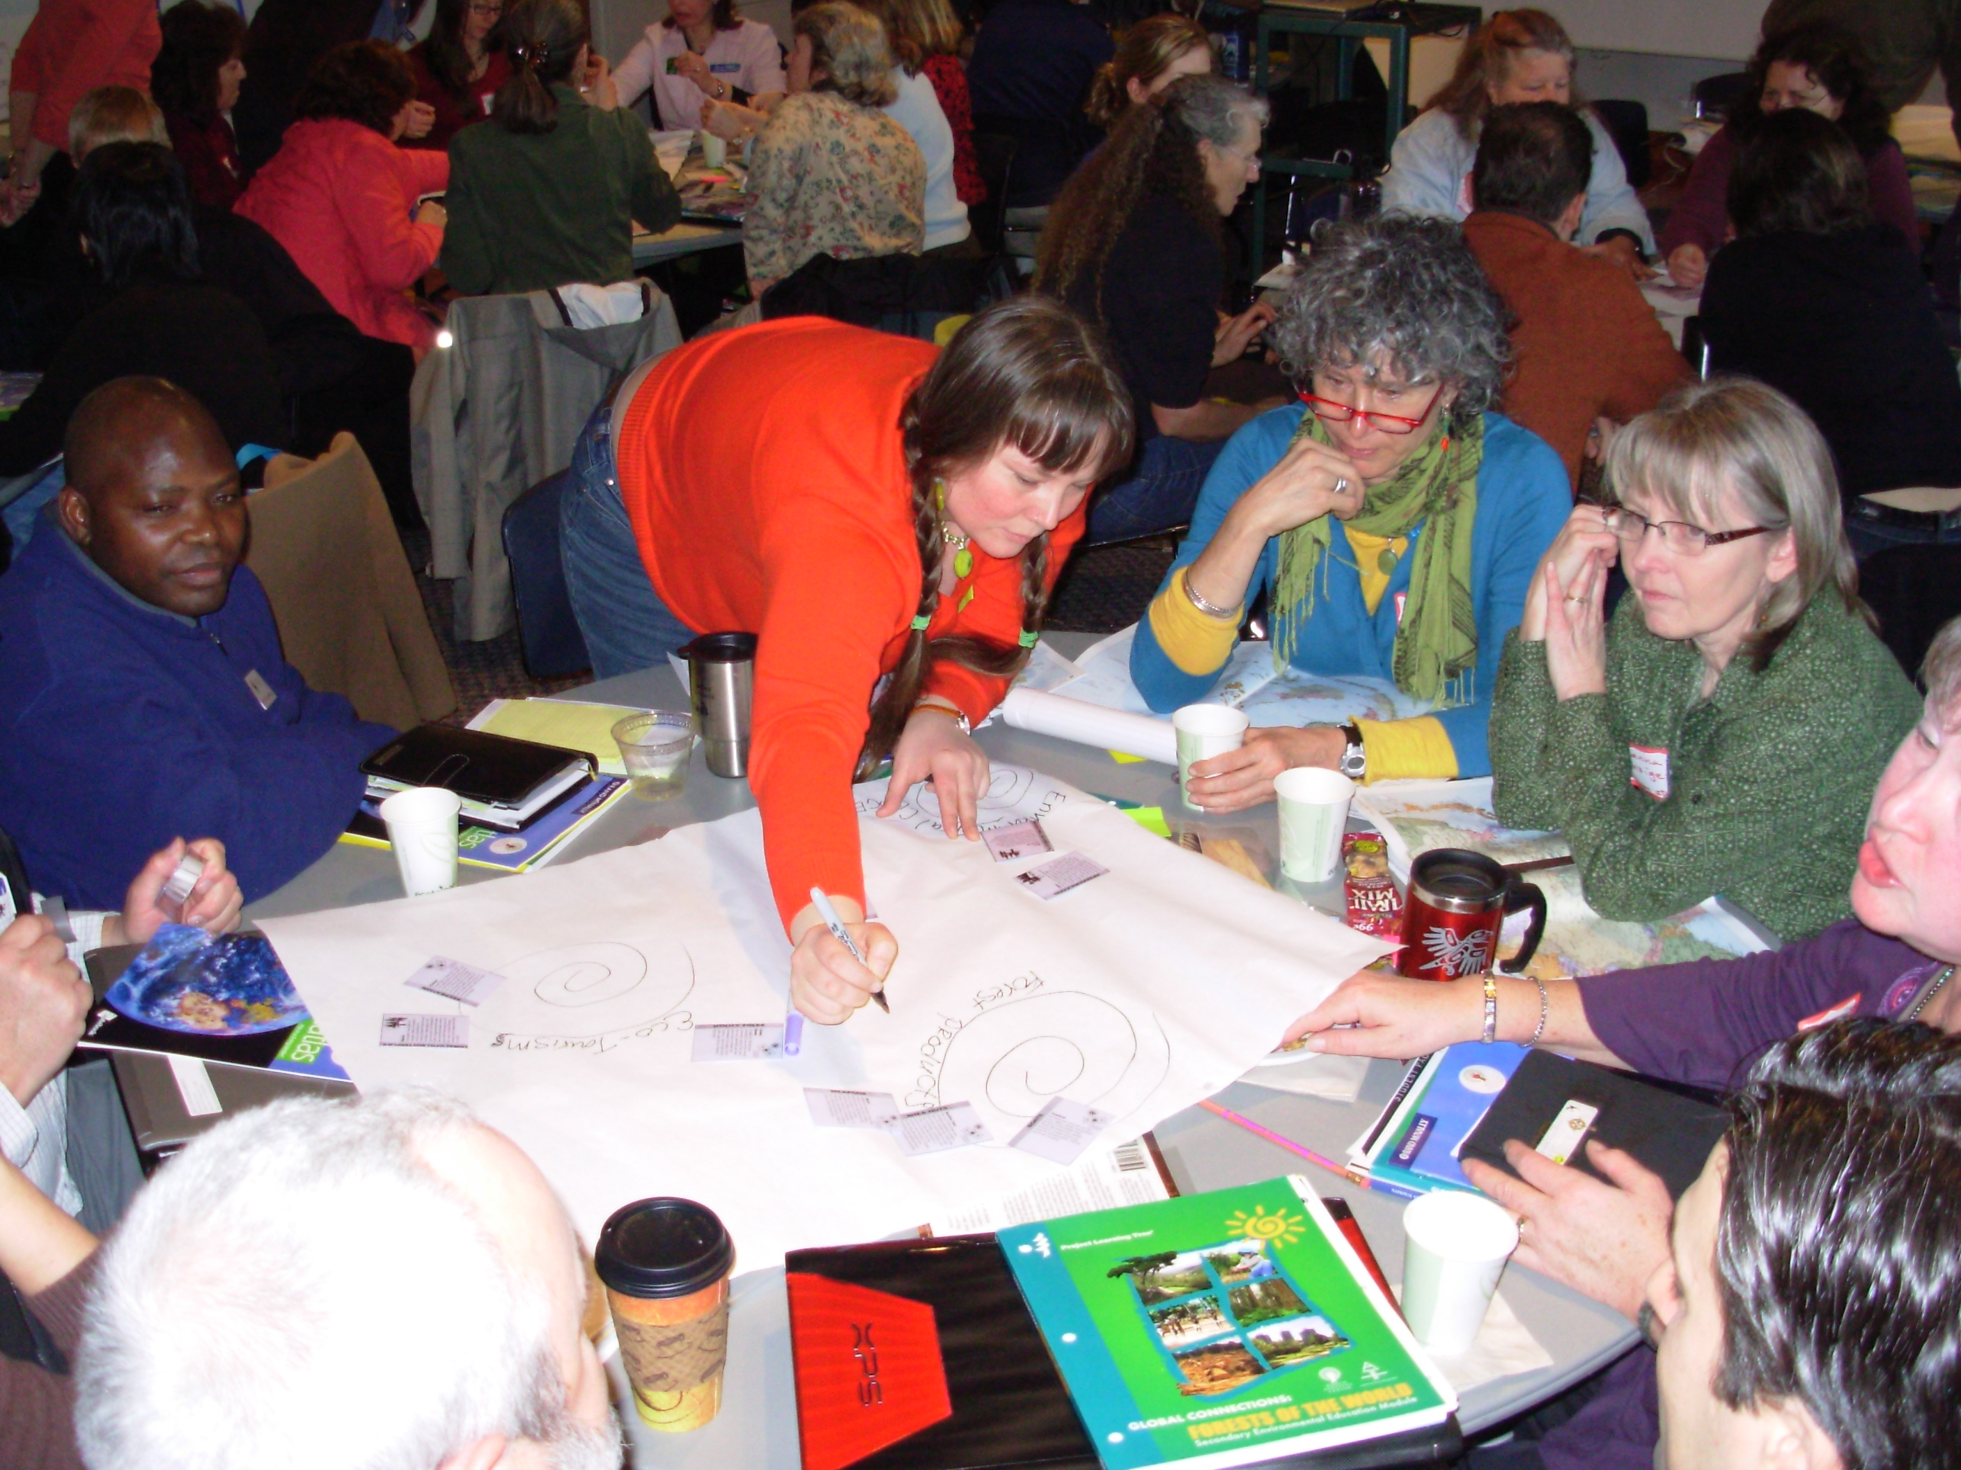

Slide 10


Slide 11
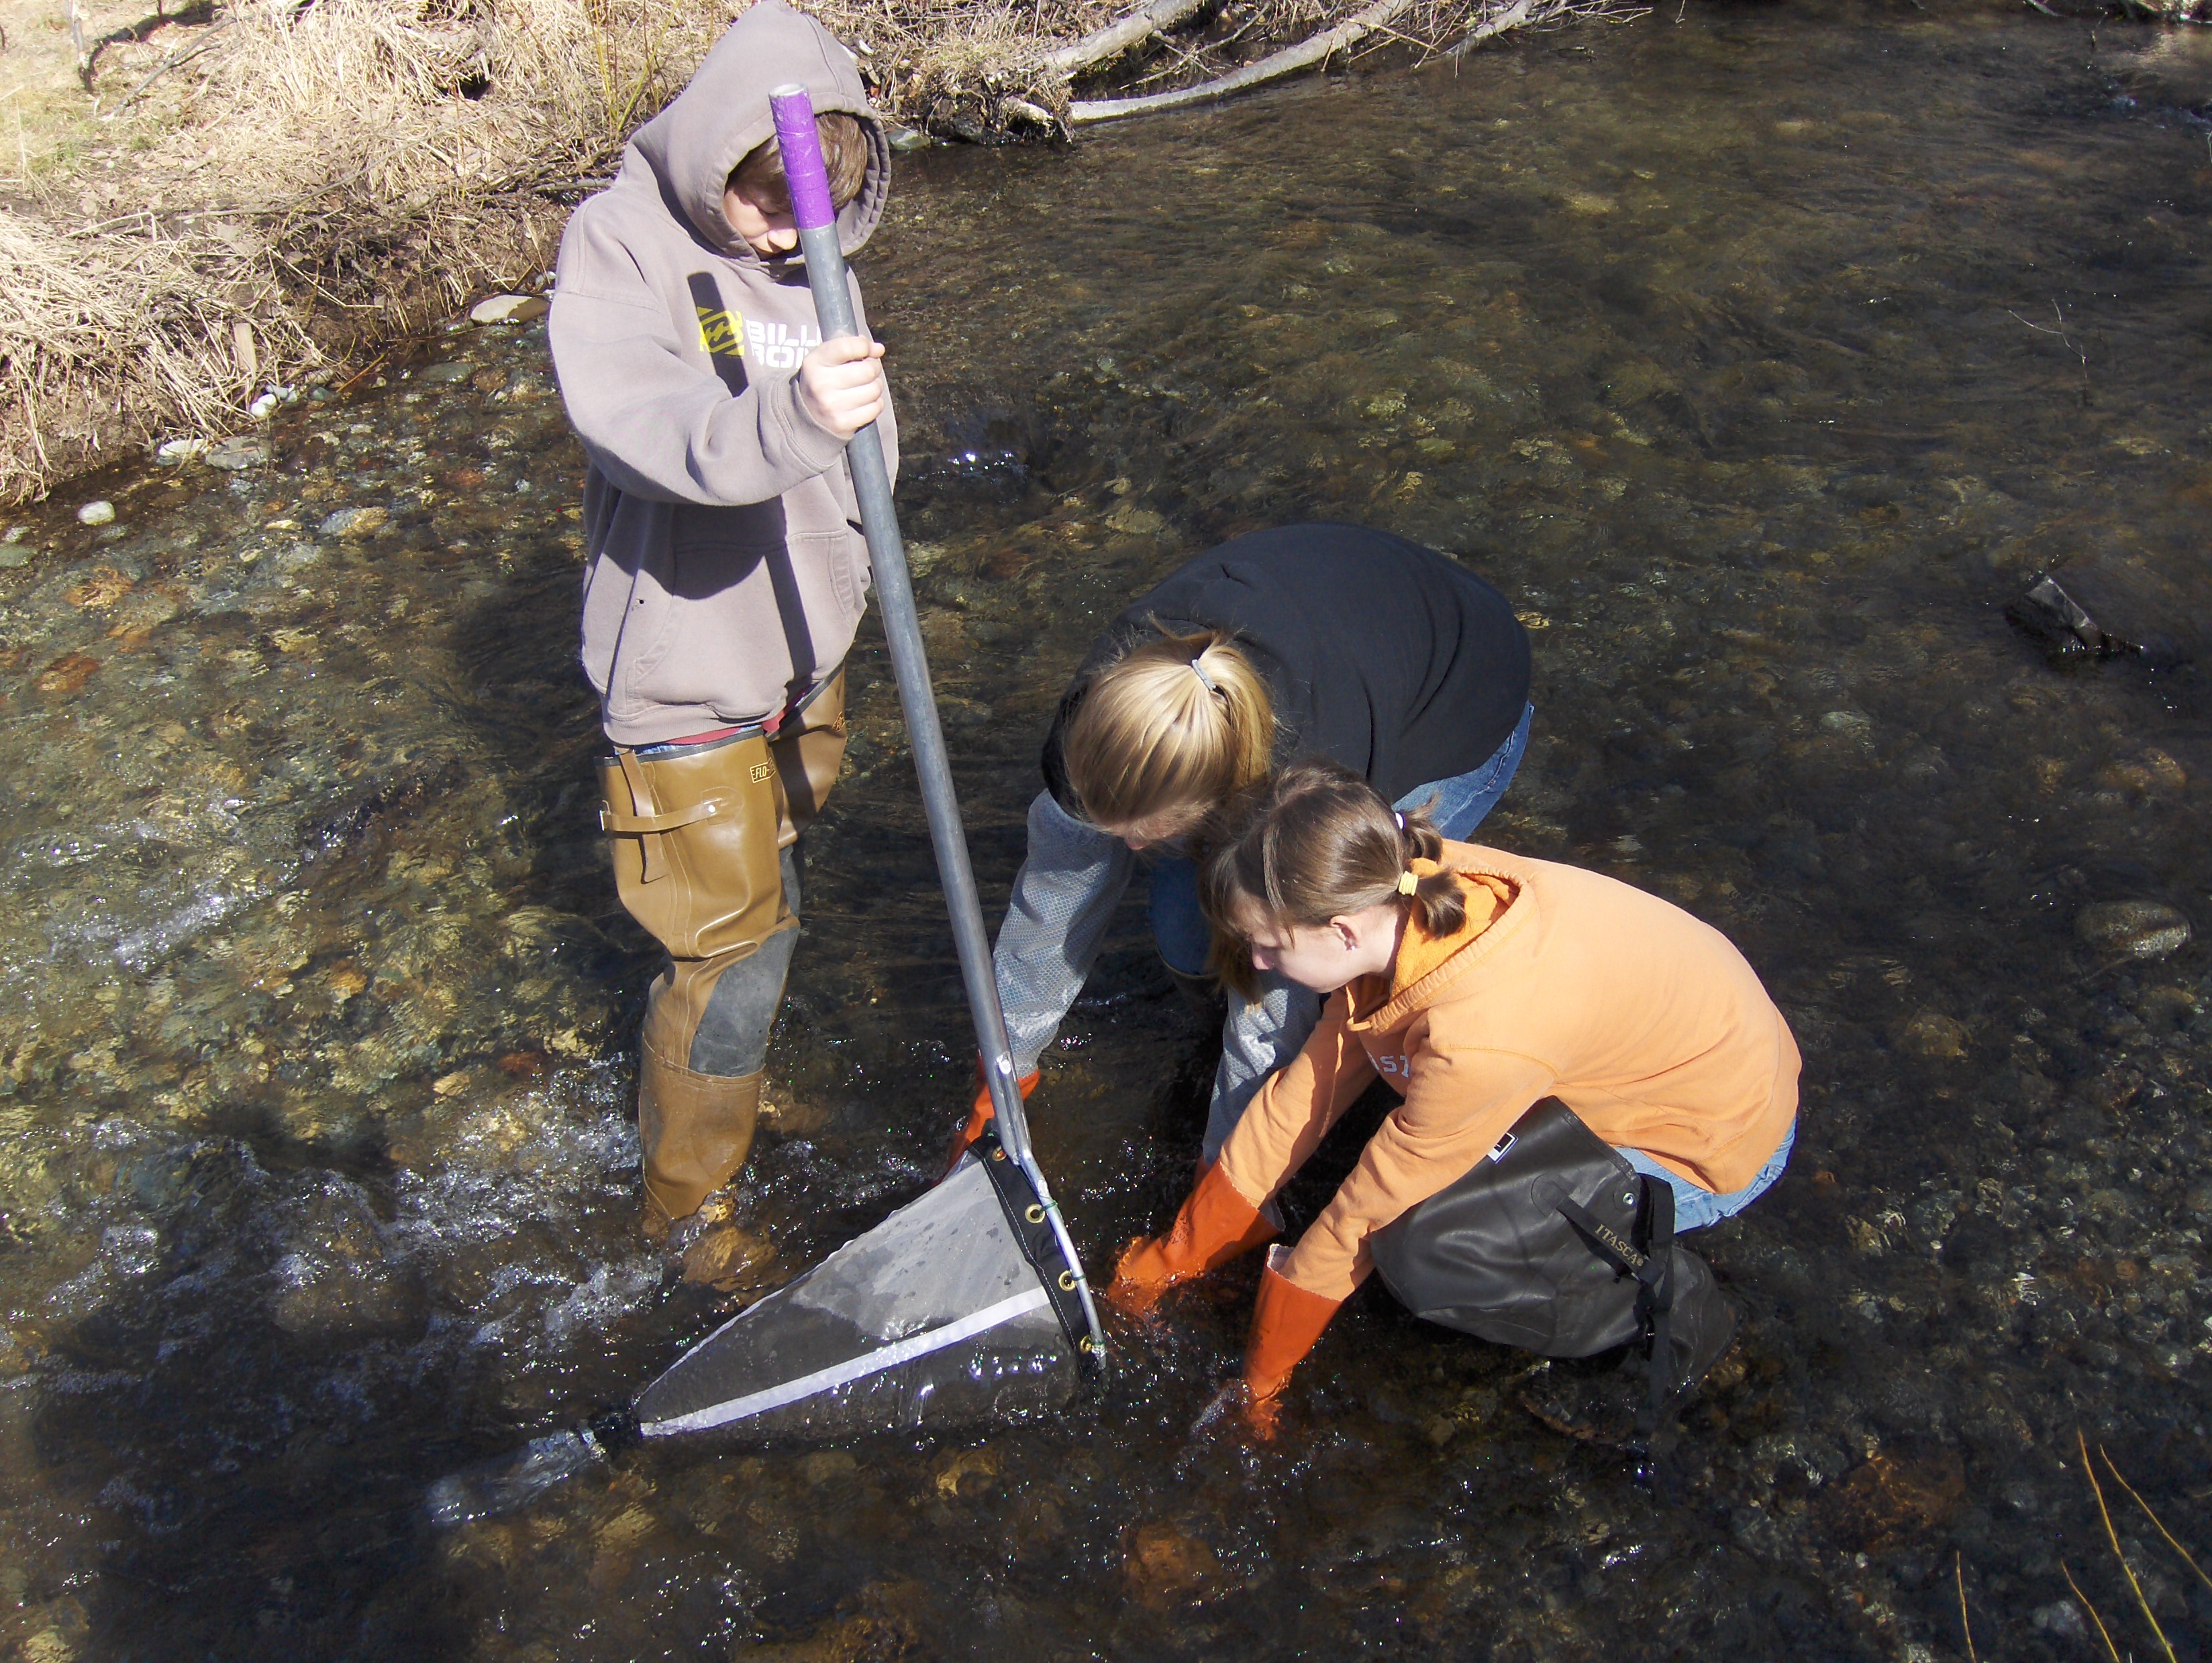

Slide 12
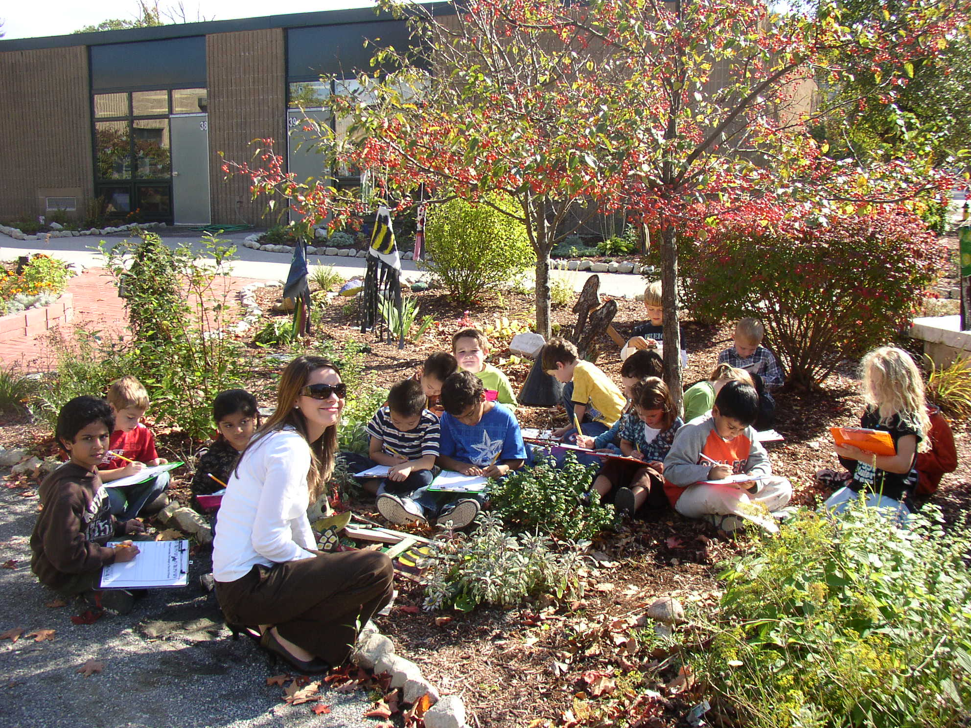

Slide 13
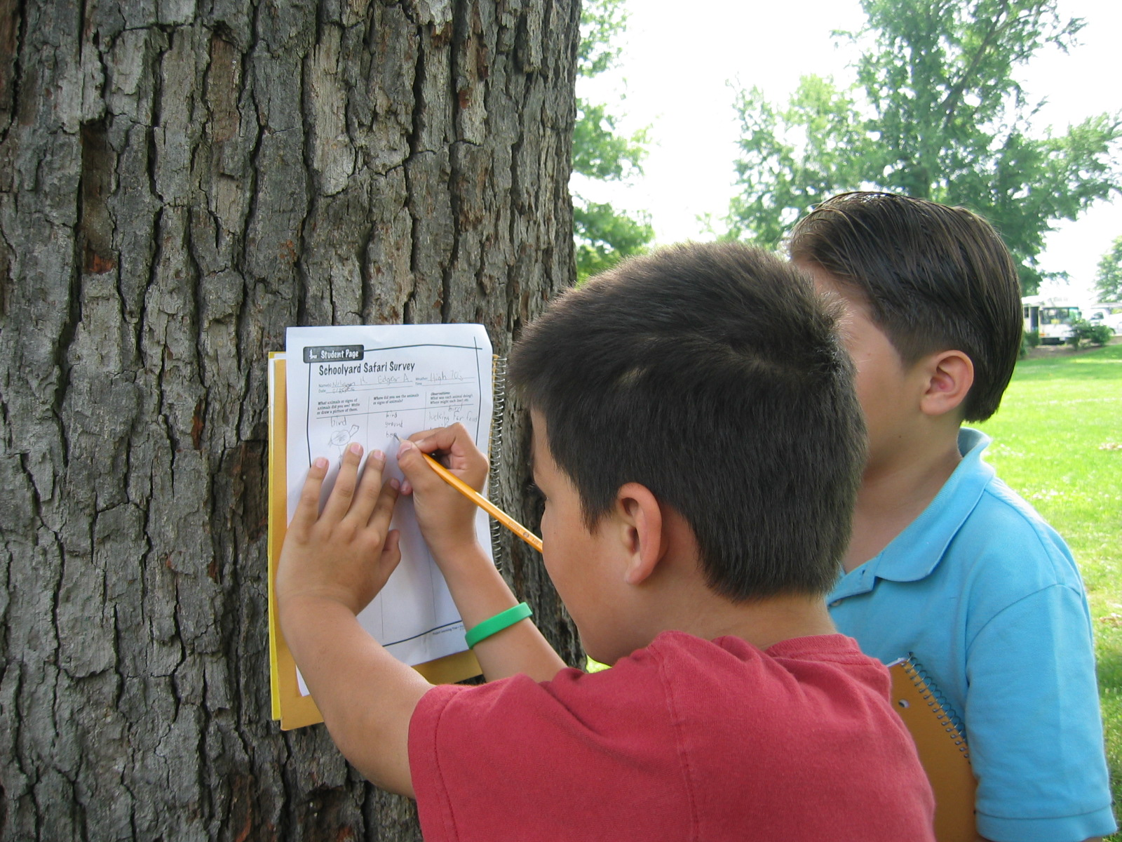

Slide 14
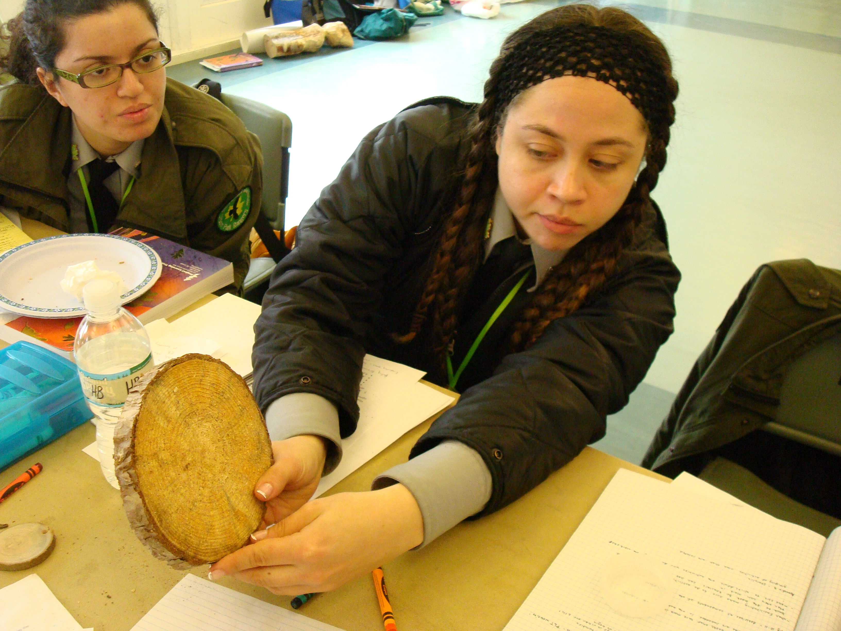

Slide 15



Project Learning Tree Montana
These workshops are funded in part from a federal award of the U.S. Forest Service, Department of Agriculture, subawarded by the Montana Department of Natural Resources and Conservation, Forestry Division to Montana State University Extension.
The Montana State University Extension Service is an ADA/EO/AA/ Veteran’s Preference Employer and Provider of Educational Outreach.

