Slide 1
Project Learning Tree
Tremendous Science!:
Workshop Title
Presenter 1 Name, Presenter 1 Title
Presenter 2 Name, Presenter 2 Title
Notes:
Remember to update the red text with your workshop-specific information.

Slide 2



Lexi Brown
MSU Extension Forestry
32 Campus Drive MS0606
Missoula MT 59812-0606
(406) 243-4706
alexios.brown@montana.edu
www.montana.edu/extension/forestry/projectlearningtree

Slide 3
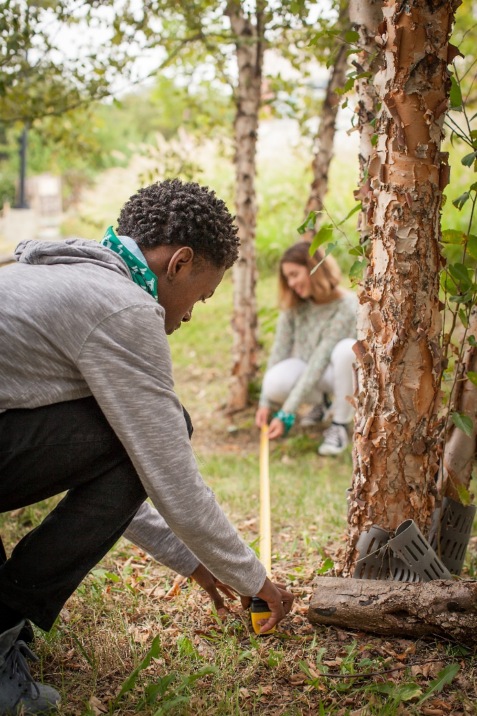
Project Learning Tree
A Comprehensive
Environmental Education
Program
  High quality, preK-12 curriculum materials
  Professional development for educators
  International network of partners

Slide 4
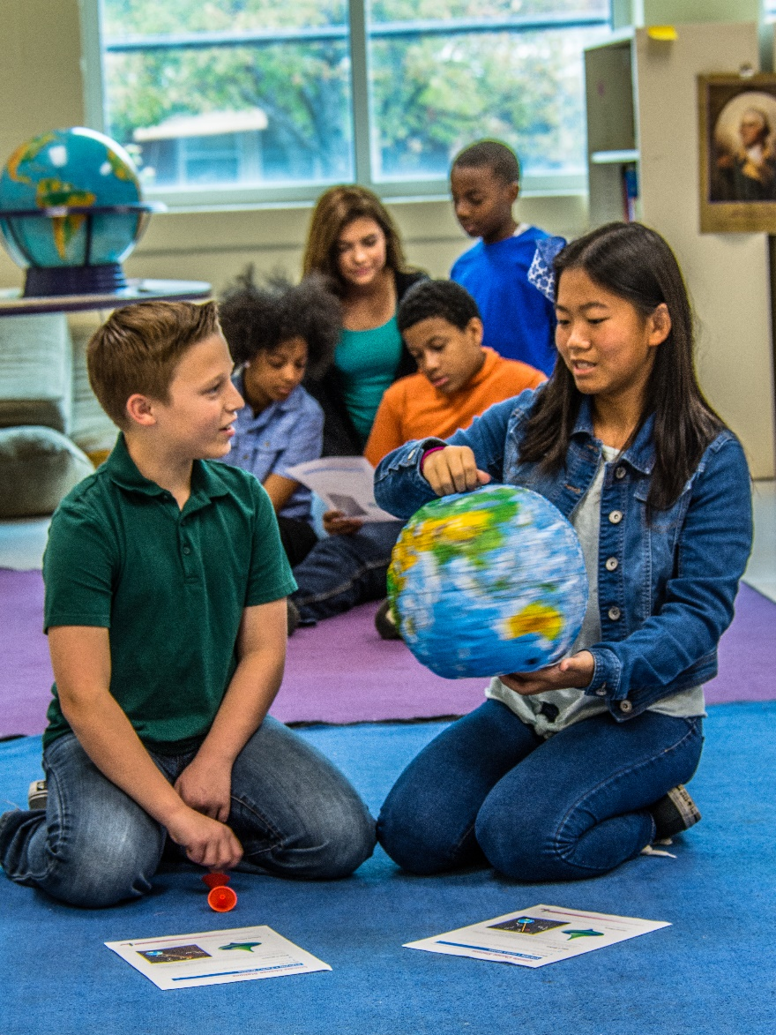
PLT uses forests as “windows on the world” to help students:
  Understand ecological systems
  Think critically and creatively
  Make informed decisions on environmental issues
  Take responsible action

Slide 5
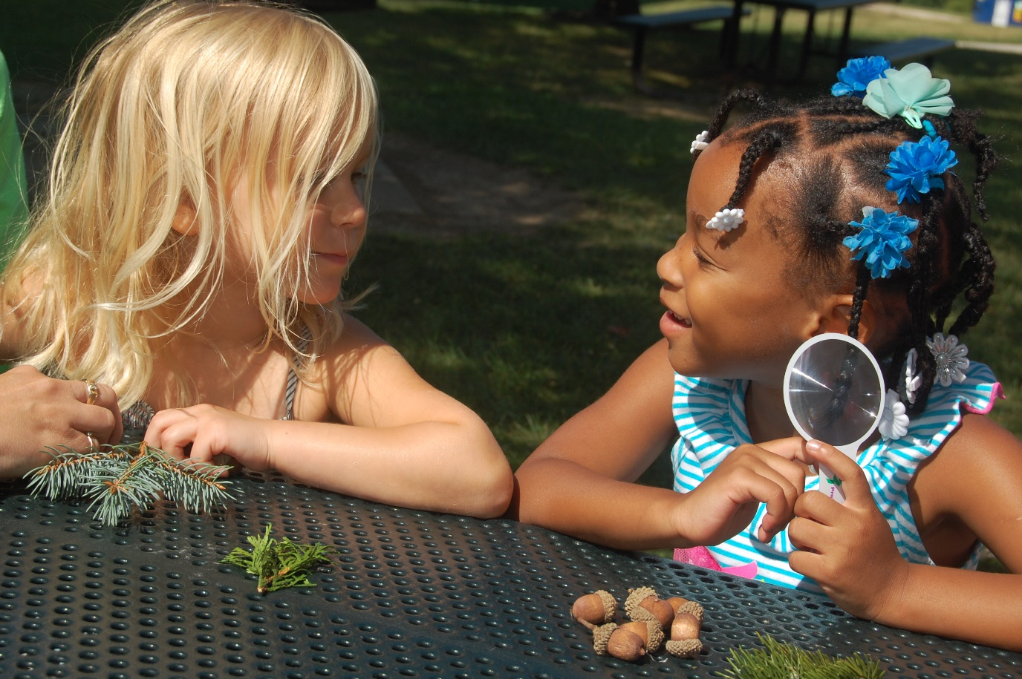
Every Tree for Itself
Notes:
Use this slide to introduce the Every Tree for Itself activity, which is the third activity in Level B of the Treemendous Science! E-Unit. Take 10-15 minutes to conduct a sampling of this lesson, using poker chips, paper squares, or math cubes, and paper plates, if desired.
The aim of the activity is to help students model and understand the conditions that trees need to live and grow.

Slide 6
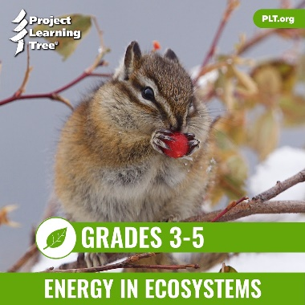
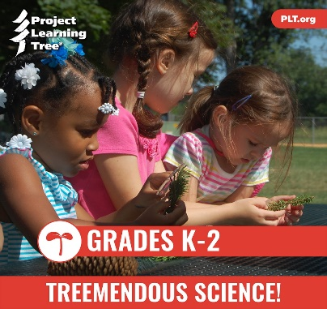
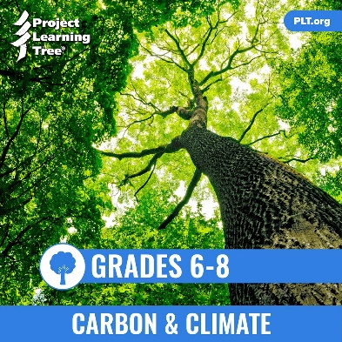
PLT’s E-Units
Designed by teachers
Housed entirely online for access anywhere
Constructed around targeted performance expectations in NGSS
Aligned with Common Core and C3 Framework
Notes:
Use this slide to introduce the PLT E-Units in general, pointing out that PLT began with the standards and NGSS’s three-dimensional approach in the initial design of the unit.
In addition, the e-units are aligned with two other academic benchmarks: Common Core (ELA and Math), and The College, Career, and Civic Life (C3) Framework for Social Studies.

Slide 7
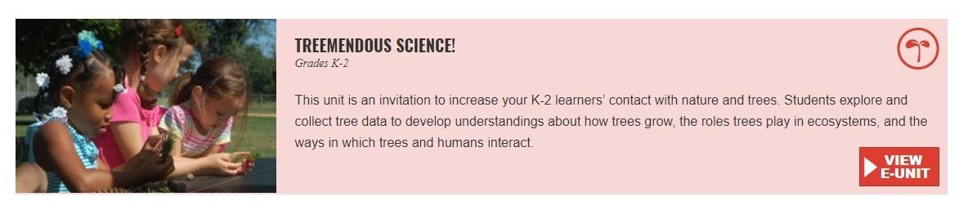
Explore the Treemendous Science!
E-Unit
  Treemendous Science E-Unit
Notes:
This slide contains links to the live e-unit website. You must be logged into your e-unit account in advance to access the embedded links.
Subsequent slides provide screen shot images if wifi is not available or reliable.

Slide 8
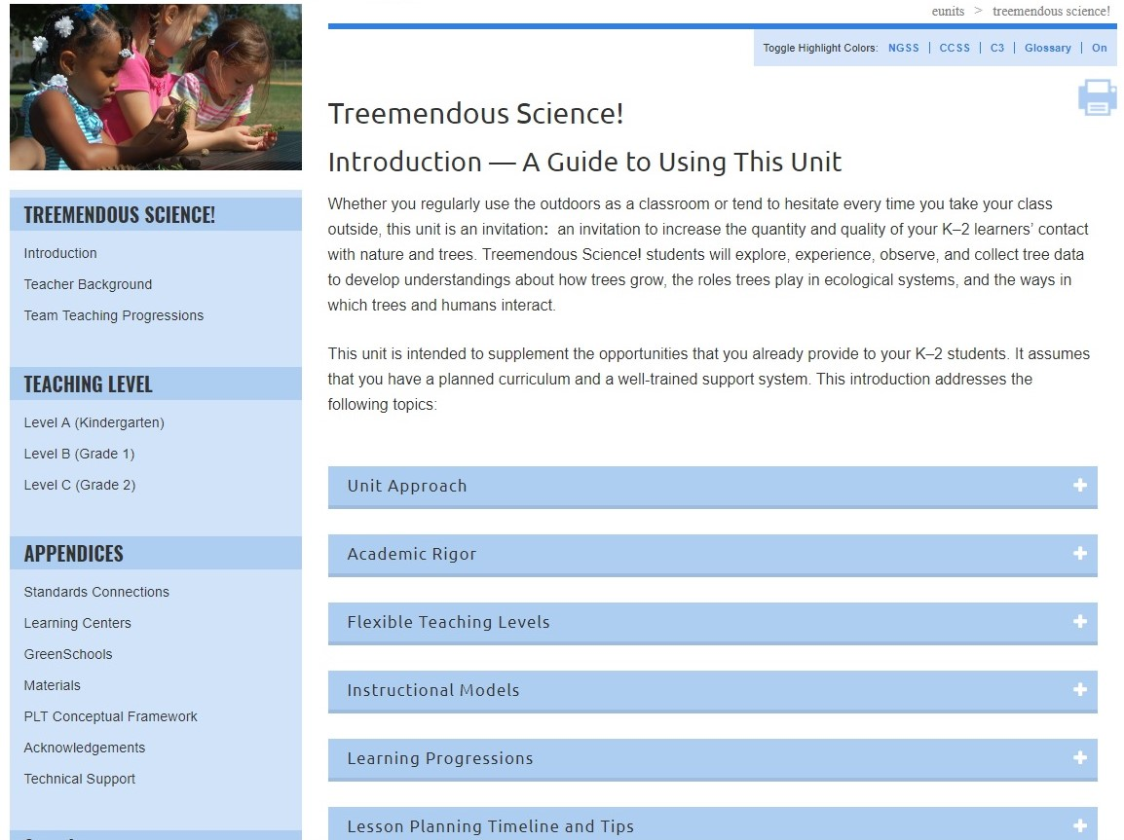
Notes:
The Treemendous Science! E-Unit is designed for grades K-2. Use this slide to highlight the many useful sections of the Introduction. Pick one or two to highlight, such as the Learning Progressions or Lesson Planning Timeline and Tips.
Through the unit, student explore, experience, and observe trees, and collect tree data to develop understandings about how trees grow, the roles trees play in ecological systems, and the ways in which trees and humans interact.

Slide 9
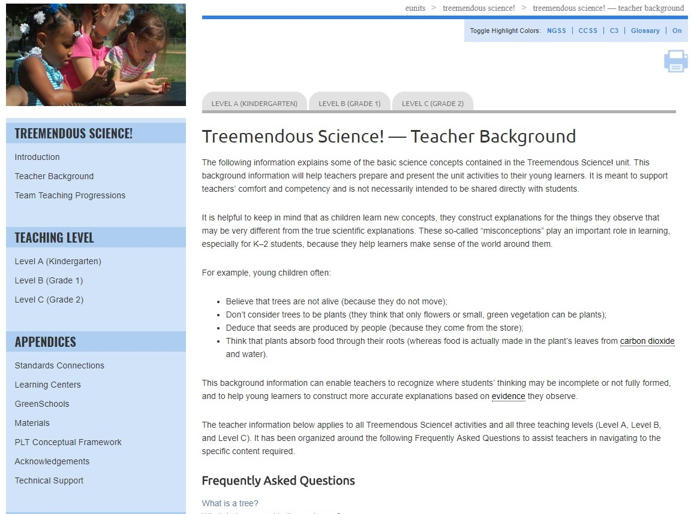
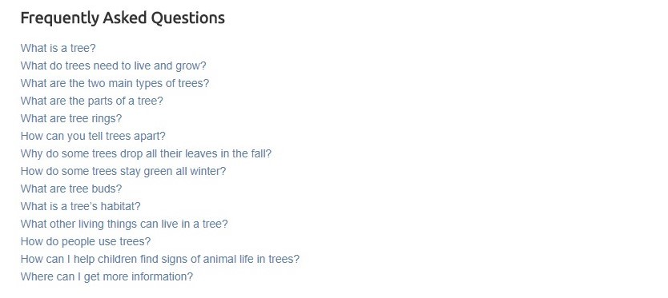
Notes:
Use this slide to point out that in-depth teacher background information is provided for the unit. Note that it is organized around “frequently asked questions” related to trees and forests.

Slide 10
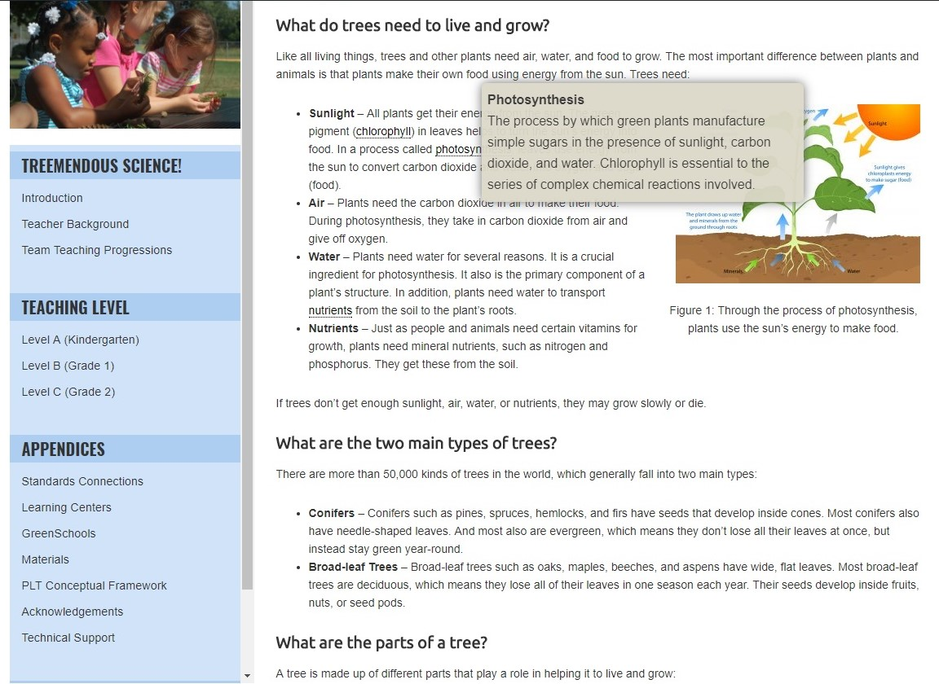
Notes:
Also note that the background and other activity sections include pop-up definitions for key vocabulary.

Slide 11

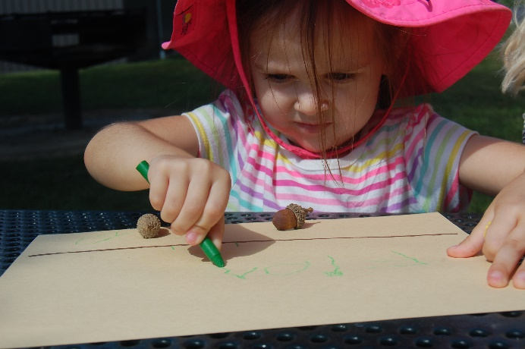
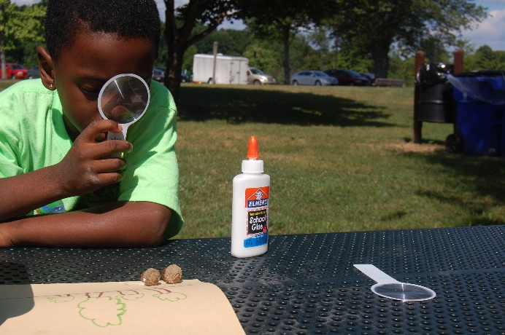
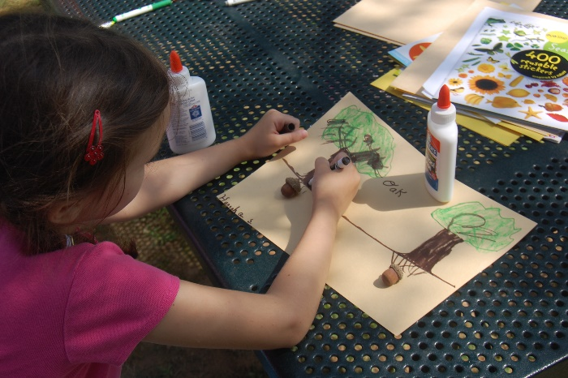
Tremendous Science!
Level
Level B
Level C
(Kindergarten)
(First Grade)
(Second Grade)
Notes:
Use this slide to explain that Treemendous Science! is organized around three levels – Level A corresponding to approximately Kindergarten, Level B to 1st Grade and Level C to 2nd Grade.
Each level has a set of activities tailored to its target grade level. An activity may occur in all levels, but with slight variations to accommodate different levels of learners (as in Adopt a Tree), or it may occur in only one level.
PLT recognizes that the K-2 grade band represents a time of great adjustment, knowledge gain, and personal growth, with different children developing at different paces. To accommodate this variability, teachers can choose activities from one level, or select activities from multiple levels to meet the specific needs of their students.

Slide 12
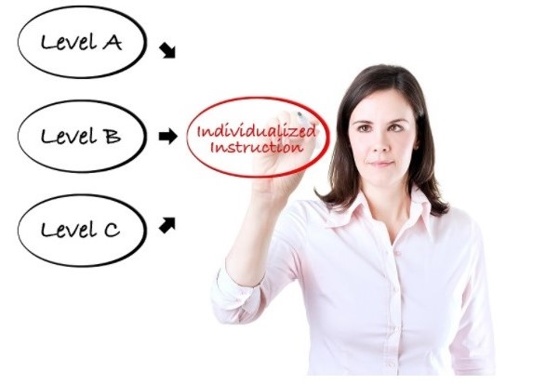
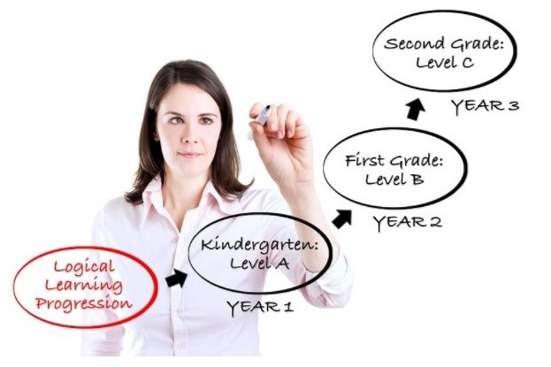
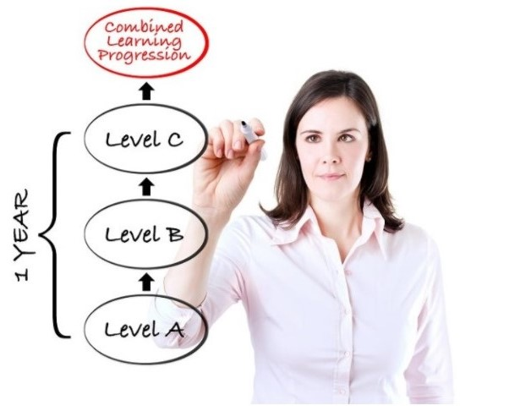
Team Teaching Progressions
Notes:
Use this slide to share different ways that teachers might use the three levels in the Treemendous Science! e-unit – either working alone or as part of a teaching team.
In one option, they could take parts from each of the Levels to individualize instruction for their students.
In a second option, they could work with other teachers in the team to teach Level A in kindergarten, Level B in first grade and Level C in second grade, thus enabling the same cohort of students to build on and refine their content knowledge over time.
In yet a third option, they could teach the three level consecutively within the same year, allowing students to gain an in-depth understanding of the unit content.

Slide 13
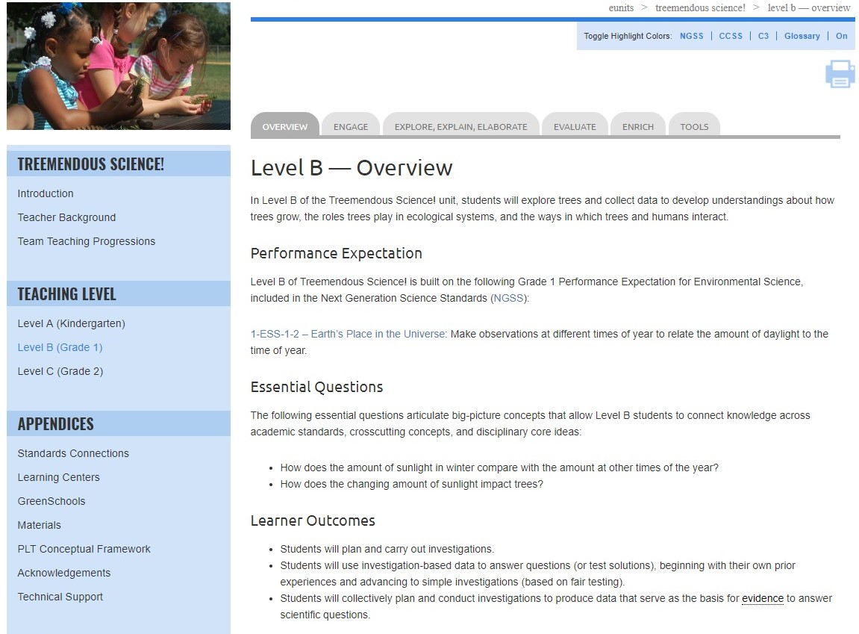
Notes:
Use this slide and those that follow to explain the K-2 E-Unit navigation and layout, using Level B as an example.
Be sure to review the unit-level blue left-hand navigation bar, as well as the gray tabs across the top for individual levels.

Slide 14
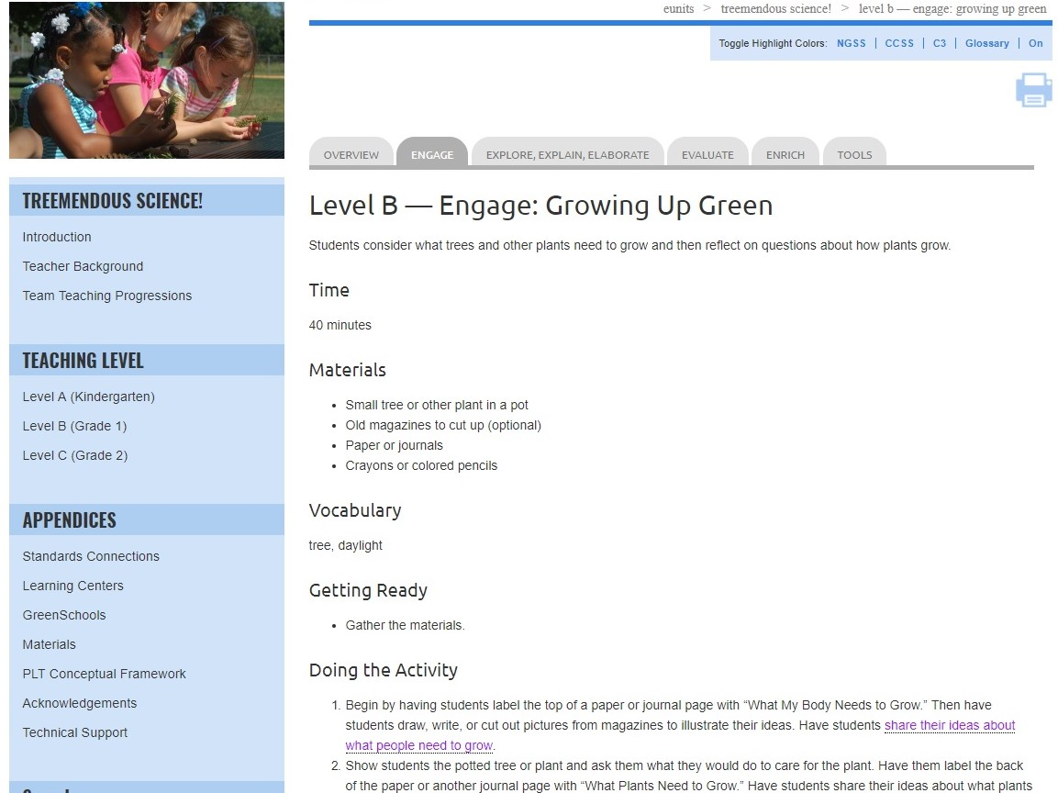
Notes:
Use this slide and the next one to point out that the unit is designed around the 5E Instructional Model:
Engage
Explore
Explain
Elaborate
Evaluate
Point out that each level contains an Engage activity, which introduces the unit activities at that level. In addition, each level contains opportunities to explore, explain, elaborate, and evaluate, as shown in the gray navigation tabs across the top.

Slide 15
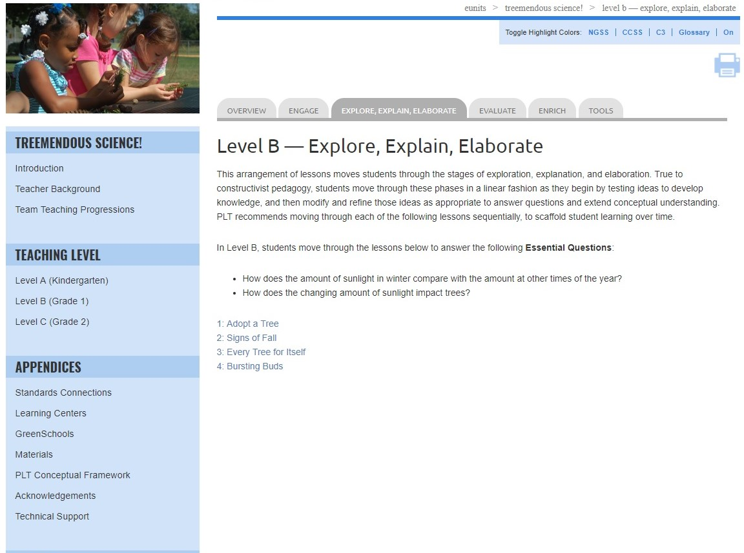
Notes:
Use this slide and the next one to point out that the unit is designed around the 5E Instructional Model:
Engagement
Exploration
Explanation
Elaboration
Evaluation
Point out that the remaining activities in the level are found under the explore, explain, elaborate tab, and provide opportunities to develop, modify, and refine their conceptual understanding.

Slide 16
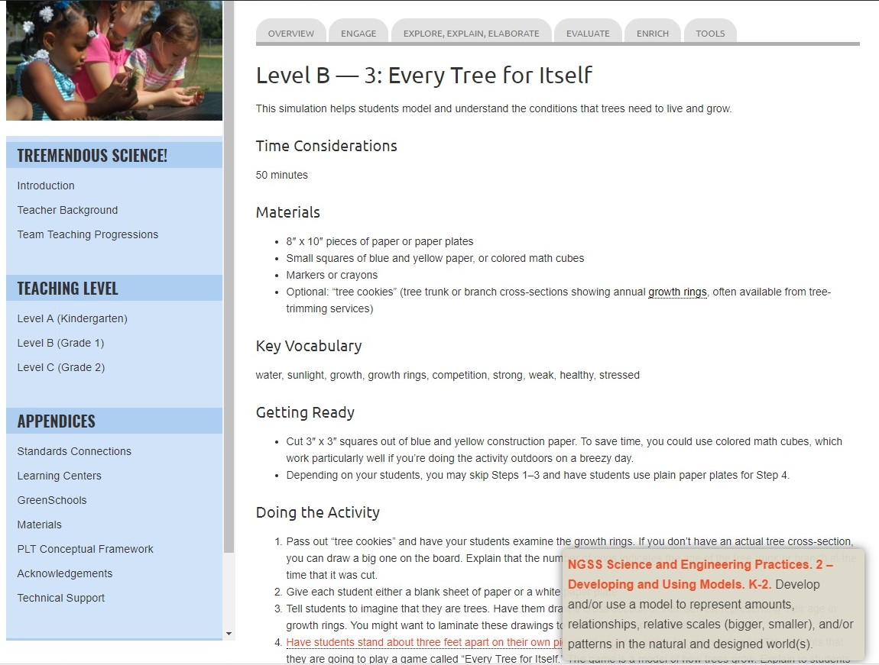
Notes:
Use this slide and the one that follows to show the interactive standards pop-up feature.
Clicking on the red text reading “Have students stand about three feet apart on their own pieces of paper or plates to represent trees” will enable a window to pop-up identifying the specific standard that is touched on with that part of the activity.
The Treemendous Science! e-unit is built around the following performance expectations from the Next Generation Science Standards (NGSS):
K-LS1-1 – From Molecules to Organisms: Structures and Processes. Use observations to describe patterns of what plants and animals (including humans) need to survive.
K-ESS2-1 – Earth’s Systems. Use and share observations of local weather conditions to describe patterns over time.
1-ESS-2 – Earth’s Place in the Universe. Make observations at different times of year to relate the amount of daylight to the time of year.
2-PS1-1 – Matter and Its Interactions. Plan and conduct an investigation to describe and classify different kinds of materials by their observable properties.
2-LS4-1 – Biological Evolution: Unity and Diversity. Make observations of plants and animals to compare the diversity of life in different habitats.
While the e-unit is based on these NGSS performance expectations, it will also help meet relevant state science standards.

Slide 17
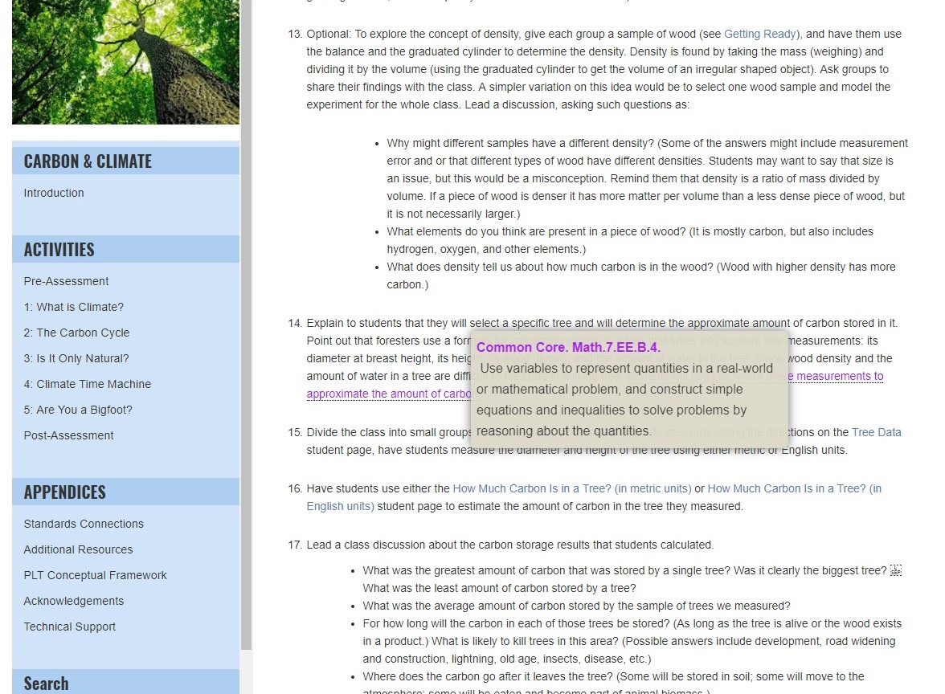
Notes:
The unit also integrates math, language arts, and other discipline areas in fun and creative ways, drawing on both mathematics and English language arts benchmarks from the Common Core State Standards.
When you click on the purple text reading “count the number of squares representing each need that they gathered” the relevant Common Core Math standards will pop up.
Remember to mention that red pop ups signify NGSS connections, purple are Common Core (English language arts and mathematics), and green are the C3 Framework (social studies).

Slide 18
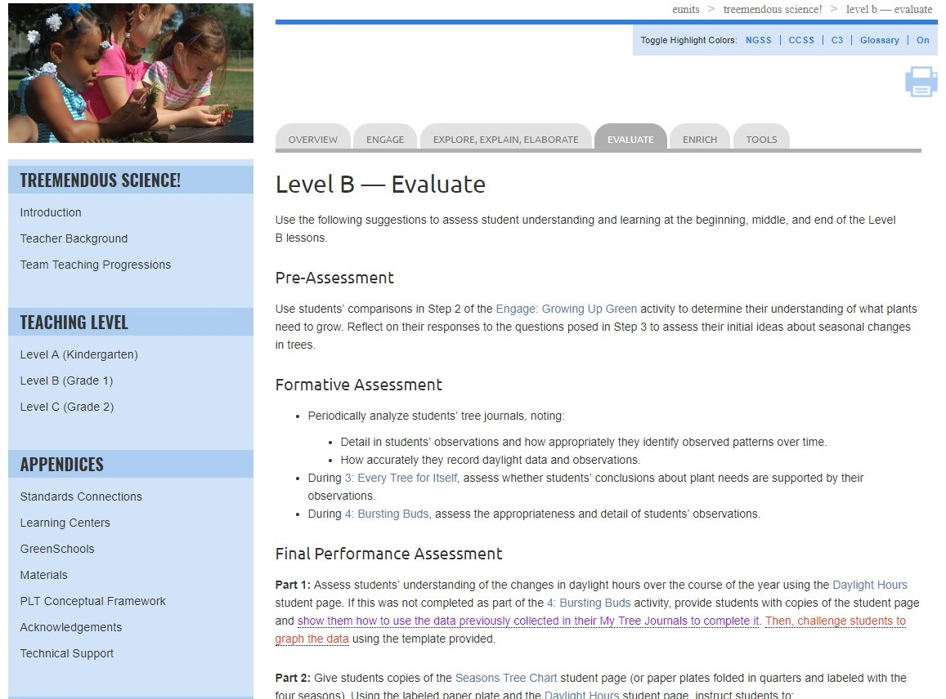
Notes:
Each level includes multiple assessment options, located in the Evaluate tab, including: Pre-Assessment, Formative Assessment suggestions, and a Final Performance Assessment.

Slide 19
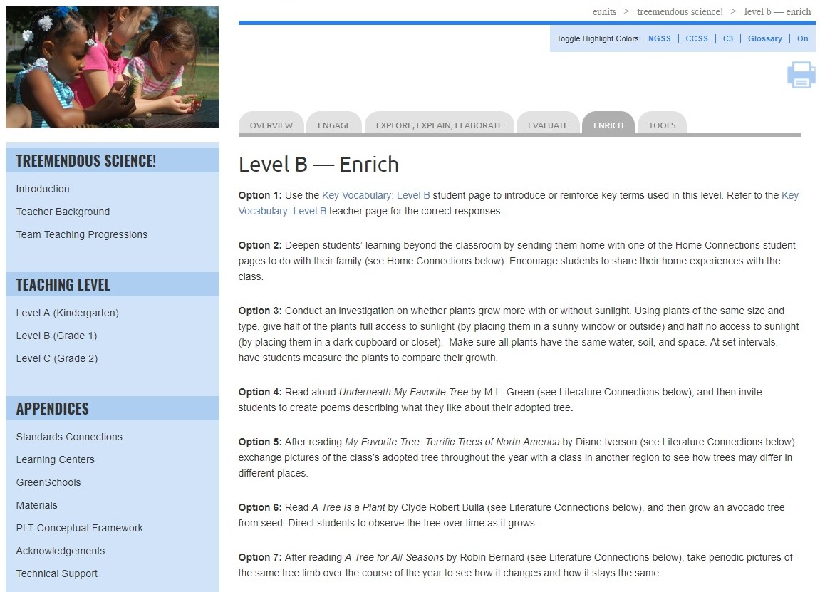
Notes:
Each level also provides suggested enrich options to extend learning. The Enrich page also includes Home Connection suggestions as well as book suggestions.

Slide 20
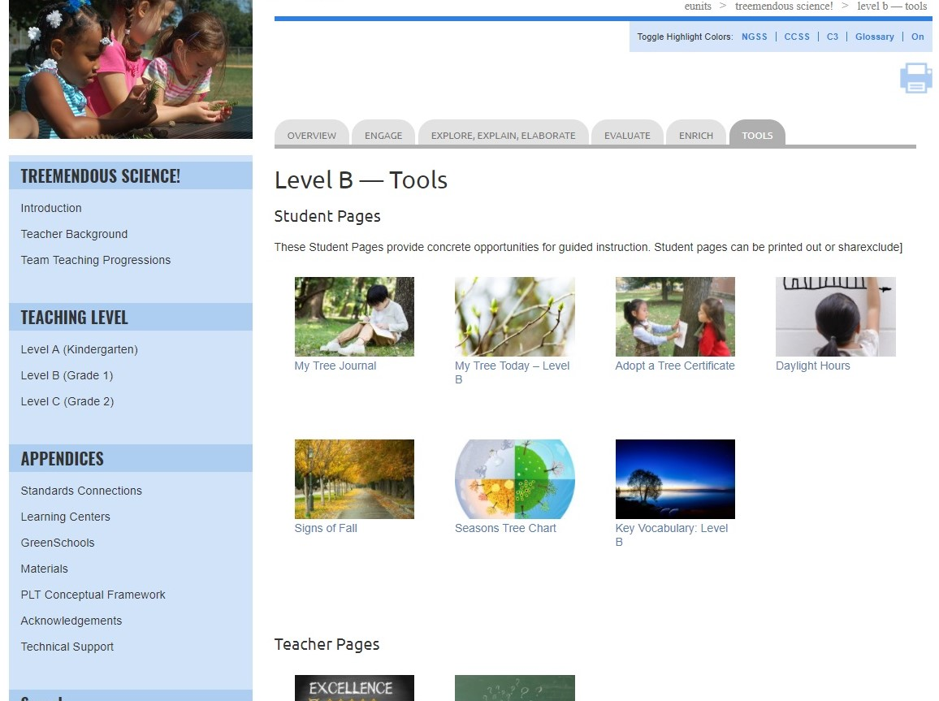
Notes:
Tools include:
Student pages
Teacher pages

Slide 21
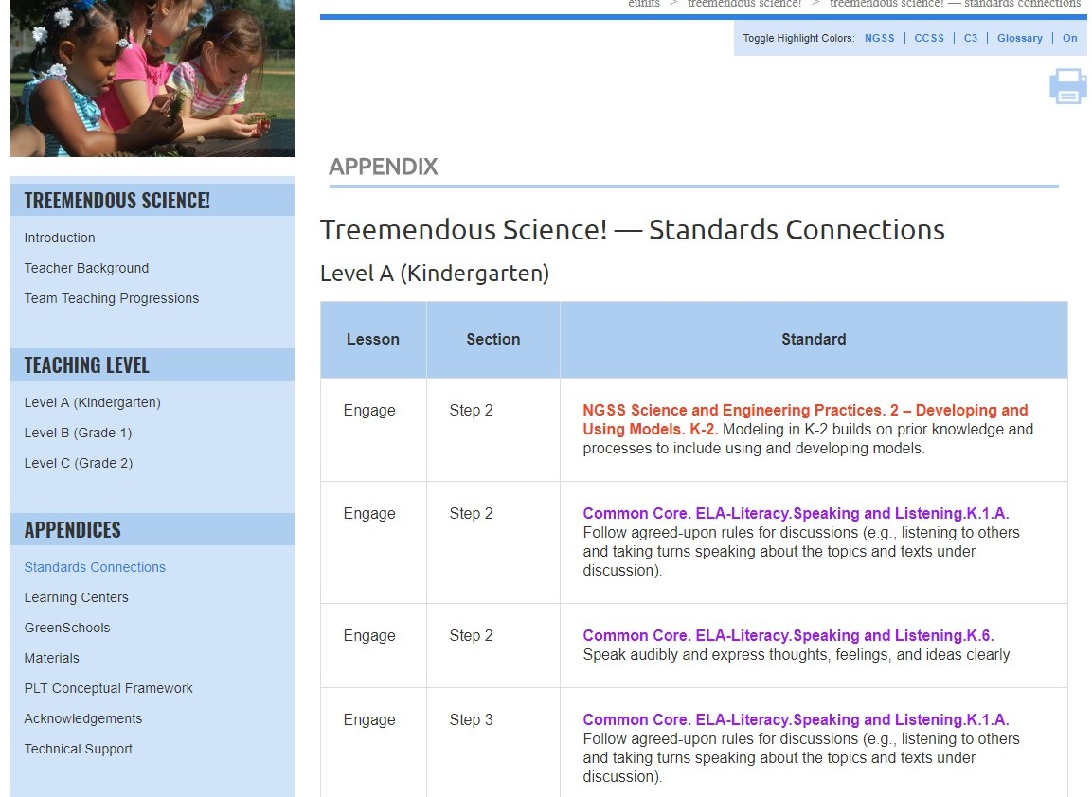
Notes:
Use this slide (and/or the others) to highlight relevant appendices for your audience; they include:
Standards Connections
Learning Centers
GreenSchools
Materials
PLT Conceptual Framework
Acknowledgements
Technical Support
Standards Connections in the appendices is a listing of all of the connections for the entire unit that are identified by the pop-up feature.

Slide 22
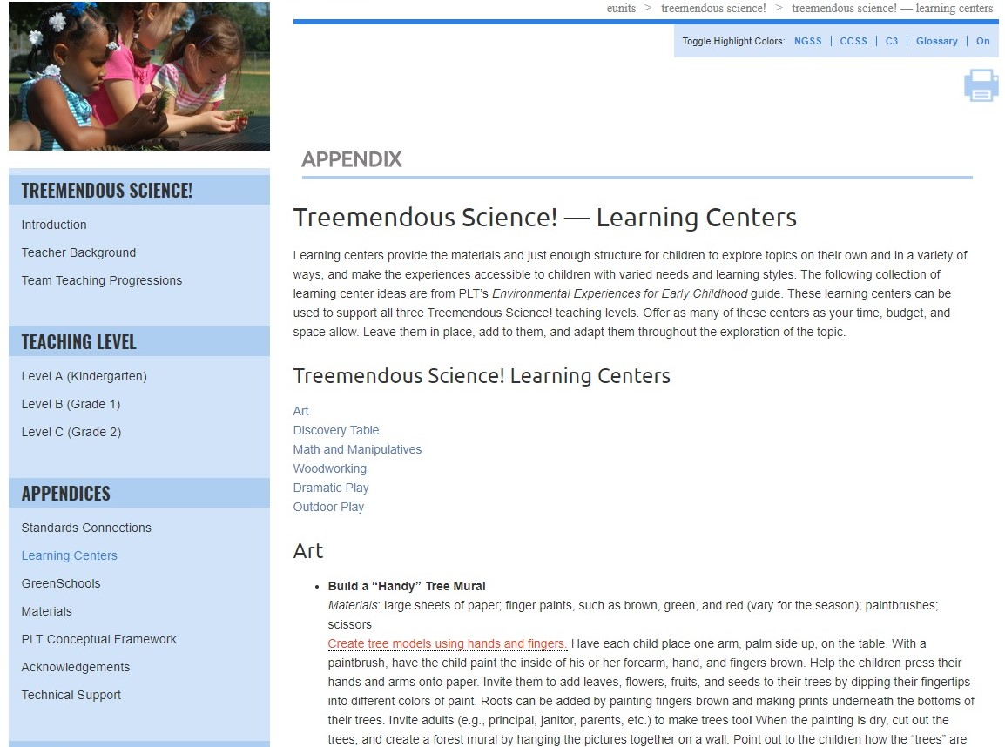
Notes:
Use this slide (and/or the others) to highlight relevant appendices for your audience; they include:
Standards Connections
Learning Centers
GreenSchools
Materials
PLT Conceptual Framework
Acknowledgements
Technical Support
Learning Centers offers a number of ideas for learning centers related to the Treemendous Science! E-Unit activities. The are from PLT’s Environmental Experiences for Early Childhood guide. Point out that learning centers provide materials and just enough structure for children to explore topics on their own and in a variety of ways, and make the experiences accessible to children with varied needs and learning styles.

Slide 23
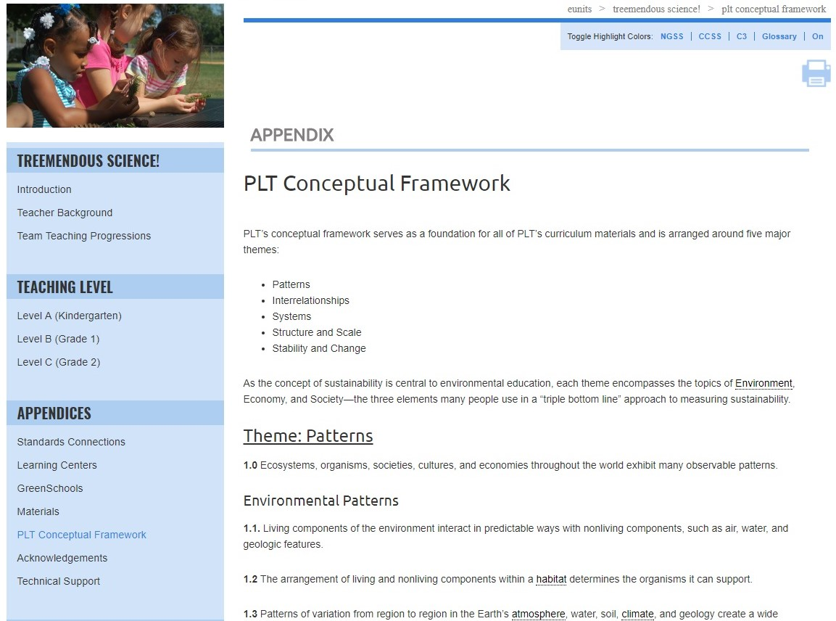
Notes:
Use this slide (and/or the others) to highlight relevant appendices for your audience; they include:
Standards Connections
Learning Centers
GreenSchools
Materials
PLT Conceptual Framework
Acknowledgements
Technical Support
The PLT Conceptual Framework serves as a foundation for all of PLT’s curriculum materials.

Slide 24
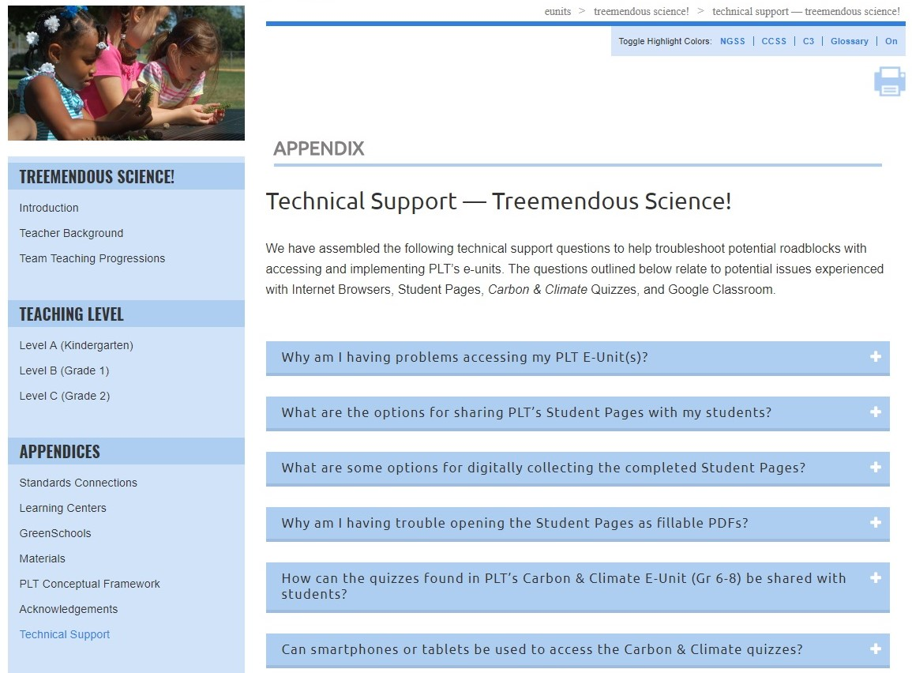
Notes:
Use this slide (and/or the others) to highlight relevant appendices for your audience; they include:
Standards Connections
Learning Centers
GreenSchools
Materials
PLT Conceptual Framework
Acknowledgements
Technical Support
Technical Support answers common technical questions to help troubleshoot potential problems with accessing and using the e-units. Questions relate to potential issues experienced with internet browsers, student pages, quizzes and Google Classroom.

Slide 25
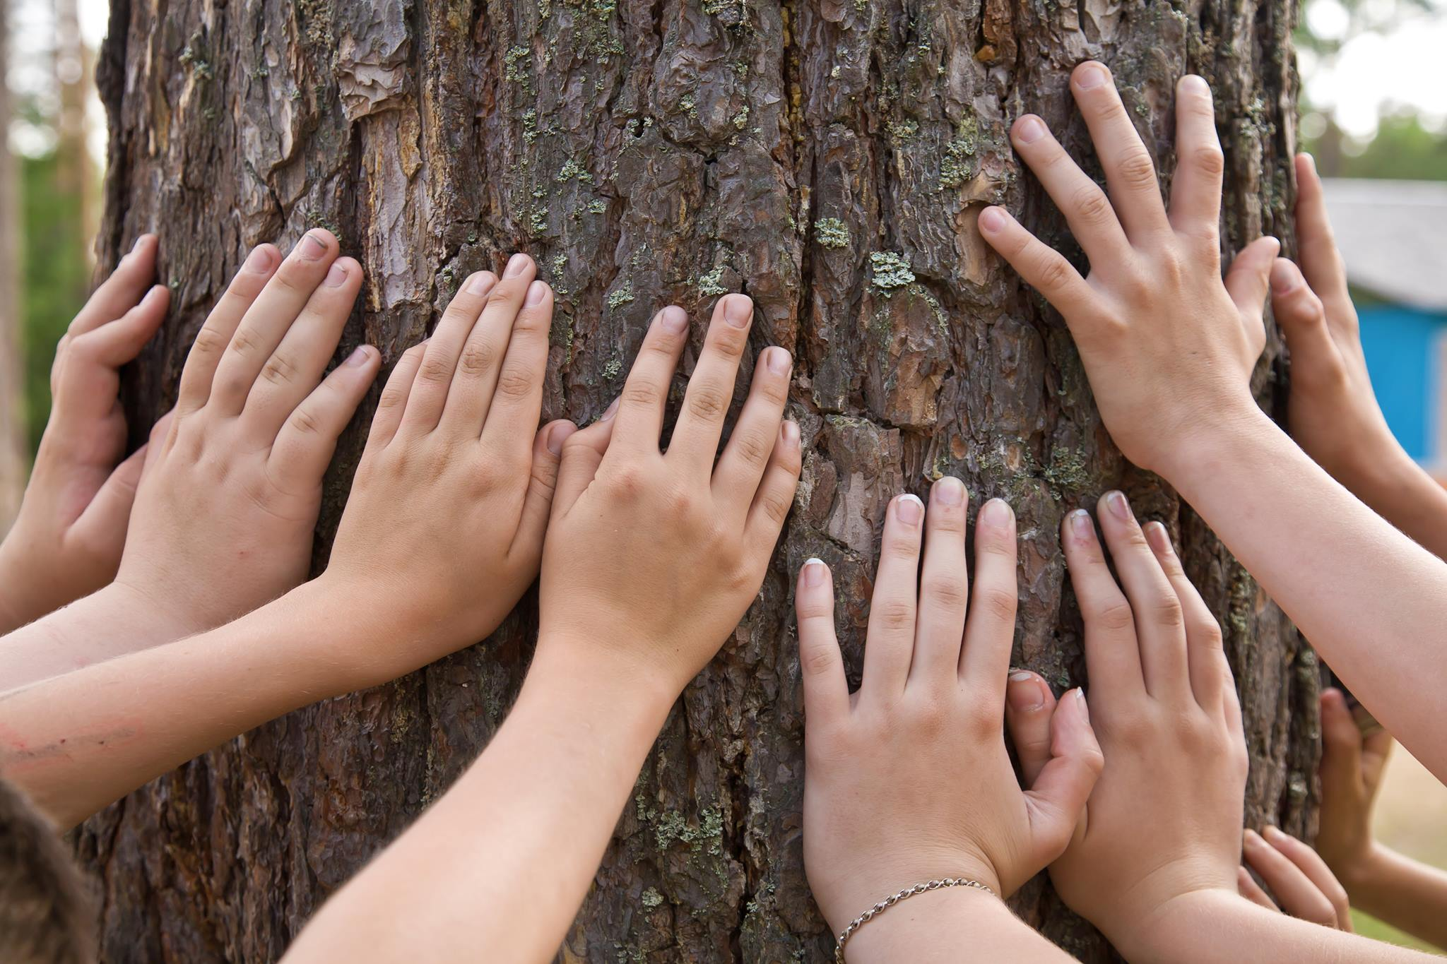
Adopt a Tree
Notes:
To elaborate, give participants a taste of another activity, Adopt a Tree, which is included in all three levels of Treemendous Science! Use this opportunity to show how the unit meets the needs of the three different levels.

Slide 26
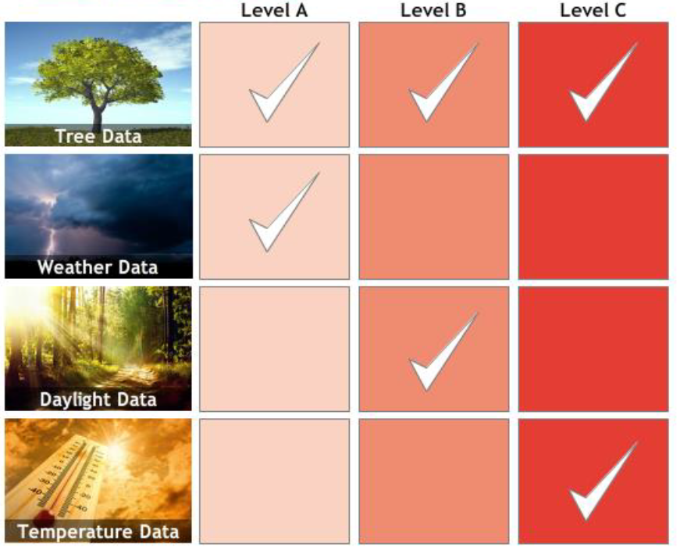
Adopt a Tree—Three Levels
Notes:
In the Adopt a Tree activity, students observe a tree over time, practice and strengthen their observation skills, look for patterns, and develop a personal connection to the adopted tree. Students at all Levels - A, B, and C - use their adopted tree as a living laboratory for different types of science exploration.
All Levels collect basic tree data. In addition:
Level A students collect weather data. They use this information to recognize the connection between changes in the seasons and the seasonal changes of their adopted tree.
Level B students collect hours of daylight data. They use patterns in the daylight data to recognize relationships between seasonal changes and changes in the amount of sunlight their adopted tree receives.
Level C collect air temperature data and compare their adopted tree’s habitat with another habitat to recognize the diversity of life in different habitats.

Slide 27

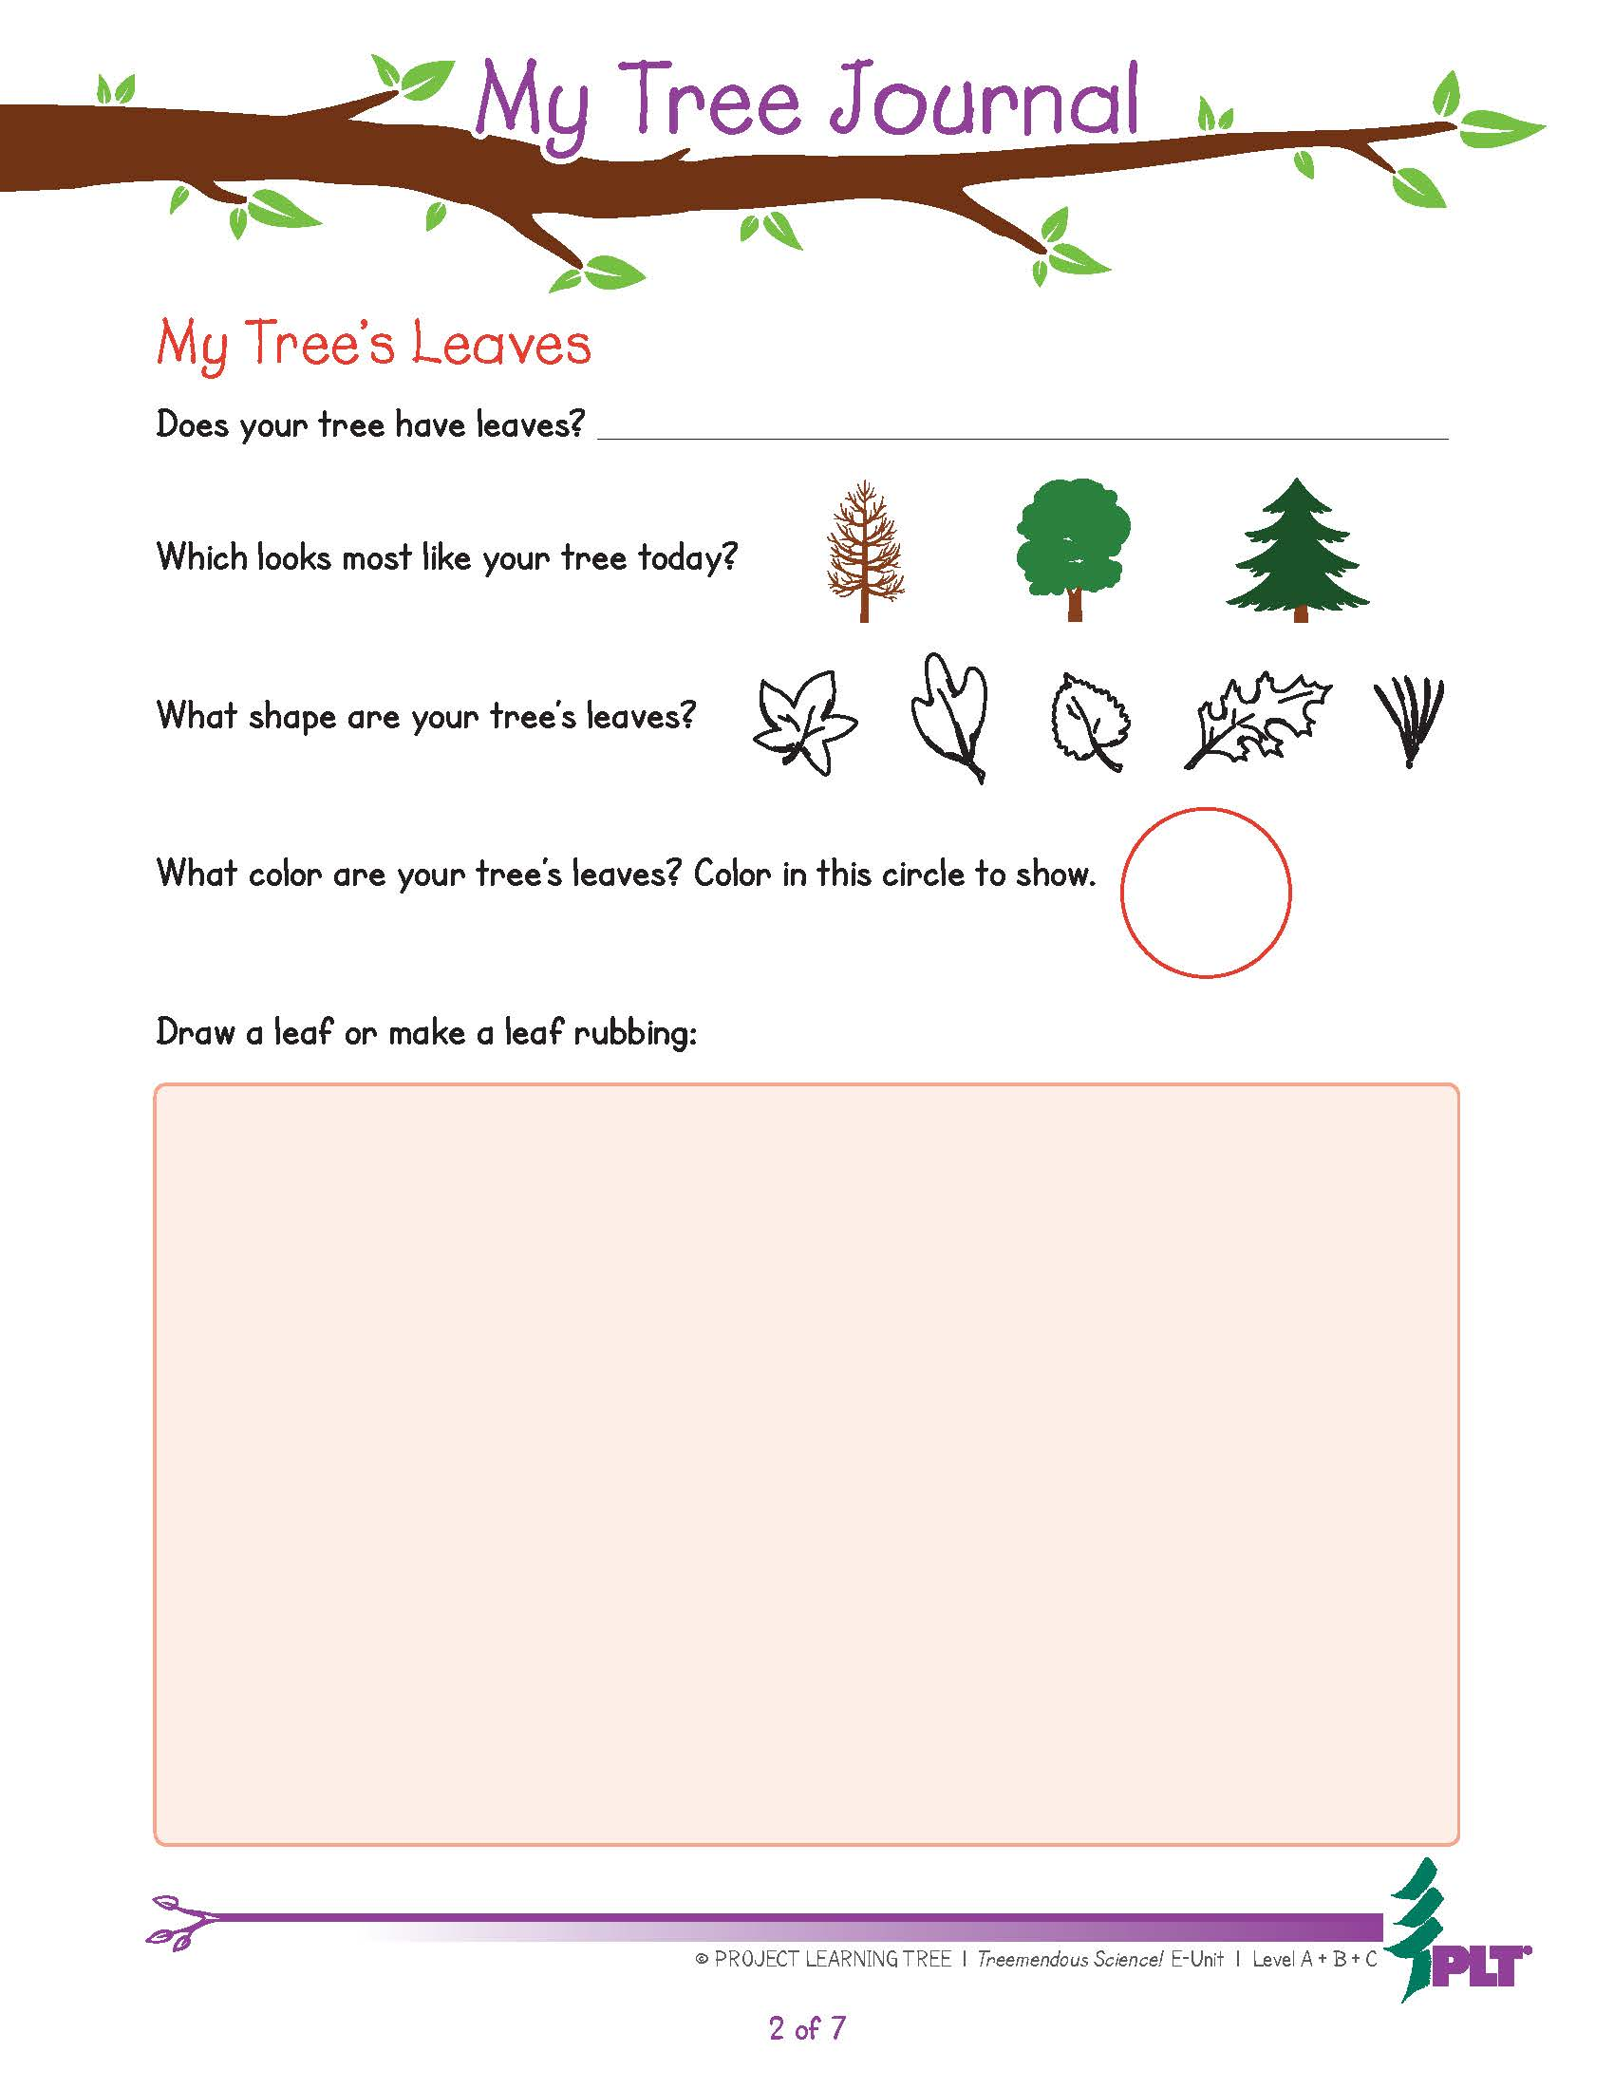
Notes:
Example student page.
One of the exciting features of the e-units are that student pages are both printable and fillable. These pages can also be downloaded and saved to your computer.

Slide 28
Treemendous Science! Activities—Level A
1: The Closer You Look
Collect data about trees.
2: To Be a Tree
Create a model of a tree.
3: Adopt a Tree
Observe a tree over time to look for patterns.
Notes:
The e-unit includes 3-5 activities in each level that helps students gain a deeper appreciation of trees.

Slide 29
Treemendous Science! Activities—Level B
1: Adopt a Tree
Observe a tree over time to look for patterns.
2: Signs of Fall
Gather data about trees as fall approaches.
3: Every Tree for Itself
Model the conditions that trees need to grow.
4: Bursting Buds
Observe leaf buds over time.
Notes:
The e-unit includes 3-5 activities in each level that helps students gain a deeper appreciation of trees.

Slide 30
Treemendous Science! Activities—Level C
1: Adopt a Tree
Observe a tree over time to look for patterns.
2: Get in Touch with Trees
Explore the different parts of trees.
3: Trees as Habitats
Inventory animals living in and among a tree.
4: Schoolyard Safari
Look for ways organisms use trees on the school grounds.
5: Habitat Pen Pals
Write letters from the perspective of organisms in different habitats.
Notes:
The e-unit includes 3-5 activities in each level that helps students gain a deeper appreciation of trees.

Slide 31
Supports for Teaching Activities
Step-by-step instructions
Extensive background section
Vocabulary exercises
Suggested books, websites, and other resources
Assessment rubrics
Printable and fillable student pages
Notes:
The Carbon & Climate e-unit contains lots of resources and materials to support teaching the activities.

Slide 32
Obtaining PLT E-Units
In-Person Professional Development
  Contact your PLT State Coordinator
  www.plt.org/your-state-project-learning-tree-program
Online Professional Development
  Self-paced online workshop included with e-unit
  $40 per e-unit at shop.plt.org
Notes:
If desired, insert your state specific contact information or upcoming workshop details.

Slide 33
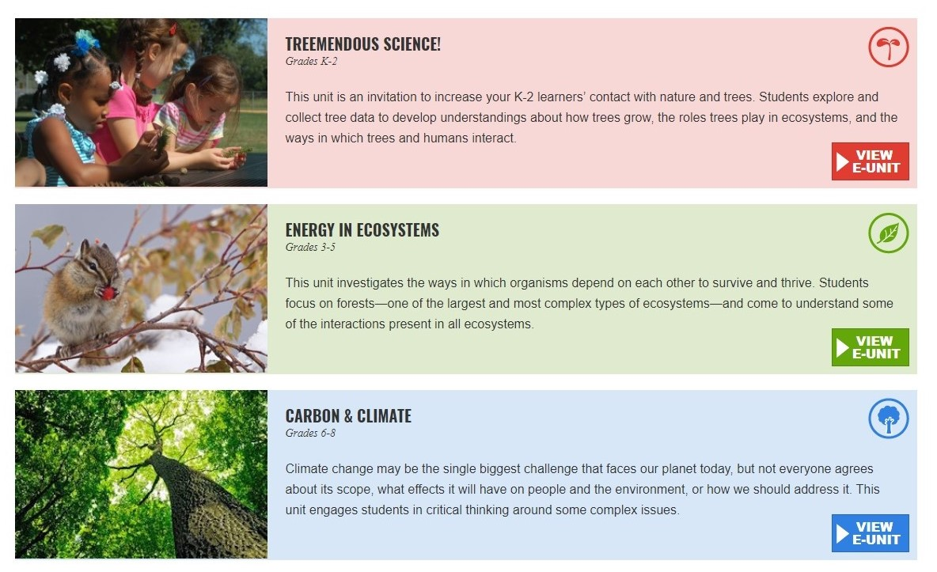
Available E-Units
Notes:
PLT has 3 e-units available at this time, each for a different grade level band.

Slide 34
Questions, Comments?
Presenter 1 Name
Presenter 1 Title, State
Presenter1email@xxxx.org
Presenter 2 Name
Presenter 2 Title, State
Presenter2email@xxxx.org
Thank you!
Notes:
Remember to update the red text with your workshop-specific information.
Distribute any evaluation forms at this time, tying survey questions to the intended workshop outcome, as appropriate.

Slide 35


Project Learning Tree Montana
These workshops are funded in part from a federal award of the U.S. Forest Service, Department of Agriculture, subawarded by the Montana Department of Natural Resources and Conservation, Forestry Division to Montana State University Extension.
The Montana State University Extension Service is an ADA/EO/AA/ Veteran’s Preference Employer and Provider of Educational Outreach.

