Slide 1

Montana 4-H Congress
Friday 7/15/22
Treat Your Brain Like the Incredible Asset It Is!
Alison Brennan
Extension Mental Health Specialist
Jennifer Munter
Project Manager

Slide 2


Welcome!
Let’s start with some trivia
For each statement, decide whether it is TRUE/FACT or FALSE/MYTH and use your thumb sign to show your answer
= TRUE/FACT
= FALSE/MYTH
Notes:
1 min
(Pass out signs as they come into the room!)

Slide 3
Trivia Q#1
The brain of a typical 18-year-old processes information the same way as the brain of a typical 40-year-old when it comes to
decision-making
Notes:
1 min

Slide 4
Trivia Q#2
Among high school students in Montana in 2021, almost 1 in 4 were offered, sold or given an on school property.
illegal drug
Notes:
1 min

Slide 5
Trivia Q#3
Only certain types of people develop an .
addiction
Notes:
1 min

Slide 6
Trivia Q#4
addiction
Anyone can develop an .
Notes:
1 min

Slide 7
Trivia Q#5
Someone who starts taking an addictive drug at the age of is more likely to become addicted than someone who starts taking it at the age of .
16
21
Notes:
1 min

Slide 8
Trivia Q#6
Among high school students in Montana in 2021, almost half said that at some point in their lives they had taken a
without a doctor’s prescription, or differently than how a doctor told them to use it.
prescription pain medication
Notes:
1 min

Slide 9
Trivia Q#7
Participation in structured extracurricular activities reduces risk of experiencing a substance use problem.
Notes:
1 min
Protective factor true

Slide 10
Trivia Q#8
more sensitive
The teen brain is to rewards and enjoyable experiences than the adult brain.
Notes:
1 min

Slide 11
Trivia Q#9
Having a family history of drug addiction increases an individual’s risk of experiencing drug use problems.
Notes:
1 min
Risk factor true

Slide 12
Trivia Q#10
Regularly practicing several different coping strategies reduces a person’s risk of experiencing drug addiction
Notes:
1 min
Protective factor true

Slide 13

Workshop Roadmap
The Teenage Brain
Science of Addiction
Rx Opioid & Rx Stimulant Misuse
Discussion: Reasons for Use and Healthy Alternatives
Tell Us Your Thoughts!
Notes:
1 min

Slide 14
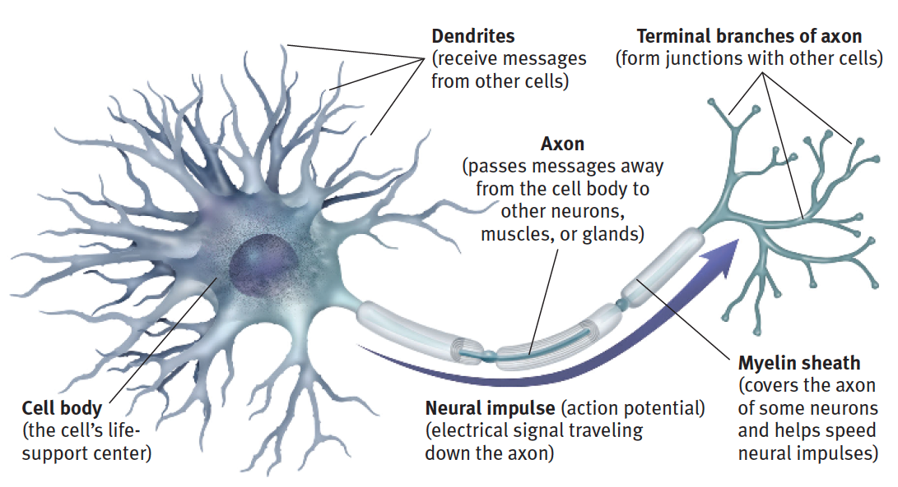
The Teen Brain
Anatomy of a Neuron (Brain Cell)
Massive increase in connections between neurons, followed by selective pruning based on experience
Increased speed of signaling between neurons
Plasticity
Myers, D., & Dewall, C. N. (2015). Psychology (11th ed.). Worth Publishers: New York.
Notes:
3 min
Plasticity: the ability of the brain to restructure and reorganize.

Slide 15
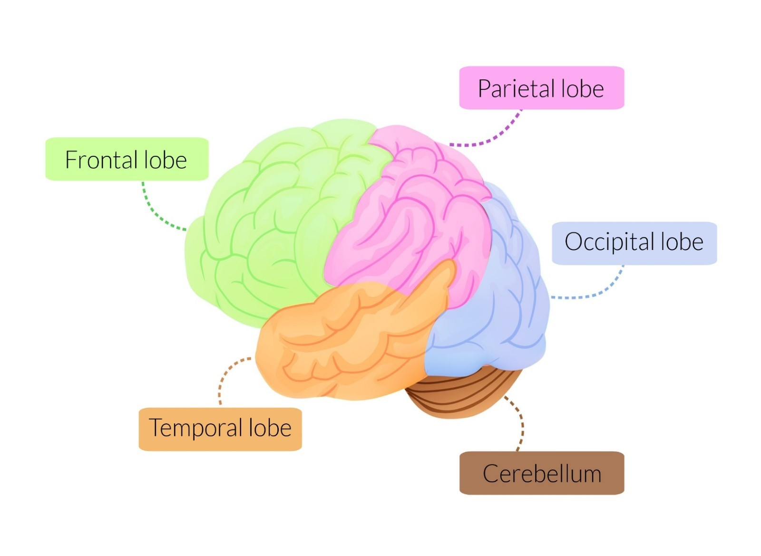
Changes to Brain Regions
Perceptions
Making sense of the world
Arithmetic and spelling
Planning
Problem solving
Emotion regulation
Behavioral control
Personality
Vision
Memory
Understanding
Language
Coordination • Balance • Posture • Motor-learning Sequence learning • Reflex memory • Emotional processing
Notes:
3 min
Back to front, inside to outside
Increased activation of limbic system; frontal lobe (prefrontal cortex) still coming online
The teen brain is more sensitive to rewards and enjoyable experiences—i.e. dopamine—than the adult brain

Slide 16
How Brain Changes Affect Your Thoughts, Feelings and Actions
Strong emotions, can shift quickly
Sensitive to social environment
Creativity and imagination
Primed for learning
Curiosity, drive for excitement and novelty
Reliance on intuition/ gut feelings
Notes:
3 min
sensitive to social environment
Especially opinions of friends and peers
Primed for learning: develop motor skills quickly; excellent time for learning another language, developing new hobbies and skills; learning about cultures and beliefs different from your own
strong emotions, can shift quickly
reliance on intuition/gut feeling
decision making and taking risks (rational vs. intuitive depends on situation)
Creativity and imagination
curiosity, drive for excitement and novelty

Slide 17
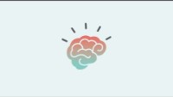
Addiction and the Brain
Notes:
Video (4 min) addiction explained (for kids)

Slide 18
Risk and Protective Factors
Risk Factors
Increase the chances of experiencing substance use problems
Examples:
•Developmental vulnerability
•Drugs are widely available at home or in the neighborhood
• Lack of adult supervision
•Family history of substance use problems
•Mental health challenges (such as depression or anxiety)
Protective Factors
Reduce risk; act as a shield against risk factors
Examples:
• Anti-drug use policies at school
• Participation in structured extracurricular activities
• Practicing multiple coping strategies (exercise, humor, breathing, music, etc.)
• Having at least one caring, supportive adult mentor
Notes:
3 min

Slide 19
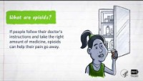
Mind Matters: Opioids
Notes:
3 min
Embed video
Might include the stat, not sure…
In 2021, 12% of Montana high school students said that at some point in their lives they had taken a prescription pain reliever without a doctor’s prescription, or differently than how a doctor told them to use it.

Slide 20
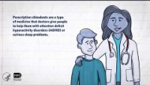
Mind Matters: Prescription Stimulants
Notes:
3 min
Embed video

Slide 21
Discussion: Reasons for Misuse and Healthy Alternatives
Identify:
Working in your groups, think of reasons MT teens might misuse Rx medications and write each reason on its own sticky note.
Categorize:
Classify each reason into one of the four categories, then send one group member to place the sticky notes on the posters.
Consider Alternatives:
For each of the four specific reasons selected by the facilitator, identify a healthy way to accomplish that goal or get that need met.
Explore Barriers and Possible Solutions:
Finally, for each of the four alternatives you identified, think of potential barriers that would make it hard to take this action.
What are some ways to eliminate or reduce these barriers?
Notes:
15 min
What are some reasons that teens in your community might misuse prescription opioids or stimulants?
Write on stickies, then categorize into “buckets” provided by NIDA:
To Feel Good
To Feel Better
To Do Better
Curiosity and Social Pressure
Four groups, assign each group one of the buckets and have them create a new poster that lists the original reason for use, then in a separate column healthy alternatives

Slide 22
Discussion: Healthy Living Leadership
How might preventing prescription drug misuse tie into your leadership role or efforts within your community?
Who is a trusted adult you can talk to if you are concerned about a friend?
Notes:
ONLY INCLUDE IF THERE IS ENOUGH TIME (AT LEAST 10 MIN REMAINING)
How does this subject (preventing prescription drug misuse) tie into your leadership role or leadership efforts in your community?
Who is a trusted adult you can talk to if you are concerned about someone?

Slide 23
Thank You For Attending Today
Before you go…
We Want Your Input!
Notes:
Tell us your preferences to help us with creation of a free online program for Montana teens!

