Slide 1
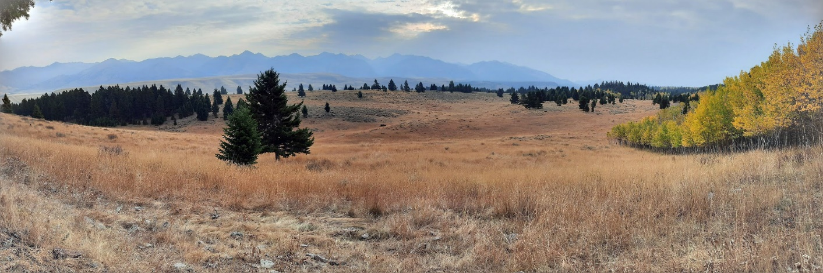


You Can Survive

Slide 2
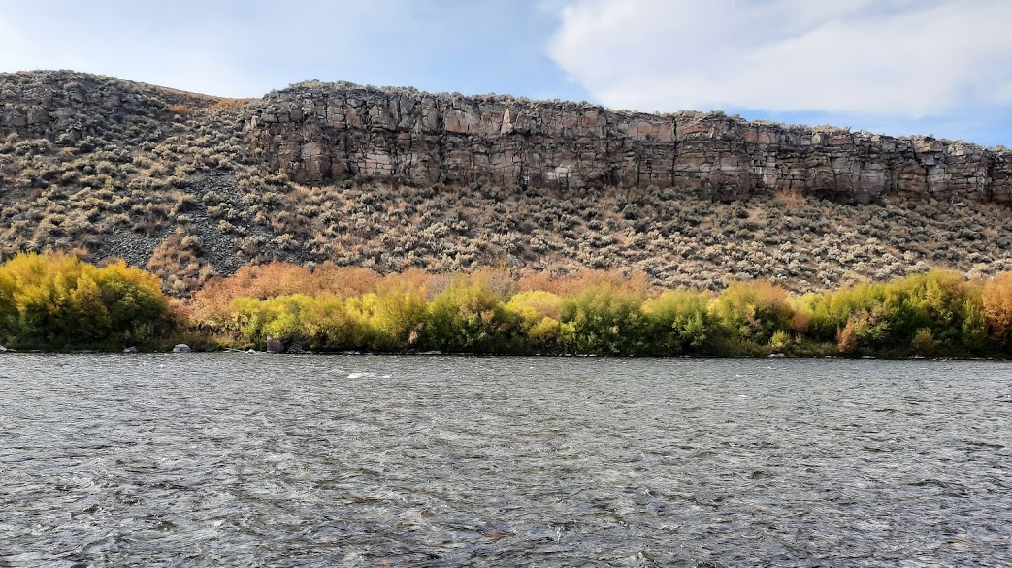
The best thing to remember is not to put yourself in a survival situation – many times this can be done by proper preparation.

Slide 3
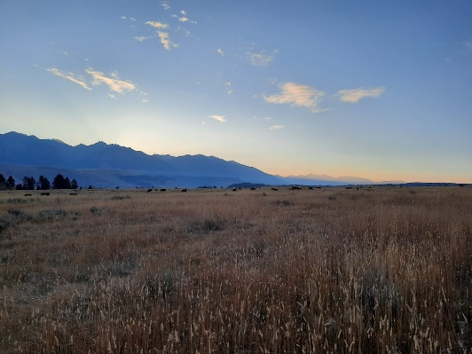
THE ESSENTIALS
For any outdoor adventure
Map/Compass
Survival Kit
Flashlight/Headlamp
Extra Food
Extra Clothes
Sunglasses
First Aid Kit
Signal Mirror
Pocket knife
Water purification
Nylon cord
Waterproof matches
Fire starter
Water/Filter/Bottles
Medications
Whistle
Insect repellents
Sunburn Preventatives
Emergency Shelter
Drinking container (metal)
Soap
A buddy or two

Slide 4
Survival kits
The survival kit should include the following;
  First Aid Kit
  Fire Starter
  Water Purification Methods
  Extra Clothing
  Extra Food
  Metal Water Container
  Emergency Shelter
  Knife/Pliers

Slide 5
Good preparation should include:
Let someone know where you are going, your itinerary, and when you expect to return.
Be familiar with your area so you are less likely to get lost – know what direction you should head if you get confused and know the natural boundaries (lakes, ridges, etc.) that surround you.

Slide 6
Maps and Compass
Using a map and compass, GPS, or other navigational devices, a hunter can understand the terrain, types of topography, unique surface features of your favorite hunting spot.

Slide 7

Maps
Maps are available on USGS website.

Slide 8
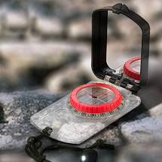
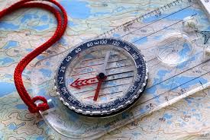
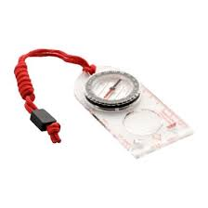
Compass

Slide 9
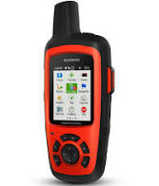
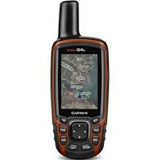
GPS

Slide 10

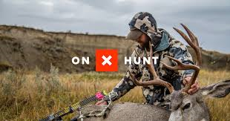
ON X HUNT
https://www.onxmaps.com/

Slide 11

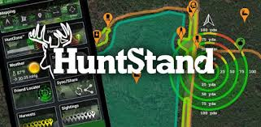
Hunt Stand
https://huntstand.com/

Slide 12

Things to remember
Most people are rescued within 24 hours.
Stay put and wait for rescue.
International sign for distress – three of anything
  Three fires
  Three shots
  Three blasts on a whistle
  Three rocks placed in a triangle

Slide 13

If you are in a survival situation

Slide 14
S - Stop where you are
T - Think of the essentials you need
O - Observe what is available to you.
P - Plan what you will do and in a
priority order.

Slide 15
Basic Needs for Survival Matching
3 seconds
3 minutes
3 hours
3 days
3 weeks
3 times
Food
Heat – retain or avoid
Oxygen
Positive Mental Attitude
Signal for help
Water

Slide 16
Answers
3 seconds
3 minutes
3 hours
3 days
3 weeks
3 times
Positive Mental Attitude
Oxygen
Heat – retain or avoid
Water
Food
Signal for help
SM 92

Slide 17
Basic Needs in Order of Priority
P.M.A.
Air
Shelter / Warmth
Water
Food

Slide 18
P.M.A.
Positive Mental Attitude
A positive mental attitude can determine 80-90% of your survival chances

Slide 19
Hypothermia
MEDICAL EMERGENCY; life threatening condition
Severe body heat loss-body temp falls below 95oF
Occurs when:
  conditions are windy, clothing is wet, and/or the individual is inactive
  extended water exposure or immersion
    1 hour or less when water temp is below 45oF
    prolonged exposure in slightly cool water (e.g. 60oF)
    thunderstorms, hail, rain and accompanying winds
Notes:
Hypothermia is a condition of abnormally low core body temperature which results when heat loss exceeds the body’s heat production. Hypothermia is usually associated with cold climates, but it can occur even in warm climates during extended exposure in thunderstorms, hail, rain, and accompanying winds, especially when the soldier has wet clothing or soldier is inactive. When exposed, watch your soldiers carefully for signs of hypothermia.
Human cells, tissues, and organs operate efficiently only within narrow temperature limits. If our body temp rises 2 degrees above the normal 98.6ºF, we may become ill. If it rises 7 degrees, we becomes critically ill. If our body temp decreases 2 degrees, we feel cold. A 7 degree decrease puts our life in jeopardy. If it drops as low as 80ºF, death is likely.

Slide 20
Hypothermia
The “umbles”-stumbles, mumbles, fumbles, and grumbles
Initial Symptoms
  shivering
  dizzy, drowsy
  withdrawn behavior
  irritability
  confusion
  slowed, slurred speech
  altered vision
  stumbling
Severe Stages
  stops shivering
  desire to lie down and sleep
  heartbeat and breathing is faint or undetectable
  unconsciousness followed by DEATH
Notes:
Signs and symptoms of hypothermia change as body temperature falls. Mental functions tend to decline first, and the person loses his ability to respond appropriately to the environment. Muscular functions deteriorate until he is too clumsy to walk or stand. Biochemical processes become slow and deficient as the body cools. Unfortunately, early signs and symptoms of hypothermia can be difficult to recognize and may easily go undetected. A victim may deny he is in trouble; believe the symptoms, not the victim.
Mental signs: Decision making ability deteriorates. His response to cold becomes slow, improper, or indifferent. His general state becomes apathetic and lethargic, and he expresses increased complaints. His cooperation in group activities decreases. He may also exhibit slurred speech, accompanied by disorientation progressing to incoherence, irrationality, and possible unconsciousness.
Physical (muscular) signs: In the early and moderate stages of hypothermia, the soldier exhibits shivering. A hypothermic victim loses fine motor ability, which may progress to stumbling, clumsiness, and falling. In severe cases, shivering ceases, and the victim exhibits stiffness and inability to move.

Slide 21
Hypothermia
Treatment
  prevent further cold exposure
  evacuate immediately if severe hypothermia
  remove wet clothing
  Re-warm with body-to-body contact or in a warmed sleeping bag
  warm, sweet liquids if conscious
  give sugared food if conscious
Notes:
Preferred method is to immediately and very gently evacuate the victim.
Moderate hypothermia:
Move the victim out of the wind to a sheltered environment. Replace wet clothing with dry clothing or sleeping bags. Cover the victim with blankets or other insulating material. Apply heating pads wrapped in towels to the casualty’s armpits, groin, abdomen. If patient is conscious and alert, give warm, nutritious fluids to drink and simple, sweetened foods to eat, including candy bars. Carbohydrates are the fuel most quickly transformed into heat and energy. Do not give alcoholic beverages or tobacco products. Wrap from head to toe and gently evacuate to a medical facility in a recumbent (lying down) position.
Severe hypothermia:
Cut away wet clothing and replace with dry clothing. Ensure that the victim’s airway remains open. Perform mouth-to-mouth resuscitation if the victim’s breathing rate drops below five respirations per minute. Apply an additional heat source. One method is to place the victim in a sleeping bag with his outer clothing removed and have another soldier remove his outer clothing and get into the sleeping bag also (monitor rescuer for hypothermia). Cover both soldiers with additional clothing. Evacuate the casualty to a medical facility as soon as possible. Handle very gently since hypothermia causes an irritable heart which could result in cardiac result. During evacuation, the soldier should be insulated from the cold surfaces of a vehicle or sled.

Slide 22
Hypothermia
Prevention
  eat properly and often
  warm liquids (non-caffeinated) and water
  wear lots of loose layers
  keep active
  stay dry
  warming tents
  get plenty of rest
  buddy watch/observation
Notes:
Prevention, early detection, and immediate evacuation are the leader initiatives through which hypothermia should be managed in the field. Prevention involves the proper use of clothing and equipment. Be alert for cold injury signs and symptoms. When hypothermia is detected in its early stage, a soldier may respond well to the removal of the cold stress. An outdoorsperson should not return to the cold until his energy and fluid reserves have been replenished.

Slide 23
Dehydration
A loss of body fluids to the point of slowing or preventing normal body functions
Increases chance of becoming a cold weather casualty, especially hypothermia
Can lead to heat cramps or heat exhaustion
Notes:
Dehydration is a deficiency in body fluids that inhibits body functions. It adversely affects the body’s resistance to cold injury. It can cause serious physical problems and make the soldier more susceptible to other problems, such as frostbite and hypothermia. Proper hydration is essential to supplying fuel and energy to body parts to facilitate heat production.
It is very easy to become dehydrated in cold weather. Soldiers fail to drink enough liquid and underestimate fluid loss from sweating. Thirst is a poor indicator of water requirements. Dehydration is a lack of water in the body. It increases your chances of becoming a cold weather injury casualty and is therefore included in this briefing. Almost all soldiers who become hypothermic are already dehydrated. Dehydration contributes to poor soldier performance in physical activities, even more so than lack of food. Cold weather requirements for water are no different than in the desert and may, in fact, exceed desert requirements b/c of the increased energy expended in operating with additional layers of clothing and trudging through the snow.

Slide 24
Dehydration
Symptoms
  dark urine
  headache
  dizziness, nausea
  weakness
  dry mouth, tongue, throat, lips
  lack of appetite
  stomach cramps or vomiting
  irritability
  decreased amount of urine being produced
  mental sluggishness
  increased or rapid heartbeat
  lethargic
  unconsciousness
Notes:
Signs: irritability, darkening urine, decreased amounts of urine being produced, dry mouth, tiredness, mental sluggishness, lack of appetite, increased or rapid heartbeat, dizziness, and even unconsciousness.

Slide 25
Dehydration
Treatment
  drink WATER or other warm liquids
  avoid caffeinated liquids (sodas, coffee, tea)
  do not eat snow
  rest
Notes:
To treat dehydration, give the individual warm liquids to drink. Warm liquids will be consumed more readily in a cold environment than cold beverages. Avoid coffee, sodas, cocoa, tea and other caffeinated beverages b/c they act as a diuretic, removing fluids from the body. Do not let the victim eat snow as this uses up body heat and might be contaminated by disease causing pathogens.
If the soldier is conscious, administer fluids by mouth. If improvement is not obvious in an hour, evacuate the patient to a medical facility. In advanced stages of dehydration, as in the case of an unconscious soldier, immediately evacuate the patient to a medical facility.

Slide 26
Dehydration
Prevention
  drink minimum of 3 quarts of water daily for inactivity and 5-6 quarts for activity
  monitor urine color – urine should be clear
  do not wait until you are thirsty
  drink hot liquids for warmth (non-caffeine)
Notes:
To prevent cold weather dehydration, soldiers should drink a minimum of 3 canteens of water daily. The thirst mechanism does not function properly in cold weather. Soldiers tend to not feel as thirsty as they do when operating in warmer climates. They should monitor their urine. Clear yellow urine means you are okay. Dark yellow urine means you need to drink more. Drink enough water to keep your urine clear. Snow is an emergency source of water. It must first be melted and purified with iodine tablets, calcium hypochlorite or boiling before being consumed.

Slide 27
Clothing
Think about the time of year you are going to be outdoors
What if the weather changes?
Use layering
  Wicking layer – pulls moisture from the skin surface (example – wool, silk, polyester, polypropylene)
  Insulating layer – retains heat close to the body (example – down, wool, fleece, pile)
  Waterproof/windproof layer – provides a barrier from the elements to reduce heat loss through convection. (example – Gortex, Laytek, Dermo-flex, Entrant, Ultrex)

Slide 28
Shoes
Comfortable
Broken in prior to the trip
Well fitting
Wear socks
Blister prevention is important

Slide 29
Water Purification
The water may look clear and beautiful as it flows in the stream…. But… look out!
Giardia lamblia (Beaver fever)
  Unhatched oval cyst that invades the digestive tract
  Only need to consume 1-10 cysts to become infected.
  Symptoms do not appear for approximately 2 weeks.

Slide 30
Giardia symptoms
Intestinal disturbance
Fever
Headache
Itching

Slide 31
Ways to purify your water
Filtration
  Safest method due to the technology in ceramic filters. No residual aftertaste.
  Need to filter at 0.2 microns - THIS IS CRUCIAL
  Price range from $75 - up
Boiling
  Effective and inexpensive
  Pre-treatment not required
  Consumes fuel and time; can not easily treat water when you are away from camp

Slide 32
Water Purification
Chemical treatment
  Long contact time is required
  Silty or dirty water requires a higher chemical concentration
    Chlorine
      Short shelf life
      Affected by pH, temperature and debris content
    Iodine
      Leaves a bitter taste
      Iodine allergy
      Health risk in large doses

Slide 33
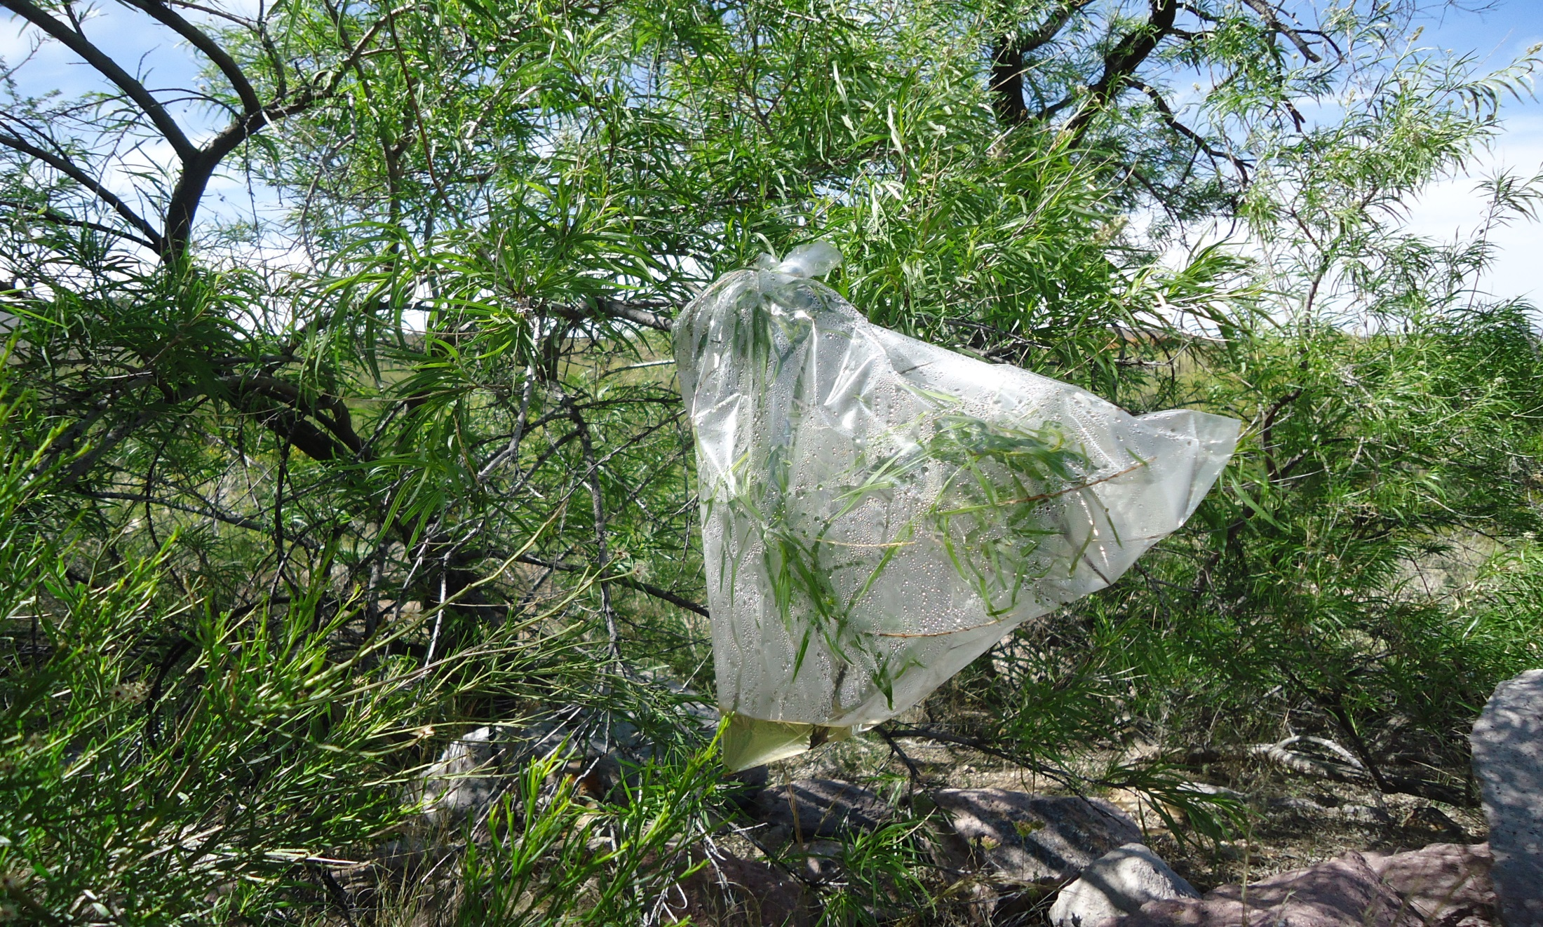
Example of Transpiration Collection

Slide 34
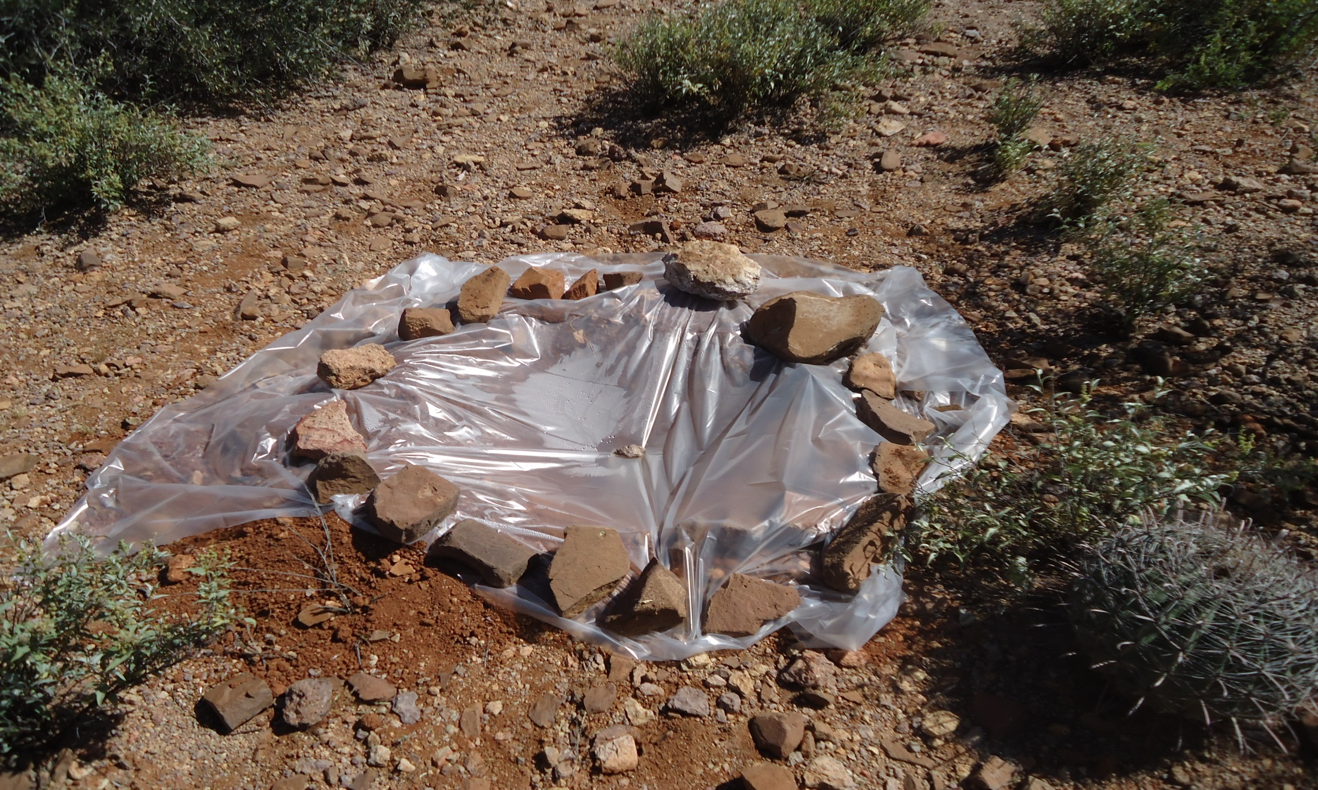
Example of a Solar Still

Slide 35
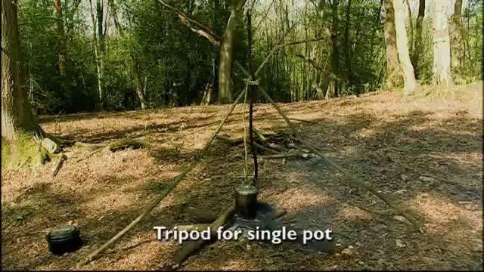
Bushcraft - Woodlore

Slide 36
PMA and Fire
Fire Tetrahedron
Fuel
Heat
Oxygen
Sustained chemical reaction

Slide 37
Heat
Build a fire
  Positive Mental Attitude
    Companion
    Mind occupied – sense of control and accomplishment
  Warmth Keeps person in one place
  Signal for help

Slide 38
Four Steps to Fire Building
Ignition Source
Tinder
Kindling
Fuel Wood

Slide 39
Where to Build and Fire Types
Where to Build a Fire
Fire Safety
Convenient Fuel Supply
Sheltered from the Elements
----------------------------------------------------------- Fire Types
a. Log Cabin Method
b. Tepee Fire

Slide 40
Sum It Up
Dress properly
Drink plenty of fluids
Eat right
Keep in shape
Get plenty of rest
Minimize periods of inactivity
Maintain a positive attitude

