Slide 1
4-H Hunting Skills Orienteering

Slide 2
Why do we need to be able to read a map and use a compass?
Not to get lost
Know hunting boundaries
Find game
Find prime hunting spots
To explore new territory
To be a good ethical hunter – give me some examples.

Slide 3
The rules of contour lines
Contour lines never cross or join contour lines of different elevation.
Contour lines appear on both sides of an area where the slope reverses direction.
Contour lines V upstream when they cross a stream.
All contour lines either close or extend to the edge of the map. Usually shown in brown.
Contour lines close or join around hills. They also close around basins and depressions.
Depressions are labeled with hachure marks inside the oval.

Slide 4
Interpreting a Topo Map
Topo maps are called quadrangles.
Cover 15’ of longitude and latitude
New ones cover 7.5’
Scale – 1:24,000 – 1” = 200 ft
Index contour is the 5th line, bold in color.
Closely spaced lines steep slope
Lines further apart gentle slope.
Legend – describes the symbols used on a map.

Slide 5
Contour Map

Slide 6
Declination

Slide 7
How to use declination
True North
Magnetic North
Magnetic Declination – the difference between magnetic and geographic north.
Four Directions
North – 0
South – 180
East – 90
West – 270

Slide 8
Compass

Slide 9
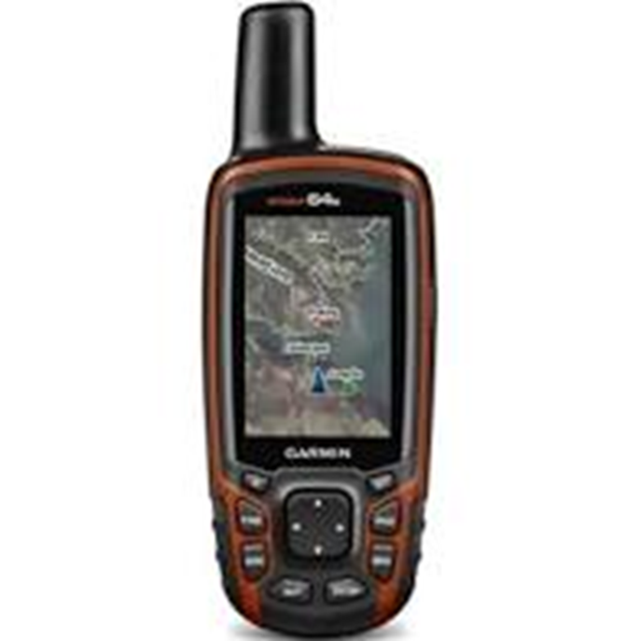
GPS

Slide 10
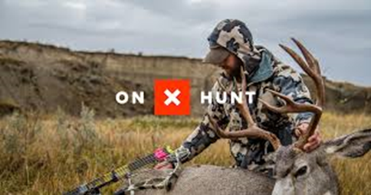
ON X HUNT
https://www.onxmaps.com

Slide 11
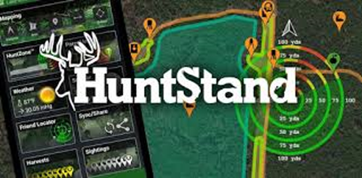
Hunt Stand
https://huntstand.com/

