Slide 1
Project 2030 Supporters
Blue Cross/Blue Shield of Montana
Montana Agricultural Experiment Station
Montana Area Agencies on Aging Association
Montana Association of Counties
Montana Bankers Association
Montana Chamber Foundation
Montana State University
Montana State University Extension
NorthWestern Energy
PPL Montana
University of Montana
Montana Council on Economic Education (MCEE)
ONE MONTANA: Bridging the Rural-Urban Divide
1
Notes:
Thank you, Jim. This slide shows the organization that provided financial support for this project. Representatives of many of these organizations are here today – would you stand for just a moment and be recognized?
I’d like to especially recognize Linda Stoll from the Area Agencies on Aging. Linda has been an enthusiastic supporter right from the beginning.
I’d also like to thank Jim for his support in coordinating work with the donors – there may have been a bit of arm twisting involved.
1

Slide 2
Project 2030:
Montana’s Aging Population
George Haynes
Doug Young
Myles Watts
Montana State University
Department of Agricultural Economics and Economics
Montana Academy of Nutrition and Dietetics
May 28, 2015 (8:45 – 9:45 am)
Great Northern Hotel - Helena
Notes:
2

Slide 3
Project 2030 Topics
Demographics
Migration
Fiscal Impacts of Aging
Consumption (income/expenditures)
  5. Summary, Conclusions, & Implications

Slide 4
Impacts of Aging
Demand
  What nutrition-related services to the elderly demand from you?
Supply
  What will you be willing to supply?

Slide 5
Demographics
Population
Age Dependency Ratios
  TDR
  YDR
  EDR
Age Dependency Ratios by County
5
Notes:
5

Slide 6
Montana Population by Age Group
Source: U.S. Census. Years 2020 and 2030 are estimates using the U.S. Census projections re-weighted with 2010 U.S. Census Data

Slide 7
Montana Age Groups as a Percent of Total Montana Population
Source: U.S. Census. Years 2020 and 2030 are estimates using the U.S. Census projections re-weighted with 2010 U.S. Census Data
Notes:
7
7

Slide 8
Age Dependency Ratios
Total Age Dependency Ratio (TDR)
  TDR = Non-Working Age ÷ Working Age
Non-Working Age Population
  0 to 17 years of age (youth)
  65+ years of age (elder)
Working Age Population
  18 to 64 years of age
Notes:
8
8

Slide 9
Age Dependency Ratios
Youth Dependency Ratio (YDR)
  YDR = 0 to 17 Age ÷ Working Age
Elder Dependency Ratio (EDR)
  EDR = 65+ Age ÷ Working Age
Notes:
9
9

Slide 10
Montana Age Dependency Ratios
Source: U.S. Census. Years 2020 and 2030 are estimates using the U.S. Census projections re-weighted with 2010 U.S. Census Data

Slide 11
Montana Age Dependency Ratios
Year | YDR | EDR | TDR
1930 | 0.60 | 0.08 | 0.68
1940 | 0.49 | 0.10 | 0.59
1950 | 0.56 | 0.15 | 0.71
1960 | 0.75 | 0.19 | 0.94
1970 | 0.68 | 0.18 | 0.86
1980 | 0.49 | 0.18 | 0.67
1990 | 0.47 | 0.23 | 0.70
2000 | 0.42 | 0.22 | 0.64
2010 | 0.36 | 0.24 | 0.60
2020 | 0.38 | 0.36 | 0.74
2030 | 0.39 | 0.48 | 0.87
Sources: U.S. Census. Years 2020 and 2030 are estimates using the U.S. Census projections re-weighted with 2010 U.S. Census Data
Notes:
11
11

Slide 12
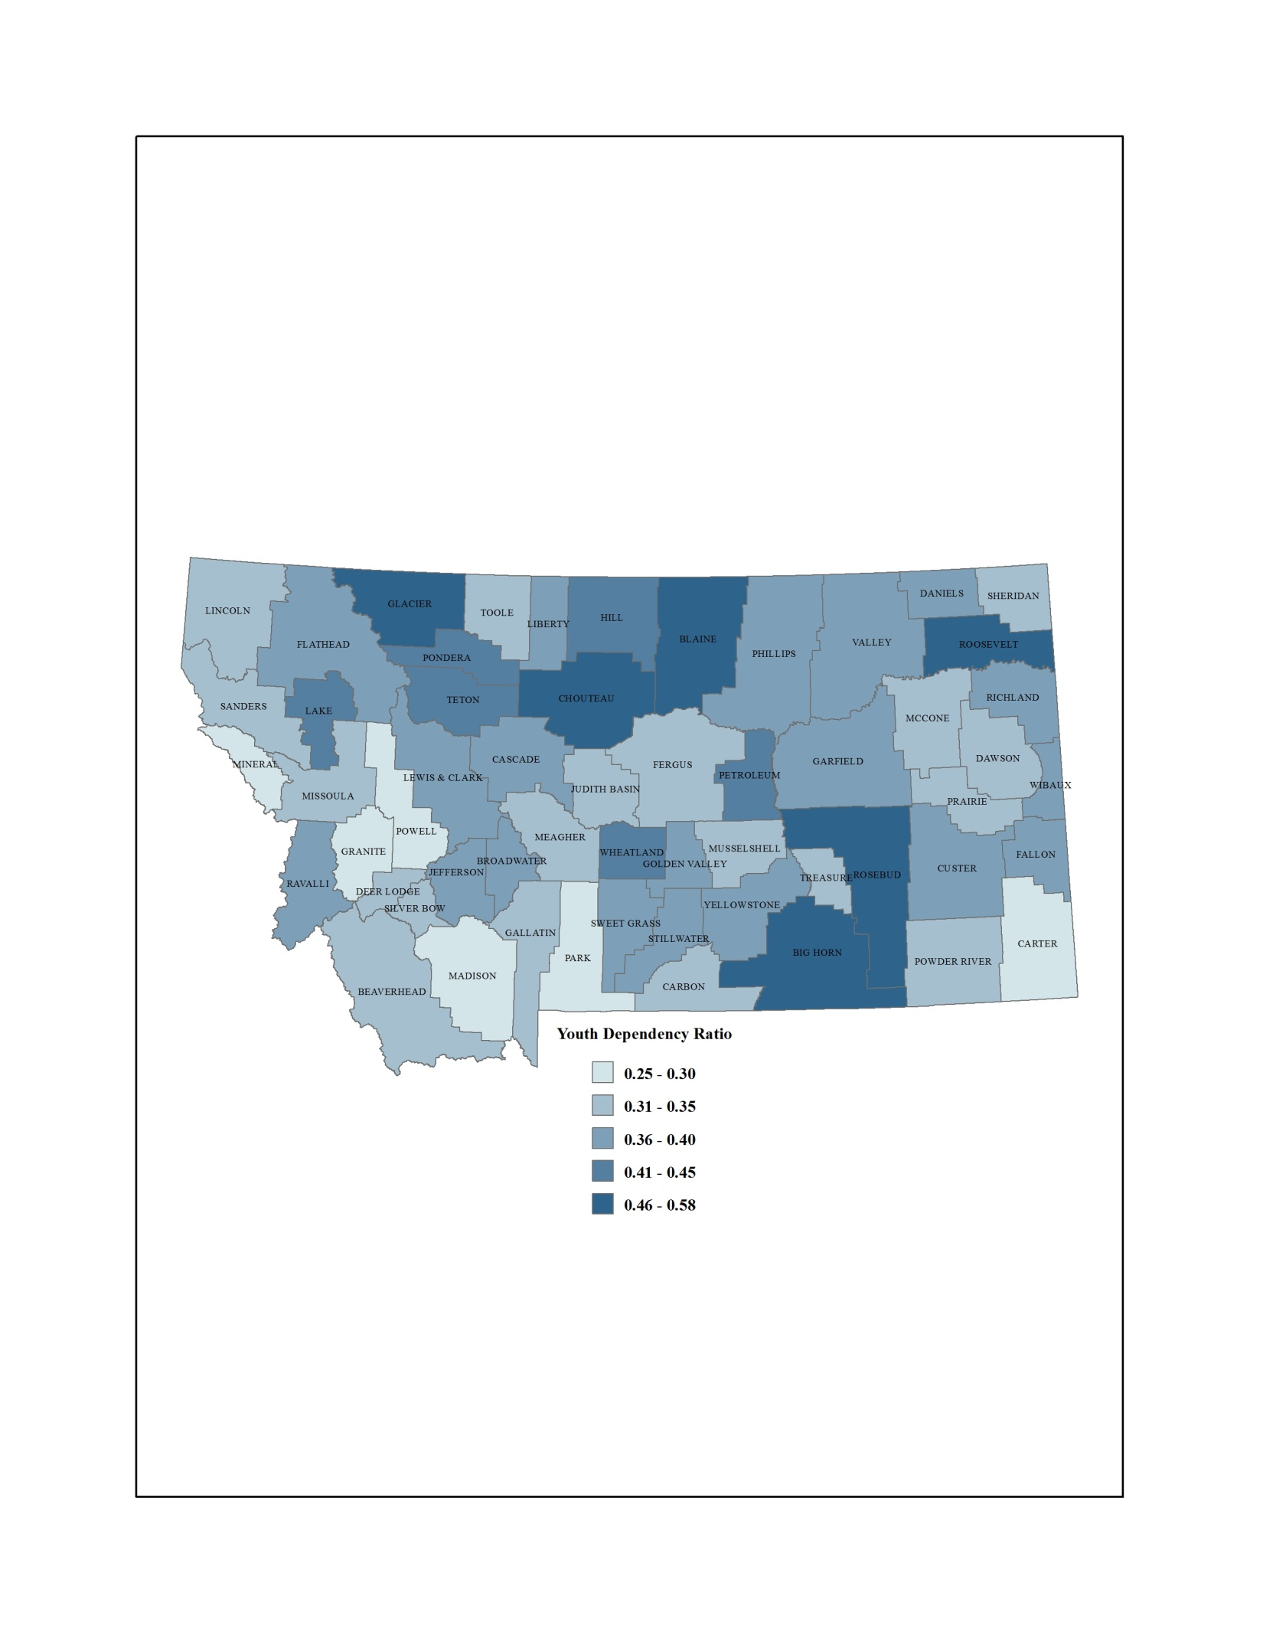
2010 YDR Montana Counties Distribution Map
Source: U.S. 2010 Decennial Census
12
Notes:
12
12

Slide 13
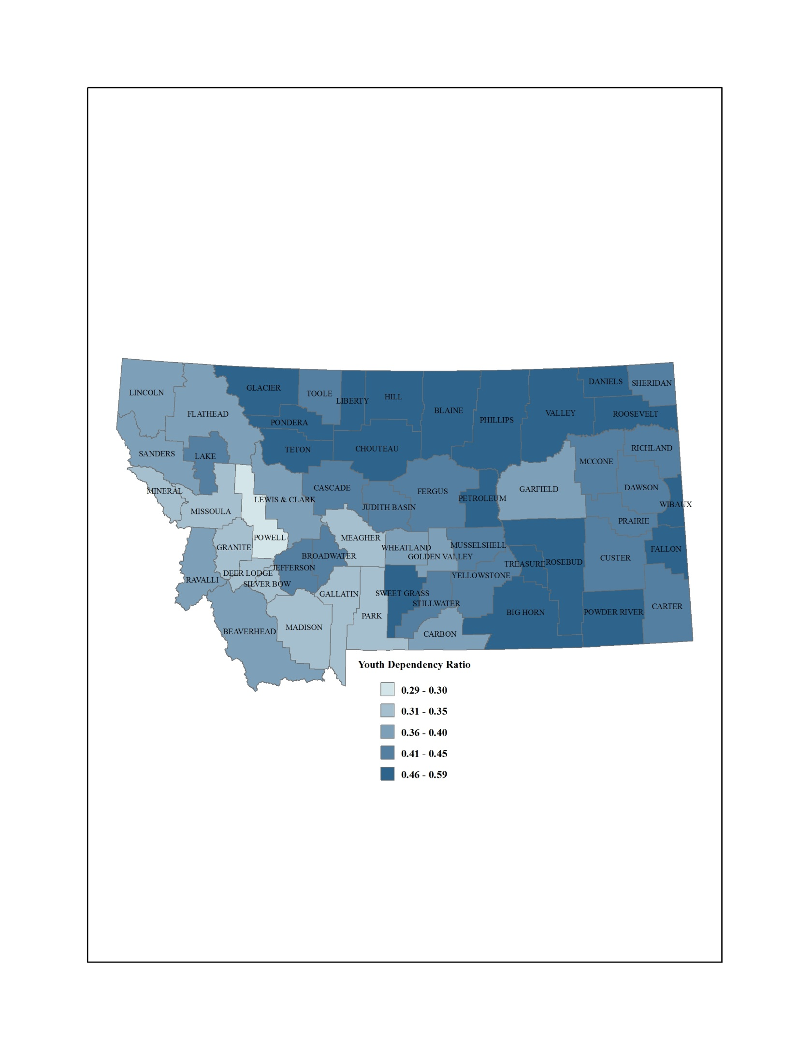
2030 YDR Montana Counties Distribution Map
Source: NPA, Inc. Population Projections revised with the 2010 Census
13
Notes:
13
13

Slide 14
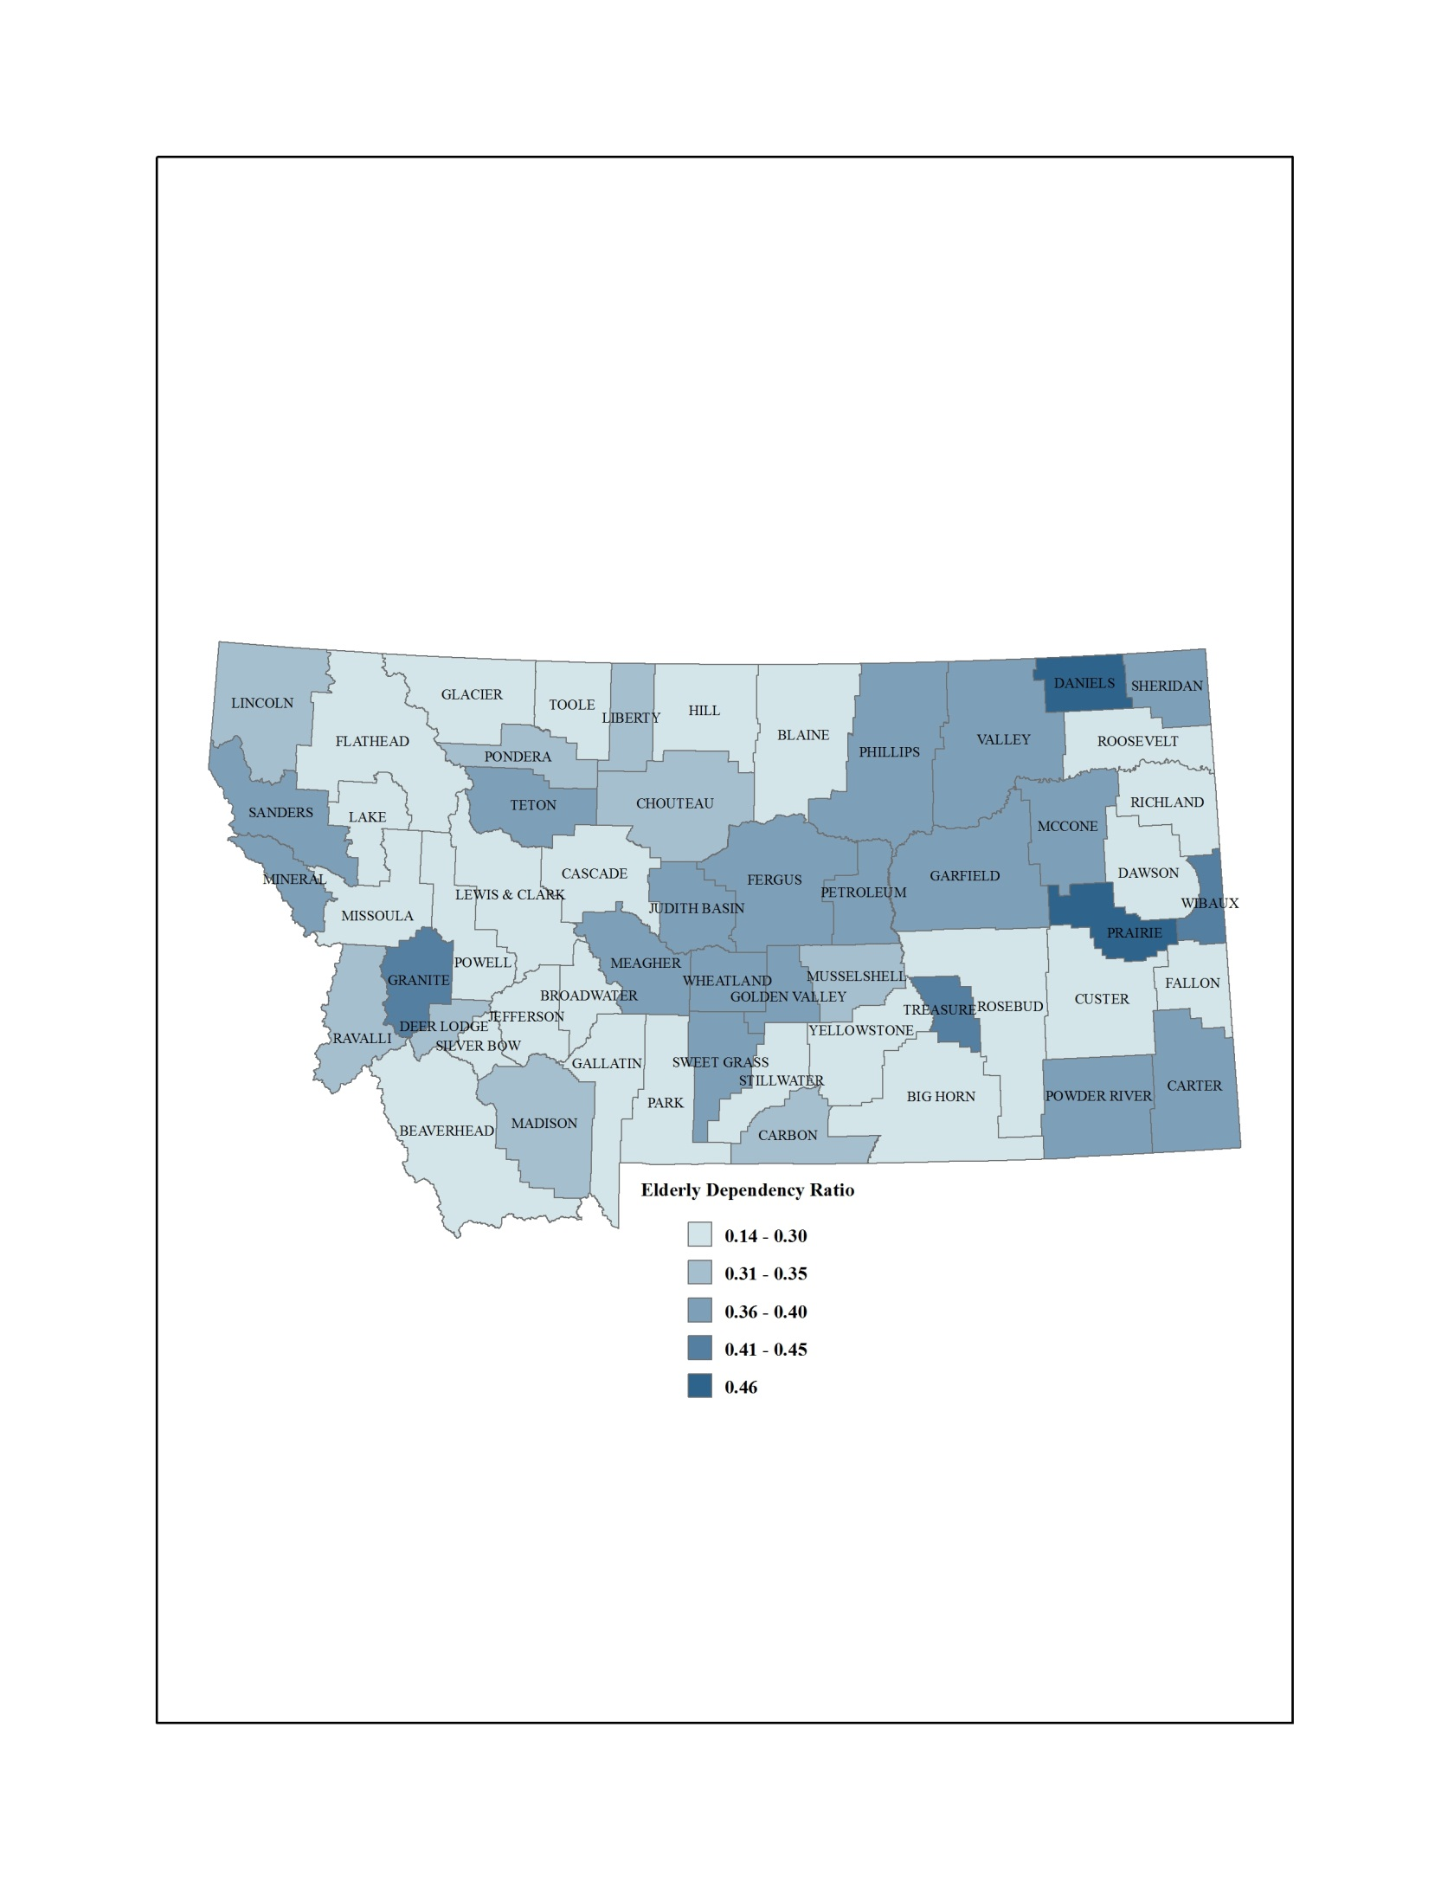
2010 EDR Montana Counties Distribution Map
Source: U.S. 2010 Decennial Census
Notes:
14
14

Slide 15
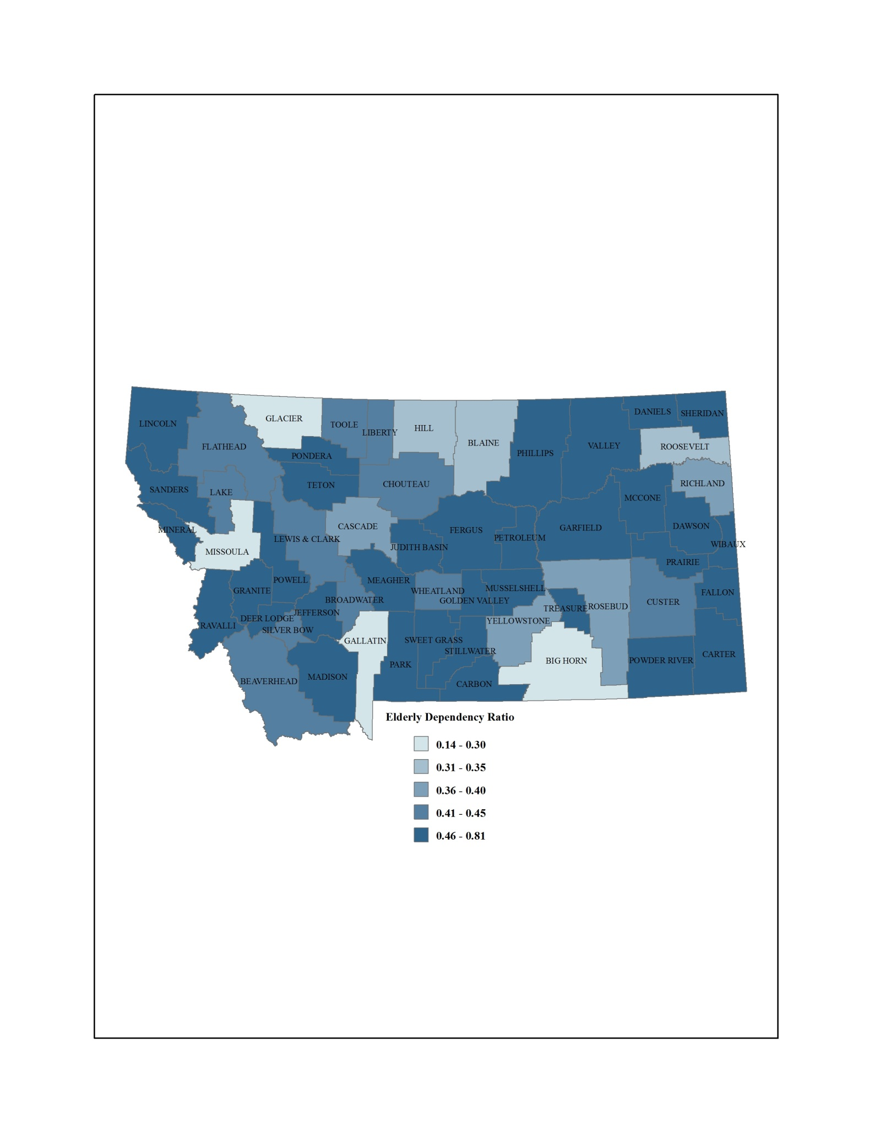
2030 EDR Montana Counties Distribution Map
Source: NPA, Inc. Population Projections revised with the 2010 Census
Notes:
15
15

Slide 16
Migration
Net Migration in Montana 2000 to 2010
Net Migration in Western/Southern Montana 2000 to 2010
Net Migration to Yellowstone County 2000 to 2010
Net Migration to Eastern/Northern Montana 2000 to 2010
16
Notes:
16

Slide 17
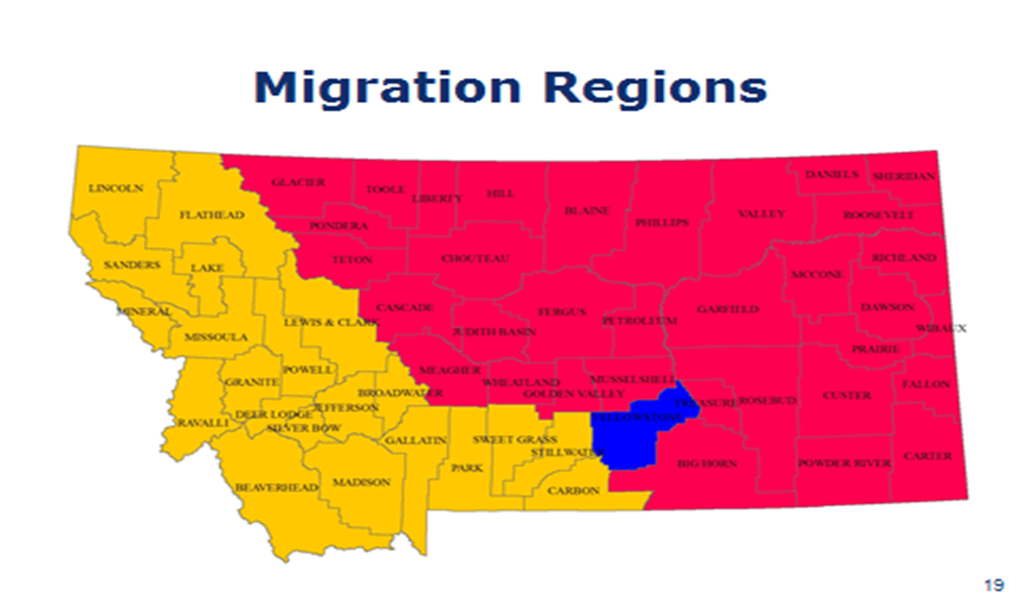

Slide 18
Net Migration
Montana 2000 to 2010
Sources: U.S. Census and CDC
18
Notes:
18

Slide 19
Net Migration
Western/Southern Montana 2000 to 2010
Sources: U.S. Census and CDC
19
Notes:
19

Slide 20
Net Migration
Yellowstone County 2000 to 2010
Sources: U.S. Census and CDC
20
Notes:
20

Slide 21
Net Migration
Eastern/Northern Montana 2000 to 2010
Sources: U.S. Census and CDC
21
Notes:
21

Slide 22
Fiscal Impacts of Aging
Aging Impacts on Expenditure
  K-12 and Higher Education
  Corrections
  Medicaid
Aging Impacts on Revenue
  See the website

Slide 23
K-12 and Higher Education
Fiscal Impacts on Expenditure

Slide 24
K-12 Education Expenditure in Fiscal Year 2009
Total Expenditure | $ 1,492,885,133
Public School Enrollment Fall 2009 | 141,807
Participation Rate: Enrollment/Population 5 to 17 | 88.0%
Expenditure per Student | $ 10,528
Expenditure per Montanan | $ 1,509
Sources: Montana Office of Public Instruction, Expenditures by Function by Enrollment Category FY2010 http://opi.mt.gov/pub/index.php?dir=School%20Finance/OPICoreDataFiles/PerPupil/&file=Perpupil1991_2011.xls Use Tab: 10obj_NO_ARRA_NO_SFSF
Montana Legislative Fiscal Division, OPI summary, Base Fiscal 2010 - Total Costs http://leg.mt.gov/content/Publications/fiscal/fr_2013/Volume%204/section%20E/OPI.pdf - Pg 10
Montana Office of Public Instruction, Montana Public School Enrollment Data October 4, 2010 www.opi.mt.gov/pdf/Measurement/EnrollBook2010.pdf - Pg 2
U.S. Census 2010 population data
Notes:
24
Note: Montana Office of Public Instruction, Expenditures by Function by Enrollment Category for FY2007. Expenditures for the Office of Public Instruction 2008 are found in the OPI budget analysis document.
Expenditures by function by enrollment category: $1,327,792,210 (2008)
Expenditures for Office of Public Instruction: $24,628,290.95 (what is this?)

Slide 25
Percent of Montana Population Age 5 to 17
Source: 2010 U.S. Census. Years 2015 to 2030 are estimates using the U.S. Census projections re-weighted with 2010 U.S. Census Data.
Notes:
25
Montana’s school age population (and enrollment) have been dropping for some time, and the trend is expected to continue, albeit unevenly. After a further drop to 2010, the share of school age kids in the total population is expected to stabilize for 10 years, before dropping again in the 2020s. Altogether, the school age share in the total population is expected to decline from 16.7% to 14.9%.

Slide 26
K-12 Expenditures per Montanan
Source: 2010 U.S. Census. Years 2015 to 2030 are estimates using the U.S. Census projections re-weighted with 2010 U.S. Census Data.
Notes:
26
A smaller share of school age kids in the total population translates into lower expenditures when spread out over all Montanans, if nothing else changes except for the age distribution. Expenditures would decline from $1,438 per person to $1,278, or about 11%.

Slide 27
University System Instructional Expenditure Year 2010
Total Appropriations | $ 160,052,417
State Appropriation | $ 151,947,492
Local Appropriations | $ 8,104,925
FTE Resident Enrollment | 31,222
Participation Rate (Enrollment/Population 18 to 24) | 33%
Expenditure per Student | $ 5,126
Expenditure per Montanan | $162
Source: Montana State University System
27
Notes:
27

Slide 28
Percent of Montana Population Ages 18 to 24
Source: 2010 U.S. Census. Years 2015 to 2030 are estimates using the U.S. Census projections re-weighted with 2010 U.S. Census Data
Notes:
28
The key demographic change in coming decades for college spending is the percentage of the population which will be of traditional college age, 18-24. In Montana it is expected to decrease from about 9.3% in 2007 to 6.8% in 2020 before rising to 7.1% by 2030. This will reduce pressure on the state budget, as indicated in the next slide.

Slide 29
Higher Education
Expenditure Per Montanan
Instruction only. Excludes MAES, ES, Fire school, Bureau of Mines, Grants and Contracts, etc.
Sources: MUS OCHE, Population Data: Year 2010 Census. Years 2015 to 2030 are estimates using the U.S. Census projections re-weighted with 2010 U.S. Census Data
29
Notes:
29
As the share of the population that is attending college decreases , the expenditure per person in Montana will decline as well, all else held constant.
Note things that may change: Percent attending college, cost per student, mix of state support and tuition.
The decline amounts to $34 per person in Montana.

Slide 30
Corrections
Fiscal Impacts on Expenditure

Slide 31
Participation and Daily Expenditures for
Corrections
Sources: D. Hall, Montana Department of Corrections for participants by age. B. Peake, Montana Department of Justice for youth court participants. Costs from Montana Department of Corrections 2011 Biennial Report and Montana Judicial Branch Youth Court At-A-Glance 2010
31
Notes:
31

Slide 32
Participation in Montana Correctional System (2012)
Sources: MT DOC and DOJ
32
Notes:
32

Slide 33
Corrections Expenditure
per Montanan by Age
Sources: MT DOC and DOJ Population: Year 2010 U.S. Census
33
Notes:
33
Based on projections of the 2008 population, correctional expenditure was expected to be about $138 per person in Montana. It is expected to decline to $120 by 2030. Over the whole time period, correctional expenditure per Montanan is expected to decline by about $18.

Slide 34
Corrections Expenditure per Montanan
Sources: MT DOC and DOJ Population: Year 2010 U.S. Census. Years 2012 to 2030 are estimates using the U.S. Census projections re-weighted with 2010 U.S. Census Data (included in 2012 are the 2010 Youth Court Numbers)
Notes:
34
The “participation rate" with the various corrections services varies with age, and as we have seen the cost per participant varies according to the particular service. Combining those two pieces of information, we can compute the cost per person of various ages. The most expensive citizens are youth, both because so many youth are involved with the courts – almost one in every eight among the 14-17 year old age group - and because the residential programs are so expensive for each participant. The next highest cost group is age 25-44 who have the highest probability of being inmates, followed by 18-24 year olds, who are slightly less likely to be inmates or otherwise under the jurisdiction of the courts. Cost diminish markedly for people age 45-64 because their participation rates are relatively low, and very few people age 65+ are involved with the correctional system.

Slide 35
Medicaid
Fiscal Impacts on Expenditure

Slide 36
Montana Medicaid Expenditures in Fiscal Year 2009 - 2010
Description | Total | Elderly | Blind and Disabled | Adults | Children
Federal and State Expenditures for Medicaid | $915,129,130 | $177,535,051 | $430,110,691 | $121,712,174 | $184,856,084
State Expenditures for Medicaid (22.35%) | $204,531,361 | 39,679,084 | $96,129,739 | $27,202,671 | $41,315,335
Number of participants | 81,597 | 6,126 | 19,059 | 11,433 | 44,979
Participation Rate | 8.2% | 4.2% | 14.6% | 1.9% | 18.9%
Expenditure per Participant | $2,507 | $6,477 | $5,044 | $2,379 | $919
Expenditure per Montanan (989,415) | $207 | $40 | $97 | $27 | $42
Sources: Montana Medicaid Program, State Fiscal Years 2009/2010, Report for the 2011 Legislature, page 9 and Summary of Public Assistance and Medical Care, State Fiscal Year 2010. Montana Department of Public Health and Human Services. www.dphhs.mt.gov/statisticalinformation/tanfstats/sfy2010/table1.pdf.
Notes:
Sources: MDPHHS – Montana Medicaid Program, State Fiscal Years 2005/2006, Report for the 2007 Legislature – 2005 Expenditures for Aged (65+)
36

Slide 37
Medicaid Expenditures per Montanan, 2010 to 2030
Sources: Bureau of Census and Montana Medicaid Program, State Fiscal Years 2009/2010, Report for the 2011 Legislature
Notes:
37

Slide 38
Medicaid Expenditures per Montanan by Medicaid Group, 2010 to 2030
Sources: Bureau of Census and Montana Medicaid Program, State Fiscal Years 2009/2010, Report
for the 2011 Legislature
Notes:
38

Slide 39
State Medicaid Physical Health Expenditure per Montanan for
Long-Term Care and Other Expenditure for Elderly, 2010 to 2030 (no trend)
Sources: Bureau of Census and Montana Medicaid Program, State Fiscal Years 2009/2010, Report for
the 2011 Legislature; and Kaiser Commission on Medicaid and the Uninsured, the Henry J. Kaiser Family Foundation
Notes:
39

Slide 40
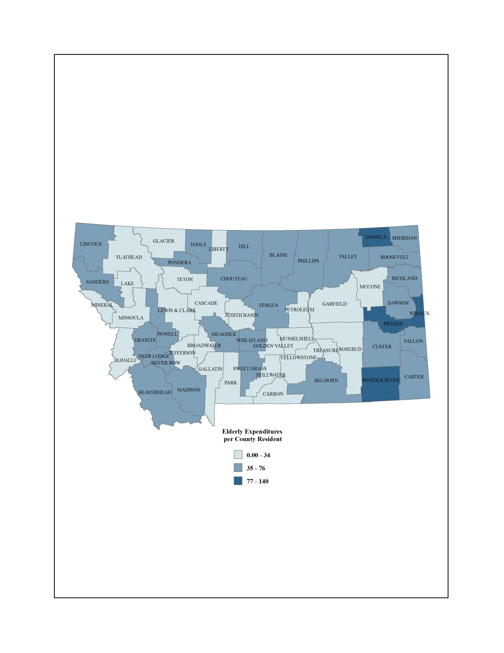
State Medicaid Expenditure for the Elderly per County Resident 2010 (no trend)
Sources: Montana Department of Public Health and Human Services, Statistical Information for 2010, Table 5 (Nursing Home) and 2010 Decennial Census
Notes:
40

Slide 41
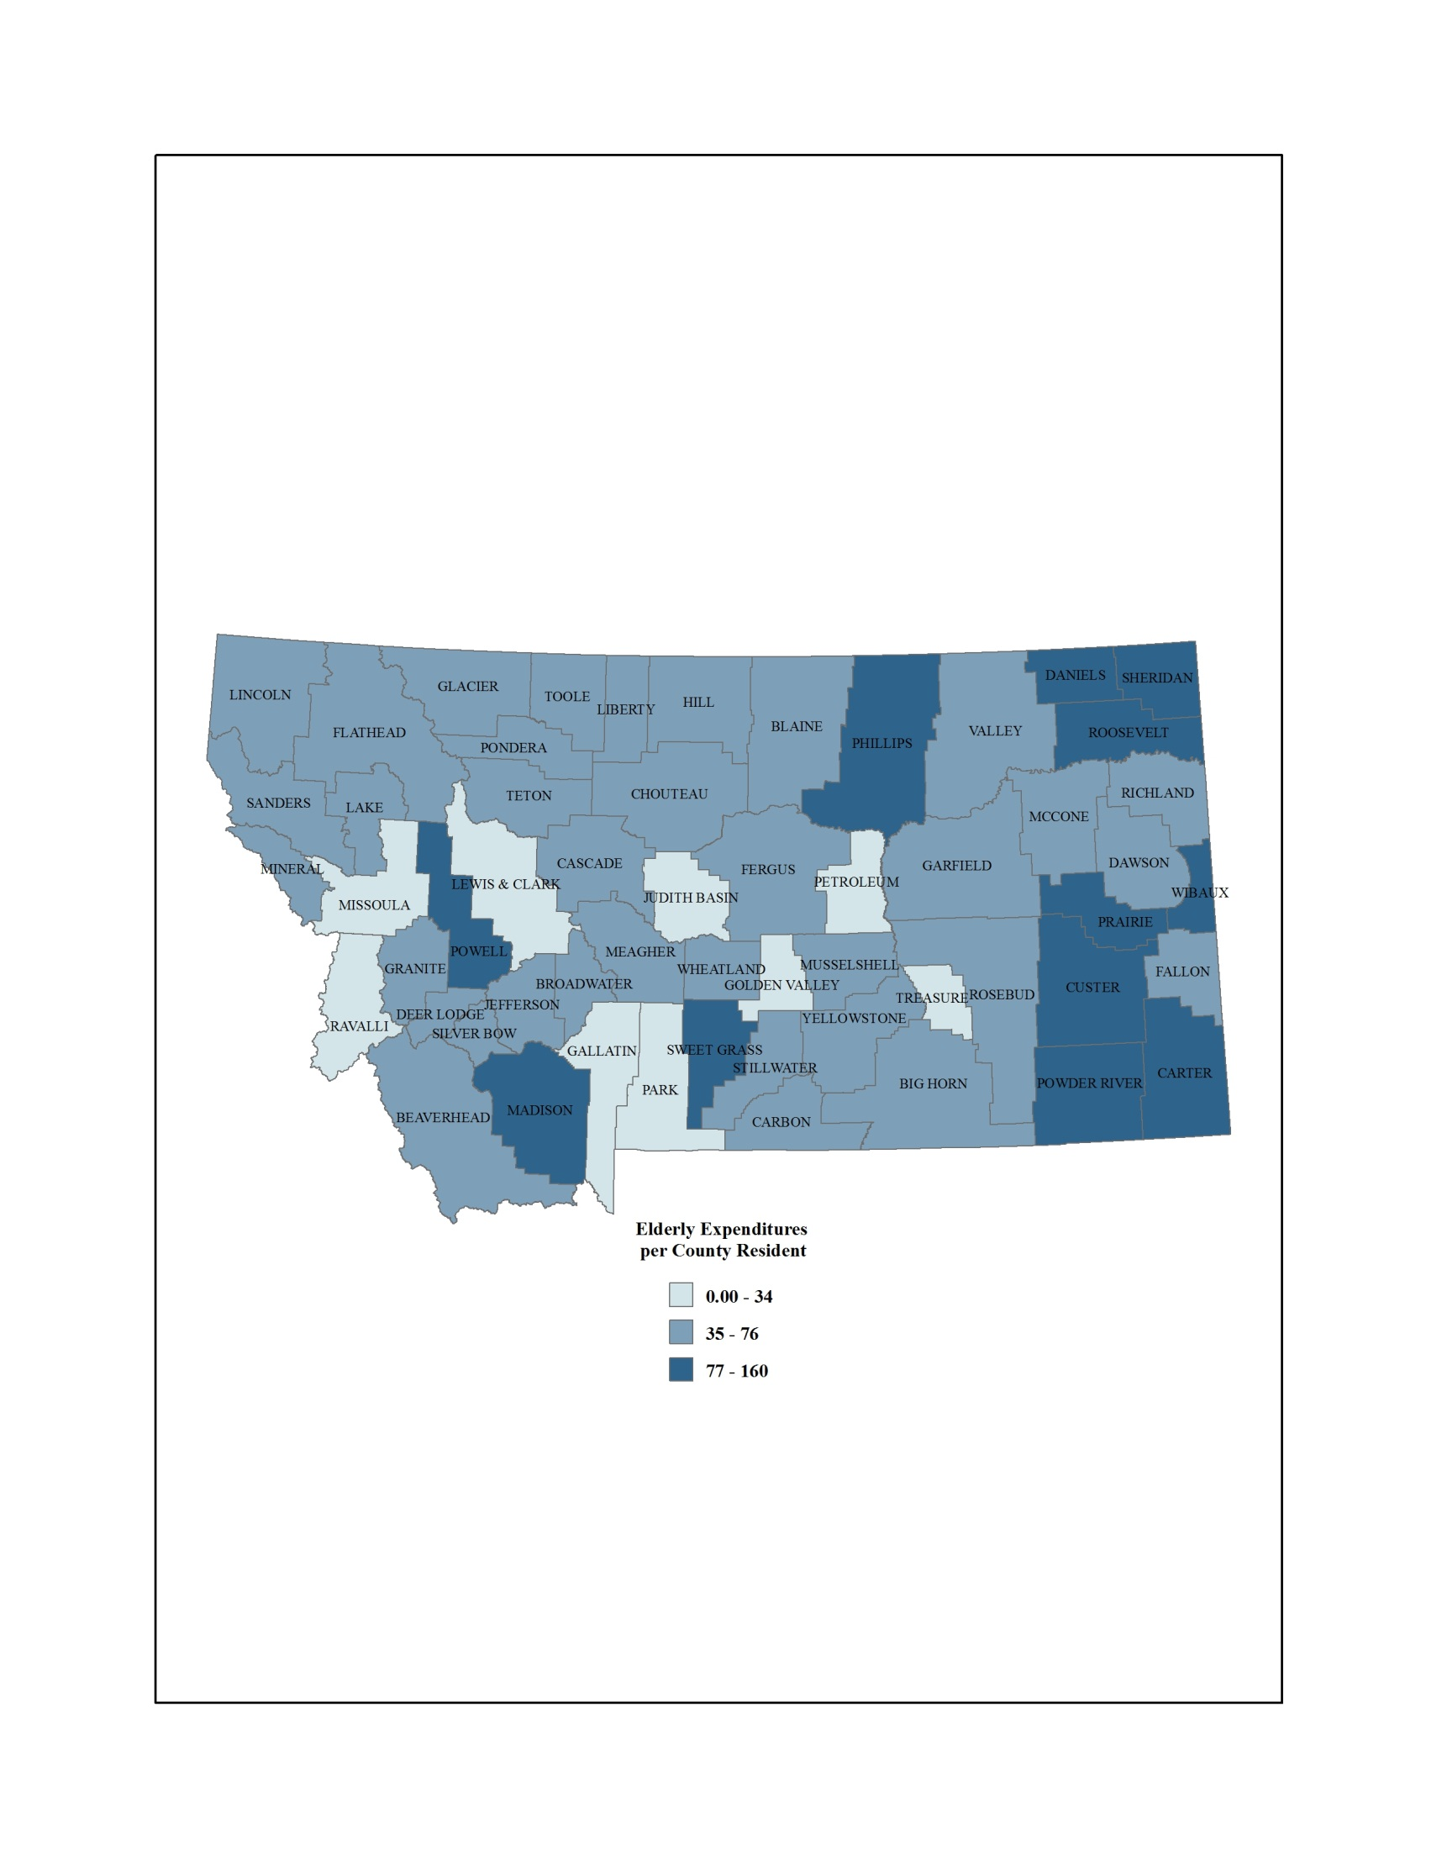
State Medicaid Expenditure for the Elderly per County Resident 2030 (no trend)
Sources: Montana Department of Public Health and Human Services, Statistical Information for 2010, Table 5 (Nursing Home); 2010 Decennial Census; and NPA, Inc. Population Projections for 2030
Notes:
41

Slide 42
Residential Property taxes
Fiscal Impacts on Revenue

Slide 43
Percentage of Persons in Each Age Group who are Head of Household
Source: U.S. Census
43
Notes:
43
There is a distinct life cycle pattern to property tax payments. (These estimates of residential property taxes are based on bureau of labor statistics data collected for the consumer expenditure survey. They include both property taxes paid by homeowners and those paid (implicitly, or on behalf of) renters.)
Persons under age 25 pay very little in property taxes, both because they are less likely to be independent heads of households and because they live in less expensive housing. Average property tax payments rise with age to 45-54, and then decline by about 25% by age 75+. The latter pattern reflects in part downsizing after children leave the home.

Slide 44
Montana Residential Property Taxes by Age
Sources: MDOR, BLS, Year 2010 U.S. Census. Years 2015 to 2030 are estimates using the U.S. Census projections re-weighted with 2010 U.S. Census Data
Notes:
44
There is a distinct life cycle pattern to property tax payments. (These estimates of residential property taxes are based on bureau of labor statistics data collected for the consumer expenditure survey. They include both property taxes paid by homeowners and those paid (implicitly, or on behalf of) renters.)
Persons under age 25 pay very little in property taxes, both because they are less likely to be independent heads of households and because they live in less expensive housing. Average property tax payments rise with age to 45-54, and then decline by about 25% by age 75+. The latter pattern reflects in part downsizing after children leave the home.

Slide 45
Residential Property Taxes
per Montanan
Sources: MDOR, BLS, Year 2010 U.S. Census. Years 2015 to 2030 are estimates using the U.S. Census projections re-weighted with 2010 U.S. Census Data
Notes:
45
The main effect of the changing age distribution will be to reduce the percentage of young people, who pay relatively little in property taxes. The percentage of elderly rises and they pay less than middle aged people, but this effect is outweighed by the decline in the young. The overall increase in residential property tax revenue is about $28 per person.

Slide 46
Individual Resident
Income Taxes
Fiscal Impacts on Revenue

Slide 47
Individual Resident Income Tax Liability per Montanan
Notes:
47

Slide 48
Summary of Revenue and Expenditure Projections
(Dollars per Montana Resident)
48
Notes:
48

Slide 49
Consumption Patterns
Life-cycle and permanent income hypotheses (true/false)
  Maintain lifetime consumption patterns by . . .
    Saving while earning income
    Dissaving in retirement
Elderly – spend less; little evidence of lifetime consumption patterns; maintain wealth
by consuming less

Slide 50
Unknowns for the Elderly
Health
Life Expectancy
Household Independence

Slide 51
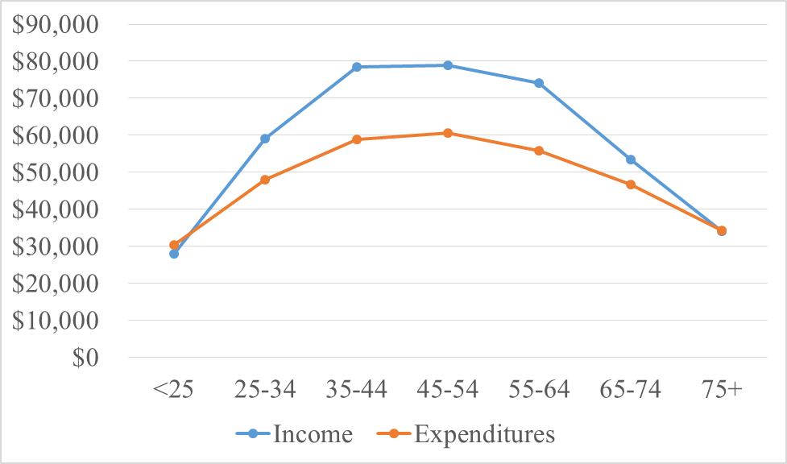
Income and Expenditures
Source: Consumer Expenditure Survey, 2013

Slide 52
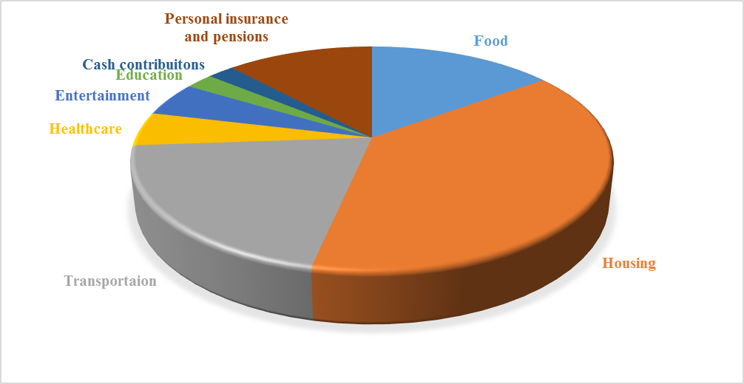
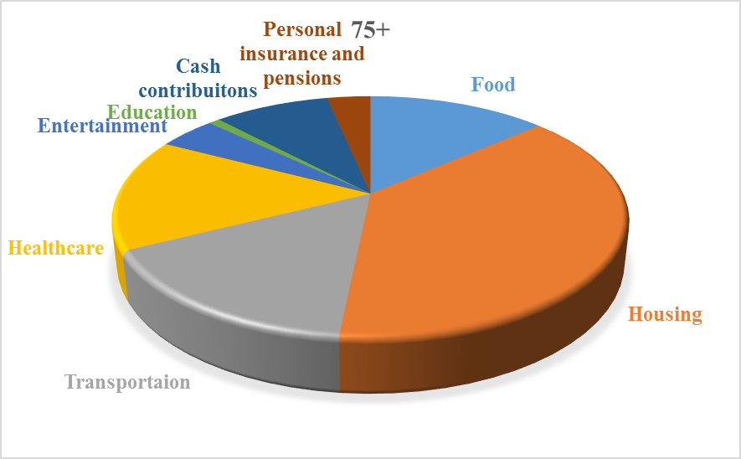
Expenditures by age
25-34 years old
75+ years
Story: food – 14 to 9%; housing 36 to 26%; trans 19 to 11%; health 5 to 11%;

Slide 53
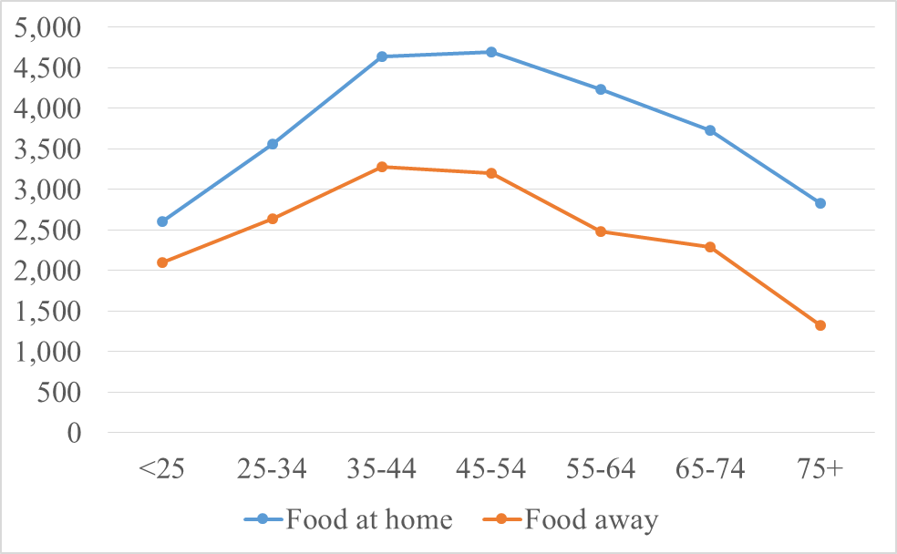
Food “at home” and “away”

Slide 54
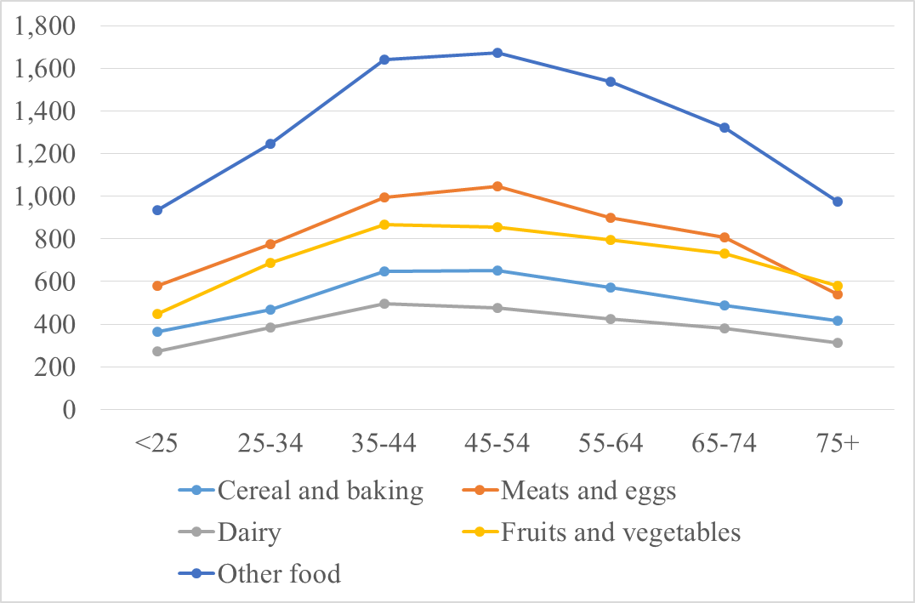
Food “at home”

Slide 55
Summary and Conclusion
55
Notes:
55

Slide 56
Summary & Conclusion
Aging will occur most rapidly in many of the rural areas of Eastern and Northern Montana.
Aging will occur least rapidly in the more urbanized areas and on Native American reservations.
56
Notes:
56

Slide 57
Summary & Conclusion
Aging alone modest impacts on budgets of state and local governments.
While expenditures on the elderly for Medicaid and other services will rise, they will be offset by lower educational and correctional costs.
57
Notes:
57

Slide 58
Summary & Conclusion
And while aging may reduce income tax revenues, these declines are likely to be offset by increased residential property taxes.

Slide 59
Summary & Conclusion
The next two decades are likely to be significantly different than the last four, because there will be a smaller “demographic dividend.”
59
Notes:
59

Slide 60
Summary & Conclusion
Income Impacts
  On the income side, the Baby Boomers will retire and women’s labor force participation rates are not expected to rise.

Slide 61
Implications for You
Demand
  What nutrition-related services to the elderly demand from you?
Supply
  What will you be willing to supply?

Slide 62

Questions
62
Notes:
LC 115 (Draft legislation on demographics):
Montana data by age were not available for the income and property tax analyses reported here.
Expenditure: Other health and human services, including mental health, law enforcement and public safety, transportation, state and local employee health and retirement systems
Revenue: Corporate license and income taxes, natural resource taxes, federal revenues “by purpose or expenditure category”
Trends in per capita income and consumption affect the tax base, as do trends in industry composition, labor force, etc.
Trends in health care, education and other costs will affect expenditures.
More could be done to break the forecasts down on a county or regional basis, for example with school enrollment.
The Census Bureau forecasts are already off a bit for Montana. While there is no doubt that Montana will get much older in coming decades, the basic demographic projections could be updated and refined.

