Slide 1
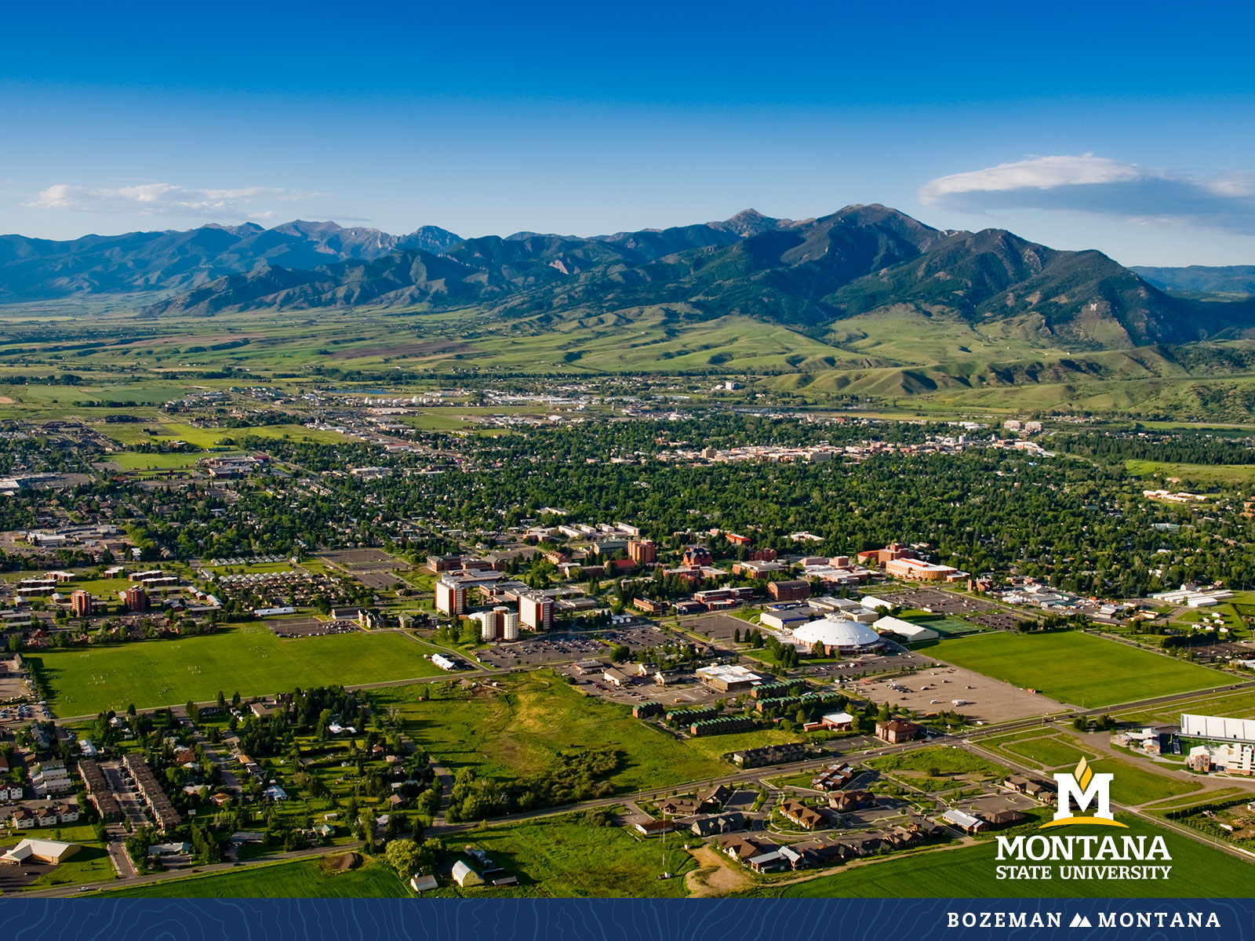
Faculty Senate Meeting Sept 14, 2022

Slide 2
Gentle Reminders
Faculty Senate is an open and public meeting
Please, only Senators speak in the meeting, unless you are specifically called on by the Chair or Chair-elect to speak
Public may address the Senate at end of the meeting during public comment

Slide 3
Agenda
Approval of Minutes
Information Updates
Courses and Programs
Senator’s Open Discussion
  Public Comment
Adjourn

Slide 4
Old Business: Approval FS Minutes 8/31/22
Do I have a motion to approve?
Any Discussion?
All those in favor of the motion or
Those not in favor of the motion indicate by saying…

Slide 5
FYI Items
  Sabbatical applications are due to the Department heads by Oct 3. https://www.montana.edu/provost/faculty/sabbaticals.html
  Allen Yarnell Student Success -Early Alert Program https://www.montana.edu/aycss/success/earlyalert.html
  No Faculty Senate Office Hours on September 16th
  University Council Items https://www.montana.edu/universitycouncil/
    International Travel Policy
    Real Estate Leasing Policy

Slide 6
Dr. Steve Swinford – Vice Provost for Curriculum Assessment and Accreditation

Slide 7
Elizabeth Asserson – Director of MSU’s Counseling and Psychological Services

Slide 8
Undergraduate Courses- First Reading:
    BIOM 365 : Astrobiology
    CHMY 404 : Advanced Inorganic Techniques
    PSCI 483 : The Politics of Authoritarianism
    STAT 337 : Intermediate Statistics with Introduction to Statistical Computing

Slide 9
Undergraduate Courses- Second Reading:
    AVMT 121 : Aviation Electronics Fundamentals
    ECNS 460 : Advanced Data Analytics in Economics
    HVC 215 : Central AC and Indoor Air Quality
    HVC 220 : Gas-Fired Furnaces and Boilers
    MUSI 235 : Keyboard Skills III
    WRIT 121 : Introduction to Technical Writing

Slide 10
Undergraduate Programs- First Reading:
    HDFC-BS : Bachelor of Science in Human Development & Family Science-Child Development Option

Slide 11
Undergraduate Programs- Second Reading:
    DSCS-BS : Bachelor of Science in Data Science

Slide 12
Graduate Courses-Second Reading:
AGTE 523 : Creative Problem Solving
ARTH 536 : Topics in Modern Art History
ARTH 537 : Topics in American Art
CSCI 521 : Distributed Computing
EDCI 538 : Supporting SEL in Diverse Learners
EMEC 540 : Biomechanics of Human Movement
NRSG 625 : Advanced Diagnostics in Primary Care

Slide 13
Graduate Programs-Second Reading:
    CERT:Graduate Certificate in Indigenous Food Systems
    EDUC-PHD : Doctor of Philosophy in Education

Slide 14
Senate Open Discussion

Slide 15
Public Comment

Slide 16
Next Meeting September 28, 2022

Slide 17
Faculty Senate Meeting Adjourned

