Slide 1
Welcome to Faculty Senate!
Stephanie McCalla
Faculty Senate Chair
Chemical & Biological Engineering
Rob Maher
Faculty Senate Chair-Elect
Electrical & Computer Engineering

Slide 2
Gentle Reminders
Faculty Senate is an open and public meeting
Please, only Senators speak in the meeting, unless you are specifically called on by the Chair or Chair-elect to speak
Public may address the Senate at end of the meeting during public comment
Be kind to each other.

Slide 3
Approval of FS Minutes from September 25, 2024
Do I have a motion to approve? Second?
Any discussion?
All those in favor of the motion indicate by saying aye
Those not in favor of the motion indicate by saying nay
Any abstaining?

Slide 4
FYI Items
Outreach and Engagement Council is reapplying to be Carnegie Community Engaged Institution
  Any engagement projects to highlight with a community partner?
  Kim Obbink: kobbink@montana.edu

Slide 5
FYI Items
2024 Dyslexia and Innovation Symposium: https://www.montana.edu/dxi/
  Oct 24, 2024 5:30 – 8:00 pm, free but need to register
Accreditation week

Slide 6

FYI Items
Engage to Empower - Elevating Student Participation & Learning: Faculty Symposium 2024
  Friday, October 25, 2024 || 12:00 PM - 2:00 PM || Inspiration Hall
  See QR code below or Center for Faculty Excellence website

Slide 7
Informational Update: University Council
Mission: Ensure institutional policies and procedures support the university's strategic plan and land grant mission.
Meets monthly, one faculty rep (faculty senate chair)
Tracy Dougher presented “student location policy”, which is required if we do distance learning – first reading, vote in November
Vehicle management policy passed with minor revisions
  If you have a vehicle under MSU insurance, please review policy
Justin Arndt finalized the operating policy, (“policy on policies”)
  Each campus establishes local processes but must:
  Have responsible party (Campus Policy Administrator or CPA)
  Policy must be reviewed by leadership and councils
  CPA reviews policies every 3 years
https://www.montana.edu/universitycouncil/

Slide 8
Informational Update: Dr. Jason Browning

Slide 9


University Data and Analytics
Jason P. Browning, Ph.D., Chief Data Officer
October 2024

Slide 10

Agenda
Evolution of data in higher education
Role of the Chief Data Officer
University Data and Analytics

Slide 11

About Jason
Senior Director, Partner Technology
EAB Global, Inc.
Executive Director of Institutional Effectiveness
Dixie State University
Assistant Vice President of Institutional Research
Northern Wyoming Community College District
Chief Data Officer
Montana State University

Slide 12
About Jason
Ph.D., Higher Education Administration
Quantitative Research Methods Minor
University of Wyoming
Master of Business Administration
Xavier University
B.A. Accounting & Economics
Bellarmine University

Slide 13

The rise of data in higher education
As early as 1865, the US Department of Education collected enrollment, earned degree, and faculty data
NCES was created in 1974; IPEDS began in 1985
The Higher Education Act Amendments of 1992 (P.L. 102-325) made IPEDS reporting mandatory
Analytics has a relatively short history in higher education
  In 1985, SACS began movement toward student outcomes-based assessment

Slide 14
The rise of data in higher education
Increasing calls for accountability and demands to address stagnant student graduation and retention rates
Performance-based funding and increased legislative interest continue to accelerate
Competition for students and overall market dynamics
Institutions increasingly turn to data and data-informed decision making

Slide 15
Becoming data-informed
Focus on asking the right research question(s)
Change what you may perceive as the deliverable
  Move from the concept of spreadsheets filled with student information
  ”Spreadsheet jockeying” wastes time and hinders replicability
Consider the question in a broader context
  If I have this question, others may have as well
  “What is the success rate of MATH 1010?” English cares too!

Slide 16

Focus of the Chief Data Officer
Creating a culture of inquiry
Welcoming climate of trust
Understand the value of asking questions
Appreciate the adventure of seeking answers
Understand that the questions you have may impact others

Slide 17
Focus of the Chief Data Officer
Breaking down silos
Data is an institutional asset
  “I mean, every university is siloed, right? But [what] we actually have here… is this notion that people– I call it tribal loyalties. Because there’s tribal knowledge, but there’s also this idea that departments and schools see themselves as members of those departments and schools and not as a member of the university.”
Promoting the utility of data
Enhancing access to data
Developing a data and analytics strategy

Slide 18

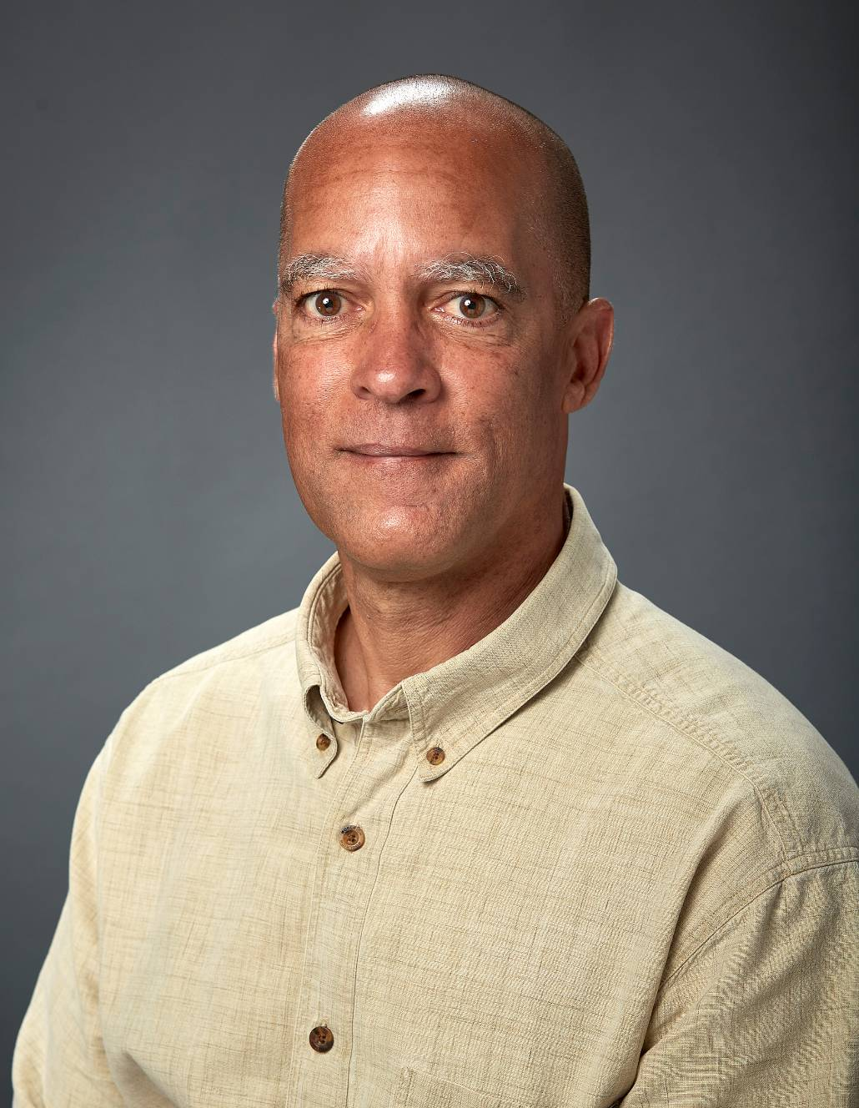
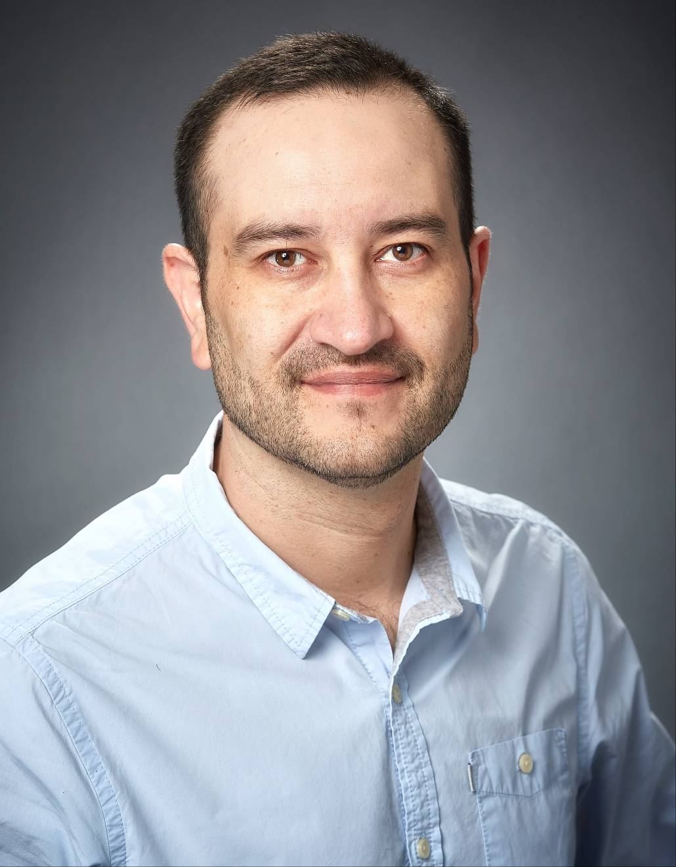
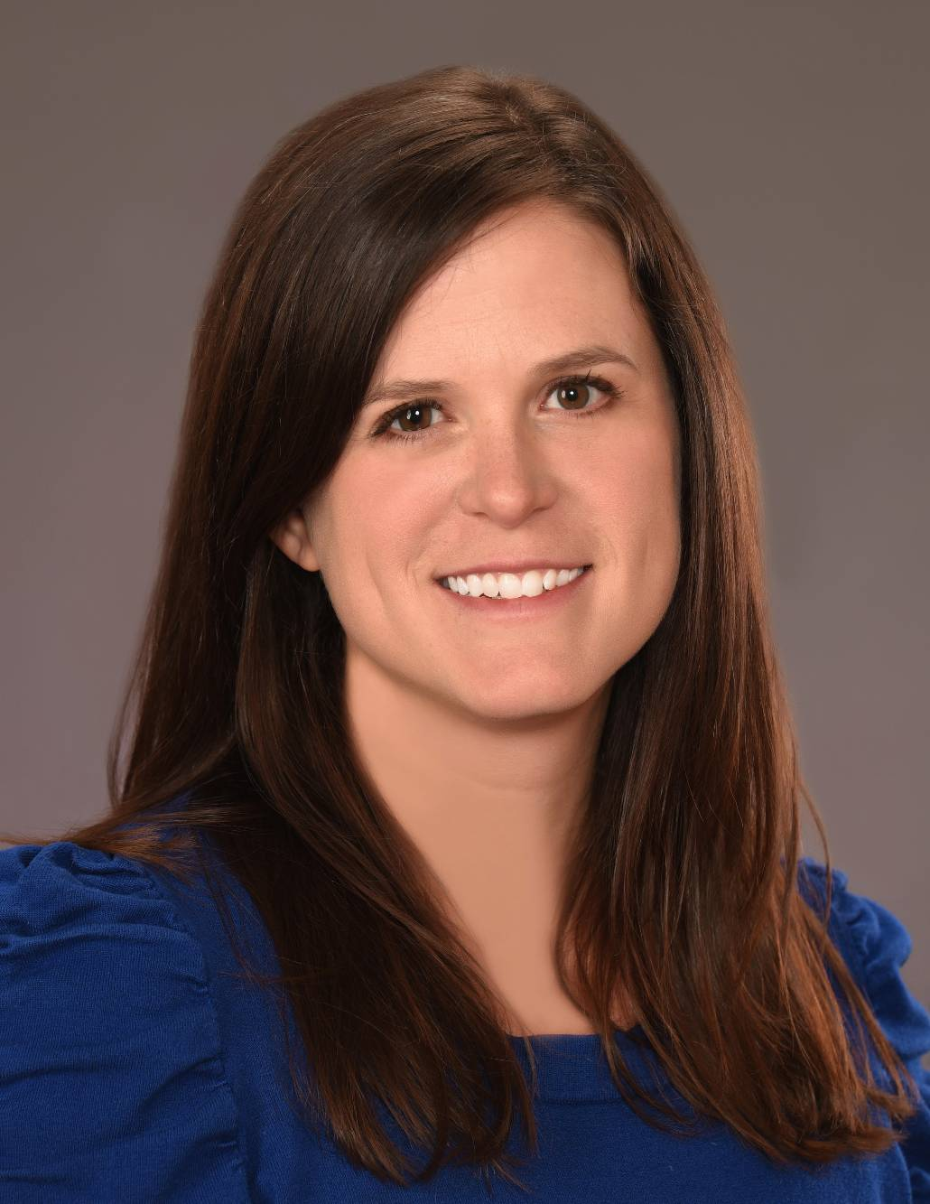
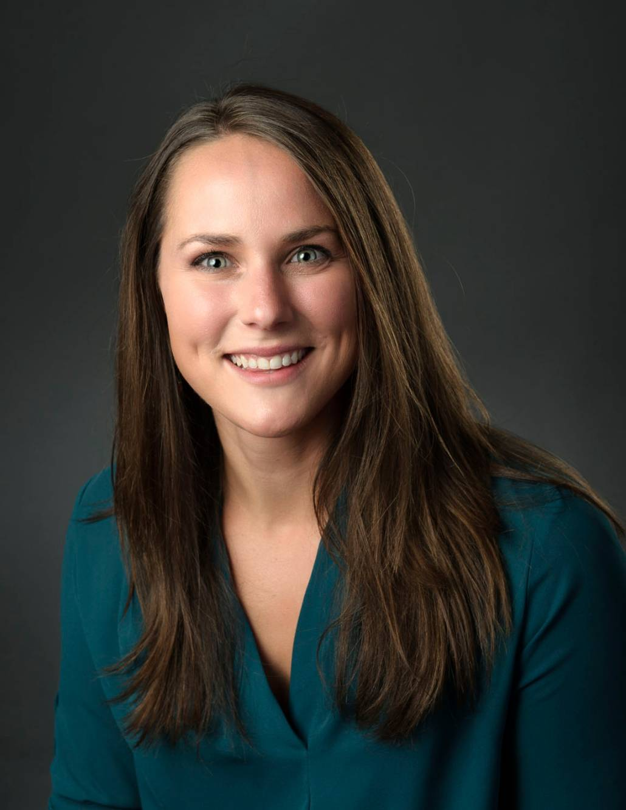


University Data and Analytics staff
Jason P. Browning, Ph.D., MBA
Chief Data Officer
Ian Godwin, Ed.D.
Associate Director
Leonardo Vallardes
Senior Data Scientist
Mary Kate Blake, Ph.D.
Senior Data Scientist
Rebecca Belou
Senior Data Scientist
Tonya Lauriski-Karriker, Ph.D.
Senior Data Scientist
Vincent Liang
Data Scientist

Slide 19

University Data and Analytics focus areas
Partnering
Data Governance
Business Intelligence

Slide 20
University Data and Analytics focus areas
Partnering
The “front door” of University Data & Analytics
Work with campus constituents to better understand data needs
Infuse data in strategic conversations and operational discussions
Provide consulting, training, and feedback to campus areas
Ian Godwin, Ed.D.
Associate Director
Rebecca Belou
Senior Data Scientist

Slide 21
University Data and Analytics focus areas
Data Governance
Author policies and procedures to manage data across campus
Establish definitions for campus data sources and variables
Create a shared understanding of data resources
Mary Kate Blake, Ph.D.
Senior Data Scientist

Slide 22
University Data and Analytics focus areas
Business Intelligence
Create dashboards, reports, and data visualizations
Author deliverables to respond to requests from campus partners
Fulfill compliance reporting and external obligations
Establish the campus business intelligence environment
Operationalize a data warehouse
Tonya Lauriski-Karriker, Ph.D.
Senior Data Scientist
Leonardo Vallardes
Senior Data Scientist
Vincent Liang
Data Scientist

Slide 23
University Data and Analytics focus areas
Partnering
Work with campus constituents to better understand data needs
Infuse data in strategic conversations and operational discussions
Governance
Author policies and procedures to aid in managing data across campus
Business Intelligence
Create dashboards, reports, and data visualizations
Provide consulting, training, and feedback to campus areas
The “front door” of University Data & Analytics
Author deliverables to respond to requests from campus partners
Fulfill compliance reporting and external obligations
Establish the campus business intelligence environment
Operationalize a data warehouse
Establish definitions for campus data sources and variables
Create a shared understanding of data resources
Provide functional oversight of a data warehouse

Slide 24
Implementing a data strategy
Data governance
  All data is defined, monitored, and verified
  Curated and reliable data
  All campus constituencies have access to and make decisions from the same relevant data
Business process improvement
  Process identification and mapping
  Understanding and incorporation of ancillary systems
  Deprecation of shadow systems

Slide 25










Implementing a data strategy
Ellucian Banner (SIS)
Warehousing Platform
Dashboards and reporting
Replicated Native Data
Instructure Canvas (LMS)
SIS
LMS
CRM
SSMS
Analytics
Anthology Reach (CRM)
Data Normalization
Self-serve data access
Campus Data Model
NavMSU
(SSMS)

Slide 26
Thank you
University Data and Analytics

Slide 27
Undergraduate Courses and Programs

Slide 28
Courses – First Reading
EDSP 410: Supporting Diverse Learners Through Collaboration
EDSP 434: Behavioral Principles of Teaching & Learning
EDSP 464: Methods of Instruction for Students with High Incidence Disabilities
EDSP 498: Internship: Special Education
EIND 415: Smart Manufacturing
HSTA 403: Plants and Power in American History
HSTA 410: Disease in America
PHL 340: American Pragmatism

Slide 29
Courses – Second Reading
ECNS 315: Urban Economics and Community Development

Slide 30
Courses Changes – First Reading
MUSI 112IA: Choir: Tenor Bass Choir
Title change from Choir: Tenor Bass Choir
Updating the title to this more specific name will facilitate registration by students into the correct ensembles.
MUSI 212IA: University Chorale
Title changed from Choir II
Updating the title to this more specific name will facilitate registration by students into the correct ensembles.
Due to CCN, title will be Choir II: University Chorale. Waiting on reply before making changes.
NUTR 401: Nutrition Assessment/Counsel
Credit change from 3 credits lecture, to 2 credits lecture, 1 credit lab
As dietetics practice evolves into more hands on assessment and intervention strategies included but not limited to taking blood pressures, physical exams, and tube feeding placement it is imperative that students are provided ample opportunities to practice these skills outside of the classroom.

Slide 31
Course Inactivations – First Reading
PSCI 414: Drug Trafficking and Governance in the Americas
Per Political Science Department Heads Dr. David Parker and Dr. Eric Austin, PSCI 414: Drug Trafficking and Governance in the Americas will be removed from the major program and catalog due to a lack of need for this course in the current curriculum and available faculty to offer it.
PSCI 415: The Political Economy of Energy
Per Political Science Department Heads Dr. David Parker and Dr. Eric Austin, PSCI 415: The Political Economy of Energy will be removed from the major program and catalog due to a lack of need for this course in the current curriculum and available faculty to offer it.

Slide 32
Course Inactivations – Second Reading
ARTH 421: Late Gothic Painting
  No longer offered
BGEN 215: Career Readiness
  We have redesigned our first year curriculum and this course is no longer required.
BIOM 497 is being used as an SA training course for all courses in the department.
  BIOH 429: Student Assistant Training for Integrated Physiology (BIOH 185)
  BIOH 432: Student Assistant Training for Advanced Human Anatomy (BIOH 411)
  BIOH 461: Tutoring Human Anatomy and Physiology I
  BIOH 463: Tutoring Human Anatomy and Physiology II
  BIOH 483: Peer Leaders for Anatomical Science Laboratories

Slide 33
Program Changes – First Reading
BEID-BS: Bachelor of Science in Technology Education -Applied Technology Management
Title changed from Technology Educaiton Industrial Technology Option
This title change is in keeping with our peer institutions with similar programs. We have found that our graduates struggle to get interviews because employers do not understand what our program is as we are still using an Antiquated name (industrial Technology). This old Title is a hold over from the 1960’s when technology education was called industrial arts.
HMHR-BS: BS in Hospitality Management: Hotel & Restaurant Management
Title change from Hospitality Management

Slide 34
Program Changes – Second Reading
MBVA-BS: Bachelor of Science in Environmental Sciences - Environmental Health Option
  Change from Bachelor of Science in Microbiology - Environmental Health Option
  The Environmental Health Option is currently in the Department of Microbiology & Cell Biology. However, it fits better as an Option in the Department of Land Resources & Environmental Sciences. LRES is proposing to oversee the Option and make the necessary small changes to the curriculum such that it is an Option within the Environmental Sciences major and it meets accreditation requirements and standards.

Slide 35
Graduate Courses and Programs

Slide 36
Courses – First Reading
GPHY 508: Advanced Geospatial Analysis for Earth Sciences
NASX 516: Buffalo Food System - Spring & Summer Seasons
NASX 517: Buffalo Food System - Fall & Winter Seasons

Slide 37
Courses – Second Reading
GEO 501: Phylogenetics

Slide 38
Courses Inactivations – Second Reading
MUSI 504: Studies in Hist and Analysis

Slide 39
Program Changes – First Reading
MTSI-MS: MS in Materials Science and Engineering
Title change from Materials Science
The proposed name change from Materials Science to Materials Science and Engineering is motivated by a strong preference expressed by both students and faculty in the program, as well as a desire for the program name to more accurately represent the cross-college (CLS and NACOE) nature of the program's participants and curriculum.

Slide 40
Senate Open Discussion

Slide 41
Public Comment
(Two minutes per person)

Slide 42
Do I have a motion to adjourn?
Second?

