Slide 1
Welcome to Faculty Senate!
Colter Ellis
Faculty Senate Chair
Associate Professor of Sociology

Slide 2
Gentle Reminders
Faculty Senate is an open and public meeting
Please, only Senators speak in the meeting, unless you are specifically called on by the Chair or Chair-elect to speak
Public may address the Senate at end of the meeting during public comment

Slide 3
Welcome Remarks from
President Cruzado

Slide 4
Approval of FS Minutes from May 3, 2023
Do I have a motion to approve?
Any Discussion?
All those in favor of the motion indicate by saying aye
Those not in favor of the motion indicate by same sign

Slide 5
Call for Nominations for Chair-Elect
Are there any nominations?
If yes, is there a second?

Slide 6
Call for Nominations for Chair-Elect
Is there a motion to hold the vote today?
Do I have a second?
Vote on the motion to hold a vote today.

Slide 7
Vote for Chair-Elect
If the vote passes, will those under consideration kindly step out of the room?
Discussion about candidate(s)

Slide 8
Vote for Chair-Elect
Do I have a motion to move to a vote?
Do I have a second?
Vote for the candidate(s)
Invite candidates back into the room

Slide 9
Congratulations to our new Chair-Elect!

Slide 10
Welcome to our New Senators
      We’re the chief governance body of the faculty
      We have the authority to frame policies, procedures and standards of the Faculty Handbook.
      We have the responsibility to foster (and protect) a climate of academic freedom

Slide 11
Welcome to our New Senators
Chair Executive Steering of Faculty Senate
President’s Executive Council (PEC)
Academic Council
Joint Academic Governance (JAGs)
University Curriculum and Programs (CPC)
Graduate Council
Planning Council
Budget Council
Research Council
Outreach and Engagement Council
Diversity Council
ADA Advisory Committee
Transportation Advisory Committee
University Retention, Tenure and Promotion
Chair Faculty Affairs Committee

Slide 12
Welcome to our New Senators
      I ask that you
      Represent your faculty as best you can
      Take notes
      Send those notes to your faculty

Slide 13
FYI Items
Learning Management System Update
  Two finalist vendors, Instructure (Canvas) and Desire2Learn (Brightspace)
  Desired transition date of Fall 2024
Humanities, Arts, and Social Sciences Faculty Charrette 09.14.2023
  Brainstorm and gather ideas on various ways we can support your scholarship
  Thursday, Sept. 14, from 3:30-5 p.m
  Please RSVP at link in the agenda
Hispanic Heritage Month 2023
  Author & Poet Javier Zamora
  September 19th, 7:00pm
  Tickets are free

Slide 14
Information Updates
Update from the 2023 Summer AI-Generated Text Working Group
Dr. Michelle Miley
CLS Associate Dean
Dr. Michael Babcock
Director of the Center for Faculty Excellence

Slide 15

Center for Faculty Excellence
Director:
Michael Babcock
mbabcock@montana.edu
Assistant Director:
Nika Stoop
nikastoop@montana.edu
Instructional Designer:
Ken Silvestri
kenneth.silvestri@montana.edu
Program Coordinator:
Emily Smith
emily.smith41@montana.edu
Moving to the 3rd Floor of the Library this week

Slide 16

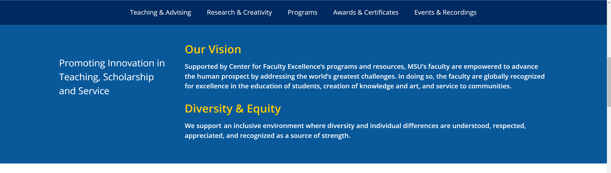

Slide 17
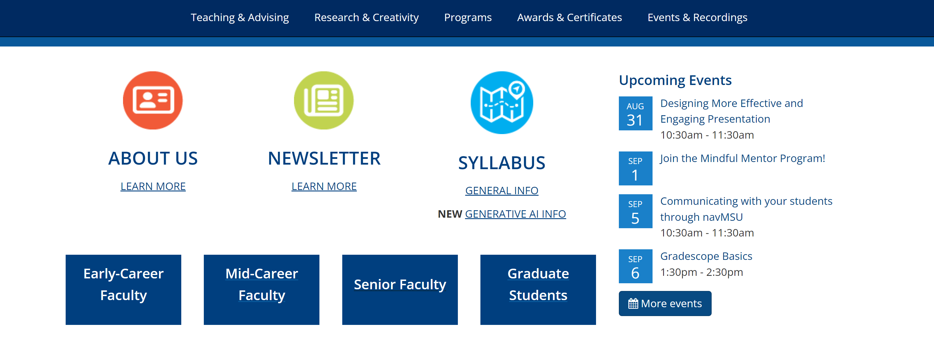

Slide 18
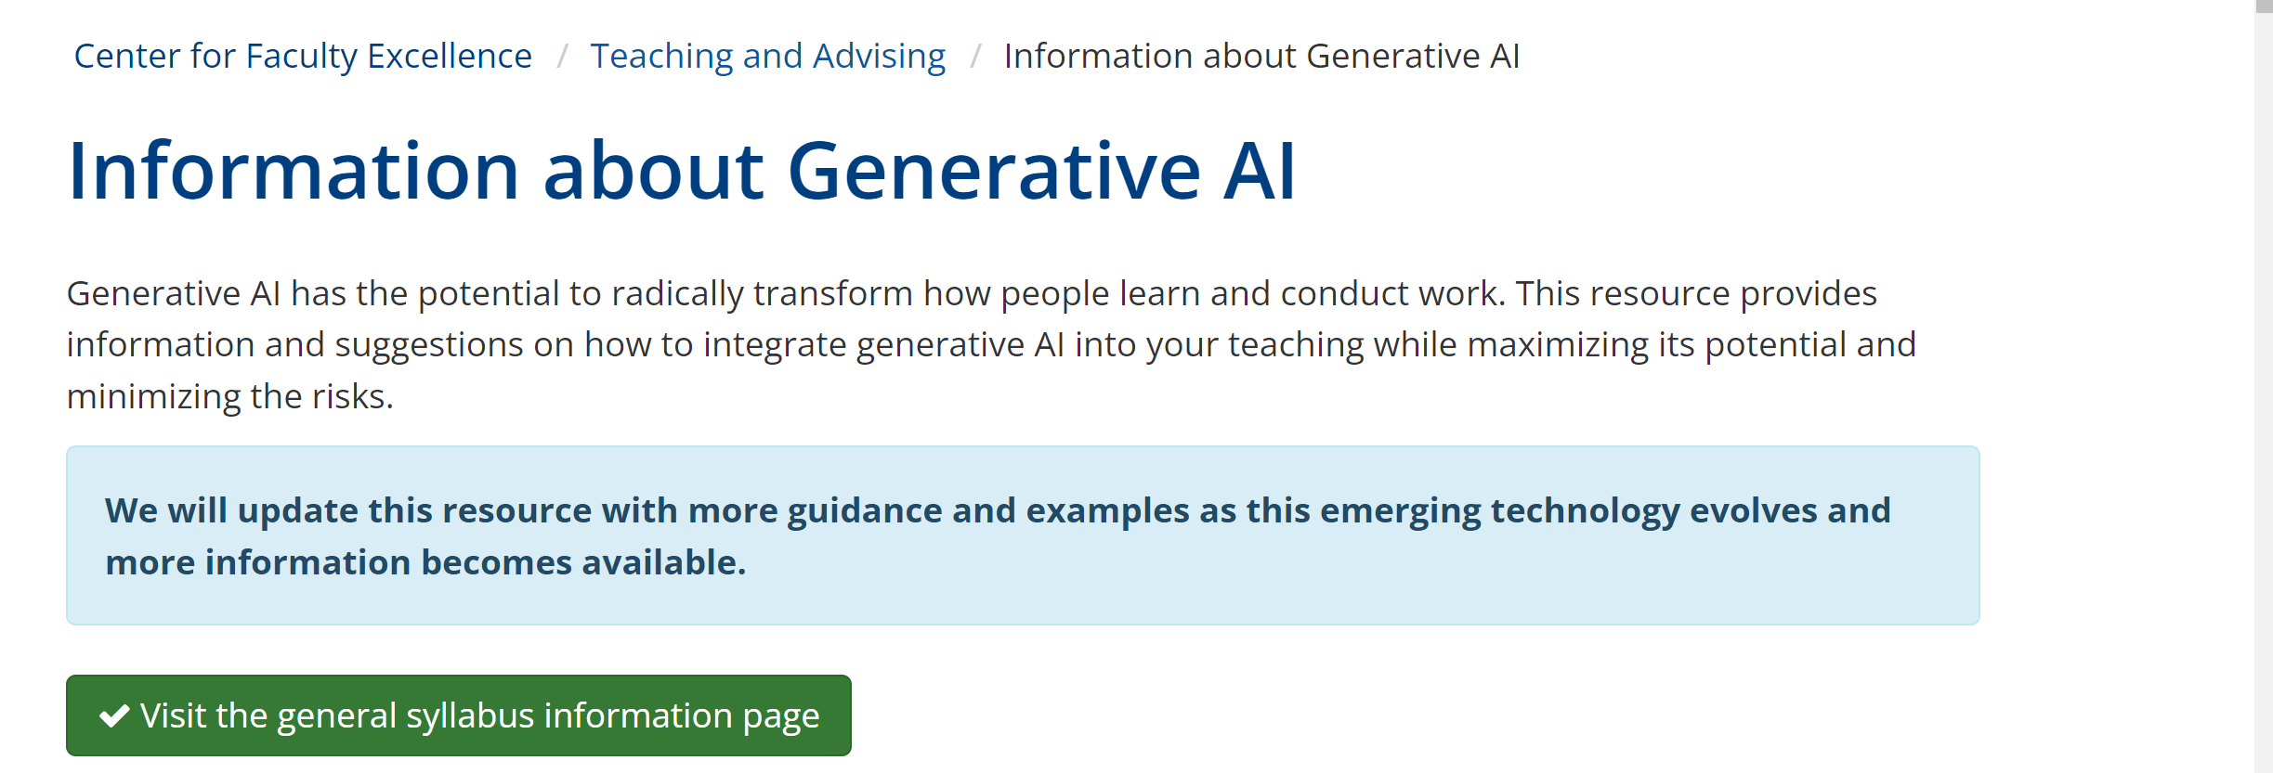
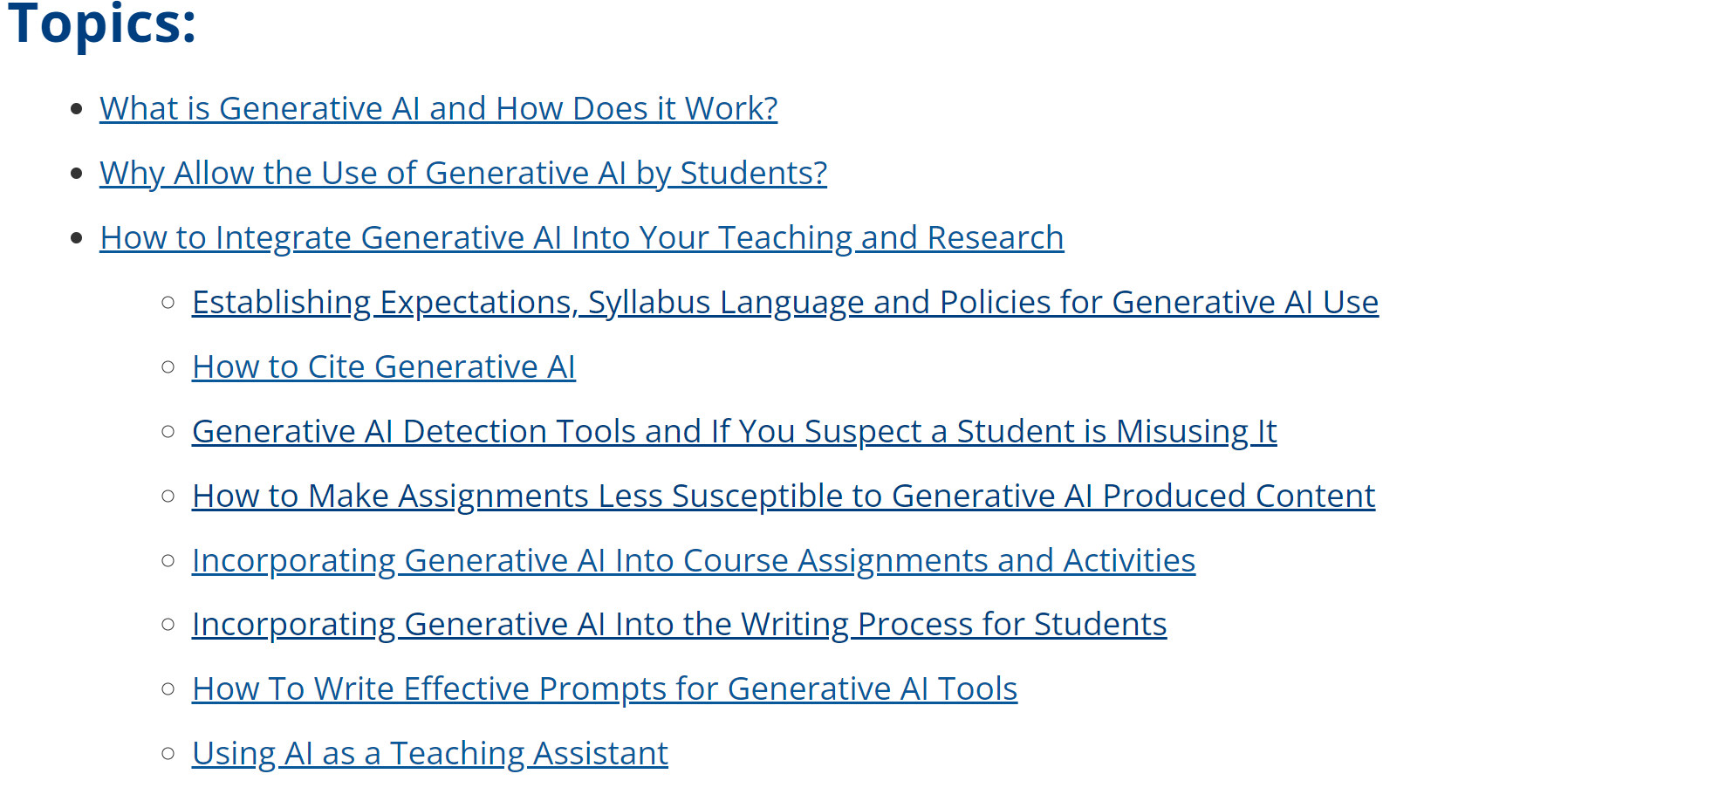

Slide 19

Generative AI Faculty Symposium
October 24th
11:30 am - 2 pm

Slide 20
Undergraduate Courses and Programs
Courses—First Reading
  ARTH 343 : Modern Art in Italy
  BIOO 315 : Aquatic Insects
  MUSI 124 : Musical Objects: Knowledge & Fluency
  MUSI 125 : Elements of Large-Scale Musical Design
  MUSI 137 : Foundations of Aural Perception
  MUSI 220 : Music Theory of Tonal Music
  MUSI 221 : Theory in 19th-Century Repertoire
  MUSI 222 : Theory in 20th-Century Repertoire
  MUSI 223 : Theory in Popular Music
  PSCI 448 : The Politics of Climate Change
  STAT 456 : Bayesian Statistical Inference

Slide 21
Undergraduate Courses and Programs
Course Changes — First Reading
  ESOF 422 : Advanced Software Engineering: Cybersecurity Practices

Slide 22
Senate Open Discussion

Slide 23
Public Comment

Slide 24
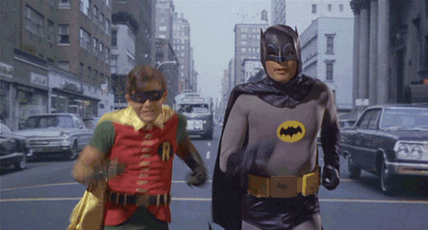
Same-Bat-Time
Do I have a motion to adjourn?
Second?
See you in two weeks!

