Slide 1
Welcome to Faculty Senate!
Colter Ellis
Faculty Senate Chair
Associate Professor of Sociology
Stephanie McCalla
Faculty Senate Chair-Elect
Chemical & Biological Engineering

Slide 2
Gentle Reminders
Faculty Senate is an open and public meeting
Please, only Senators speak in the meeting, unless you are specifically called on by the Chair or Chair-elect to speak
Public may address the Senate at end of the meeting during public comment

Slide 3
Approval of FS Minutes from September 27, 2023
Do I have a motion to approve?
Any Discussion?
All those in favor of the motion indicate by saying aye
Those not in favor of the motion indicate by same sign

Slide 4
FYI Items
MUS formally decided on Canvas for the system-wide LMS.
Fall 2023 Commencement on Friday, December 15th at the Brick Breeden Fieldhouse at 8:41am. You can submit an RSVP online form by December 1st.
Social Media Policy approved by University Council on 10/4/23

Slide 5
FYI Items
Software Procurement Update
  UIT is working on a list of all software currently available to the MSU system. They are revitalizing a tool called “Software Atlas” to accomplish this: https://www.montana.edu/cpa/apps/softwareatlas/index.php
  Procurement is working on a flow-chart/diagram that will show how the software procurement process works.
  We are exploring ways to increase communication between faculty, UIT, and procurement. The current CFAC process will serve as a starting point.

Slide 6

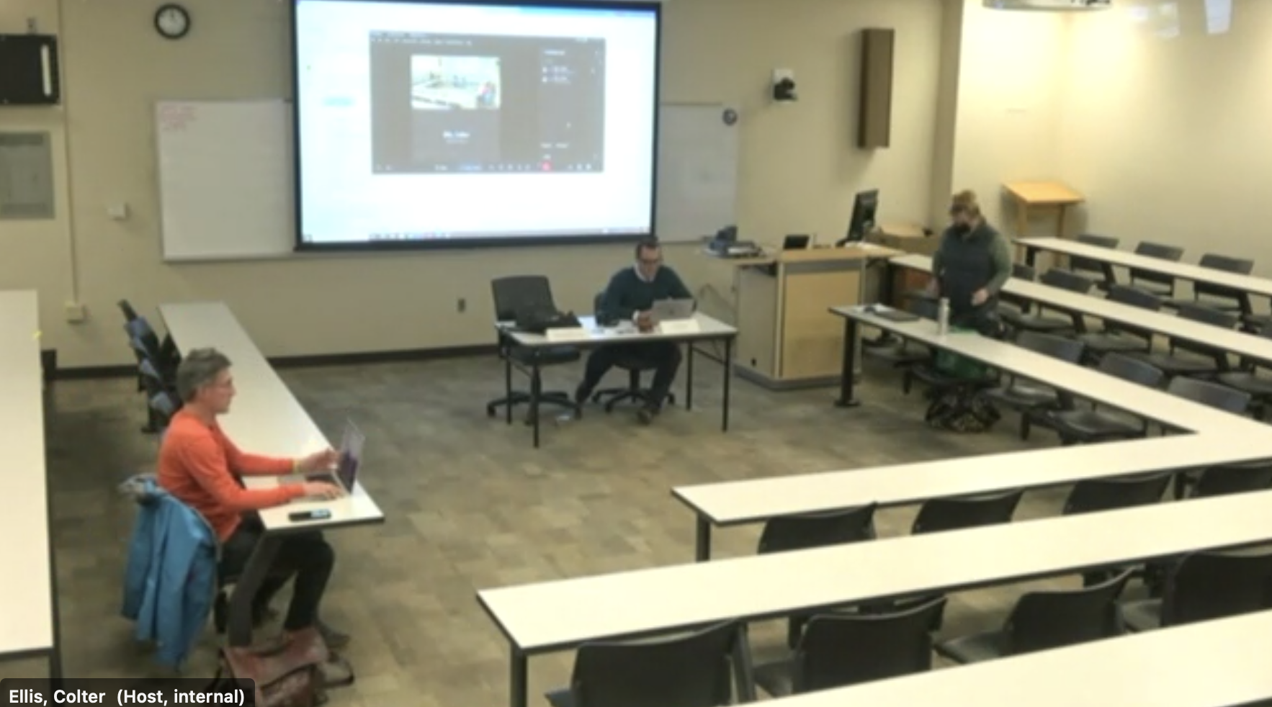
Faculty Senate Room Changes

Slide 7
FYI Items
Indigenous Mentoring Program
    Friday, October 27 || 9:00 am-4:00 pm || Register here
    Presented by Dr. Sweeney Windchief – Associate Professor, Higher Education. Light lunch served.

Slide 8
FYI Items
Getting together with All-Staff Council
November

Slide 9
VPRED Candidates- Faculty Session
Alison Harmon, October 16, 2023
Faculty Session: 3:15-4:15 pm: Animal BioScience Room 138
Open Forum: 4:30-5:30 pm: Byker Auditorium; Chem/BioChem Building
Jim Reecy, October 18, 2023
Faculty Session: 3:15-4:15 pm: Animal BioScience Room 138
Open Forum: 4:30-5:30 pm: Byker Auditorium; Chem/BioChem Building
Rick Bevins, October 19, 2023
Faculty Session: 3:15-4:15 pm: Animal BioScience Room 138
Open Forum: 4:30-5:30 pm: Byker Auditorium; Chem/BioChem Building

Slide 10
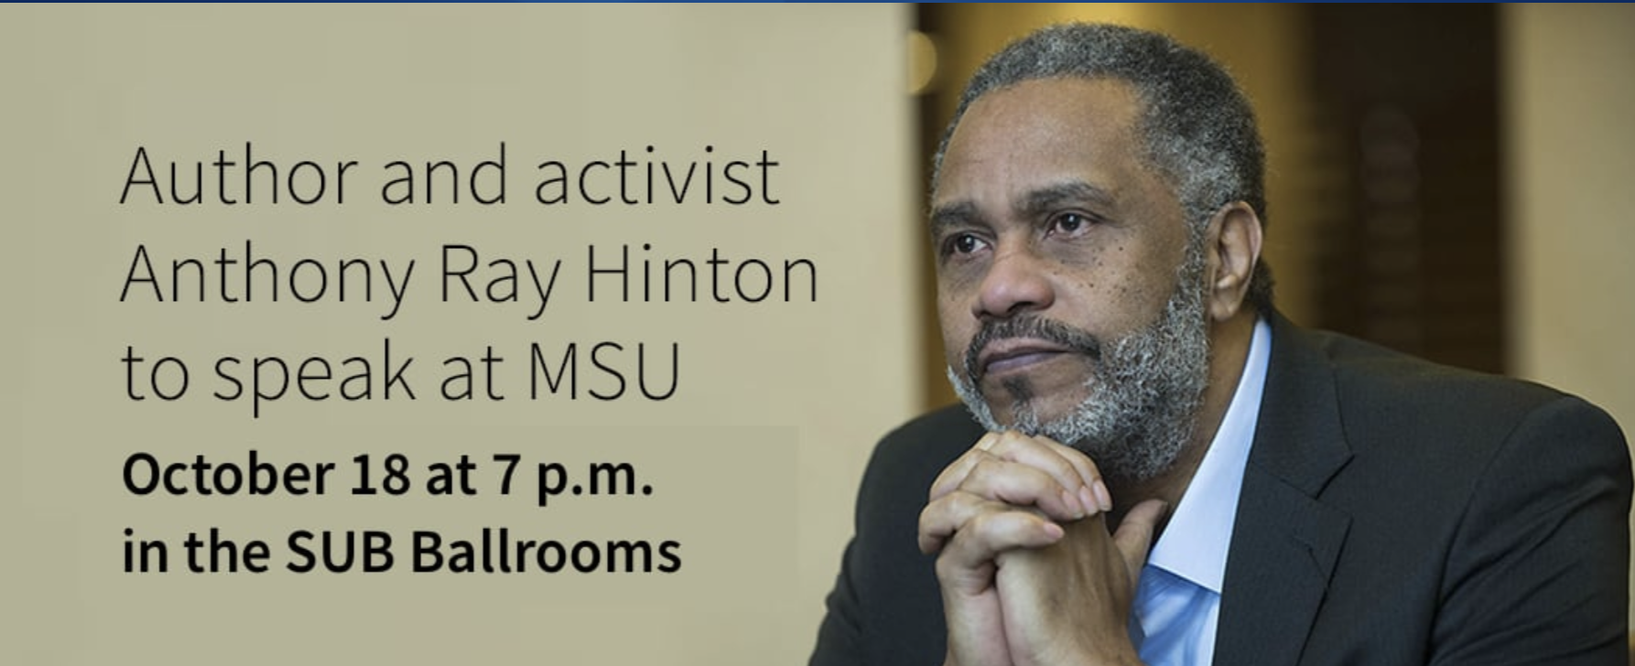

Slide 11
Information Updates
Ariel Donohue: MUS’s Annual Diversity Report
Betsy Asserson: Student Mental Health Resources

Slide 12

MSU’s annual diversity report
Ariel Donohue
Senior Diversity and Inclusion Officer

Slide 13
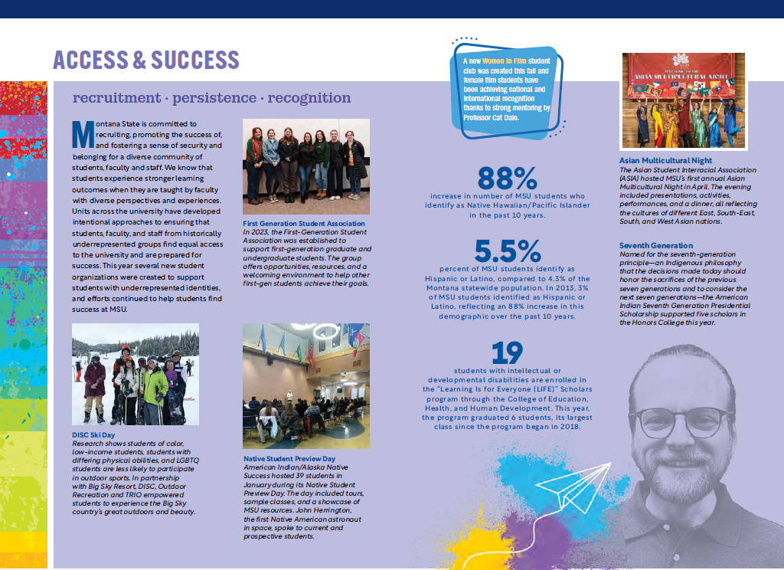
Organized by themes from MSU’s Diversity and Inclusion Framework
Highlights work from around campus
Contextualizes data
Find online at montana.edu/diversity/
report2023/

Slide 14
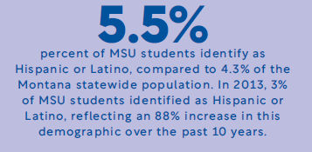

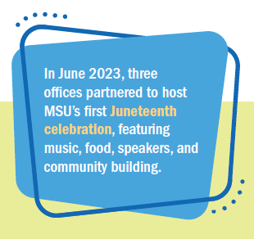
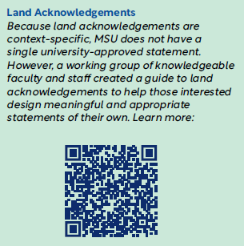
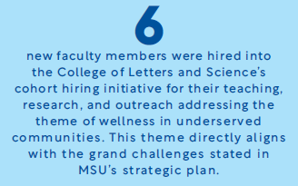

Slide 15

Phase 1:
  Online course, “Diversity without Division: Introducing the Moral Courage Method of Communicating across Divides
  October 2023 – January 2024’
Phase 2:
  Practice Plan workshop and weekly practice
  January – April 2024
Phase 3:
  Certify Moral Courage Mentors for MSU
  Summer 2024

Slide 17

Counseling and Psychological Services
Betsy Asserson, Ph.D., Director
Licensed Psychologist

Slide 18
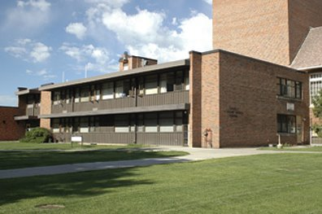
Counseling & Psychological Services
Swingle Hall above Student Health Services
  18 licensed mental health providers
Free & Confidential counseling services for students
  Individual, couples, group therapy, substance use counseling
  In-person and telehealth services
  Crisis response (walk-in and on-site)
Prevention and educational programming for campus
    MHFA, Kognito, QPR, CPS resources, coping strategies, etc.
Staff Training and Consultation
    Safe Zone, Diversity, mental health/crisis response, etc.
www.montana.edu/counseling
www.montana.edu/suicide-prevention

Slide 19
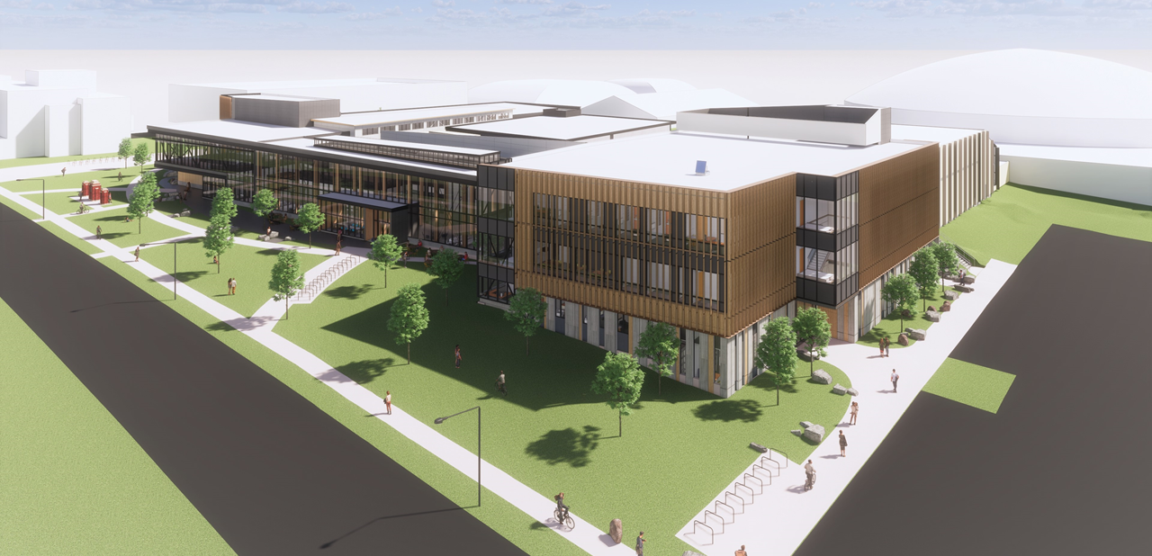
Student Wellness Center
Coming Spring 2024

Slide 20
Overview of College Mental Health
National
>60% of college students met criteria for at least one mental health disorder (a 50% increase since 2013)
Between 2009-2015, UCC utilization increased by 30-40% (enrollment grew by 5%)
Roughly 25% of students screened positive for depression and anxiety
71% agreed that they currently needed help for mental health problems
Suicide is the second leading cause of death for college students
MSU (2019)

Slide 21

Mental health & academics
51% of MSU students would reach out to faculty, TA, or advisor for mental health concerns (HMS, 2019; n=719).
More than 75% of undergrads who have considered dropping out of school indicate emotional stress as the primary reason.
~80% of faculty report having a 1:1 discussion with a student about their mental health, 51% have a clear understanding of how to recognize emotional/mental distress (Lipson et al, 2021).

Slide 22
AY 2022-23 CPS Data
Appointment Statistics:
Average Time for Intake Appointment: 4.2 days
11,000 Clinical Appointments
  630 crisis appointments
1684 unique clients served
36% had seriously considered suicide

Slide 27

Support for Faculty
Learn what to look for and attend trainings
Check in with students regularly
Reach out to consult
Refer students to appropriate resources

Slide 28
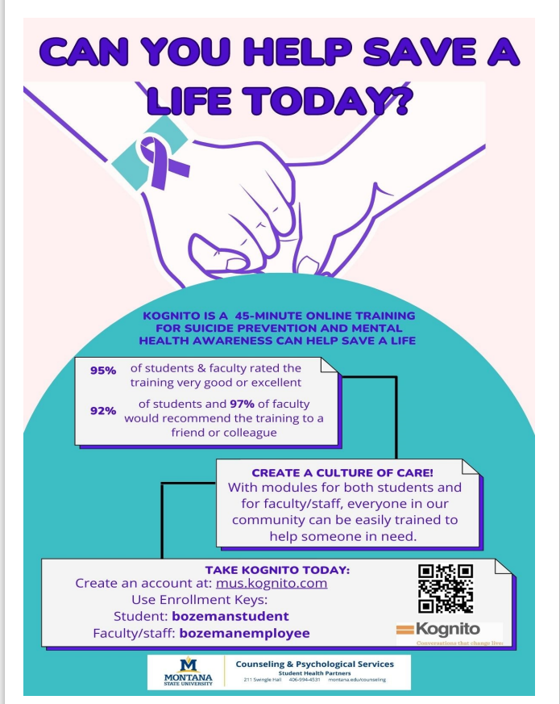
Faculty Training
Question, Persuade, Refer (QPR)
Mental Health First Aid
Kognito
Recognizing Students in Distress
www.montana.edu/suicide-prevention/SuicidePreventionProgramming.html

Slide 29

Campus Resources
Police (911)
  If situation is imminent (life is at risk in current moment) – statements, texts, emails
  Mental health/safety in question
  Their behavior is questionable, or they leave your presence during a crisis
Counseling & Psychological Services (406-994-4531)
  To consult about how to support a student or colleague or respond to a situation
  To provide crisis intervention and referral
  To support other staff/supervisors
CARE Referral and Dean of Students (406-994-2826)
  https://cm.maxient.com/reportingform.php?MontanaStateUniv&layout_id=7
  To enhance support for a student of concern
  Dean of Students staff will reach out to student
Benefits
  EAP: https://choices.mus.edu/eap-work-life.html 1-866-750-1327
  Wellness: https://wellness.mus.edu/

Slide 30



Community & National Support
For a person in crisis, or support in helping them, 24-7
Counselor Referrals: 211
Suicide & Crisis Lifeline: 988
Crisis Text Line: 741741

Slide 31

Questions or Comments?
THANK YOU!
basserson@montana.edu

Slide 32
Undergraduate Courses and Programs
Courses—First Reading
  GPHY 401 : Environmental Planning and Management Toolkit
  MCH 220 : Geometric Dimensioning and Tolerancing Metrology

Slide 33
Undergraduate Courses and Programs
Courses—Second Reading
  BMIS 312 : Data Analytics II
  HDFS 468 : Home Visiting for Families
  HLD 346 : The Leader's Way: Deep Listening, Systems & Processes

Slide 34
Undergraduate Courses and Programs
Course Changes — Second Reading
  LS 499R :Senior Capstone
    Change in title
    Credit change

Slide 35
Undergraduate Courses and Programs
Course Inactivations
  HDFS 454 : Professional Issues - Senior Seminar
    Hasn't been offered in several years and has been prelaced by HDFS 494.

Slide 36
Graduate Courses and Programs
Courses—First Reading
  ASTR 550 : Radiative Processes in Astrophysics
  ASTR 561 : Astrophysics of Galaxies
  ECIV 444 : Civil Engineering Computations
  ECNS 503 : Microeconomic Theory I
  FILM 528 : Non-Fiction Film Performance

Slide 37
Graduate Courses and Programs
Course Changes — First Reading
  ASTR 560 : Stellar Astrophysics
    Rubric change from PHSX
    Title change from Astrophysics
    The Physics Department is updating the program and requirements for the PhD in Physics. This course is being slightly revised as part of the change.
  ERTH 524 : K-14 Earth System Science
    Credit change from 2 to 3.
    Although the learning outcomes for this course have not changed, the time needed for students to complete more complex activities related to these learning outcomes has increased. As such, we'd like to propose a move from 2 credits to 3 credits for this course to account for the time changes.

Slide 38
Graduate Courses and Programs
Courses—First Reading (cont)
  FILM 505: Critical Approaches to Science and Natural History Filmmaking
    Credit change from 3 to 4
    Title change from Crit Apprch Nat Hst Filmmaking
    The course meeting time will increase to 4 hours / week with a seminar format. The credit change from 3 to 4 credits reflects this
  PHSX 501: Mathematical Methods and Their Applications in Classical Mechanics
    Title changed from Advanced Classical Mechanics
    Physics is updated program requirements for PhD in Physics.

Slide 39
Graduate Courses and Programs
Courses—First Reading (cont)
  FILM 505: Critical Approaches to Science and Natural History Filmmaking
    Credit change from 3 to 4
    Title change from Crit Apprch Nat Hst Filmmaking
    The course meeting time will increase to 4 hours / week with a seminar format. The credit change from 3 to 4 credits reflects this
  PHSX 501: Mathematical Methods and Their Applications in Classical Mechanics
    Title changed from Advanced Classical Mechanics
    Physics is updated program requirements for PhD in Physics.

Slide 40
Graduate Courses and Programs
Course Inactivations
  CSCI 520 : Distributed Systems
    The instructor who developed and teaches this course is no longer at MSU. Furthermore, the course has been replaced by CSCI 521
  CSCI 548 : Reasoning Uncertainty
    This course is being replaced by a recently approved course, CSCI 546: Advanced Artificial Intelligence.
  DGED 614 : IGERT: Advanced Methods in Geobiology
    Course was part of an NSF grant and is not being offered.
  DGED 676 : IGERT: Geobiological Systems Science – Internship
    Course was part of an NSF grant and is not being offered.
  ESOF 523 : Software Testing and Analysis
    Instructor who developed this course no longer at MSU. No other faculty have proper background to teach.

Slide 41
Senate Open Discussion

Slide 42
Public Comment

Slide 43

Do I have a motion to adjourn?
Second?

