Slide 1
Welcome to Faculty Senate!
Colter Ellis
Faculty Senate Chair
Associate Professor of Sociology
Stephanie McCalla
Faculty Senate Chair-Elect
Chemical & Biological Engineering

Slide 2
Gentle Reminders
Faculty Senate is an open and public meeting
Please, only Senators speak in the meeting, unless you are specifically called on by the Chair or Chair-elect to speak
Public may address the Senate at end of the meeting during public comment

Slide 3
Approval of FS Minutes from
October 11, 2023
Do I have a motion to approve?
Any Discussion?
All those in favor of the motion indicate by saying aye
Those not in favor of the motion indicate by same sign

Slide 4

FYI Items
Faculty Senate & All Staff Council Reception in the Blackbox Theater
Next Faculty Senate meeting will also be held in the Blackbox Theater

Slide 6
FYI Items
PI Training soon – Save the date! Tuesday November 7th, 2023, 8:30am – 12 noon in Byker Auditorium. Please RSVP by October 30th to maryalice.trage@montana.edu
Oct 30 – Nov 3 (next week!) is the Montana State University Climate Week 2023:
https://www.montana.edu/communitydevelopment/climateweek.html

Slide 7
Information Updates
Athletics update from the Director of Athletics (AD) Leon Costello and Senior Associate AD Jamie Rizzuto.
Accreditation update from Dr. Tracy Dougher, Vice Provost for Curriculum, Assessment, and Accreditation

Slide 8

ATHLETICS UPDATE
Fall 2023
October 25, 2023

Slide 9
Notable Fall Accomplishments
OUR 375 STUDENT-ATHLETES MAINTAIN 3.37 GPA AND 80% HAVE A 3.0 GPA OR BETTER
LAST YEAR, 155 BOBCAT STUDENT-ATHLETES WERE NAMED TO BIG SKY CONFERENCE ALL ACADEMIC TEAMS, 127 EARNED DEAN’S LIST HONORS, 84 HAD ALL A’S.
WON THE BIG SKY PRESIDENT’S CUP, SIGNIFYING THE BEST ACADEMIC AND ATHLETIC PROGRAM IN THE CONFERENCE. THE MEN WON THE BIG SKY ALL-SPORTS TROPHY AND THE WOMEN FINISHED SECOND.
THE BRAWL OF THE WILD SERIES CHAMPIONS SEVEN YEARS IN A ROW.
BOBCAT FOOTBALL HOSTED ESPN COLLEGE GAME DAY, SCHOOL-RECORD 12 WINS (2 YEARS IN A ROW), 23 CONSECUTIVE HOME WINS (BEST IN THE COUNTRY), 3 STRAIGHT FCS SEMIFINAL APPEARANCES, AND FIRST BIG SKY CONFERENCE TITLE IN 10 YEARS.
MEN’S AND WOMEN’S BASKETBALL WON CONFERENCE CHAMPIONSHIPS AND THE FIRST TIME FOR THE MEN’S PROGRAM TO QUALIFY FOR BACK-TO-BACK NCAA TOURNAMENTS.
A TOTAL OF 7 ALL-AMERICANS IN TRACK AND FIELD AND A NATIONAL RUNNER-UP IN THE STEEPLECHASE
BOBCAT SKIING PLACED 6TH AT NCAA CHAMPIONSHIPS WITH 6 NAMED ALL-AMERICAN.
WOMEN’S GOLF BROKE THE 18-HOLE SCORING RECORD TWICE THIS YEAR AND SCARLET WEIDIG VELAZQUEZ WAS AN INDIVIDUAL CHAMPION YET AGAIN.
BOTH RODEO TEAMS WON THE BIG SKY REGION LAST YEAR. MEN CURRENTLY #1 IN THE COUNTRY AND WOMEN #3.
SET BIG SKY CONFERENCE RECORD FOR ATTENDANCE AT A VOLLEYBALL MATCH
IN TENNIS, MARTA GARCIA-REBOREDO WON THE BEDFORD CUP SINGLES TITLE AND THE DOUBLES TEAM OF MAX RELIC AND ADRAS NECZ ADVANCED TO THE ITA MOUNTAIN REGINAL SEMIFNALS.
AND A SPECIAL SHOUT OUT TO OUR BOBCAT SPIRIT SQUADS. YOU SEE THEM EVERYWHERE REPRESENTING MSU AND BOBCAT ATHLETICS. THANK YOU FOR YOUR DEDICATION TO MSU ATHLETICS.

Slide 10
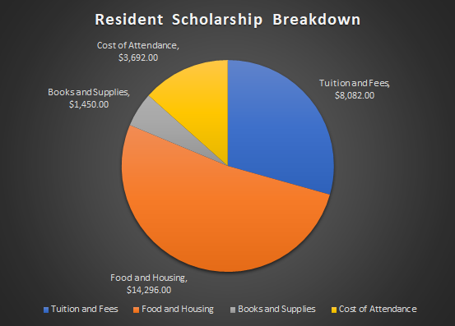
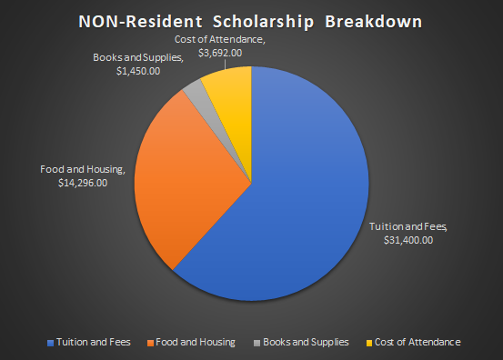
Anatomy of a Scholarship

Slide 11
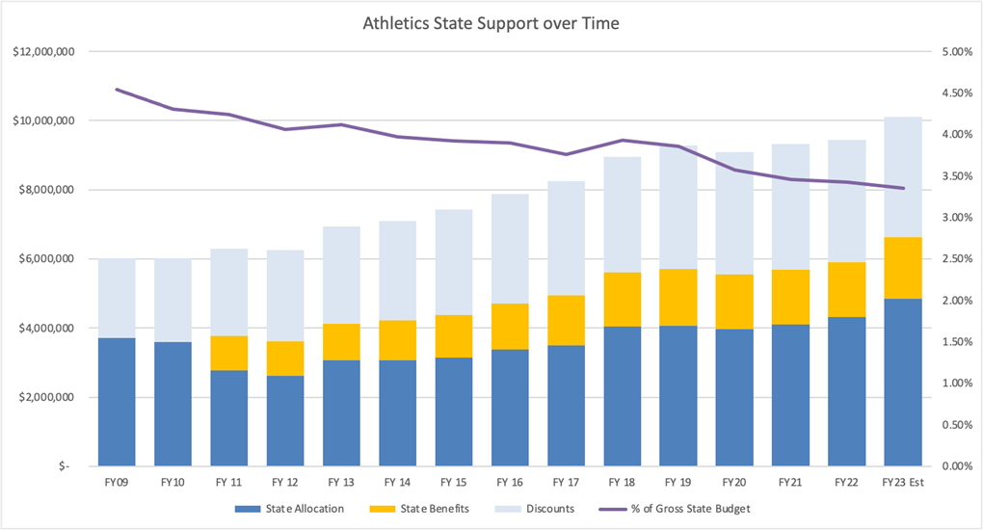
Athletics State Support Over Time

Slide 12
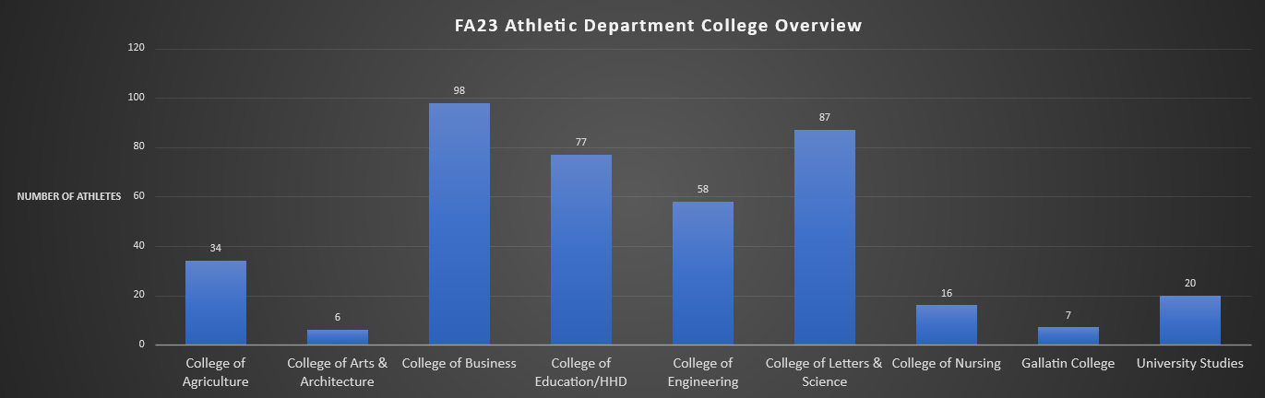
Student-Athletes Across All Departments

Slide 13
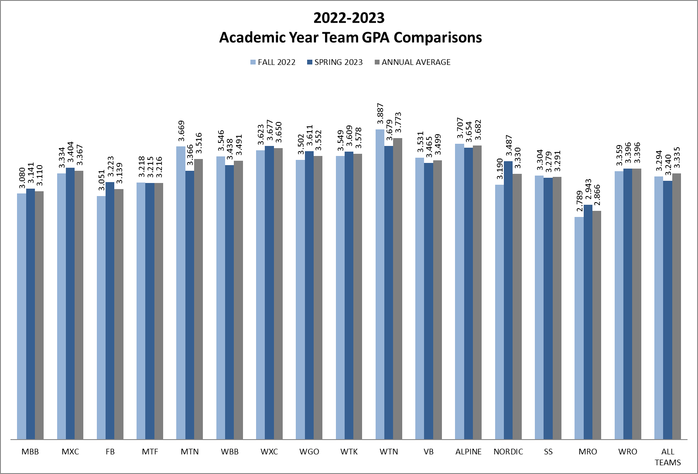
22-23 Team GPAS

Slide 14
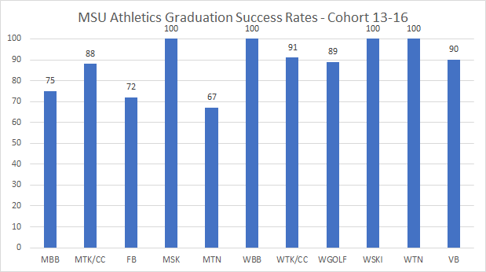
Graduation Success Rates

Slide 15
Grade Checks
Grade Check Process
  Email out to Faculty/Professors on Campus notifying them of the Process and Dates
  3 Rounds, 5 weeks, 10 weeks, and right before the Drop Date
  When SA is marked at-risk:
    Immediate email to Academic Coordinator
    Forwarded to head coaches and position coaches with an action plan for the student
    Student-athlete involved in plan and it is executed
    Regular meetings with coaching staffs weekly
  If no improvement, please continue to communicate

Slide 16
Struggling Student-Athletes
Communication and continuous communication
  Grade Checks or when you initially realize a student-athlete is struggling
  The more information the better (missing class, not logging in, inattentive, etc)
  MSUNav Alerts
Student-Athletes respond more quickly because of the support system around them and because of their love of their sport
Understanding of travel, practice, sport commitments
Support of their love of athletics

Slide 17
Thank You! Questions?

Slide 18
Showing Our Work
Preparing for our Accreditation Site Visit October 2024
Tracy Dougher
Vice Provost for Curriculum, Assessment, & Accreditation

Slide 19
What is Accreditation?
Accreditation is a process of recognizing educational institutions for performance, integrity, and quality that entitles them to the confidence of the educational community and the public.
https://nwccu.org/accreditation/

Slide 20
While accreditation criteria and procedures of accrediting agencies differ, the principles underlying eligibility and levels of expectation are similar in their intent to:
foster excellence through the development of criteria and guidelines for assessing educational quality and institutional effectiveness;
encourage institutional improvement through continuous self-study and evaluation;
ensure the educational community, the general public, and other organizations that an institution has clearly defined and appropriate educational objectives, has established conditions under which their achievement can reasonably be expected, appears in fact to be substantially accomplishing them, and is so organized, staffed, and supported that it can be expected to continue to do so
provide counsel and assistance to established and developing institutions
https://nwccu.org/accreditation/

Slide 21
What does membership look like?
Accredited institutions must follow a schedule of accreditation-related activities known as the Seven Year Cycle and abide by NWCCU’s Eligibility Requirements, Standards, and Policies.
These activities include:
Submission of an Annual Report;
Submission of self-study reports in years Three (Mid-Cycle Report), Six (Policies, Regulations, and Financial Resources Report), and Seven (Evaluation of Institutional Effectiveness Report) of the accreditation cycle;
Additional ad hoc reports, as requested by the Board of Commissioners; and,
Reports of any changes that fall under the Commission’s Substantive Change Policy.
Throughout the seven-year cycle, every institution is reviewed by NWCCU staff, teams of peer evaluators, and the Board of Commissioners to confirm institution is working to fulfill its mission, addressing problems identified previously, continuously improving, offering high quality education, and supporting student success and closing equity gaps.
https://nwccu.org/accreditation/

Slide 24
Undergraduate Courses and Programs
Courses—First Reading
  PHOT 355: The Experimental Color Darkroom

Slide 25
Undergraduate Courses and Programs
Course Changes — First Reading
  LSCI 121: Digital Information Literacy: Library Research Skills
    Credit change from 3 to 1
    This course was previously a 1 credit course and was modified to meet current student needs. As the needs of our students and our focus on retention efforts have shifted post-pandemic, the Library curriculum committee feels this is the best choice to offer our students an option for success.

Slide 26
Undergraduate Courses and Programs
Course Changes — First Reading
  PHOT 374: The Experimental B&W Darkroom
    We are hard numbering a course we have offered under 494, The Experimental Color Darkroom. Sometimes these two courses get confused and one is all silver gelatin black and white, one is all color paper. We will propose to call the new 494/now 3XX class The Experimental COLOR Darkroom and this The Experimental B&W Darkroom to clearly differentiate. That is the only change. It also more closely matches the title of the textbook The Experimental Darkroom.
  HSTR 146IH: The Silk Road: Religion and Globalization
    Title change from History and Culture of the Silk Road.
    New title is more accurate to the course and not so broad.

Slide 27
Undergraduate Courses and Programs
Course Inactivations – Second Reading
  ACT 109: Beginning Racquetball
    Course is no longer being taught as there are no racquetball courts on campus.
  DANC 150: Social Dance
    Course is no longer being taught.
  EDEC 271: Paraprofessional Experience in Early Childhood
    No longer being offered.
  EDSP 307: Exceptional Learners Lab
    No longer being offered.

Slide 28
Undergraduate Courses and Programs
Course Inactivations – Second Reading
  FILM 100IH: Intro to Film & Photography
    This course is too similar to FILM 101IH Understanding Film and Media and thus we are eliminating this one and making 101IH the required course. *** Note, this course will be taught SUMMER 2023 and then inactivate Fall 2023.
  HDFS 459: Reaching the Hurt Child
    Course has been replaced by HDFS 451 and is no longer being taught.
  PHOT 304: Recent History of Photography
    This class is being replaced by PHOT 301 Photo: Global Histories and Perspectives. It was supposed to be deleted in the 2023-24 catalog but since it was taught for one last time Spring 2023 we couldn't do it that soon.

Slide 29
Undergraduate Courses and Programs
Courses—Second Reading
  GPHY 401: Environmental Planning and Management Toolkit
  MCH 220: Geometric Dimensioning and Tolerancing Metrology
Course Inactivations – Second Reading
  HDFS 454: Professional Issues - Senior Seminar
    Hasn't been offered in several years and has been replaced by HDFS 494.

Slide 30
Graduate Courses and Programs
Courses—First Reading
  ECIV 544 : Civil Engineering Computations
  GPHY 501 : Environmental Planning and Management Toolkit
Courses—Second Reading
  ASTR 550 : Radiative Processes in Astrophysics
  ASTR 561 : Astrophysics of Galaxies
  ECIV 444 : Civil Engineering Computations
  ECNS 503 : Microeconomic Theory I
  FILM 528 : Non-Fiction Film Performance

Slide 31
Graduate Courses and Programs
Course Changes — Second Reading
  ASTR 560 : Stellar Astrophysics
    Rubric change from PHSX
    Title change from Astrophysics
    The Physics Department is updating the program and requirements for the PhD in Physics. This course is being slightly revised as part of the change.

Slide 32
Graduate Courses and Programs
Course Changes — Second Reading
ERTH 524 : K-14 Earth System Science
  Credit change from 2 to 3.
  Although the learning outcomes for this course have not changed, the time needed for students to complete more complex activities related to these learning outcomes has increased. As such, we'd like to propose a move from 2 credits to 3 credits for this course to account for the time changes.

Slide 33
Graduate Courses and Programs
Course Changes — Second Reading
FILM 505: Critical Approaches to Science and Natural History Filmmaking
  Credit change from 3 to 4
  Title change from Crit Apprch Nat Hst Filmmaking
  The course meeting time will increase to 4 hours / week with a seminar format. The credit change from 3 to 4 credits reflects this increase in meeting time and more accurately reflects the in-class and out of class workload expectations.

Slide 34
Graduate Courses and Programs
Course Changes — Second Reading
PHSX 501: Mathematical Methods and Their Applications in Classical Mechanics
  Title changed from Advanced Classical Mechanics
  Physics is updating program requirements for PhD in Physics.
PHSX 519: Mathematical Methods and Their Applications in Electromagnetic Theory
  Title changed from Electromagnetic Theory I
  Physics is updated program requirements for PhD in Physics.
PHSX 580: Conceptual Physics for Teachers
  Number changed from 575 which is reserved for the professional paper and project.

Slide 35
Graduate Courses and Programs
Course Inactivations – Second Read
  CSCI 520 : Distributed Systems
    The instructor who developed and teaches this course is no longer at MSU. Furthermore, the course has been replaced by CSCI 521
  CSCI 548 : Reasoning Uncertainty
    This course is being replaced by a recently approved course, CSCI 546: Advanced Artificial Intelligence.
  DGED 614 : IGERT: Advanced Methods in Geobiology
    Course was part of an NSF grant and is not being offered.
  DGED 676 : IGERT: Geobiological Systems Science - Internship
    Course was part of an NSF grant and is not being offered.
  ESOF 523 : Software Testing and Analysis
    Instructor who developed this course no longer at MSU. No other faculty have proper background to teach.

Slide 36
Graduate Courses and Programs
Program Inactivations – Second Reading
  MADO-CERT : Online Graduate Certificate for Dual Enrollment Mathematics Teachers
    Program has not generated interest or applicants.

Slide 37
Senate Open Discussion

Slide 38
Public Comment

Slide 39
Do I have a motion to adjourn?
Second?

Slide 40


