Slide 1
Welcome to Faculty Senate!
Colter Ellis
Faculty Senate Chair
Associate Professor of Sociology
Stephanie McCalla
Faculty Senate Chair-Elect
Chemical & Biological Engineering

Slide 2
Gentle Reminders
Faculty Senate is an open and public meeting
Please, only Senators speak in the meeting, unless you are specifically called on by the Chair or Chair-elect to speak
Public may address the Senate at end of the meeting during public comment

Slide 3
Approval of FS Minutes from
November 8, 2023
Do I have a motion to approve?
Any Discussion?
All those in favor of the motion indicate by saying aye
Those not in favor of the motion indicate by same sign

Slide 4
FYI Items
Faculty Athletic Representative Position
Announcing this year’s Art Wall competition for Norm Asbjornson Hall to replace the third floor Art Wall with a new 20’ x 10’ design.
  The online submission site for proposals will be open December 1, 2023 – January 19, 2024.
Reminder about the Health Minds Study: MSU, in conjunction with the University of Michigan, is conducting a campus-wide survey about faculty and staff health and well-being called the Healthy Minds Study.
Research Development Day is on January 11, 2023; RSVP by December 7

Slide 5
Follow-up Items
Thank you again to the Provost, VP Terry Leist, All-Staff Council, and Faculty Senators for making the All-Staff Council and Faculty Senate Reception a success.

Slide 6
Information Updates
Nicole Motzer, Research Development Day

Slide 7

Office of Research Development
Office of the Vice President for Research and Economic Development
Dr. Nicole Motzer, Director
11/29/2023 | Faculty Senate

Slide 8
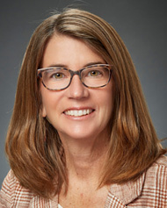
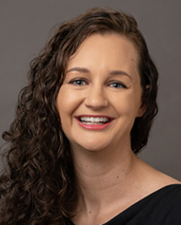

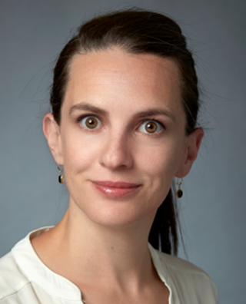
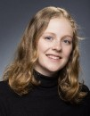
Who we are
Dr. Liz Shanahan
Dr. Nicole Motzer
Dr. Daniel Grant
Tracy Gatlin, CRA
Cailin Casey
Dr. Helaina Stergas
(arriving January)

Slide 9
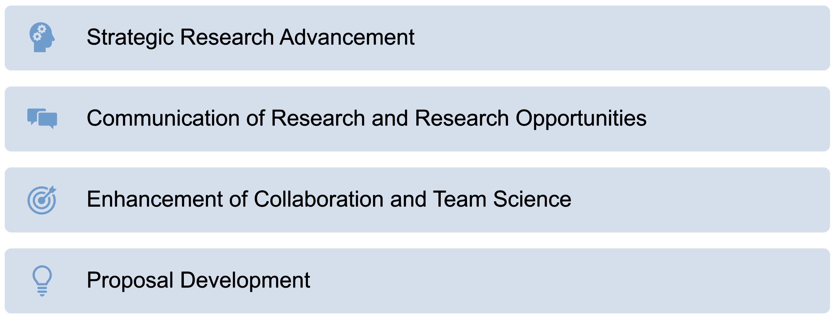
What we do

Slide 10
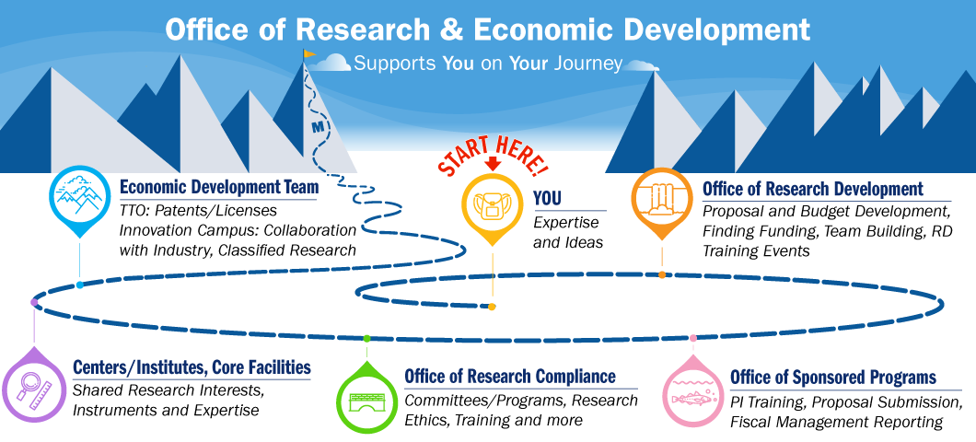
ORD
OSP
ORC
Image of the VPRED journey

Slide 11
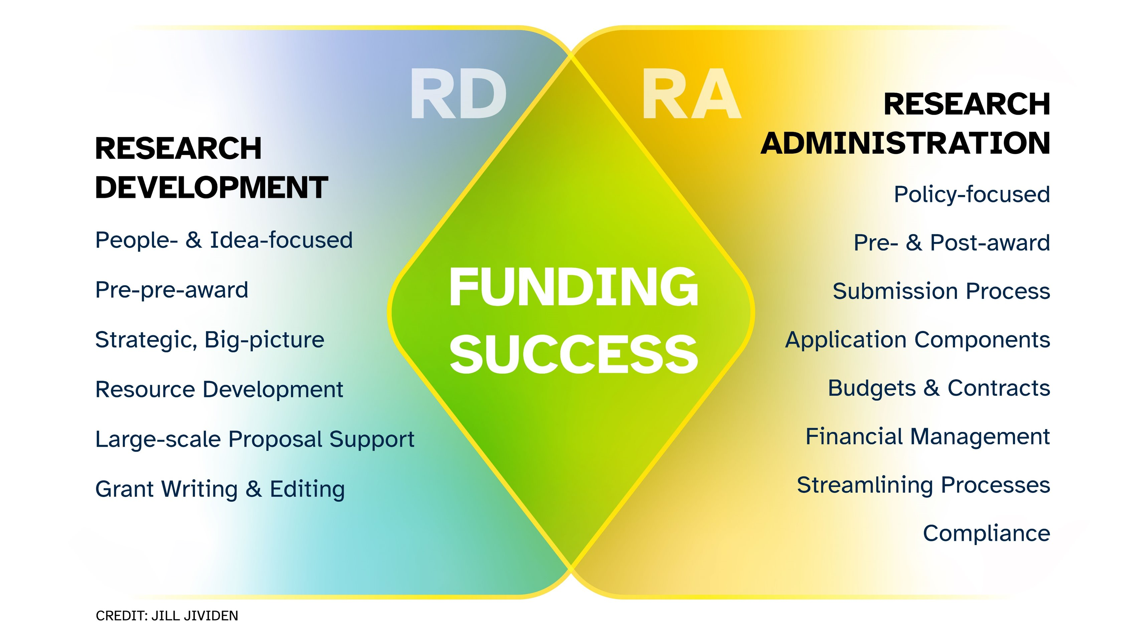

Slide 12


Slide 13
Participating Program Officers: (as of 9/19/2023)
Humanities Montana, Jill Baker, Executive Director
Institute of Museum and Library Sciences (IMLS), Dr. Ashley Sands, Senior Program Officer, Library Services
Montana Arts Council, Brian Moody, Program Officer
National Aeronautics and Space Administration (NASA), Jeanne King, Partnership Specialist, NASA Glenn Research Center
National Endowment for the Humanities (NEH), Dr. Joshua Sternfeld, Senior Program Officer
National Institutes of Health (NIH), Dr. Becky Miller, Program Leader, Office of the Director (OD)
National Science Foundation (NSF), Dr. Ron Joslin, Program Director, Chemical, Bioengineering, Environmental and Transport Systems (CBET)
National Science Foundation (NSF), Dr. Josie Miranda, Program Director, Social, Behavioral and Economic Sciences (SBE)
National Science Foundation (NSF), Dr. Enrique Pumar, Program Director, Science of Broadening Participation
National Science Foundation (NSF), Dr. John A. Schlueter, Program Director, Materials Research (DMR)
United States Environmental Protection Agency (EPA), Dr. Wendy O'Brien, Director, Laboratory Services 7 Applied Science Division
United States Department of Agriculture (USDA) National Institutes of Food and Agriculture (NIFA), Danielle Farley, Program Specialist, Animal Systems Division
United States Department of Energy (DOE), Dr. Todd Anderson, Acting Associate Director, Office of Biological and Environmental Research

Slide 14
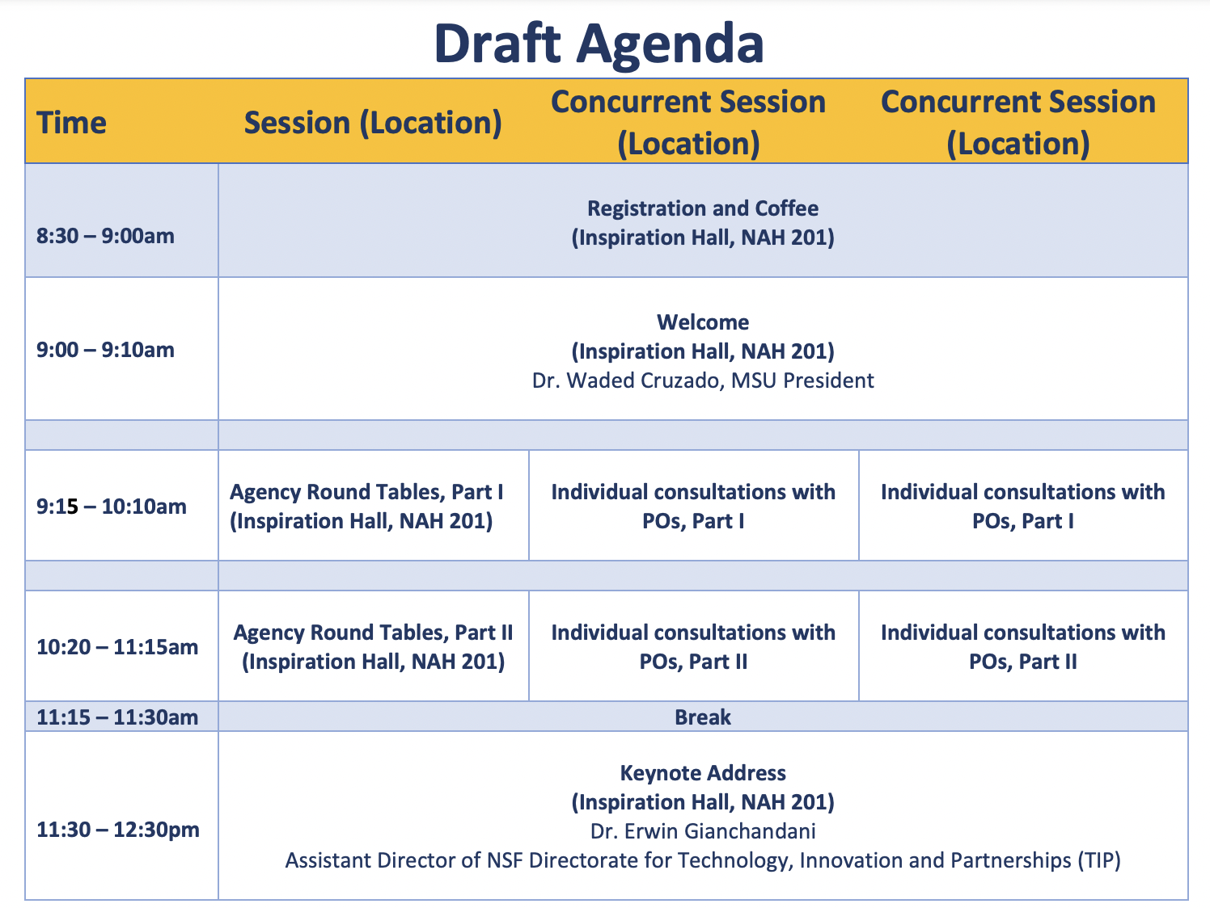
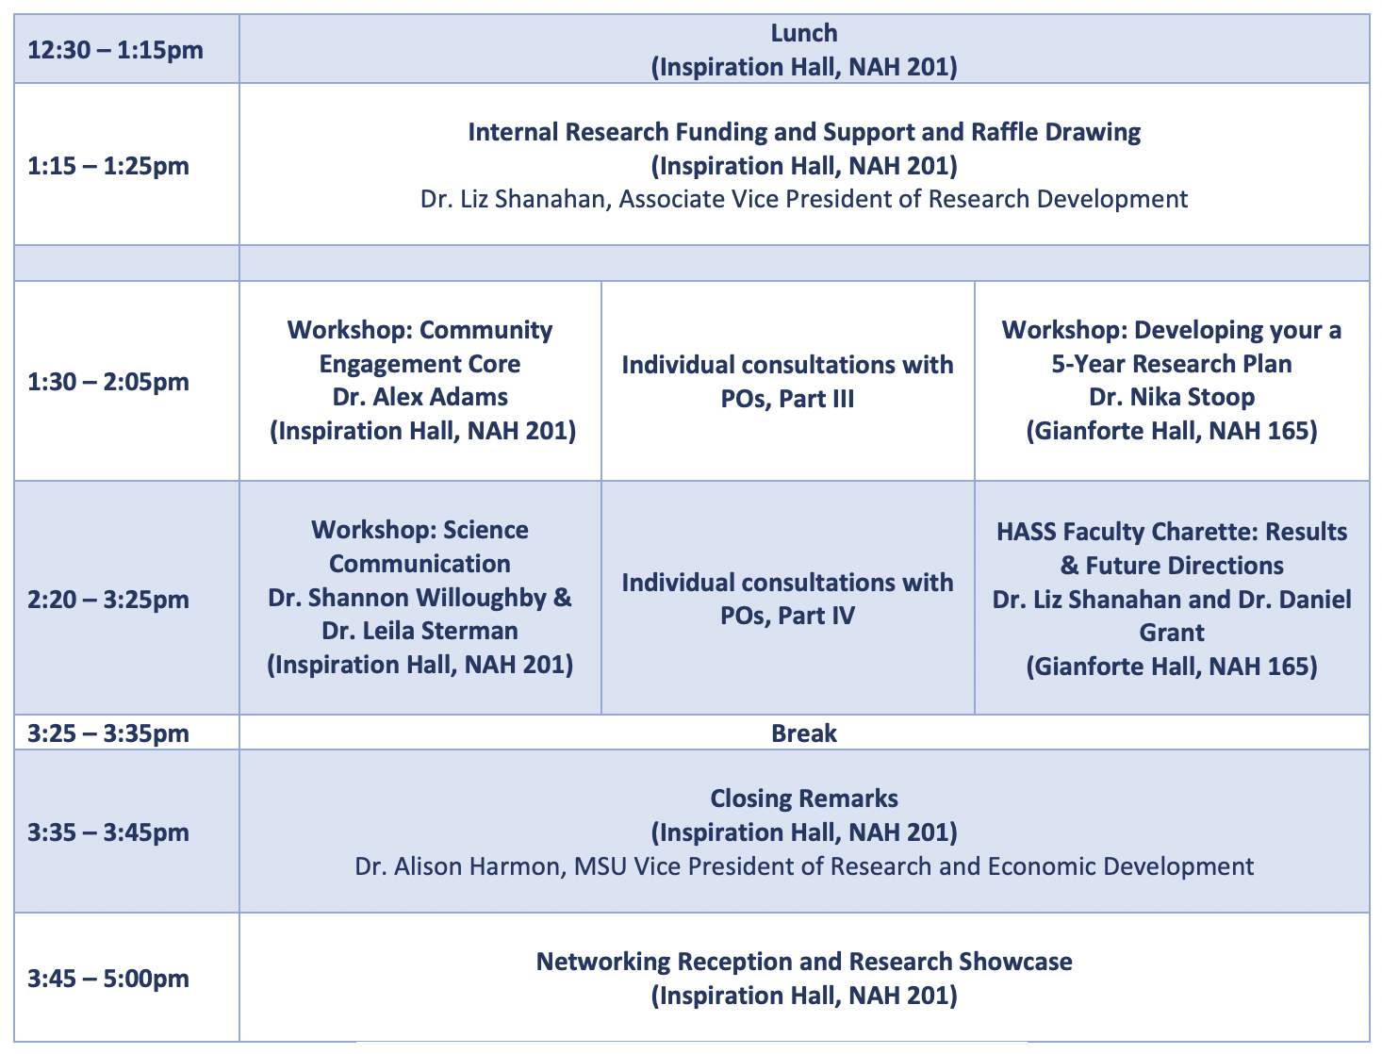
RD Day 2024 – Agenda

Slide 15
Register by December 7 for
  An exciting keynote discussion with NSF leadership
  Your chance for 1:1 consultations with a wide array of program officers (first come, first served--time slots to be released to registrants this week)
  Skill-building workshops to enhance grant funding success
  Interdisciplinary, cross-campus networking
https://montana.qualtrics.com/jfe/form/SV_9zPgHoKDkn7dthc

Slide 16

Contact ORD
Email ord@montana.edu
or me nicole.motzer@montana.edu
Visit our website to request support
www.montana.edu/research/ord

Slide 17
Thank you!
Questions?

Slide 18
Undergraduate Courses and Programs
New Courses – Inactivations First Reading
  ECNS 335 : Energy Economics
  M 194 : Introduction to Mathematical Sciences
  NRSG 488 : NCLEX Preparation
  SOCI 363 : Crime Prevention

Slide 19
Undergraduate Courses and Programs
Course Changes — Second First Reading
  ANTY 467 : Archaeological Field School
    Change from 1-9 credits to 3 credits
    Addition of two learning outcomes
  BIOH 411 : Advanced Human Appendicular Anatomy
    Title change from Advanced Human Anatomy
  BIOO 162CS : Insects and Human Society
    Change from 2 credits lecture, 1 credit lab to 3 credits lecture
  NEUR 409 : Human Neuroanatomy
    Change in number from 309
    Request to change to 400 level to accommodate graduate students needing the course.

Slide 20
Undergraduate Courses and Programs
Course Inactivations – First Reading
  FILM 493 : Study Tour
    We have not offered this class in years. It may be resurrected in the future in a different format, study tour format not dependent on travel to a Hollywood model but perhaps associated with travel to film festivals.
  NEUR 455 : Molecular Medicine
    No faculty available to teach course.
  STAT 217 : Intermediate Statistical Concepts
    Replaced by STAT 337
  STAT 401 : Applied Methods in Statistics
    Renumbered to STAT 500

Slide 21
Undergraduate Courses and Programs
Course Inactivations – Second Reading
  NEUR 430 : Neuroethology
    No faculty to teach course
  NEUR 435 : Cognitive Neuroscience
    No faculty to teach course
  NEUR 440 : Neuroscience of Mental Illness
    No faculty to teach course
  NEUR 444 : Modeling Brain Disorders
    No faculty to teach course

Slide 22
Undergraduate Courses and Programs
New Programs – First Reading
  BS: Environmental Economics and Policy

Slide 23
Graduate Courses and Programs
New Courses — First Reading
  CSCI 583 : Integrating Computer Science in Science Classrooms
  ERTH 587 : Invertebrate Paleontology for Teachers
  M 554 : Abstract Algebra II
  NRSG 616 : Psychiatric Case Formulation

Slide 24
Course Inactivations — First Reading
  NEUR 510 : Topics in Neurobiology
    No faculty to teach course
  NEUR 535 : Principles of Neuroscience
    No faculty to teach course
  NEUR 545 : Current Neuroscience
    No faculty to teach course

Slide 25
Course Changes — Second Reading
  FILM 515 : Science and Natural History Film Production
  Credits changed from 3 to 4
    The course is listed as a 3 credit course, yet the class meets for the time required for a 4 credit course. The required workload meets our requirement for a 4 credit course as well. The change to a 4 credit course will better reflect the importance of the course and also better reflect the time commitment students are making to the course and the work requirements.

Slide 26
Senate Open Discussion

Slide 27
Public Comment

Slide 28
Executive Session
(Honorary Doctorates)

Slide 29
Do I have a motion to adjourn?
Second?

