Slide 1
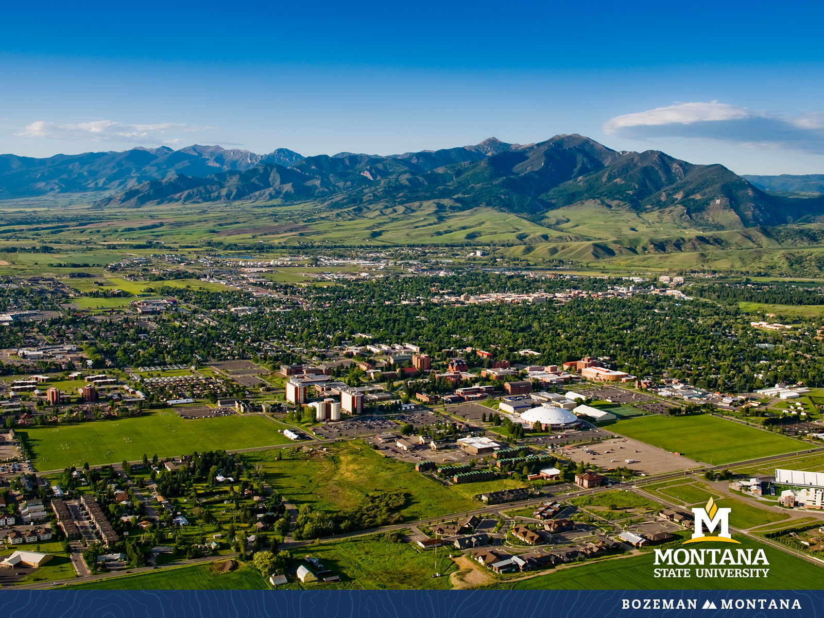
Faculty Senate Meeting January 25, 2023

Slide 2
Gentle Reminders
Faculty Senate is an open and public meeting
Please, only Senators speak in the meeting, unless you are specifically called on by the Chair or Chair-elect to speak
Public may address the Senate at end of the meeting during public comment

Slide 3
Agenda
Approval of Minutes
Welcome and Purpose of Senate
Information Updates
Courses and Programs
Old Business
Senator’s Open Discussion
  Public Comment
Adjourn

Slide 4
Approval FS Minutes 12/07/22
Do I have a motion to approve?
Any Discussion?
All those in favor of the motion or
Those not in favor of the motion indicate by saying…

Slide 5
  Welcome to all new senators – Please provide your contact information to Jennifer and Keely
  Purpose of Faculty Senate
        Faculty Senate is the chief governance body of the faculty of Montana State University.
        Faculty Senate has the authority to frame policies, procedures and standards of the Faculty Handbook.
        Foster a climate of academic freedom
        Promote consistency in tenure, promotion in academic rank, workload, and salary
        Uphold academic standards, and uphold standards and procedures of accountability concerning faculty ethics and responsibilities
        Provides a means for faculty and administration to interact and discuss University business including strategic planning, budgeting, curriculum, accreditation, and graduation requirements.

Slide 6
FYI Items
  Faculty Senate Office Hours for Spring 2023
    These will be held via Webex Tuesdays from 1 pm to 2 pm and Wednesdays from 2 pm to 2:45 on senate weeks and 3 pm on non-senate weeks
    Webex links are on agenda and Faculty Senate Brightspace page

Slide 7
FYI Items
    Legislative Involvement
    Testifying or providing information in your official university capacity: This occurs only when authorized by the OCHE legislative team. If you are contacted by a legislator, government agency or interest group requesting your expertise on pending legislation, the first step is to notify me at janelle.booth@montana.edu.
    Providing public comment as a private citizen: You have the constitutional right to express your opinions to the Montana Legislature. If you wish to weigh in on legislation on your own behalf, please be aware that Montana statute limits what you can do on work time and with work resources as a government (university) employee. You may not use your official university email address, work computer or work time to submit public comment. All personal public comment must be done outside of work hours, using your personal email address and computer. You may list your professional title in order to establish credibility (if applicable to the subject), but you must clearly state at the beginning of any testimony that you are speaking as a private citizen and not on behalf of your employer.

Slide 8
FYI Items
    Congratulations to the recipients of the Spring 2023 Founders Day Faculty Award. Please plan on attending and promoting the recognition on Thursday, February 16, 2023, 8:30 am – 10:30 am in NAH, Inspiration Hall.
    Save the Date: 100th Day of Student Recognition May 5, 2023

Slide 9
FYI Items
  ORD Internal Funding Opportunities
    HASS Grant Program: Feb 13, 2023
    Research Expansion Funds (REF): Feb 21, 2023
    Scholarship and Creativity (S & C) Grant Program: Feb 21, 2023
    Proposal Enhancement Grant (PEG) : Rolling

Slide 10
  Export Control Policy
  Quinton King – Office of Research Compliance

Slide 11
  Preregistration of Freshman
  Dr. Durward Sobeck – Vice Provost

Slide 12
HHD Department Reorganization- First Reading
    Reorganization of the Dept. of Health and Human Development into three separate Departments.
      Department of Food Systems, Nutrition & Kinesiology will include the following academic programs: Kinesiology, Health Enhancement K-12, Food & Nutrition, Sustainable Food and Bioenergy Systems, Hospitality Management and 1 minor in coaching
      The Department of Human Development and Community Health will include the following academic programs: Human Development and Family Science, Early Childhood P-3 and Community Health.
      The Department of Counseling includes academic programs in Marriage, Couple & Family Counseling, Mental Health Counseling, School Counseling and 2 graduate certificate programs in Addictions Counseling and Mental Health Support.
    The reorganization will result in a more manageable workload for department leaders and contribute to a more sustainable leadership model. The new organizational structure will facilitate improved curriculum management and increase the visibility of all programs for student recruitment purposes. The reorganization will also contribute to greater name recognition and identification for each new department and enhance both students and faculty

Slide 13
New Business – Introduction of Sustainability in the Curriculum Initiative
CSAC MSU Sustainability Definition:
Sustainability at MSU is a process and resulting actions through which the campus community lives out the Land Grant mission by cultivating resilience for the natural environment, economic viability, and social welfare to meet the needs of our campus and Montana's urban, rural, and tribal communities.
CSAC Sustainability in the Curriculum:
Sustainability classes in the MSU Curriculum teach students to become global citizens and live out the Land Grant mission by cultivating resilience for our natural environment, economic viability, and social welfare to meet the needs of our urban, rural, and tribal communities.

Slide 14
Graduate Courses -First Reading:
  ARTH 538 : Constructions of Gender & Sexuality in Art
    To be co-convened with existing course ARTH 437, Graduate students are expected to do additional work including a longer paper, in-class mentoring and discussion, and supplementary readings.

Slide 15
  Old Business: Updates on Previous Items
    International Travel Policy
    Compensation
    Graduate Student Policies
    Honors college curriculum review

Slide 16
Senate Open Discussion

Slide 17
Public Comment

Slide 18
Next Meeting February 8, 2023
Leon Johnson 346

Slide 19
Faculty Senate Meeting Adjourned

