Slide 1
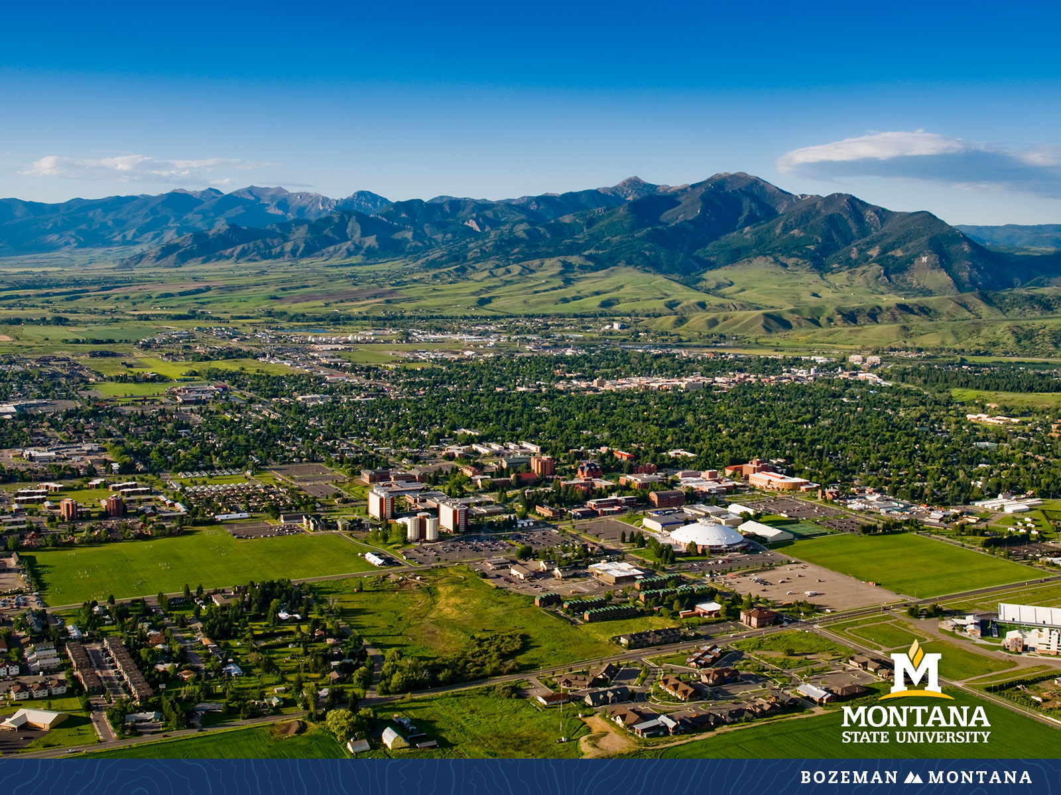
Faculty Senate Meeting February 8, 2023

Slide 2
Gentle Reminders
Faculty Senate is an open and public meeting
Please, only Senators speak in the meeting, unless you are specifically called on by the Chair or Chair-elect to speak
Public may address the Senate at end of the meeting during public comment

Slide 3
Agenda
Approval of Minutes
Information Updates
Courses and Programs
Old Business
Senator’s Open Discussion
  Public Comment
Adjourn

Slide 4
Approval FS Minutes 01/25/22
Do I have a motion to approve?
Any Discussion?
All those in favor of the motion or
Those not in favor of the motion indicate by saying…

Slide 5
FYI Items
    Congratulations to the recipients of the Spring 2023 Founders Day Faculty Award. Please plan on attending and promoting the recognition on Thursday, February 16, 2023, 8:30 am – 10:30 am in NAH, Inspiration Hall.
    Founders Day Awards for Student Excellence will also be on Thursday, February 16, 2023 at 5:30 pm. $25 per ticket available from the Alumni Foundation

Slide 6
FYI Items
  Save the Date: 100th Day of Student Recognition May 5, 2023
  ORD Internal Funding Opportunities
    HASS Grant Program: Feb 13, 2023
    Research Expansion Funds (REF): Feb 21, 2023
    Scholarship and Creativity (S & C) Grant Program: Feb 21, 2023
    Proposal Enhancement Grant (PEG) : Rolling

Slide 7
FYI Items
  MSU Leadership Institute: A Conversation With Dmitry Muratov: Nobel Peace Prize Winner
  February 22 at 7:30 pm
  https://tinyurl.com/DmitryMuratovTickets

Slide 8
  Student Mental Health Update
  Betsy Asserson – Director, University CPS

Slide 9
New Business – Mental Health Resolution
i. The Faculty Senate of Montana State University (MSU) recognizes that maintaining and improving mental health, and well-being are critical for faculty, staff, and students to achieve their goals and the mission of MSU. Montana currently ranks 3rd in suicide rate but has consistently ranked in the top 3 since 2014 (CDC/National Center for Health Statistics, 2020). Suicide is the 9th leading cause of death in Montana and has consistently been a top 10 leading cause of death since 2014 (CDC/National Center for Health Statistics, 2020). Suicide is also the 2nd leading cause of death for college-aged adults in Montana (CDC/National Center for Health Statistics, 2020). Faculty Senate supports MSU’s efforts to provide training to the MSU community to identify and refer colleagues and students who may be at risk of suicide or are otherwise in mental health distress. Therefore:

Slide 10
New Business – Mental Health Resolution
• We encourage faculty colleagues to take the free online suicide prevention programming, Kognito, to recognize distress in themselves, their students, and others and to enhance their knowledge of local and campus resources.
• We encourage faculty to participate in and share their knowledge of campus mental health resources with their colleagues and students to build on MSU’s culture of care.
• We encourage faculty to acknowledge the importance of mental health by including campus mental health resources for students in their syllabi.

Slide 12
New Business – Mental Health Resolution
Discussion
Vote will be held at the next meeting to allow Senators to consult with constituents

Slide 13
New Business – Sustainability in the Curriculum Initiative
Sustainability in the curriculum — Sustainability in the MSU Curriculum empowers students to become local and global citizens and live out the Land Grant mission by cultivating resilience for the natural environment, economic viability, and social welfare to meet the needs of our campus and urban, rural, and tribal communities.
Sustainability-focused courses have a primary and explicit focus on empowering students to become local and global citizens and live out the Land Grant mission by cultivating resilience for the natural environment, economic viability, and social welfare to meet the needs of our campus and urban, rural, and tribal communities.
Sustainability-inclusive courses incorporate a unit or module on empowering students to become local and global citizens and live out the Land Grant mission by cultivating resilience for the natural environment, economic viability, and social welfare to meet the needs of our campus and urban, rural, and tribal communities.

Slide 14
New Business – Sustainability in the Curriculum Initiative
Each Senator is asked to consult with faculty in their departments and provide an assessment of the degree options offered by their Department, and input results into the tracking spreadsheet on the Faculty Senate Brightspace page (Example courses are provided in the spreadsheet and as a word document in the Brightspace folder).

Slide 15
HHD Department Reorganization- Second Reading
    Reorganization of the Dept. of Health and Human Development into three separate Departments.
      Department of Food Systems, Nutrition & Kinesiology will include the following academic programs: Kinesiology, Health Enhancement K-12, Food & Nutrition, Sustainable Food and Bioenergy Systems, Hospitality Management and 1 minor in coaching (15 Tenure Track and FTE Non-tenure track )
      The Department of Human Development and Community Health will include the following academic programs: Human Development and Family Science, Early Childhood P-3 and Community Health. (12 Tenure Track and FTE Non-tenure track )
      The Department of Counseling includes academic programs in Marriage, Couple & Family Counseling, Mental Health Counseling, School Counseling and 2 graduate certificate programs in Addictions Counseling and Mental Health Support. (8 Tenure Track and FTE Non-tenure track)
    Additional Information - Faculty within programs worked together to determine which unit each program fit best in keeping in mind shared curriculum and accreditations.

Slide 16
Undergraduate New Courses -First Reading:
AHMS 295 : Allied Health Externship Prep Seminar
ECIV 231 : Introduction to Engineering Hydrology
HSTR 316 : Ancient India: Text and Ritual

Slide 17
Undergraduate Course Changes -First Reading:
BIOB 260 : Cellular and Molecular Biology
  Credit change from 4 to 5
NRSG 469 : Culturally Responsive Care in Nursing: The (Specific Culture) Experience
  Credit change from 2-6 to 1-6
PHOT 113RA : The Magic of the Darkroom I
  Title change from Understanding Photography
PHOT 213 : The Magic of the Darkroom II
  Title change from Intermediate Photography
SPNS 323 : Advanced Spanish Grammar & Pronunciation
  Title change from Advanced Grammar

Slide 18
Undergraduate Course Inactivations -First Reading:
ECIV 331 : Engineering Hydrology
PHOT 303 : Early History of Photography

Slide 19
Undergraduate New Programs -First Reading:
05.0201-C : Africana Studies Certificate
CNC-CTS : CNC Robotic Tending and Integration
  It was previously approved as a temporary program and now needs to go through a full workflow.

Slide 20
Graduate Courses -First Reading:
  ARTH 538 : Constructions of Gender & Sexuality in Art
    To be co-convened with existing course ARTH 437, Graduate students are expected to do additional work including a longer paper, in-class mentoring and discussion, and supplementary readings.

Slide 21
  Old Business:
    Age of courses revision
    Time-related policies revision

Slide 22
Senate Open Discussion

Slide 23
Public Comment

Slide 24
Next Meeting February 8, 2023
Leon Johnson 346

Slide 25
Faculty Senate Meeting Adjourned

