Slide 1
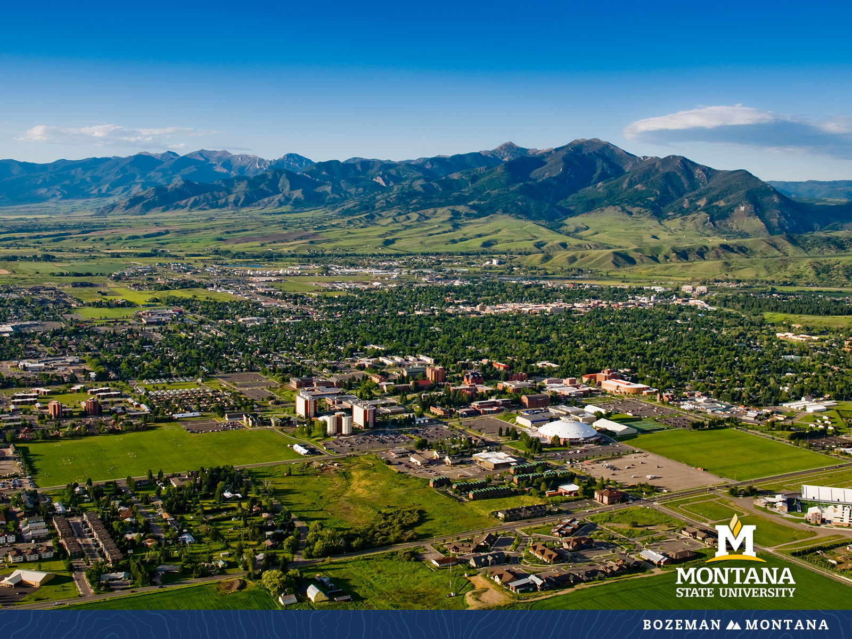
Faculty Senate Meeting October 12, 2022

Slide 2
Gentle Reminders
Faculty Senate is an open and public meeting
Please, only Senators speak in the meeting, unless you are specifically called on by the Chair or Chair-elect to speak
Public may address the Senate at end of the meeting during public comment

Slide 3
Agenda
Approval of Minutes
Information Updates
Courses and Programs
Old Business
Senator’s Open Discussion
  Public Comment
Adjourn

Slide 4
Old Business: Approval FS Minutes 9/28/22
Do I have a motion to approve?
Any Discussion?
All those in favor of the motion or
Those not in favor of the motion indicate by saying…

Slide 5
FYI Items
  Spring Awards of Excellence- nominations due November 15
    Primarily Faculty but Outreach and Engagement award is 1 faculty and 1 staff

Slide 6
FYI Items
  Childcare Grant- Dr. Christine Lux, Dr. Craig Ogilve (graduate school), ASMSU- $1.465 million
    Offering extended hour, evening, and/or weekend childcare by partnering with existing licensed center
    Providing childcare tuition assistance for low-income student parents using a sliding scale fee structure
    Providing wrap-around services to student parents, including financial counseling, mental health support, nutrition resources, and assistance in finding childcare in on-campus facilities or nearby licensed childcare centers, family and group programs
    Enhancing the early childhood education undergraduate academic program and improve the professional preparation of the early childhood workforce, including providing skills training and mentored practice in infant and toddler care to interested students as well as stipend support for participation in the CCAMPIS project.

Slide 7
FYI Items
  Policies under consideration in University Council
    Proposed - Employee ADA and Appeal
    Proposed - Research Misconduct

Slide 8
  Alison Harmon
  Vice President for Research and Economic Development

Slide 9
  Bill McKenny
  Associate Dean of Students
  Student Code of Conduct Updates

Slide 10

Proposed Updates to the Montana State University Code of Student Conduct

Slide 11
Agenda For Today’s Presentation
What is a Code of Student Conduct?
How did we change it?
How does the Code apply to faculty & why does it matter?
What did we change?
Why does this matter? What difference does it make?
Can I submit feedback?

Slide 12
What is a Code of Student Conduct?
Sets Expectations for MSU Community
Ensures Due Process for Students
Reference for Faculty, Staff, Students, Families
Includes Policies and Procedures
  Student Responsibilities
  Prohibited Conduct Policies:
    Academic & Student Conduct
  Conduct Processes
    Academic Misconduct
    Disruptive Student
    Academic Grievance
    Discrimination, Harassment & Retaliation
    Student Conduct
  Appeal Processes

Slide 13
How did we Change It?
The Current Code of Student Conduct was originally approved in August 2006
Most recently revised in November 2019
The first meeting to discuss revisions: June 10, 2021
  Working group from DOS, Compliance, and Legal
  Over 15 working meetings and countless hours outside the meetings
  Consulting with departments as needed
Track changes, reviews, and more track changes…

Slide 14
How does the Code apply to Faculty?
Why Does it Matter?
Disruptive Behavior in the Classroom
Academic Misconduct
  Instructor imposed sanctions
  Referral to Dean of Students
Course Dismissal
  Temporary
  Permanent
Academic Grievances
  Appeal Process to Department Head
Academic Decision Appeals
  Appeal Process to College Dean

Slide 15
What did we change?
More definitions
  Student
  Student Organization
  University Interest
Jurisdiction of the Code
Clarification of student responsibilities
Modernization of policies
  Copyright Infringement (e.g. Chegg)
  Hazing
  Alcohol, Drugs, and Smoking
Timelines sped up
Consolidation of processes
Clarification of procedures
  Notices
  Administrative agreements
  Pre-Hearing conference
  Sanctions
  Appeals
Records retention
Removal of Faculty Expectations

Slide 16
Why Does This Matter?
Better reflects the University today
Improves readability and understanding
Speeds up processes
Protects the safety and integrity of the community
Ensures due process
  Faculty, Staff, & Students

Slide 17
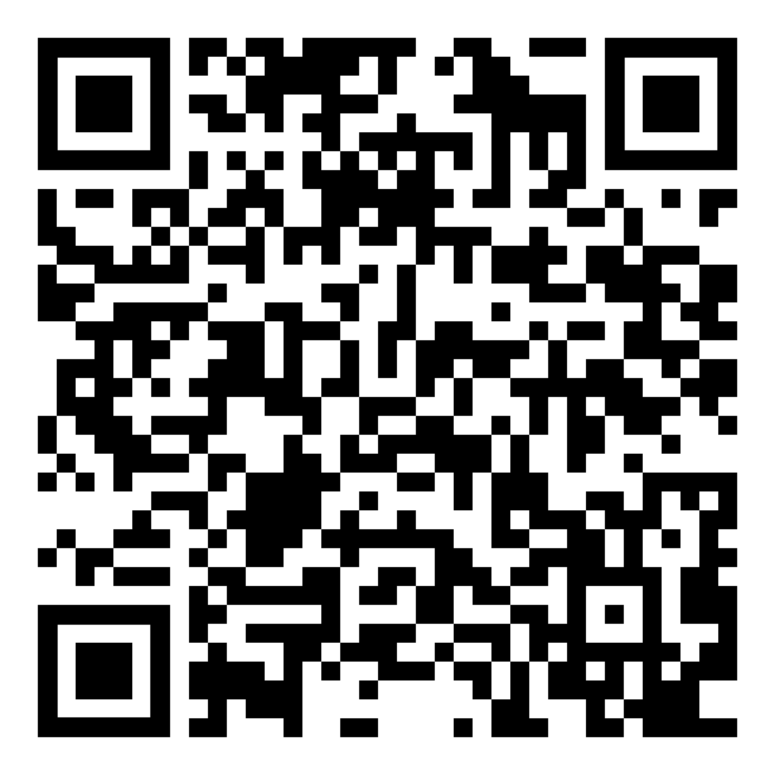
What’s Next? How do I Provide Feedback?
Continue to share the document with interested parties across campus
Gather feedback and take under consideration
Goal:
  Approval by University Council in December 2022
  Implementation January 1, 2023
Want to Review the Document?
Want to provide feedback or talk with DOS about the changes?
www.montana.edu/knowyourcode

Slide 18
Undergraduate Courses- First Reading:
    AVMT 100 : Introduction to Aviation Maintenance Mathematics/Basic Physics
    HEE 200 : K-12 Motor Learning Development
    HVC 270 : Energy-Efficient HVAC Technologies and Renewable Energy
    LIFE 298 : Internship
    M 362 : Linear Optimization
    MUSI 236 : Keyboard Skills IV
    ACT 252 : Introduction to Contemporary Dance*

Slide 19
Undergraduate Courses- Second Reading:
    AVMT 175 : Aircraft Electrical Systems

Slide 20
Undergraduate Course Changes- First Reading:
    ANTY 441 : Social Movements & Community Activism
        Changed from ANTY 441 : Social Movements in Japan
    HLD 221 : Critical Thinking, Writing and Leading
        Changed from HLD 221 : Critical Thinking & Leading
    MUSI 312IA : Choir III: Advanced Treble Choir
        Changed from MUSI 312IA : Choir III: MSU Chorale
    HSTA 464 : History of the American West*
        Change from Trans-Mississippi West
    SPNS 342 : Spanish Literature and Art*
        Change from Passion & Politics in Spanish Literature

Slide 21
Graduate Courses-First Reading:
CHTH 690 : Doctoral Dissertation

Slide 22
Graduate Programs-Second Reading:
    FCSED-CER : Family and Consumer Sciences Education Graduate Certificate

Slide 23
Old Business
International Travel Policy Implementation – Working Group Update
Faculty Salary / Budget Update
Convocation

Slide 24
Senate Open Discussion

Slide 25
Public Comment

Slide 26
Next Meeting October 26, 2022

Slide 27
Faculty Senate Meeting Adjourned

