Slide 1
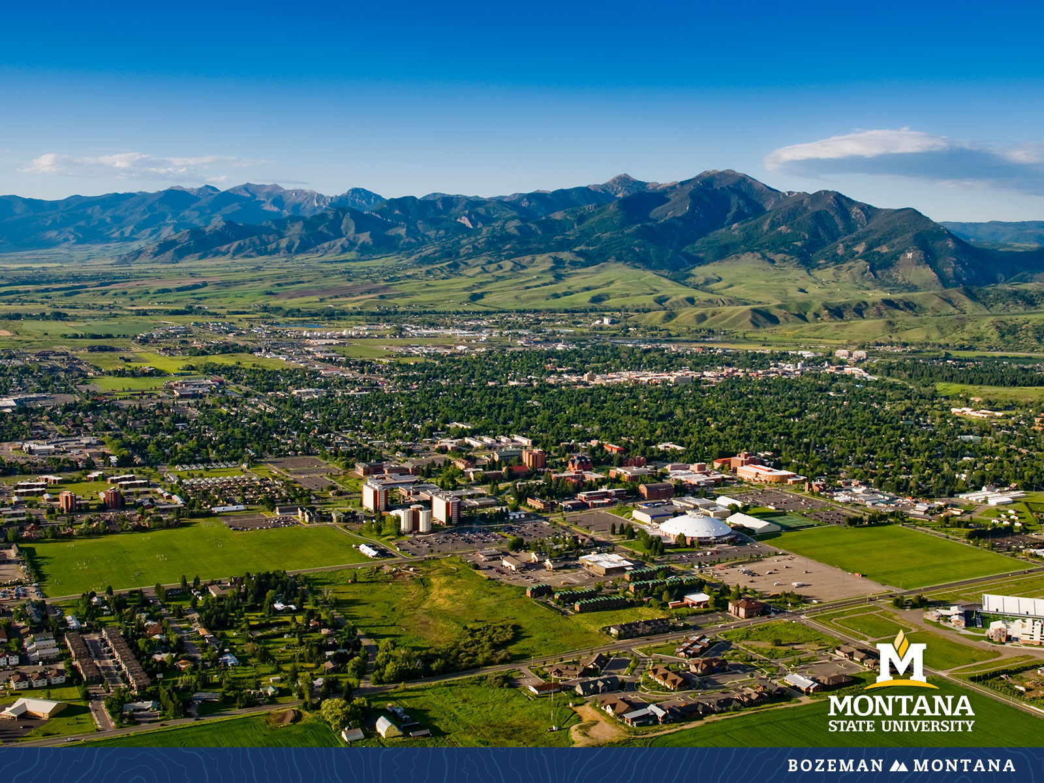
Faculty Senate Meeting October 26, 2022

Slide 2
Gentle Reminders
Faculty Senate is an open and public meeting
Please, only Senators speak in the meeting, unless you are specifically called on by the Chair or Chair-elect to speak
Public may address the Senate at end of the meeting during public comment

Slide 3
Agenda
Approval of Minutes
Information Updates
Courses and Programs
Old Business
Senator’s Open Discussion
  Public Comment
Adjourn

Slide 4
Old Business: Approval FS Minutes 10/12/22
Do I have a motion to approve?
Any Discussion?
All those in favor of the motion or
Those not in favor of the motion indicate by saying…

Slide 5
FYI Items
  Spring Awards of Excellence- nominations due November 15
    Primarily Faculty but Outreach and Engagement award is 1 faculty and 1 staff
  Inventory of Course and Program Fees
    Ongoing – check in with DH if you need fees adjusted or new fees added

Slide 6
FYI Items
    Alumni Foundation Excellence Awards – Change to two awards per college- adding Gallatin and graduate students
    Institutional Diversity Report – AY 2012-2022
    Dyslexia and Innovation Symposium- Oct 27-28
      https://www.montana.edu/dxi/

Slide 7
  Megan Lasso
  Director, University Budget Office

Slide 8

Financial Overview
Where do we get our money?
  All Funds Breakdown
  Budget Process
  Investment Overview
How do we spend our money?
  Current Unrestricted by Expense Category
  Current Unrestricted by Program
MUS Operating Budget Reports

Slide 9

Fund Overview and Examples
Current Unrestricted
Auxiliary
Designated
Ticket Sales, Testing Svcs, Fees
Tuition and State Funds
Room and Board
Restricted
Plant
Grants and Donors
Capital Project, Mand Fees

Slide 10
Financial Overview
MSU-Bozeman Revenue by Fund Type – FY22 Actuals
Total Revenue = $754,684,876
Current Unrestricted (Net) = $231,045,811
Non-State =
$523,639,065
Source: BoR Annual Operating Reports

Slide 11
Budget Processes
Legislative Process
  2023 is a legislative year
    Runs from January to April of 2023
  Present Law Requests Submitted by OCHE
  Governor’s budget is released on 11/15/22
Montana University System Process
  Tuition and fees will be approved in May 2023
Montana State University Process
  Non-State vs State Funds
  Current Unrestricted investments

Slide 12
Financial Overview
Where have we made investments?
  A net total of $39.8M has been invested from FY18-FY23
    Investments Areas
      Faculty and Staff Salaries
      Capital Projects and Maintenance
      IT Infrastructure
      Need-Based Aid
      Student Success Programs

Slide 13
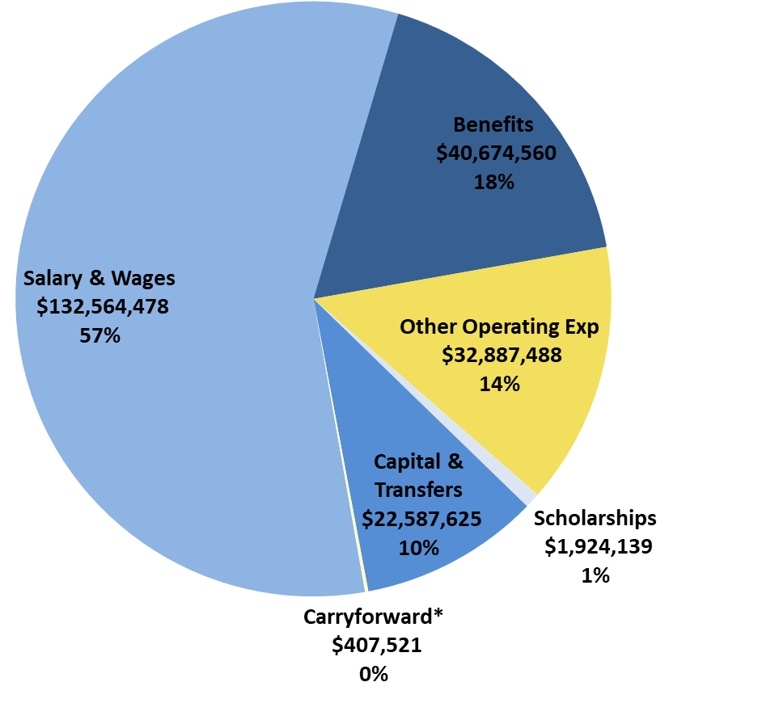
Financial Overview
MSU-Bozeman Current Unrestricted
Expenditures By Type, FY22 Actuals
Net Current Unrestricted Total = $231,045,811
Waivers Total
(not included) = $39,432,406
Note: Net of Tuition Waivers & Scholarships
Carryforward included, but not recorded in MUS reports
Source: BoR Annual Operating Reports

Slide 14
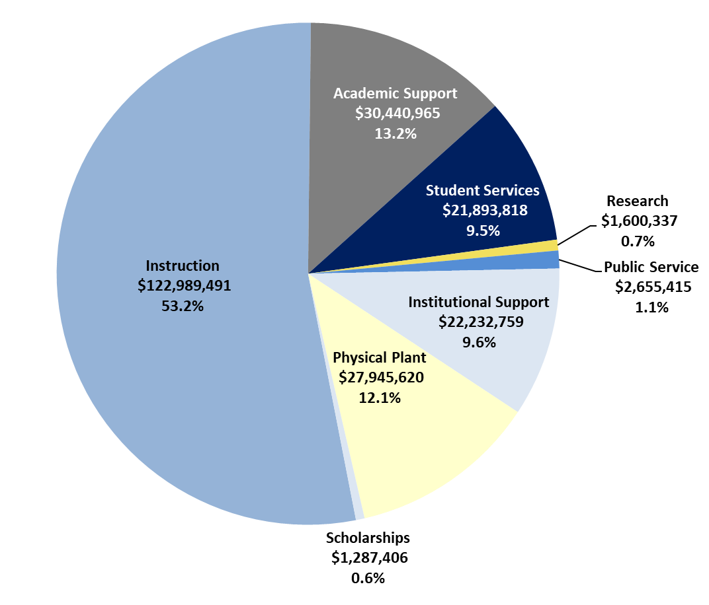
Financial Overview
MSU-Bozeman Current Unrestricted
Expenditures By Program, FY22 Actuals
Board of Regents Instruction Target = 50%
MSU at 53.2%
Board of Regents Instruction, Academic Support, and Student Services Target = 70%
MSU at 75.9%
Note: Includes $150,000 MT PBS in Public Service
Includes $407,521 in carryforward in Instructions
Source: MUS Operating Budget Reports

Slide 15
Discussion and Questions

Slide 16
  Dr. Robert Mokwa
  Provost

Slide 17
MSU Faculty Senate
Fall 2022 Summary Report
By: Provost Bob Mokwa
October 26, 2022
Data Sources:
1) MSU Office of Planning Analysis
https://www.montana.edu/opa/kpi/index.html
2) Montana University System Operating Budgets
https://www.mus.edu/data/operating_budgets/FY22/MSU-FY22-Operating-Budget-Summary_final.pdf

Slide 21
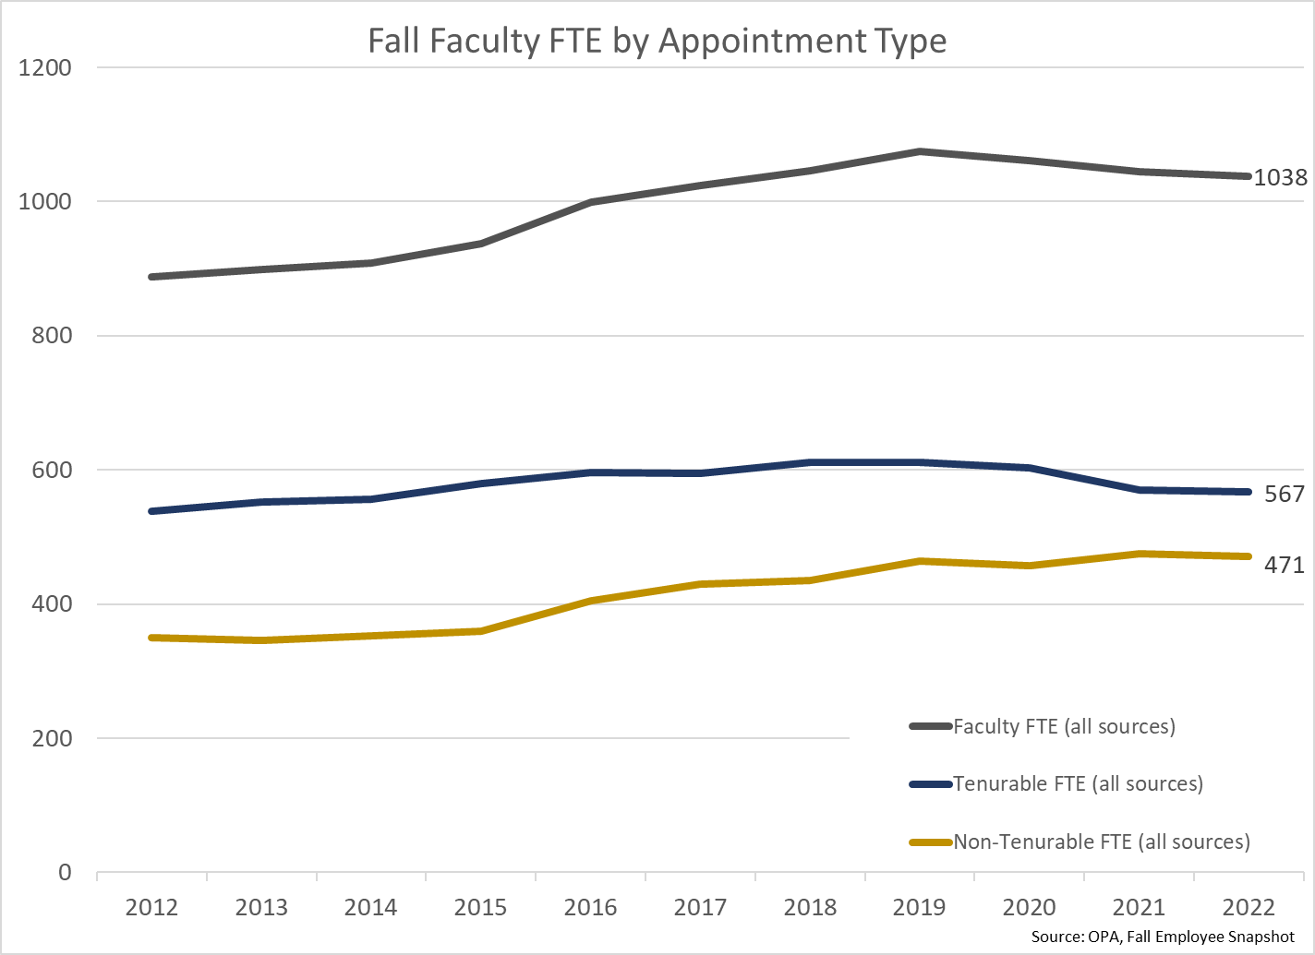

Slide 25
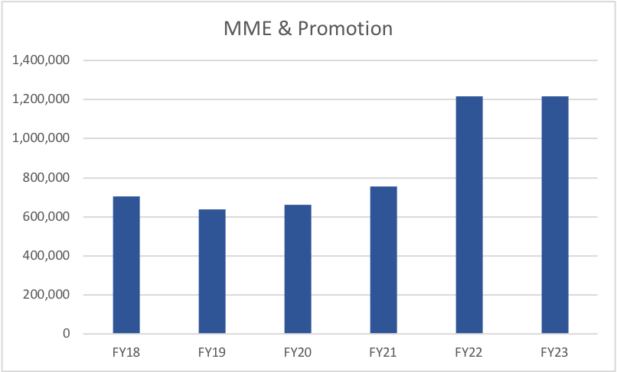
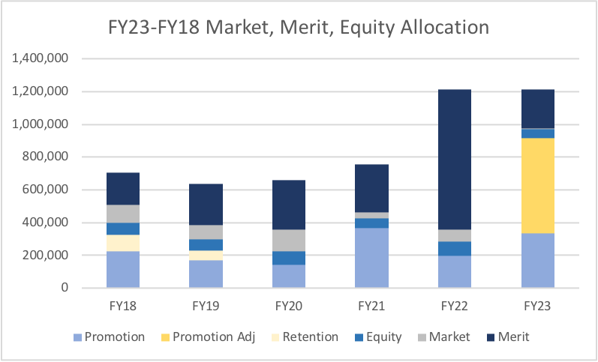

Slide 26
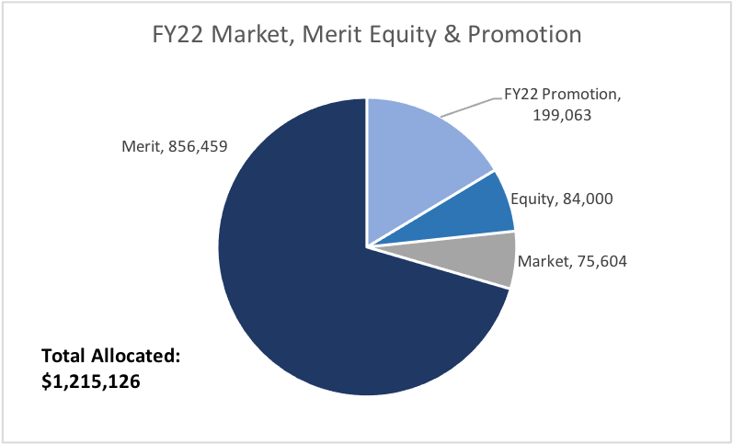
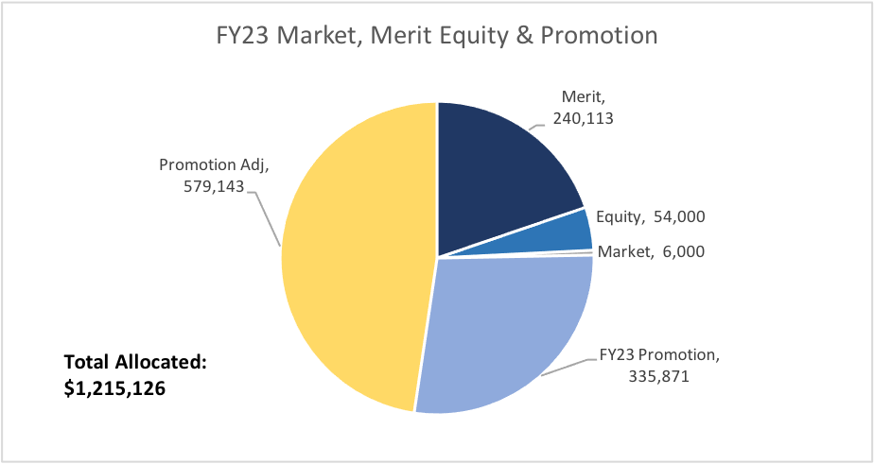

Slide 27
Supplemental Faculty Compensation
$7,351,737 in FY22
Summer session research: 288 T/TT, $14,192 avg.
Summer session teaching: 133 T/TT, $9,353 avg.
Incentive Program for Researchers: 98 T/TT, $14,598 avg.
Stipends/Awards/Ad Comp: 101 T/TT, $4,884 avg.
Total T/TT compensation increase: +13% ($54M to $62M)

Slide 28
Thank you!

Slide 29
Undergraduate Courses- First Reading:
    SOCI 375 : Law & Globalization
    EENV 498 : Internship
    HSTR 426 : History of Yoga: East and West
    ITS 125 : Fundamentals of Voice and Data Cabling
    ITS 250 : CCNA 3: Exploration
    ITS 252 : CCNA 4: Exploration
    MCH 242 : CNC Probing and Macros

Slide 30
Undergraduate Courses- Second Reading:
    AVMT 100 : Introduction to Aviation Maintenance Mathematics/Basic Physics
    HEE 200 : K-12 Motor Learning Development
    HVC 270 : Energy-Efficient HVAC Technologies and Renewable Energy
    LIFE 298 : Internship
    M 362 : Linear Optimization ^{*parked for additional review}
    MUSI 236 : Keyboard Skills IV

Slide 31
Undergraduate Course Changes- First Reading:
    ECHM 201 : Material and Energy Balances for Chemical & Biological Processes
      Title change from Elementary Principles of Chemical and Biological Engineering
    PSCI 347 :The U.S. Congress and the Legislative Process
      Title change from Legislative Process
      Number change from 306 to 347, per OCHE/CCN.

Slide 32
Undergraduate Course Changes- Second Reading:
    ANTY 441 : Social Movements & Community Activism
        Changed from ANTY 441 : Social Movements in Japan
    HLD 221 : Critical Thinking, Writing and Leading
        Changed from HLD 221 : Critical Thinking & Leading
    MUSI 312IA : Choir III: Advanced Treble Choir
        Changed from MUSI 312IA : Choir III: MSU Chorale

Slide 33
Graduate Courses-First Reading:
    HDFS 550 : Critical Science & FCS Curriculum Development

Slide 34
Graduate Courses-Second Reading:
    CHTH 690 : Doctoral Dissertation

Slide 35
Graduate Course Changes-First Reading:
HDCO 550 : Counseling Research and Evaluation
  Credit change from 2 to 3
MSSE 503 : Integrating Literature into the Biology/Life Science Classroom
  Title changed from MSSE 503 : Integrating Literature into the Science Classroom

Slide 36
Graduate Course Inactivations-First Reading:
    M 571 : Principles of Action Research in Mathematics Education
      Course has not been offered in over a decade. Students instead take M 577.
    M 572 : Investigating Problems in Mathematics Education
      Course has not been offered in over a decade. Students now take M 577 instead.

Slide 37
Graduate Programs-First Reading:
DNMW-DNP : Doctor of Nursing Practice - Nurse Midwife

Slide 38
Graduate Program Changes-First Reading:
SCNS-MED : School Counseling

Slide 39
Old Business
  Policies under consideration in University Council
    Proposed - Research Misconduct

Slide 40
Senate Open Discussion

Slide 41
Public Comment

Slide 42
Next Meeting November 9, 2022

Slide 43
Faculty Senate Meeting Adjourned

