Slide 1
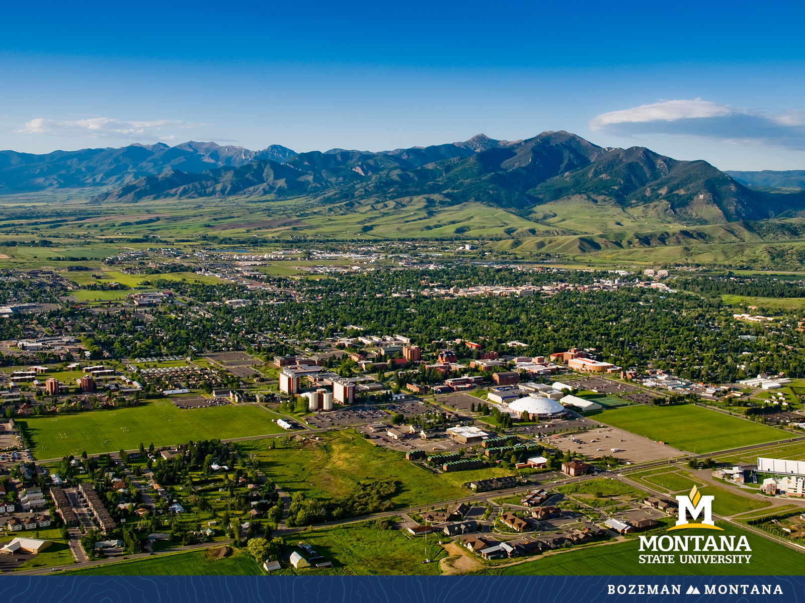
Faculty Senate Meeting December 7, 2022

Slide 2
Gentle Reminders
Faculty Senate is an open and public meeting
Please, only Senators speak in the meeting, unless you are specifically called on by the Chair or Chair-elect to speak
Public may address the Senate at end of the meeting during public comment

Slide 3
Agenda
Approval of Minutes
Information Updates
New Business
Courses and Programs
Old Business
Senator’s Open Discussion
  Public Comment
  Executive Session
Adjourn

Slide 4
Approval FS Minutes 11/30/22
Do I have a motion to approve?
Any Discussion?
All those in favor of the motion or
Those not in favor of the motion indicate by saying…

Slide 5
FYI Items
  MSU’s first-ever Research Development Day – Jan 12, 2023
In addition to a keynote from the Head of NSF’s Office of Integrative Activities Dr. Alicia Knoedler, the event will feature informational sessions and one-on-one consultations with federal program officers (advance sign-up required).
https://www.montana.edu/calendar/events/43447

Slide 6
FYI Items
  You are all invited to attend the 2023 MSU Library Open House on Tuesday, January 17, 2023. This year the event will be held in-person from 3-6 p.m. on the 2nd floor of the Library. For the 2023 Open House, the Library will broadly celebrate a theme of "Opening Possibilities." The Library is looking forward to gathering with MSU faculty, staff, graduate students, and Bozeman community members to enjoy food and beverages, listen to music, and explore the services offered by MSU Library and its partners. For more information, please visit this page: https://www.lib.montana.edu/about/news-and-events/annualevents/open_house/2023_open_house.html.

Slide 7
FYI Items
    Student Art Wall competition: The Norm Asbjornson Hall first-floor artwork panel (approximately 20 feet wide x 10 feet high) is adjacent to the main passenger elevator on the south side of the central atrium. The winning student or team will receive a $2,500 scholarship and funding for the materials and installation.
    Proposals must be submitted electronically by Friday, January 20, 2023.

Slide 8
  New Business:
  Conferral of Degrees
  Post-humous degree candidate
  Dr. Tony Campeau, Registrar

Slide 9
Undergraduate Courses- Second Reading:
    MCH 242 : CNC Probing and Macros
    ACT 253 : Intermediate Mountaineering
    ACT 266 : Introduction to Bike-packing
    ACT 267 : Introduction to Outdoor Gear Repair
    ACT 268 : Introduction to Ski/Board Repair and Maintenance
    ACT 273 : Single Pitch Instructor Course
    ACT 278 : Wilderness First Responder Recertification
    ACT 282 : Personal Trainer Certification
    AHMA 207 : Medical Assisting in Healthcare Specialties
    SOCI 415 : Sociology of Trauma

Slide 10
Graduate Course Changes-Second Reading:
    NRSG 614 : Vulnerability and Health Care in Diverse Communities
      Add an additional lab credit for accreditation purposes

Slide 11
  Old Business:
  Age of courses revision
  Time-related policies revision
  Research faculty as chairs of committees

Slide 12
Senate Open Discussion

Slide 13
Public Comment

Slide 14
Executive Session

Slide 15
Executive Session
Honorary Doctoral Candidates

Slide 16
Executive Session
Special Election for Chair-Elect Position
  Motion to affirm that the term in office for the incoming Chair will be through the end of the 2023-24 AY
  Continuing search for chair-elect for either Spring 2023 or for the 2023-24 AY

Slide 17
Next Meeting January 25, 2023
Leon Johnson 346

Slide 18
Faculty Senate Meeting Adjourned

