Slide 1
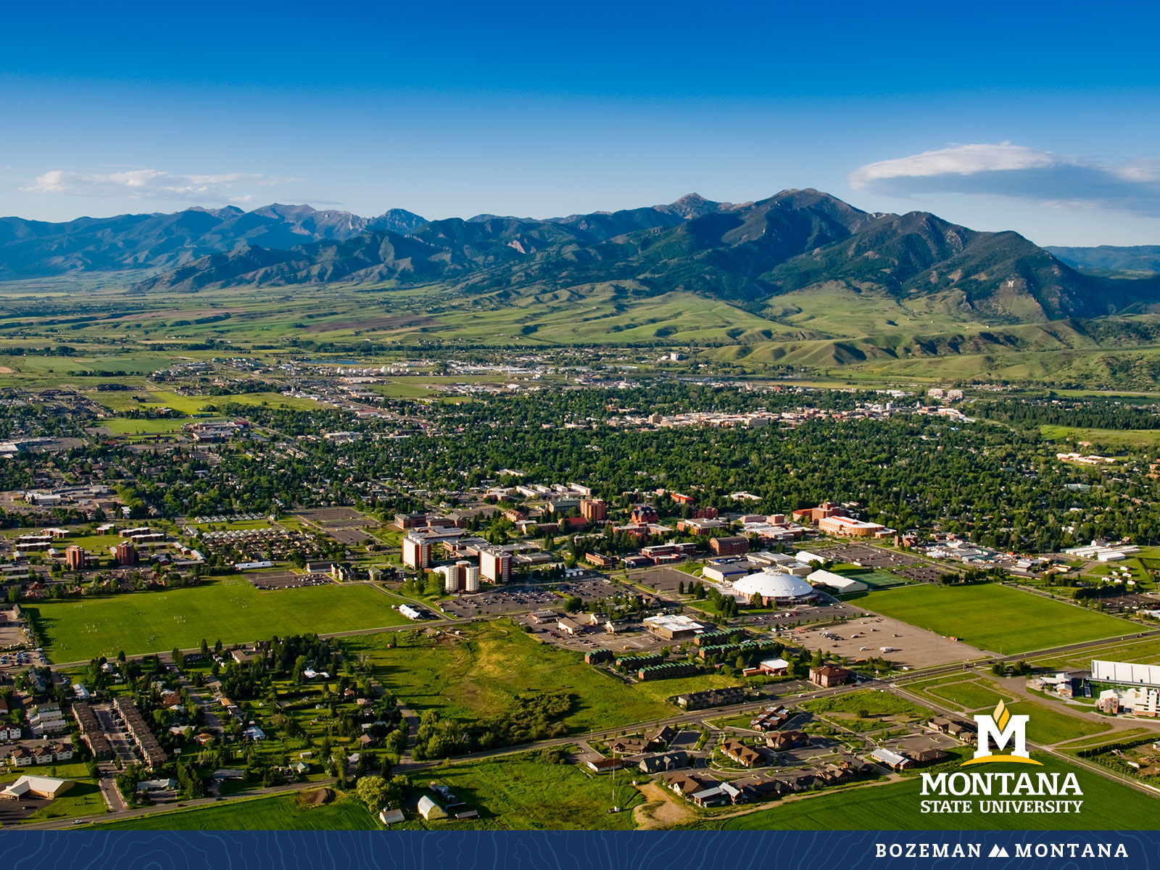
Faculty Senate Meeting August 31, 2022

Slide 2
Gentle Reminders
Faculty Senate is an open and public meeting
Please, only Senators speak in the meeting, unless you are specifically called on by the Chair or Chair-elect to speak
Public may address the Senate at end of the meeting during public comment

Slide 3
Thank you!
A complex job well done.
Best wishes Bradford Watson.

Slide 4
Introduction:
Dr. Eric Austin
Interim Chair Faculty Senate
Filling in for Dr. Michael Brody for Fall 2022

Slide 5
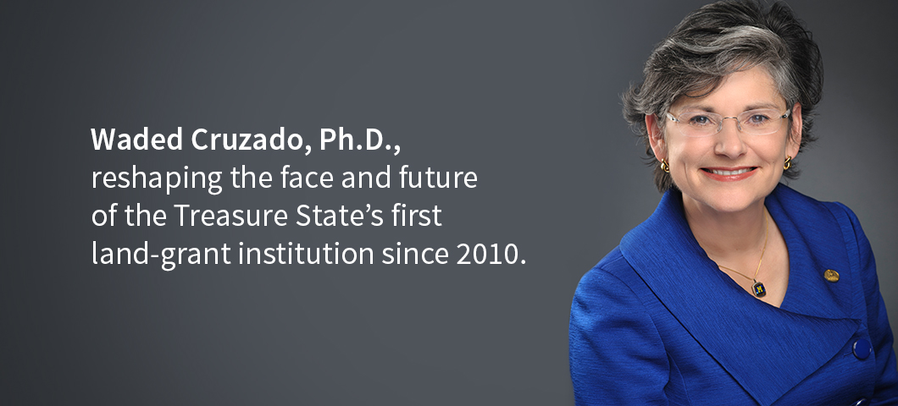

Welcome President Cruzado

Slide 6
Senate Rules of Engagement
  D2L Brightspace: faculty senate
  Emails: personal, group
    Eric.austin@montana.edu
    brody@montana.edu
    Jennifer.thomson@montana.edu
    facultysenate@montana.edu
    keely.holmes@montana.edu
  Faculty Senator Hours: M- 9 to 10 am, F 2 to 3 pm

Slide 7
Agenda
Approval of Minutes
Information Updates
Courses and Programs
Senator’s Open Discussion
  Public Comment
  Executive Session: Honorary Doctorate
Adjourn

Slide 8
Old Business: Approval FS Minutes 5/4/22
Do I have a motion to approve?
Any Discussion?
All those in favor of the motion or
Those not in favor of the motion indicate by saying…

Slide 9
FYI Items
  University Planning Council:
    https://www.montana.edu/planningcouncil/
    2022-23 and 2023-24 Priorities
  Panopto
    https://ato.montana.edu/panopto/transition/
  Chosen Name
    https://www.montana.edu/chosenname/

Slide 10








FYI Items
  MUS Learning Management System
    OCHE Task Force
Form Committee and Advisory Groups
Needs Analysis / RFI
Issue RFP & Solicit Feedback
Implementation
Steering Committee
Campus Teams
Academic Liaisons
Vendor presentations w/ follow-up survey and focus groups to identify RFP themes
Student & faculty testing of sandbox environments
Transition & training planning
3rd party tool integration
Phased transition
December 2021
April 2022
RFP issued: July 2022 Selection: Nov 2022
Planning: Spring 2023
Transition: Summer ‘23 to Summer `25

Slide 11
FYI Items
  University Council
    University Student Accommodations and Appeals Policy
    Jennifer Glad, Associate Legal Counsel; Mike McNeil, Director of Disability Service
    The proposed new policy addresses the university’s process for students to request accommodations to access university programs, activities and services. It also provides an appeal process for when a student disagrees with the accommodation process or a decision regarding disability accommodations.
    Limited Submission Research Policy
    Nicole Motzer, Director, Office of Research Development
    The proposed revisions modernize the policy’s language; remove procedures from the policy so that changes to the process can be implemented in real time, such as changes to technology; and transfer management of limited submission opportunities from the Office of Sponsored Programs to the Office of Research Development.
  MT 988 Project – Social Art/Design for Impact
    Bruce Barnhart, an assistant teaching professor in the School of Art

Slide 12
A Refresher on Faculty Senate Bylaws
  Purpose
  Policies
  Membership
  Responsibilities
  Meetings
  Committees
  Faculty Senate Web Page

Slide 13
Old Business:
  Course and Program Approvals
  OCHE Guidelines for New Programs
  Review by Curriculum and Programs Committee
  https://www.montana.edu/provost/committees/cpc.html
See senate website first reading
    Faculty Senate Upcoming Meetings
    Second senate reading next meeting for discussion
    Moves to Senate Executive Steering for final Approval

Slide 14
New Program Proposals:
1. Internal MSU Academic Plan- official list of potential new programs
2. Request to Plan – allows OCHE pre-approval
3. Campus Planning and Review- CIM Proposal prepared and submitted
4. Approval by BOR
5. Approval by Northwest Commission on Colleges and Universities (NWCCU)
CIM Requirements for New Programs
- Program Requirements and Curriculum
- Implementation Plans
- Assessment Plan
- Budget Projections – meet with Budget and Finance
- Institutional Support Information
- Library and Information Resource needs
- Board of Regents forms signed by Dean
CIM Approvals for New Programs
- Associate Provost
- Department Curriculum Committee
- Department Head
- College Curriculum Committee
- Academic Programs Working Group
- Faculty Senate
- BOR Prep
- Dean’s Council
- Financial Aid
- Associate Provost
- BOR
- NWCCU

Slide 15
New Course Proposals:
1. Preparation- learning outcomes and proposed syllabus
2. Campus Planning and Review- CIM Proposal prepared and submitted
3. Approvals in CIM
4. Registrar builds course in Banner
CIM Approvals for New Courses
- Provost Office
- Department Curriculum Committee
- Department Head
- College Curriculum Committee
- Dean
- Curriculum and Progams Committee (CPC)
- Faculty Senate
-Two readings and then final approval in Senate Steering
- Common Course Numbering

Slide 16
Undergraduate Courses- First Reading:
    AVMT 121 : Aviation Electronics Fundamentals
    ECNS 460 : Advanced Data Analytics in Economics
    HVC 215 : Central AC and Indoor Air Quality
    HVC 220 : Gas-Fired Furnaces and Boilers
    MUSI 235 : Keyboard Skills III
    WRIT 121 : Introduction to Technical Writing

Slide 17
Undergraduate Programs- First Reading:
    DSCS-BS : Bachelor of Science in Data Science

Slide 18
New Graduate Courses-First Reading:
AGTE 523 : Creative Problem Solving
ARTH 536 : Topics in Modern Art History
ARTH 537 : Topics in American Art
CSCI 521 : Distributed Computing
EDCI 538 : Supporting SEL in Diverse Learners
EMEC 540 : Biomechanics of Human Movement
NRSG 625 : Advanced Diagnostics in Primary Care

Slide 19
Graduate Course Changes-First Reading:
    ECIV 515 : Adv Structural Analysis
      Change in credits -The course is being changed from 2 credits to 3 credits in order to cover more topics, and to cover existing topics in more detail.
    EDCI 522 : Information Literacy Instruction
      Title change from EDCI 522 : Info Resources & Services -Changes are being made in order to bring course description and title in alignment with current professional standards and curricular changes.
    EDCI 549 : Reading Promotion in the School Library
      Title change from EDCI 549: Applications of Literature for Children and Young Adults- Changes are being made in order to bring course description and title in alignment with current professional standards and curricular changes.

Slide 20
Graduate Course Changes-First Reading:
    EDU 643 : Leading Social Justice
      Change of rubric from EDLD -Changing the rubric of this course from EDLD 643 to EDU 643 will increase visibility and access for students across three Department of Education programs (Adult & Higher Education, Curriculum & Instruction, and Educational Leadership), instead of focusing exclusively on students in the Educational Leadership program.
    EIND 511 : Design for Quality of Life
      Changed from Advanced Human Factors

Slide 21
New Graduate Programs-First Reading:
    CERT:Graduate Certificate in Indigenous Food Systems
    EDUC-PHD : Doctor of Philosophy in Education

Slide 22
Senate Open Discussion

Slide 23
Senate Open Discussion

Slide 24
Public Comment

Slide 25
Executive Session – Honorary Doctorate

Slide 26
Next Meeting September 14, 2022

Slide 27
Faculty Senate Meeting Adjourned

