Slide 1
Faculty Senate Meeting
May 04, 2022
WELCOME

Slide 2
Gentle Reminders
Faculty Senate is an open and public meeting
Please, only Senators speak in the meeting, unless you are specifically called on by the Chair or Chair-elect to speak
Public may address the Senate at end of the meeting during public comment

Slide 3
Agenda
Approval of Minutes
Conferral of Degrees
Information Updates
Courses and Programs
Old Business
Senator’s Open Discussion (time permitting)
  Public Comment
  Executive Session – Honorary Degree
Adjourn

Slide 4
Approval of 04.20.2021 Minutes
Motion to approve
Second
Discussion
Voice Vote

Slide 5
Conferral of Degrees
Registrar Tony Campeau

Slide 6
FYI Items
  Commencement is Friday May 13, 2022
    Please RSVP
  Course Evaluations Open April 25 thru May 06
  MyInfo Rolling Updates
  Updated MSU Policy and Procedures website
    https://www.montana.edu/policy/
  Senator Hours
    Monday 11:30-12:30, Thursday 10:30-11:30 Via WebEx

Slide 7
Information Items
  New Chair Elect
  Jennifer Thomson
  MUS Learning Management System
  Survey open until May 06
  Panopto Update

Slide 8
Information Items
  Update on Sabbatical Letters
  Two Letters – One External and One Internal
  Specific direction on content of letter

Slide 9
Strategic Plan Priority Recommendations
GOAL 3.3: Foster a culture of collaboration, continuous improvement and individual growth
GOAL 1.1: Broaden access for underrepresented populations and increase academic success for all students through excellence in undergraduate education.
GOAL 1.2: Expand high-quality graduate education

Slide 10
ATHLETICS UPDATE
‘Year of the Bobcats’
May 4, 2022

Slide 11
Fall 2021 Student-Athlete Academic Statistics
 | Fall 21
Avg Student-Athlete GPA | 3.28
Students on President’s List | 43
Students on Dean’s List | 97
Teams with 3.5+ GPA | 6
Student-Athletes with Term GPA >3.0 | 71%
Fall Graduates | 20

Slide 12
Athletic Accomplishments
Cross Country/Track and Field
Two XC Athletes qualified for NCAA Cross Country Championships
Volleyball
5th Consecutive Winning Season
Skiing
3 Athletes First Team All American Honors
Talbot and Bekkestad earned MVP accolades from RMISA
4 players to Second Team All Big Sky
Jordan Radick named Big Sky Conference Freshman of the Year
Riley Segar became first bobcat to earn Elite 90 Award
Corbett and Hamilton earned all-America honors at NCAA Indoor Championships
Outdoor still on but exceptional performances and records broken

Slide 13
Athletic Accomplishments
Football
Tied School Record with 12 wins and Advanced to National Championship game
Men’s Basketball
4th ever NCAA Tournament Appearance
Women’s Basketball
3rd ever NCAA Tournament Appearance
2 Bobcats Taken in the NFL Draft, 3 others signed as undrafted free agents
Troy Anderson earned All American Honors for 3rd time, while 3 others named all-Americans
Won both Big Sky Conference Tournament and regular season title, first time since 1997
Won more Big Sky Conference games, 16, than any team ever in the program’s history.
Darian White was a unanimous First Team All Big Sky Selection; MVP of Tournament and Defensive POY
Kola Bad Bear was named to the all-Big Sky Third-Team and garnered Big Sky All-Tournament Team

Slide 14
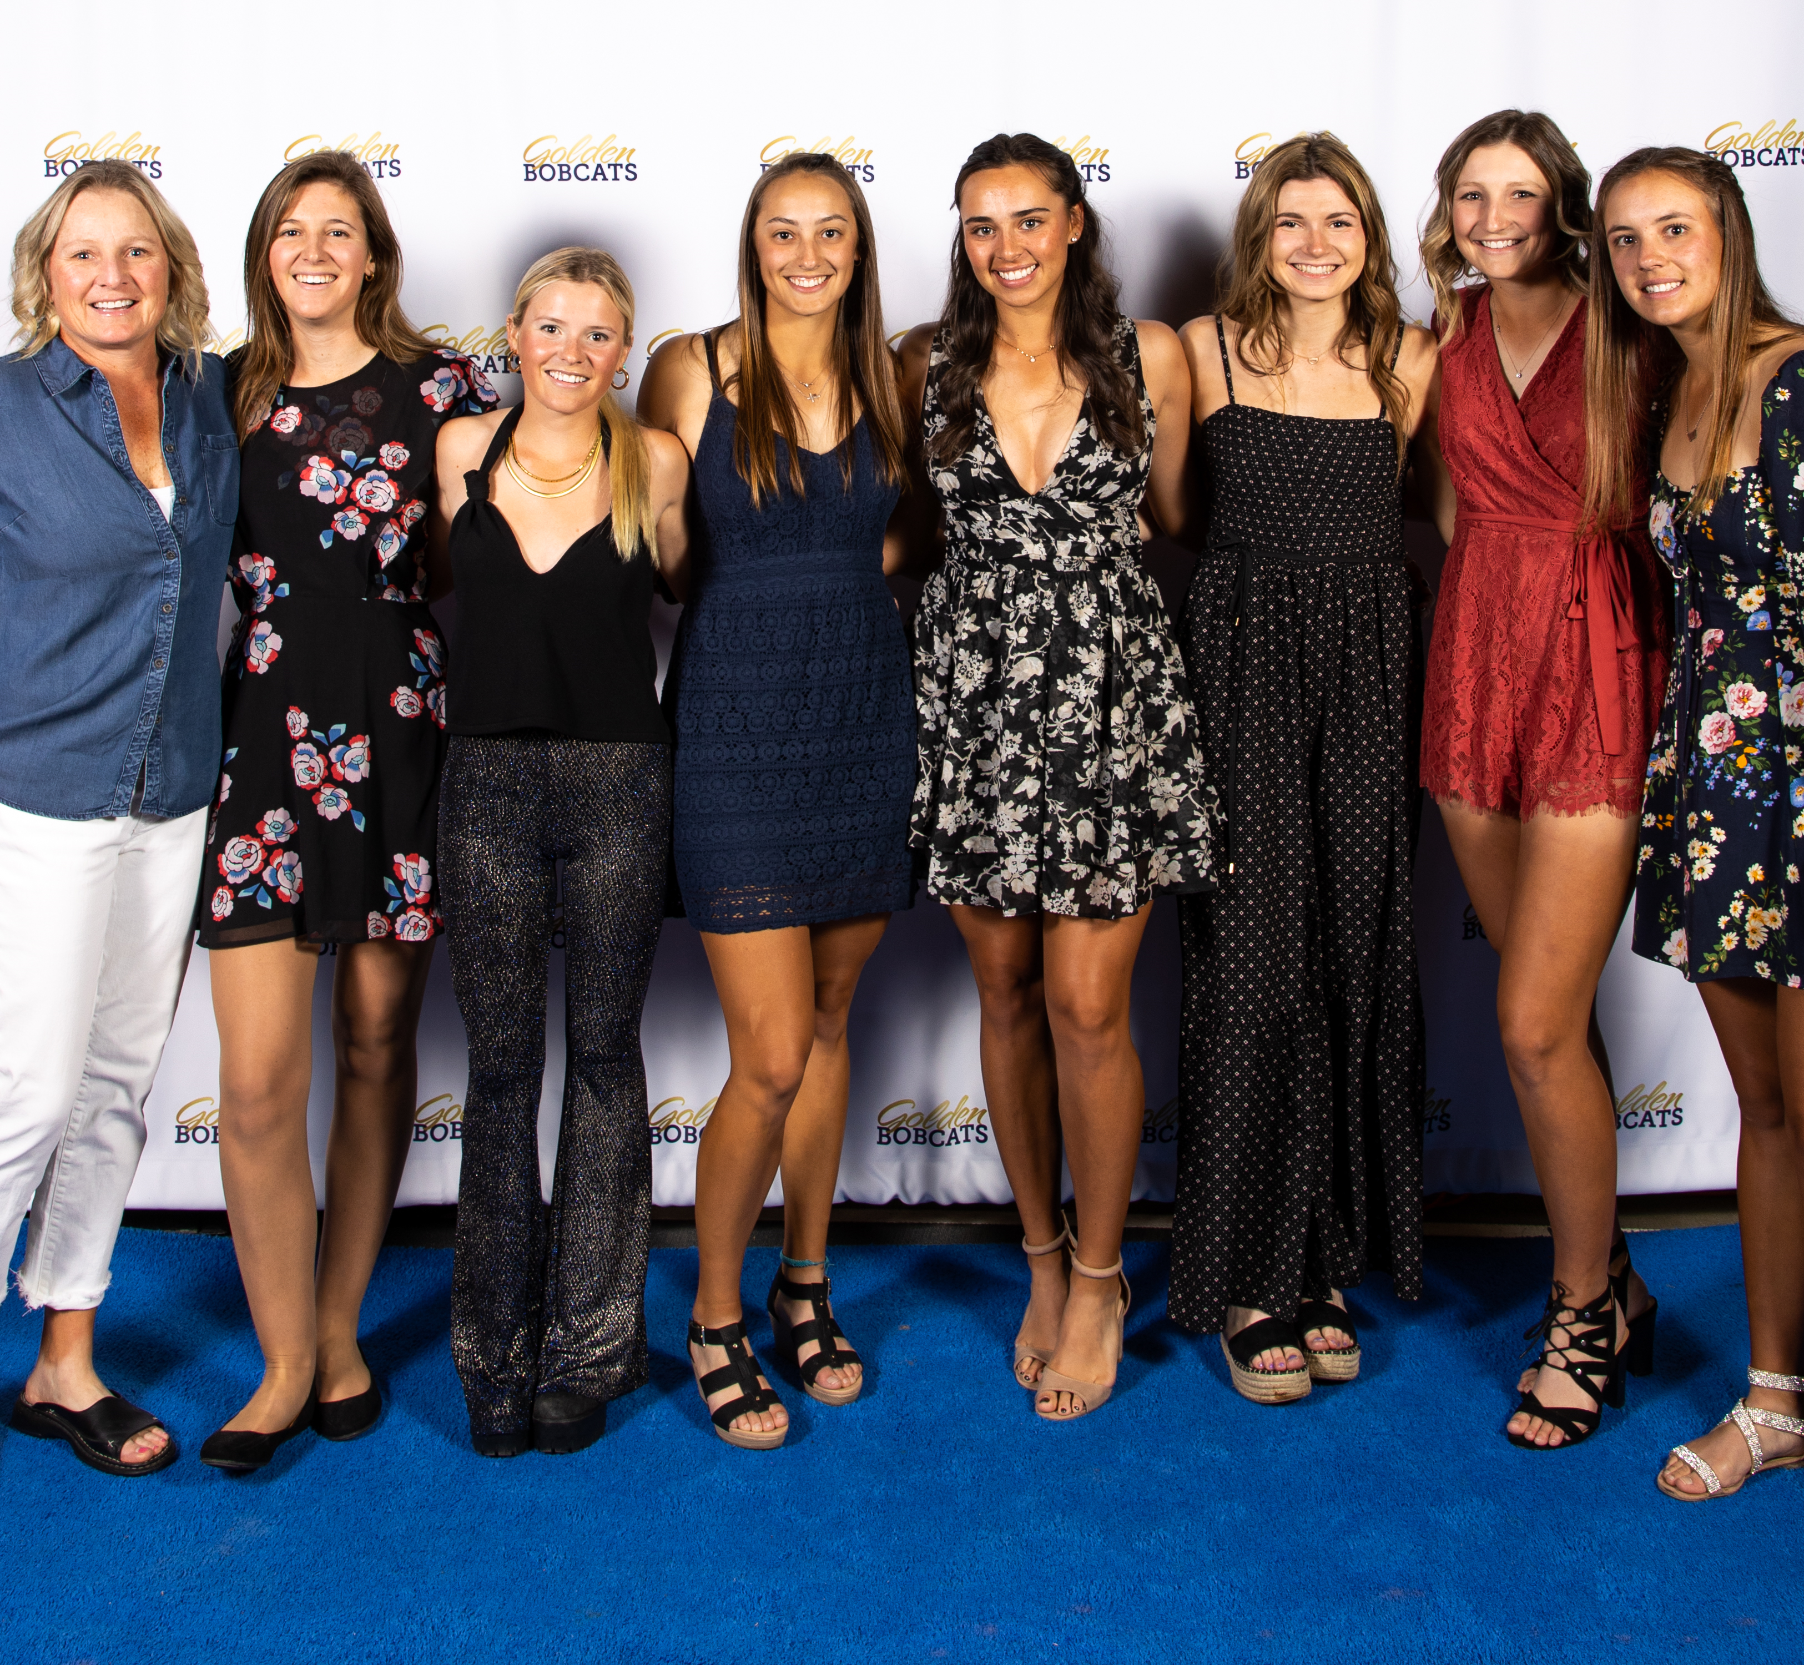
Athletic Accomplishments
Women’s Tennis
Highest Fall Team GPA at 3.767
Men’s Tennis
Golf
Excellent Team GPA of 3.46 in Fall
Clinched Brawl of the Wild Trophy with Win over Griz
Big Sky Conference regular season champions
Doubles team ranked nationally
Kameryn Basye won the individual title at Battle of Old Works as team finished 2nd.

Slide 15
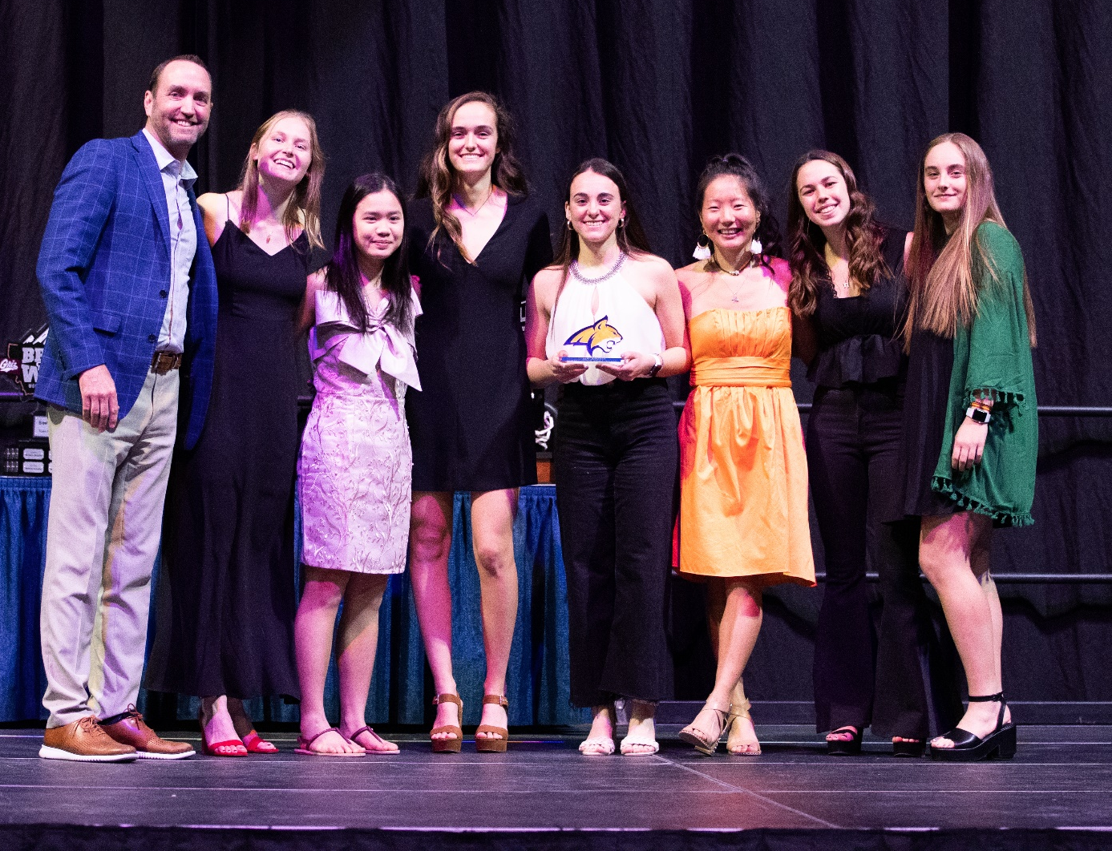
Celebration of Student-Athletes
Return of the Golden Bobcats

Slide 16
Upcoming
Projects
Locker Rooms
Academic Center
Health and Wellness
Fieldhouse Weight and Training Room

Slide 17
Questions

Slide 18
Undergraduate Courses (second reading)
PSCI 336 : European Union (Summer 2022)
HVC 240 : HVAC Systems II (Fall 2022)
MUSI 212IA : Choir II (Fall 2022)
ACTG 421 : Data Analytics for Accountants
  Title changed from
Accounting Information Systems II
  Course title update to better reflect course LOs & content.

Slide 19
Graduate Courses (second reading)
HDCO 540 : Mental Health, Identity Development, and Understanding (Summer 2022)

Slide 20
Old Business

Slide 21
Faculty Responsibilities Policy

Slide 22
Faculty Responsibilities Policy
Be available to students outside of class through regularly scheduled for in-person meetings and individual student appointments. As part of their student-focused duties, faculty are expected to post and observe at least three hours of in-person office hours per week during an academic semester in which they have teaching or instructional-related responsibilities. Office hours should be scheduled at times that are reasonably convenient to students, consistent and predictable, and held in accessible academic spaces on campus such as a faculty office, studio, or laboratory. Faculty will prioritize student meetings over other activities during regularly posted office hours. When teaching online courses, virtual office hours may be used instead of in-person. Faculty will clearly communicate their office hours to students and their department head or director in writing each semester in their classes and that they advise.

Slide 23
Faculty Responsibilities Policy
  Be available to students outside of class through regularly scheduled, in-person office hours and individual student appointments. As part of their student-focused duties, faculty are expected to post and observe at least three hours of in-person office hours per week during an academic semester in which they have teaching or instructional related responsibilities. Office hours should be scheduled at times that are reasonably convenient to students, consistent and predictable, and held in accessible academic spaces on campus such as a faculty office, studio, or laboratory. Faculty will prioritize student meetings over other activities during regularly posted office hours. When teaching online courses, virtual office hours may be used instead of in-person. Faculty will communicate their office hours to students and their department head or director in writing each semester.

Slide 24
Senator’s Open Discussion

Slide 25
Public Comment
Please state your full name
and affiliation.

Slide 26
Executive Session

Slide 27
Faculty Senate Meeting
May 04, 2022
ADJOURNED

