Slide 1
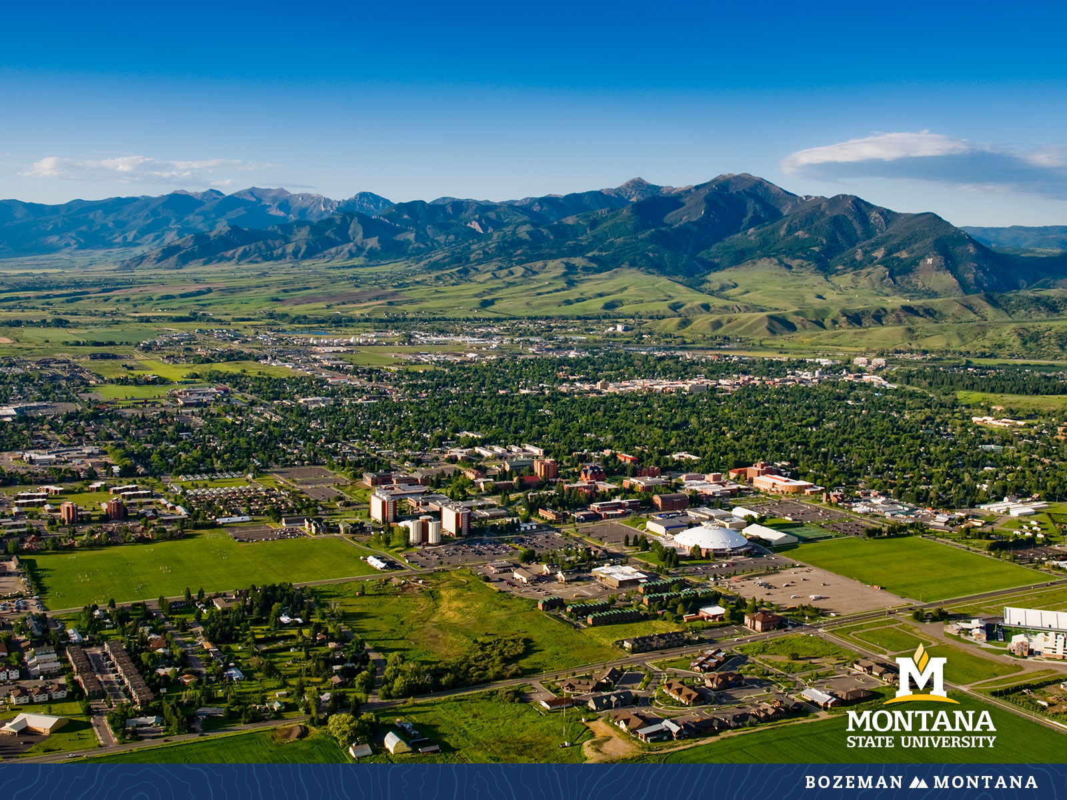
Faculty Senate Meeting Sept 28, 2022

Slide 2
Gentle Reminders
Faculty Senate is an open and public meeting
Please, only Senators speak in the meeting, unless you are specifically called on by the Chair or Chair-elect to speak
Public may address the Senate at end of the meeting during public comment

Slide 3
Agenda
Approval of Minutes
Information Updates
Courses and Programs
Senator’s Open Discussion
  Public Comment
Adjourn

Slide 4
Old Business: Approval FS Minutes 9/14/22
Do I have a motion to approve?
Any Discussion?
All those in favor of the motion or
Those not in favor of the motion indicate by saying…

Slide 5
FYI Items
  Sabbatical applications are due to the Department heads by Oct 3. https://www.montana.edu/provost/faculty/sabbaticals.html
  Allen Yarnell Student Success -Early Alert Program https://www.montana.edu/aycss/success/earlyalert.html

Slide 6

FYI Items
  Hispanic Heritage Month Sept 15-Oct 15.
https://www.montana.edu/diversity/resources/training/hispanic_heritage_month.html
Next event is Panel Discussion on Community and Connection in Gallatin Valley – Oct 12 at noon in SUB Alumni Lounge

Slide 7
George Haynes/Leon Costello- Fall Athletics Update

Slide 8
Undergraduate Courses- First Reading:
    AVMT 175 : Aircraft Electrical Systems

Slide 9
Undergraduate Courses- Second Reading:
    BIOM 365 : Astrobiology
    CHMY 404 : Advanced Inorganic Techniques
    PSCI 483 : The Politics of Authoritarianism
    STAT 337 : Intermediate Statistics with Introduction to Statistical Computing

Slide 10
Undergraduate Program Change- Second Reading:
    HDFC-BS : Bachelor of Science in Human Development & Family Science-Child Development Option

Slide 11
Graduate Programs-First Reading:
    FCSED-CER : Family and Consumer Sciences Education Graduate Certificate

Slide 12
Senate Open Discussion

Slide 13
Public Comment

Slide 14
Next Meeting October 12, 2022

Slide 15
Faculty Senate Meeting Adjourned

