Slide 1
First-Generation Student Resources
Here at Montana State University a variety of committees, programs, and student clubs have come together to provide the following resources for all students. With this, we all have the same goal in mind: to give first-gen students the resources they need to thrive and succeed in higher education.

Slide 2

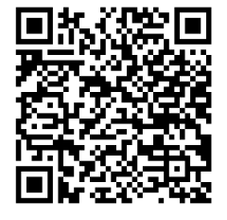
First-Generation Students Association
Our Mission: To provide a welcoming environment through planned and coordinated activities and programs to offer first-generation students positive and high-impact experiences and support.
About us:
Student organization established in Nov 2022.
Student organization of the year in 2023.
Open to graduate students and undergraduate students.
Scan the QR code to learn more about our mission and join our student organization!
Email: firstgens.montanastate@gmail.com
Instagram: msu_firstgenerationstudents

Slide 3
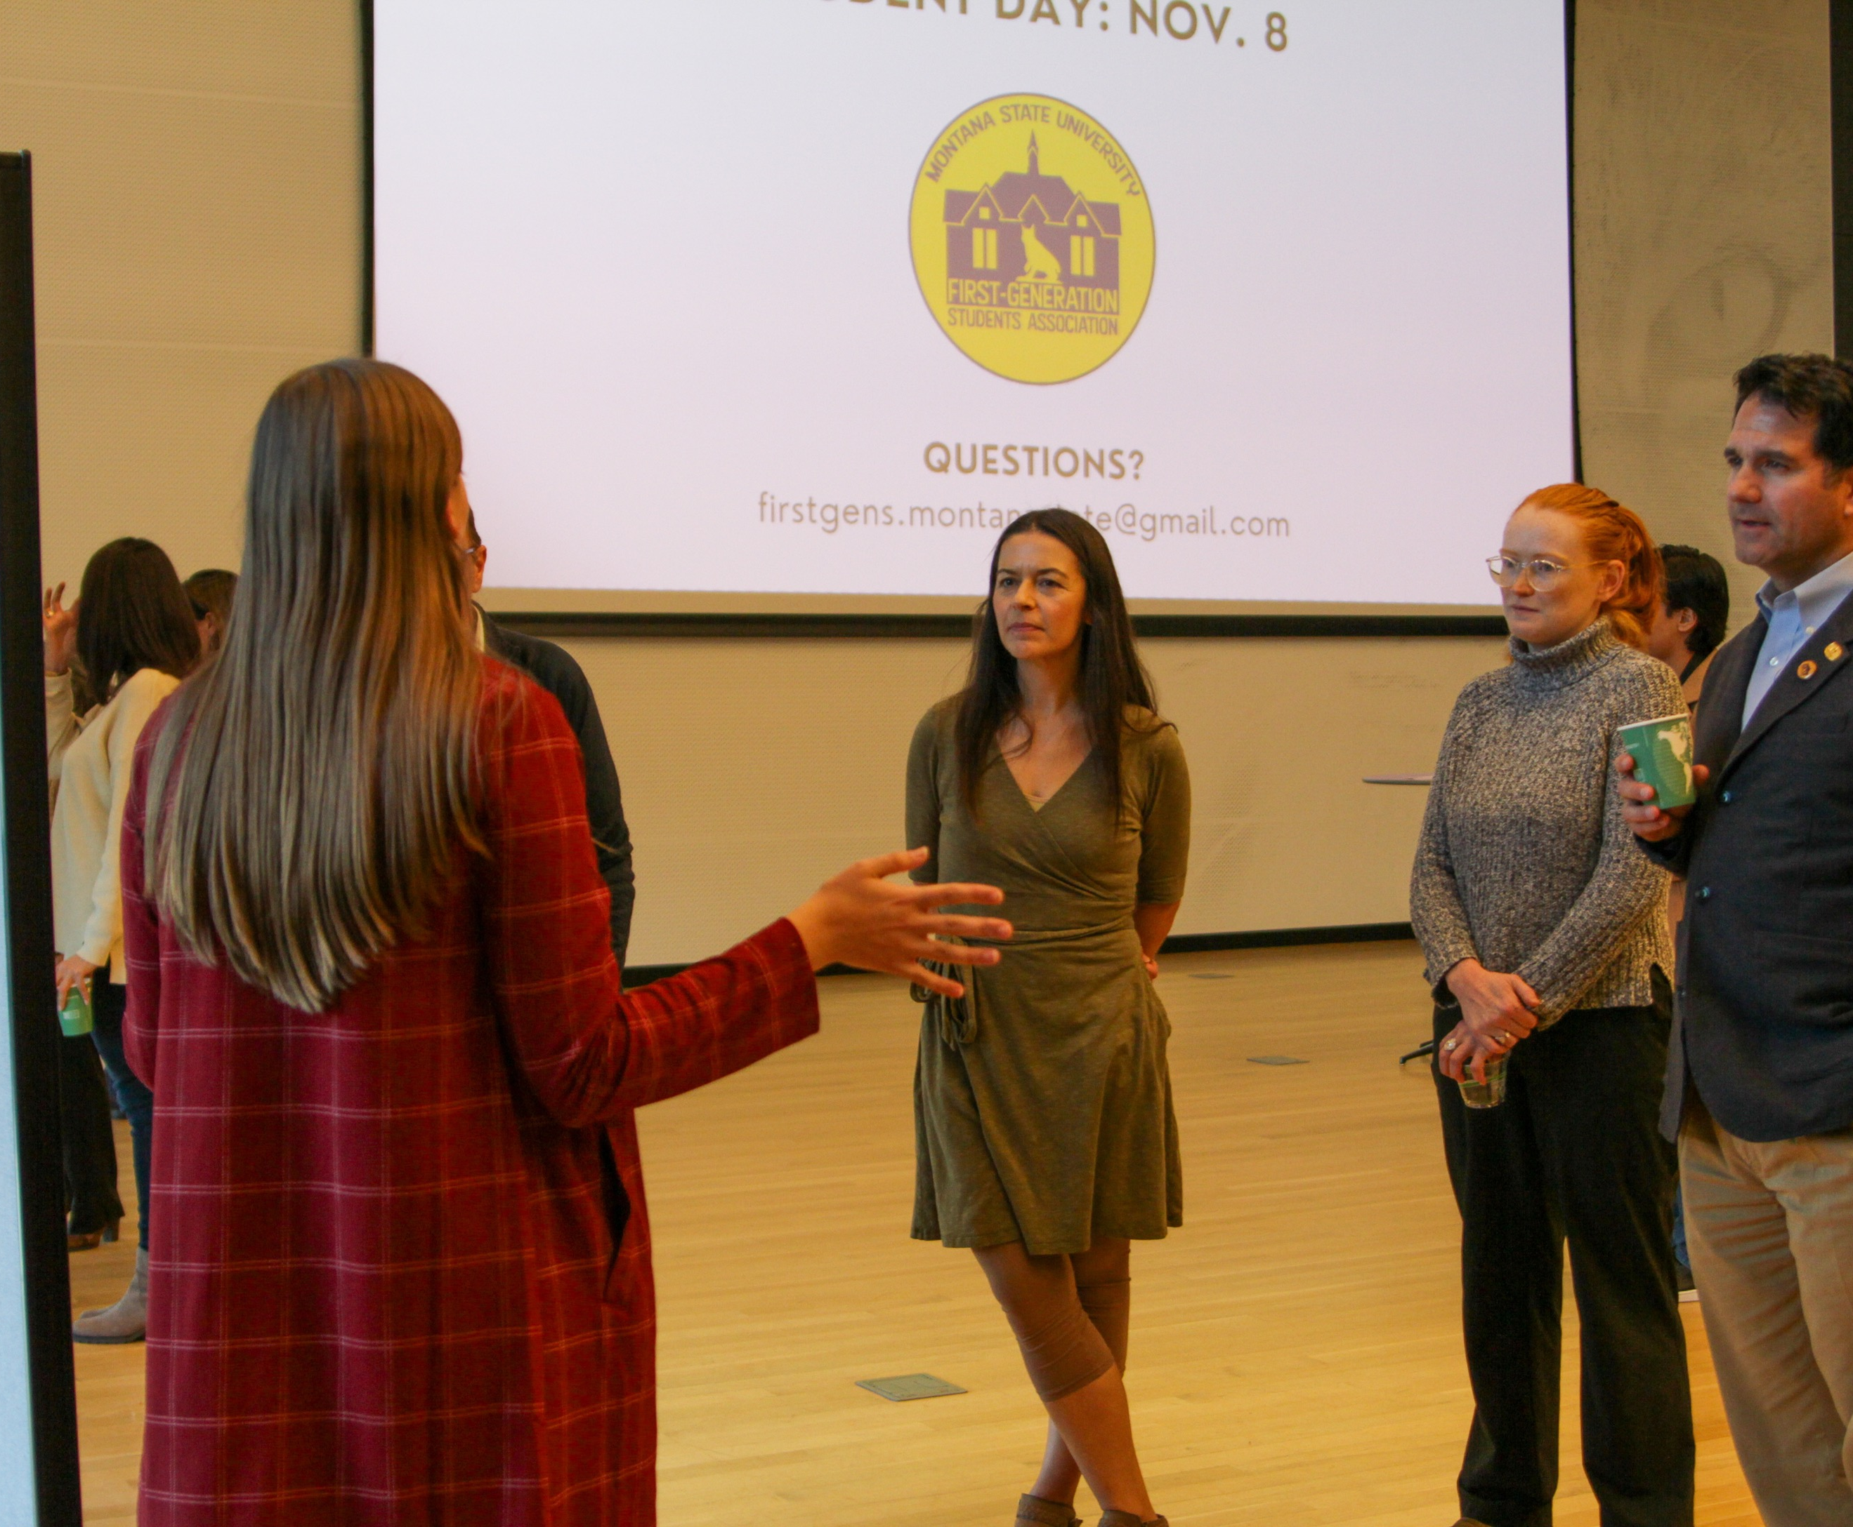
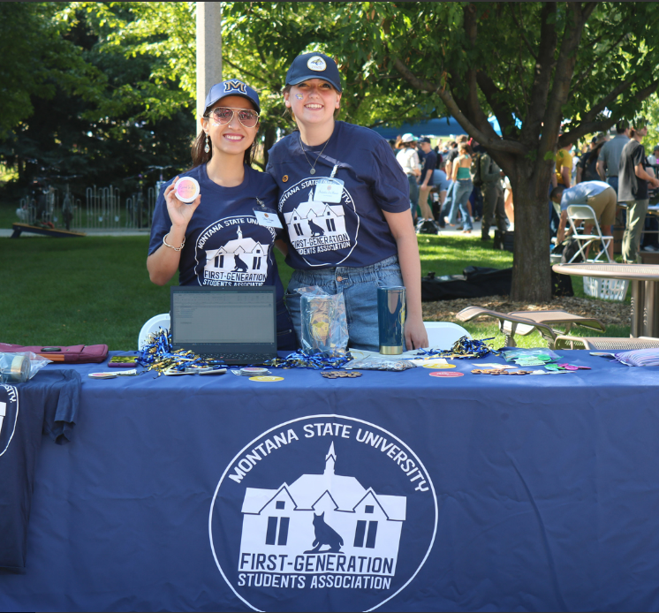
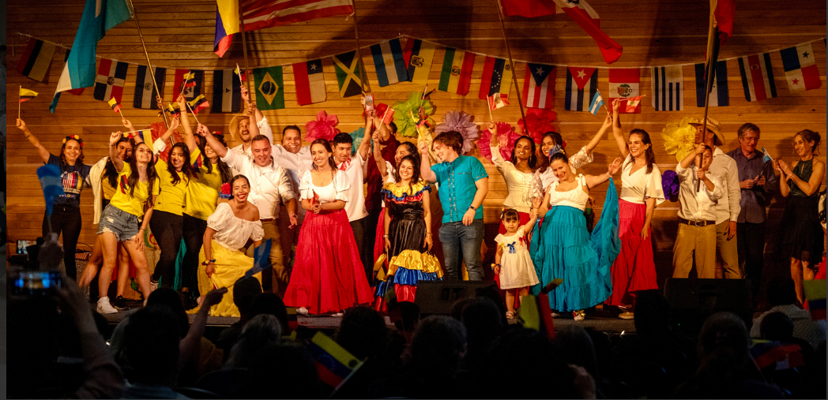
First-Generation Students
Association

Slide 4
First-Generation Committee
Main Goal: Improve retention and graduation rates of First-Generation students through increased awareness, highlighting resources, and increasing institutional support
Brainstorm and collaborate on new strategies to implement for First-Generation student success
Comprised of faculty, staff, and student representatives from across campus
Subcommittees
  National First-Generation College Celebration Planning Committee
  First-Generation Graduation Celebration Planning Committee
  First-Scholars Network Team

Slide 5
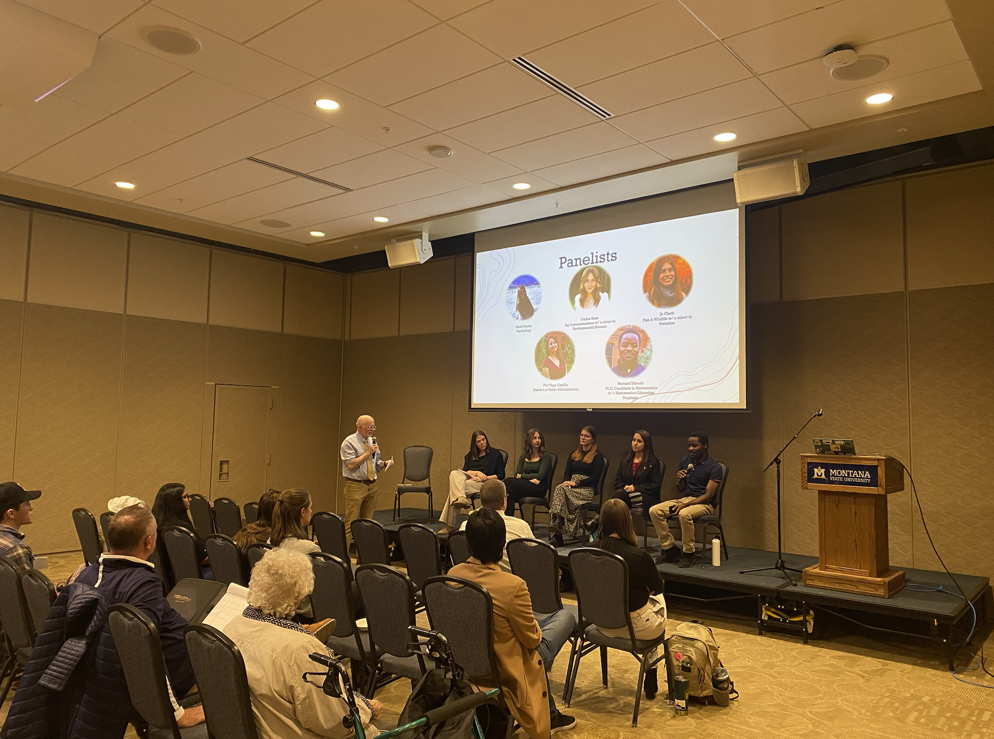
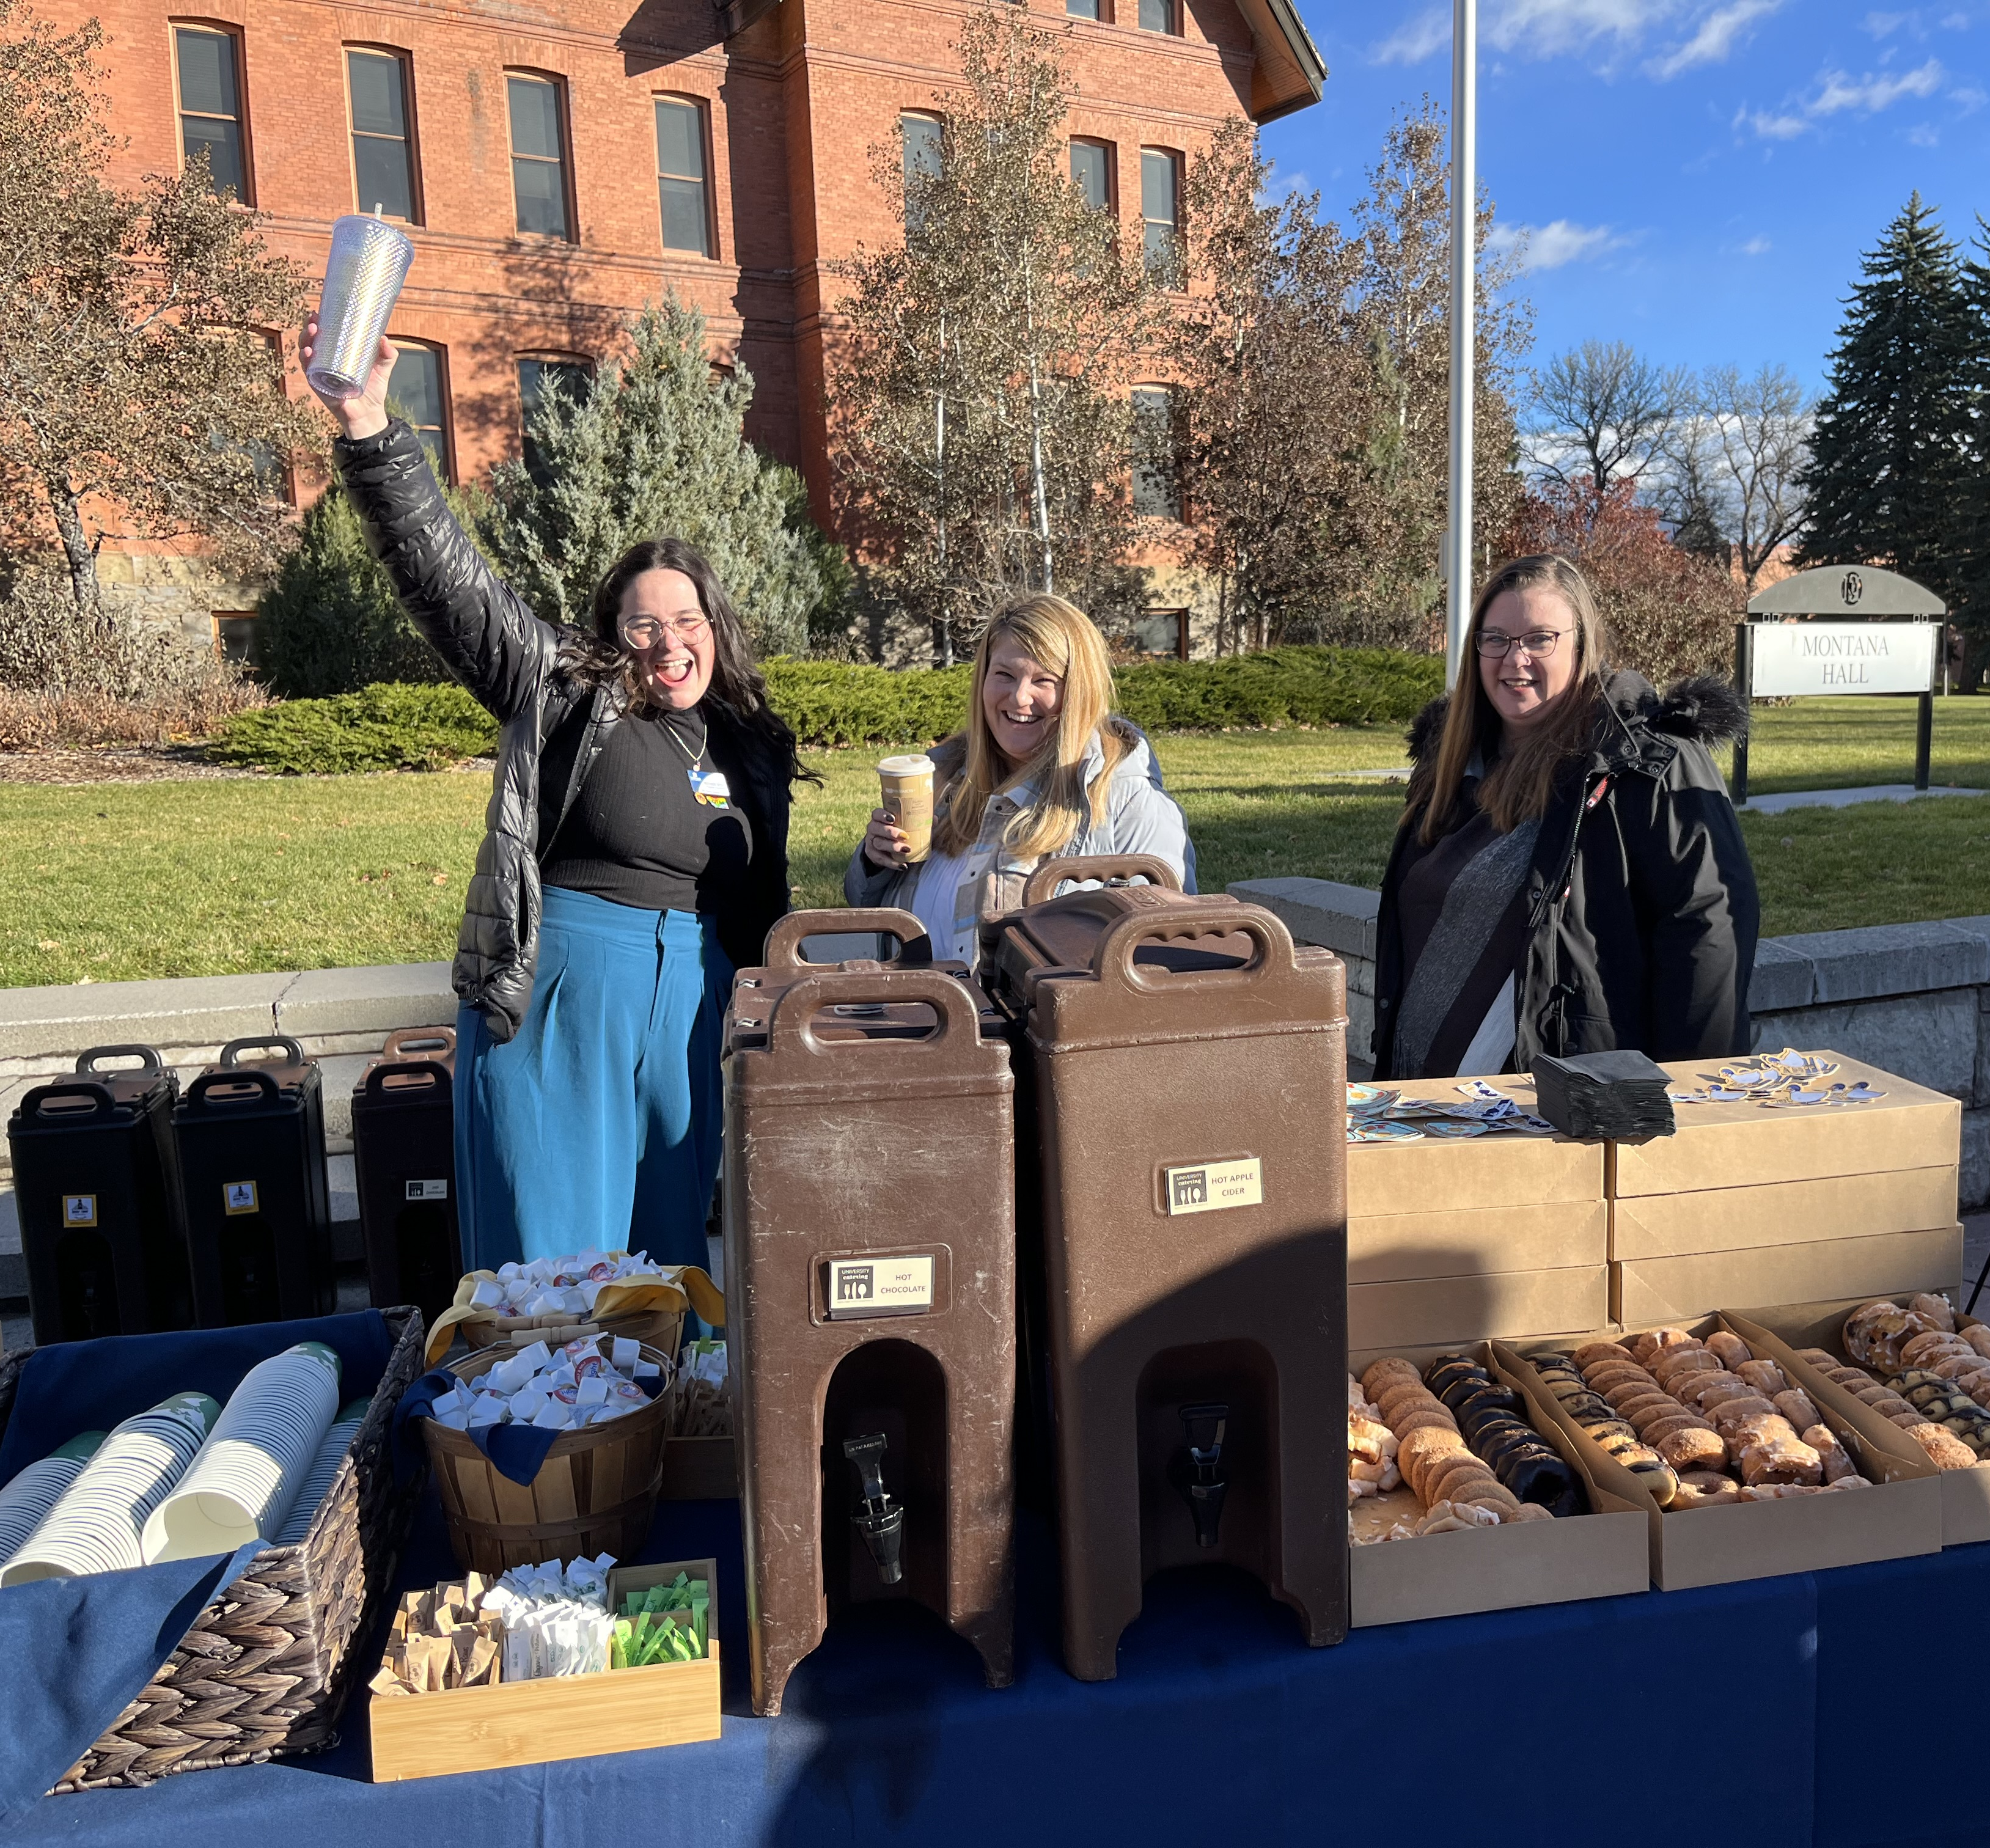
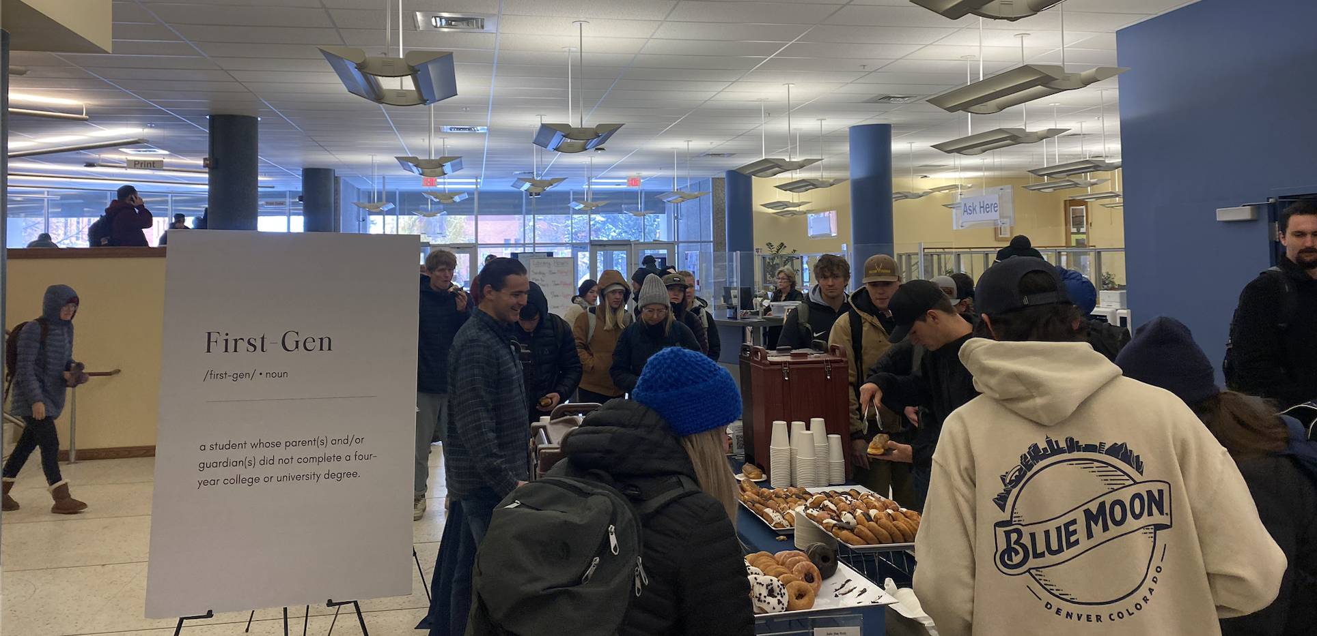
First-Generation Committee

Slide 6
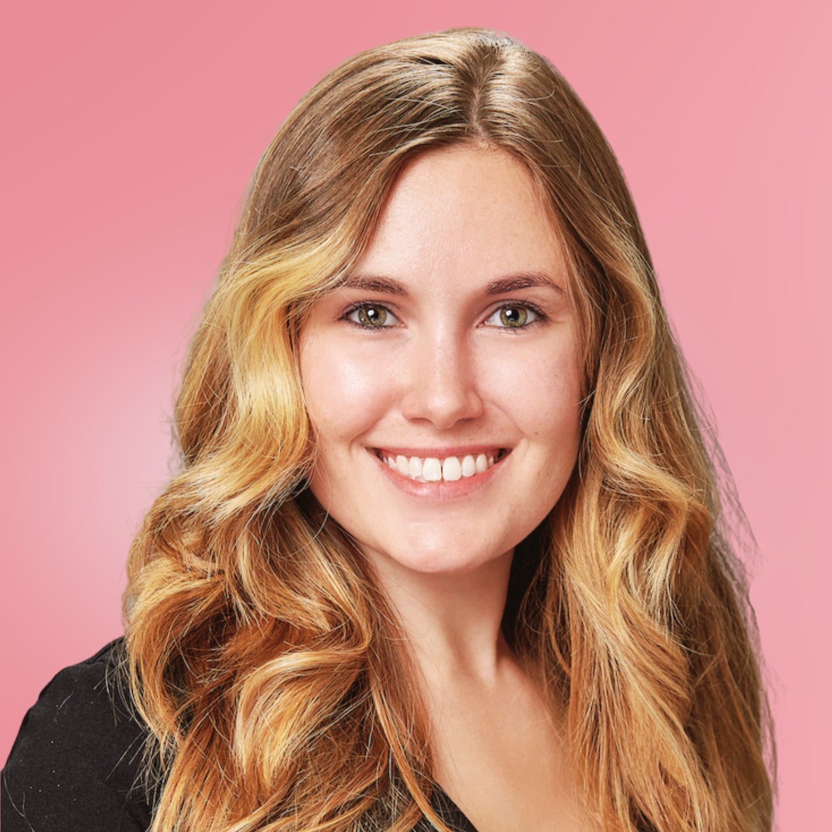
Testimonials from First-Gen Grads
Katrina Lyon
Hometown: Highwood, IL
Program: PhD in Microbiology & Immunobiology
Why are you proud to be a first-gen grad student?
I am proud to be a first-gen graduate student because I am pushing the limits of where my family has had the opportunity to go. My grandparents grew up poor in Italy and didn't finish the 4th grade. In addition, neither of my parents were able to get a college degree. I have no doubt that higher education will open doors for myself and my family.

Slide 7
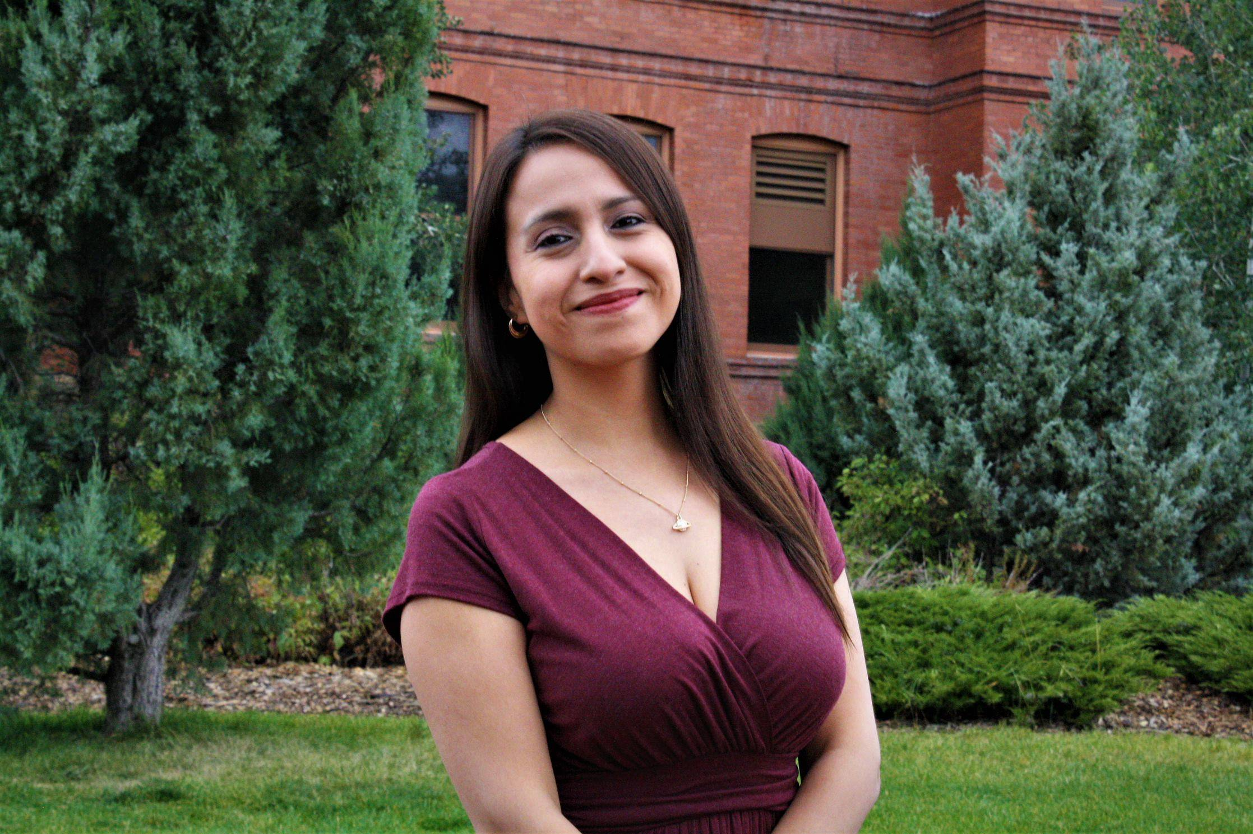
Testimonials from First-Gen Grads
Flor Vega-Castillo
Hometown: Lima, Peru
Program: Master in Public Administration
What advice do you have for first-gen grad students?
Even though you have probably had to face many things "on your own," you'll discover that we are never alone. You always find friends, mentors, faculty, and anyone that will give you a piece of advice when you need it. Accept all your emotions and embrace every situation as difficult as it might look. In the end, you'll feel you've learned and that you can go further. Ask for help, share your opinions, stand up for your values, and know that, like yourself, there are many people who are willing to receive some help, but most importantly, willing to offer valuable help to others.

Slide 8
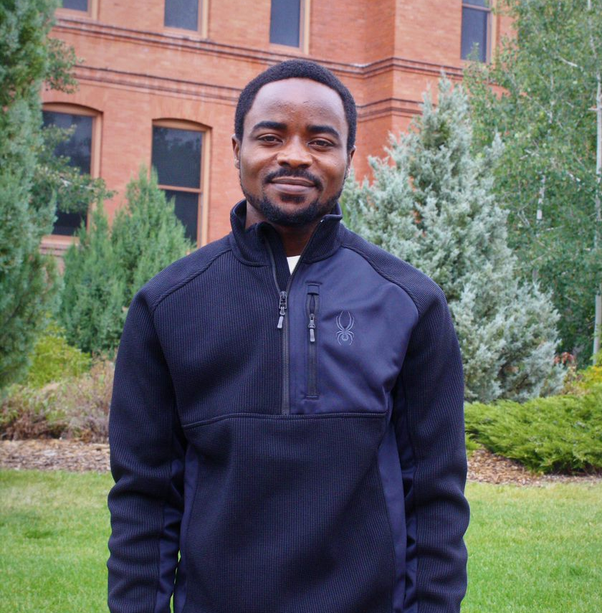
Testimonials from First-Gen Grads
Bernard Yeboah
Hometown: Kumasi, Ghana
Program: PhD in Mathematical Sciences
Why are you proud to be a first-gen grad student?
To be the one to set the pace in your family is not an easy journey, however, not everyone gets such a privilege. This implies the privilege I have as a first-generation student and especially a graduate student, demands that I set a great example for the next generation.

Slide 9
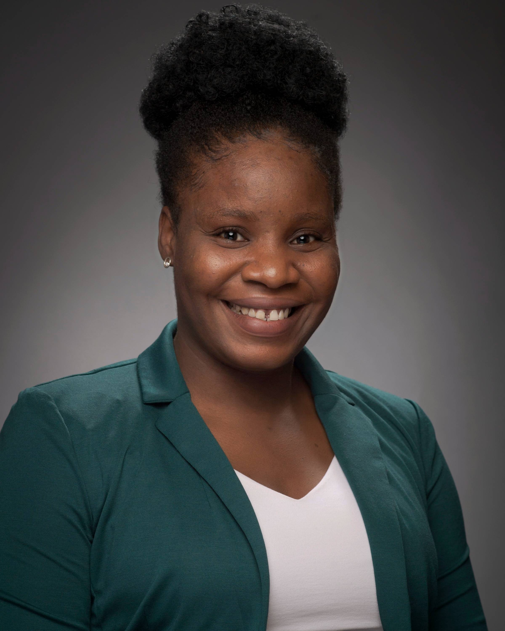
Testimonials from First-Gen Grads
Victoria Adedoyan
Hometown: Kogi State, Nigeria
Program: PhD in Biochemistry
Why are you proud to be a first-gen grad student?
I am proud because I am breaking barriers within my family and paving the way for future generations to pursue higher education and achieve their dreams. Despite facing challenges and navigating unfamiliar terrain, I am charting a path of success and accomplishment. My journey is a testament to my resilience, determination, and the value of education in shaping a brighter future for myself and those who will follow in my footsteps

Slide 10
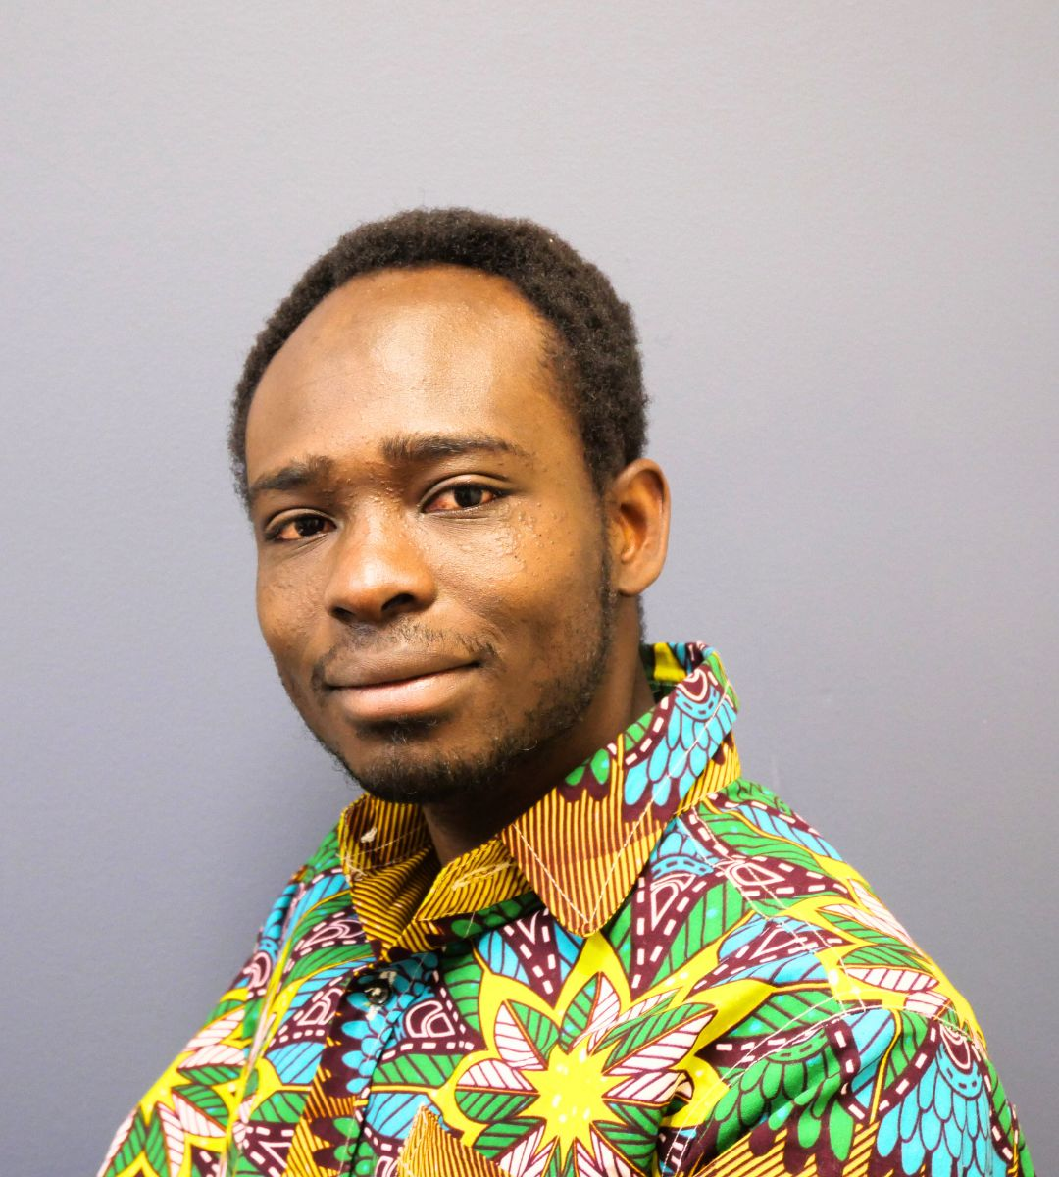
Testimonials from First-Gen Grads
Nana Mensah
Hometown: Takoradi, Ghana
Program: PhD in Mathematical Sciences
What advice do you have for first-gen grad students?
Connect with other first-generation graduate students who understand your experiences and can offer support and encouragement. Additionally, seek out faculty and staff members who are committed to your success and can provide mentorship and guidance as you navigate your academic journey.

