Slide 1

American Indian Probate Reform Act of 2004 (AIPRA)
Polson
June 7, 2012

Slide 2

Marsha A. Goetting
Montana State University
Extension Family Economics
Specialist
Department of Agricultural
Economics & Economics

Slide 3
Thank you ITI Experts
Dan Decker
Rose Tellier

Slide 4
Thank you
Deb DuMontier
  Litigation Coordinator
  U.S. Department of the Interior
  Office of the Special Trustee for American Indians

Slide 5
Special request from planning committee
Don’t be boring
Don’t put people
to sleep zzzzzzzz
Don’t be a dud!!!!

Slide 6

Marsha’s version of
Notes:
6

Slide 7
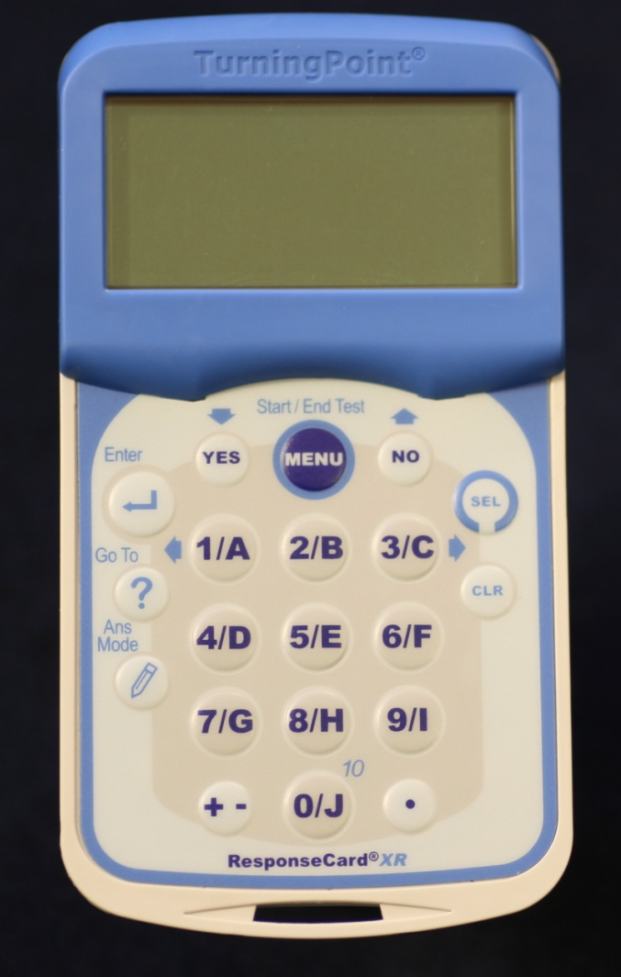
Using response clicker
Is already ON
Don’t press these buttons
  Menu
  Enter
  Go to
  Clear
Notes:
7

Slide 8

Test your clicker press 3/C
1/A
2/B
3/C
4/D
Not Accepting
Answers
Notes:
8

Slide 9
Screen shows your answer
1/A
2/B
3/C
4/D
Your Answer
1/A
Notes:
9

Slide 10

Practice: Why I am attending the meeting
Sounded like information I should know
My spouse made me here
My children suggested I attend
8
Countdown

Slide 11
Must respond before end of time
Enter answer text...
6
Countdown

Slide 12
Practice: At this point in time are you?
Married
Single
Divorced
Separated
Widowed
8
Countdown

Slide 13
What if I entered a wrong answer? Last response counts
Your Answer
4D
1/A
2/B
3/C
4/D
Notes:
13

Slide 14
Practice: Number of years living in Montana
0 – 9
10 – 19
20 – 29
30 – 39
40 – 49
50 & over
8
Countdown

Slide 15
For Yes No questions
Do not use
these keys:
  “Yes” or
  “No”
Notes:
15

Slide 16
For Yes or No questions
Use
  1, if yes
  2, if no
Notes:
16

Slide 17
Have you previously attended a session explaining the American Indian Probate Reform Act (AIPRA)?
Yes
No
8
Countdown

Slide 18
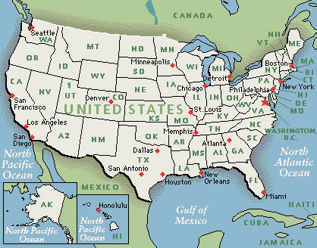
Purpose of AIPRA
To Prevent Further Fractionation of Trust Lands
To Encourage Consolidation of
Indian Land
Ownership

Slide 19

Fractionation:
  Each owner has an undivided interest (ownership) in the entire parcel
  Increasing number of owners with each passing generation

Slide 20
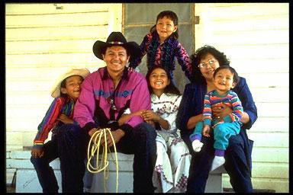
Fractionation
6 generation family

Slide 21
1st generation
Original
Allottee

Slide 22
2nd generation
Original
Allottee
1/3
1/3
1/3

Slide 23
3rd generation
Original
Allottee
1/3
1/3
1/3
1/9
1/9
1/9

Slide 24
4th generation
Original
Allottee
1/3
1/3
1/3
1/9
1/9
1/9
1/36
1/36
1/36
1/36

Slide 25
5th generation
Original
Allottee
1/3
1/3
1/3
1/9
1/9
1/9
1/36
1/36
1/36
1/36
1/144
1/144
1/144
1/144

Slide 26
6th generation
Original
Allottee
1/3
1/3
1/3
1/9
1/9
1/9
1/36
1/36
1/36
1/36
1/144
1/144
1/144
1/144
?
?
?
26

Slide 27
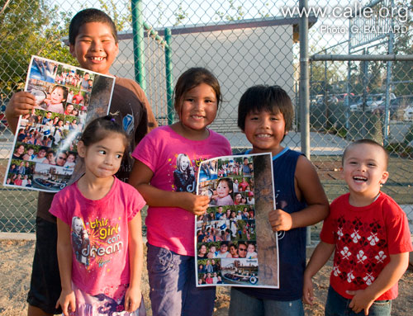
6th generation with 3 children
1 1 1
144 3 432
=
x

Slide 28
6th generation
Original
Allottee
1/3
1/3
1/3
1/9
1/9
1/9
1/36
1/36
1/36
1/36
1/144
1/144
1/144
1/144
1/432
1/432
1/432
28

Slide 29
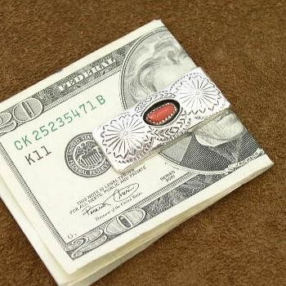
Fractionation by $$$$
Example
  Lease
  Dollar
  Amounts

Slide 30

1st generation
$1,002
Annual
Income

Slide 31
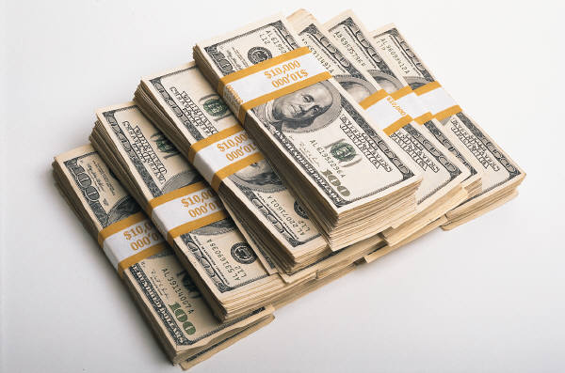
2nd generation
$1,002
Annual Income
$334
$334
$334

Slide 32
3rd generation
$1,002
Annual Income
$334
$334
$334
$111.33
$111.33
$111.33

Slide 33

4th generation
$1,002
Annual Income
$334
$334
$334
$111.33
$111.33
$111.33
$27.83
$27.83
$27.83
$27.83

Slide 34

5th generation
$1,002
Annual Income
$334
$334
$334
$111.33
$111.33
$111.33
$27.83
$27.83
$27.83
$27.83
$6.96
$6.96
$6.96
$6.96

Slide 35

6th generation
$1,002
Annual Income
$334
$334
$334
$111.33
$111.33
$111.33
$27.83
$27.83
$27.83
$27.83
$6.96
$6.96
$6.96
$6.96
$2.32
$2.32
$2.32

Slide 36

AIPRA controls Trust Property
  Trust Lands
  IIM Accounts

Slide 37
AIPRA: Probate Sections
Effective for persons who pass away on or after June 20, 2006

Slide 38
Fact Sheet #3
How is Reservation Land Owned by Individuals?
Trust Status?
Fee Status?

Slide 39
What is the status of your real property on the Flathead reservation?
Trust
Fee simple
Have both
types
Don’t know
8
Countdown

Slide 40
Do you own land off the Flathead reservation?
Yes
No
8
Countdown

Slide 41
Is your land located in Montana?
Yes
No
I don’t own any land off reservation
8
Countdown

Slide 42

Montana
For fee land, vehicles & financial accounts:
  Montana Intestacy Statutes apply if you pass away without a will & are a Montana resident

Slide 43
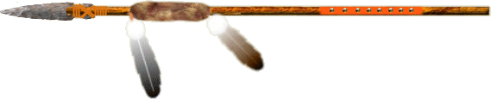
Fee Status
Land passes according to law of state where land is located

Slide 44
Personal property
AIPRA does not affect:
    Checking Accounts
    Saving Accounts
    Vehicles
Law of State where have domicile controls

Slide 45
Do you own undivided interests in trust lands on other reservations?
Yes
No
8
Countdown

Slide 46
AIPRA requirement
Interests on all reservation land must pass to:
  Eligible heirs to retain trust status

Slide 47
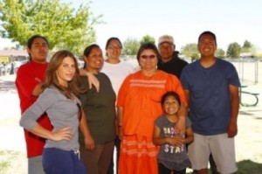
Eligible heirs
(Defined under AIPRA)
Children
Grandchildren
Great
grandchildren
Brothers & sisters
Half brothers & sisters by
blood
Parents

Slide 48
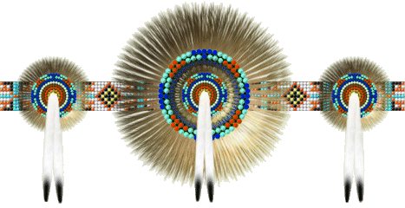
AIPRA distribution among eligible heirs:
Depends on percentage of undivided interest owned by the person who passed away

Slide 49

Do you own:
Undivided Interests
  5% or more?
  Less than 5%?

Slide 50
Fact Sheet #4
Your Individual Trust Interest (ITI) Statement: How to read it

Slide 51
Where do I get my ITI?
OST Individual Indian Monies
  Statement of Account
  Also includes Real Property Assets

Slide 52
Have you received a copy of your ITI statement?
Yes
No
8
Countdown

Slide 53
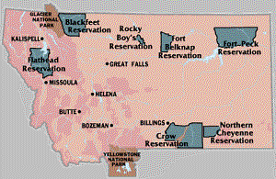
Where do I get my ITI?
Land Title & Records Office
  CSKT Tribal Lands Department

Slide 54
Pablo 406-675-2700
Ext 1240
  George Ducharme
    LTRO Manager
  Carolee Wendeworth
    LTRO Assistant

Slide 55
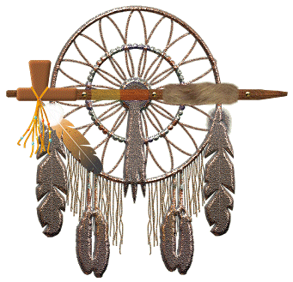
Important fact on ITI Statement:
Amount of undivided ownership owned in each parcel

Slide 56

List of Real Property Assets
Left hand side—Trust Land
  Undivided Ownership
Decimal to 12 places
  0.017361354281

Slide 57
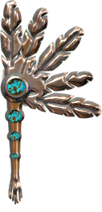
Because AIPRA uses percent
Convert decimal to % by moving 2 places to the right
  .0173611111
  = 1.7%

Slide 58
Ex: ITI Statement
0.017366111123 =1.7% Ft Peck
0.156250000243=15.6% Flathead
0.007812500047= 0.8% Blackfeet
0.114583333345= 11.5% Ft Peck
0.007812500034 = 0.8% Flathead
0.026041666756 = 2.6% Ft Hall

Slide 59
Use ITI to determine % of ownership
5% interest or more?
Less than 5% interest?

Slide 60
ITI Experts will share later
Dan Decker
Rose Tellier

Slide 61
Fact Sheet #7
If your undivided interest in each allotment is:
less than 5%
What Happens If You Pass Away Without Writing a Will?

Slide 62

AIPRA
Single Heir Rule
Undivided interest of less than 5%
  passes to one person in following order…..

Slide 63
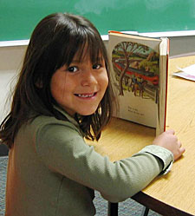
Single Heir Rule
(less than 5% & no will)
First priority:
  Oldest surviving eligible child

Slide 64
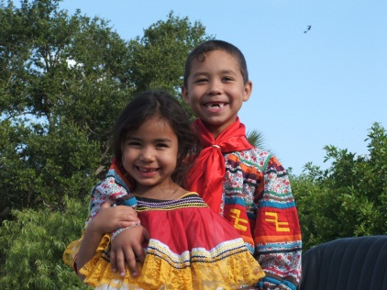
Single Heir Rule
(less than 5% & no will)
If no surviving
eligible child
  Oldest surviving eligible grandchild

Slide 65
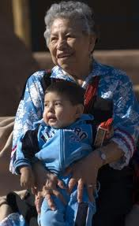
Single Heir Rule
(less than 5% & no will)
If no surviving eligible grandchild
  Oldest surviving eligible great- grandchild

Slide 66
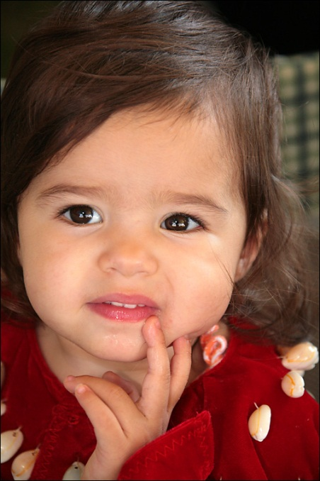
Single Heir Rule
(less than 5% & no will)
If no surviving eligible child, grandchild or great grandchild
  Tribe

Slide 67
Single Heir Rule
(less than 5% & no will)
If tribe does not have jurisdiction
  Equal shares to Co-owners

Slide 68
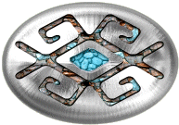
Summary priority
(less than 5% & no will)
Oldest Surviving Eligible
Child
Oldest Surviving
Grandchild
Oldest Surviving great
Grandchild
Tribe with jurisdiction
Co-Owner

Slide 69
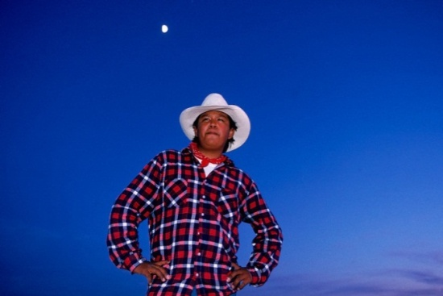
Example: Single person
AIPRA defines Single as
  Never married
  Widowed
  Divorced
(less than 5% & no will)

Slide 70

Example 1: Sara
Single Peron who has no written will
  No living parents
  No Spouse
  No Children
  No Grandchildren
  No Great Grandchildren

Slide 71
ITI Statement
.0173661111 = 1.7% Ft Peck
.0156250000 = 1.6% Flathead
.0078125000 = 0.8% Blackfeet
.0114583333 = 1.1% Ft Peck
.0078125000 = 0.8% Flathead
.0260416667 = 2.6% Ft Hall
(Each is less than 5%)

Slide 72
Who receives her interests in land because Sara has no written will and no heirs?
State of MT
Tribe with jurisdiction
State where land located
Federal government
8
Countdown

Slide 73
Single Heir Rule
(no will)
Undivided interest of less than 5% passes to:
  Tribe with jurisdiction on each reservation

Slide 74
Tribe on each reservation inherits
.0173661111 = 1.7% Ft Peck
.0156250000 = 1.6% Flathead
.0078125000 = 0.8% Blackfeet
.0114583333 = 1.1% Ft Peck
.0078125000 = 0.8% Flathead
.0260416667 = 2.6% Ft Hall
Because each interest is less than 5%

Slide 75

Example 2: Single person, no spouse
Has living Children
(less than 5% & no will)

Slide 76
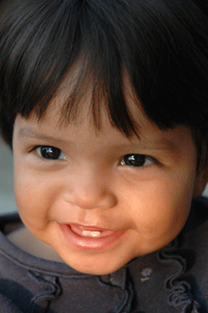
Children defined
(AIPRA)
Biological
Must be an eligible heir

Slide 77
Example 2: Dad passes away with 2 eligible heirs
DAD
Child
Age 19
Child
Age 29
(less than 5% & no will)

Slide 78
Dad’s ITI Statement
.0173661111 = 1.7% Ft Peck
.0156250000 = 1.6% Flathead
.0078125000 = 0.8% Blackfeet
.0114583333 = 1.1% Ft Peck
.0078125000 = 0.8% Flathead
.0260416667 = 2.6% Ft Hall
(Each interest is less than 5%)

Slide 79
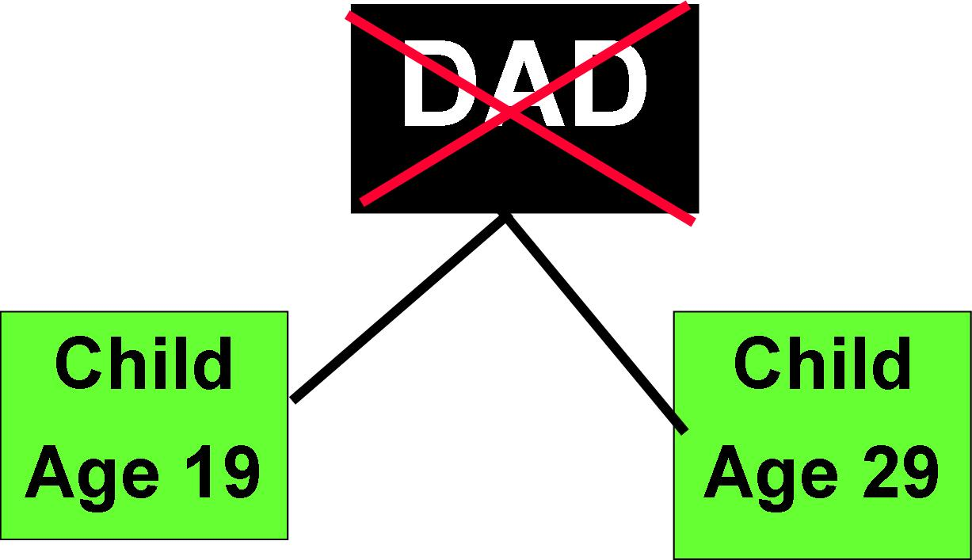
Who received the less than 5% interests when Dad has no written will?
State of MT
Tribe where land located
Oldest child
Youngest child
Federal government
8
Countdown

Slide 80
Single Heir Rule
All interests pass to oldest surviving eligible child
(Because each interest is less than 5% & no will)

Slide 81
Child age 29 receives
Child
Age 19
DAD
Child
Age 29
(less than 5% & no will)

Slide 82

Passes to oldest child – age 29
.017366111 = 1.7% Ft Peck
.015625000 = 1.6% Flathead
.007812500 = 0.8% Blackfeet
.011458333 = 1.1% Ft Peck
.007812500 = 0.8% Flathead
.026041666 = 2.6% Ft Hall
(Receives interests on each reservation with less than 5%)

Slide 83
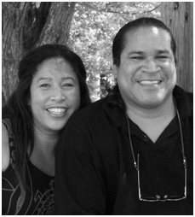
Married--AIPRA
AIPRA definition includes as married
  Separated
  Legal separation
  Common law not recognized under AIPRA

Slide 84
Example 3: Married
(interests of less than 5% & no will)
Husband passes away
  Survivor (wife)
      Who is not living on any of the parcels
  No children

Slide 85
Husband’s ITI Statement
.0173661111 = 1.7% Ft Peck
.0156250000 = 1.6% Flathead
.0078125000 = 0.8% Blackfeet
.0114583333 = 1.1% Ft Peck
.0078125000 = 0.8% Flathead
.0260416667 = 2.6% Ft Hall
(Each interest is less than 5%)

Slide 86
Who receives the husband’s interest no written will?
Federal government
Tribe
Spouse
Deceased person’s Parents
State where land located
8
Countdown

Slide 87
Single Heir Rule
(less than 5% & no will)
There is no surviving eligible:
  child, or
  grandchild, or
  great-grandchild

Slide 88
Example 3: Survivor is wife not living on parcel
  All interests pass to Tribe where land located

Slide 89
Passes to Tribe where interest is located
.0173661111 = 1.7% Ft Peck
.0156250000 = 1.6% Flathead
.0078125000 = 0.8% Blackfeet
.0114583333 = 1.1% Ft Peck
.0078125000 = 0.8% Flathead
.0260416667 = 2.6% Ft Hall
(Each interest is less than 5%)

Slide 90
Example 3: Wife not living on parcel
Spouse receives none of the interests.
    Why????
      Husband owned
      less than 5% interests

Slide 91
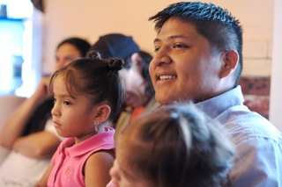
Example 4:
Survivors:
  Husband
    Not living on the parcel
  3 Children
(interests less than 5% & no will)

Slide 92
Example 4: Survivors: Husband & 3 Children
(interests of less than 5% & no will)
Wife
Husband
Child
Age 18
Child
Age 22
Child
Age 24

Slide 93
ITI Statement
.0173661111 = 1.7% Ft Peck
.0156250000 = 1.6% Flathead
.0078125000 = 0.8% Blackfeet
.0114583333 = 1.1% Ft Peck
.0078125000 = 0.8% Flathead
.0260416667 = 2.6% Ft Hall
(Each interest is less than 5%)

Slide 94
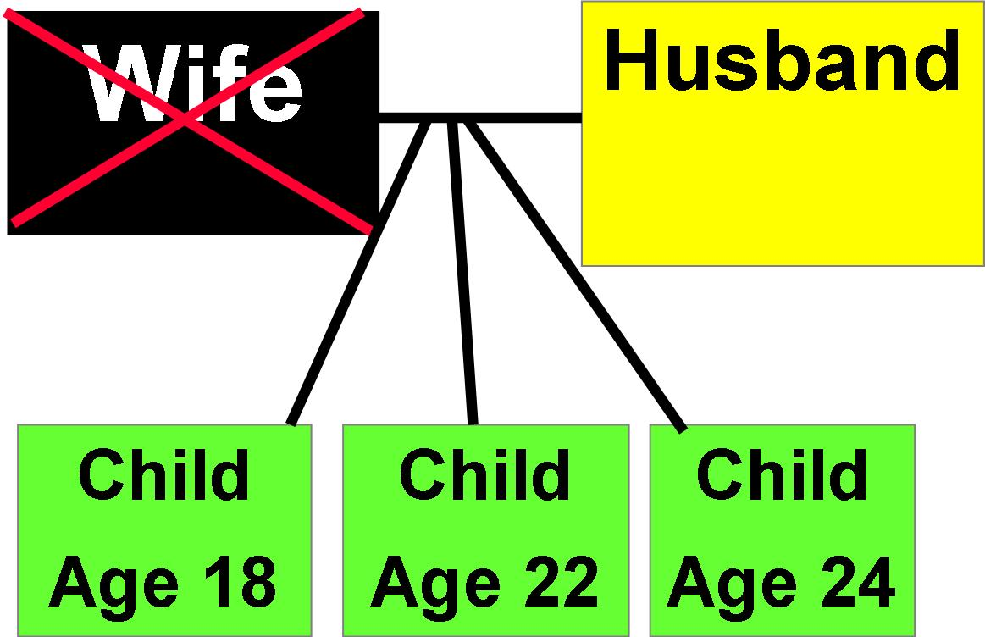
Who receives the interest if wife doesn’t have a written will?
State of MT
Tribe
Oldest Surviving Child
Oldest Grandchild
8
Countdown

Slide 95
Single Heir Rule
(no will)
Interests of less than 5%
  pass to oldest surviving eligible child

Slide 96
Husband & younger children do not inherit (less than 5% & no will)
Wife
Husband
0
Child
Age 18
0
Child
Age 22
0
Child
Age 24
All

Slide 97
24 year old receives all
.0173661111 = 1.7% Ft Peck
.0156250000 = 1.6% Flathead
.0078125000 = 0.8% Blackfeet
.0114583333 = 1.1% Ft Peck
.0078125000 = 0.8% Flathead
.0260416667 = 2.6% Ft Hall
(Because each interest is less than 5%)

Slide 98
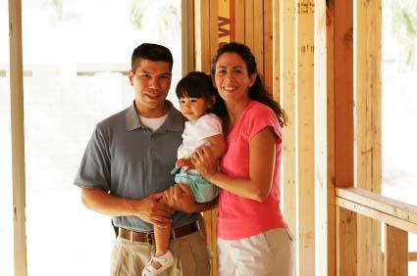
Example 5:
Survivors
  Wife
    living on one of the parcels
  3 children
(Interests of less than 5% & no will)

Slide 99
Spouse lives on parcel
.017366111 = 1.7% Flathead
.015625000 = 1.6% Ft Belknap
.007812500 = 0.8% Blackfeet
.011458333 = 1.1% Ft Peck
.007812500 = 0.8% Standing
.026041666 = 2.6% Ft Peck
(Interests of less than 5% & no will)

Slide 100
Husband dies
Wife
Lives on
Flathead
parcel
Husband
Child
Age 18
Child
Age 22
Child
Age 24

Slide 101
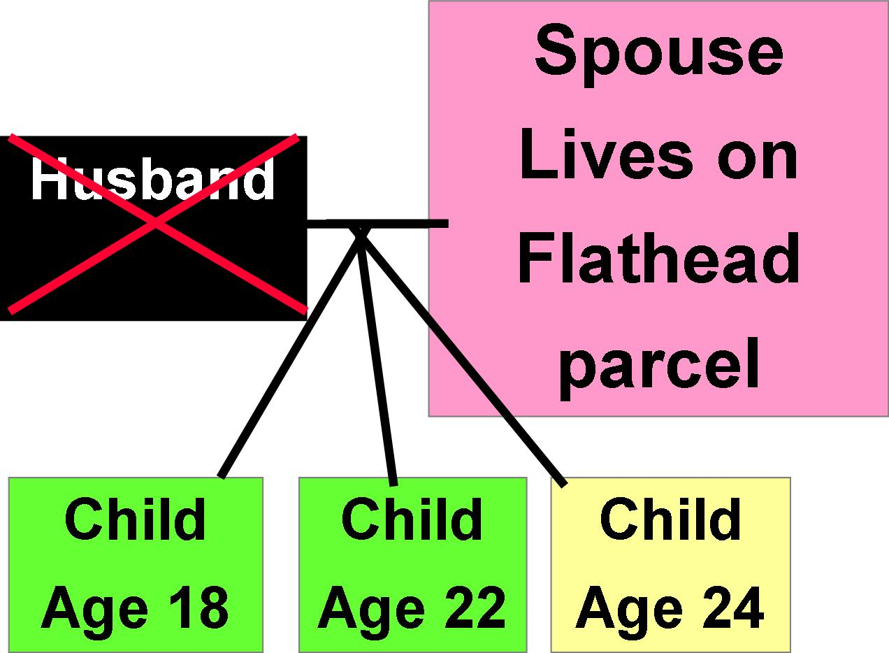
Who receives the interest no will? (less than 5%)
State of MT
Tribe
Wife
Oldest Child
All children inherit
8
Countdown

Slide 102

Exception: Single Heir Rule
If spouse living on parcel:
  He/she receives life estate on that parcel, including the family home
(Interests of less than 5% & no will)

Slide 103
Trust Land
(Interests less than 5%& no will)
Husband
Wife
Life Estate
Child
Age 18
0
Child
Age 22
0
Child
Age 24
parcels
with less
than 5%

Slide 104
Life Estate
(Interest of less than 5% & no will)
Allows life tenant to have possession of property during his/her lifetime
  But not ownership of property

Slide 105
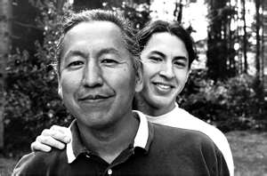
Single Heir Rule: No will
After death of Mom, oldest child (remainderman) receives:
  Remainder interest
    home
    land

Slide 106
Upon Mother’s passing oldest child receives:
Remainder interest
  1.7% parcel Flathead
    Includes family home
(less than 5% & no will)

Slide 107
Spouse passes away
(Interests of less than 5% & no will)
Wife
Husband
Child
0
Child
0
Oldest child
Receives
Flathead
interest

Slide 108
More information:
Fact Sheet #7
  Your undivided interest of less than 5%:
  What Happens if you pass away without a written will ?

Slide 109

Fact Sheet #6
Your Undivided
Interest:
5% or more
What happens if you pass away without a written will?

Slide 110
To find out how much interest you own:
Check your Individual Trust Interest Statement

Slide 111
ITI Statement…Which one is 5% or more?
0.0173661111
0.1056250000
0.0078125000
0.0114583333
0.0478125000
0.0260416667
8
Countdown

Slide 112
ITI Statement which is 5% or more??
0.0173661111 on Ft Peck
0.1056250000 on Flathead = 10.5%
0.0078125000 on Blackfeet
0.0114583333 on Ft Peck
0.0478125000 on Flathead
0.0260416667 on Ft Hall

Slide 113
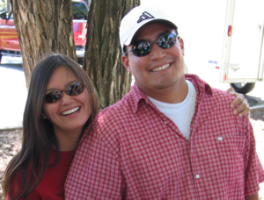
Family Situations
  Single
  Married
(Interests of 5% & more, no will)

Slide 114
Example 1:
Single Person
No Children
Parents are living
(Interests of 5% or more, no will)

Slide 115
5% or more on ITI
.0173661111 = 1.7% Ft Peck
.1056250000 = 10.0% Flathead
.5078125000 = 50.0% Blackfeet
.0114583333 = 1.1% Ft Peck
.0878125000 = 8.0% Flathead
.0260416667 = 2.6% Ft Hall

Slide 116
Both parents alive
Mother
Father
Single
Person
Passed Away
(Interests of 5% or more, no will)

Slide 117
Parents inherit equally
Mother
1/2
Father
1/2
Single
Person
Passed Away
(Interests of 5% or more, no will)

Slide 118
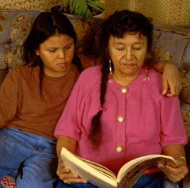
Example 2:
Single Person
No children
Mother is only
living parent
(Interests of 5% or more, no will)

Slide 119
Mother receives all
Mother
ALL
Father
Deceased
Single
Person
Passed Away
(Interests of 5% or more, no will)

Slide 120
Example :
Single Person
No children
Parents are alive
3 living sisters
(Interests of 5% or more, no will)

Slide 121
Survivors: 3 sisters & parents
Father
Mother
Single
person passed
away after
Father & Mother
Sis
Sis
Sis
(Interests of 5% or more, no will)

Slide 122
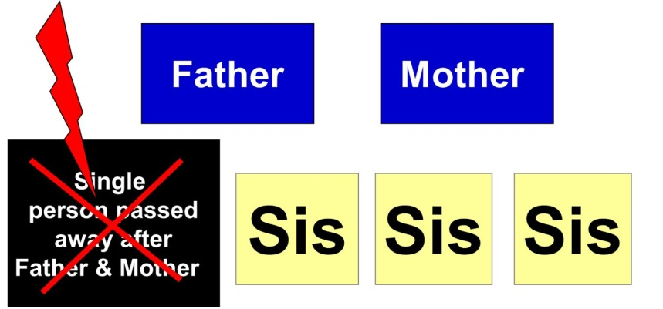
Who receives the interests if they are 5% or more when a single person dies without a will?
Mother & Dad equally
Sisters equally
1/5 to each (mother, dad, three sisters)
Tribe with jurisdiction
8
Countdown

Slide 123
Priority are parents
Father
1/2
Mother
1/2
Single
person passed
away after
Father & Mother
Sis
0
Sis
0
Sis
0
(Interests of 5% or more, no will)

Slide 124
Example 3:
Single Person
(Interests of 5% or more, no will)
No children
Parents are deceased
3 living sisters

Slide 125
Survivors: 3 sisters
Father
Mother
Single
person passed
away after
Father & Mother
Sis
Sis
Sis
(Interests of 5% or more, no will)

Slide 126
Single Person
(Interests of 5% or more, no will)
If parents are deceased, undivided interest passes equally to:
Brothers & Sisters

Slide 127
Equal Amounts to Sisters
Father
Mother
Single
person passed
away after
Father & Mother
1/3
1/3
1/3
(Interests of 5% or more, no will)

Slide 128
Example 4:
Single Person
No children
Parents are deceased
2 sisters are deceased
2 brothers are living
(Interests of 5% or more, no will)

Slide 129
2 Brothers survive
Sisters passed
away before brother
(Interests of 5% or more, no will)

Slide 130
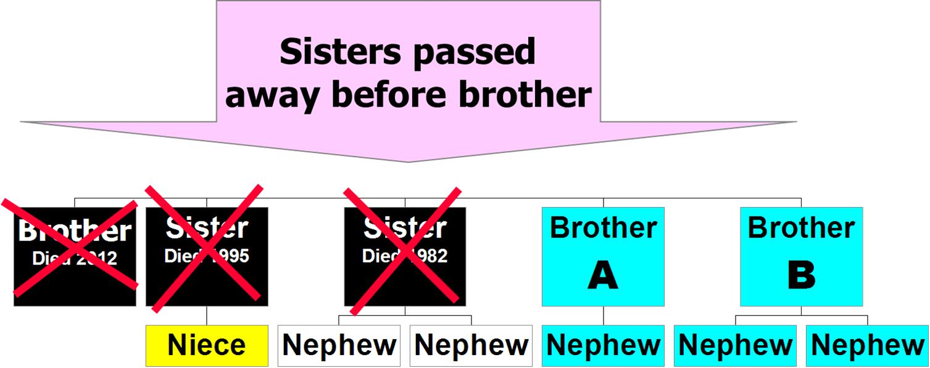
Who receives the interests of 5% or more no will?
Brothers equally 1/2
Niece & nephews equally 1/6 each
Brothers, niece & nephews equally 1/8 each
Tribe with jurisdiction

Slide 131
Equally to Living Brothers
(Interests of 5% or more & no will)

Slide 132
Example 5:
Single Person
(Interests of 5% or more, no will)
No children
Parents are deceased
2 sisters & 1 brother are deceased
1 brother is living

Slide 133
Example 5:
Single Person
(Interests of 5% or more & no will)

Slide 134
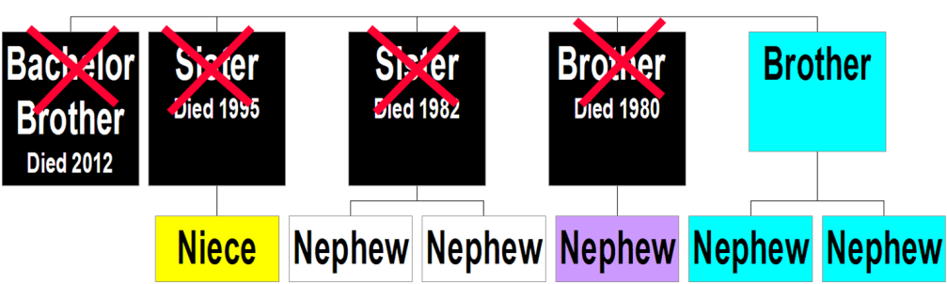
Who receives 5% or more interests no will?
Living brother receives all
Niece & nephews equally 1/6 each
Living brother, niece & nephew equally 1/7 each
Tribe with jurisdiction

Slide 135
Living brother receives all
(Interests of 5% or more & no will)

Slide 136
Example 6:
Single Person
(Interests of 5% or more, no will)
No children
Parents are deceased
All sisters & brothers deceased
Survived by niece & nephews

Slide 137
Nieces & Nephews
Do NOT Inherit
(Interests of 5% or more no will)

Slide 138
Distribution
Land passes to
  Tribe where interest in parcel is located
(Interests of 5% or more, no will)

Slide 139
Example 7:
Single
  With Children
(Interests of 5% & more, no will)

Slide 140
Survivors : 3 children
Single
Parent
Passed
Away
Child
Child
Child
(Interests of 5% & more, no will)

Slide 141
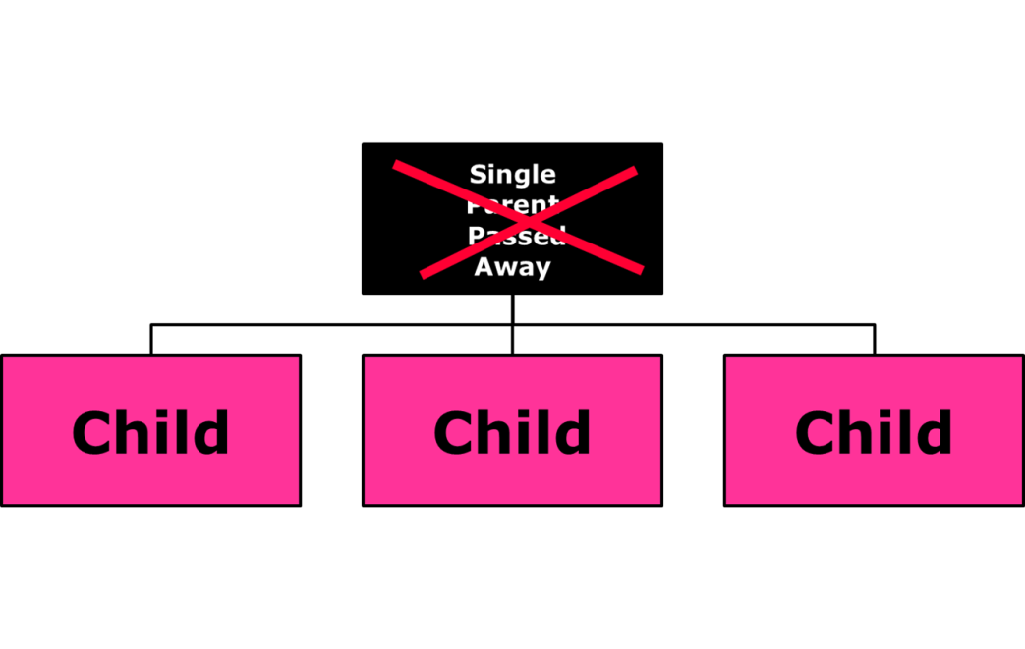
Who receives interest of 5% or more with no will?
Children equally 1/3 each
Tribe
State of MT
Federal Government
8
Countdown

Slide 142
Children Share Equally
(Interests of 5% & more, no will)
Single
Parent
Passed
Away
Child
1/3
Child
1/3
Child
1/3

Slide 143
Example 8:
(Interests of 5% & more, no will)
Single person:
  3 living children
  6 living grandchildren

Slide 144
Survivors Children & Grandchildren
(Interests of 5% & more, no will)
Parent
Child
Grand
child
Child
Grand
child
Grand
child
Child
Grand
child
Grand
child
Grand
child
Grandchildren

Slide 145
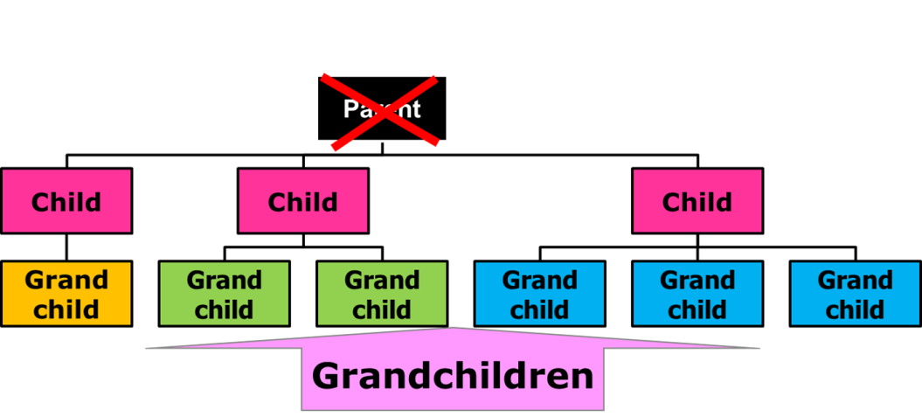
Who receives interests of 5% or more no written will?
Children equally 1/3 each
Grandchildren equally 1/6 each
Children and grandchildren 1/9 each
Tribe
8
Countdown

Slide 146
Children Share Equally
(Interests of 5% & more, no will)
Parent
1/3
0
1/3
0
0
1/3
0
0
0
Grandchildren

Slide 147
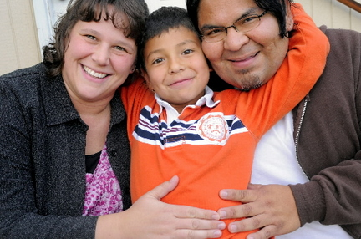

Example 9:
(Interests of 5% or more, no will)
What if survivors are ?
  1 deceased child who is survived by a child
  2 living children who have children

Slide 148
Child
passed
away
before
parent
What does grandchild
receive, if any?
(Interests of 5% & more, no will)
Parent
Son
Grand
child
Son
Grand
child
Grand
child
Daughter
Grand
child
Grand
child
Grand
child
Grandchildren

Slide 149
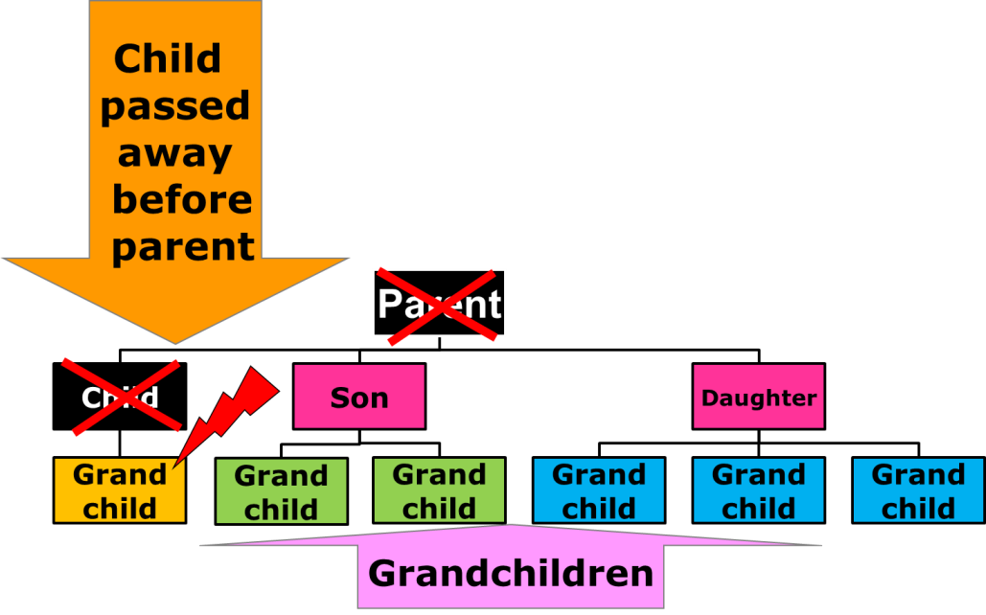
What share does grandchild receive, if any, if parent owned 5% or more and had no will?
None
1/3
1/8
1/6
8
Countdown

Slide 150
Legal Term
(Interests of 5% & more, no will)
  Right of Representation
Grandchildren have a right to inherit what their parent would have received if he/she had lived

Slide 151
Grandchild inherits by right of representation
Child
passed
away
before
parent
(Interests of 5% & more, no will)
Parent
Son
1/3
1/3
0
0
1/3
0
0
0
Grandchildren

Slide 152
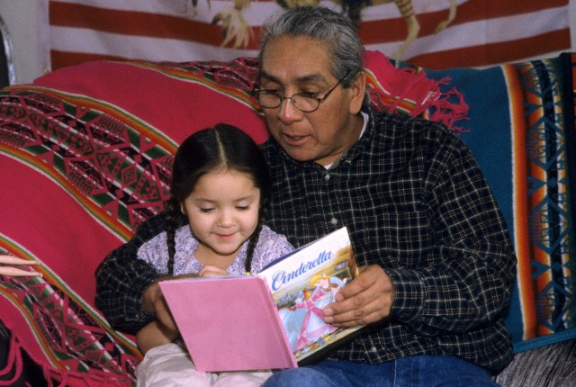
Example 10:
What if survivors are?
  a deceased son who is survived by 1 child
  a deceased daughter who is survived by 2 children
(Interests of 5% or more, no will)

Slide 153
Survivors: 1 Child & 6 Grandchildren
Two
Children
passed
away
before
parent
(Interests of 5% & more, no will)
Parent
Son
Grand
child
Son
Grand
child
Grand
child
Daughter
Grand
child
Grand
child
Grand
child
Grandchildren

Slide 154
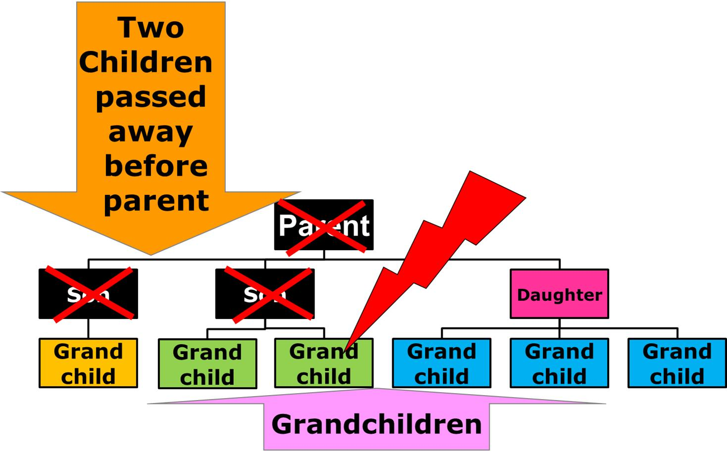
What will grandchild with red lighting bolt receive, if anything, if grandparent owned 5% more?
Nothing
1/3
1/6
1/7
8
Countdown

Slide 155

Right of Representation
Grandchildren receive the share their parent would have received if he/she had lived.
(Interests of 5% & more, no will)

Slide 156
Survivors: 1 Child & 6 Grandchildren
Two
Children
passed
away
before
parent
(Interests of 5% & more, no will)
Parent
Son
1/3
Son
1/6
1/6
1/3
0
0
0
Grandchildren

Slide 157
Example 11:
What if survivors are?
  a deceased son who is survived by 1 child
  a deceased daughter who is survived by 3 children
  a living child with two kids
(Interests of 5% or more, no will)

Slide 158
Survivors: Child & Grandchildren
Child
passed
away
before
parent
(Interests of 5% & more,
no will)
Child
passed
away
before
parent
Parent
Son
Grand child
Son
Grand child
Grand child
Daughter
Grand child
Grand child
Grand child
Grandchildren

Slide 159
Right of Representation
Grandchildren receive the share their parent would have received if he/she had lived.
(Interests of 5% & more, no will)

Slide 160
Survivors: Child & Grandchildren
Child
passed
away
before
parent
(Interests of 5% & more,
no will)
Child
passed
away
before
parent
Parent
Son
1/3
1/3
0
0
Daughter
1/9
1/9
1/9
Grandchildren
Right of Representation

Slide 161
Example 12:
What if?
  All children passed away before their parents & grandchildren are living?
(Interests of 5% or more, no will)

Slide 162
Survivors: Grandchildren
All
Children
passed
away
before
parent
Parent
Son
Grand child A
Son
Grand child B
Grand child C
Daughter
Grand child D
Grand child E
Grand child F
Grandchildren
(Interests of 5% & more, no will)

Slide 163
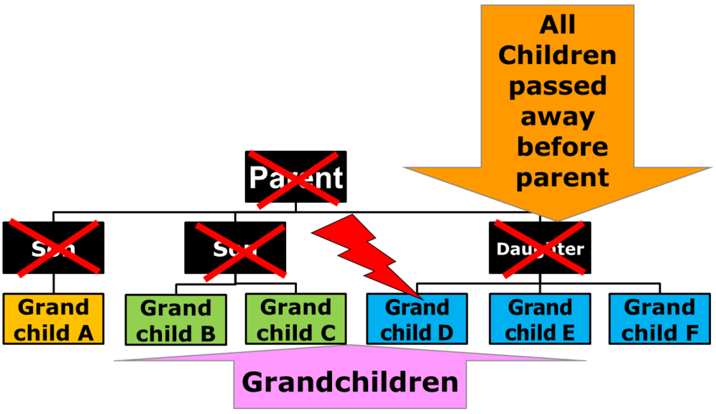
What share, if any, will grandchild D receive if grandchildren are only survivors & Grandparent owned 5% or more?
1/9
1/3
1/6
None, passes to Tribe
None, passes to Federal government
8
Countdown

Slide 164
Survivors: Grandchildren
All
Children
passed
away
before
parent
Parent
Son
1/3
Son
1/6
1/6
Daughter
1/9
1/9
1/9
Grandchildren
(Interests of 5% & more, no will)

Slide 165
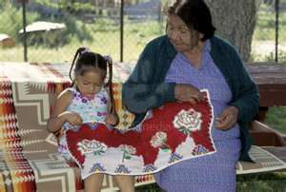
Example 13:
What if?
  survivors are children, grandchildren & great grandchildren?
(Interests of 5% or more, no will)

Slide 166
Child
passed
away
before
parent
Child
passed
away
before
parent
John
Daughter
Grandchild
0
1/2
0
0
Son
1/6
1/6
1/6
John’s
Grandchildren
John’s
Great-
grandchild

Slide 167
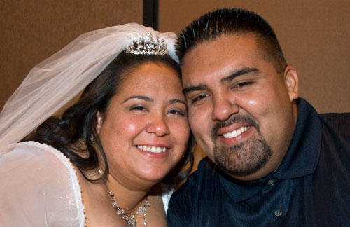
Family situation
Married person

Slide 168
Example 1: Married
No children
Parents are alive
(Interests of 5% or more, no will)

Slide 169
ITI Statement ownership
.0173661111 = 1.7% Ft Peck
.1056250000 = 10.0% Ft Belknap
.5078125000 = 50.0% Blackfeet
.0114583333 = 1.1% Ft Peck
.0878125000 = 8.0% Standing R
.0260416667 = 2.6% Ft Hall
(Interests of 5% or more, no will)

Slide 170
Husband dies; Wife Has Priority
(Interests of 5% & more, no will)
Father
Mother
Wife
receives
life estate
Husband

Slide 171
Wife dies; Husband has priority
(Interests of 5% & more, no will)
Father
Mother
Husband
receives
life estate
Wife

Slide 172
Example 2: Married
Husband passes away
  Wife living
  3 living children
(Interests of 5% or more, no will)

Slide 173
Survivors
Wife
Husband
Their
Child
Their
Child
Their
Child
(Interests of 5% or more, no will)

Slide 174
ITI Statement ownership
.0173661111 = 1.7% Ft Peck
.1056250000 = 10.0% Ft Belknap
.5078125000 = 50.0% Blackfeet
.0114583333 = 1.1% Ft Peck
.0878125000 = 8.0% Standing R
.0260416667 = 2.6% Ft Hall
(Interests of 5% or more, no will)

Slide 175
Wife – Life Estate
Wife
Life Estate
Husband
Their
Child
Their
Child
Their
Child
(Interests of 5% or more, no will)

Slide 176
Married – no will
5% or more interest
Trust property passes to surviving spouse as a life estate without regard to waste.

Slide 177
Legal Term
Without regard to waste:
  Life tenant can do anything to land while the he/she is alive

Slide 178
Life estate for surviving spouse
Any income from trust lands during his/her lifetime

Slide 179
Life estate income
Spouse receives
  Lease
  Royalties
  Mineral income
  Rent

Slide 180
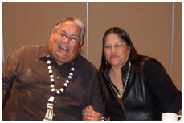
Passing of spouse
Property held in life estate for wife (mother) passes to the remaindermen
  Children

Slide 181
Trust property
Wife
Life Estate
Husband
Remainder Interest
Their
Child
Their
Child
Their
Child
(Interests of 5% or more, no will)

Slide 182
Remainder Interests
(Interests of 5% & more, no will)
Parent
1/3
0
1/3
0
0
1/3
0
0
0
Grandchildren

Slide 183
Legal term
Grandchildren inherit remainder interests by
  Right of Representation
(Interests of 5% & more, no will)

Slide 184
Remainder interests
Child
passed
away
before
parent
(Interests of 5% & more, no will)
Parent
Son
1/3
1/3
0
0
1/3
0
0
0
Grandchildren

Slide 185
Remainder Interests
Two
Children
passed
away
before
parent
Parent
Son
1/3
Son
1/6
1/6
1/3
0
0
0
Grandchildren
(Interests of 5% & more, no will)

Slide 186
Remainder Interests
Two
Children
passed
away
before
parent
Parent
Son
1/3
Son
0
0
Daughter
1/9
1/9
1/9
(Interests of 5% & more, no will)
Grandchildren

Slide 187
Summary
Retaining & receiving trust land depends on:
  Eligible heirs
  % interest owned
  Family situation
  Whether a will is written

Slide 188
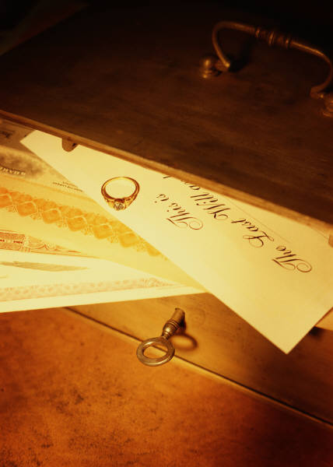
Writing a will
Fact Sheet #9

Slide 189
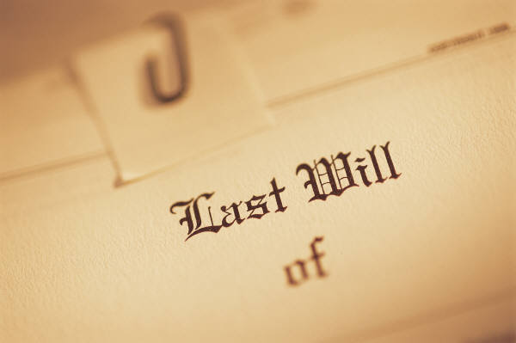
Written will
Provides you with the ability to control where your undivided interests in trust lands & IIM money goes

Slide 190

At what age can I write a will?
Age 18 & older

Slide 191

Does a will have to be written?
YES!!!
  Includes
    Typed
    Computer software

Slide 192

Does my will have to be witnessed?
Federal law--YES
Two disinterested witnesses

Slide 193

HOLOGRAPHIC WILL—AIPRA rules
Signature & provisions in handwriting of the will maker
2 disinterested witnesses

Slide 194

Confederated Salish and Kootenai Tribes
Limited will drafting services
    Also stores wills

Slide 195
AIPRA
Special Rule
  If undivided interests are left to more than one person in a written will

Slide 196
AIPRA presumption
Heirs Inherit
  Joint tenancy with right of survivorship

Slide 197
Joint Tenancy
On passing of one
  survivors take all

Slide 198
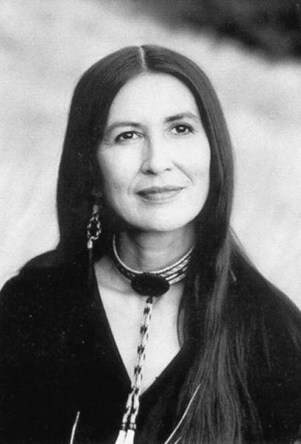
Example:
Mary wills her interests in land to her 3 children equally but doesn’t mention title

Slide 199
AIPRA assumes joint tenancy among children
Parent
Passed
Away
JT
JT
JT

Slide 200
Later one child passes away
Parent
Passed
Away
JT
JT
JT

Slide 201
Second child passes away, property owned by surviving child
Parent
Passed
Away
JT
JT
Solely
Owned

Slide 202
If Mary had left interests as Tenancy in Common among children….
Parent
Passed
Away
TC
1/3
TC
1/3
TC
1/3

Slide 203
Later one child passes away
Parent
Passed
Away
TC
1/3
1/3
1/6
1/6

Slide 204
Second child passes away
Parent
Passed
Away
TC
TC
1/3
1/9
1/9
1/9
1/3

Slide 205

Where to keep your will?
Safe Place
  CSKT offers
  will storage

Slide 206

Changing will
Can be changed during lifetime as long as you are competent

Slide 207
Review Will
Marriage
Remarriage
Divorce
Birth of child
Adoption of child
Passing of heir (con’d)

Slide 208
Review will (cont’d)
Move to another reservation
Acquire
additional
property

Slide 209

Adopted Child
Tribal adoption Laws
  Treated as child of will maker’s, not biological parents’ child

Slide 210
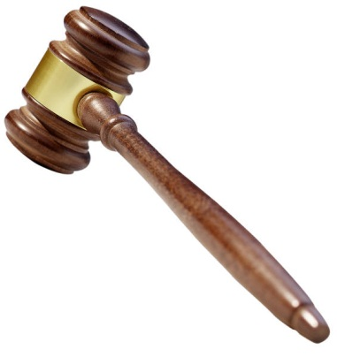
Pretermitted child (omitted)
If not mentioned in will
  May be able to inherit same share that he/she would have received without a will

Slide 211
Divorce
Under AIPRA
  Former spouse does not receive property mentioned in will

Slide 212
Separation-AIPRA
Separation is not equivalent to divorce
  Still married even if separated for years
  Spouse receives what you leave to him/her in will

Slide 213
Self proved will
Affidavit
  Will maker & witnesses sign & acknowledge they were witnessing the signing of will before notary

Slide 214

Self proved will
Notary
  Also signs &
  dates the will
  Use his/her official seal on the will

Slide 215
Residuary clause
Last clause
  Person to receive any part that may be left after rest of will clauses are carried out

Slide 216

Summary
Have residuary clause
Be sure to date & sign signature
Signatures of 2 witnesses are required

Slide 217
More Information
Writing a Will
Fact Sheet #9

Slide 218
American Indian Probate Reform Act (AIPRA)
IIM Accounts are in Trust

Slide 219
Your (IIM) Account
What happens to your IIM money if you pass away without a will?
Fact Sheet #13

Slide 220
IIM accounts
Money earned from
  Leases
  Timber/land sales
  Grazing
  Mineral royalty payments

Slide 221
Do you have an IIM Account?
Yes
No
Don’t
Know
8
Countdown

Slide 222
ASK
CSKT technician for IIM accounts
  Debbie Caye
  406-675-2700
  Ext. 1015

Slide 223

How to get my IIM Statement of Account?
Toll free
  1-888-678-6836
    Enrollment number
    IIM Account number
    Last 4 numbers of SS#
    Date of birth
    Mailing address

Slide 224
Trust Status
Indian spouse & eligible heirs
  retain trust status of money in account

Slide 225

Non-Indians
Who are left money in IIM by written will
Secretary of Interior distributes IIM monies directly to them

Slide 226
IIM distribution
(no will)
Depends on family situation
  Single
  Married

Slide 227
Example 1: Single
IIM $5,000 no will
Parents are living
  No spouse
  No children
  No grandchildren
  No great grandchildren

Slide 228
IIM account: $5,000
(no will)
Mother
$2,500
Dad
$2,500
Single
Person

Slide 229
Passes to surviving eligible parent no will
Mother
$5,000
Father
Single
Person

Slide 230
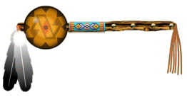
Example 2:
If no spouse, no children, no grandchildren, no great grandchildren or no parents
  Brothers & sisters split IIM money

Slide 231
IIM account: $3,000
IIM (no will)
Father
Mother
Single
person passed
away after
Father & Mother
$1,000
$1,000
$1,000

Slide 232
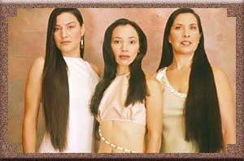
Example 3:
Single Person
(no will)
IIM $3,000
  No children
  Parents deceased
  Has brothers & sisters, some deceased some living

Slide 233
2 living, 2 deceased
Sisters passed
away before
brother
$3,000 in deceased Brother’s IIM

Slide 234
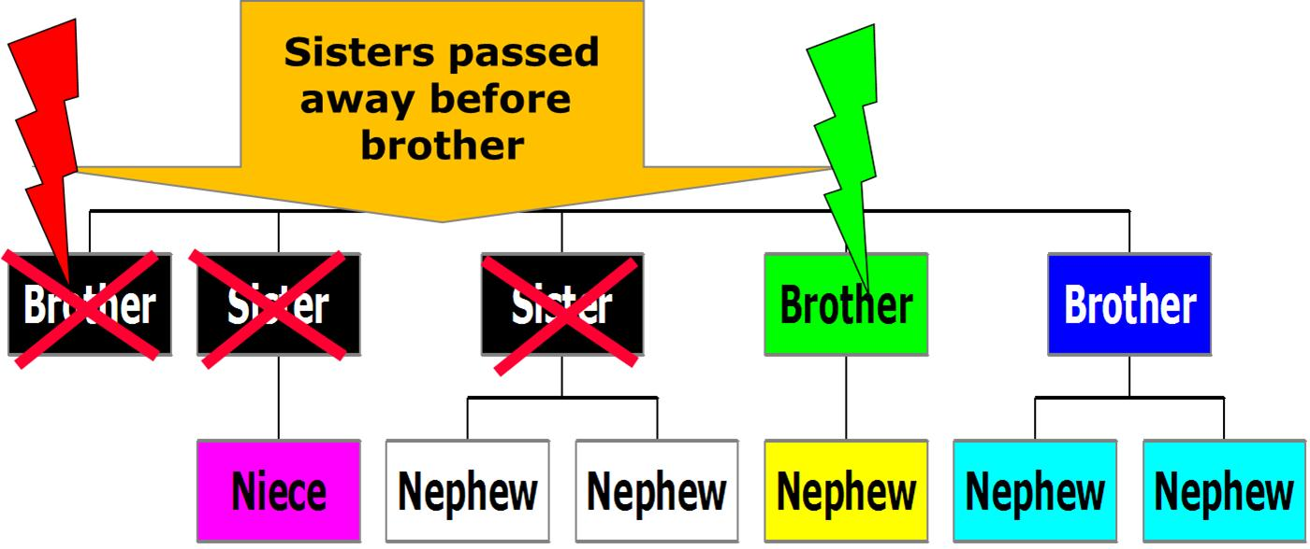
How much will brother with red lighting bolt receive of $3,000 IIM?
$3,000
$1,500
$375
Nothing

Slide 235
IIM Distribution

Slide 236
IIM Distribution

Slide 237
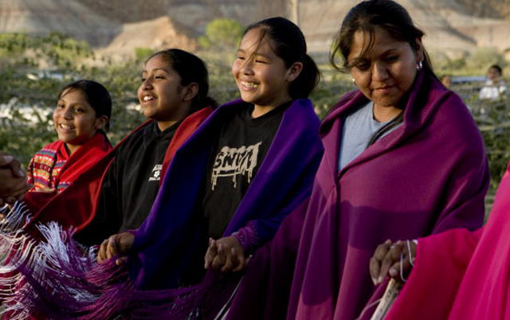
Example 4:
($3,000 IIM no will)
Single
  with children

Slide 238
Survivors : 3 kids
Single
Parent
Passed
Away
Child
Child
Child
($3,000 IIM no will)

Slide 239
$3,000 in IIM passes in equal shares
Single
Parent
Passed
Away
Child
$1,000
Child
$1,000
Child
$1,000
(IIM no will)

Slide 240
Example 5:
$3,000 in IIM (no will)
Single person
  3 living children
  6 living grandchildren

Slide 241
Equal shares to children
($3,000 IIM no will)
Parent
$1,000
0
$1,000
0
0
$1,000
0
0
0
Grandchildren

Slide 242
Child
passed
away
before
parent
$3,000 IIM distribution
Parent
Son
$1,000
$1,000
0
0
$1,000
0
0
0
(no will)
Grandchildren
Right of representation

Slide 243
Two
Children
passed
away
before
parent
Parent
$1,000
Son
$500
$500
$1,000
0
0
0
Son
$3,000 IIM
Distribution no will
Grandchildren
Right of representation

Slide 244
$3,000 IIM distribution
Two
Children
passed
away
before
parent
Parent
Son
$1,000
$1,000
0
0
Daughter
$333
$333
$333
Grandchildren

Slide 245
Survivors: grandchildren
All
Children
passed
away
before
parent
($3,000 IIM no will)
Parent
Son
$1,000
Son
$500
$500
Daughter
$333
$333
$333
Grandchildren

Slide 246
Summary
(no will)
IIM Account Distribution
  depends upon family situation for a single person

Slide 247
Married Person $2,000 IIM
Survivor
  Wife
  No children
(no will)

Slide 248
$2,000 IIM no will
Wife
$2,000
Husband

Slide 249
$9,000 IIM account
Husband
Husband
Wife
Wife
Their
Child
Their
Child
Their
Child

Slide 250
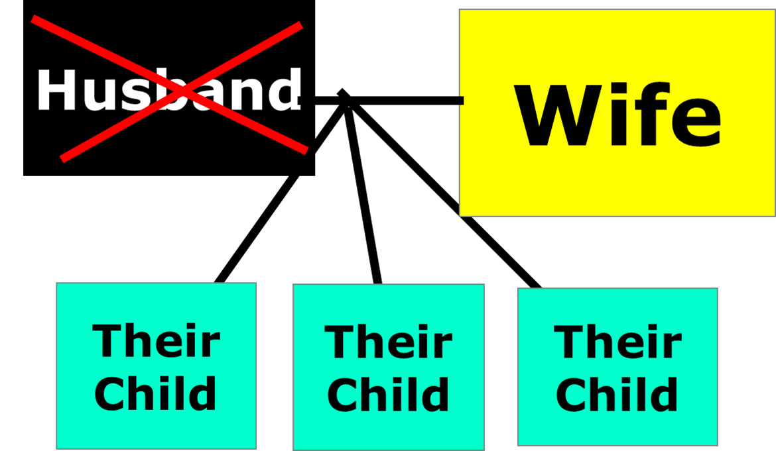
How is the $9,000 in the IIM account divided?
$9,000 wife
$3,000 to each child, 0 to wife
$3,000 to wife, $2,000 to each child
$4,500 to wife, $1,500 to each child
8
Countdown

Slide 251
IIM $9,000 no will
Wife
1/3
$3,000
Husband
Equally divide 2/3 = $6,000
Their
Child
$2,000
Their
Child
$2,000
Their
Child
$2,000

Slide 252
Husband
$9,000
Wife
$3,000
Equally divide 2/3 = $6,000
Their
Child
$2,000
Their
Child
$2,000
Their
Child
$2,000
Grand
Child
$1,000
Grand
Child
$1,000
Grand
Child
0

Slide 253

Summary
If AIPRA rules don’t fit your family, write a will

Slide 254
Resources
CSKT
  George Ducharme
  Carolee Wendeworth
  Dan Decker
  Rose Tellier

Slide 255
Resources
Indian Land Tenure Foundation
  Message Runner Volume 5
  www.iltf.org
  151 East County Road B2
  Little Canada, MN
  55117-1523

Slide 256
Resources
Indian Lands Working Group
  Indianlandworkinggroup.org
  2401 12th Street NW
  Albuquerque, NM 87104

Slide 257

Your Opinion Please
257
Notes:
257

Slide 258
What is your reaction to using the response clickers?
Like using them
Sort of useful
So-So
Not too impressed
Didn’t like using them at all
8
Countdown

Slide 259
How did you learn about this meeting?
Newspaper
Invited by a friend
Radio
Newsletter
Flyer
Other, write on card
8
Countdown

Slide 260
What area would you like to receive more information?
Understand my ITI statement
Writing a will
Provisions of AIPRA
Other, write on card
8
Countdown

Slide 261
What is your opinion of the co-sponsors displays?
Excellent
Very good
Average
So-So
Not helpful
8
Countdown

Slide 262
Rank the knowledge you gained from today’s program
Didn’t learn anything new
Gained a little
Neutral
Gained some
Gained a lot
8
Countdown

Slide 263
Rank the level of motivation that this program provided for you take actions.
No motivation
A little motivation
Neutral
Some motivation
Lots of motivation
8
Countdown

Slide 264

Best wishes as you proceed with learning more about AIPRA through the packet of information
Marsha, Nori, Dan, Rose & the co-sponsors
264
Notes:
264

