Slide 1

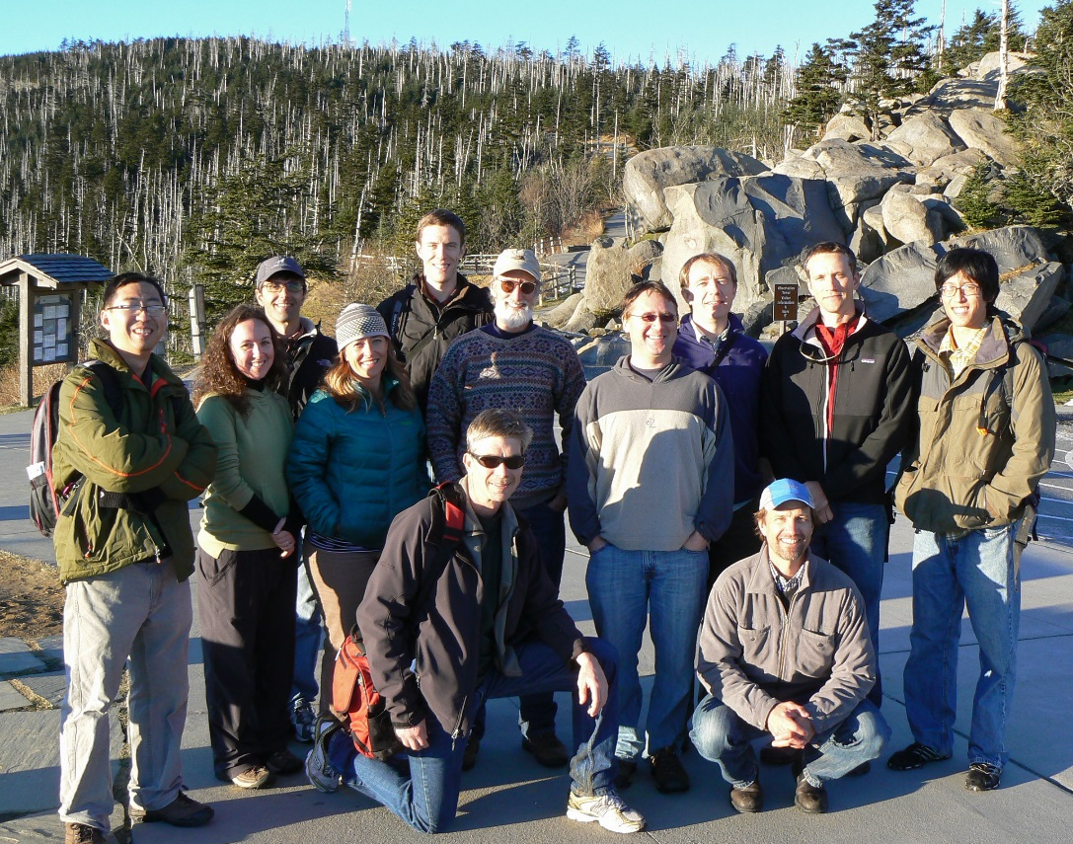




Landscape Climate Change Vulnerability Project (LCC_VP)
Montana State University:
Andy Hansen, Nate Piekielek, Tony Chang, Regan Nelson, Linda Phillips, Erica Garroutte
Woods Hole Research Center:
Scott Goetz, Patrick Jantz, Tina Cormier, Scott Zolkos
NPS I&M Program:
Bill Monihan and John Gross
NPS / Great Northern LCC:
Tom Olliff
CSU Monterey Bay / NASA Ames:
Forrest Melton, Weile Wang
Conservation Science Partners:
Dave Theobald,
Colorado State University:
Sara Reed
Clingman’s Dome, Great Smoky Mountain NP
NASA Applied Sciences Program
(NNH10ZDA001N - BIOCLIM)
NPS I&M Program
Notes:
1

Slide 2
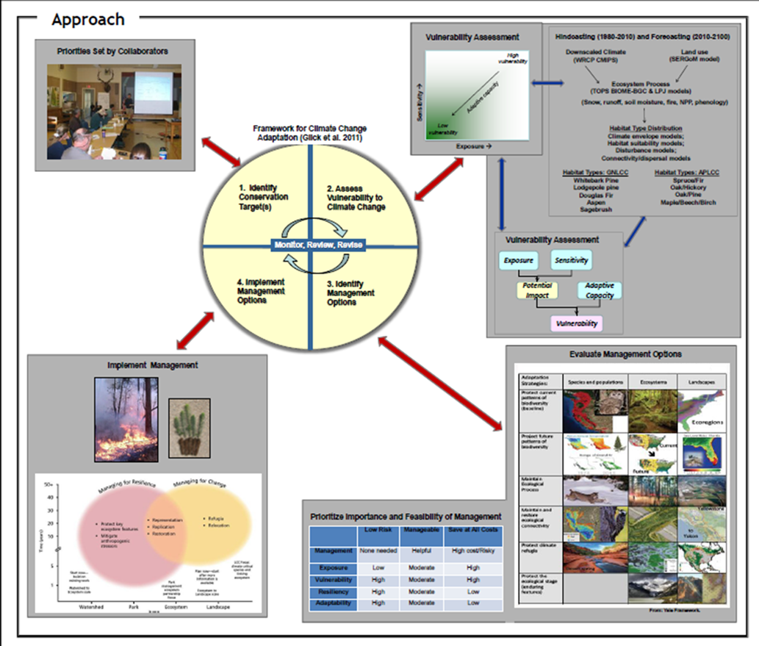
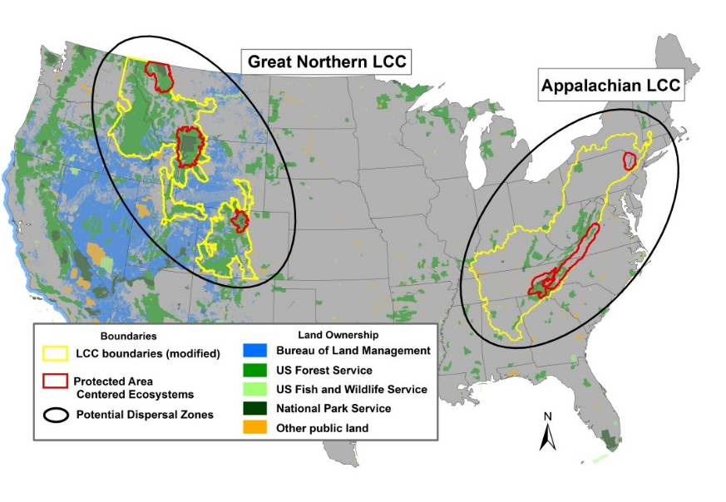
Goals and Objectives
Goal
Demonstrate the four steps of a climate adaptation planning strategy in two LCCs using NASA and other data and models.
Notes:
2
Our goal is to demonstrate in two lccs.

Slide 3
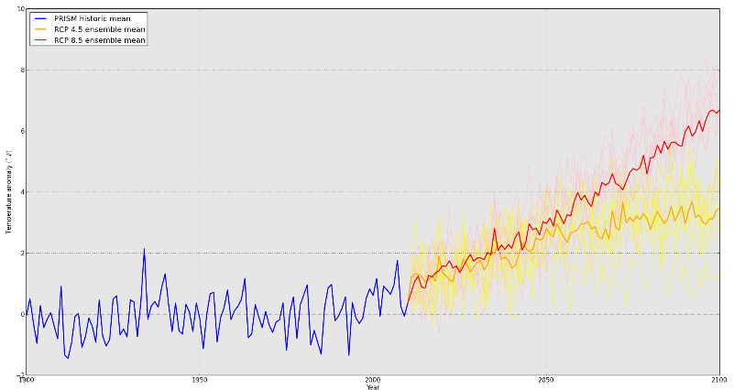
Climate Change

Slide 4
Projected Ecosystem Processes
Melton et al. 2013

Slide 5
Figure 9. Seasonal April 1 snow water equivalent projected by the by the TOPS model for the ensemble average of global climate models for the coming century under three IPCC scenarios.

Slide 6
Figure 11. Stream runoff projected by the by the TOPS model for the ensemble average of global climate models for the coming century under three IPCC scenarios.

Slide 7
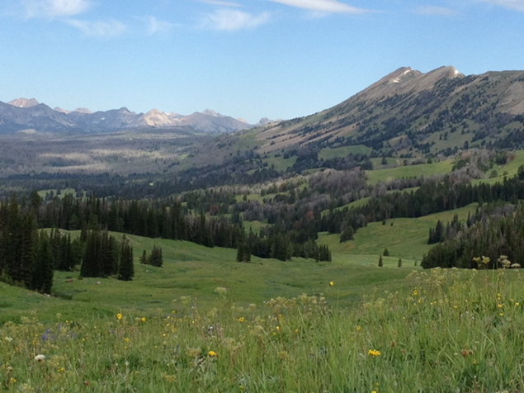
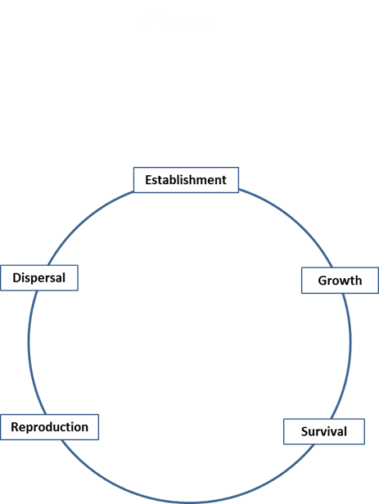
Vegetation Response to Climate Change
Vegetation response to climate change involves:
Climate effects on the demography of a plant species

Slide 8
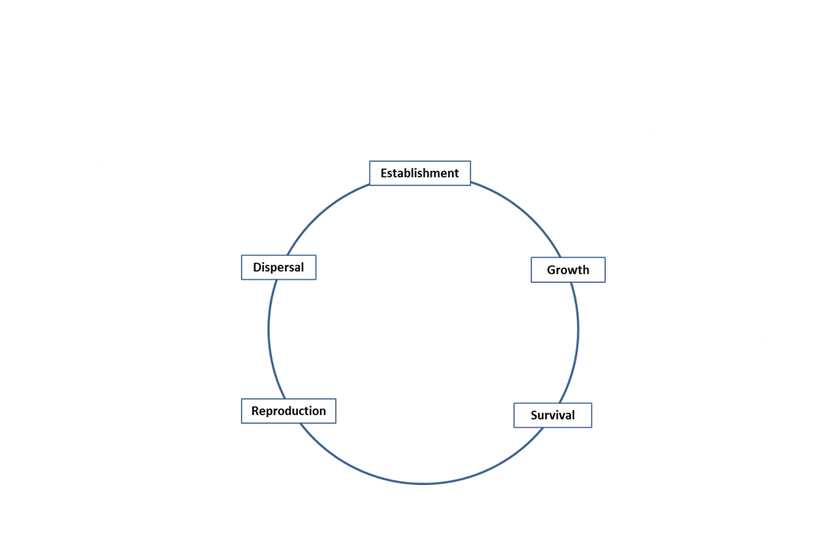
Vegetation Response to Climate Change
Vegetation response to climate change involves:
Climate effects on the demography of a plant species
Climate effects on other ecosystem components

Slide 9



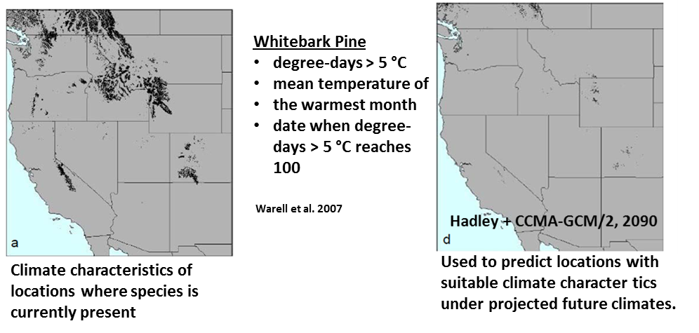
Vegetation Response to Climate Change
Realism Certainty
Climate Suitability for Presence
Presence

Slide 10
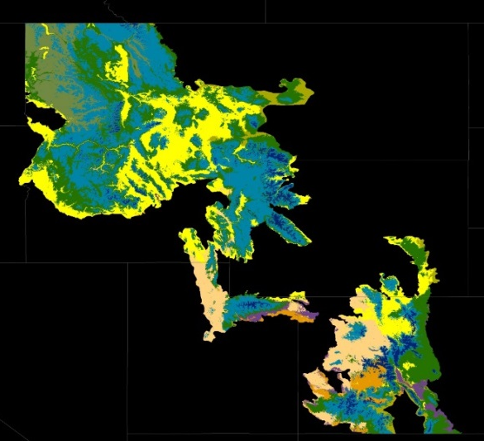
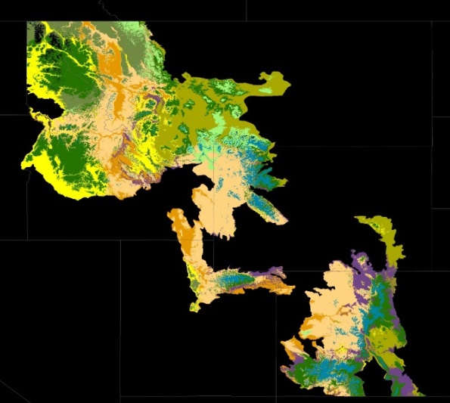
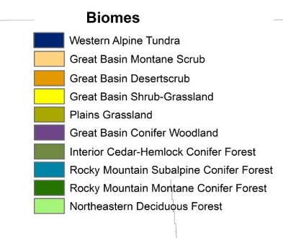
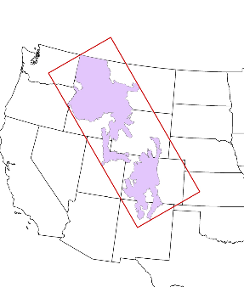
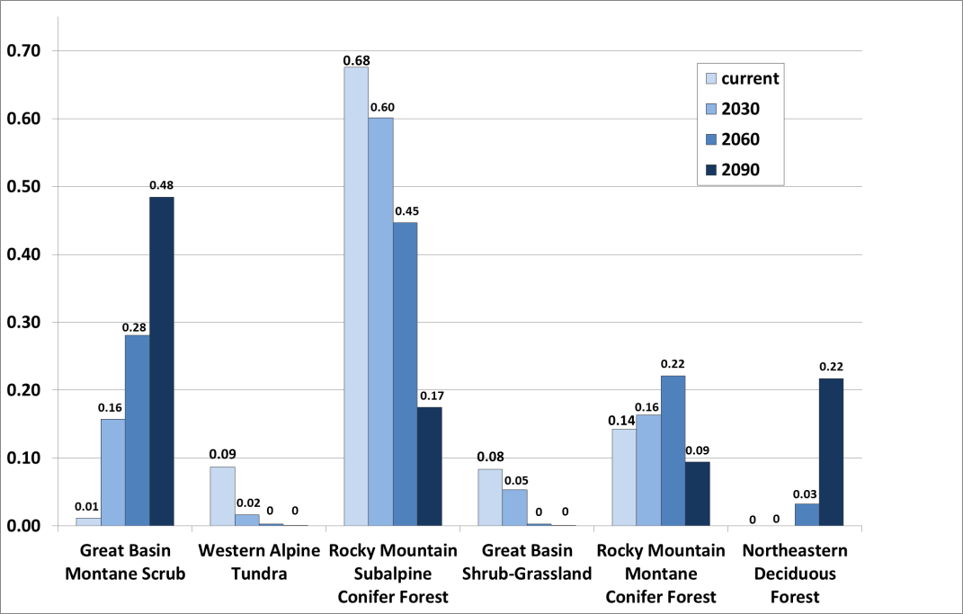
Synthesize Current Knowledge on Vulnerability
Great Northern LCC - Projected Biome Shift
Current
2090
Winner
Losers
GYE PACE
Data from Rehfeldt et al. 2012

Slide 11
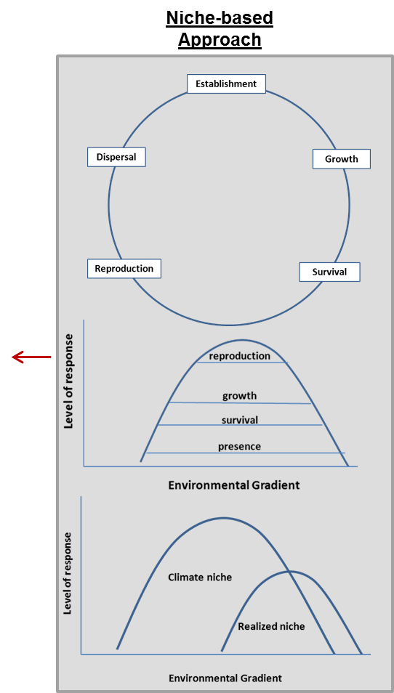
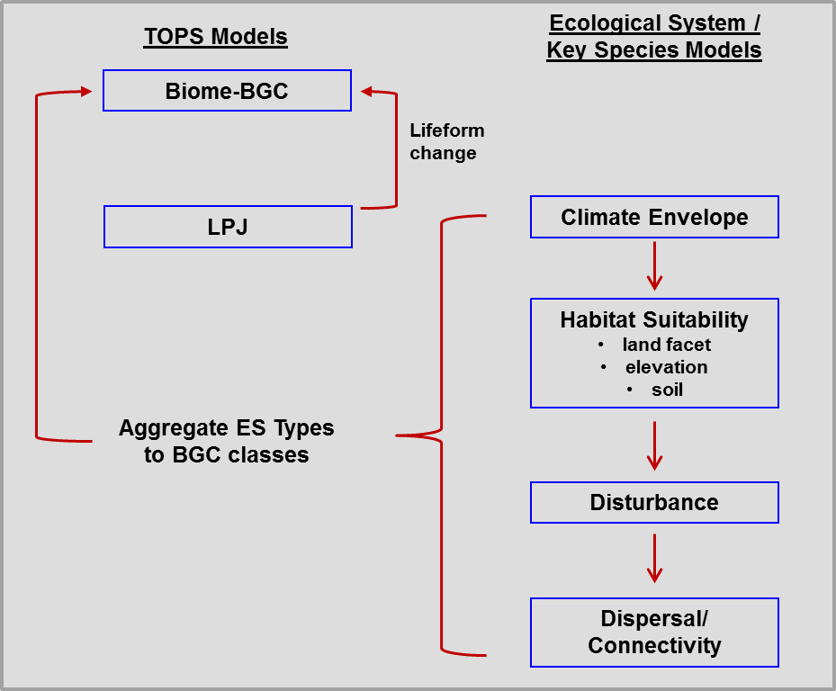
NASA LCCVP Approach

Slide 12
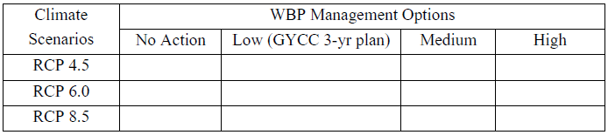
Develop and Simulate Management Alternatives
Simulate potential outcomes of alternative management options:
  Evaluate current WBP Strategy against forecasts.
  Create two additional options that require new agency tolerances.

Slide 13
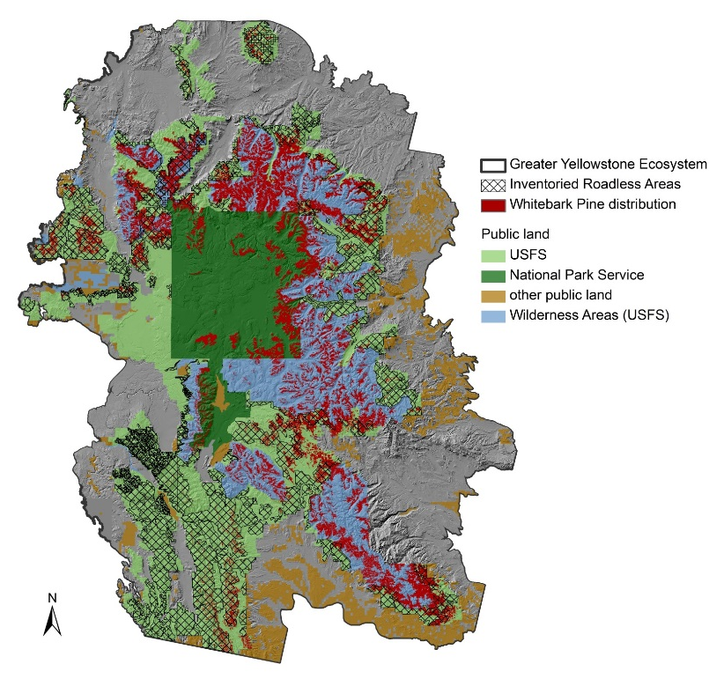
Develop and Simulate Management Alternatives
Challenge: Agencies / land allocation types differ in tolerance to management.
Greater Yellowstone Ecosystem
Agency/Allocation | Legal Direction/Mgt Philosophy | WBP Restoration Tools allowed or likely | % WBP
National Forests | Multiple use Ecological integrity | All Planting seedlings/sowing seeds Pruning Wildland and prescribed fire use Targeted fire suppression Mechanical thinning Research/Monitoring | 5%
NF – Wilderness Area | Most actions prohibited or discouraged | Wildland fire use Research/Monitoring | 54%
NF – Inventoried Roadless Areas | Actions less restricted but remoteness an issue | Planting seedlings/sowing seeds Wildland fire use Research/Monitoring Mechanical thinning (but requires USDA Secretarial approval) | 27%
Yellowstone National Park | Park Service Policy: “Take no action that would diminish the wilderness eligibility of an area” AND/BUT “Management actions…should be attempted only when knowledge and tools exist to accomplish clearly articulated goals.” | Wildland fire use Research/Monitoring | 10%
Grand Teton National Park |  | Planting seedlings/sowing seeds Pruning Wildland fire use Research/Monitoring | 3%

Slide 14
Evaluate Management Alternatives
WBP Goals, Cost of Implementation, Ecosystem Services
Ecosystem Service Valuation
Whitebark pine ecosystem services valued:
Hydrologic regulation
Provisioning for other species
Wilderness aesthetics and recreation
Valuation methods:
Conjoint survey analysis to estimate total value (both use and non-use values including non-consumptive eco-system services)
Market-based analysis for marketable ecosystem services (e.g., water replacement)
Ecosystem values used for cost-benefit analysis
Costs of each management alternative will be compared with the benefit / value of the ecosystem services resulting from the alternative
The management alternative with the largest net benefit (benefits – costs) would be recommended for adoption

Slide 15
Evaluate WBP Response to Treatments
Statistical species distribution modeling by life history stage
Process modeling of WBP and competing species

Slide 16

Vegetation Modeling Needs
Realism Certainty
More realistic models with lower uncertainty at greater ecosystem scales
Presence
For Example:
Where are locations in GYE where controlling competing vegetation would allow recruitment to reproductive age classes under climate change?

Slide 17
Stand to Global Scale Modeling Approaches
Stand-scale models
Gap (i.e., ZELIG )
Growth-Yield (i.e. FVS)
Landscape models
Mechanistic - (FireBGCv2)
Deterministic – (SIMMPLE)
Global Models
DGVMS – (MAPSS)
Notes:
Various modeling approaches have been used to project forest/vegetation response to climate, disturbance.
At stand-scales, gap models, for example simulate individual tree establishment, growth and mortality at the scale of small forest gaps.
Landscape models, such as FireBGCv2 operate at scales of hundreds of thousands of ha.
At global scales, dynamic vegetation models are frequently used to simulate vegetation response to climate. Vegetation in these models is often represented by biomes or plant functional types, rather than individual species.
Biome-BGC has been applied from stand to global scales. But, it represents a single, static vegetation type at the level of a biome.

Slide 18
Stand to Global Scale Modeling Approaches
Stand-scale models
Gap (i.e., ZELIG )
Growth-Yield (i.e. FVS)
Landscape models
Mechanistic - (FireBGCv2)
Deterministic – (SIMMPLE)
Ecosystem-scale models
LPJ-GUESS
Global Models
DGVMS – (MAPSS)
Notes:
Need an ecosystem-scale approach
LPJ-GUESS might be a good compromise

Slide 19
Desired Model Characteristics
For modeling vegetation dynamics at greater ecosystem scales:
Capable of simulating individual species/communities
Links climate with ecosystem processes
Simulates disturbance
Large spatial scale
  Ex. Yellowstone & Grand Teton Ecosystem ~42,500 km²

Slide 20
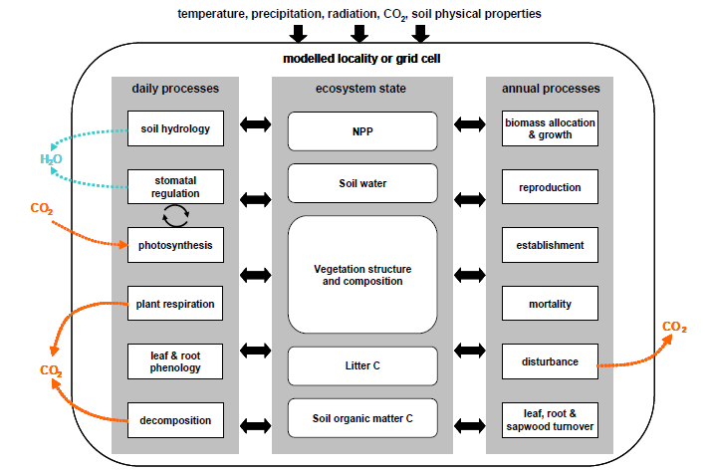
LPJ-GUESS Overview
Notes:
Regional to global model simulates dynamics and composition of vegetation in response to changes in climate, atmospheric CO2 concentration,
Physiological processes include photosynthesis, autotrophic and heterotrophic respiration, which are calculated at a daily time-step
Carbon allocation (to leaves, sapwood, and fine roots) is based on a set of rules that determine plant growth. Carbon allocation is determined at the end of the simulation year by dividing annual NPP into the 3 growth compartments.
Plant establishment, growth, mortality, and decomposition determine vegetation composition and successional dynamics and are respond to light, water availability.
Fire is the primary disturbance modeled in LPJ-GUESS.

Slide 21
Inputs
Climate data: monthly temp., precip., shortwave radiation, CO₂
Soil data: soil texture
Vegetation: PFT/species, bioclimatic limits, ecophysiological parameters
LPJ-GUESS
Photosynthesis
Respiration
Allocation
Establishment, growth, mortality, decomposition
Outputs
Vegetation types
Biomass
Carbon storage
C & H20 fluxes
NPP, NEE
Fire-induced mortality
CO₂, etc. emissions
Fuel consumption

Slide 22
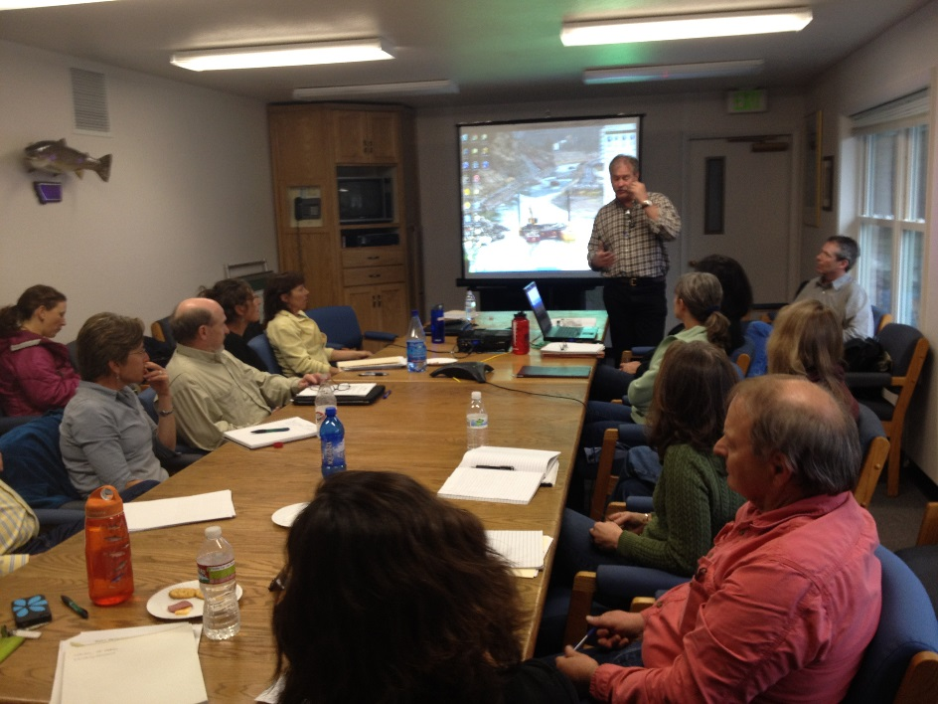
Recommendations for Implementation
Workshop with GYCC WBP Subcommittee and managers from WBP range to interpret results and make recommendations

Slide 23
Time Table
Schedule | Year 1 |  |  |  |  | Year 2 |  |  |  | Year 3
Task | 1Q |  | 2Q | 3Q | 4Q | 1Q | 2Q | 3Q | 4Q | 1Q | 2Q | 3Q | 4Q
Study Design
Pre-implementation Workshop
Objective 1
Ecological forecasting
Objective 2
Paleo analyses
Objective 3:
Management alternatives workshop
Objective 4: Evaluate alternatives
Analyze mgt alternatives on WBP status
Conduct benefits surveys
Analyze cost/benefits of alternatives
Objective 5
Workshop to define recommendations
Data Transfer and Archive
Targeted meetings to share results and science products
GNLCC Science Webinar
Finalize all data products
Archive all materials

