Slide 1
WHITEBARK PINE DISTRIBUTION MODELS UNDER PROJECTED FUTURE CLIMATES IN THE GYA
Tony Chang, Andrew Hansen, Nathan Piekielek
Montana State University
Tom Olliff
NPS IMR and Great Northern LCC

Slide 2
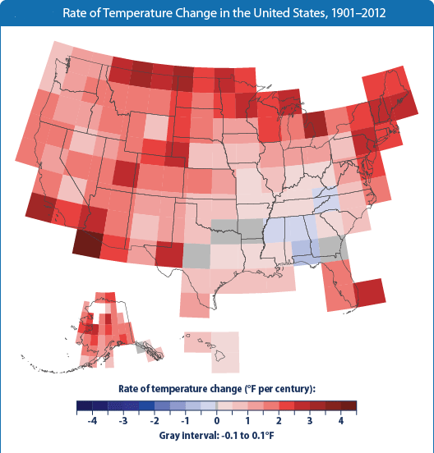
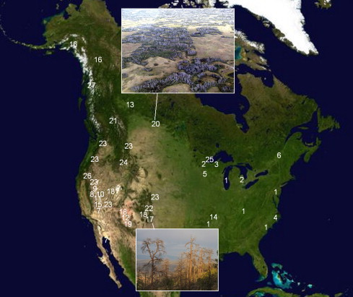
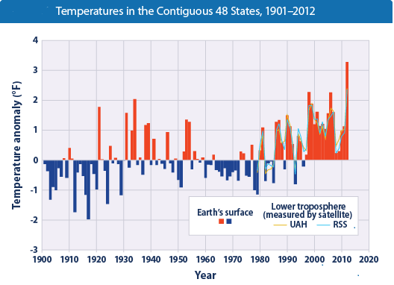
Vegetation response to climate
Evidence of vegetation die off related to climate induced physiological stress. (Allen et al. 2010)
Notes:
Global temperatures have increased over the past century and are projected to rise substantially in the next coming century.
While future changes in climate are expected to influence the ecosystem, evidence of vegetation dieoff in many locations in the across the planet.
Aspen (populus tremuloides) in Alberta Canada, and Ponderosa Pine in Jemez Mountains, New Mexico.

Slide 3
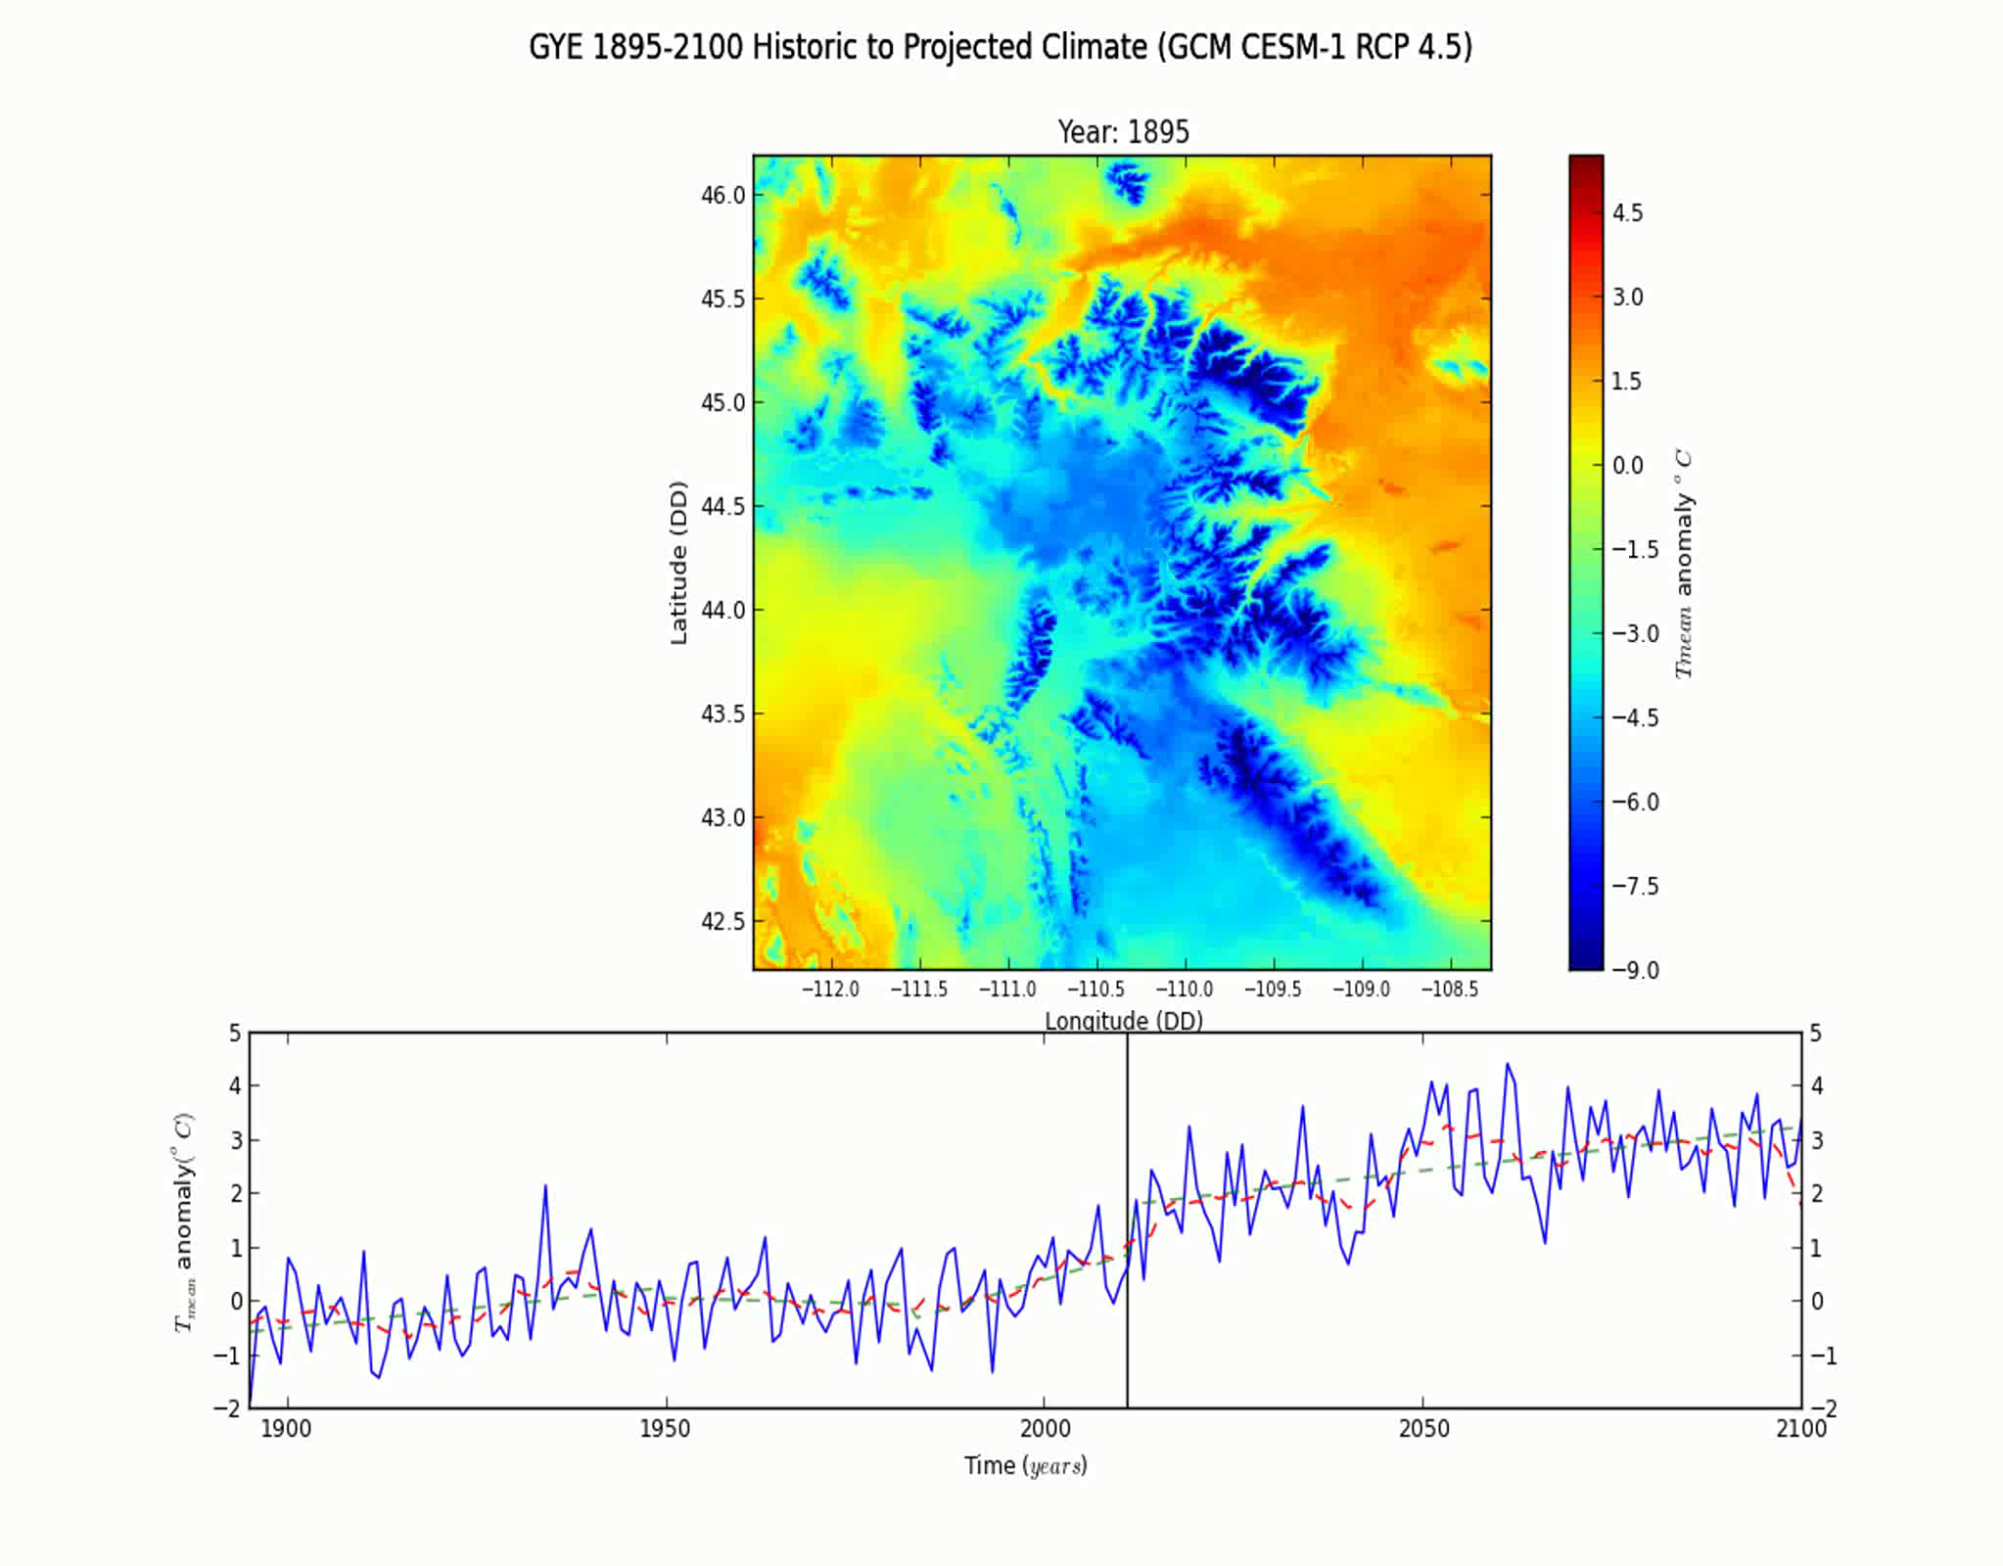
Temperature change in the GYA
Difference in annual temperature from the 1900-2010 mean

Slide 4
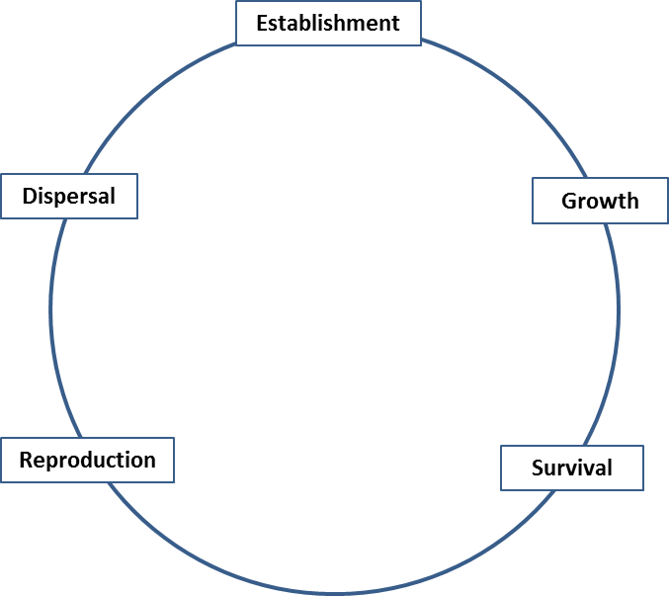
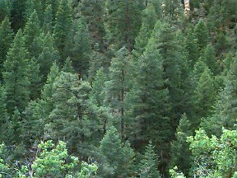
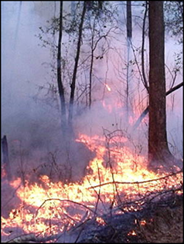
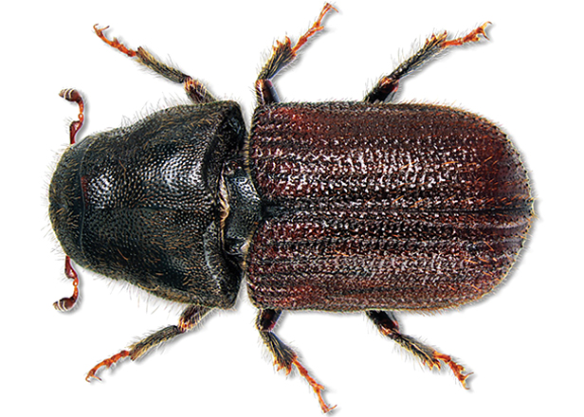
Climate and Whitebark Pine
Climate limits WBP at each life history stage through availability of resources.
Indirect impacts

Slide 5
Question (science)
How will the bioclimatic habitat envelope for Whitebark pine respond to shifts in the GYA climate?

Slide 6
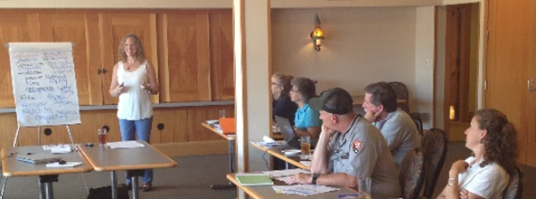
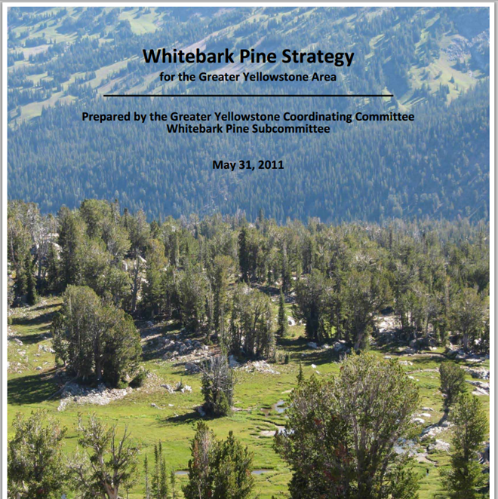
Question (applied)
What locations in GYA will likely have suitable climates for WBP and may be candidates for restoration strategies for GYCC?

Slide 7
Methods (Response Data Sources)
Current model on “Adult” class tress (DBH≥8”)
2,569 data points (936 presence, 1,633 absence)
Data Source | Adults | Seedling Saplings | Growth Rates | Mortality (Adults) | Reproduction
GYCC | Stand type Canopy cover Maturity Presence Dominance |  |  | Perimeters of burned WBP Canopy damage
WLIS | Density | Regen |  | BR presence BR % infection % WBP mortality
FIA | Presence Density by size class | Seedling Sapling density | DBH remeasure | Remeasurement of marked trees
GYRN I&M | Density by size class | Density by size class |  | Mortality rate BR presence | Presence by size class
USDA FS |  |  |  | Pest detection Damage type Severity Dead trees/ac
Notes:
One of the most complete WBP datasets in the GYE

Slide 8

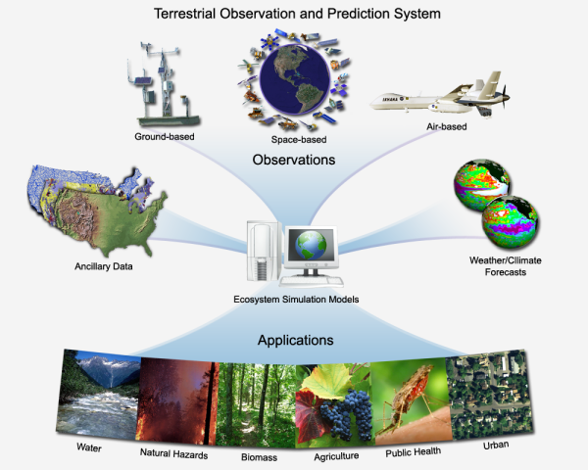
Methods (Predictor Data)
Historic Climate Data
  PRISM 800m climate
    (Daly et al. 2011)
  (1900-2010) monthly
Projected Future Climate
  (NASA TOPS)
  CMIP5 Downscaled GCMs
  (2010-2100) monthly

Slide 9
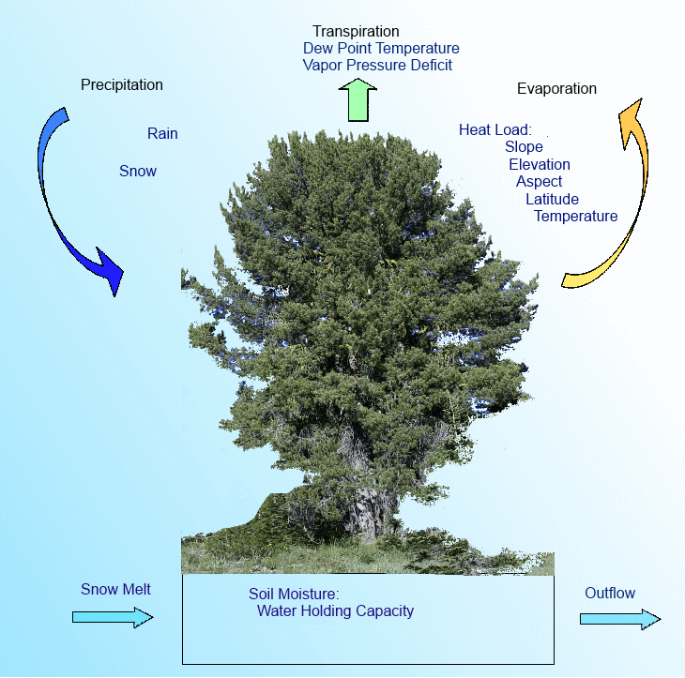
Water Balance Modeling
Derived monthly water balance variables using Thornthwaite equation.
Provides 10 additional climate metrics

Slide 10
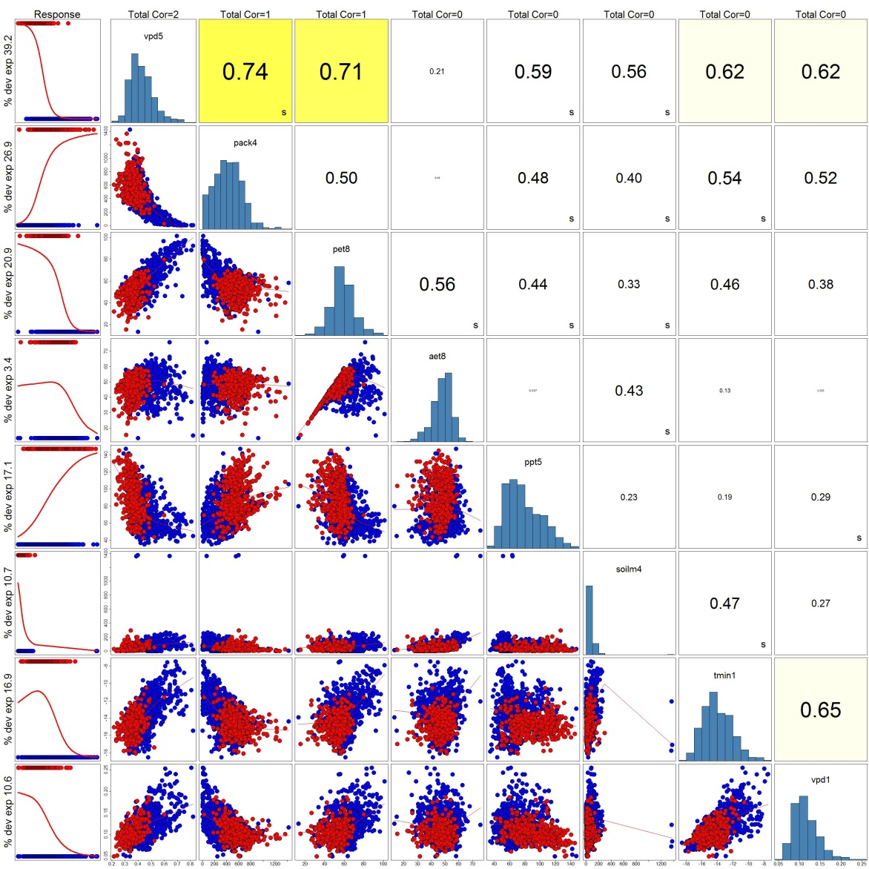
Predictor Variable Selection
Climate summarized using 1950-1980 means
122 predictor covariates
Suite considering ecologically meaningful predictors
Notes:
Selection for high deviance and reduction of collinearity. Leading predictors that explain the most deviance are VPD8, Tmax8, and SWE5

Slide 11
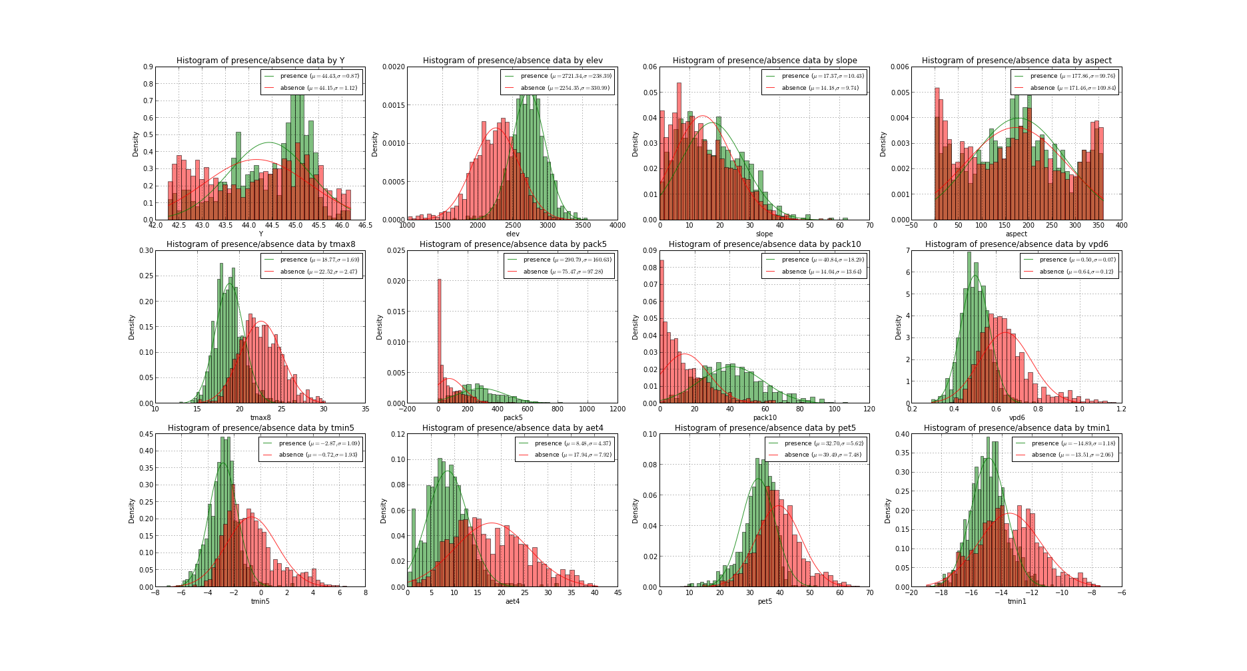
Presence/Absence Data Distributions

Slide 12
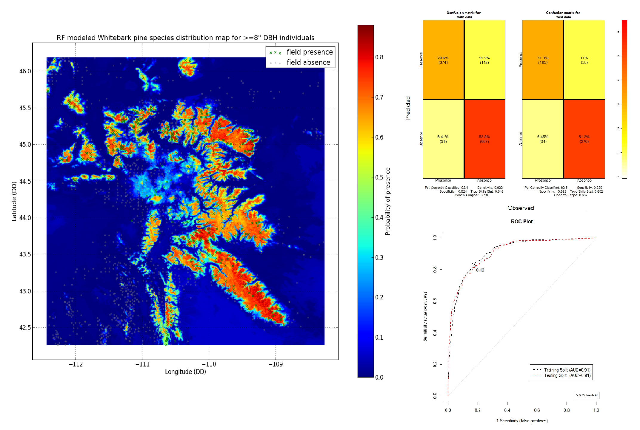
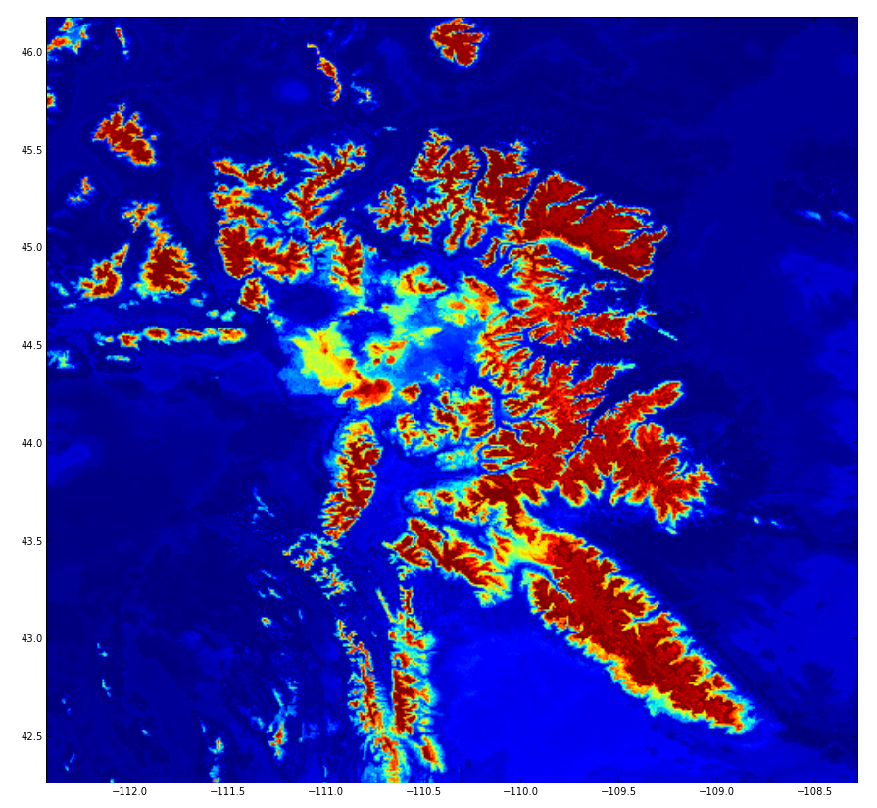
Results
Leading predictors:
Tmax8, SWE5, VPD6

Slide 13
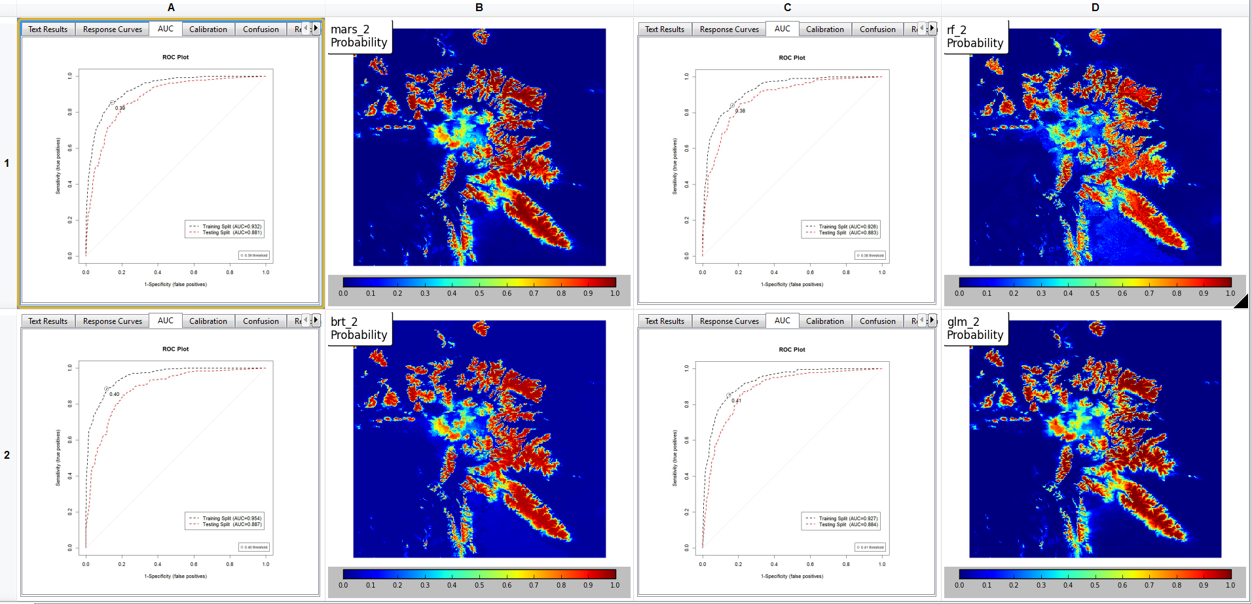
Diagnostic: Multi-method Model Fitting

Slide 14
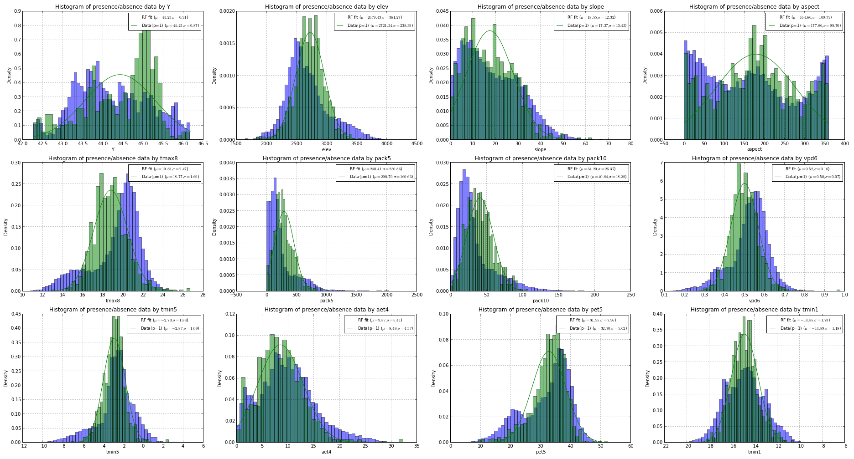
Covariate Distributions

Slide 15
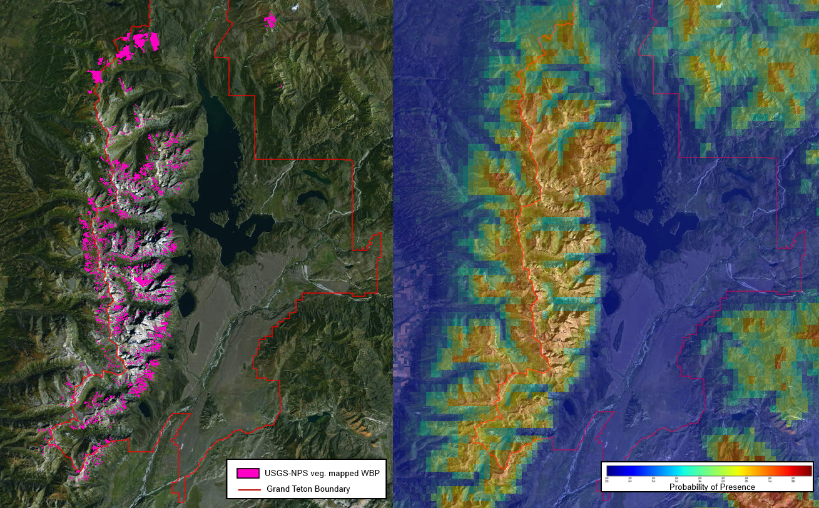
Diagnostics

Slide 16
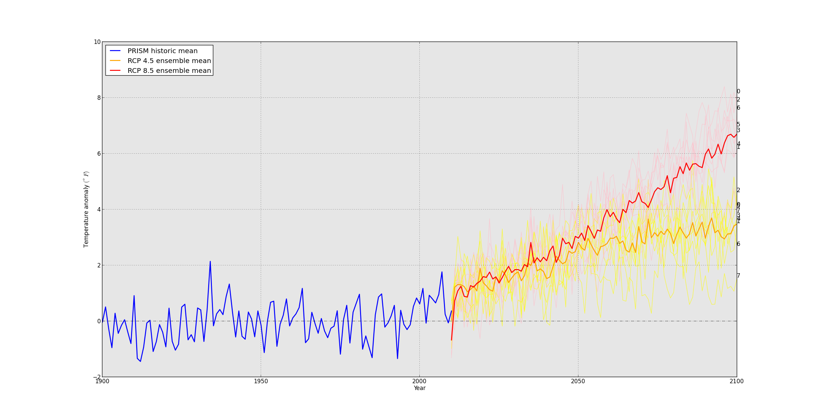
GCM variability

Slide 17
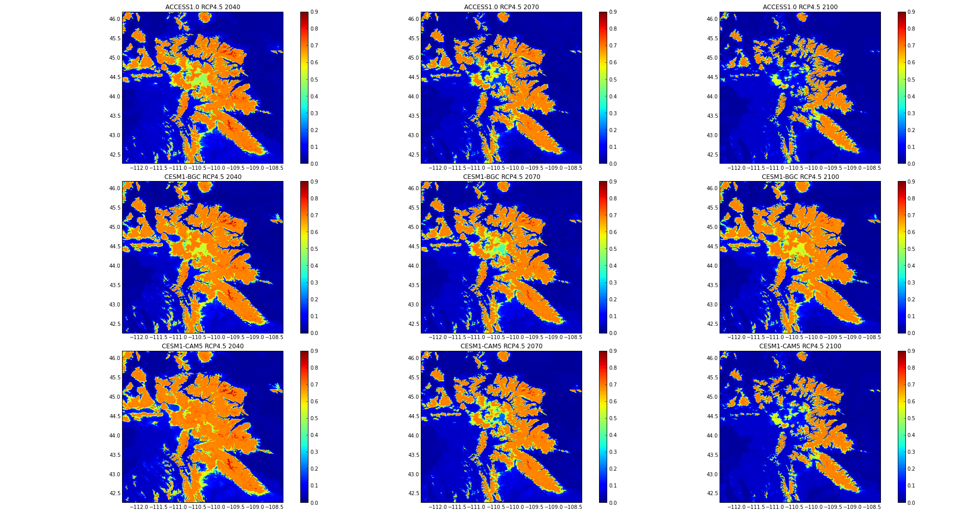
Future Projections (RCP 45)

Slide 18
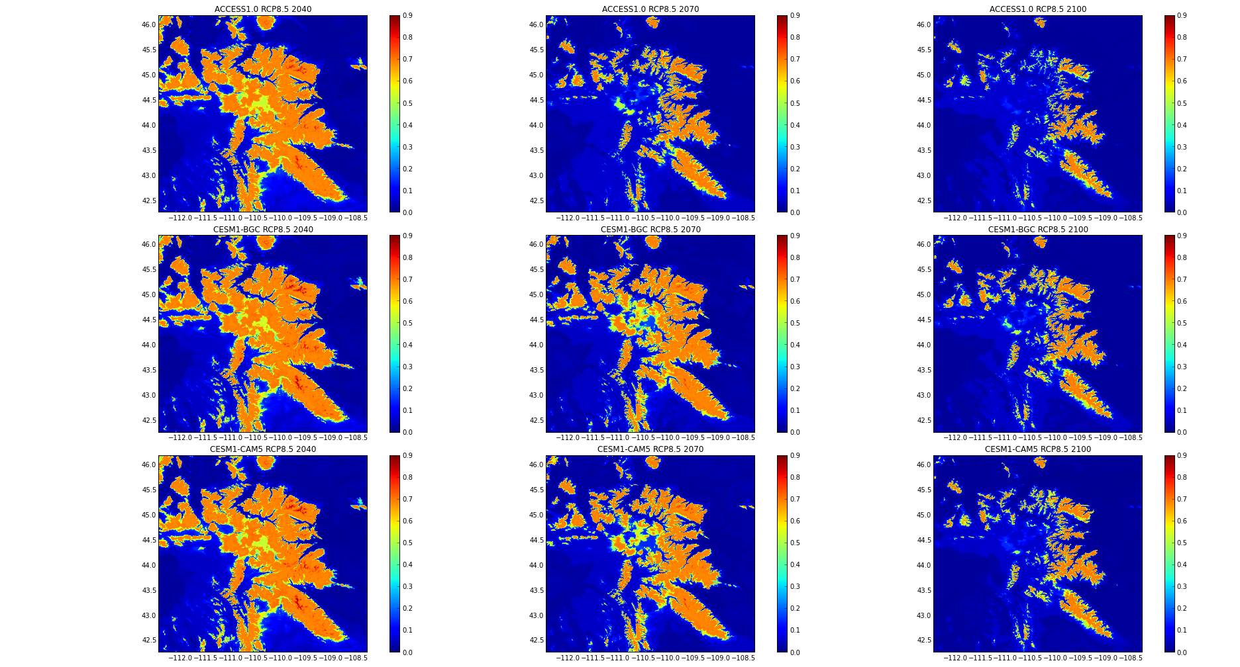
Future Projections (RCP 85)

Slide 19
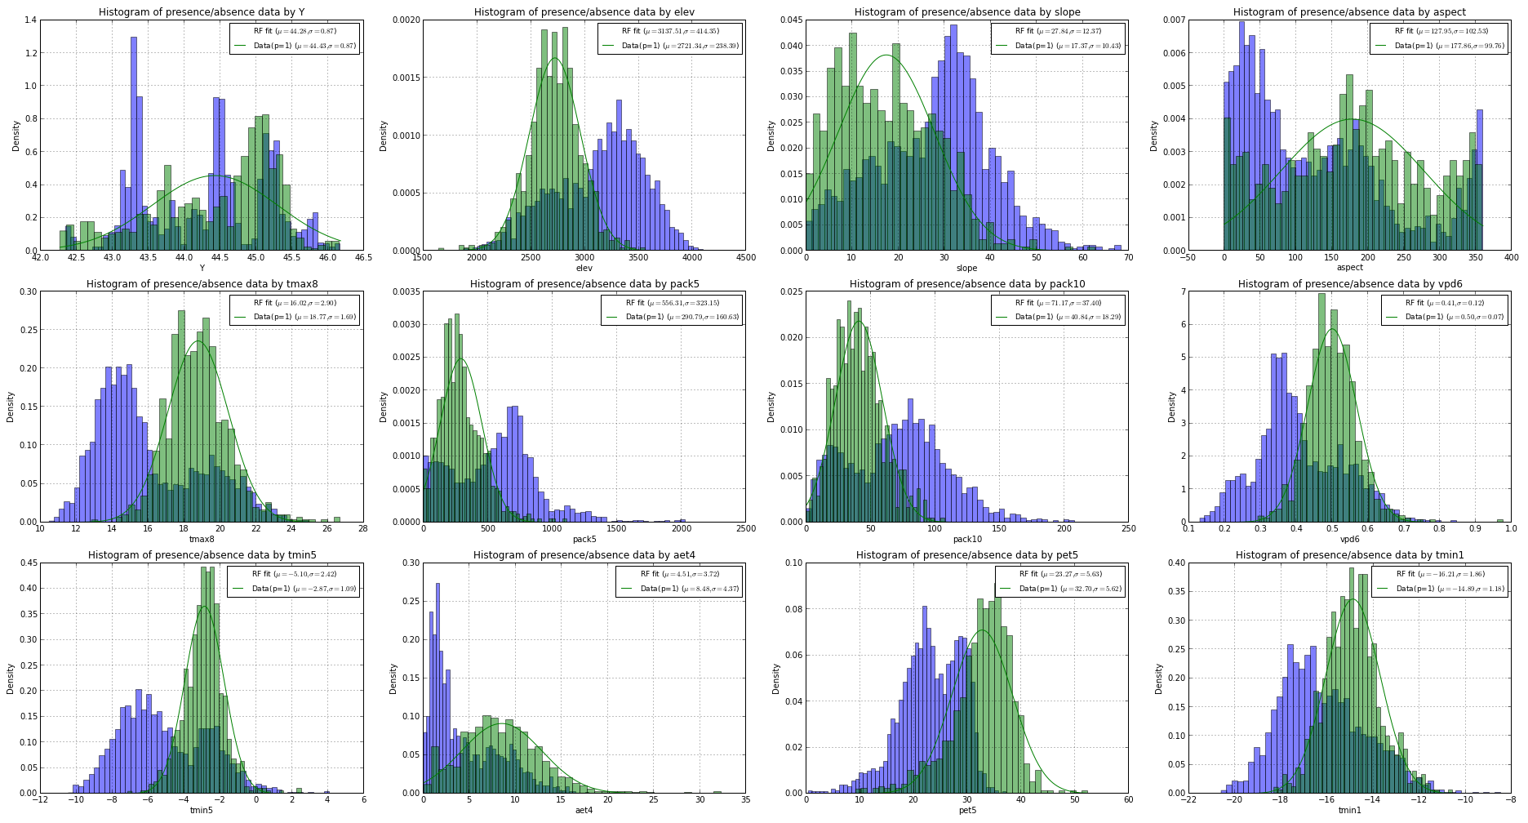
Covariate Distributions
(CESM-1 CAM5, RCP 85, 2040)

Slide 20
Geographic properties of areas of suitable climate
Prob. Presence > 50% | Current | 2040 | 2070 | 2100
Area | 28,732 km² | 10,227 km² (65% reduction) | 6,160 km² (79% reduction) | 3,949 km² (86% reduction)
Mean elevation | 2,974 m (9,754 ft) | 3,214 m (10,541 ft) | 3,288 m (10,784 ft) | 3,363 m (11,030 ft)
Elevation Range | 2,226 – 4,101 m (7,301 – 11,030 ft) | 2,478-4101 m (8,127 – 11,030 ft) | 2,545-4,101 m (8,347 – 11,030 ft) | 2,643-4,101 m (8,669 – 11,030 ft)

Slide 21
Implications for GYCC WBP strategy
Analysis identifies loss of historic bioclimatic habitat by the year 2100
Areas and locations of climate suitable habitat for restoration of adult WBP
Does not account explicitly for disturbance, dispersal, and competition

Slide 22
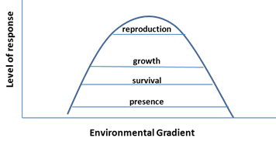
Next Steps…
Envelope analysis to reveal climatic suitable areas for other life history stages
Expansion of model to more GCMs and scenarios

Slide 23


Acknowledgements
NASA Applied Sciences Program (Grant 10-BIOCLIM10-0034)
NASA Land Cover Land Use Change Program
North Central Climate Sciences Center
NSF EPSCoR Track-I EPS-1101342 (INSTEP 3)

Slide 24
Questions

Slide 25
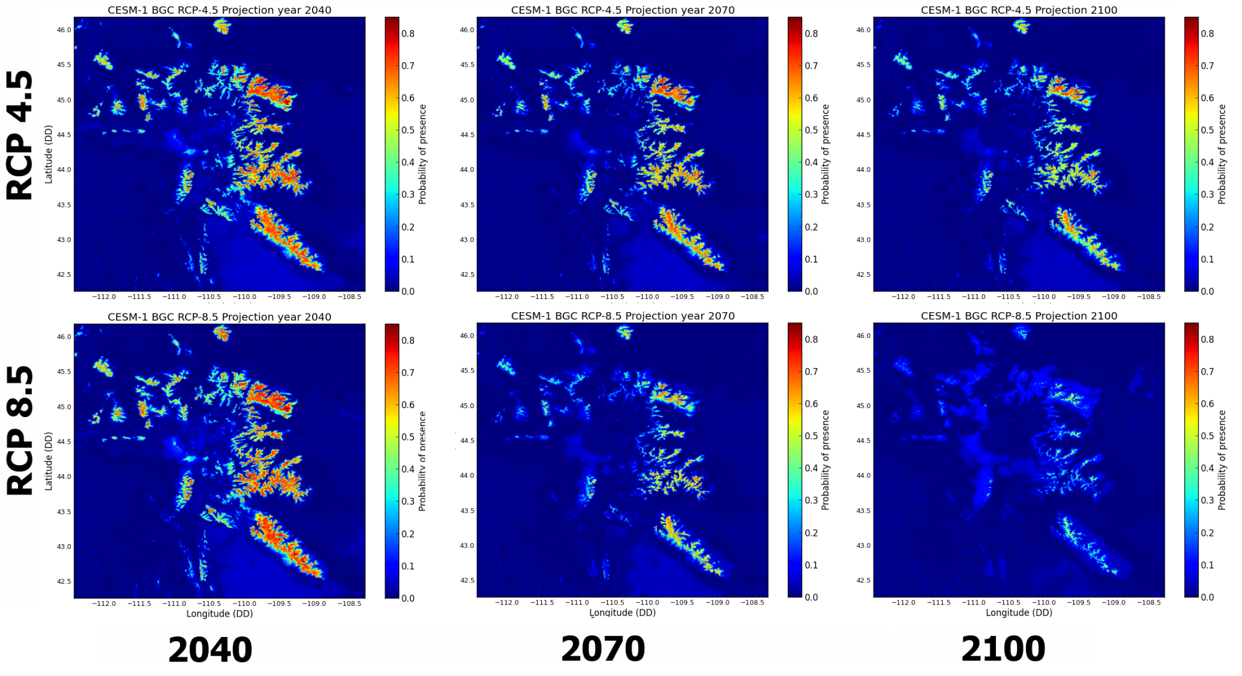
Future Projections
Notes:
Climate envelope shift towards higher elevations

Slide 26
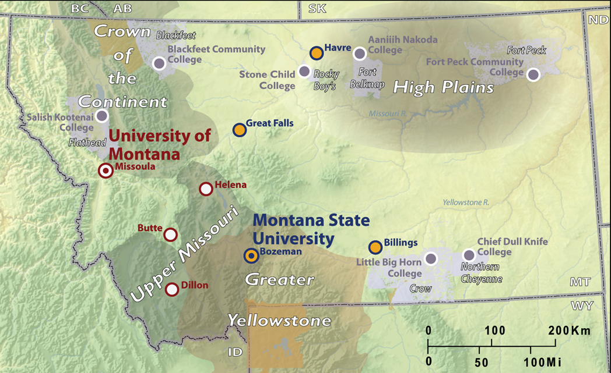



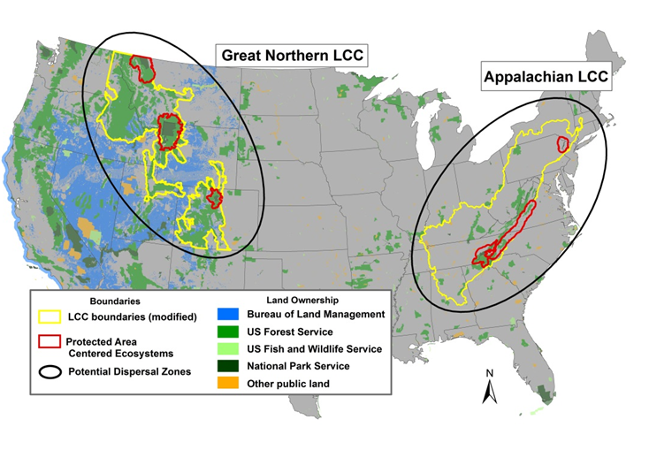
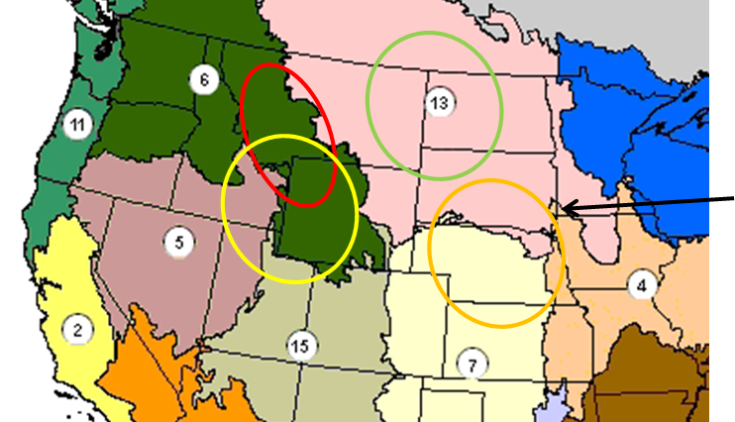
Science Collaboration
MSU
Hansen Lab
Nate Piekielek, Linda Phillips, Tony Chang, Regan Nelson, Erica Garroute, Katie Ireland
Whitlock Lab & IoE
Todd Kipfer, Virginia Ignalis
Liz Shanahan
UM
Running Lab
Jared Oyler, Ashley Ballantyne, Kelsey Jencso, Michael Sweet
Helen Naughton
Hansen Lab, MSU
Tom Olliff, NPS / Great Northern LCC
John Gross, Bill Monihan, NPS I&M
Dave Theobald, Conservation Science Partners
Forest Melton, NASA Ames
Scott Goetz, Woods Hole Research Center
Jeff Morresette, Dennis Ojima, NCCSC
Hansen Lab, Whitlock Lab MSU
Running Lab, UM
Barry Noon, Susan Skagan, Colorado State University and USGS
Bill Lauenroth Lab, University of Wyoming
Diane Debinski Lab, Iowa State University

