Slide 1
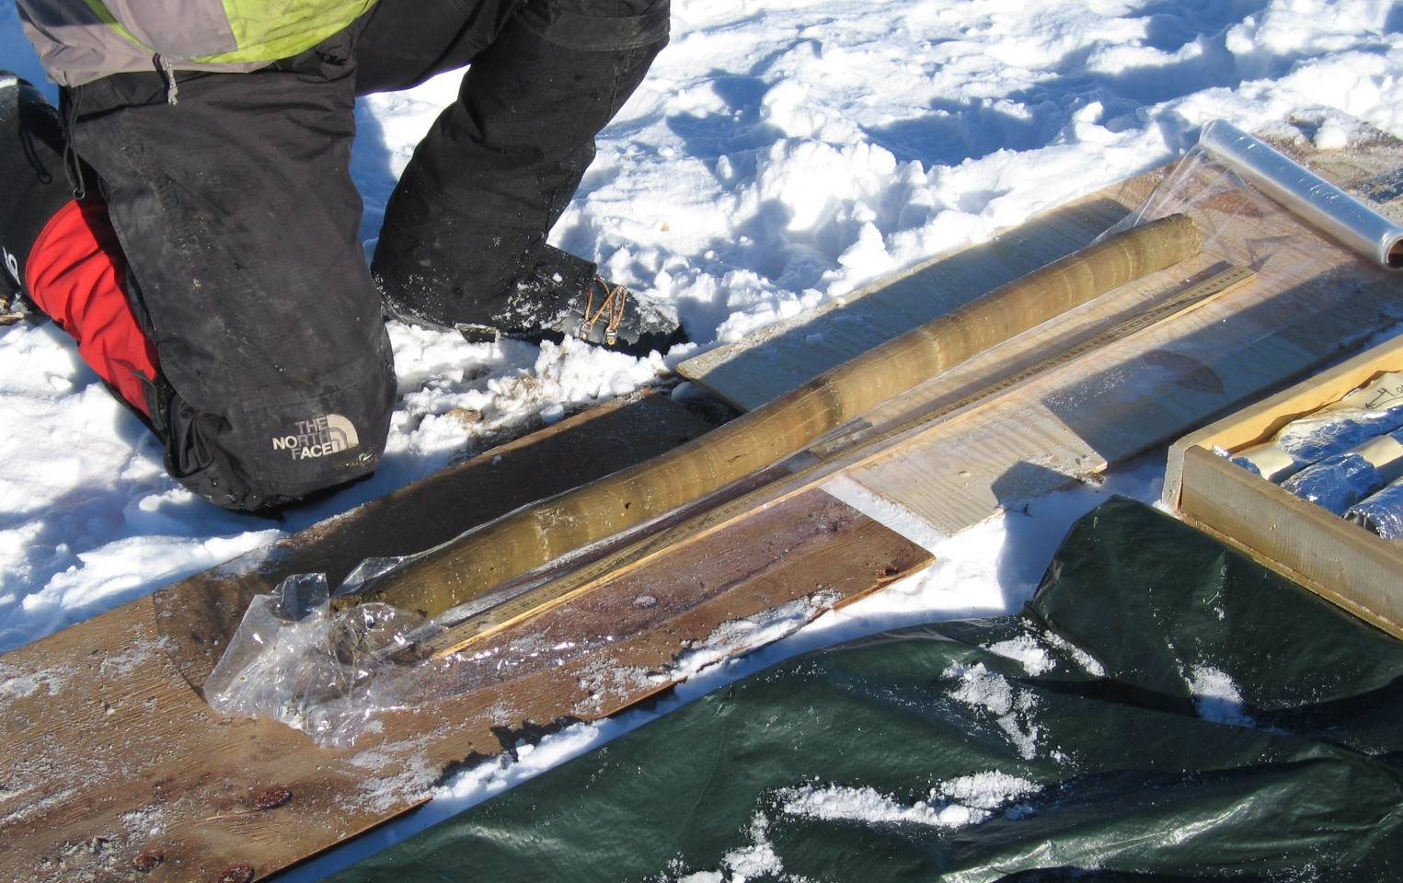
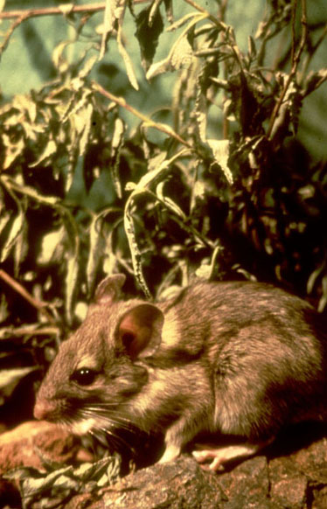
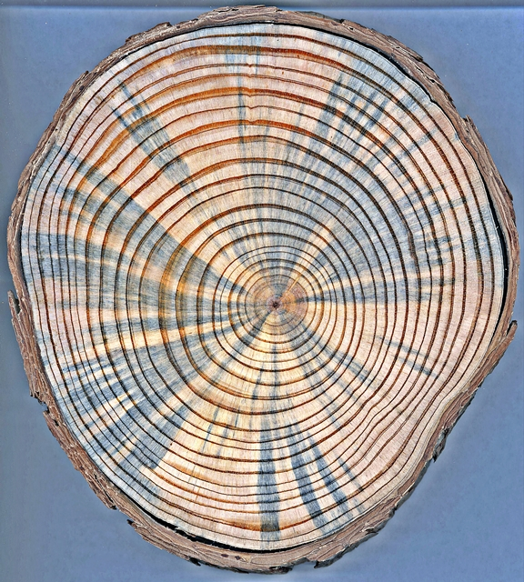
WBP paleorecords
Pollen/plant macrofossils
from lake-sediment cores
Packrat midden records
Dendroclimatology/dendroecology and remnant wood

Slide 2
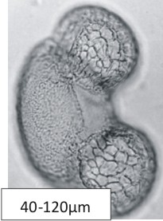
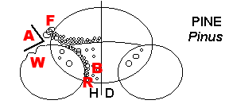
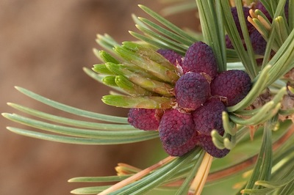
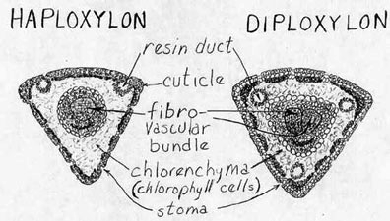
P. albicaulis-type pollen
Photo: S. Steinman

Slide 3
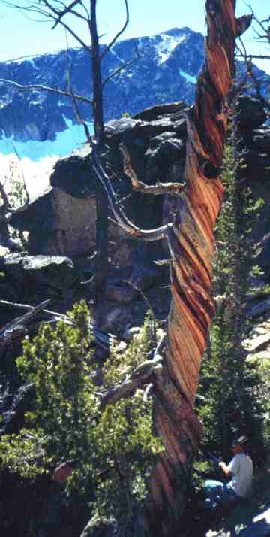
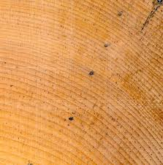
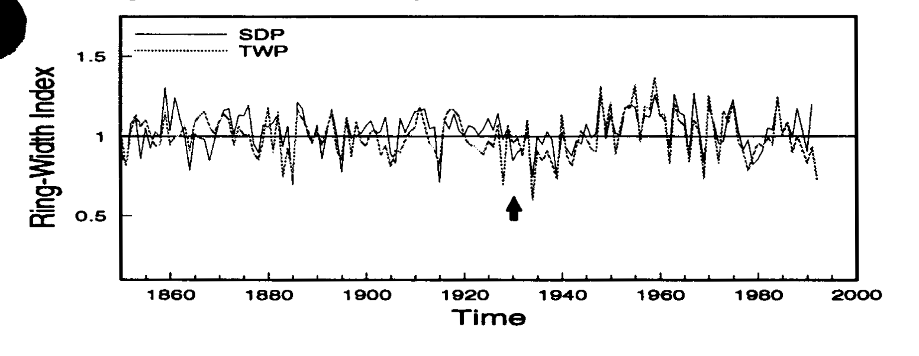
Growth patterns in WBP
Swetnam & Perkins, 1994
Perkins & Swetnam, 1996

Slide 4
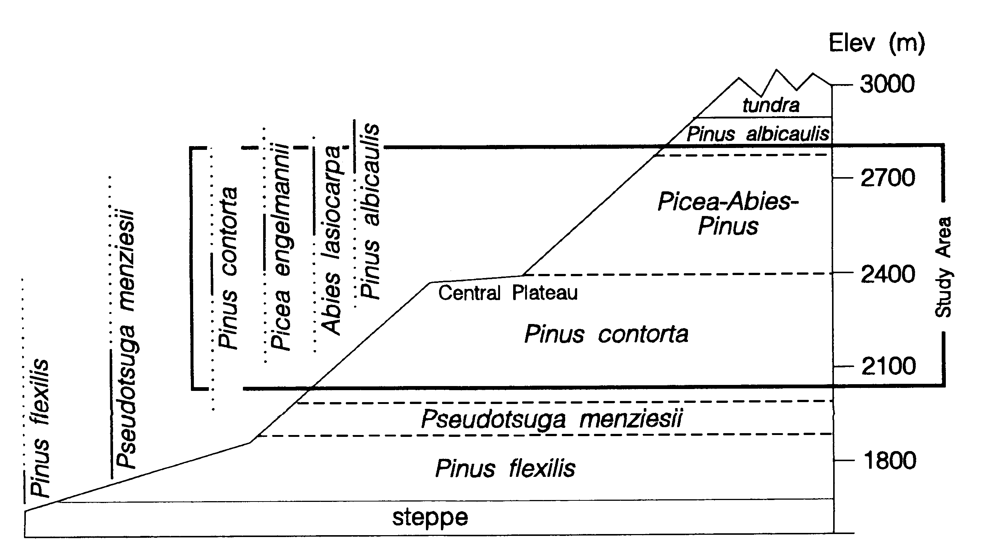
WBP fossil wood
Remnant wood, 1 ka, 6-10 ka

Slide 5
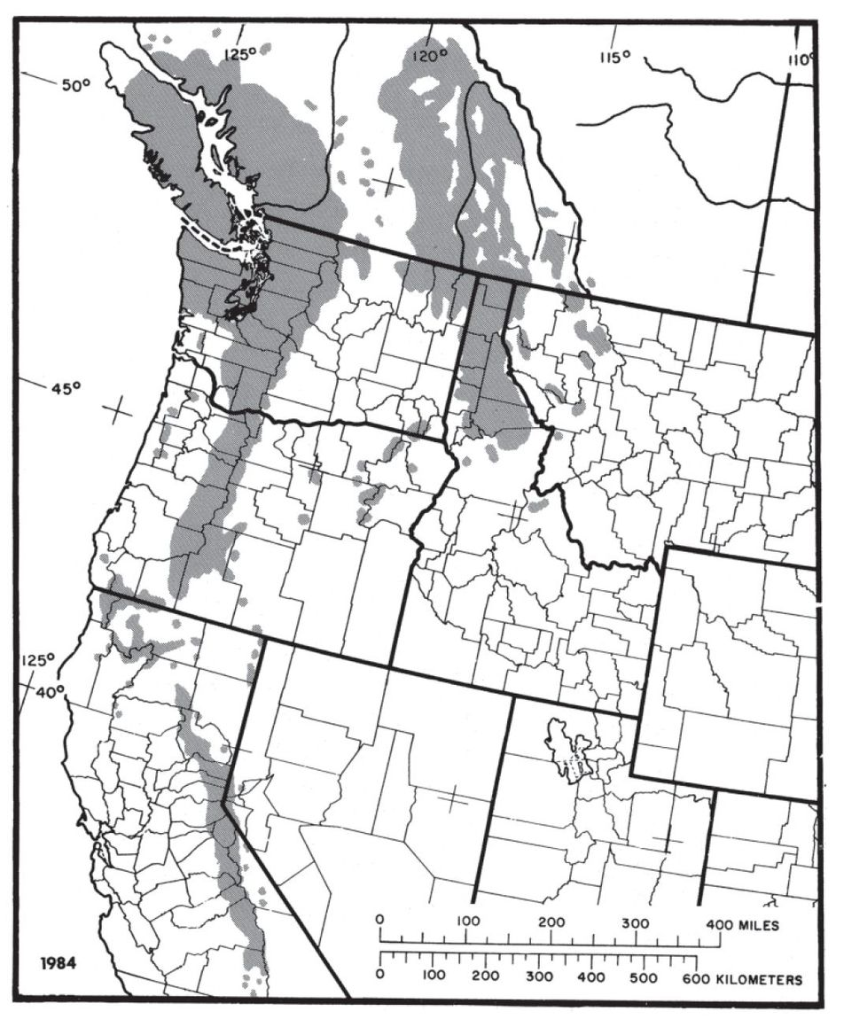
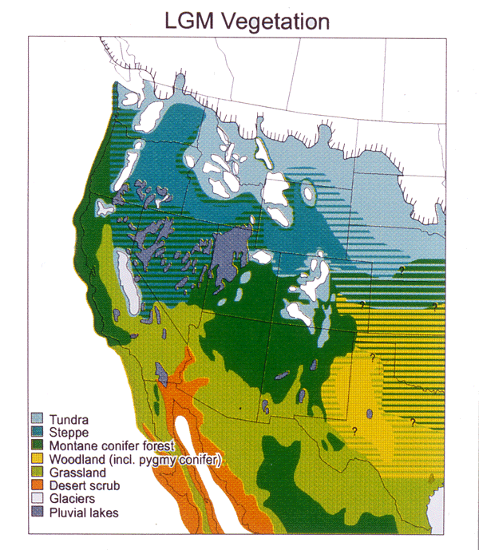
Present and LGM vegetation

Slide 6
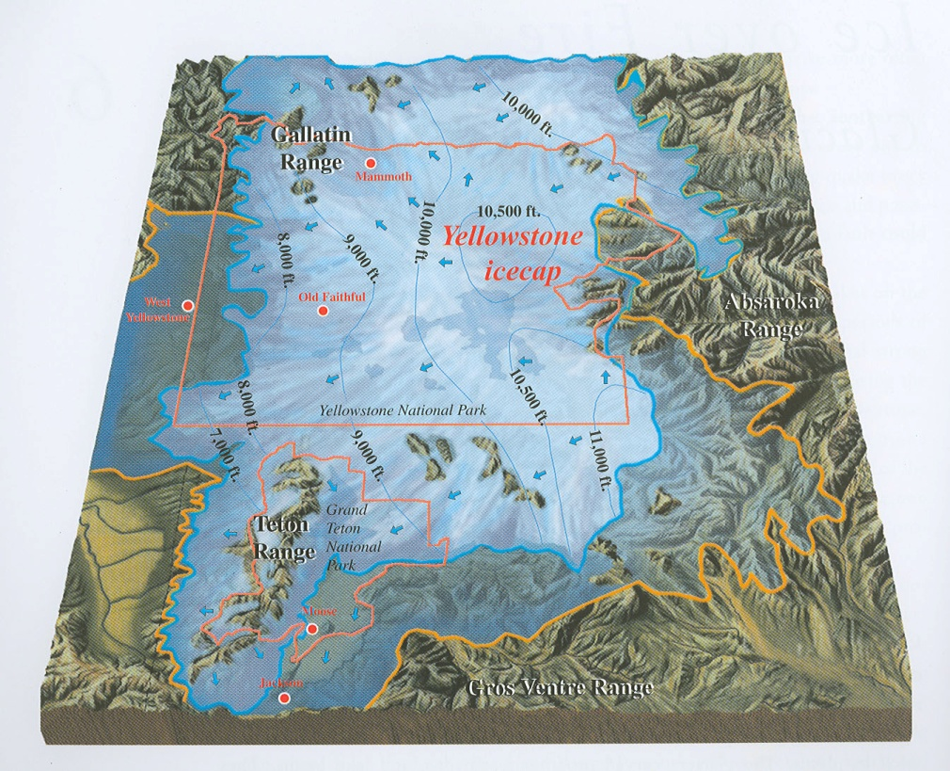
Glacial Yellowstone

Slide 7
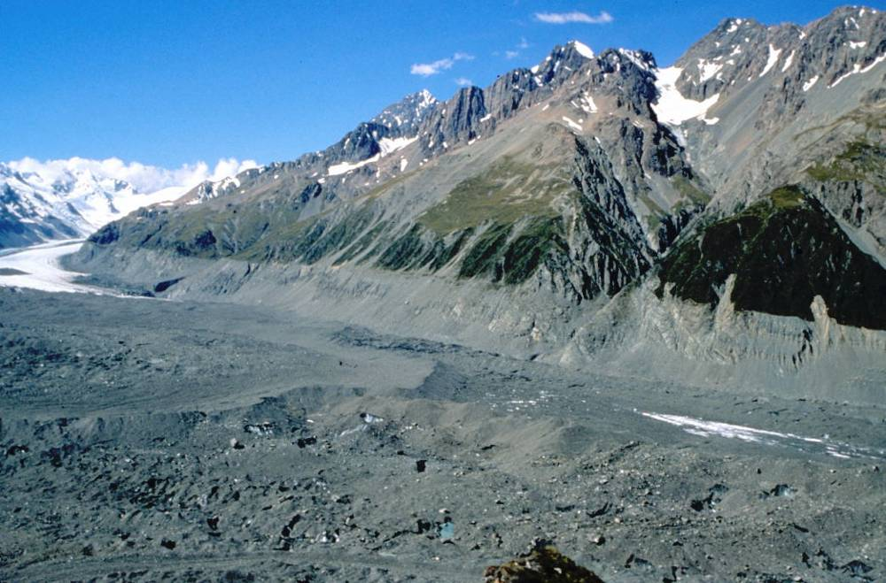
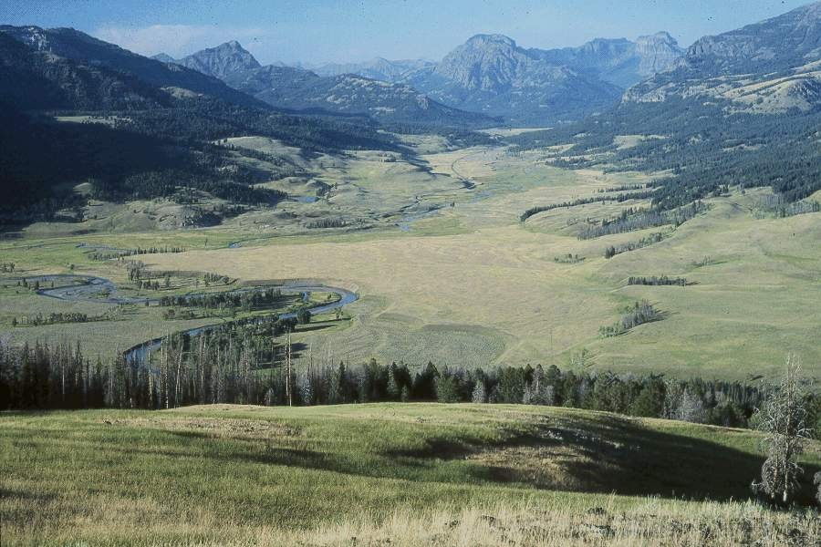
GYE vegetation history
GYE ~17,000 years ago
GYE today

Slide 8
GYE vegetation history
Vegetation history along a transect: comparing three records
T. Krause, PhD research

Slide 9
GYE Vegetation History
T. Krause, PhD research

Slide 10
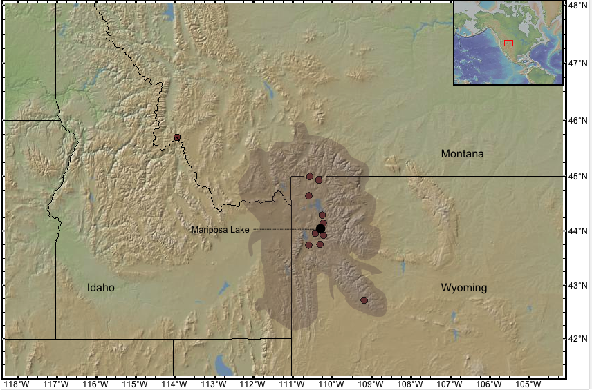
GYE Vegetation History
Mariposa Lk

Slide 11
GYE Vegetation History
WBP pollen

Slide 12
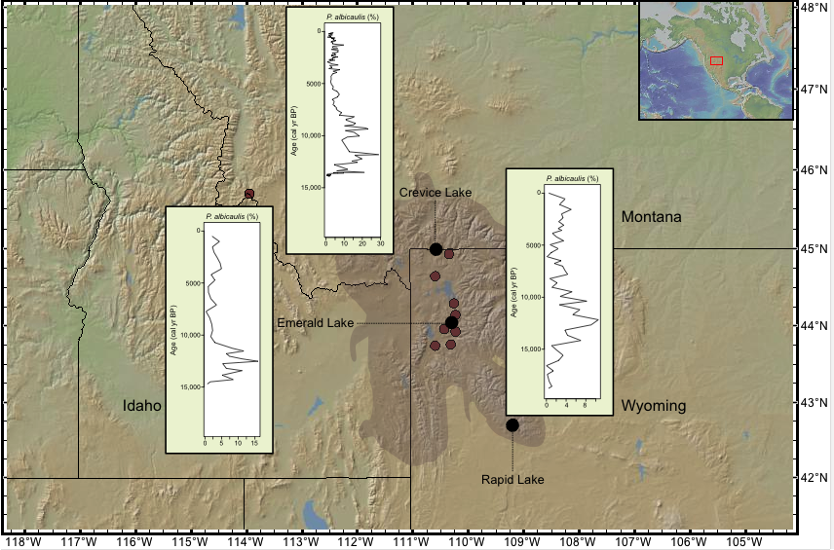
GYE Vegetation History
Crevice Lk
Emerald Lk
Rapid Lk

Slide 13
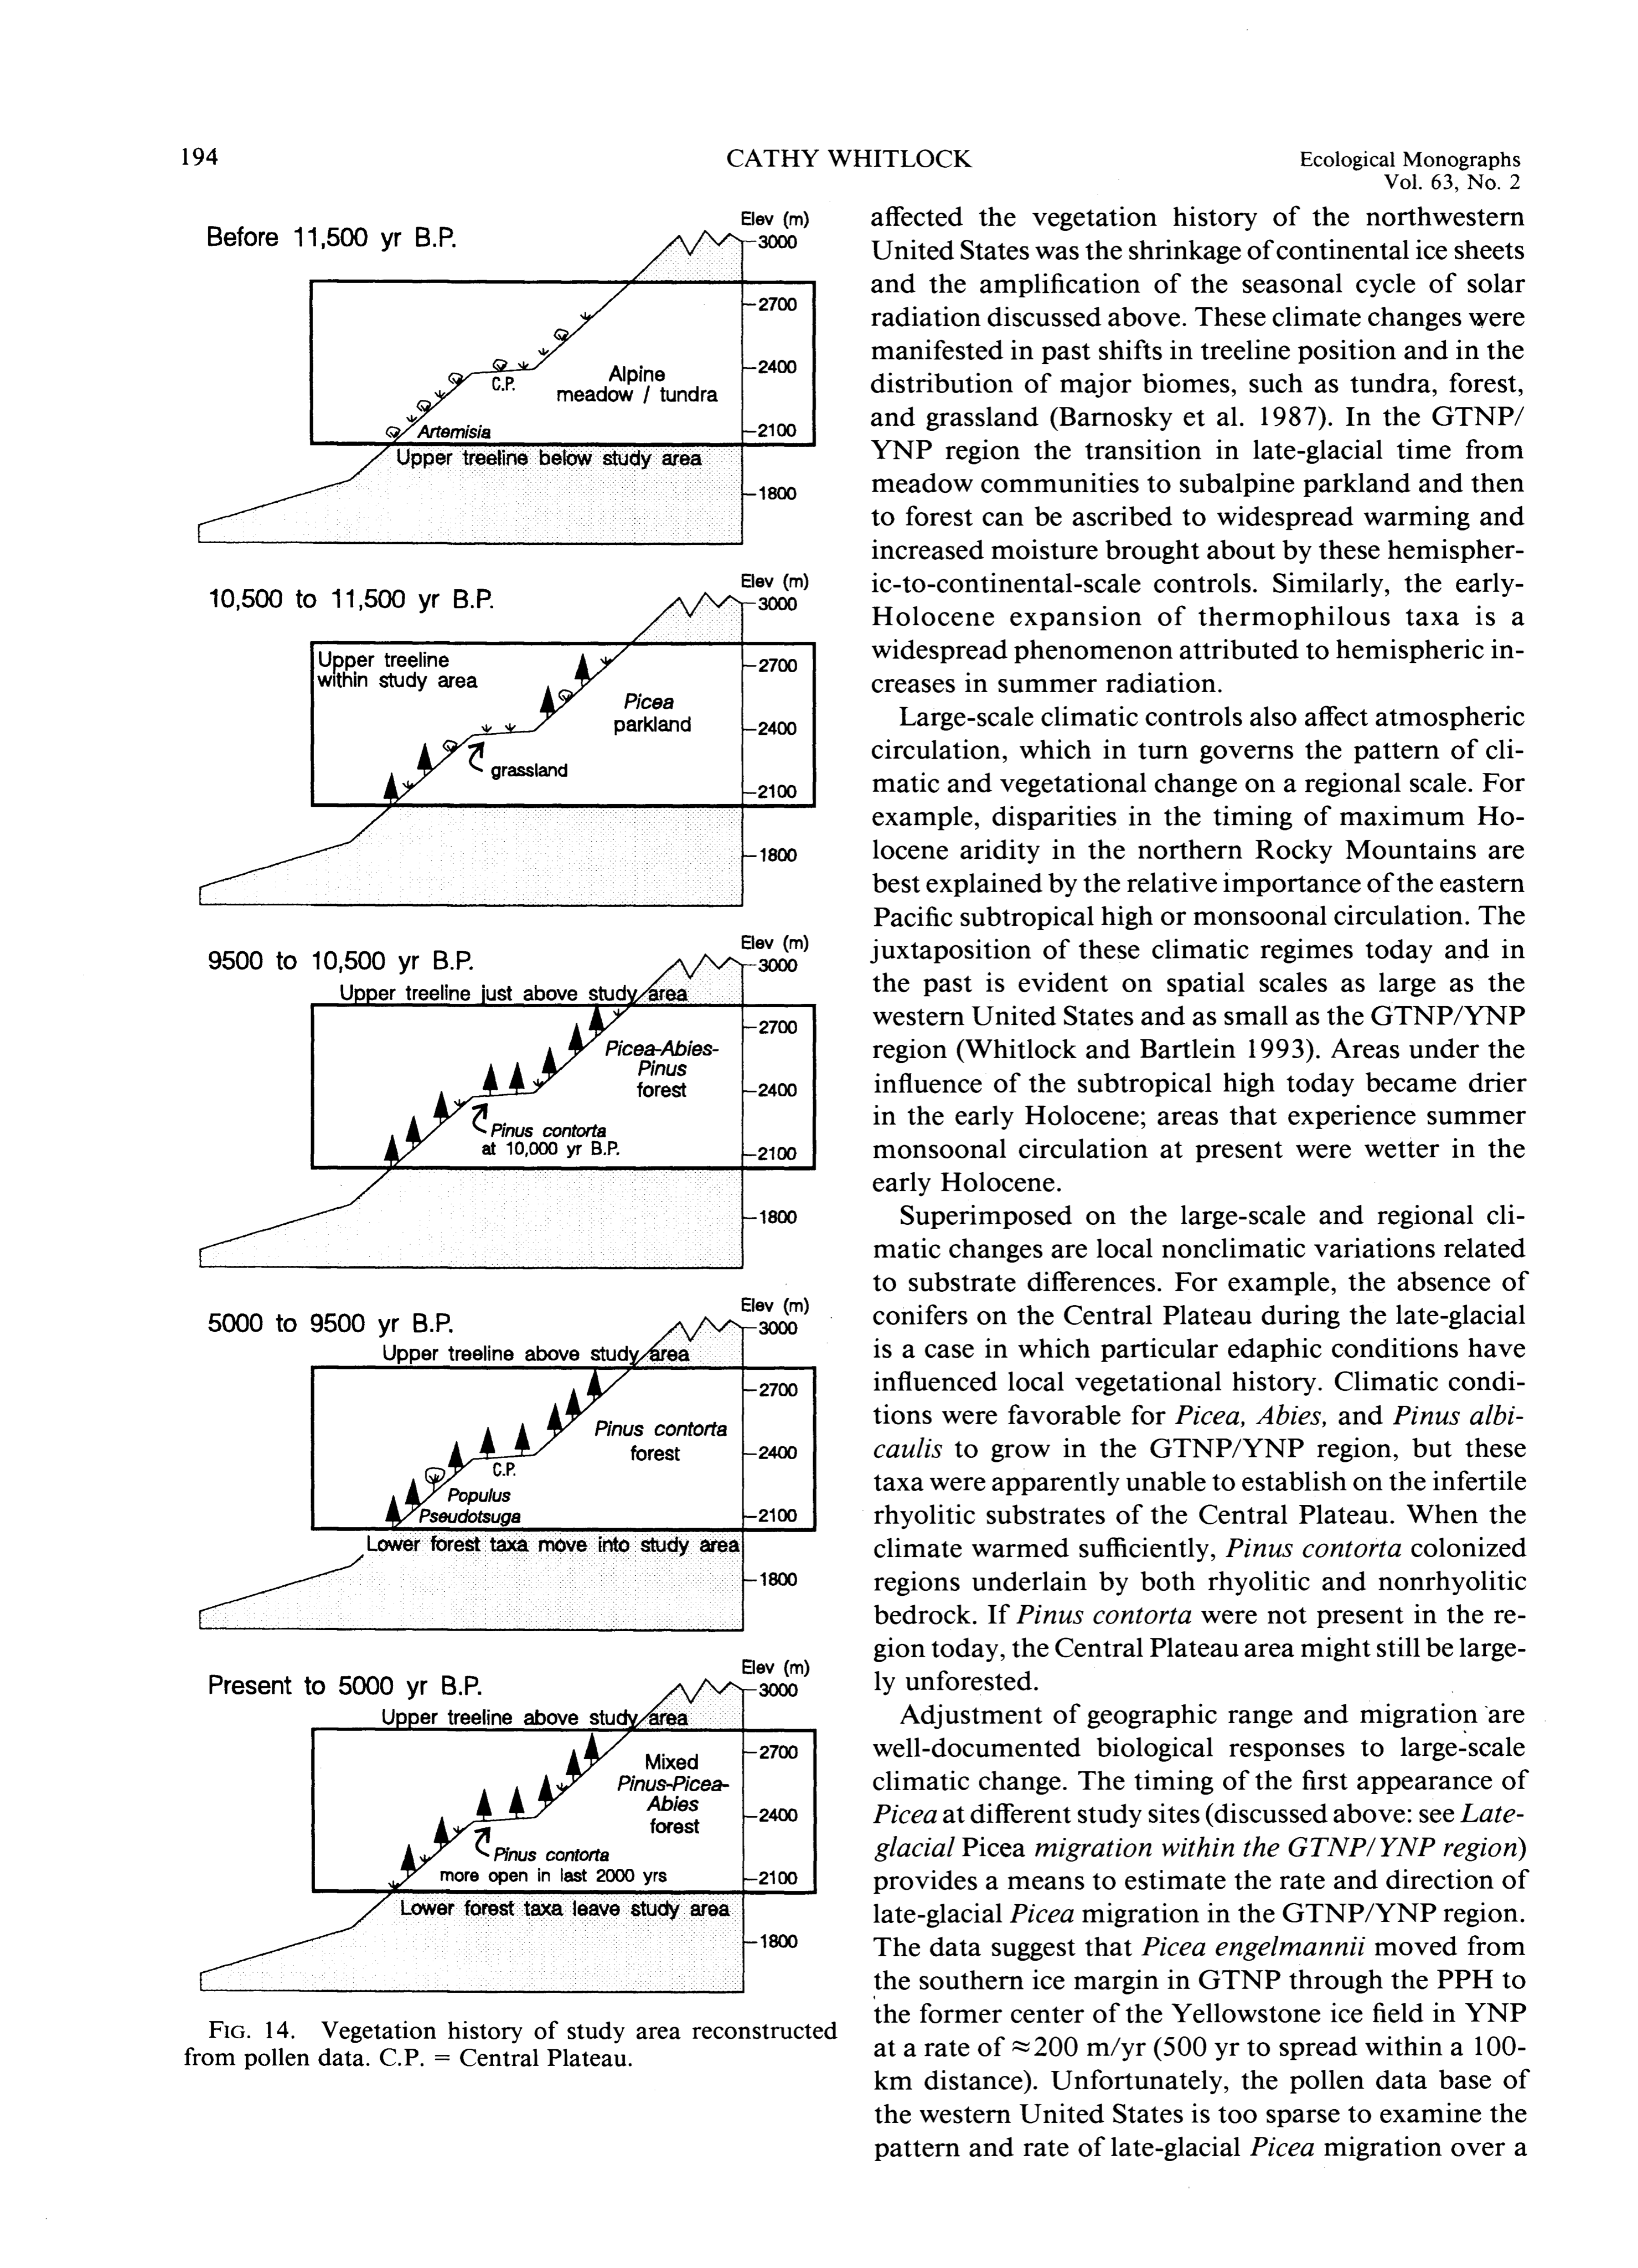
GYE Vegetation History
Before 13.5 ka
5.7-10.7 ka
12-13.5 ka
0-5.7 ka
10.7-12 ka
WBP Heyday:
Late-glacial period (before 11,000 yr)
Late Holocene (last 5000 yr)

Slide 14
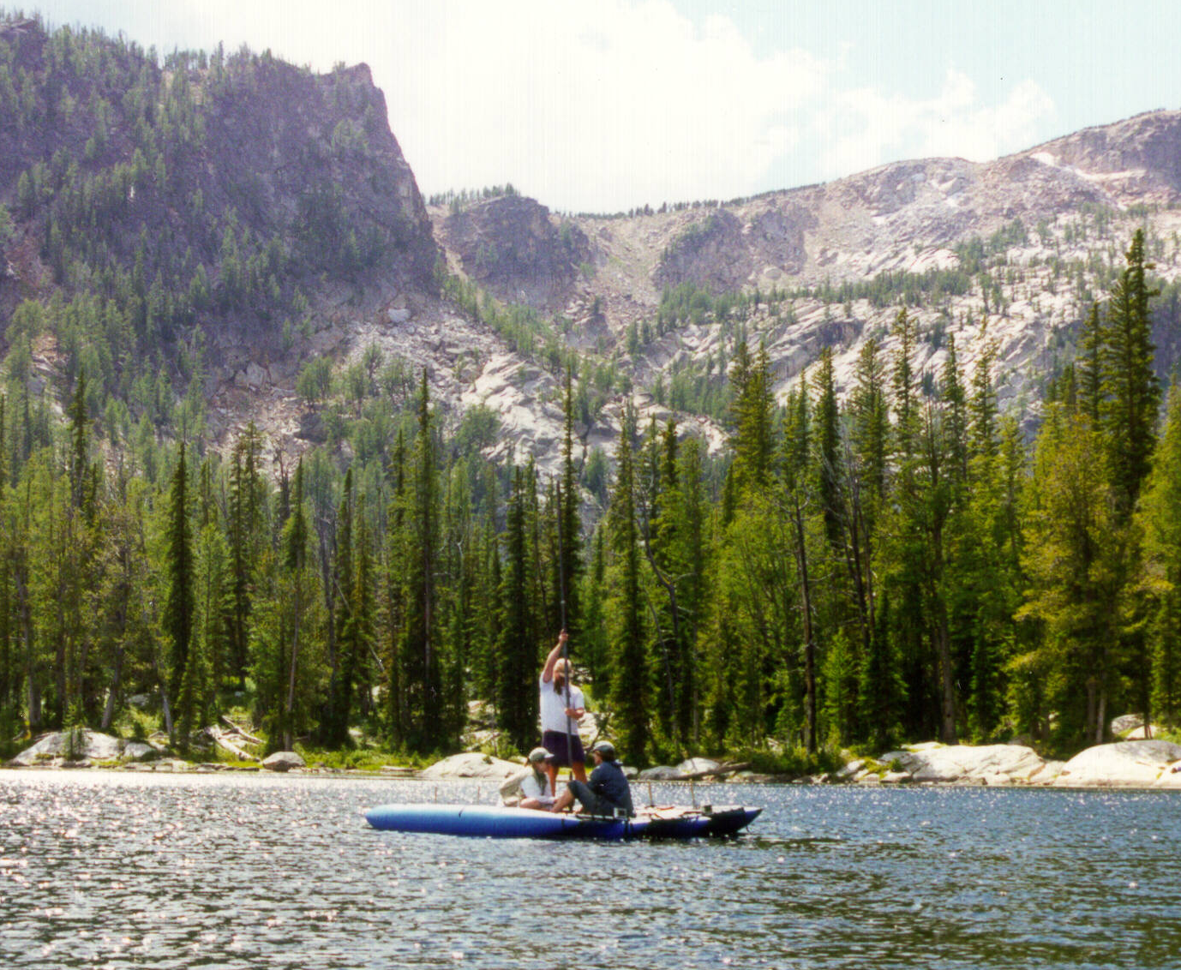
Northern Rockies
Baker Lk, 2300 m asl
Pintler Lk, 1921 m asl

Slide 15
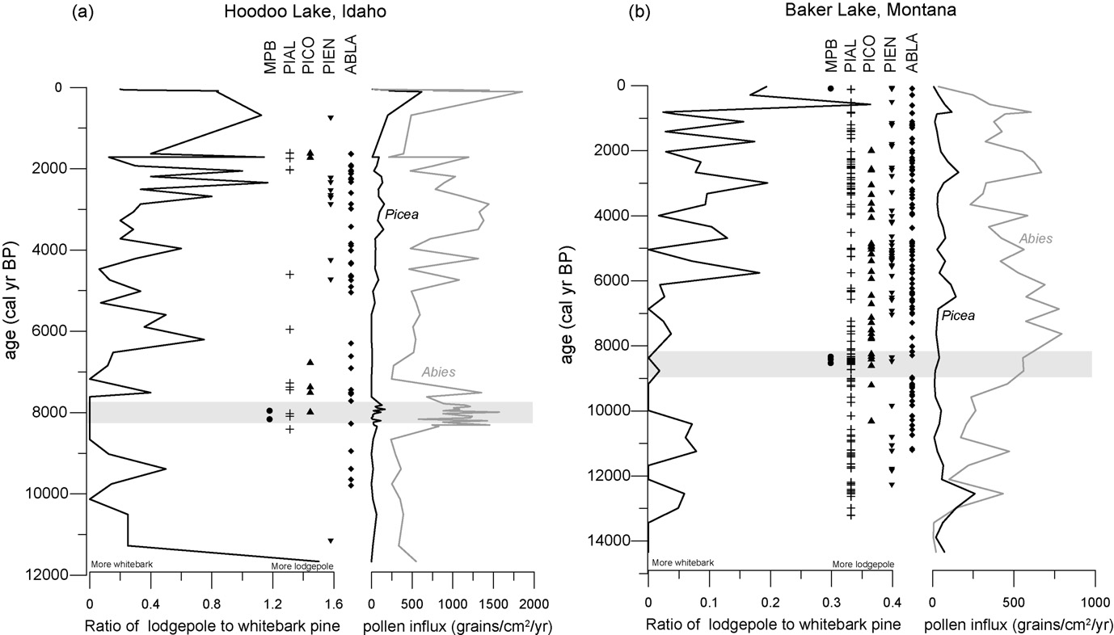
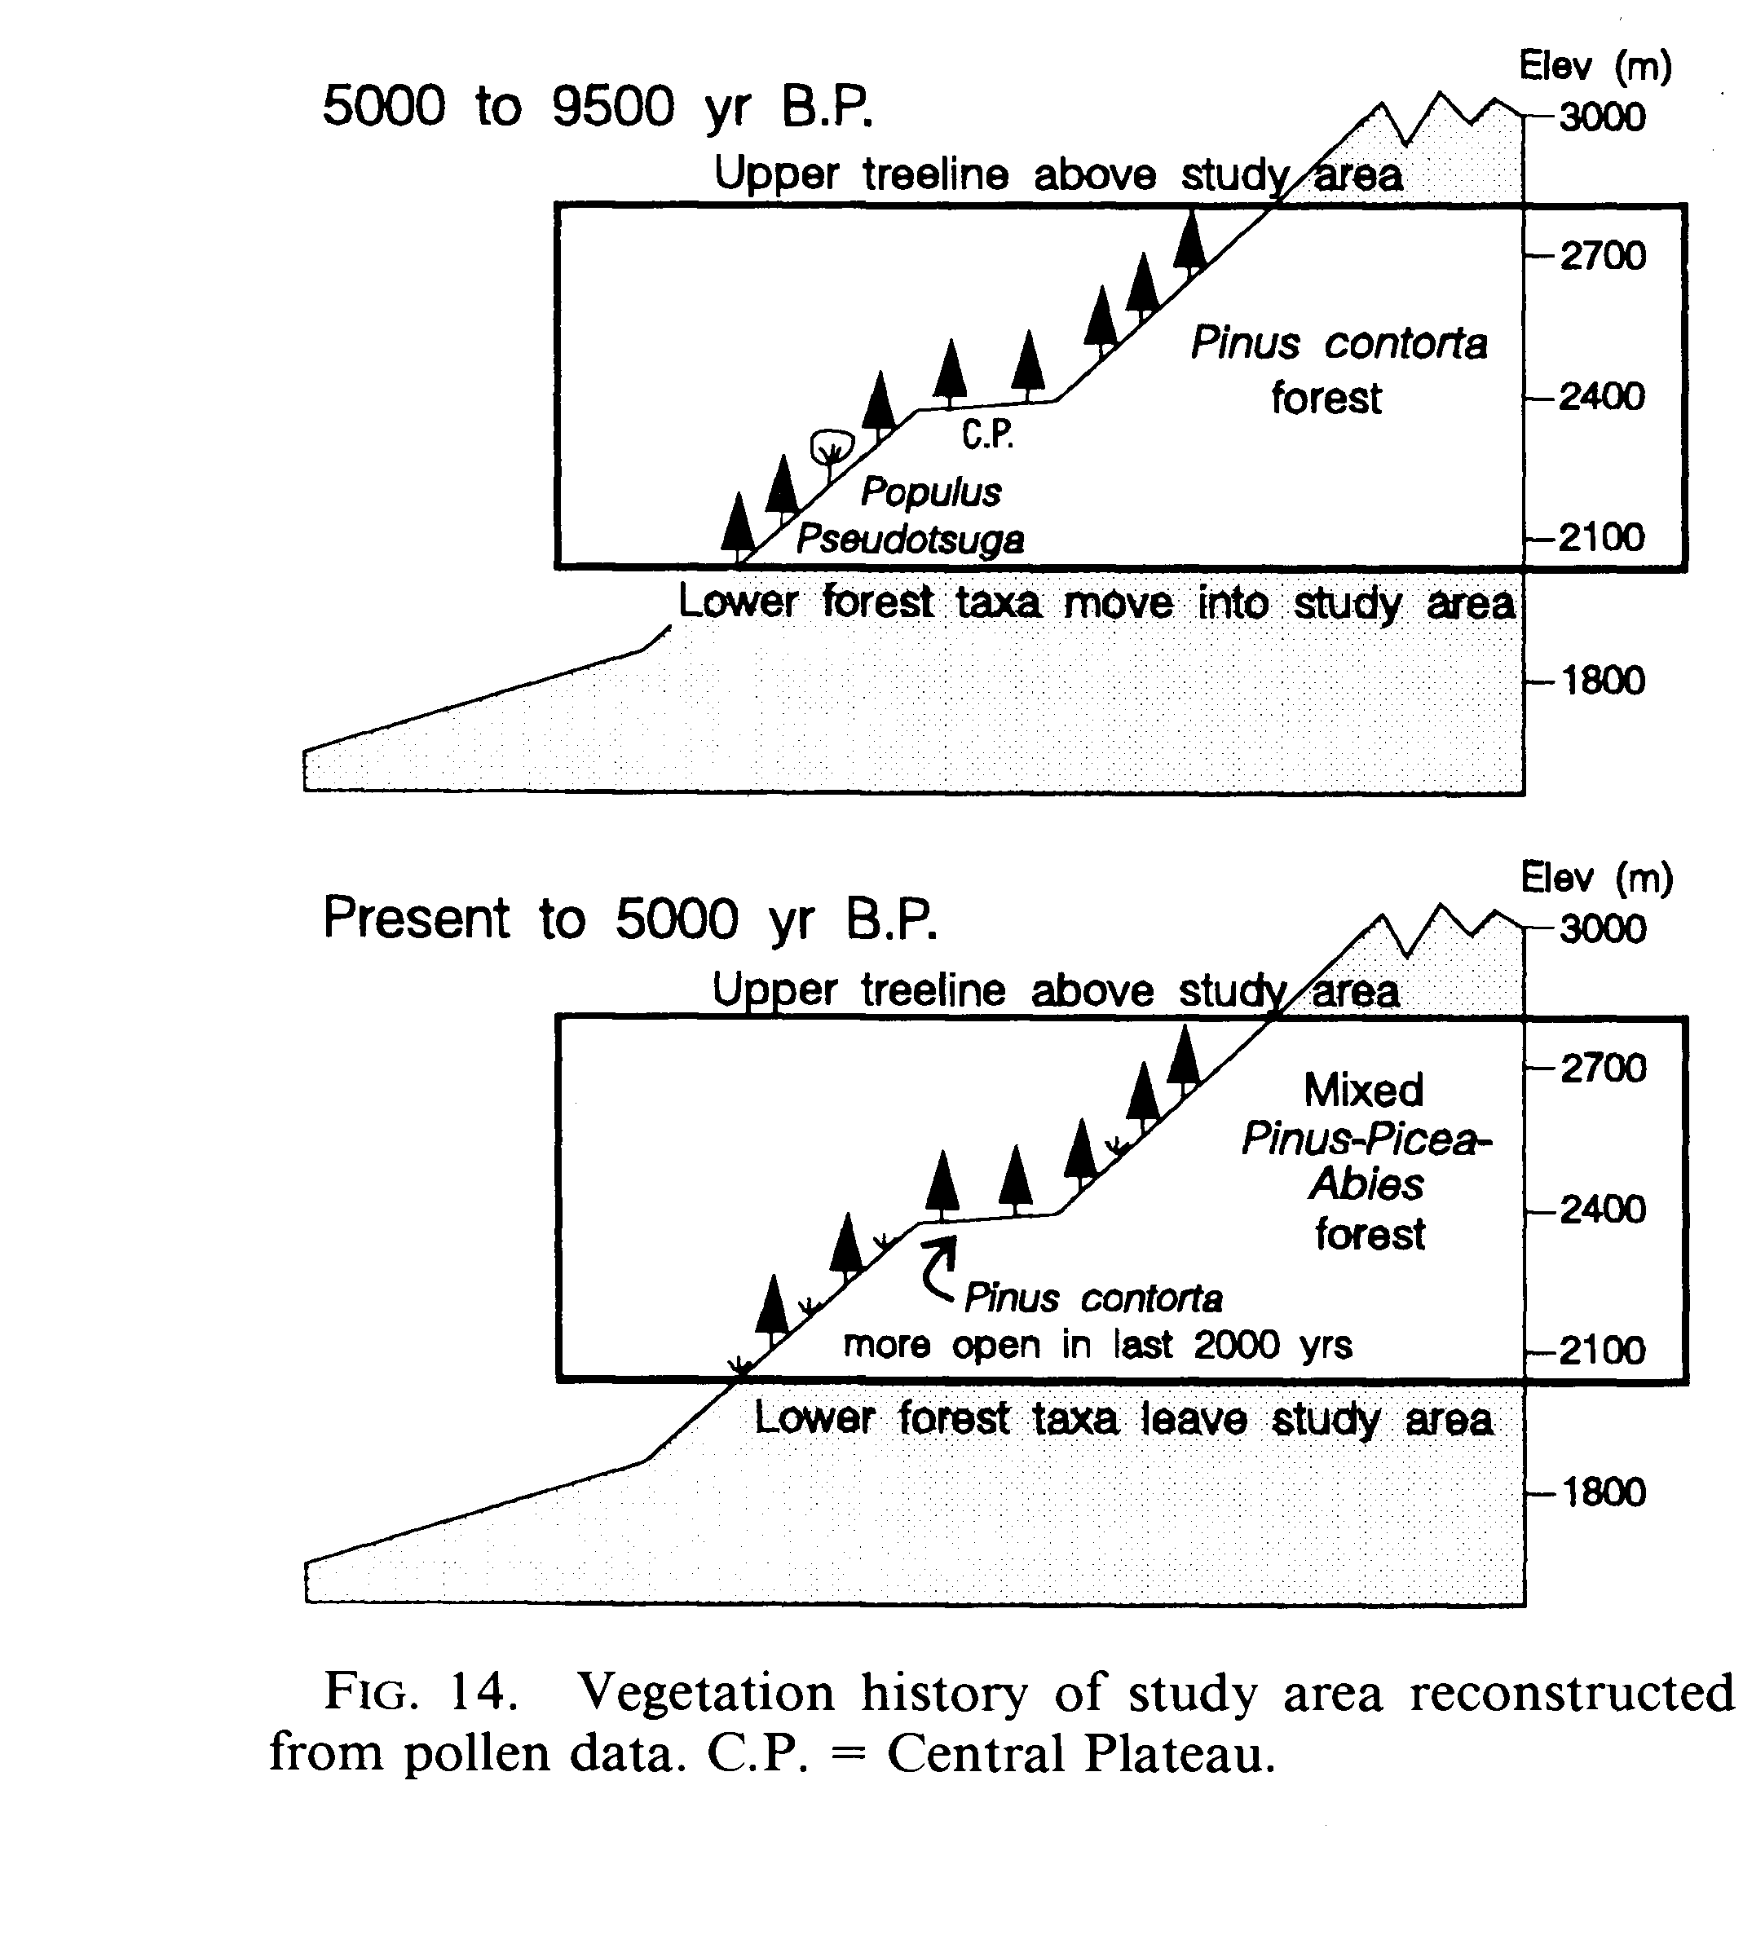
WBP & MPB
Past outbreaks associated with cool, effectively wet conditions
5.7-10.7 ka
12.2-13.4 ka
Last 5.7 kyr
10.7-12.2 ka
Brunelle et al., 2008

Slide 16
MPB & Fire
Two periods of MPB outbreaks: ca. 8000-8500 yr BP, 1930 AD
Both times of low fire occurrence.
Brunelle et al., 2008

Slide 17
What do we not know?
Information gaps
Better understanding of WBP history and environmental change
WBP distribution during past warm periods: MCA (800-1200 AD) or the early Holocene
Rates/nature of WBP response to past climate change
Long-term linkages between WBP and fire
Synergistic disturbances in the past
Promising opportunities
Good potential sites in key regions
Anthracology and soil charcoal approaches
New modeling strategies
eDNA in lake sediments
Research above timberline

Slide 18
NC CSC Paleoclimate Database

Slide 19
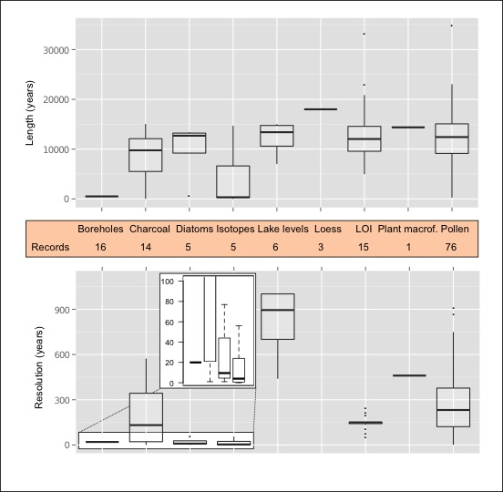
Length and Resolution

Slide 20
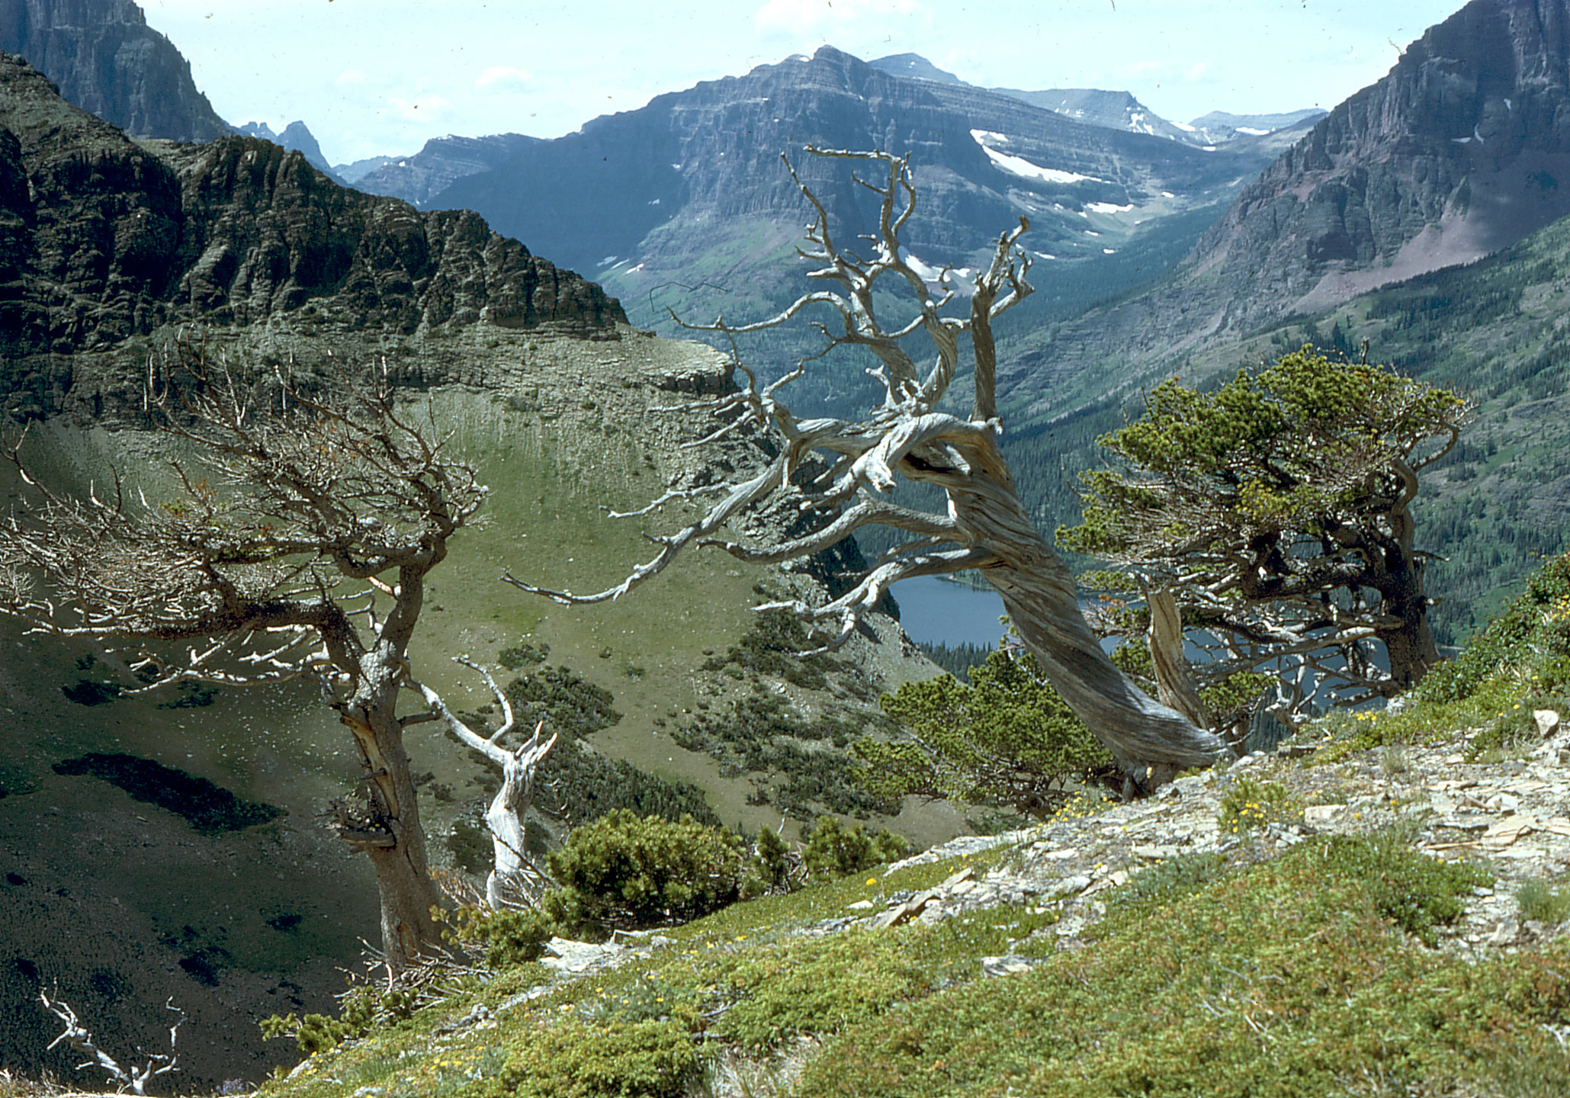




Paleoecology of whitebark pine over the last 20,000 years
Photo: M. Kaufmann 2004
Cathy Whitlock & Virginia Iglesias
Montana Institute on Ecosystems
Montana State University

