Slide 1
Ecosystem Valuation and Choice Experiments
Helen T. Naughton Department of Economics University of Montana
Notes:
A good child has many names:
Discrete choice experiment—choice experiment—choice analysis—conjoint analysis—attribute-based models
Since I am an environmental economist I will use my term.

Slide 2
EPA Science Advisory Board
Valuation of ecological systems and services is important
in national rule makings,
where executive orders often require cost-benefit analyses and
several statutes require weighing of benefits and costs.

Slide 3
EPA Science Advisory Board
Regional EPA offices can find valuation important
in setting program priorities and
in assisting other governmental and non-governmental organizations
in choosing among environmental options and
communicating the importance of their actions to the public.

Slide 4
EPA Science Advisory Board
Ecological valuation can also help EPA to improve
the remediation of hazardous waste sites and
make other site-specific decisions.

Slide 5
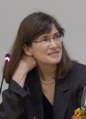
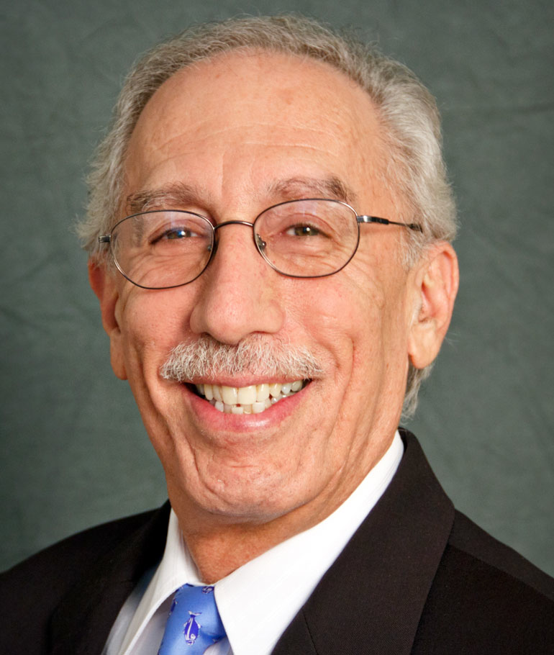
What does an environmental economist look like?
Notes:
Alan Krupnick—president of the association of environmental and resource economists.
Vic Adamowicz—one of the authors of the first choice experiment paper in environmental economics.
Martin Weitzman—the Harvard professor that got caught stealing horse manure.
Trudy Cameron—my environmental economics professor.
Trudy said that the biggest challenge for environmental economist is to sit around a table with ecologists.

Slide 6
What does an ecologist look like?

Slide 7
What does an ecologist look like?
Oh wait, you guys know!

Slide 8
Can they get along?

Slide 9
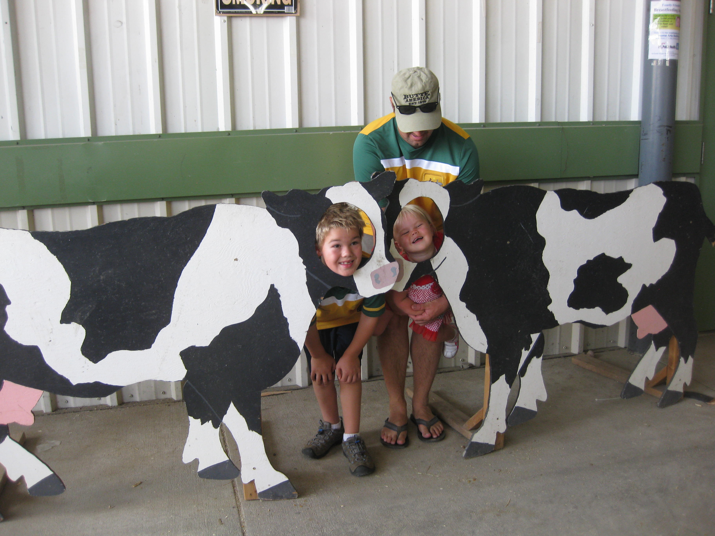

Slide 10
An Opportunity
Philosophical debates:
Value
Utility
Etc.
Hopefully, not an obstacle.

Slide 11
Ecological Value vs. Economic Value?
Notes:
Academic disciplines have different approaches to describing values
Not so surprising in a world where no two individuals will ever fully share values
In fact even individual values change continually.

Slide 12
Environmental Economics
Offers tools to conceptualize people’s values.
Notes:
So, instead in this messy world we have people who develop tools that help us conceptualize values
Or should we not even try?

Slide 13
Tools in a messy world
Notes:
Medical science isn’t perfect either—it uses cool and sharp scalpels to cut through perfectly healthy tissue to remove unhealthy tissue. Still we put our hope in that the doctor who is treating us has our best health in mind.

Slide 14
Market-based methods
Value goods traded in the market.

Slide 15
Non-market valuation
Recognizes that non-traded ecosystem goods and services have real (economic) value.

Slide 16
Contingent Valuation and Choice Experiments
Survey-based
Stated preference methods
Estimate value or willingness to pay (WTP)
Intended to capture total value
Use
Non-use

Slide 17
Contingent Valuation of White Pine Blister Rust Management
Suppose managers treat 50% of the high-elevation forests in the Western United States. As a result, these acres will be healthy in 100 years from now. The remainder of the acreage would not be treated. Would your household be willing to pay a one-time cost of $100 to fund this program?
Mean per household WTP=$172
Aggregate annual WTP of Western U.S. households is about $4.7 billion

Slide 18
Contingent Valuation of South Platte River Restoration
The survey provides a lot of information about the ecosystem services of the river.
Would you vote for the restoration fund if it cost $X/month?
Estimates mean household WTP=$21
Aggregate annual WTP of regional households living along South Platte river is between 18 and 71 $million

Slide 19
Choice Experiment
More flexible than contingent valuation
Involves modeling complex trade-offs between ecosystem attributes

Slide 20
Design of Choice Sets
A set of attributes affecting the choice
Reflect actual characteristics of the ecosystem in the study area

Slide 21
Examples of Choice Experiments
Adamowicz et al. (1994) valued water-based recreation in Alberta
Choice experiment involved asking respondent to choose between different recreation opportunities with varying attributes and day use or entry fee.

Slide 22
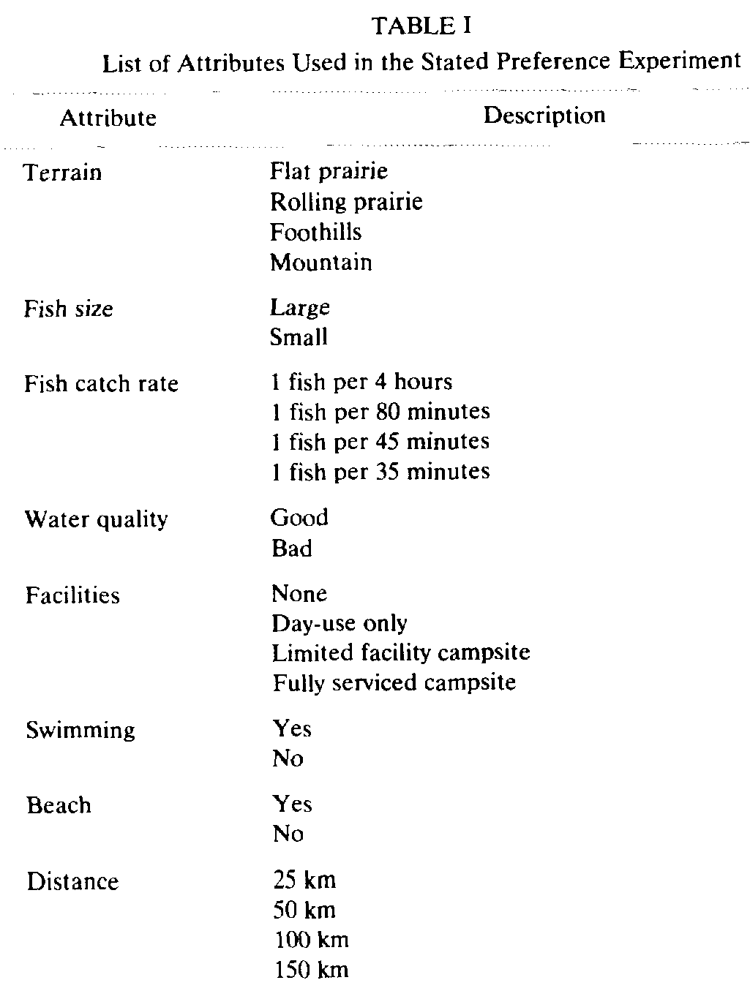

Slide 23
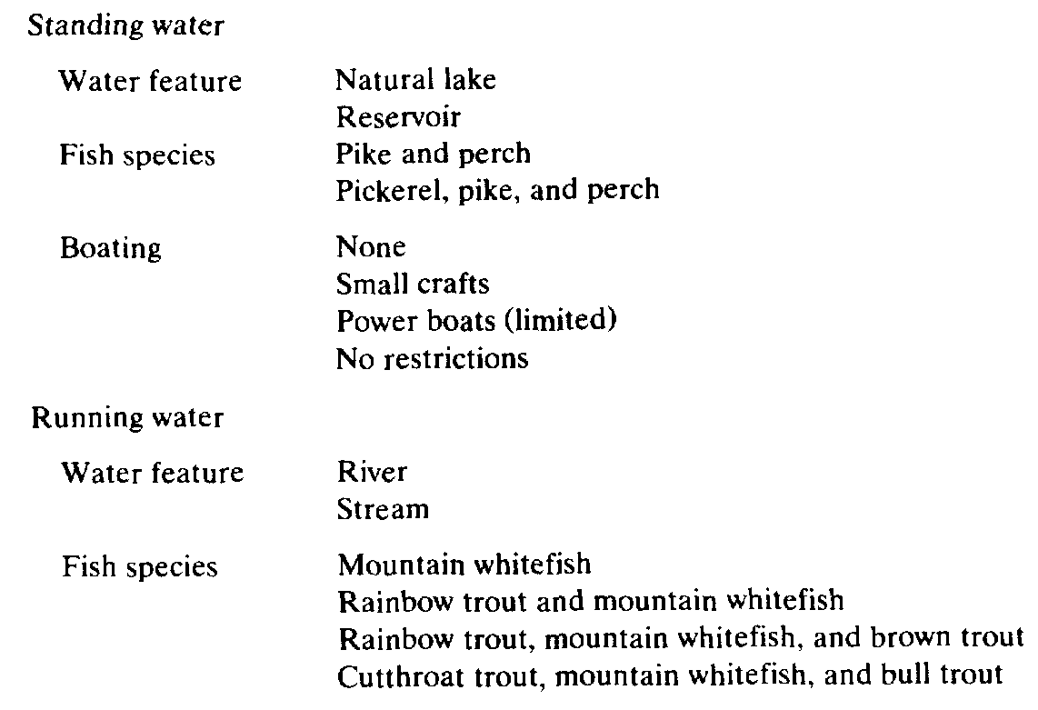
Table 1, cont.

Slide 24
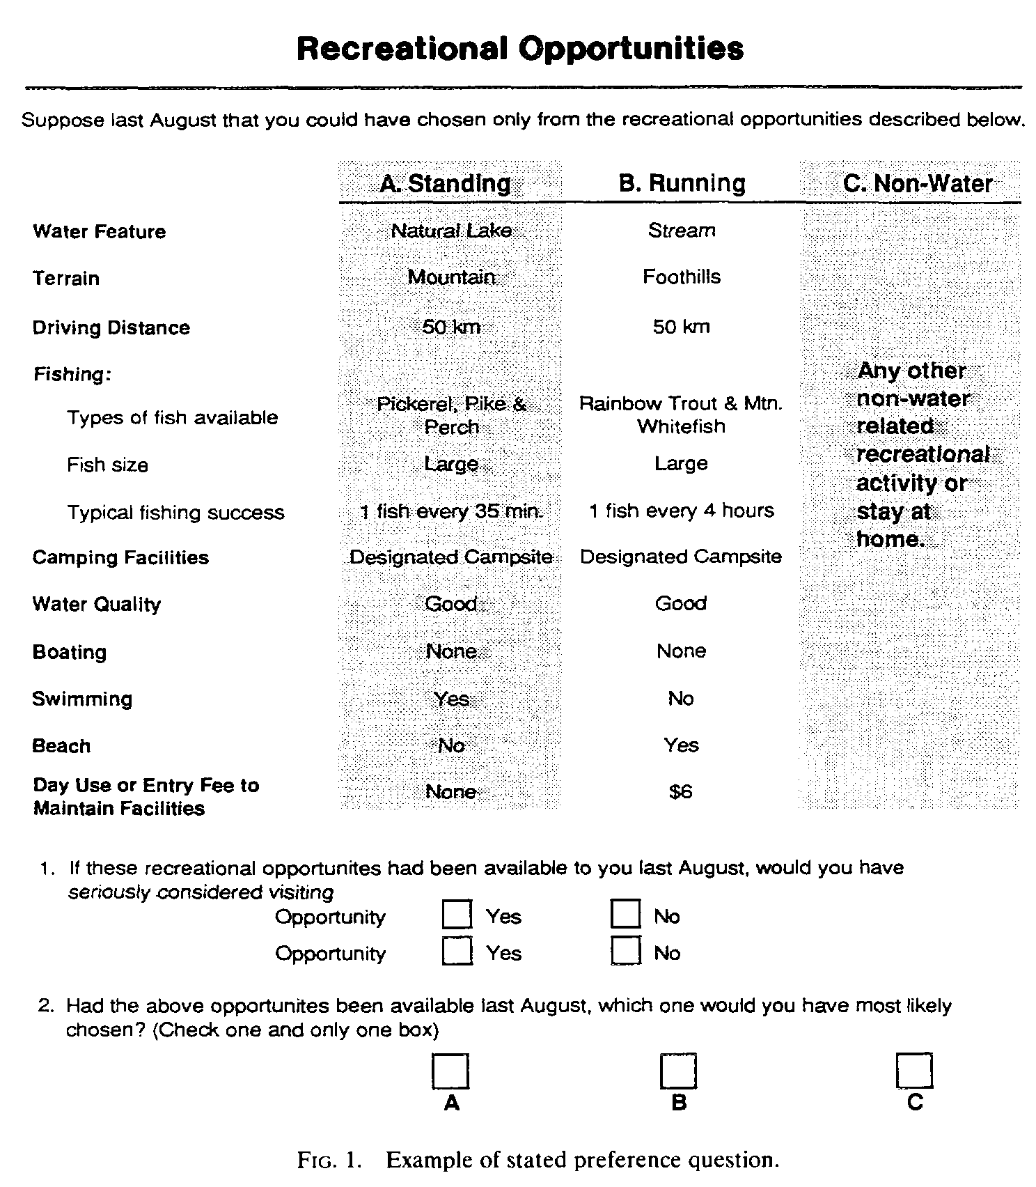

Slide 25
Preferred characteristics of rec. opportunities:
Larger fish
Increased catch rates
Good water quality
Availability of swimming
Beaches

Slide 26
WTP for Forest Management in Saskatchewan

Slide 27
WTP for improvements to threatened population of Woodland Caribou in Alberta

Slide 28
WTP for marine mammal recovery programs in the St. Lawrence Estuary

Slide 30
WTP for Biodiversity Action Plan in the UK

Slide 31
WTP for the “best” marine biodiversity protection option is estimated more than £70/year

Slide 32
WTP for Rural Landscapes in Ireland

Slide 33
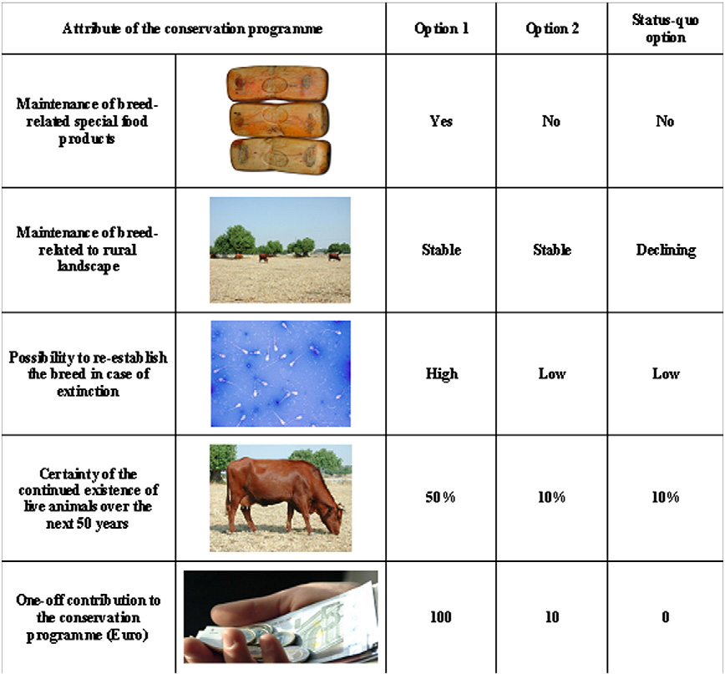

Slide 34
Distribution of Total Economic Value

Slide 35
Choice Experiments Have Their Flaws
Hypothetical bias
High cognitive burden
Complexity-induced choice inconsistency
Results depend on the information given, specially for less-known environmental goods
Relatively new method—flaw or an opportunity?

Slide 36
I will need your help!
Designing the choice experiment:
An iterative process
Needs to include clear language about ecological and management issues
Needs to be easily accessible to the average resident

Slide 39
We will expand our vocabulary!
What is an externality?
What are economic values?
Choice experiment vs. conjoint analysis

Slide 40
My hopes for the project:
To get along after it’s all said and done.
To apply the state of the art methods.
To learn a bunch in the process!
Notes:
The science is the easy part!

Slide 41
Studies discussed
Adamowicz et al. 1994
Boxall et al. 2009
Boxall et al. 2011
Campbell et al. 2011
Colombo et al. 2013
Hoyos 2013
Josbtvogt et al. 2013
Kaczan et al. 2013
Loomis et al. 2000
Norwood and Lusk 2011
Palomo et al. 2013
Siikamaki and Layton 2006
Torres et al. 2011
Zander et al. 2013

