Slide 1
Ecosystem Valuation
Ecosystems offer benefits to current and future generations. Ecosystem services are defined as the flow of benefits from nature to people.
The basic aim of valuation is to determine the preference of the user: how much better or worse off they would consider themselves to be as a result of changes in the supply of certain ecosystem goods and services.
By expressing these preferences and relating them to measures of human well-being, representing a significant portion of the total economic value of the environment. Substantial positive economic values can be attached to many of the marketed and non-marketed services provided by ecosystems.

Slide 2
Ecosystem Goods & Services Typology
Provisioning Regulating Cultural
Goods produced or Benefits obtained Non-material benefits
provided by ecosystems from regulation of from ecosystems
• food ecosystem processes • spiritual
• fresh water • climate regulation • recreational
• fuel wood • disease regulation • aesthetic
• genetic resources • flood regulation • inspirational
• educational
Supporting
Services necessary for production of other ecosystem services
• Soil formation
• Waste Treatment and Nutrient cycling
• Primary production
Adapted from Millennium Ecosystem Assessment Ecosystems and Human Well Being (2003) to help meet the needs of decision-makers and the public for scientific information concerning the consequences of ecosystem change for human well-being and options for responding to such changes (http://www.millenniumassessment.org/en/index.aspx).

Slide 3
Non-Market Valuation Techniques
Revealed-preference approaches
Travel cost: Valuations of site-based amenities are implied by the costs people incur to enjoy them.
Market methods: Valuations are directly obtained from what people must be willing to pay (WTP) for the service or good or willingness to accept (WTA) compensations for changes in their level of use of service or good.
Hedonic methods: The value of a service is implied by what people will be willing to pay for the service through purchases in related markets, such as housing markets (e.g., open-space amenities).
Production approaches: Service values are assigned from the impacts of those services on economic outputs (e.g., increased shrimp yields from increased area of wetlands).
Cost-based approaches
Replacement cost: The loss of a natural system service is evaluated in terms of what it would cost to replace that service (e.g., tertiary treatment values of wetlands if the cost of replacement is less than the value society places on tertiary treatment).
Avoided cost: A service is valued on the basis of costs avoided, or of the extent to which it allows the avoidance of costly averting behaviors, including mitigation (e.g., clean water reduces costly incidents of diarrhea).
Stated-preference approaches
Contingent valuation: People are directly asked their willingness to pay or accept compensation for some change in ecological service (e.g., willingness to pay for cleaner air).
Choice modeling: People are asked to choose or rank different service scenarios or ecological conditions that differ in the mix of those conditions (e.g., choosing between wetlands scenarios with differing levels of flood protection and fishery yields).
Notes:
National Research Council 2005. Valuing Ecosystem Services: Toward Better Environmental Decision-Making The
National Academies Press, Washington D.C.

Slide 4
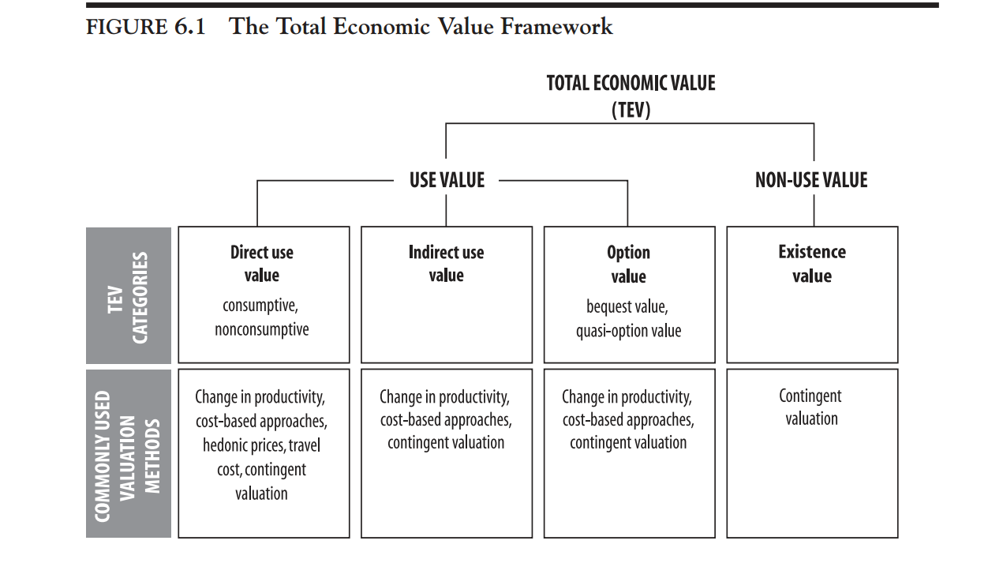
TEV from MEA

Slide 5
TEV for WBP?
Use Values Non-Use Values
direct indirect bequest existence
potable water flood control charismatic species

