Slide 1




Potential Impacts of Climate Change on Vegetation in the Appalachian LCC
Patrick Jantz, Tina Cormier, Scott Zolkos, Scott Goetz and the LCCVP Group
NASCB July 10, 2014
Missoula, MT
Photo credit: Andri Kyrychok

Slide 2
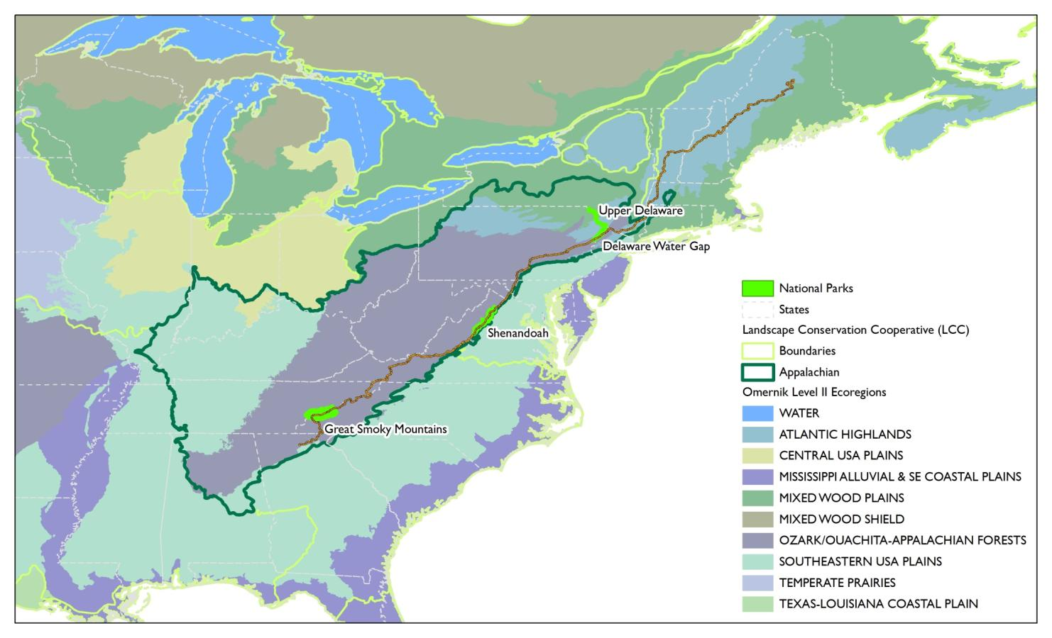
Appalachian LCC
Notes:
Temperate broadleaf and mixed forest with high elevation boreal forest remnants at high elevation.

Slide 3
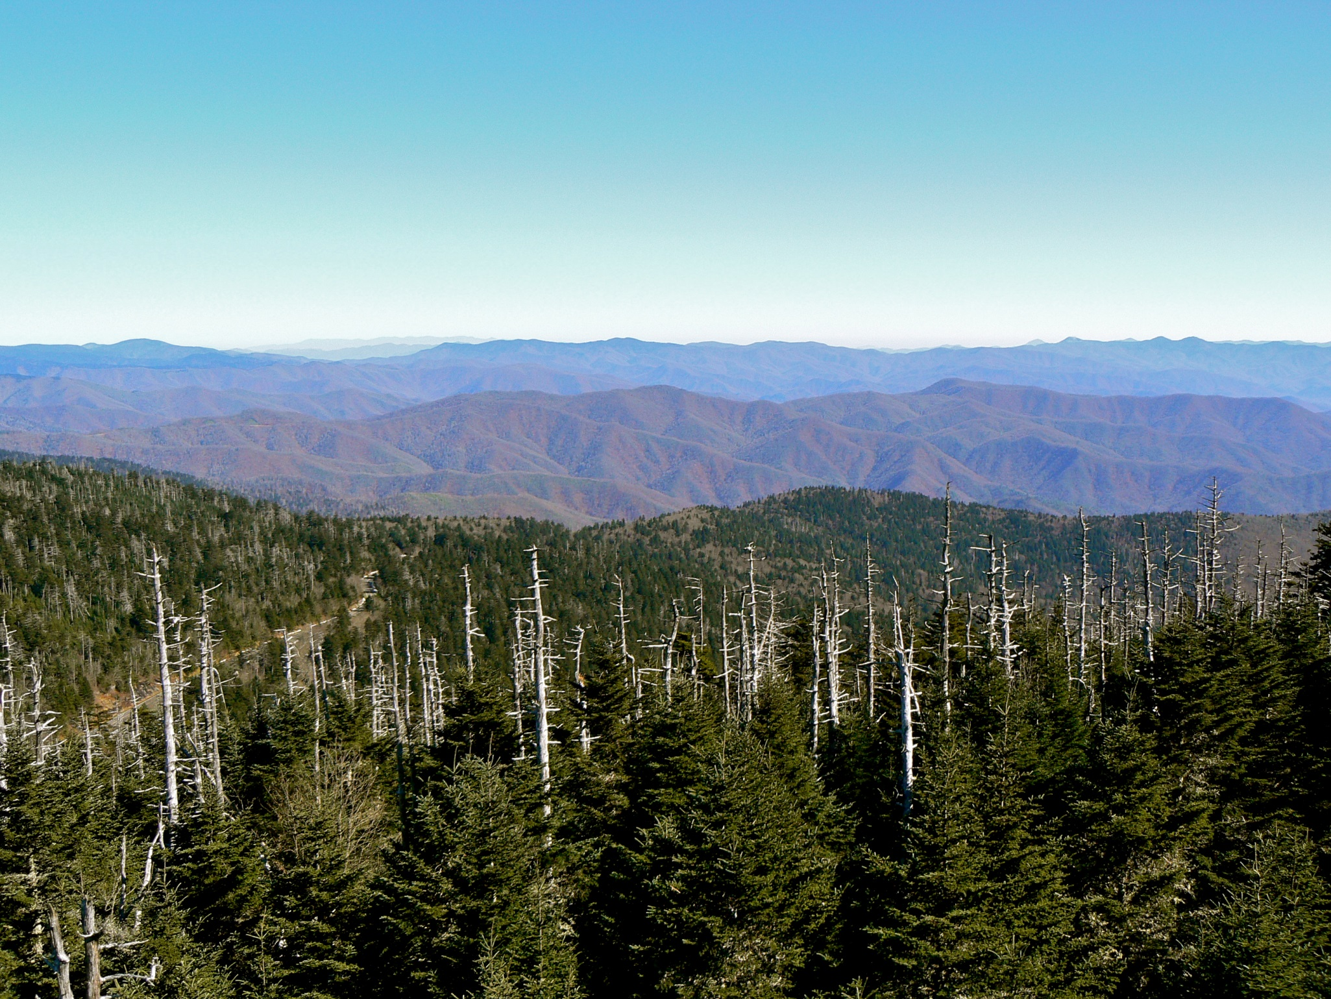
Appalachian LCC
Notes:
Temperate broadleaf and mixed forest with high elevation boreal forest remnants at high elevation.

Slide 4
Approach
Summarize existing species distribution model results for the eastern U.S. (Iverson et al. 2008, McKenney et al. 2011)
Summarize projected climate in terms of historical range of variability for target NPS units
Ecosystem process models to gain insight into the nature of climate change induced stressors
Bioclimatic envelope modeling for major vegetation types
Bioclimatic envelope modeling for individual species

Slide 5
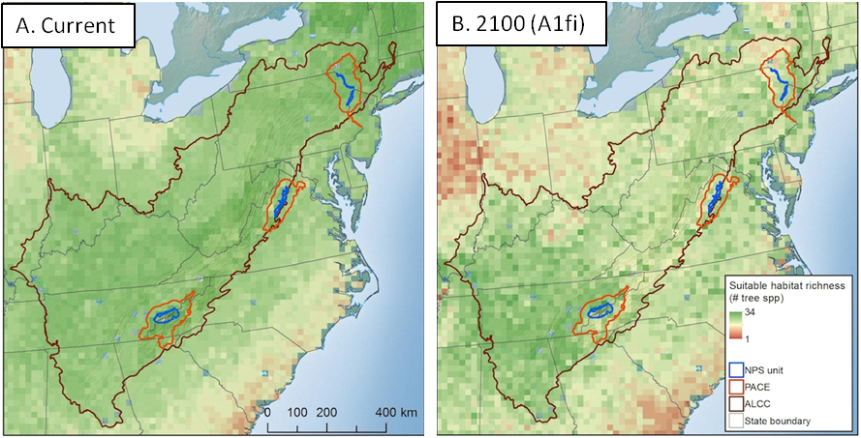
Published species distribution models (Iverson et al. 2008, McKenney et al. 2011)
Decline in habitat richness of 32 key tree species
Zolkos et al. in review
Notes:
Synthesis of Iverson and McKenney’s work

Slide 6
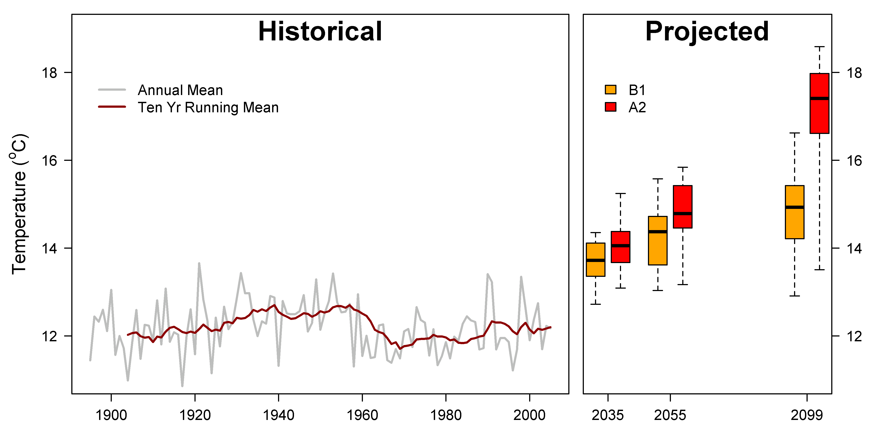
Shenandoah Projected Climate
Results are similar for other NPS units
Notes:
This is SHEN + PACE but the story is the same across all our focal units. By 2035 under high emissions scenario, most climate models indicate that average conditions will exceed the historical range of variation.

Slide 7
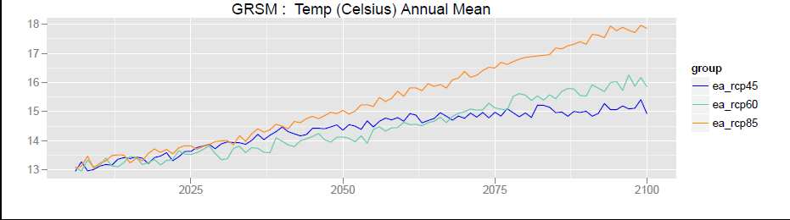
Ecosystem Process Projections
Notes:
Ppt either stable or increasing. Temperature increasing. Snow water equivalent decreasing. Soil water not much trend. Productivity increased in the spring, decreased overall. A net decline in productivity annually. ET increases in all seasons. Decline in productivity likely due to water stress from increased evaporative demand from lengthened growing season and higher summer temperatures.

Slide 8
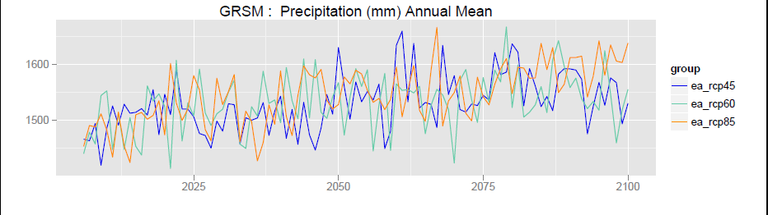
Ecosystem Process Projections
Notes:
Ppt either stable or increasing. Temperature increasing. Snow water equivalent decreasing. Soil water not much trend. Productivity increased in the spring, decreased overall. A net decline in productivity annually. ET increases in all seasons. Decline in productivity likely due to water stress from increased evaporative demand from lengthened growing season and higher summer temperatures.

Slide 9
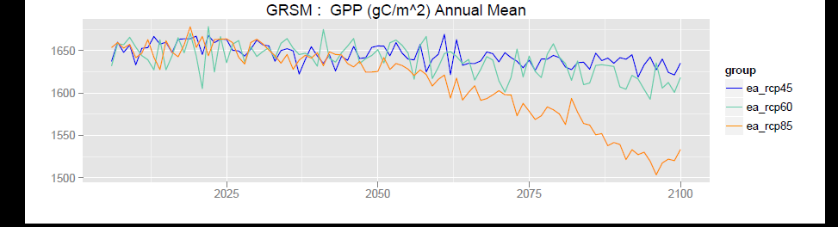
Ecosystem Process Projections
Results are similar for other NPS units
Notes:
Ppt either stable or increasing. Temperature increasing. Snow water equivalent decreasing. Soil water not much trend. Productivity increased in the spring, decreased overall. A net decline in productivity annually. ET increases in all seasons. Decline in productivity likely due to water stress from increased evaporative demand from lengthened growing season and higher summer temperatures.

Slide 10
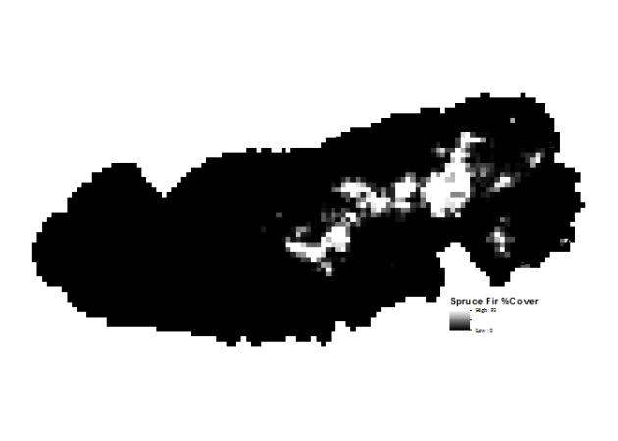
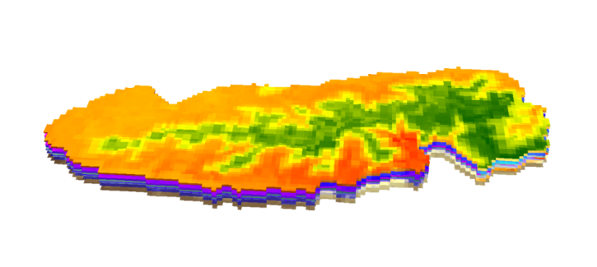

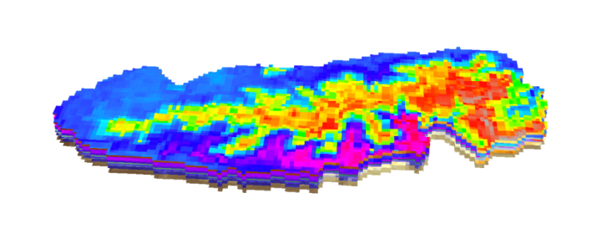
Reference or training data: Field observations of target species or map of vegetation types, e.g. biomes, communities.
Predictors: stack of ecologically relevant variables (e.g., climate, soil type, etc.).
Bioclimatic Envelope
Model (aka SDM)
Estimates and projections: apply models to current or projected conditions
Probability of presence or suitability estimates
Current suitability
Future suitability time 1
Future suitability time 2 . . . time n.
Notes:
I’ll refer to these as bioclimatic envelope models for short but they’re often referred to as species distribution models, or habitat suitability models. We want to form a multidimensional picture of the factors that correlate with the observed species distribution. Niche theory underpins this approach and in this case we’re representing the realized niche of a species. With vegetation types, niche theory is less appropriate so we think of them as ecologically indexed indicators of the extent and nature of projected climate change.

Slide 11
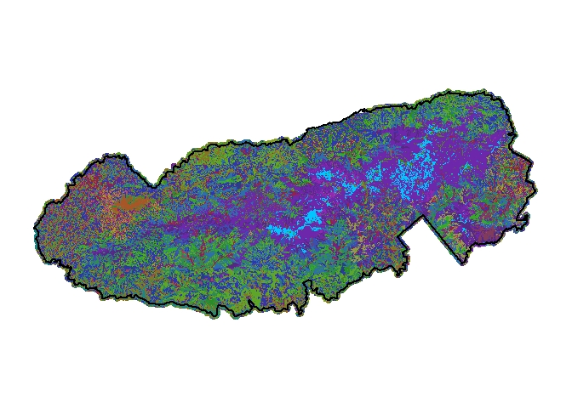
Envelope Modeling for Vegetation Types
Our objective is to use bioclimatic envelope models as “ecologically scaled metrics of the extent and nature of projected climate change” (Jackson et al. 2009) in support of vulnerability assessment.
Response variable: NPS/USGS vegetation map gridded to 800m cells represents suitability for vegetation types
Predictors: NEXDCP30 gridded climate, STATSGO soils, potential relative radiation, twi
Notes:
Our goal here is to use bioclimatic envelope models as “ecologically scaled metrics of the extent and nature of projected climate change” Jackson et al. 2009
Northern Hardwoods, Spruce Fir, Oak-Pine systems

Slide 12
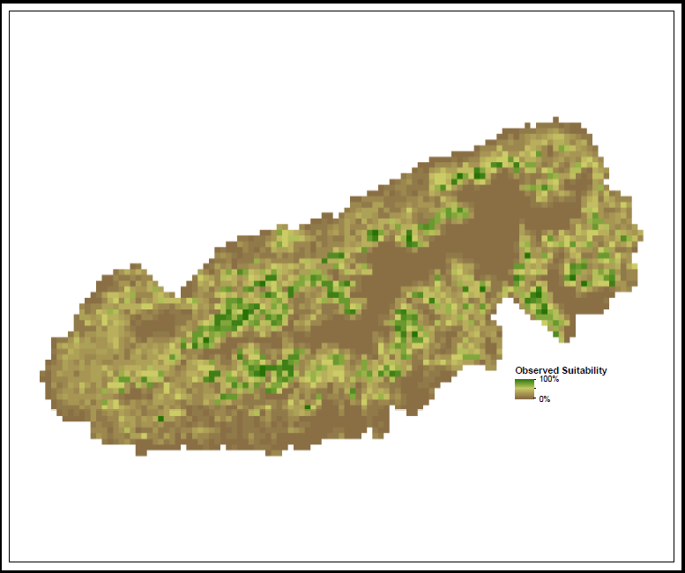
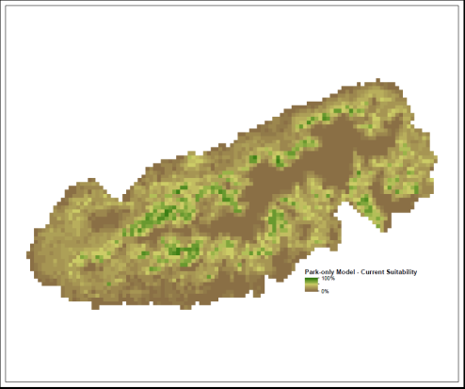
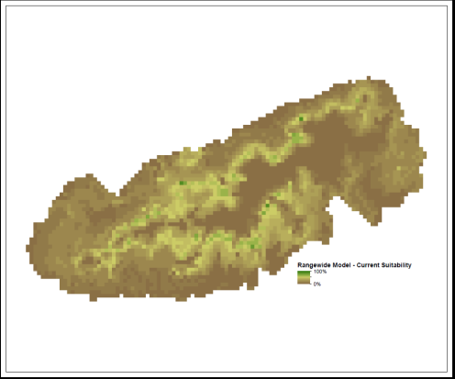

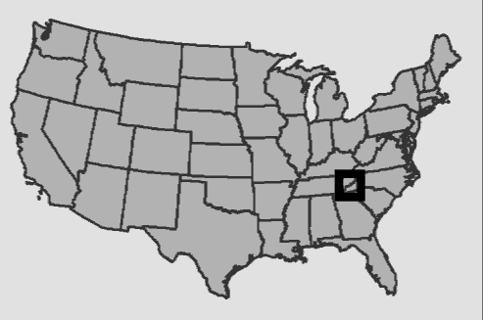
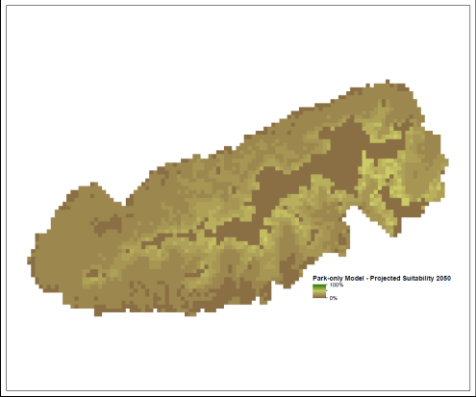
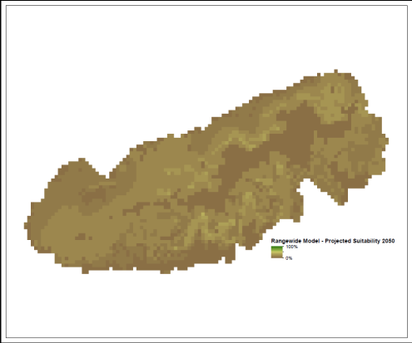
Cove Forest
Current Mapped
Current modeled – park only
Current modeled – rangewide
2050 modeled – park only
2050 modeled – rangewide
Notes:
Cove model outputs

Slide 13
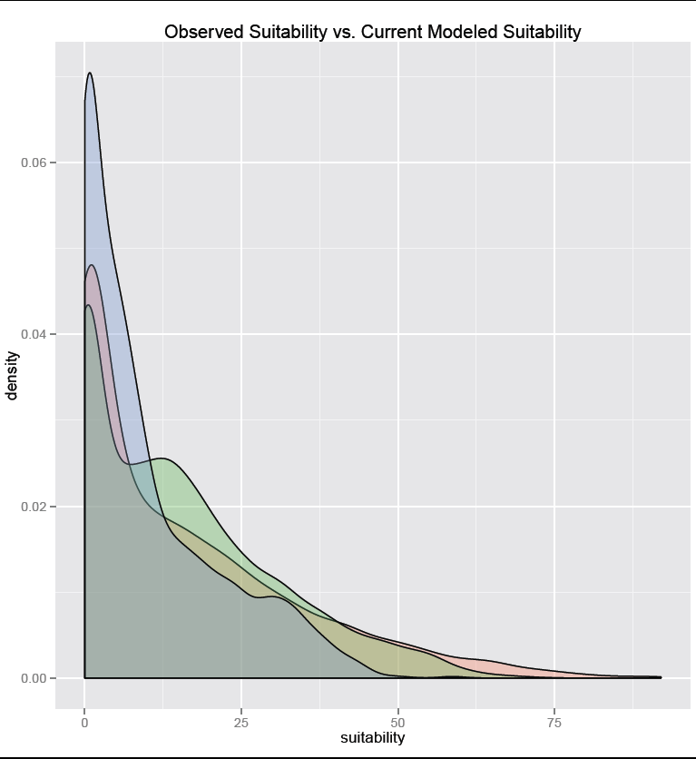
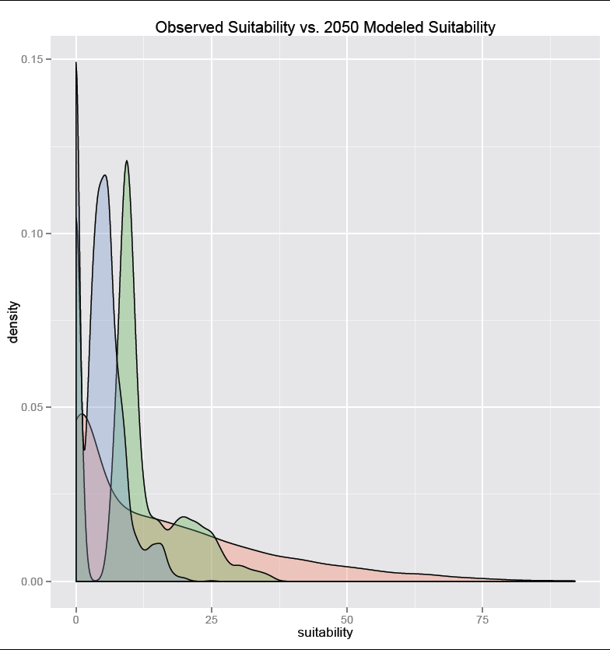
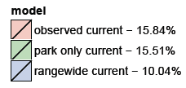
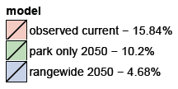
Cove Forest
Notes:
Cove forest histograms. We capture the distribution of values relatively well although we overepresent at values around 15 and underepresent at the high end. We’re missing the cove-ness of the most suitable sites. Overall, suitability in currently occupied areas declines by 2050, especially in the most suitable areas.

Slide 14
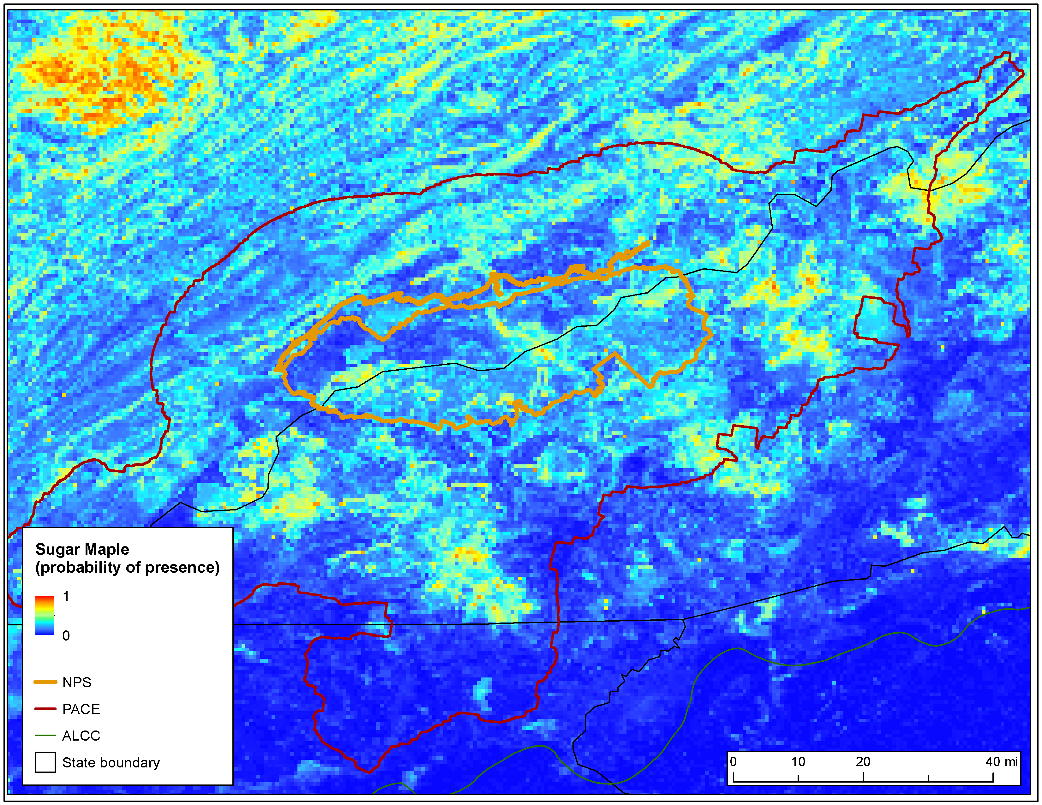
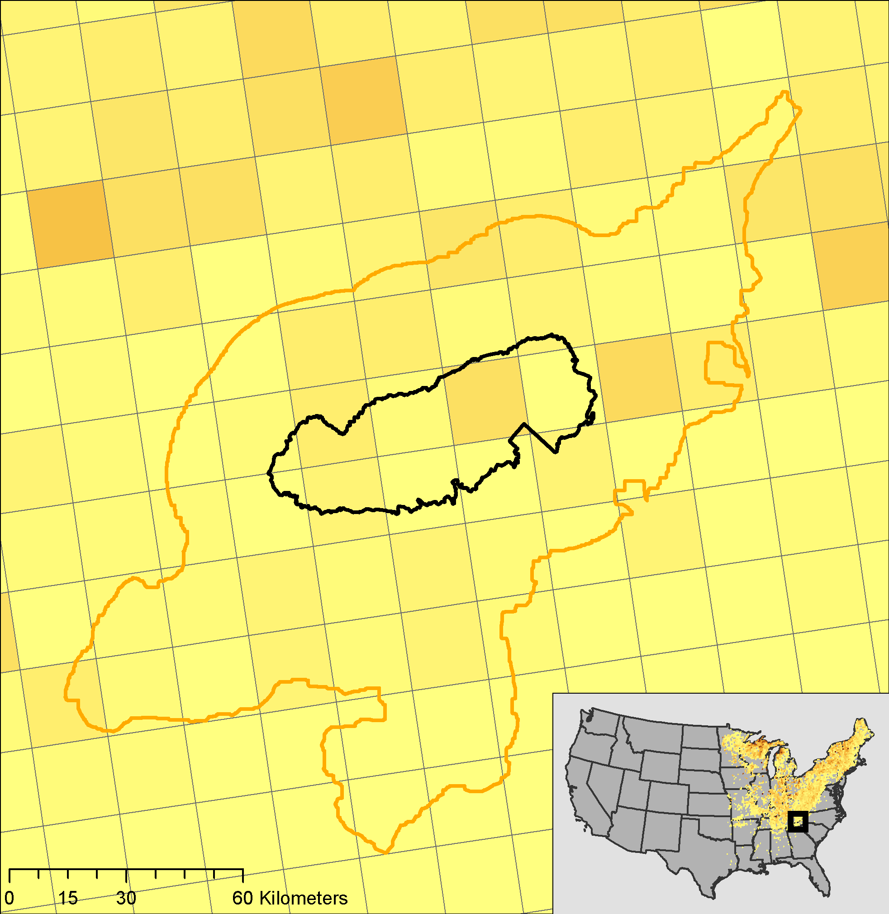
Species Distributions
Notes:
Sugar maple example outputs (800m). Regional patterns look good although there are apparent overestimates near the border with Georgia (relative to FIA gridded plots).

Slide 15
Conclusions
Preliminary results from veg. distribution models, ecosystem process models, plus synthesis of existing distribution models point to significant shifts in forest communities as a result of climate change.
Cove Forest models indicate that topoclimates need better representation
Next step to use these results to help identify areas within NPS units where species/communities may persist longest and which may be high management priorities.
Notes:
High elevation forest communities with distributions that are driven by low minimum temperatures face greatest risks.

Slide 16
Thanks!
  We acknowledge support from NASA Climate and Biological Response grant NNH10ZDA001N
Photo credit: Andri Kyrychok

Slide 17
Extra
Notes:
Sugar maple example outputs (800m).

Slide 18


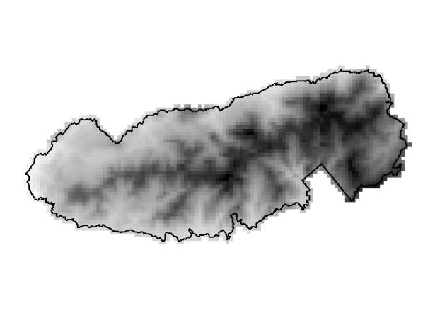
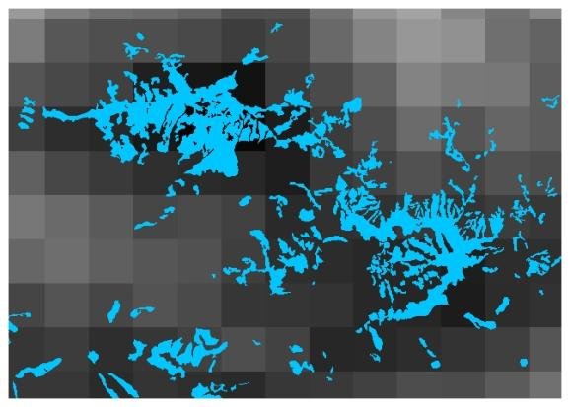
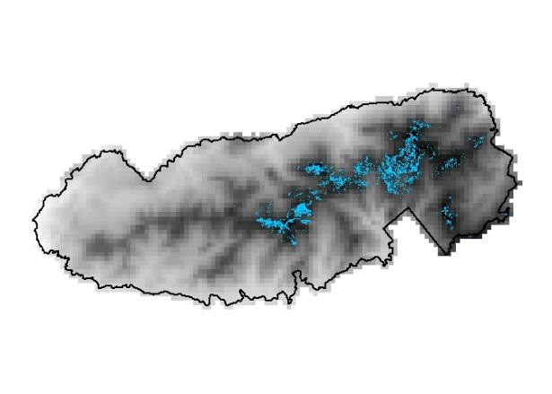
INPUT: Fine scale NPS vegetation map represents ES suitability
OUTPUT: ES-level %cover/habitat suitability map
+
INPUT: Bioclimatic variables (e.g., max temp of warmest month)
Use veg classification to calculate %cover in each larger pixel

Slide 19
Species Level Mapping:
Sugar Maple
Notes:
Resolution is important for capturing climates associated with topography

Slide 20
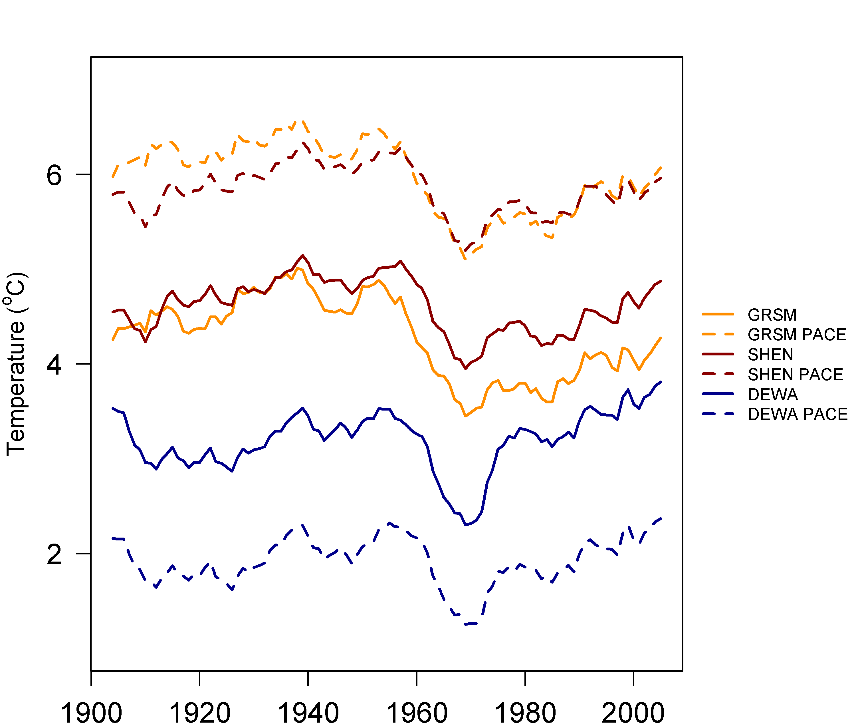
Recent Historical Trends
10 year moving average of annual minimum temperature
Notes:
Climate is dynamic, however, and minimum temperatures have increased in all parks since the 1970s. In DEWA, the decade from 1996-2005 was the warmest of the period. 3 solid lines are Park units, 3 dashed lines are PACEs.

Slide 21
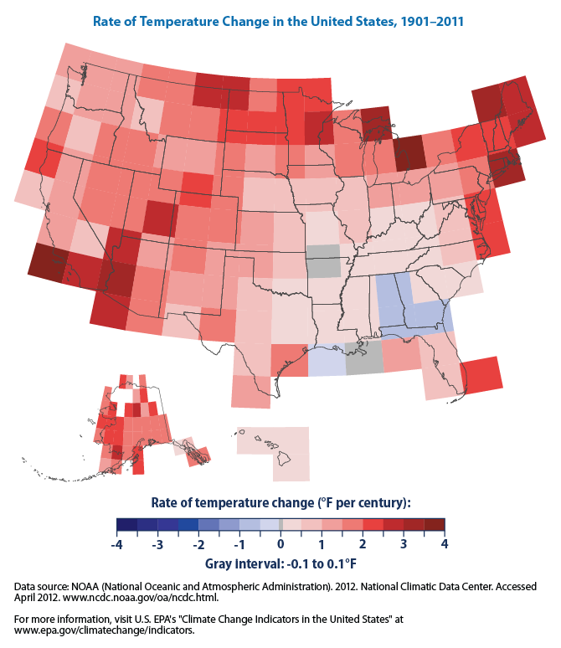
Notes:
Southeast has some of the lowest rates of temperature change in the U.S. in the 1900’s.

