Slide 1
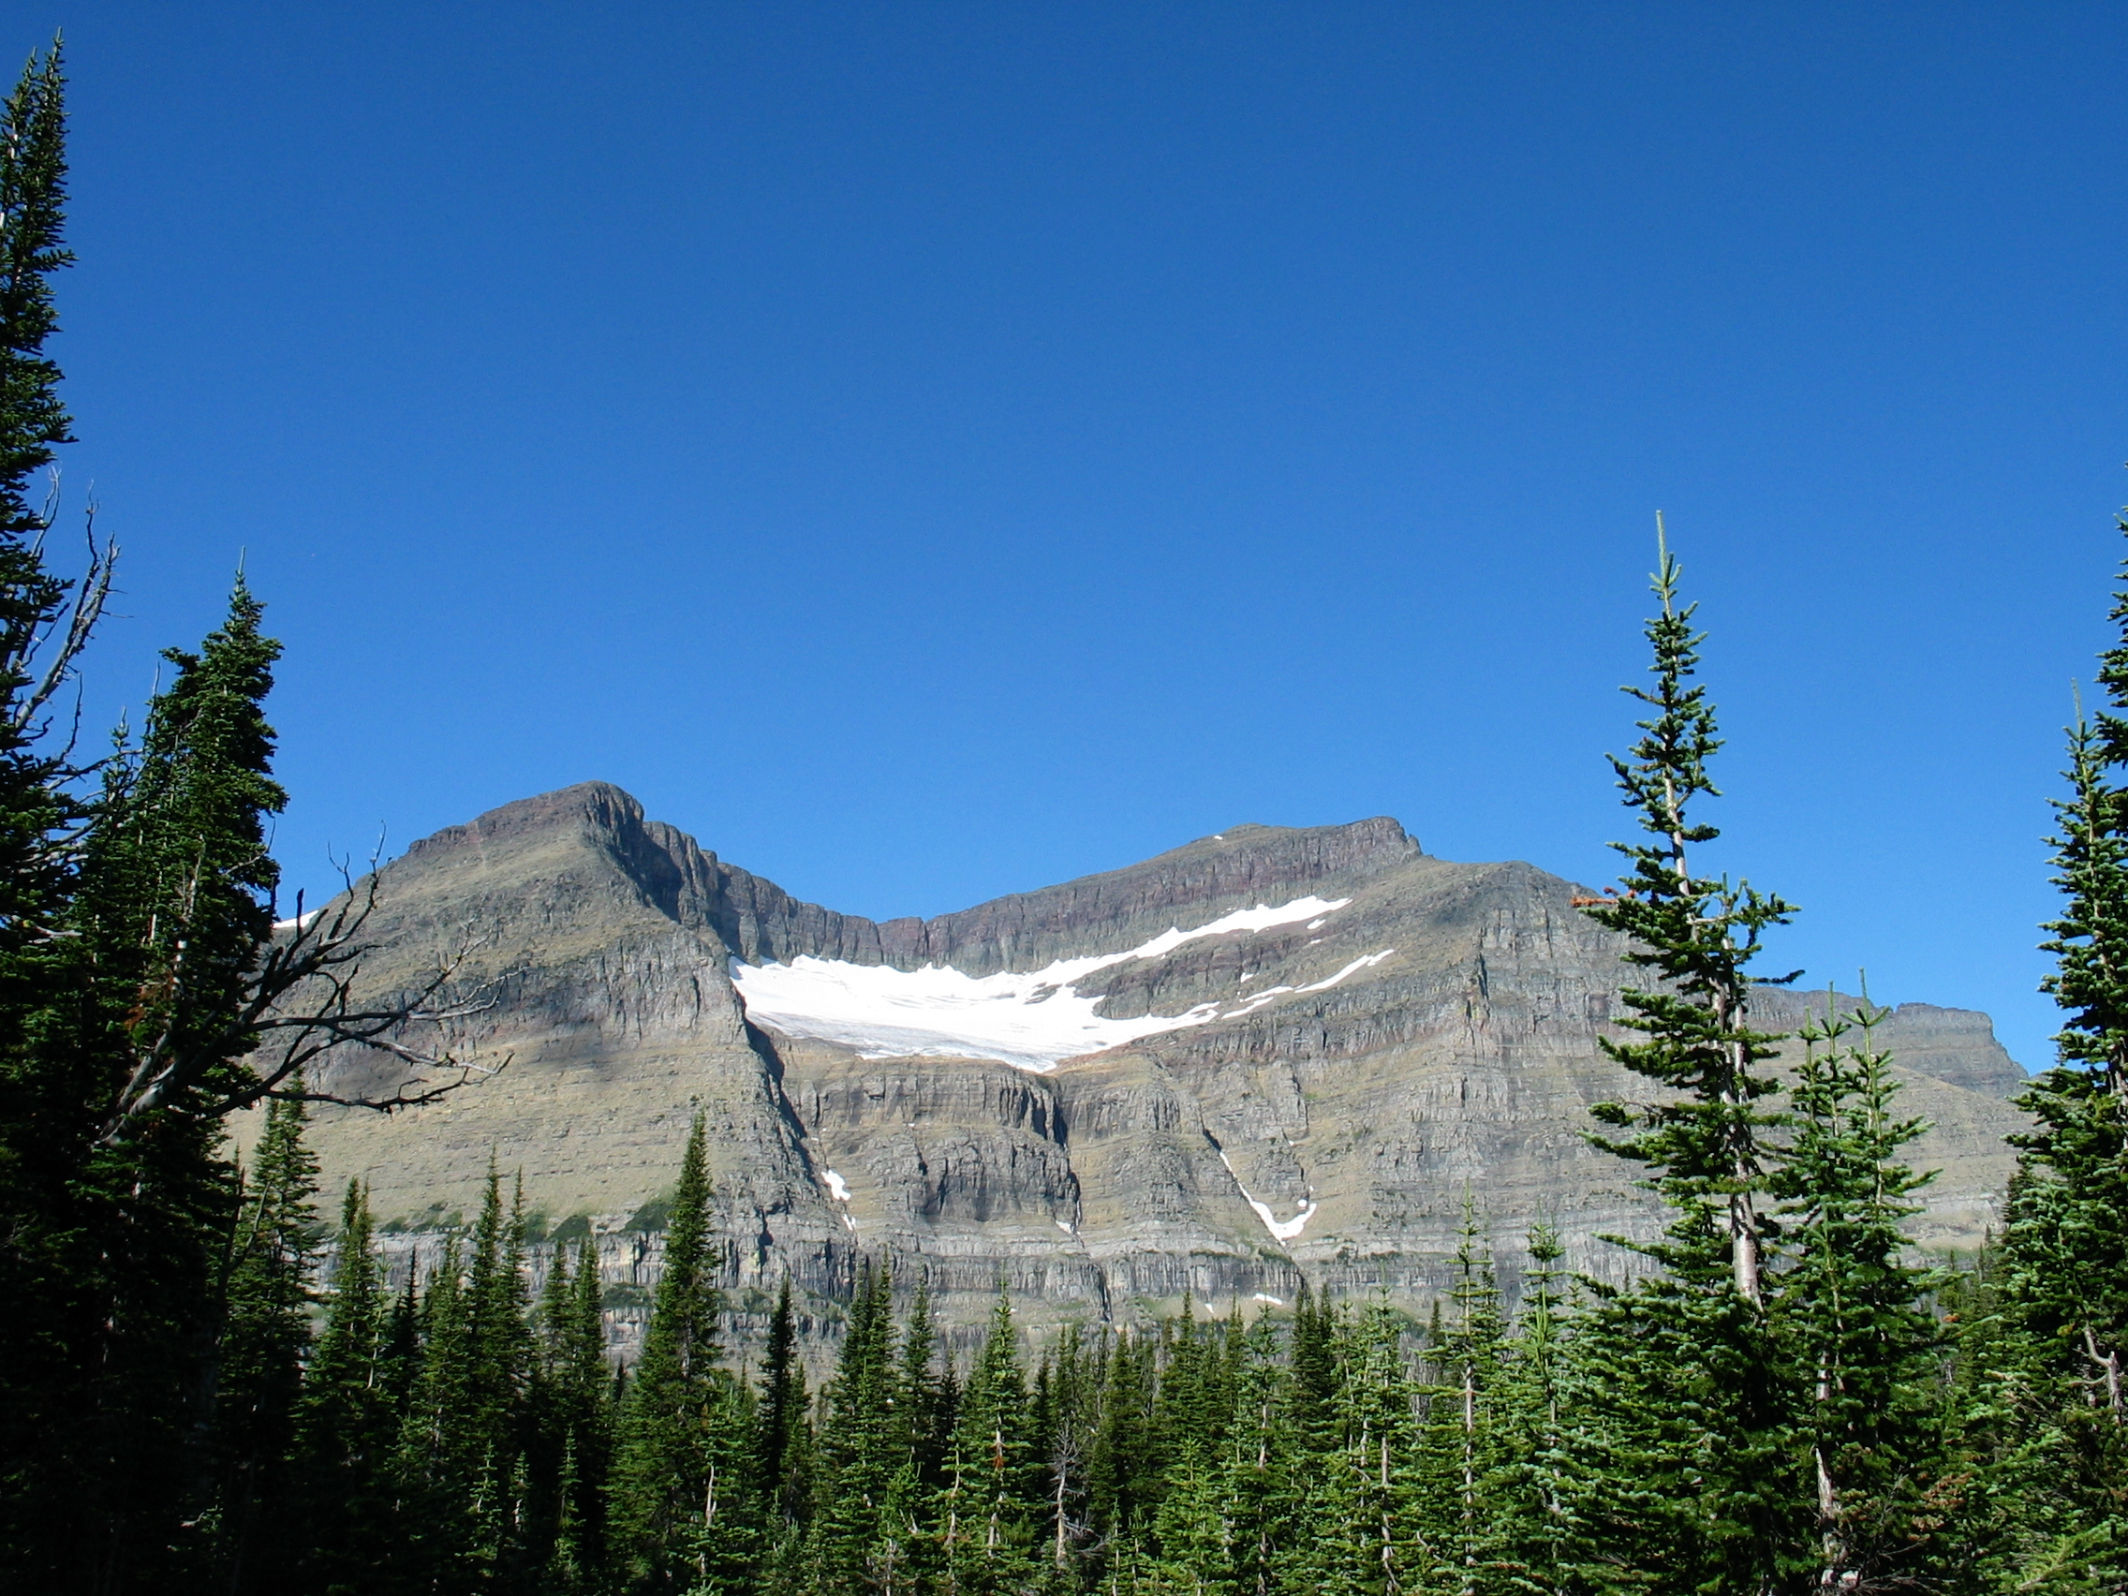

A Conceptual Framework for Linking Climate Science with Management
John Gross | Andy Hansen
Tom Olliff | Bill Monahan
Dave Theobald | Forrest Melton
Scott Goetz | Nathan Piekielek
Tony Chang | Patrick Jantz
July 14, 2014
SCB, Missoula, MT
Climate Change Response Program National Park Service

Slide 2
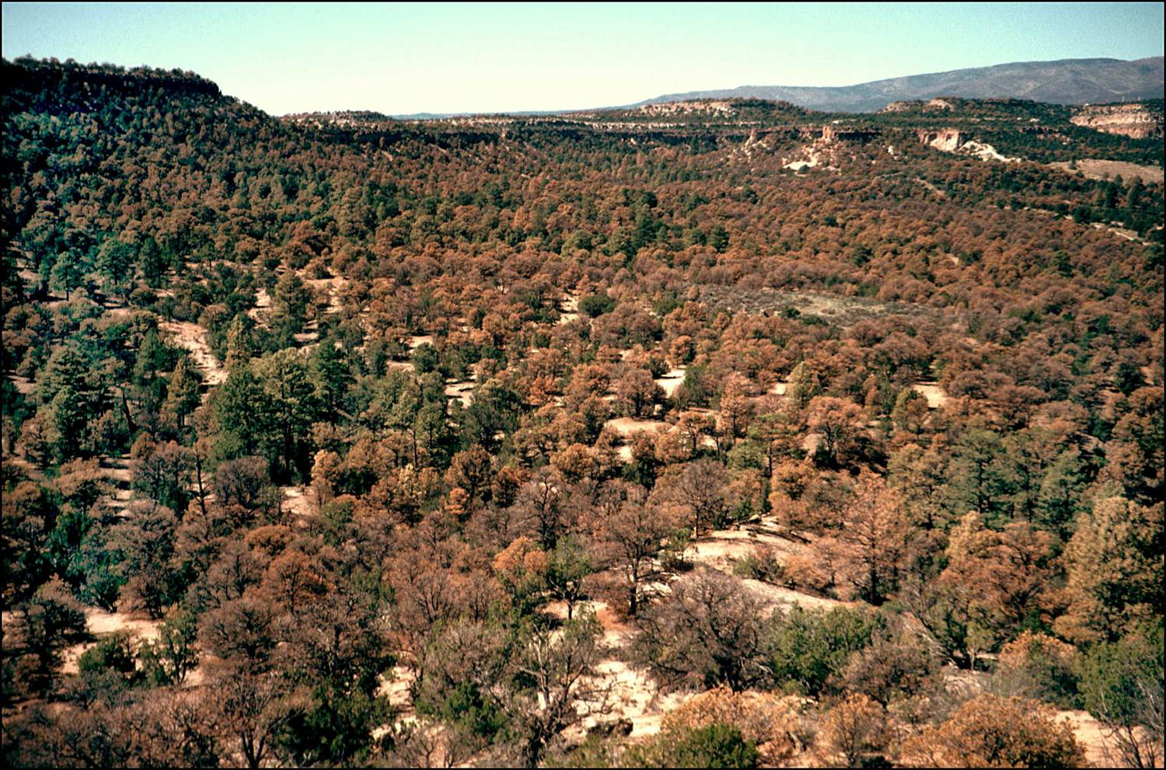
Pinyon mortality at Bandelier National Monument. Photo: Craig Allen
Notes:
The effects of climate change are pervasive, and apparent throughout the US and much of the world. There’s really no argument about whether climate change is occurring, but it’s obviously still a huge issue.

Slide 3
What should we do?
Pinyon mortality at Bandelier National Monument. Photo: Craig Allen
Notes:
The big question that many managers are now asking is simply “What should we do about it?”

Slide 4
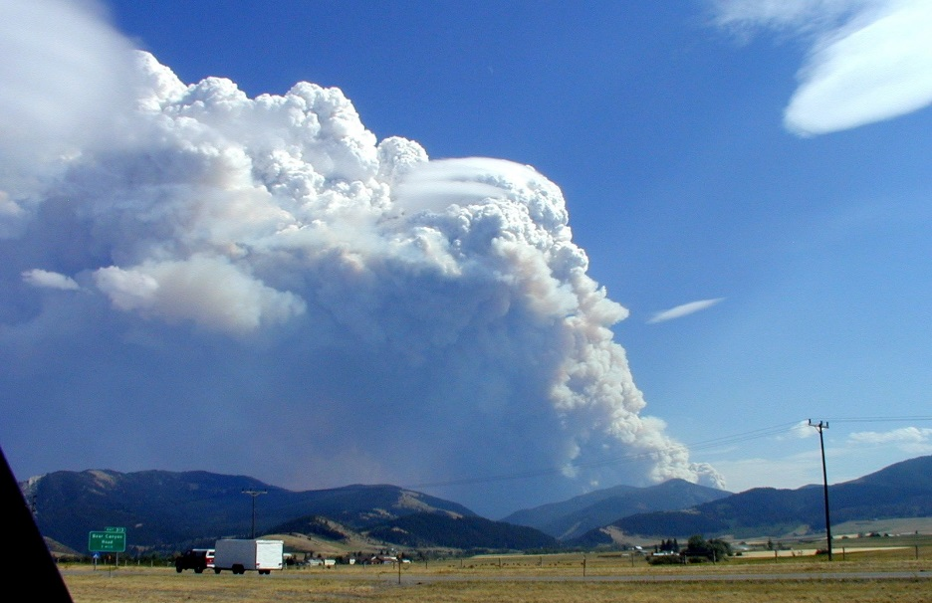
Mitigation: Reducing causes of climate change, mostly reducing GHGs.
Adaptation: Adjusting to and coping with actual or expected climate changes.
Notes:
IPCC Adaptation Adjustment in natural or human systems in response to actual or expected climatic stimuli or their effects, which moderates harm or exploits beneficial opportunities. Various types of adaptation can be distinguished, including anticipatory, autonomous and planned adaptation:
Anticipatory adaptation – Adaptation that takes place before impacts of climate change are observed. Also referred to as proactive adaptation.
Autonomous adaptation – Adaptation that does not constitute a conscious response to climatic stimuli but is triggered by ecological changes in natural systems and by market or welfare changes in human systems. Also referred to as spontaneous adaptation.
Planned adaptation – Adaptation that is the result of a deliberate policy decision, based on an awareness that conditions have changed or are about to change and that action is required to return to, maintain, or achieve a desired state

Slide 5
Managing Natural Resources under Climate Change
Challenges
Time horizon longer than planning and management horizons
Relevant areas larger than management units
High uncertainties in science (climate change, ecological response) and management effectiveness
Coordination among multiple management units and jurisdictions
Approach and methods rapidly evolving
Notes:
While mitigation measures are often obvious, it’s not a simple question for climate adaptation. There are many challenges …

Slide 6

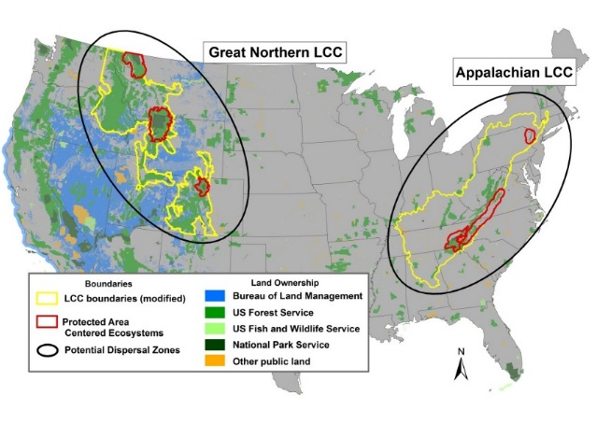
Landscape Climate Change Vulnerability Project (LCC-VP)
Goal
Demonstrate the four steps of a climate adaptation planning strategy using NASA and other data and models, in two LCCs.
1. Identify
Conservation
Targets
2. Assess
Vulnerability
To Climate
Change
Monitor, Review, Revise
4. Implement
Management
Options
3. Identify
Management
Options
(Stein & Glick 2011)
Notes:
6
Our goal is to demonstrate what can be described as a 4-step climate adaptation in two Landscape Conservation Cooperatives.
(click)
Our study sites are in the Rockies, characterized … and Appalachian mountain region, characterized by …

Slide 7

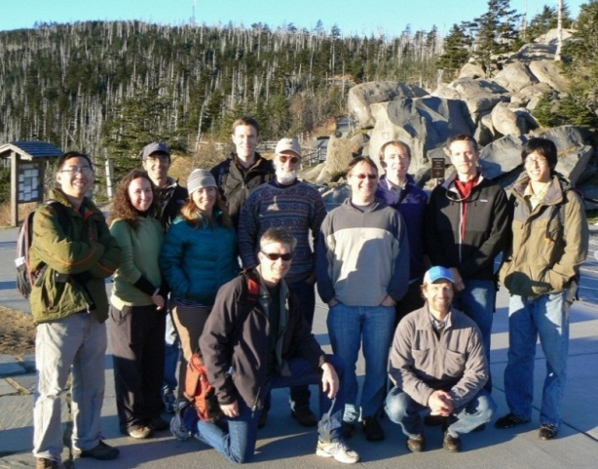



Project Team (LCC-VP)
Montana State University
A. Hansen, N. Piekielek, T. Chang,
L. Phillips, E. Garroutte
NPS / Great Northern LCC
T. Olliff
NPS I&M & CCRP Programs
B. Monahan, J. Gross
CSU Monterey Bay / NASA Ames
F. Melton, W. Wang
Conservation Science Partners
D. Theobald
Woods Hole Research Center
S. Goetz, P. Jantz, T. Cormier,
S. Zolkos
Great Smoky Mountain NP
NASA Applied Sciences Program
Notes:
7
We undertook the challenge of linking science to management via a NASA – funded projection. Today, we’d like to share results from a number of the activities that fall loosely under the umbrella of the project.

Slide 8
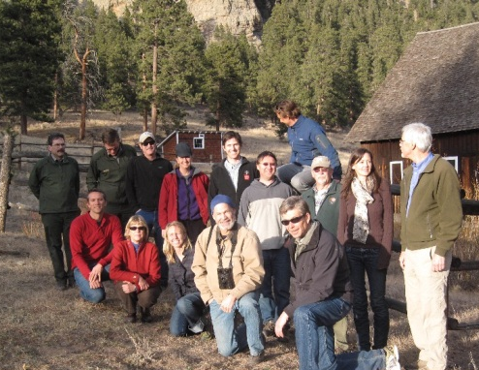
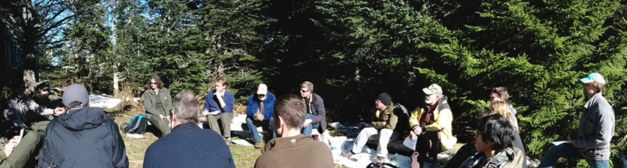
Agency Collaborations
Western US
Great Northern LCC - Tom Olliff
NPS I&M Greater Yellowstone Network - Kristen Legg
NPS I&M Rocky Mountain Network - Mike Britten
Greater Yellowstone Coordinating Committee Whitebark Pine Subcommittee - Karl Buermeyer & Virginia Kelly
Grand Teton National Park - Kelly McClosky
Yellowstone National Park - Ann Rodman
Rocky Mountain National Park - Ben Bobowski
Eastern US
NPS I&M Appalachian Highlands Network - Robert Emmott
NPS I&M Eastern Rivers and Mountains Network - Matt Marshall
NPS I&M Mid-Atlantic Network - Jim Comiskey
Delaware Water Gap National Recreational Area - Richard Evans & Leslie Morelock
Great Smoky Mountains National Park - Jim Renfro
Shenandoah National Park - Jim Schaberl
Notes:
Large number of collaborators from the science and management communities.

Slide 9
SYM 7 Wildland Ecosystems Under Climate Change: Pioneering Approaches to Science and Management in the US Northern Rockies and Appalachians
A conceptual framework for linking climate science with management
John Gross, NPS
Exposure across the GNLCC and APLCC: Climate, land use, ecosystem process Forrest Melton, NASA Ames and CA State University
Potential impacts of climate change on vegetation in the Appalachian LCC
Patrick Jantz, Woods Hole Research Center
Potential impact of climate change on vegetation in the Great Northern LCC
Andy Hansen, Montana State University

Slide 10
SYM 7 Wildland Ecosystems Under Climate Change: Pioneering Approaches to Science and Management in the US Northern Rockies and Appalachians
Tree and shrub species habitat suitability across Greater Yellowstone under climate change
Nathan Piekielek, Montana State University
Climate change management evaluation and implementation, with a focus on whitebark pine
Tom Olliff, Great Northern LCC
Panel: Linking climate science and management discussion panel: Key opportunities and challenges in protected areas.
Bill Monahan NPS (Moderator)
  Ben Bobowski Rocky Mountain NP
  Dave Hallac Yellowstone NP
  Virginia Kelly Greater Yellowstone Coordinating Committee
  Patrick Jantz Shenandoah National Park / Woods Hole

Slide 11
- Species
- Ecosystem
- Biomes
- Exposure
- Sensitivity
- Adaptive Capacity
1. Identify
Conservation
Targets
2. Assess
Vulnerability
To Climate
Change
Monitor, Review, Revise
- Policy
- Practice
- Institutional Changes
- Reduce Exposure
- Reduce Sensitivity
- Increase Adaptive
Capacity
4. Implement
Management
Options
3. Identify
Management
Options
From: Stein and Glick 2011. Chapter 1. Introduction in Scanning the Conservation Horizon: A guide to climate change vulnerability assessment. National Wildlife Federation, Washington, DC.
Notes:
So back to our project. The 4-step framework looks simple, but there are many important details …
- multi-scale

Slide 12
Generalized Adaptation Framework
1. Identify conservation goals and objectives
Revisit planning as needed
7. Track action effectiveness and ecological responses
2. Assess climate impacts and vulnerabilities
Adjust actions as needed
Re-assess vulnerability as needed
6. Implement priority adaptation actions
3. Review/revise conservation goals and objectives
5. Evaluate and prioritize adaptation actions
4. Identify adaptation options
Stein et al. 2014. Climate-Smart Conservation: Putting Adaptation Principles into Practice

Slide 13
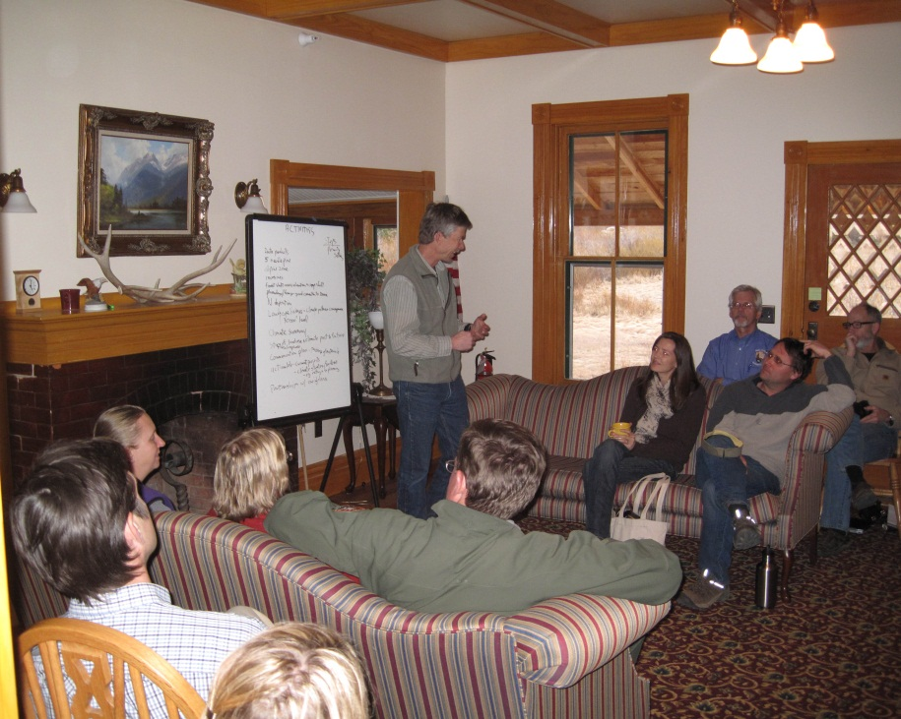
Identify conservation targets
What’s going to be different in the future?
How does CC challenge existing goals?
Which high priority resources should be the focus?

Slide 14
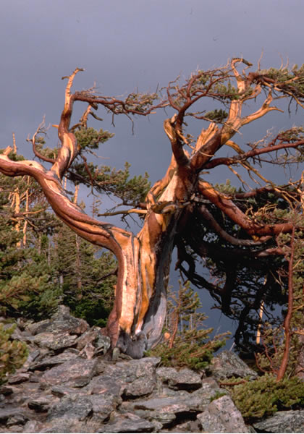
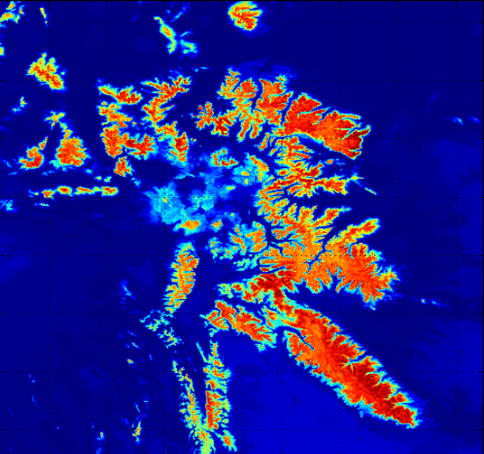
CC issues identified by collaborators :
Access to existing and emerging knowledge
Projections for dominant forest types and systems
5-needle pines (whitebark, limber pine)
Cove forests, eastern spruce-fir, other hardwoods
Notes:
One issue is simply capacity. Managers don’t have time to read the literature, check out internet sites, or in general attend these conferences. A key issue is to communicating what we’re doing and results in digestible quantities. One yearly meeting doesn’t do it – it’s overwhelming for both the scientists and managers.
But we pretty quickly settled on a couple issues that the parks need to address. These include …
For eastern, cove hardwoods, spruce-fir, northern hardwood, and oak-hickory.

Slide 15
What’s at risk and why?
Exposure
Sensitivity
Potential
Impact
Adaptive
Capacity
Vulnerability
Notes:
our approach to VA followed the IPCC conceptual model, where Vuln = f(3 factors)

Slide 16
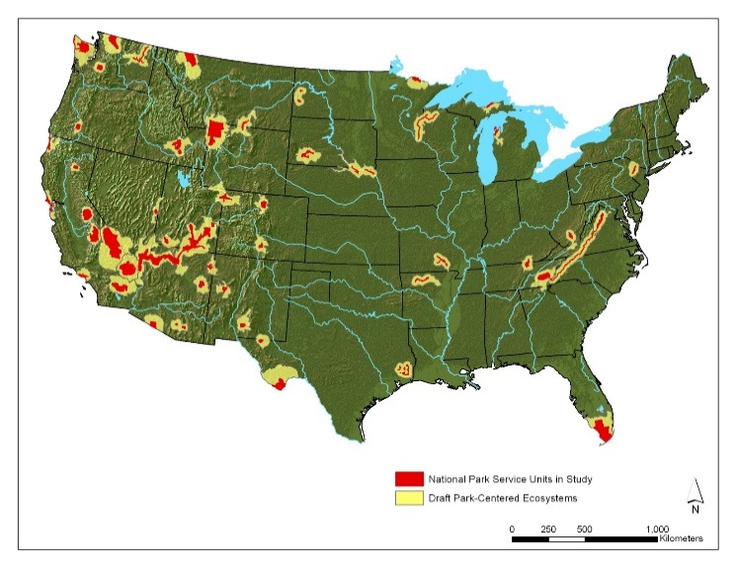
Assessing Vulnerability
Exposure of US National Parks to Land Use and Climate Change 1900-2100 Hansen et al. 2014 Ecological Applications
1. Define the surrounding Protected Area Centered
  Ecosystem (PACE; Hansen et al. 2011).
Quantify past exposure.
1900-2010
Land Use Change
Climate Change
Invasive Species
Exposure
Sensitivity
Potential
Impact
Adaptive
Capacity
Vulnerability
Notes:
16
Example wbp. This keystone veg type is declining dramatically. Wbp was just listed as a candidate species, and grizzly were relisted due to loss of wbp. Gycc committee has dev a suite of adap mgt strategies. We are working with them (just met with them 2 days ago) to id the questions we can answer to help inform these strategies.

Slide 17
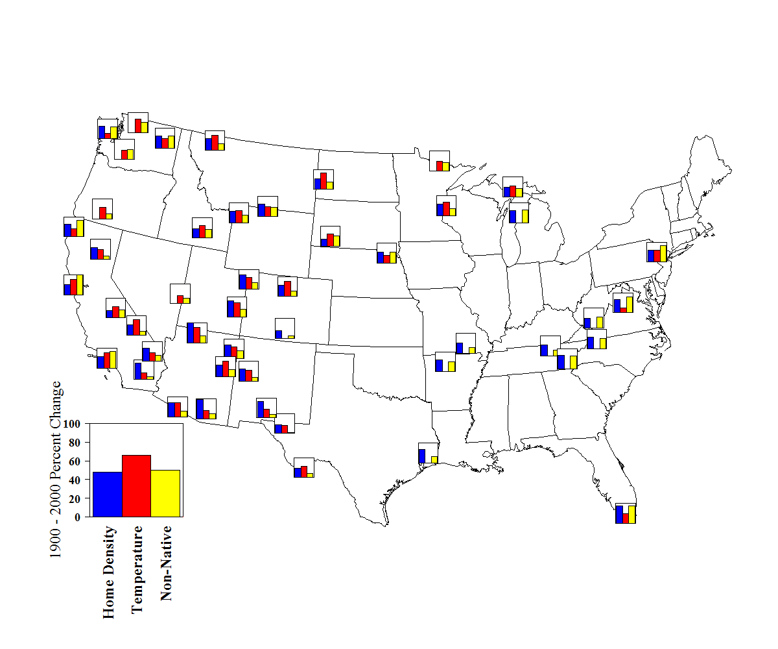
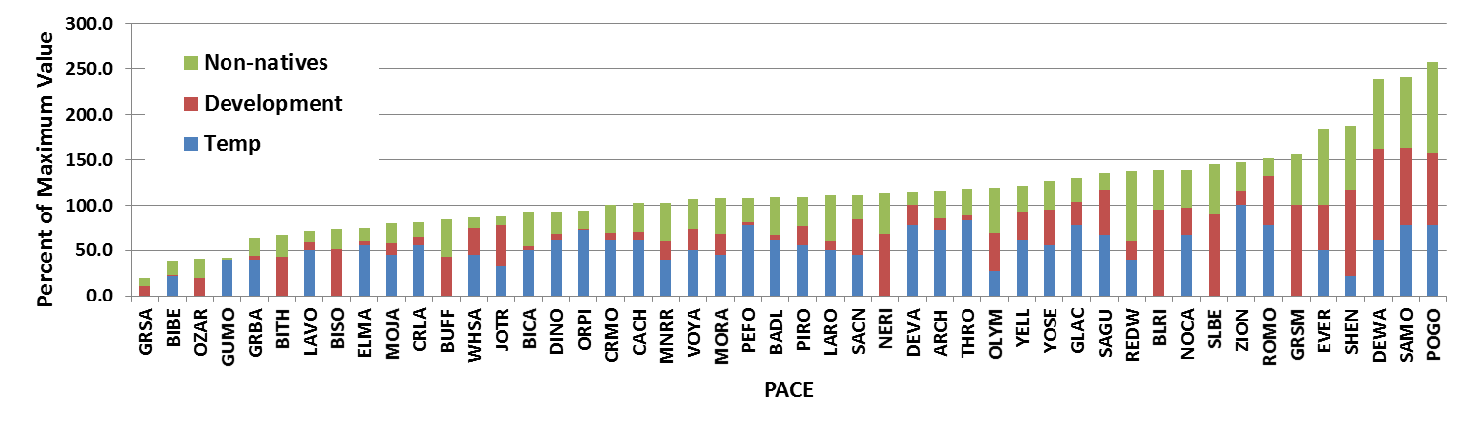
1900-2000

Slide 18
Assessing Vulnerability
Exposure of US National Parks to Land Use and Climate Change 1900-2100 Hansen et al. 2014 Ecological Applications
1. Define the surrounding Protected Area Centered
  Ecosystem (PACE; Hansen et al. 2011).
2. Quantify past exposure.
3. Quantify potential future exposure and potential impact.
4. Consider implications for management.
2010-2100
Land Use Change
Climate Change
Exposure
Sensitivity
Potential Biome Type
Potential
Impact
Adaptive
Capacity
Vulnerability
Notes:
18

Slide 19
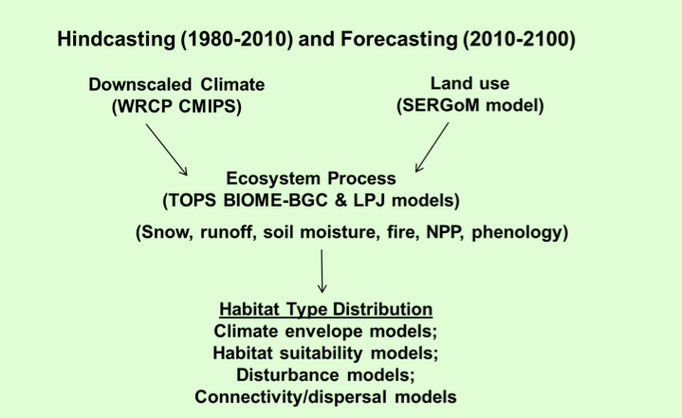
Ecological Forecasting

Slide 20
Multi-scale assessment of vulnerability
 | Species | Ecological System | LCC-Scale
Exposure | CC Projections; TOPS variables | CC Projections; TOPS variables | CC Projections; TOPS variables
Sensitivity | SDMs; Life history traits | Climate variation; LPJ modeling | Biome BGC responses; NPP controls
Adaptive Capacity | Species & habitat traits; Life history traits | Connectivity; Refugia; Topography | ES diversity; Connectivity; Land forms

Slide 21
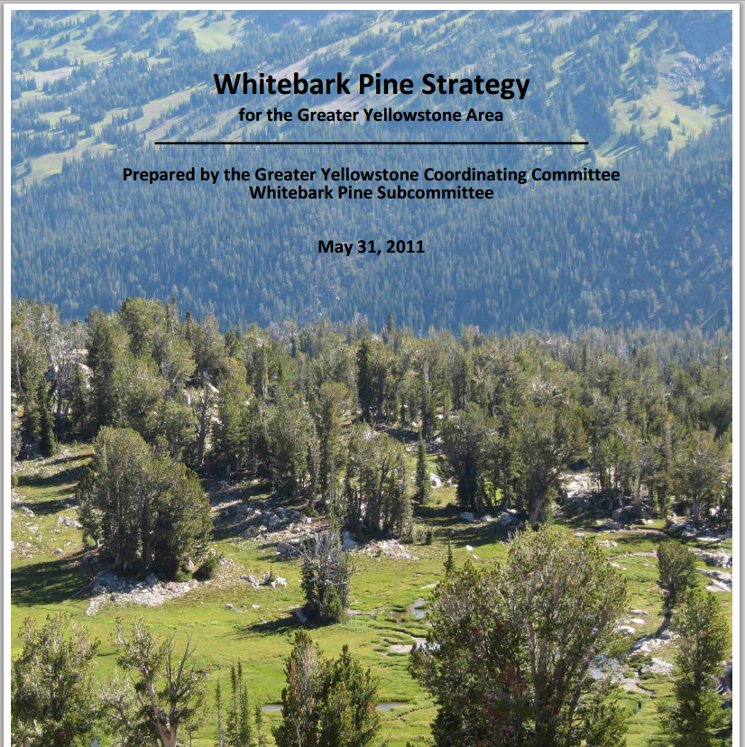

Informing Resource Management Decision
Collaboration with GYCC WBP Subcommittee
Whitebark pine VA feeds into adaptation process
Use forecasts to evaluate current strategy
Identify new options based on forecasts and potential responses

Slide 22
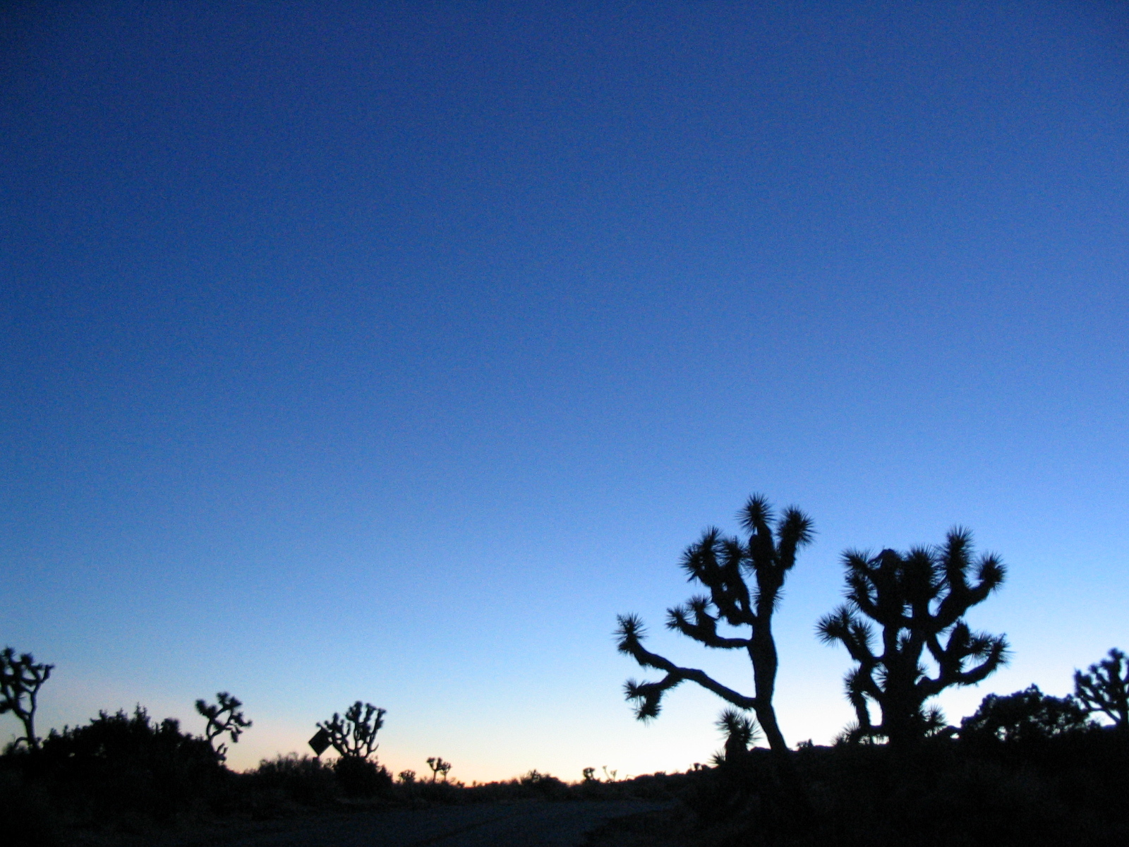
Comprehensive framework for adaptation
Applying multi-scale, state-of-the-art science to resource management
Expect end-to-end accomplishments
Questions?
Notes:
Focus on a ONLY a few issues – don’t overwhelm.

