Slide 1


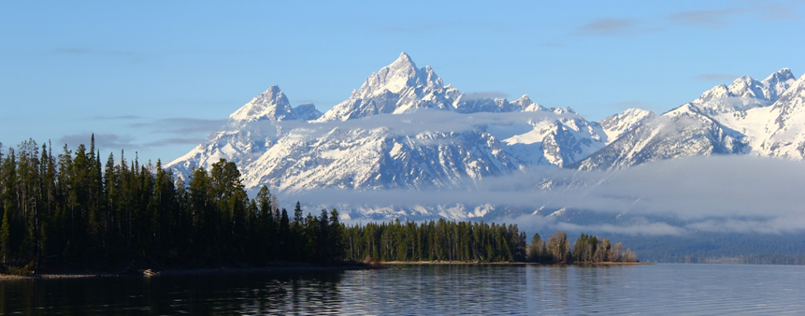
Which tree species and biome types are most vulnerable to climate change in the US Northern Rocky Mountains?
Andy Hansen and Linda Phillips
Ecology Department
Montana State University
NASA Applied Sciences Program
(NNH10ZDA001N - BIOCLIM)
Notes:
1

Slide 2
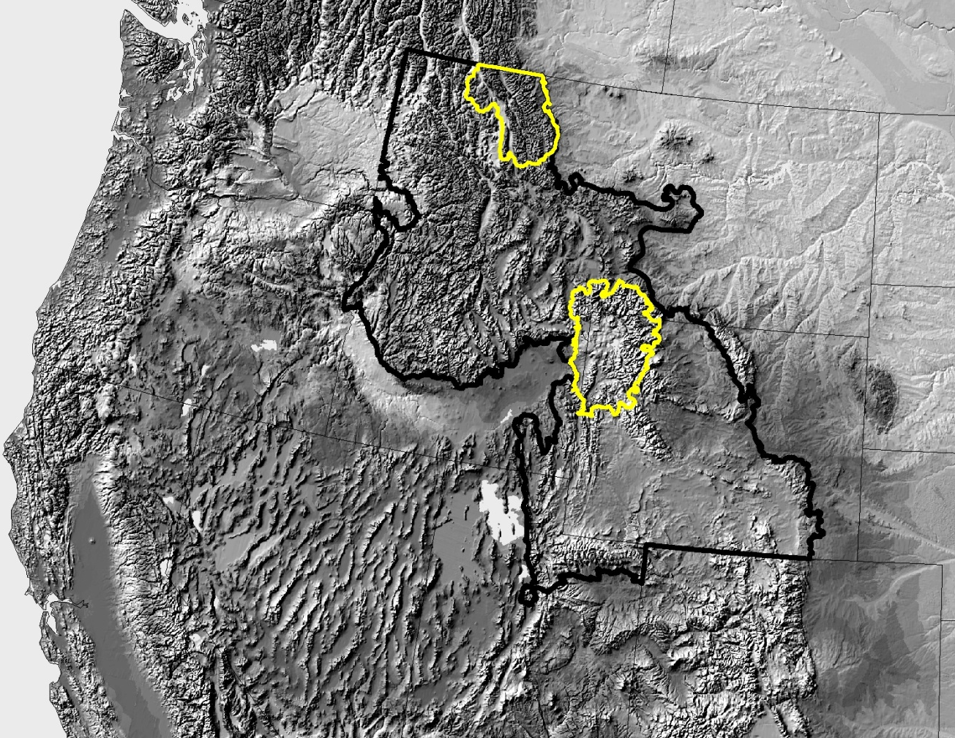
Goal
Synthesize published studies to assess potential impact of climate change on biome types and tree species in the GNLCC and in the Greater Yellowstone and Glacier ecosystems.
Great Northern LCC
Protected area centered Ecosystems
Notes:
2
Our goal is to demonstrate in two lccs.

Slide 3
Components of Vulnerability
Exposure
Sensitivity
Potential
Impact
Adaptive
Capacity
Vulnerability
Notes:
3
Our goal is to demonstrate in two lccs.

Slide 4
Components of Vulnerability
Climate change
Species climate tolerances
Exposure
Sensitivity
Projected climate suitability
Potential
Impact
Adaptive
Capacity
Vulnerability
Notes:
4
Our goal is to demonstrate in two lccs.

Slide 5
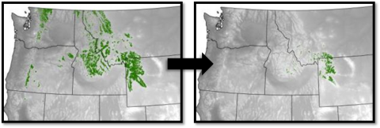
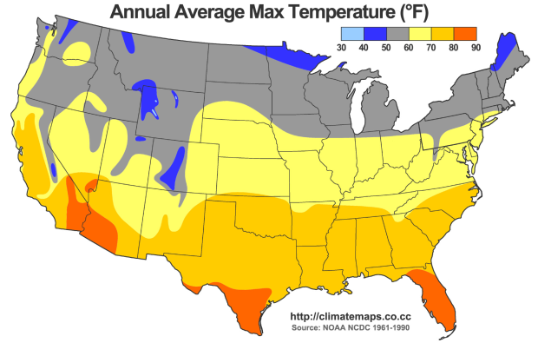
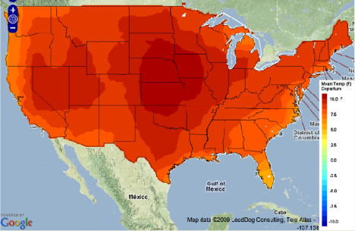
Climate Envelop Modeling
Presence 1950-1980 = f(climate)
WBP Presence 1950-1980
Climate 1950-1980
Climate 2100 = Prob of Presence 2100
Projected Climate 2100
Probability of Presence 2100

Slide 6
Climate Envelop Modeling
Identifies the places projected to have suitable climate for presence of the species in the future.
Ignores
Soils
Disturbance
Pests
Competition with other species
Adaptive capacity: dispersal, genetic variation, etc.
Utility
Climate suitability is a strong indicator of where viable populations may be able to exist.
Other controlling factors can be manipulated through management.
Thus, knowledge of climate suitability is a critical first filter for deciding where apply management.

Slide 7
Studies Synthesized
Study | Statistical modeling method | Reference and future projection periods | Scenarios / GCMs | Vegetation units
Rehfeldt et al. 2012 | Random Forests | 1961-1990 2030, 2060, 2090 | A1, B2 / Consensus of CGCM3, GFDLCM21, HADCM3 | Biomes
Crookson et al. 2010 | Random Forests | 1961-1990 2030, 2060, 2090 | A1, B2 / CGCM3, GFDLCM21, HADCM3 | Tree species
Coops and Waring 2011 | Decision Tree Regression | 1950-1975 2020’s, 2050’s, 2080’s | A1, B2 / CGCM3 | Tree species
Gray & Hamann 2013 | Random Forests | 1961-1990 2020s, 2050s, 2080s | Consensus of AIFI, A2, B1, B2 under CGCM, CSIRO2, HADCM3, ECHAM4, PCM | Tree species
Bell et al. 2014 | Baysian Logistic Regression | 1981-2010 2070-2099 | A1, B2 / Average of 16 GCMs | Tree species
Selected based on: GNLCC or wider in extent; used comparable GCMs, scenarios, methods; grain size projection results available.

Slide 8
Future Climate Projection: Scenarios
IPCC Third/Fourth Assessment Report (2001, 2007)
A2: “Business as usual emissions”
B1: “Global reductions in emissions”
A2 and B1 separately:
Crookston et al.
Coops & Waring
Bell et al.
A2 and B1 concensus:
Rehfeldt et al.
Gray & Hamann

Slide 9
Future Climate Projection
IPCC Third/Fourth Assessment Report (2001, 2007)
IPCC Fifth Assessment Report
(2013)

Slide 10
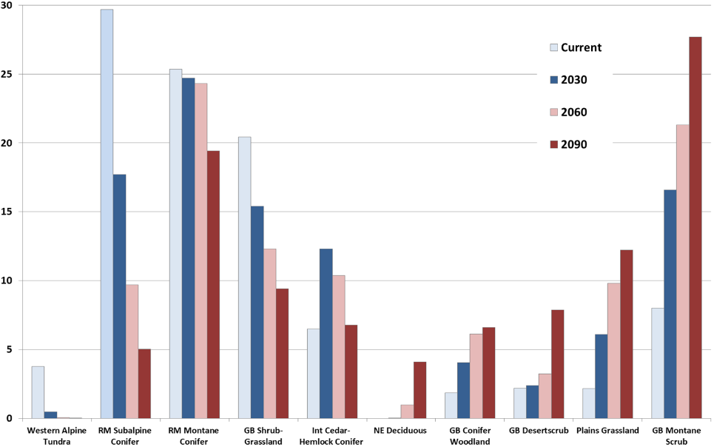
Biome Types

Slide 11
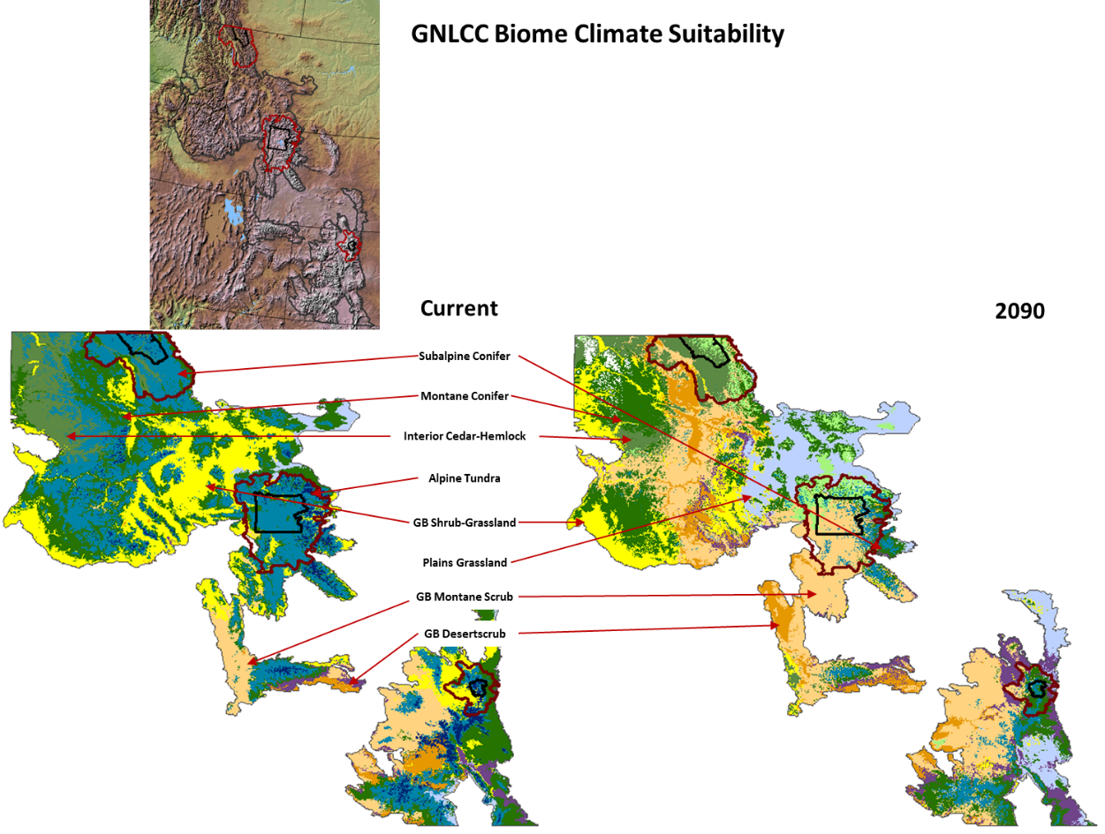
Biome Types

Slide 12
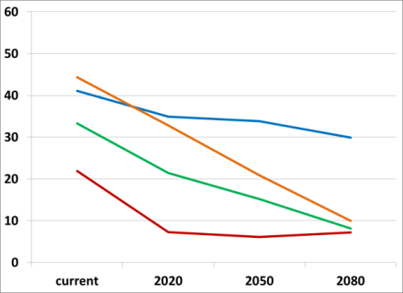
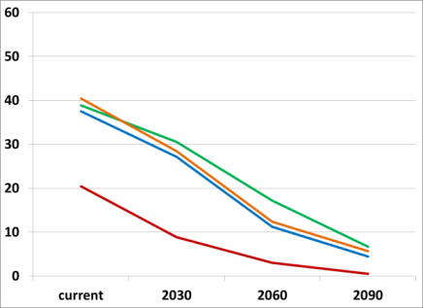
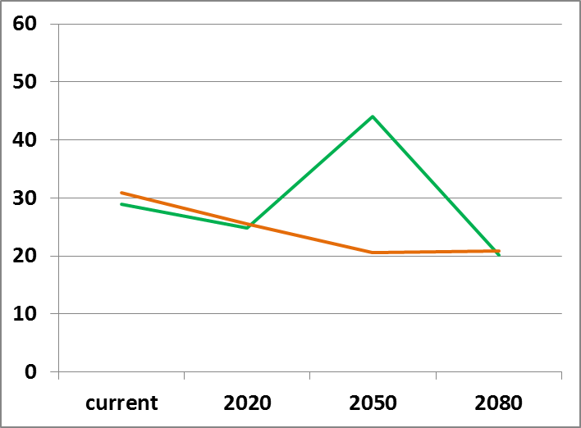
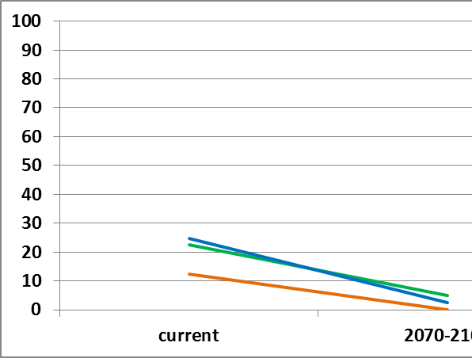
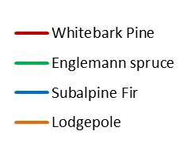
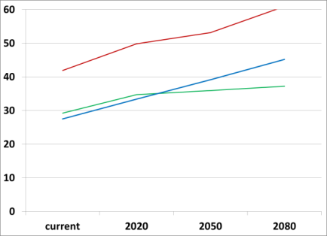
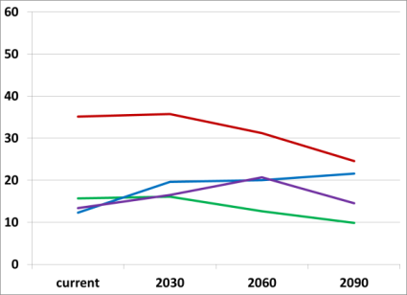
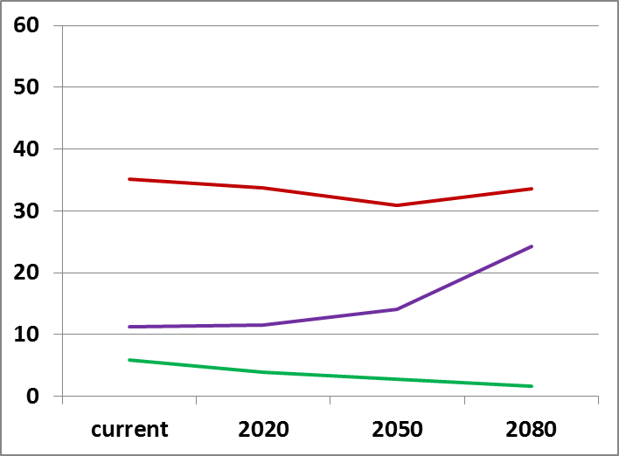
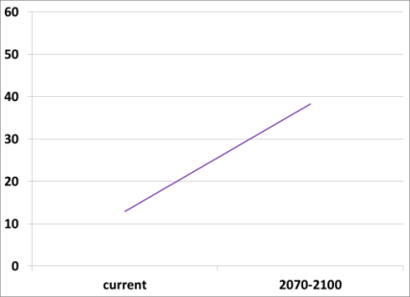
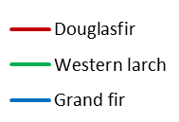
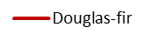
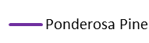
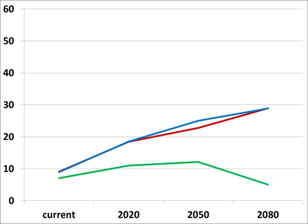
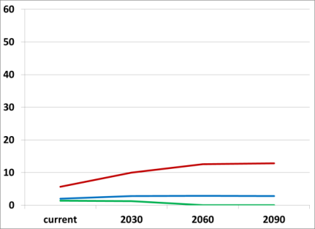
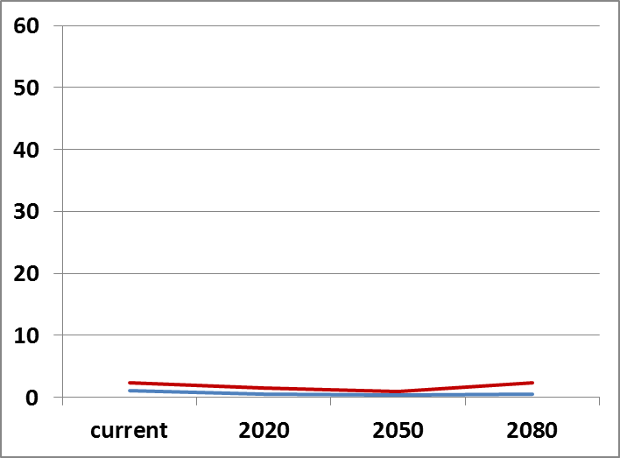
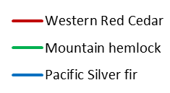
A2 Scenario
Tree Species
Coops & Waring
Crookston et al.
Gray & Hamann
Bell et al.
Subalpine
Montane
Mesic
Western redcedar
Western hemlock
Percent of GNLCC Suitable in Climate, Reference Period to 2100

Slide 13
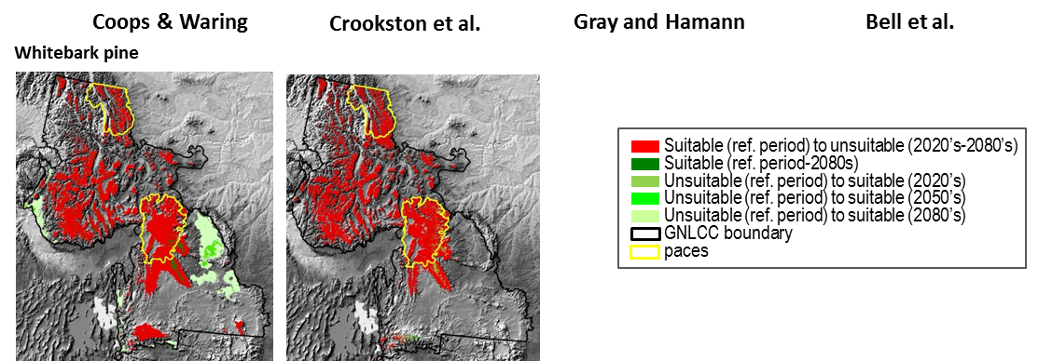
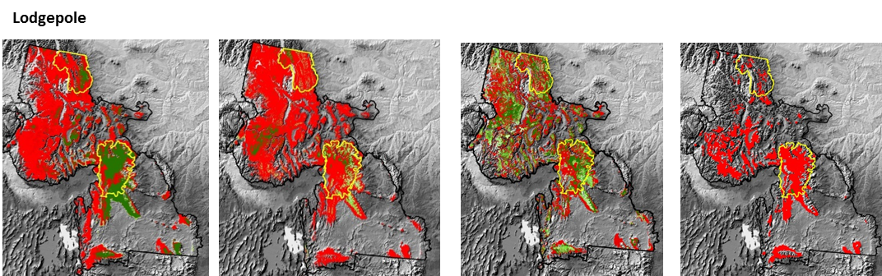
Change in Spatial Patterns
A2 Scenario

Slide 14
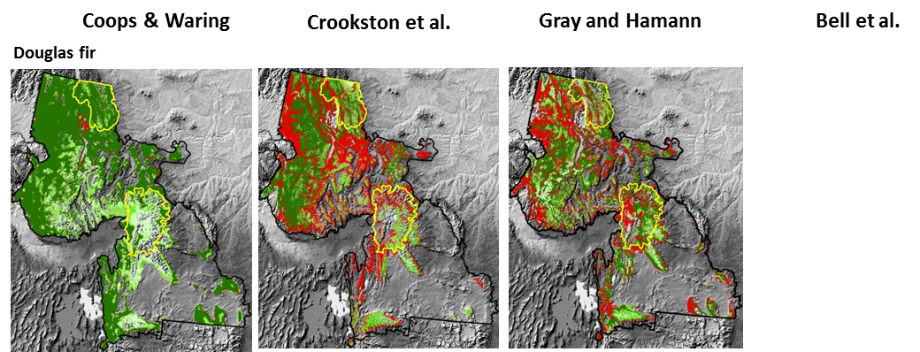
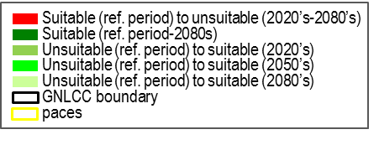
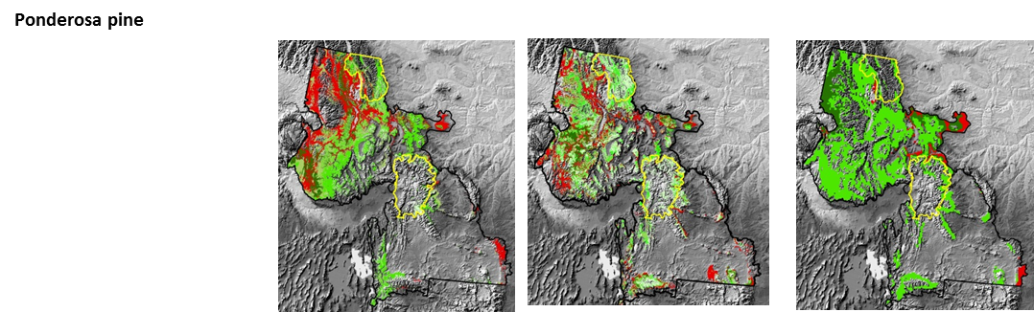
Change in Spatial Patterns
A2 Scenario

Slide 15
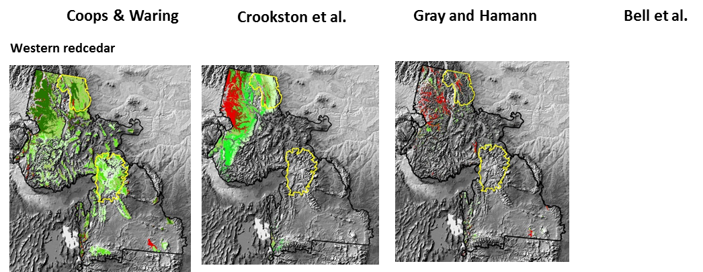
Change in Spatial Patterns
A2 Scenario

Slide 16
Change in Spatial Patterns
Species expansions of Coops & Waring suspect because they used a GCM subsequently found to project cooler and wetter conditions in the Pacific Northwest than a 20 GCM ensemble average (Mote et al. 2005, 2008).
A2 Scenario

Slide 17
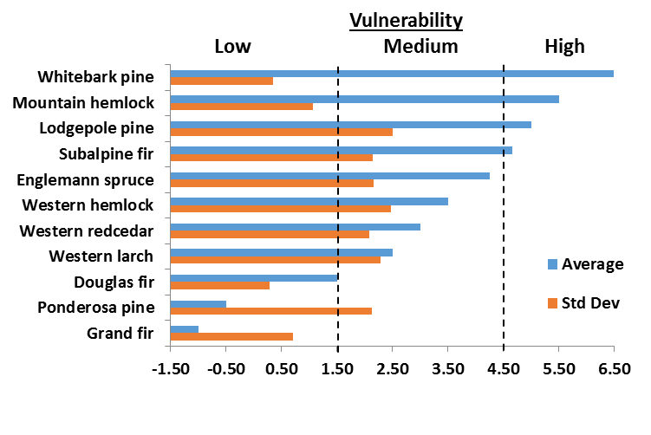
Vulnerability Assessment Based on Potential Impact
Time Period | Metric | Units | Vulnerability Ranking
Current Period | Area of suitable habitat | Percent of study area | 5: Very high (<10% of area) 4: High (10<30% of area) 3: Medium (30<50% of area) 2: Low (50<75% of area) 1: Very low (>=75% of area)
Late century (e.g., 2070-2090) | Loss of reference-period suitable habitat | Percent loss of area from the reference period | 5: Very high (>75%) 4: High (>50-75%) 3: Medium (>30-50%) 2: Low (>10-30%) 1: Very low (<=10%)
 | Naturally colonizable newly suitable habitat by 2070-2090 | % gain in suitable habitat <=30 km from ref suitable) | 0: very low gain (0<10%) -1: low gain (10<50%) -2: mod gain (50<100%) -3: large gain (100<150%) -4: very large gain (>=150%)
 | Newly suitable habitat by 2070-2090 requiring assisted migration | Percent gain in suitable habitat >30 km from ref suitable) | 0: low gain (0<20%) -1: mod gain (20<100%) -2: large gain (>100%)
A2
Scenario

Slide 18
Climate Suitability as a Component of VA
Utility
Climate suitability is a strong indicator of where viable populations may be able to exist.
Knowledge of climate suitability is a critical filter for deciding where apply management.
Dawson et al. 2011
Climate-envelop modeling is one component of the needed assessment methods.

Slide 19
Questions for WBP Climate Suitable Area
Ecosystem services provided by WBP are likely to be reduced.
But, will WBP maintain viable populations?
Might micro-refugia provide adequate climate space to allow viable populations to persist?
Do genetic variants exist that are better able to tolerate more extreme climate conditions?
How did WBP persist through warmer periods during the Holocene?
Is mountain pine beetle ever known to cause local extinction of host species?
Can WBP be viable under warmer and drier conditions if competing vegetation is controlled?

Slide 20
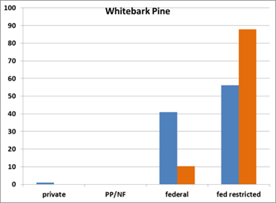
Opportunities for Management
Distribution of suitable climates among land allocation types.
Ref. period
2080’s
Crookston et al. / A2

Slide 21
Opportunities for Management
Which adaptation strategies are legal and/or appropriate in each land allocation type?
Adaptation Strategy | Land Allocation Type
 | Private | Private protected and nonfederal public | Federal multiple use | Defacto roadless and wilderness | National park | Designated wilderness and roadless
Monitoring and research | X | X | X | X | X | X
Planning | X | X | X | X | X | X
Vulnerability assessment | X | X | X | X | X | X
Passive management | X | X | X | X | X | X
Active management | X | X | X

Slide 22
Conclusions
Areal extent of suitable climate for WBP and other subalpine species is likely to be greatly reduced, with reductions in the ecosystem services they provide.
Research is needed on WBP population viability.
The vulnerability of Mountain hemlock in the GNLCC is poorly known.
Resource managers will better understand these changes and be able achieve natural resource objectives if they begin investing in some or all of the adaptation strategies.

Slide 23
Acknowledgements
NASA Applied Sciences Program (Grant 10-BIOCLIM10-0034)
NSF EPSCoR Track-I EPS-1101342 (INSTEP 3)
NASA Land Cover Land Use Change Program
North Central Climate Sciences Center
Federal agency collaborators

