Slide 1
Tree and shrub species habitat suitability across the Greater Yellowstone under climate change
Society for Conservation Biology Meetings
Missoula, MT
Nathan Piekielek
Andrew Hansen
Tony Chang

Slide 2
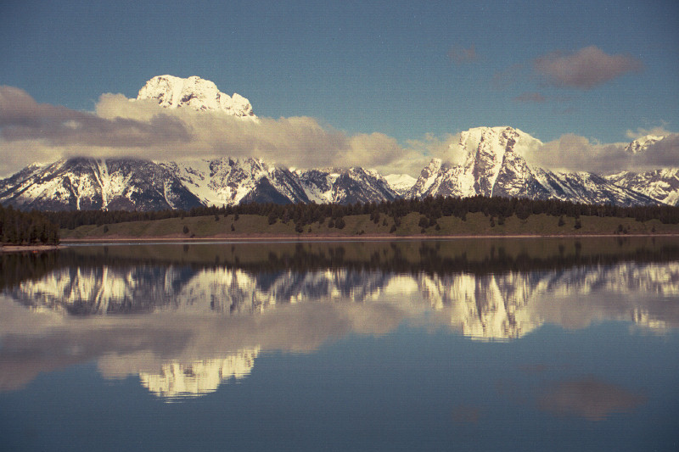
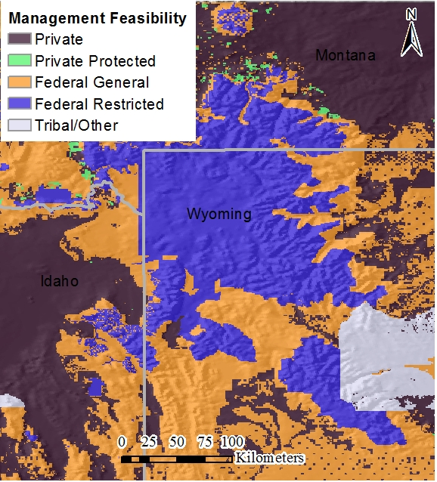

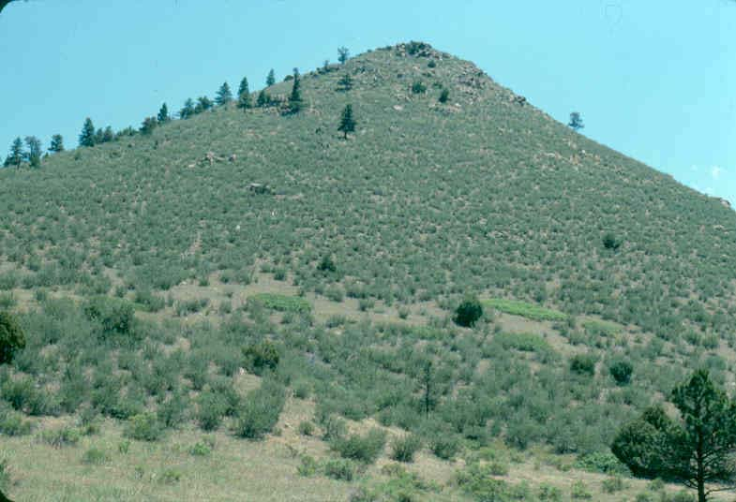
Introduction
Response to CC will require coordinated ecosystem management
  GYE important test bed
  Greater Yellowstone Coordinating Committee (GYCC)
Results of prior continental scale veg studies do not agree
  Future trees vs shrubs
Objective:
  Provide NR managers with local results on potential impacts + opportunities
  across 4 elevation zones

Slide 3
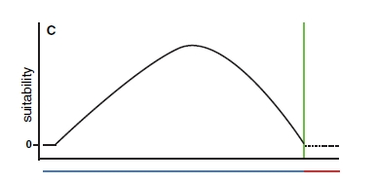
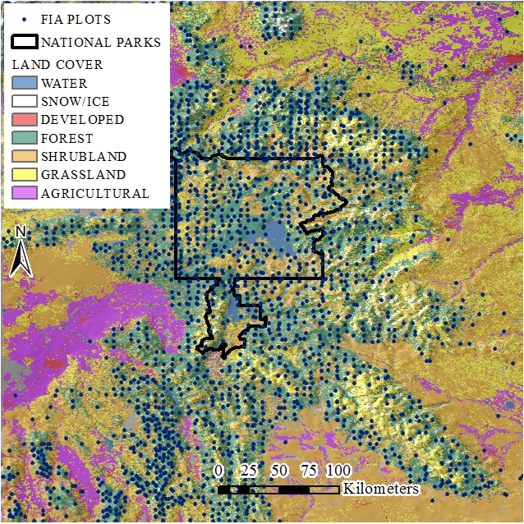
Methods – species distribution models
Application of niche theory
Identifies tolerances of species in multiple climate and other dimensions
Interpolation of present day conditions
Application to future climates to examine change
Often does little to consider dispersal, biotic interactions
(Anderson 2013)

Slide 4

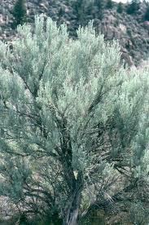
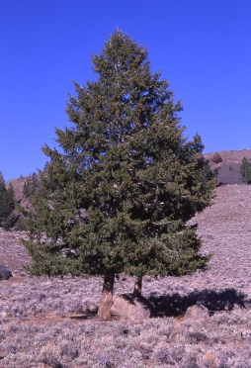
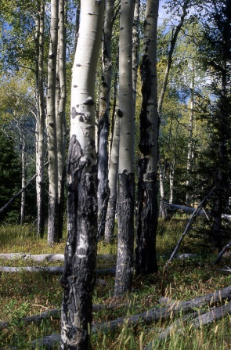



Species | Abbreviation | GYE Habitat niche
Sagebrush | artr | Soil recharge followed by extended dry period
Lower treeline
Juniper | jusc | Broad temp., and dry
Limber pine | pifl | Broad temp., rocky soils
Montane forest
Aspen | potr | Moist seeps, concavities
Douglas fir | psme | Warm and moist
Lodgepole pine | pico | Cold and drought hardy, tolerant of sandy soils
Subalpine forest
Engelmann spruce and Subalpine fir | pien, abla | Cold and snowy, low evaporative demand, water not limiting
Photo credits:
Yellowstone photo collection

Slide 5
Predictor Category | Predictor Name | Abbreviation | Time Period Summary | Importance Rank
Water-balance
 | Soil water deficit (pet – aet) | deft | September | 1
 | Snowpack | pack | April | 2
 | Soil moisture | soilm | June | 4
Soils and topography
 | Sand fraction | sandfract | N/A | 3
 | Rock volume | rckvol | N/A | 5
 | Topographic wetness index | twi | N/A | 7
 | Direct incoming solar radiation | srad | N/A | 6

Slide 6
Results
Species | # Presence (n=2489) | Model Discrimination (AUC)
Sagebrush | 251 | 0.731
Lower treeline
Juniper | 198 | 0.961
Limber pine | 266 | 0.655
Montane forest
Aspen | 417 | 0.863
Douglas fir | 863 | 0.777
Lodgepole pine | 1190 | 0.768
Subalpine forest
Engelmann spruce | 962 | 0.765
Subalpine fir | 533 | 0.857

Slide 7
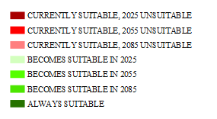
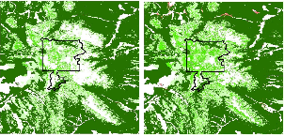
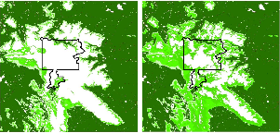
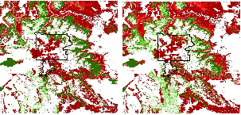
RCP4.5 8.5
Sagebrush
+40%
(+/-17%)
Lower treeline
Juniper +55%
(+/-16%)
Limber pine -29%
(+/-21%)

Slide 8
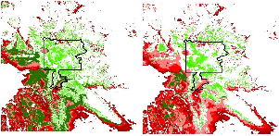
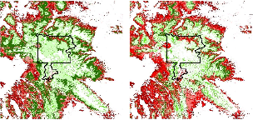
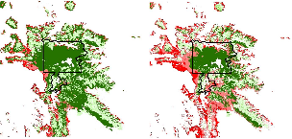
RCP4.5 8.5
Montane forest
Aspen -60%
(+/- 36%)
Douglas fir -73%
(+/-28%)
Lodgepole pine -85%
(+/-41%)

Slide 9
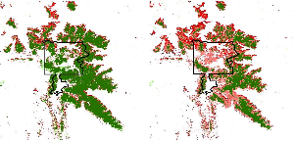
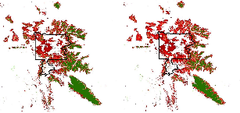
Subalpine forest
RCP4.5 8.5
Englemann spruce -90%
(+/- 41%)
Subalpine fir -80%
(+/- 52%)

Slide 10

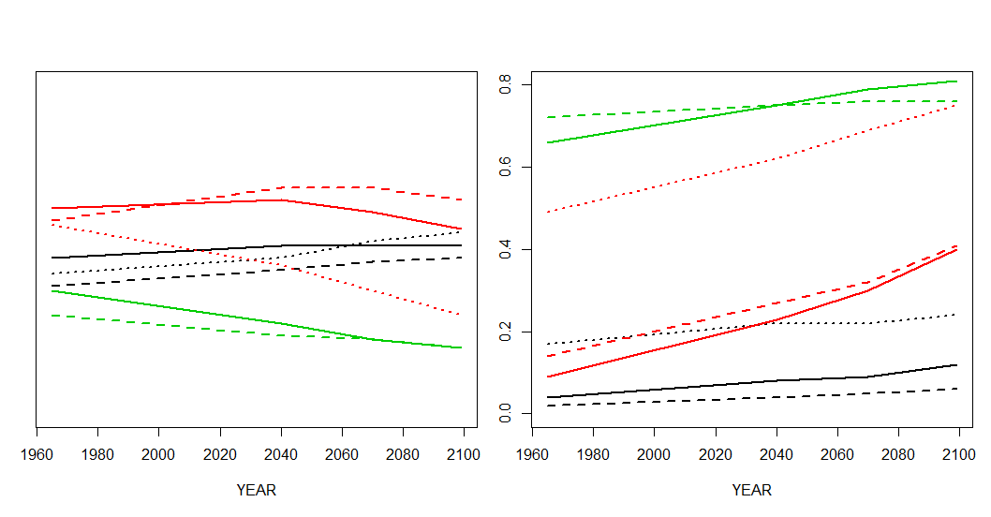
% Suitable on
Federal general
% Suitable on
Federal restricted

Slide 11
Discussion and Management Implications
deft9 and pack4 = longer drier growing season
Increasing suitability for artr and jusc across study area and elev.
Montane habitat biggest upslope movers
  Most sensitive to interactions between soil conditions and water-availability
Subalpine species habitat retracted upslope
  Unsuitable upslope soil conditions/mountain tops?
Sagebrush cons. opportunity?
    > half on federal lands by mid-century
Montane spcs biggest increase on federal general lands
  Valuable economic and biodiv.
Subalpine species may require help?
  Plant in alpine when suitable
  Control wildfire
  Control competing veg
  Would require changes to existing management policy
What are desired future conditions for subalpine forests?

Slide 12




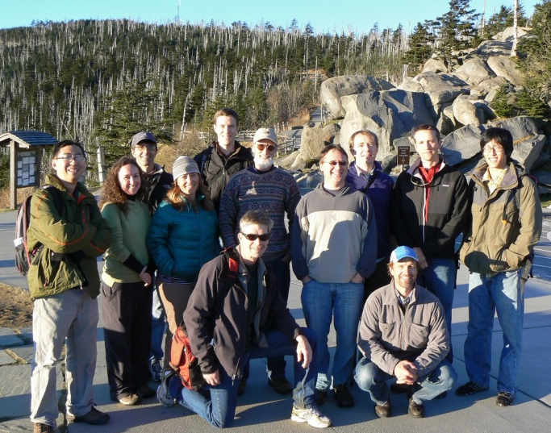
Acknowledgements
Funding and Software for Assisted Habitat Modeling provided by the USGS North Central Climate Science Center, Montana NSF EPSCoR, and NASA Applied Sciences.
Thank you for productive collaboration with the entire NASA Landscape Climate Change Vulnerability Project team.

