Slide 1
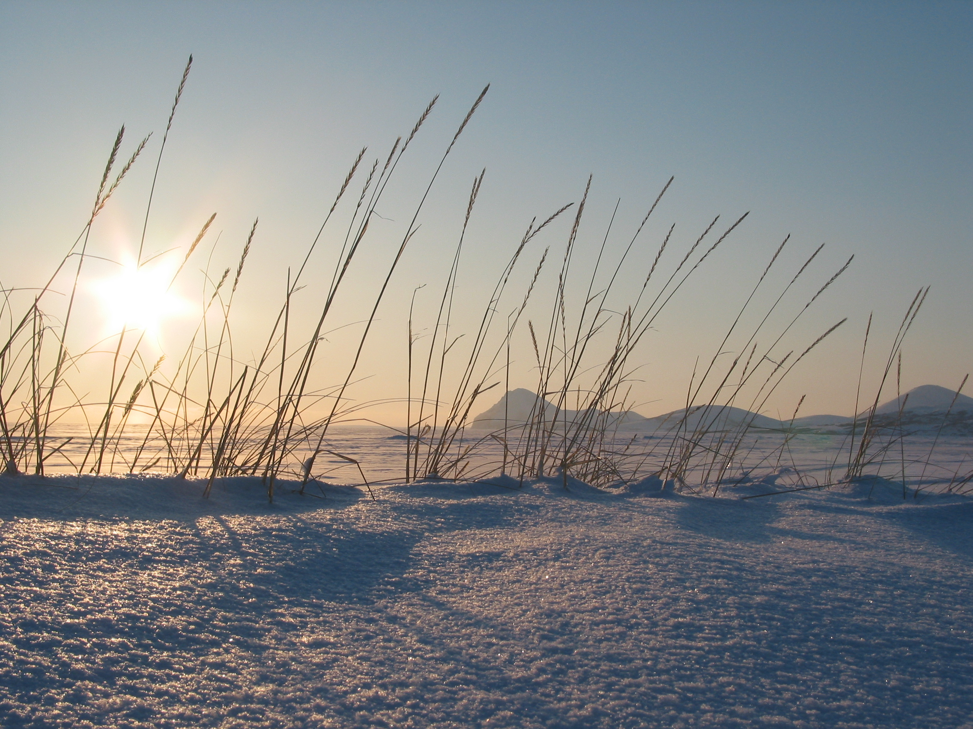
Effects of climate change on phenology and forage quality in Rocky Mountain National Park and Estes Park, Colorado
Erica Garroutte
M.S. Candidate

Slide 2
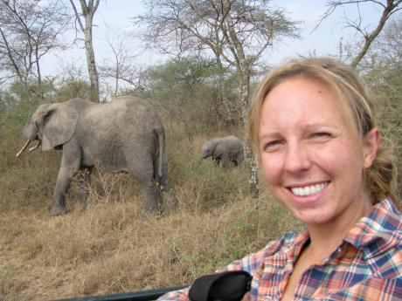
Erica Garroutte
M.S. Candidate
Landscape Biodiversity Lab
Montana State University
-B.A. in Biology from Colorado College 2003 - 2007
-Education Staff/Consultant
Cheyenne Mountain Zoo
2007 - present
-Research Assistant/ Student Advisor
SFS Center for Wildlife Management Studies in East Africa, 2009 - 2012
-land-use changes
-human/wildlife conflict
-Kilimanjaro Trip Leader
Putney Student Travel, 2012

Slide 3
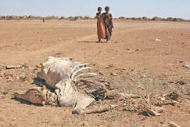
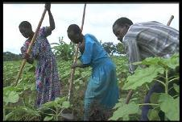
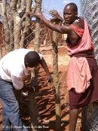
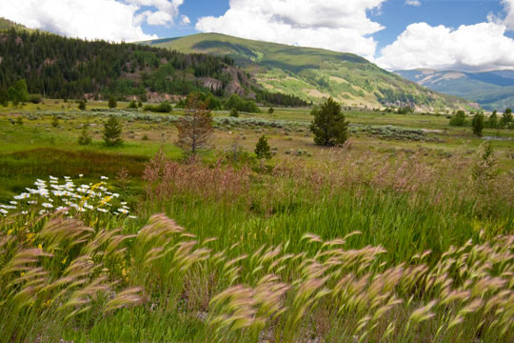
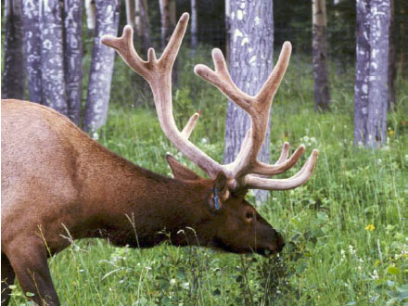
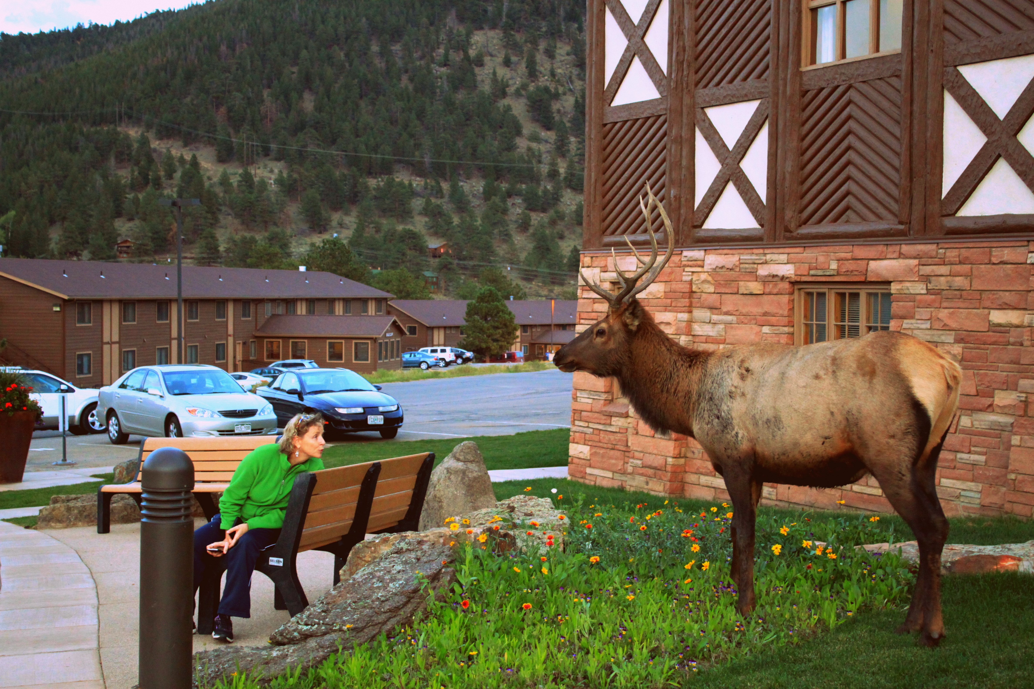
How will climate change affect human land-use/wildlife relationships?
Drought
Agriculture
Human/wildlife conflict
Kimana, Kenya and Manyara, Tanzania, East Africa
Phenology shifts
Change elk habitat use
Human/elk conflict
Rocky Mountain National Park/Estes Park Colorado

Slide 4
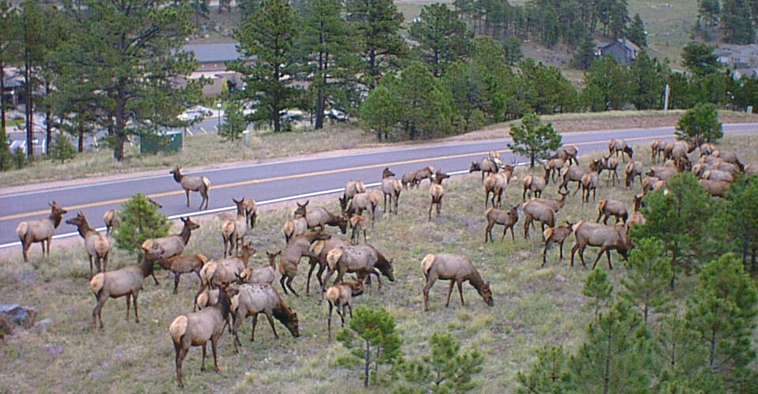
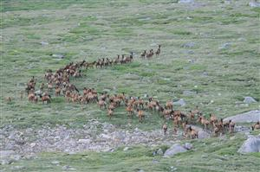


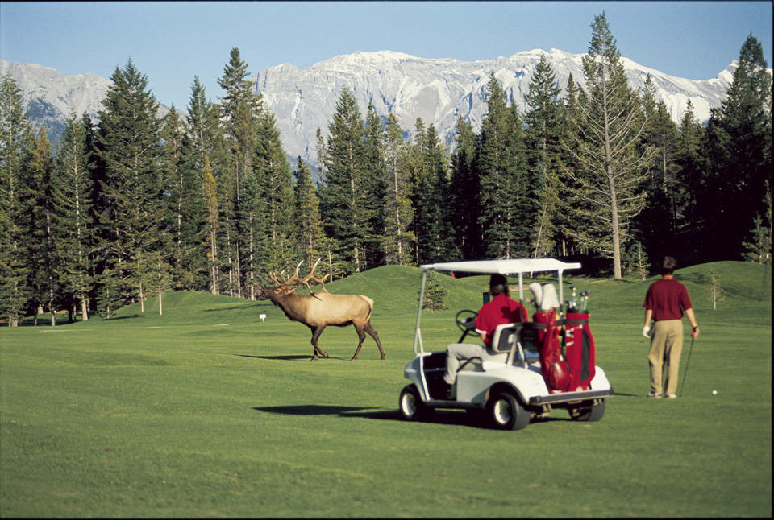
Climate Change Effects on Forage Phenology
Climate Change =
Accelerated/delayed snowmelt Temp increase Precipitation
Change in phenology
Low
elevation
High
elevation
50-100% population increase
Altered movement
Inyoue 2000
Wang et al. 2002
Wang et al. 2002
Urban elk?
Mckenzie 2001

Slide 5
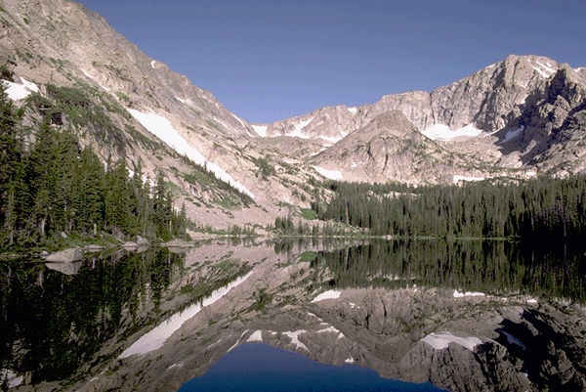
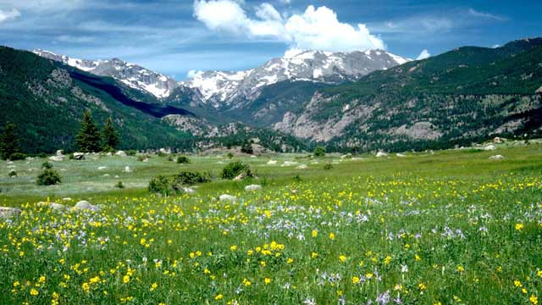
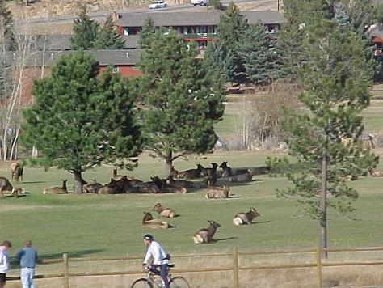
Phenology effects on forage quality in Rocky Mountain National Park/Estes Park
Cebrian et al. 2008
Early snowmelt = early phenology
high digestibility
Late snowmelt = late phenology
low digestibility
1.) How does phenology differ across the RM ecosystem? Future projections?
2.) How does forage quality change with phenology?
High elevation
Low elevation
Urban

