Slide 1

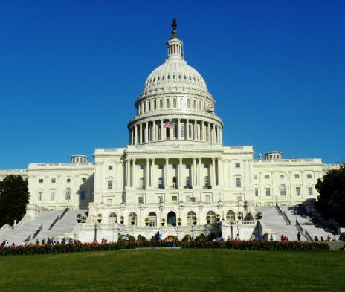
Regan Nelson

Slide 2
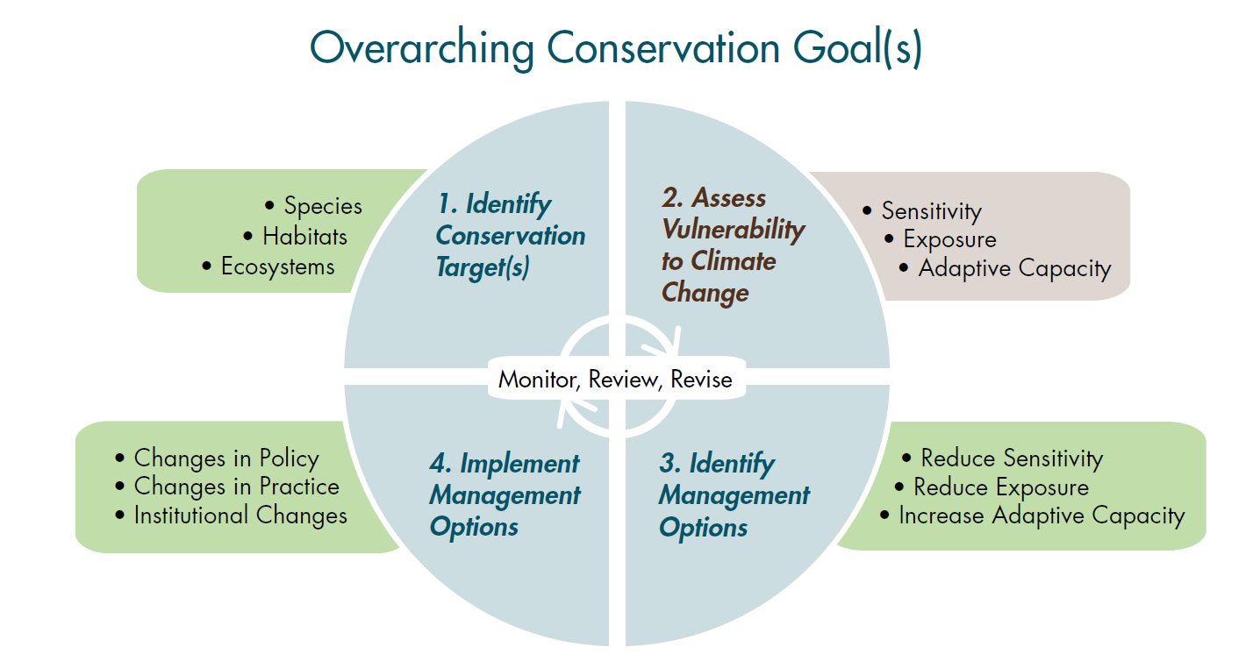
Project Conceptual Design (Glick et al. 2011)
and Landuse Change!

Slide 3
Landuse Change
Existing Landuse
Possible Futures
Scenario 1 Scenario 2 Scenario 3
Projected Landuse 1
Projected Landuse 2
Projected Landuse 3
Vulnerability Assessment
Focal species or process
Vulnerability Assessment
(x 3 scenarios)

Slide 4
Landuse Change
Housing Density + Energy Development (Conservative)
Projected Landuse 1
Housing Density + Energy Development (Aggressive)
Projected Landuse 2
Buffered Core Areas (using Wade 2011)
Projected Landuse 3

Slide 5

1. Define Climate Adaptation Networks
2. Identify Conservation Targets
Regional Context
7. Monitor, Review, Revise
3. Conduct Vulnerability Assessments
6. Implement Management
4. Identify Adaptation Options
Protect current biodiversity
Protect future biodiversity
Maintain ecological processes
Maintain/restore connectivity
Protect climate refugia
Protect landscape features
5. Conduct Risk Assessment
Feasibility
Expense
Robustness to uncertainty
Timeframe of impacts
Consistency with policy
Stakeholder buy in

Slide 6
Literature Review
Heller (2009): #1 theme “the need for regional institutional coordination for reserve planning and management and to improve connectivity
“Engage in regional, multi-ownership planning to make adaptive actions more effective” (Spies, et al. 2010)

Slide 7
Potential Research Goal
Demonstrate how vulnerability assessments can inform spatially-explicit adaptation options at a regional (and thus cross-jurisdictional) scale
  Maximize the match between adaptation options and management mandates
  Identify “low-hanging fruit” and areas of mis-match
Given mis-matches, what governance structures and/or policies may be meaningful or needed at the regional level?
Notes:
1) We can’t do everything everywhere, so how much do we need to do to meet our conservation objective?
2) What decision criteria will help us prioritize among actions? Economic feasibility, regulatory feasibility, social feasibility, potential unintended consequences, synergies with other management objectives, potential for removal or modification, consistency with current management practice, robustness to uncertainty in future climate projections
3) Uncertainty: scenario planning – “no regrets”; formal risk assessment – provides quantitative analysis; structured decision-making;

Slide 8
NASA Applied Sciences Program
Questionnaire for LCC-VP Collaborators
1. Describe your level of knowledge about past change climate and land use from 1900 to present and about projected future climate and land use to 2100 .
2. What is your current approach to managing natural resources under climate and land use change? List 3-5 of the key steps you use to go from identifying potential conservation concerns to implementing management to alleviate concerns for high priority issues?
3. Do you currently have the data and decision support tools necessary to execute these steps?
4. What are the major conceptual challenges you face in executing these steps?
5. What additional resources (concepts, data, and/or tools) would improve your ability to manage under climate and land use change?

