Slide 1
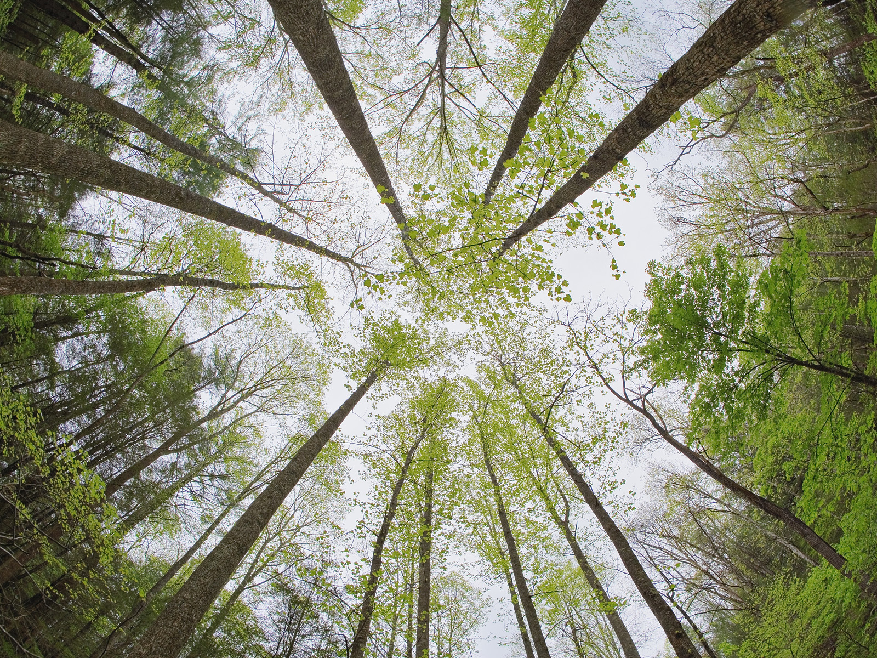
Climate Vulnerability of Eastern U.S. Forests
Patrick Jantz, Tina Cormier, Scott Goetz, Scott Zolkos
Woods Hole Research Center
May 21, 2013
Jackson Hole, WY
Photo credit: Andri Kyrychok

Slide 2
Distribution Modeling
Predictor Variables
  Dynamic
    Climate
      Bioclimatic variables
      Growing degree days (Sork et al. 2010)
    TOPS
    SERGOM
Notes:
Water balance (Lutz et al. 2010) ?

Slide 3
Distribution Modeling
Predictor Variables
  Static
    Soils (STATSGO)
      Mineral component fraction (sand, silt, clay)
      Bulk density
      pH
      Available water capacity
      Depth to bedrock
    Potential relative solar radiation (Pierce et al. 2005)

Slide 4
Distribution Modeling
Response Variables
  Park scale
    USGS - NPS Vegetation Characterization Program veg maps
  PACE and rangewide scales
    FIA plot data (fuzzed up to 0.5 mile ~ 800m)
    Cross check with models built from precise coordinates for a subset of species

Slide 5
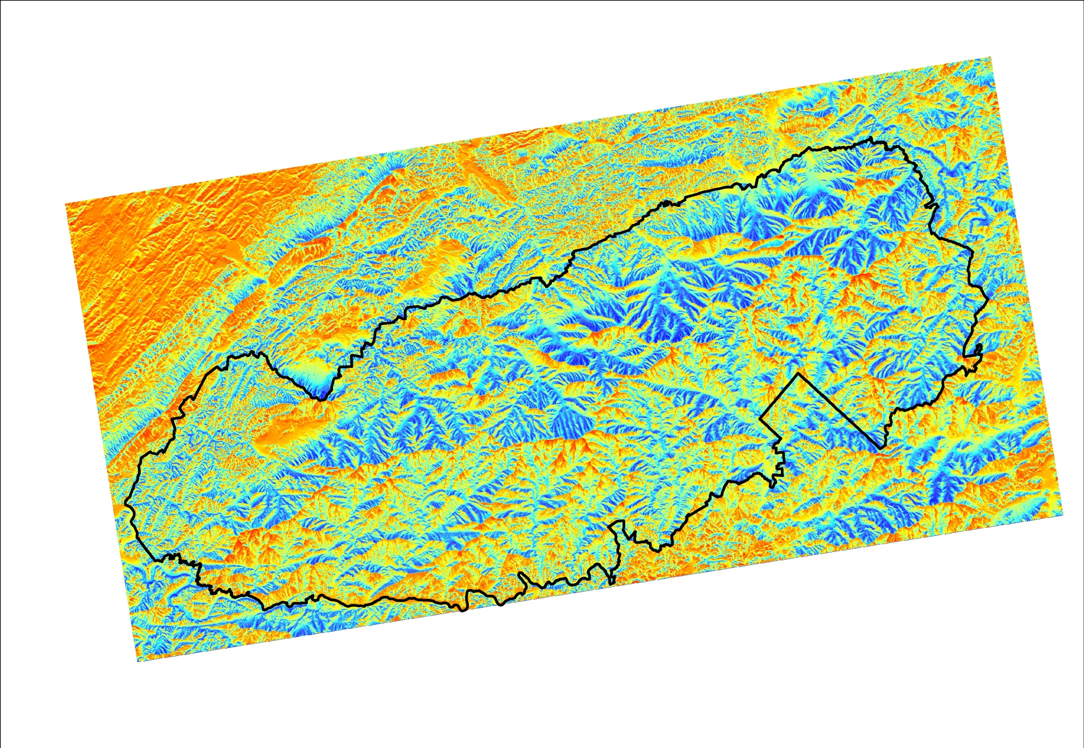
Potential Relative Solar Radiation (30m)

Slide 6
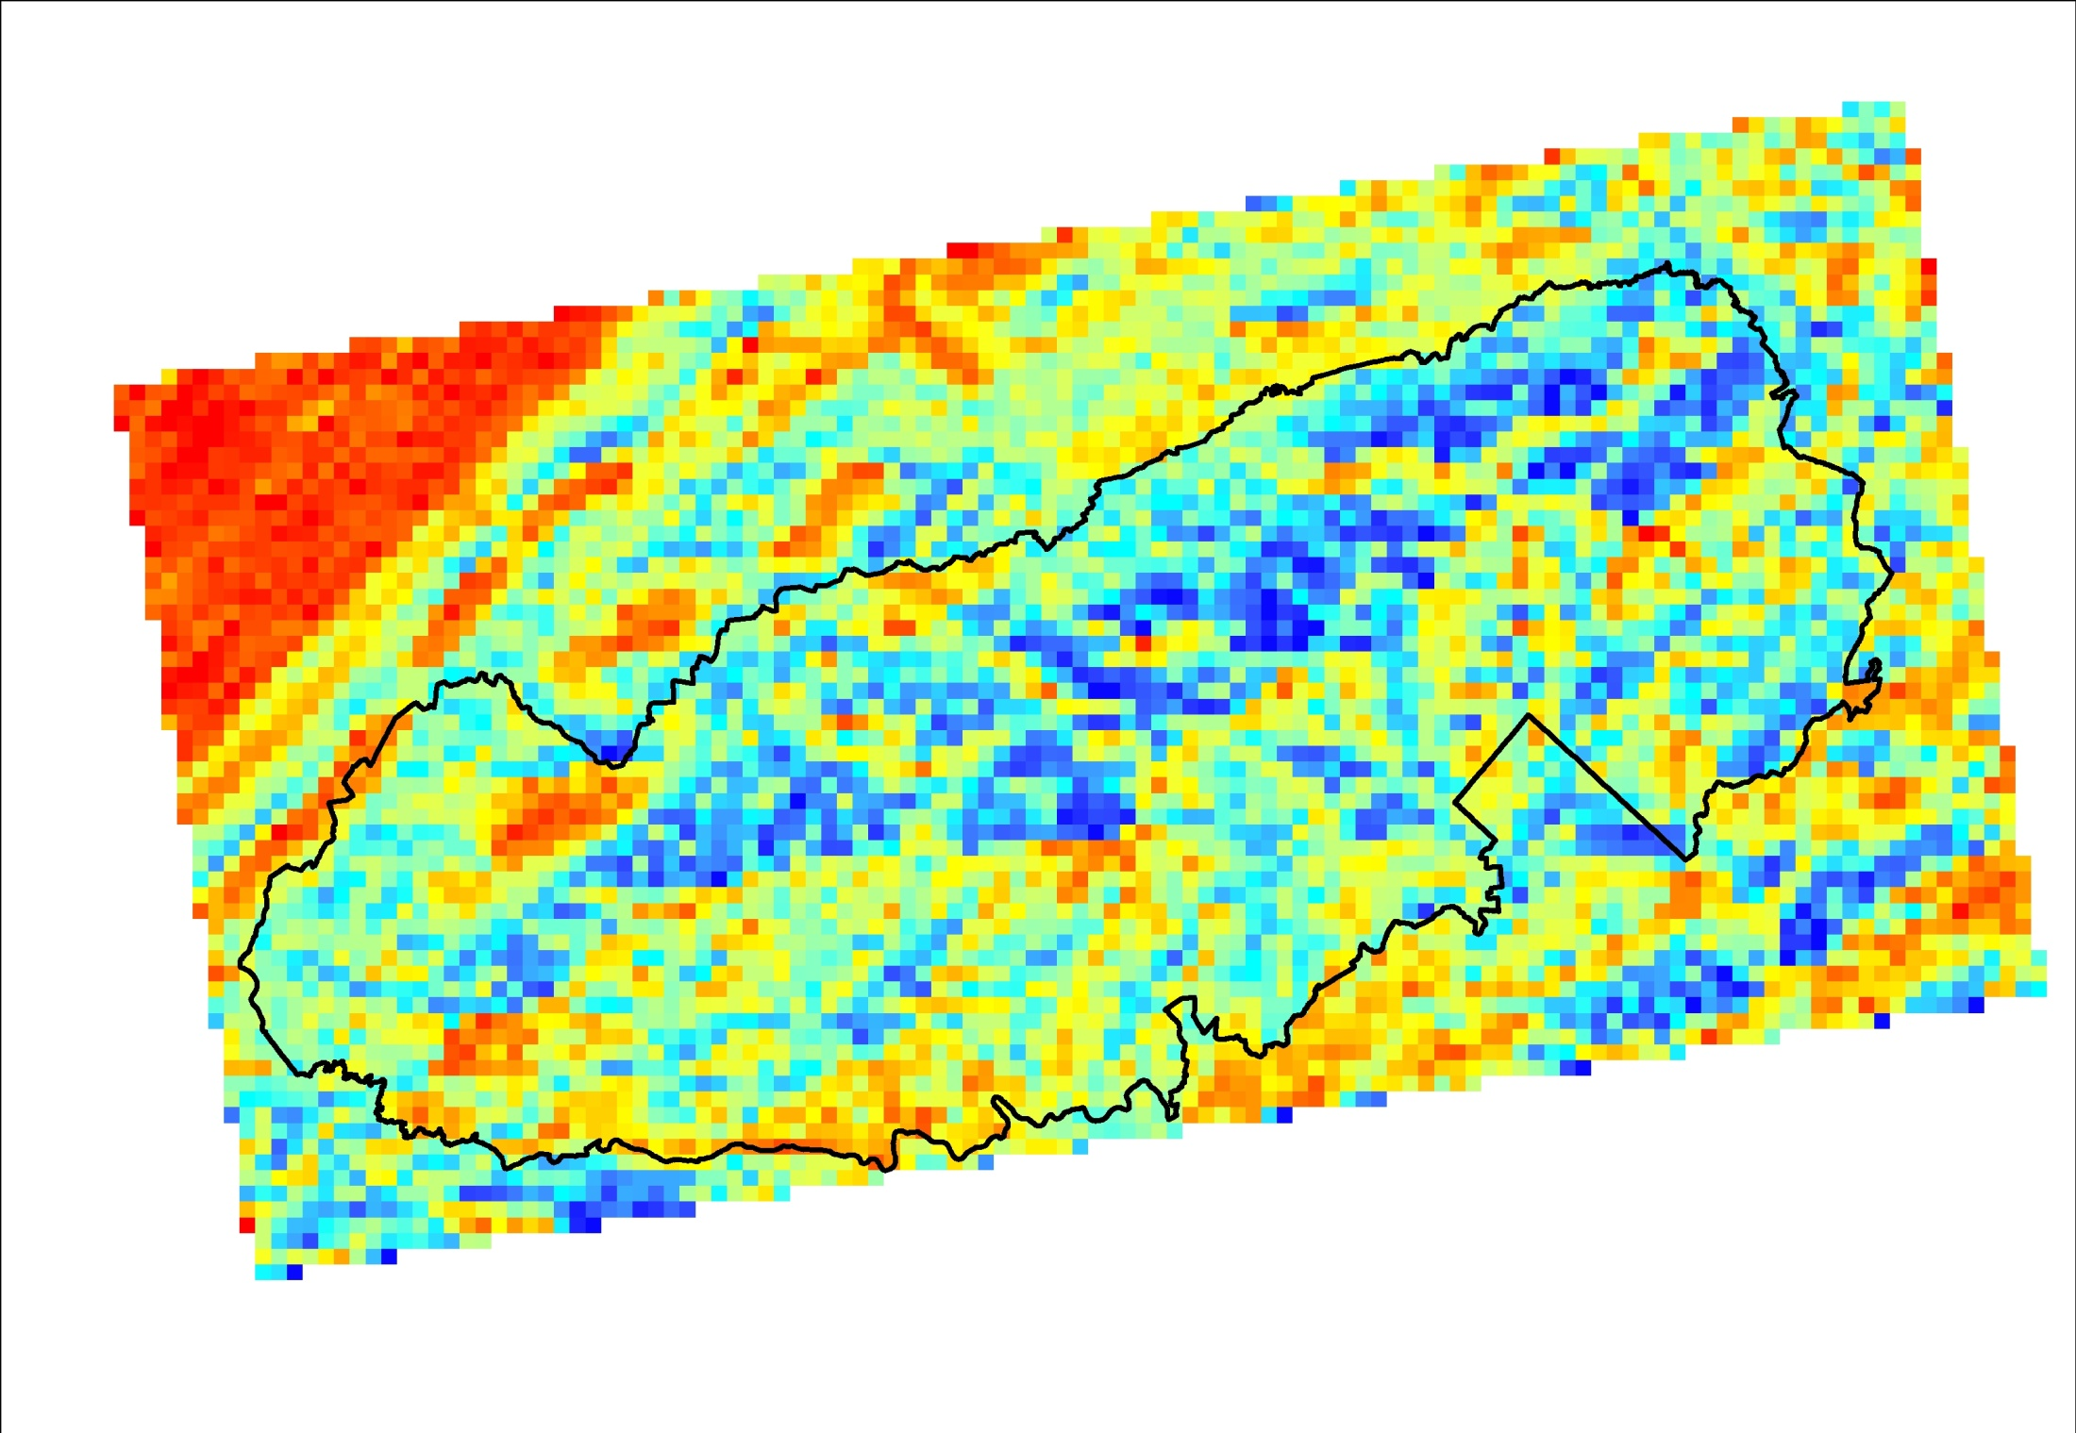
Potential Relative Solar Radiation (800m)

Slide 7
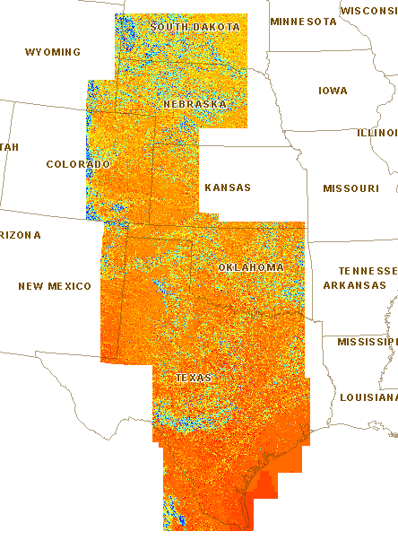

Slide 8
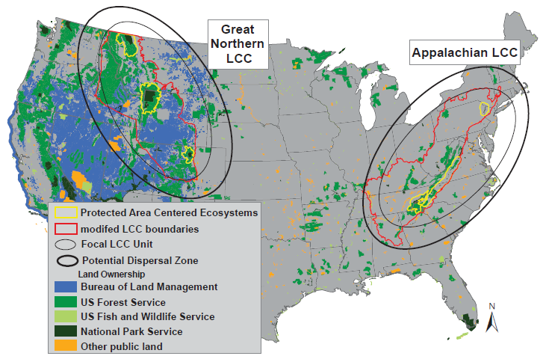
NPS to Rangewide Scale Modeling
Species | Common Name
Acer saccharum | Sugar Maple
Aesculus flava | Yellow Buckeye
Betula alleghaniensis | Yellow Birch
Fagus grandifolia | American Beech
Fraxinus americana | White ash
Liriodendron tulipifera | Tulip Poplar
Pinus strobus | Eastern White Pine
Quercus alba | White Oak
Quercus rubra | Red Oak
Tsuga canadensis | Eastern Hemlock
Ecological Systems
Spruce-Fir
Cove Hardwood
Northern Hardwood
Oak Hickory
Hemlock
Montane Alluvial
Mixed Mesophytic
Pine-Oak
Notes:
Assess change in suitable climate conditions for individual spp. as a measure of risk for that ecological system at the park scale.

Slide 9
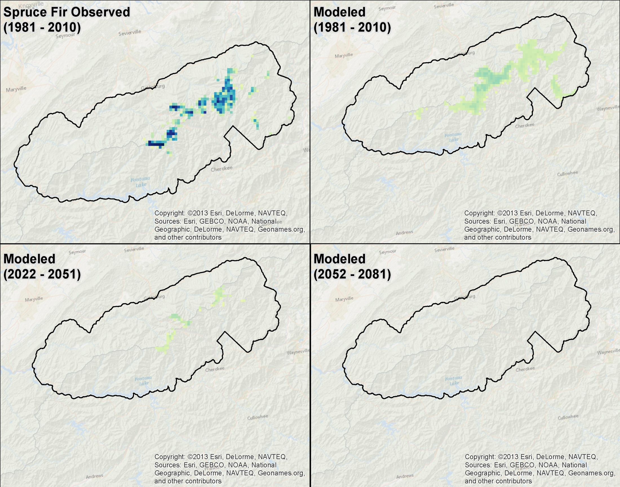

Slide 10
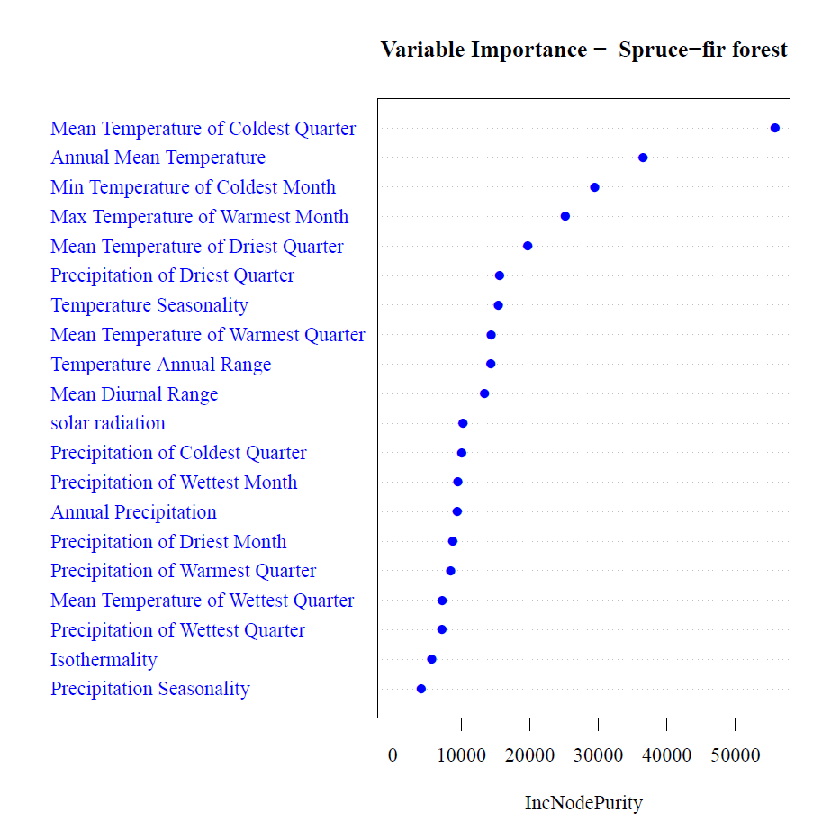

Slide 11
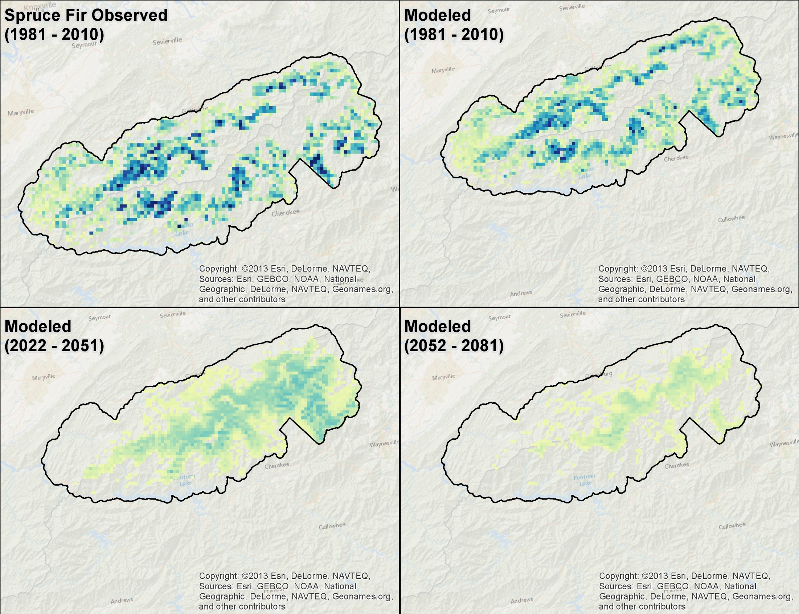

Cove Forest Observed
(1981 - 2010

Slide 12
