Slide 1
Identifying Adaptation Management Options for Whitebark Pine in the Greater Yellowstone Ecosystem
May 22, 2013

Slide 2
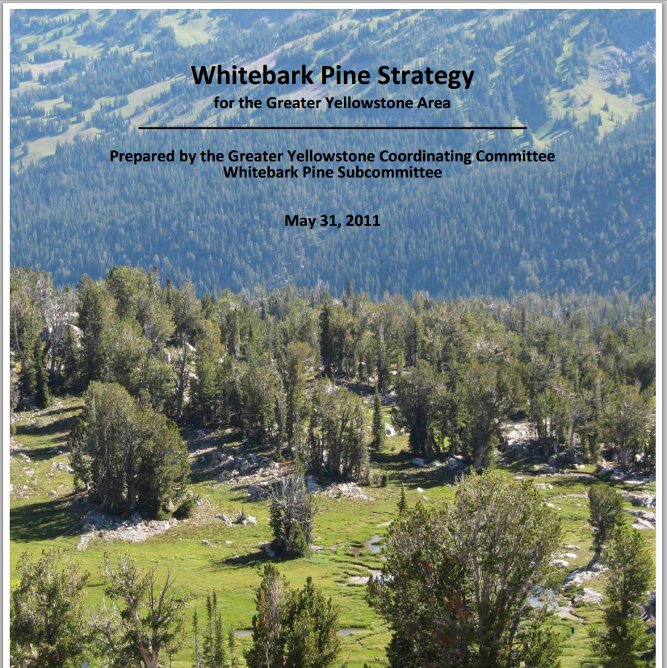
Collaborators: Greater Yellowstone Coordinating Committee (GYCC) Whitebark Pine Subcommittee (WBPSC)
Goal: Update and inform the implementation of the WBP Strategy given forecasted climate change
Notes:
MPB: aerial evaluation in summer of 2009 documented over 50% of WBP stands have already suffered high to complete mortality of overstory trees, and 95% of forest stands containing WBP have measurable MPB activity.
Blister rust: average infection rates in plots average 20%, range from 0% to 84%.
WBP is a candidate species for listing under the Endangered Species Act (2011 warranted but precluded)
WBP strategy goal: “maintain functioning WBP ecosystems in the GYE” Includes 5 strategic objectives for protecting and restoring existing WBP.
Does not consider the role of climate change.

Slide 3
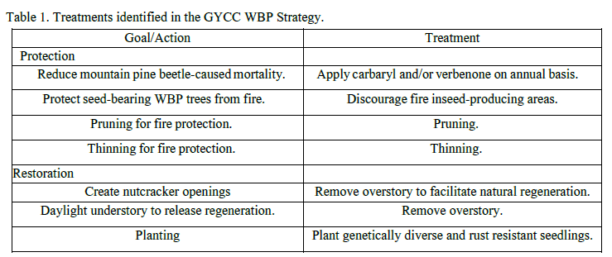
Current management strategies
Notes:
These are the management treatments identified by WBPSC. They mainly deal with
Reducing impacts from WBP by applying carbaryl
Reducing impacts from blister rust by pruning cankers where feasible
Protecting high-value stands from fire, given the low production of seed due to stress, and loss of reproducing adults
Removing competition (mainly SAF, but also Lodgepole and Doug-fir)
Facilitating regeneration by creating openings
Facilitating regeneration through planting, either by sowing direct seeds or planting seedlings

Slide 4
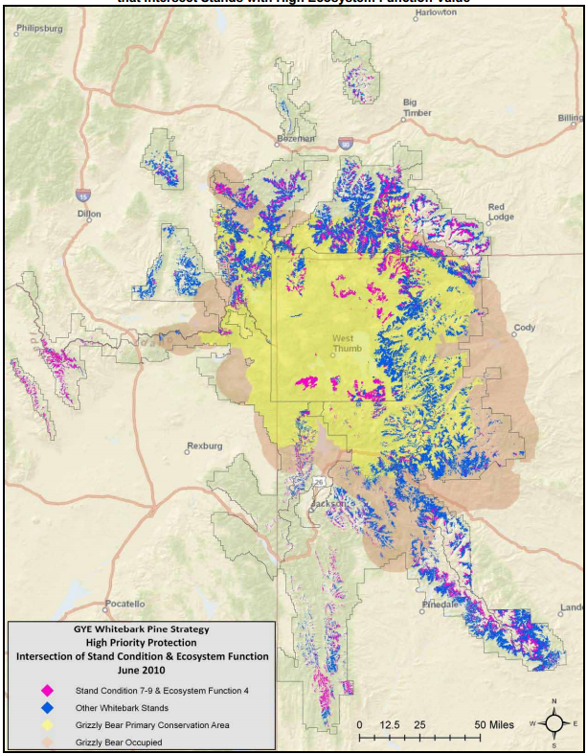
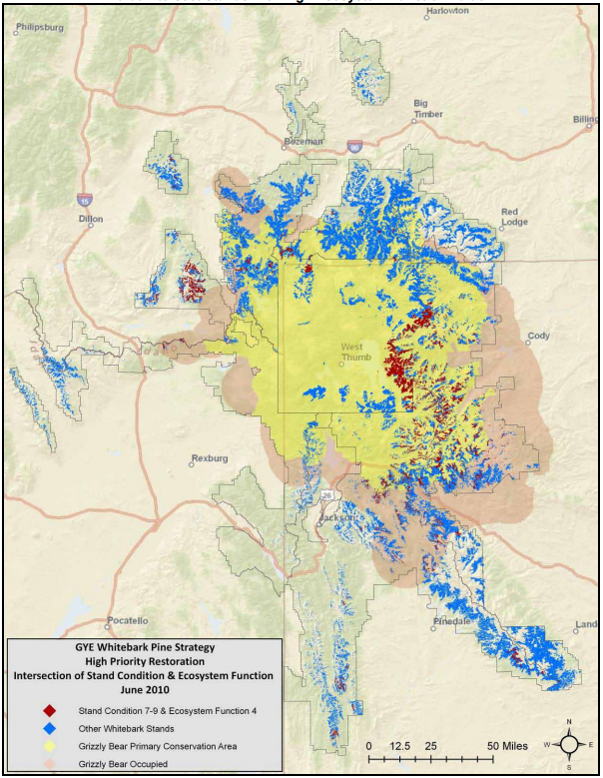
Existing Prioritization
Notes:
Figure on LEFT. Stands in pink have high protection scores for both stand condition and ecosystem function. High ecosystem
function depicted on this map is defined as stands dominated by whitebark pine with low overstory mortality. All other
whitebark pine stands are in blue. The grizzly bear PCA and occupied areas are also depicted. All whitebark pine stands are
represented.
Figure on RIGHT. Stands in red have high restoration scores for both stand condition and ecosystem function. High ecosystem
function depicted on this map is defined as stands dominated by whitebark pine with low overstory mortality. All other
whitebark pine stands are in blue. The grizzly bear PCA and occupied areas are also depicted. All whitebark pine stands are
represented.

Slide 5
Whitebark Pine Subcommittee Questions
Where should WBP treatments be placed in the landscape to be effective under a future climate?
At a landscape scale, how effective would the climate informed treatments be under current land allocation constraints? For example, is connectively and genetic exchange maintained under future climate and current land allocation?
What spatial distribution of WBP treatments is necessary to maintain functioning WBP regardless of current land allocation constraints?
How will the values of ecosystem services vary under various treatments and future climate scenarios?

Slide 6
Where should WBP treatments be placed in the landscape to be effective under a future climate?
WBP Refugia: where we expect WBP to remain on the landscape | Protection activities
WBP Loss: where we expect the climate envelope for WBP to be lost | Protection and Restoration activities
WBP Gain: where we expect the climate envelope for WBP to become suitable | Planting and connectivity analysis

Slide 7
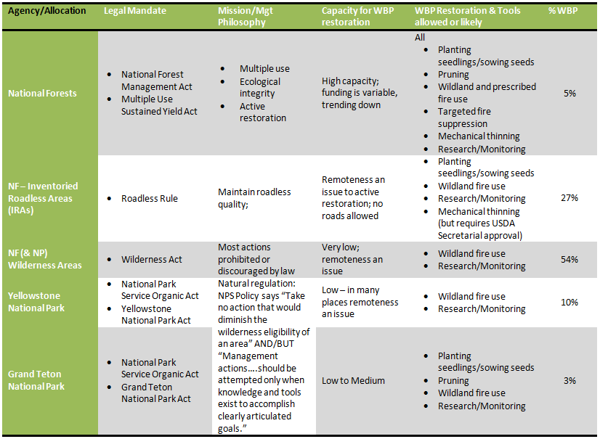
At a landscape scale, how effective would the climate informed treatments be under current land allocation constraints?

Slide 8
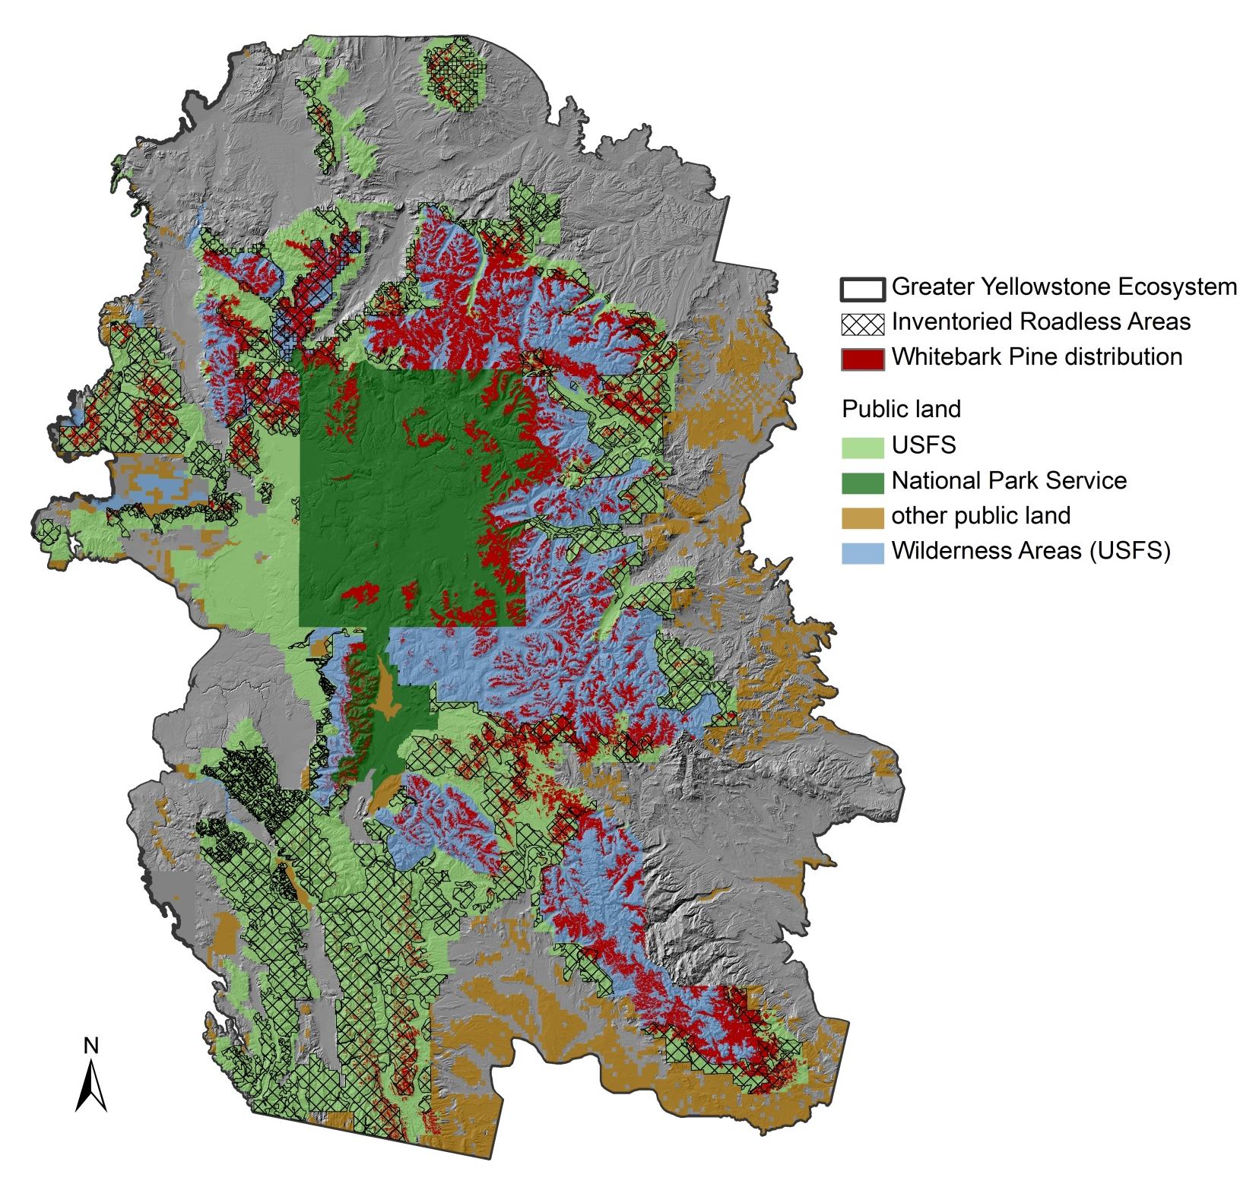

Slide 9
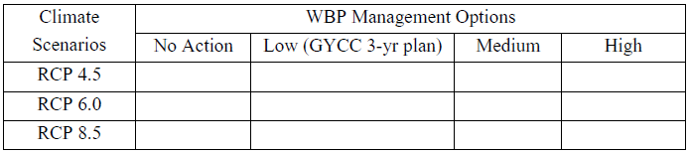
Methods
At a landscape scale, how effective would the climate informed treatments be under current land allocation constraints?
What spatial distribution of WBP treatments is necessary to maintain functioning WBP regardless of current land allocation constraints?
Notes:
Management Scenarios:
No Action Plan assumptions
Available funding is $0
No management actions directly targeting WBP are taken
Low Effort Plan assumptions
Available funding is (NEED DOLLAR AMOUNT)
Management actions are limited to:
Chemical treatments anywhere
Thinning for fire protection and to augment natural regeneration only in stands close to roads (THIS LEAVES OUT IRAs and WILDERNESS).
No prescribed fire (to reduce fuel loads around WBP stands).
No planting.
Moderate Effort Plan assumptions
Available funding is (NEED DOLLAR AMOUNT)
Management actions are limited to:
Chemical treatments anywhere
Thinning for fire protection and to augment natural regeneration anywhere outside of IRAs and wilderness areas.
Fire protection anywhere outside of IRAs and wilderness areas.
Planting anywhere outside of IRAs and wilderness areas.
Heroic Effort Plan assumptions
Unlimited funding (or maybe we just put a very high dollar amount on it)
Management actions can include:
Chemical treatments anywhere
Thinning for fire protection and to augment natural regeneration, fire protection and planting anywhere they are ecologically appropriate

Slide 10
Evaluation of Management Scenarios
For each climate/management scenario:
Quantification of WBP distribution
Quantification of connectivity/fragmentation of distribution
Quantification of cost
Quantification of benefit (using market and non-market valuation techniques)

Slide 11
Recommendations
Are there “no regrets” actions robust under each climate scenario?
Are specific policy changes recommended given analysis?
  OR
Are uncertainties too large to make concrete recommendations? If so…..
Scenario planning workshop

