Slide 1
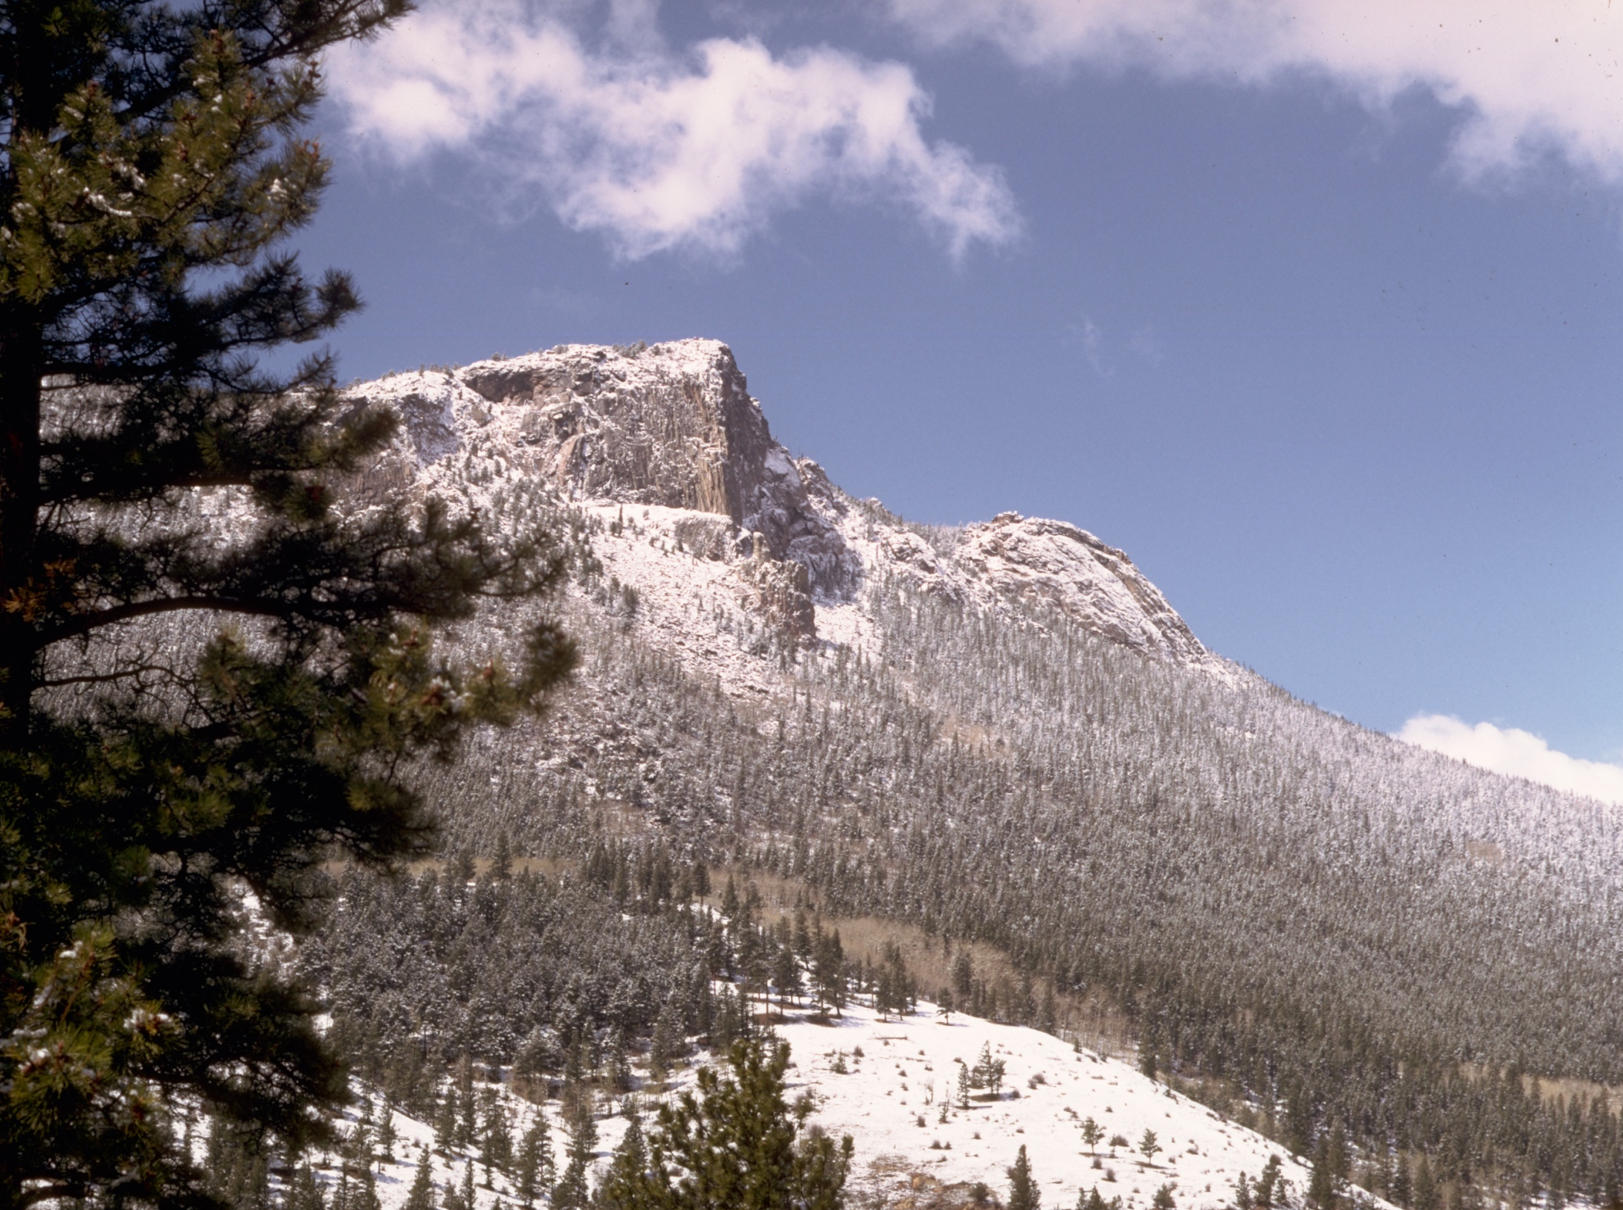

A Climate-based Interpretation
of Limber Pine Management
Scenarios in Rocky Mountain
National Park
Contributors:
Bill Monahan, Tammy Cook, Jeff Connor, Ben Bobowski (NPS)
Forrest Melton (NASA Ames)

Slide 2
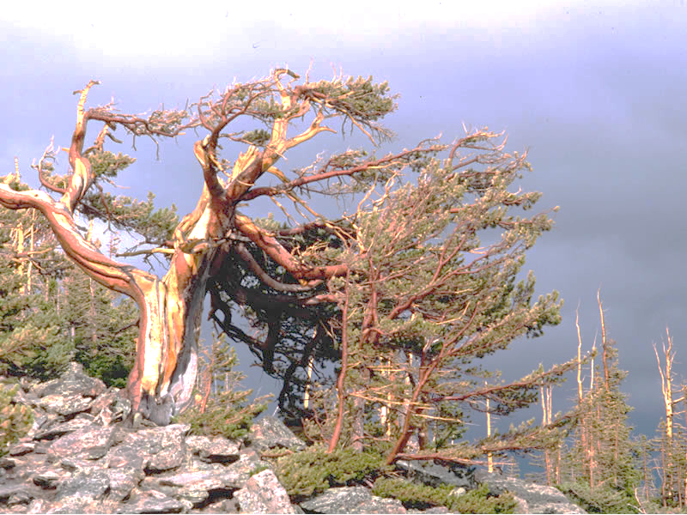
Key Management Questions
Abiotic:
How long will current distribution remain climatically suitable (manage for stasis)?
When and where will areas outside the current distribution become more climatically suitable (manage for change)?
Biotic:
How will biotic drivers further shape climatic response (manage for biotic-abiotic interaction)?

Slide 3
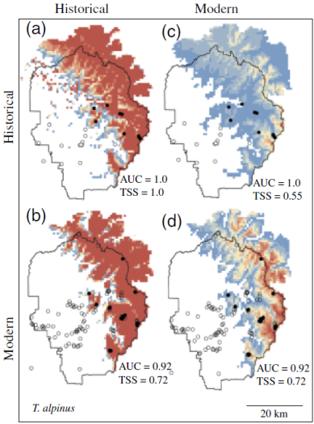
What we can Reliably Forecast
Abiotic:
Species distribution models are often used to successfully predict species’ geographic responses to climate change
Biotic:
Unfortunately, we still lack sufficient ecological knowledge and data to reliably forecast complex biotic-abiotic interactions
Rubidge et al. (2011)

Slide 4
A Compromise Approach
Quantitative models/forecasts
Use current and future climate interpolations along with known limber pine occurrences in Rocky to model and forecast responses to climate change
Expert evaluation & interpretation
Scientists and managers collectively evaluate and interpret the likelihood of forecasts in light of key model assumptions and missing ecological complexity
Identify management scenarios
Scientists and managers collectively identify possible management scenarios that emerge from the expert evaluation and interpretation of the quantitative models and forecasts

Slide 5
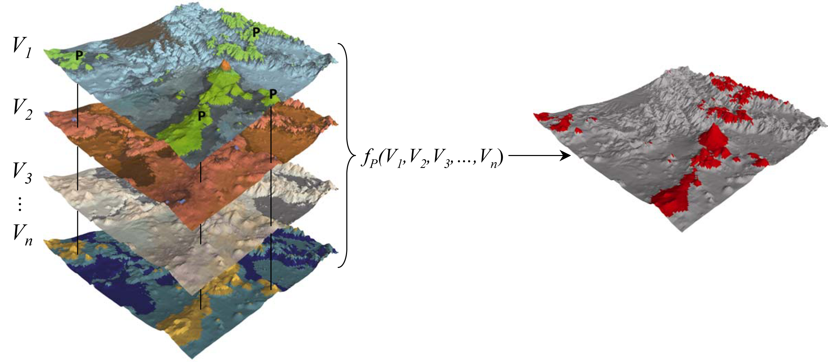
Modeling Methods (Overview)

Slide 6
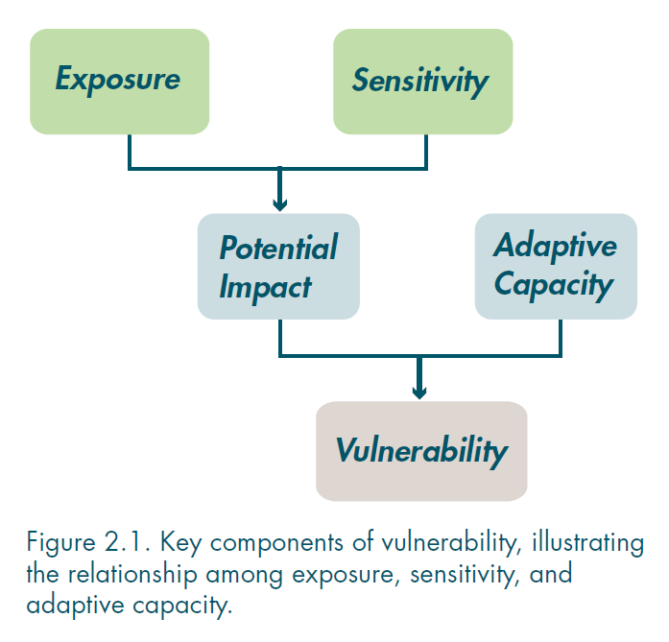
Vulnerability
Species distribution models are fed exposure and infer sensitivity to estimate potential impact
Glick et al. (2012)

Slide 7
Model Training Uncertainty
Estimates of potential impact are especially influenced by:
Variables used to define exposure (e.g., climate only vs. climate + land use)
Spatial scale at which response (occurrence) is measured:
Different assumptions about the biological scale(s) at which species’ traits governing distribution operate
True scale(s) almost always unknown, but niches often assumed to be conserved at species level (rangewide)
Park 3
Park 2
Park 1
Rangewide
Environmental gradient

Slide 8
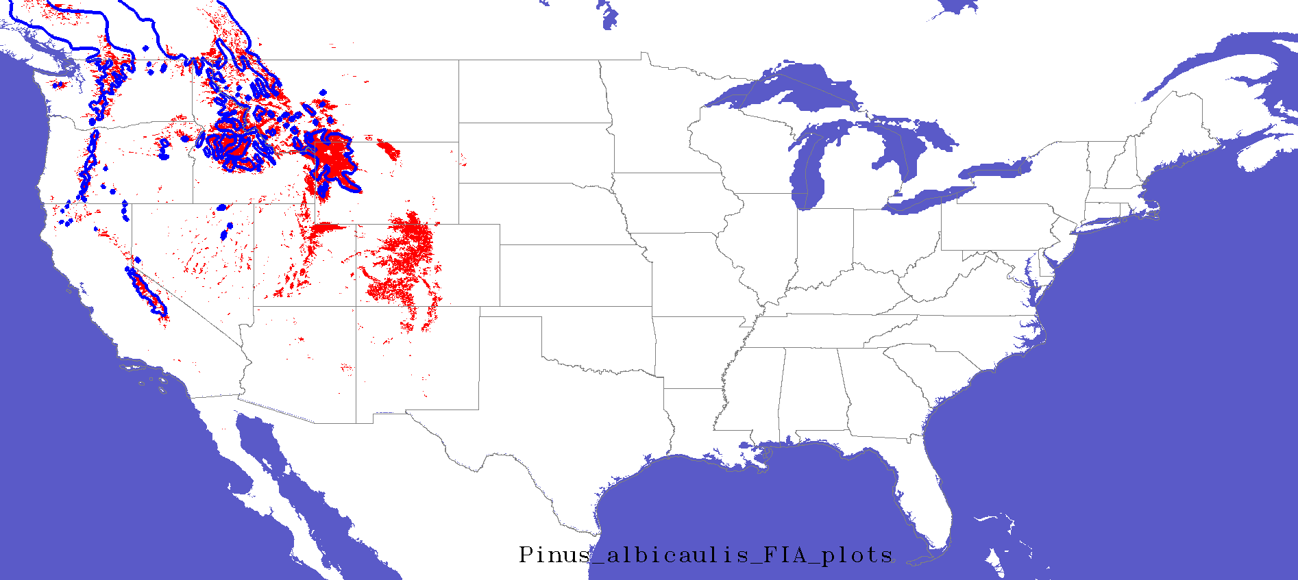
But…
Rangewide models often have serious errors of omission and commission in parks
Troubling for managers and hard for us to get their buy-in
omission
commission

Slide 9
Catch22
High risk of underestimating species’ capacities to respond to change…
But model likely to provide tight current predictions that appeal to managers
Park 3
Park 2
Park 1
Rangewide
Low risk of underestimating species’ capacities to respond to change…
But model may have low predictive power at management (park) relevant scale
Environmental gradient
So one soln is to at least bracket these scales and “embrace” the uncertainty

Slide 10
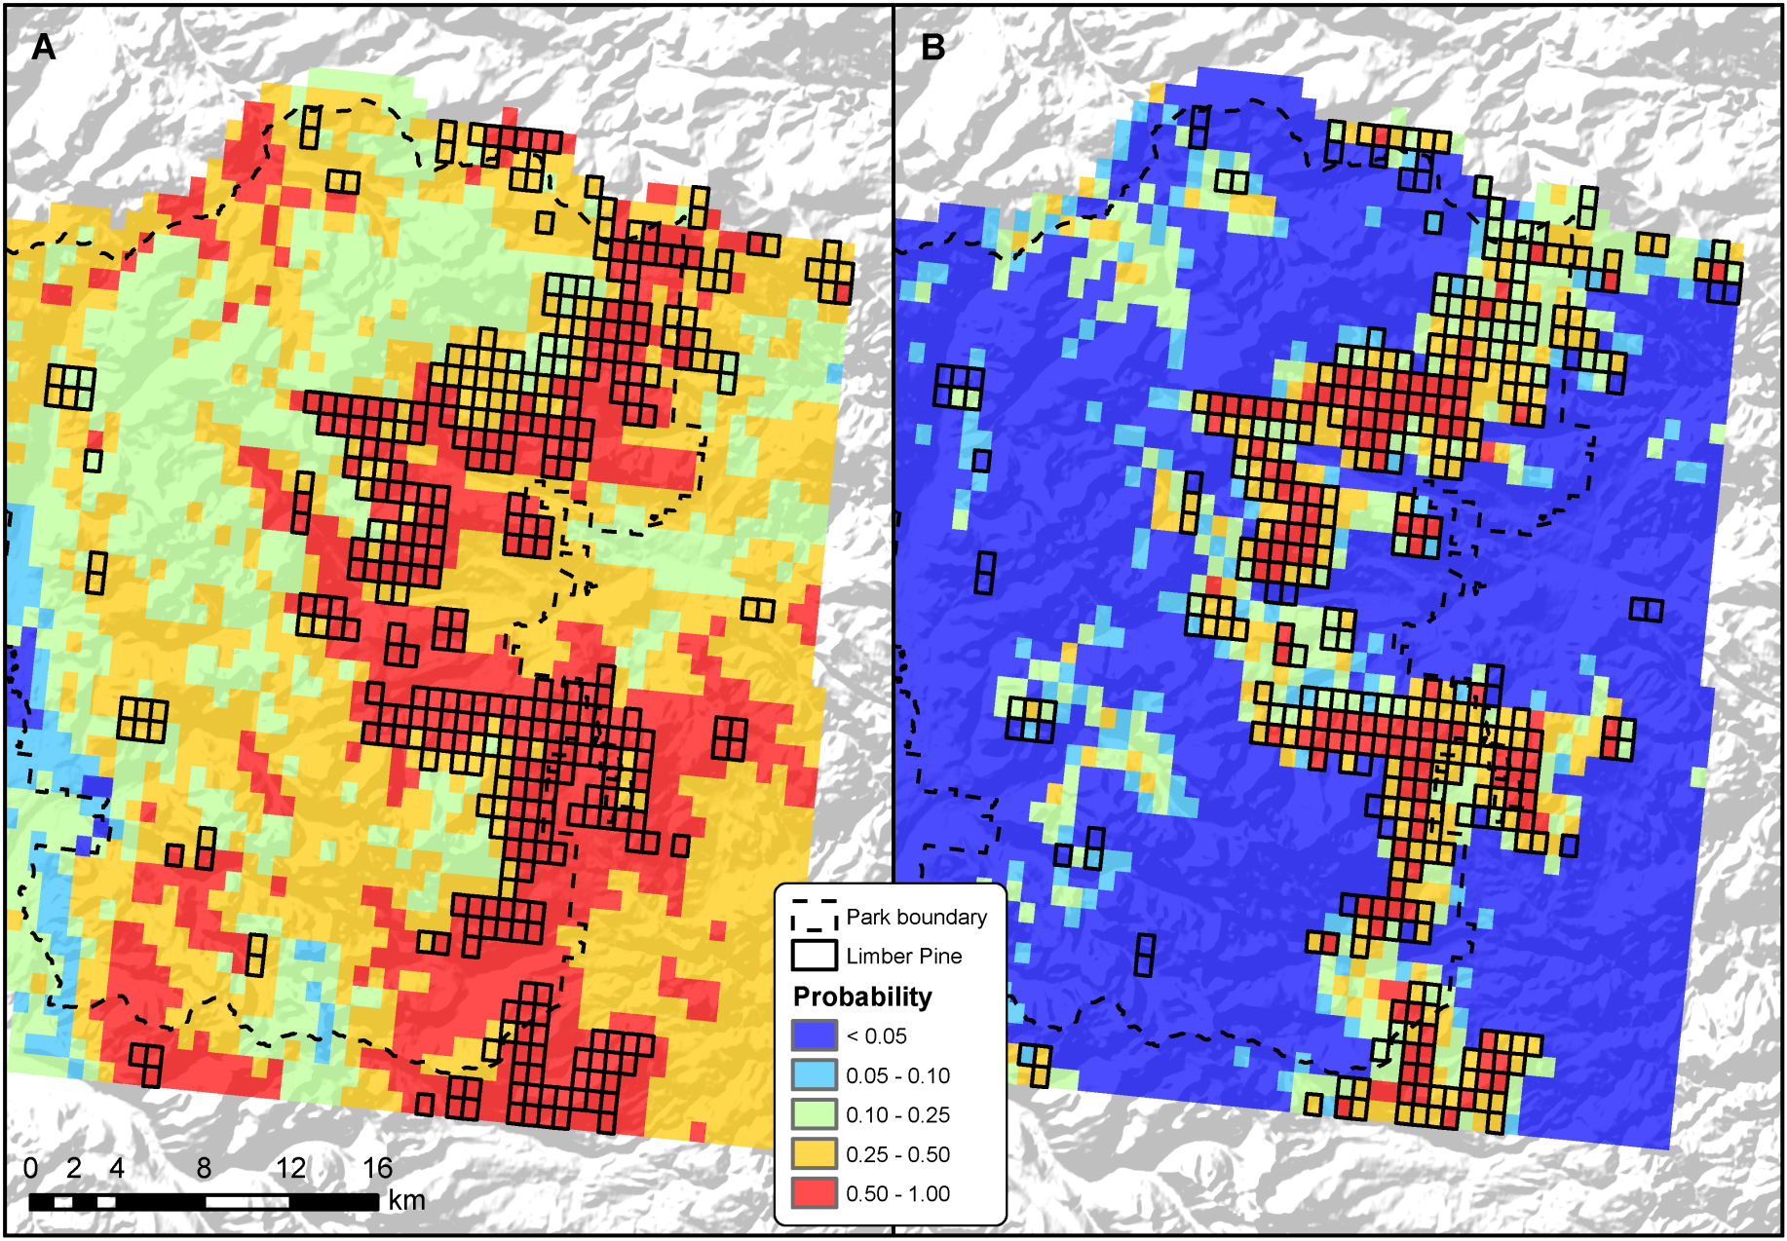
Results: Current Training
Rangewide
Park-scale

Slide 11
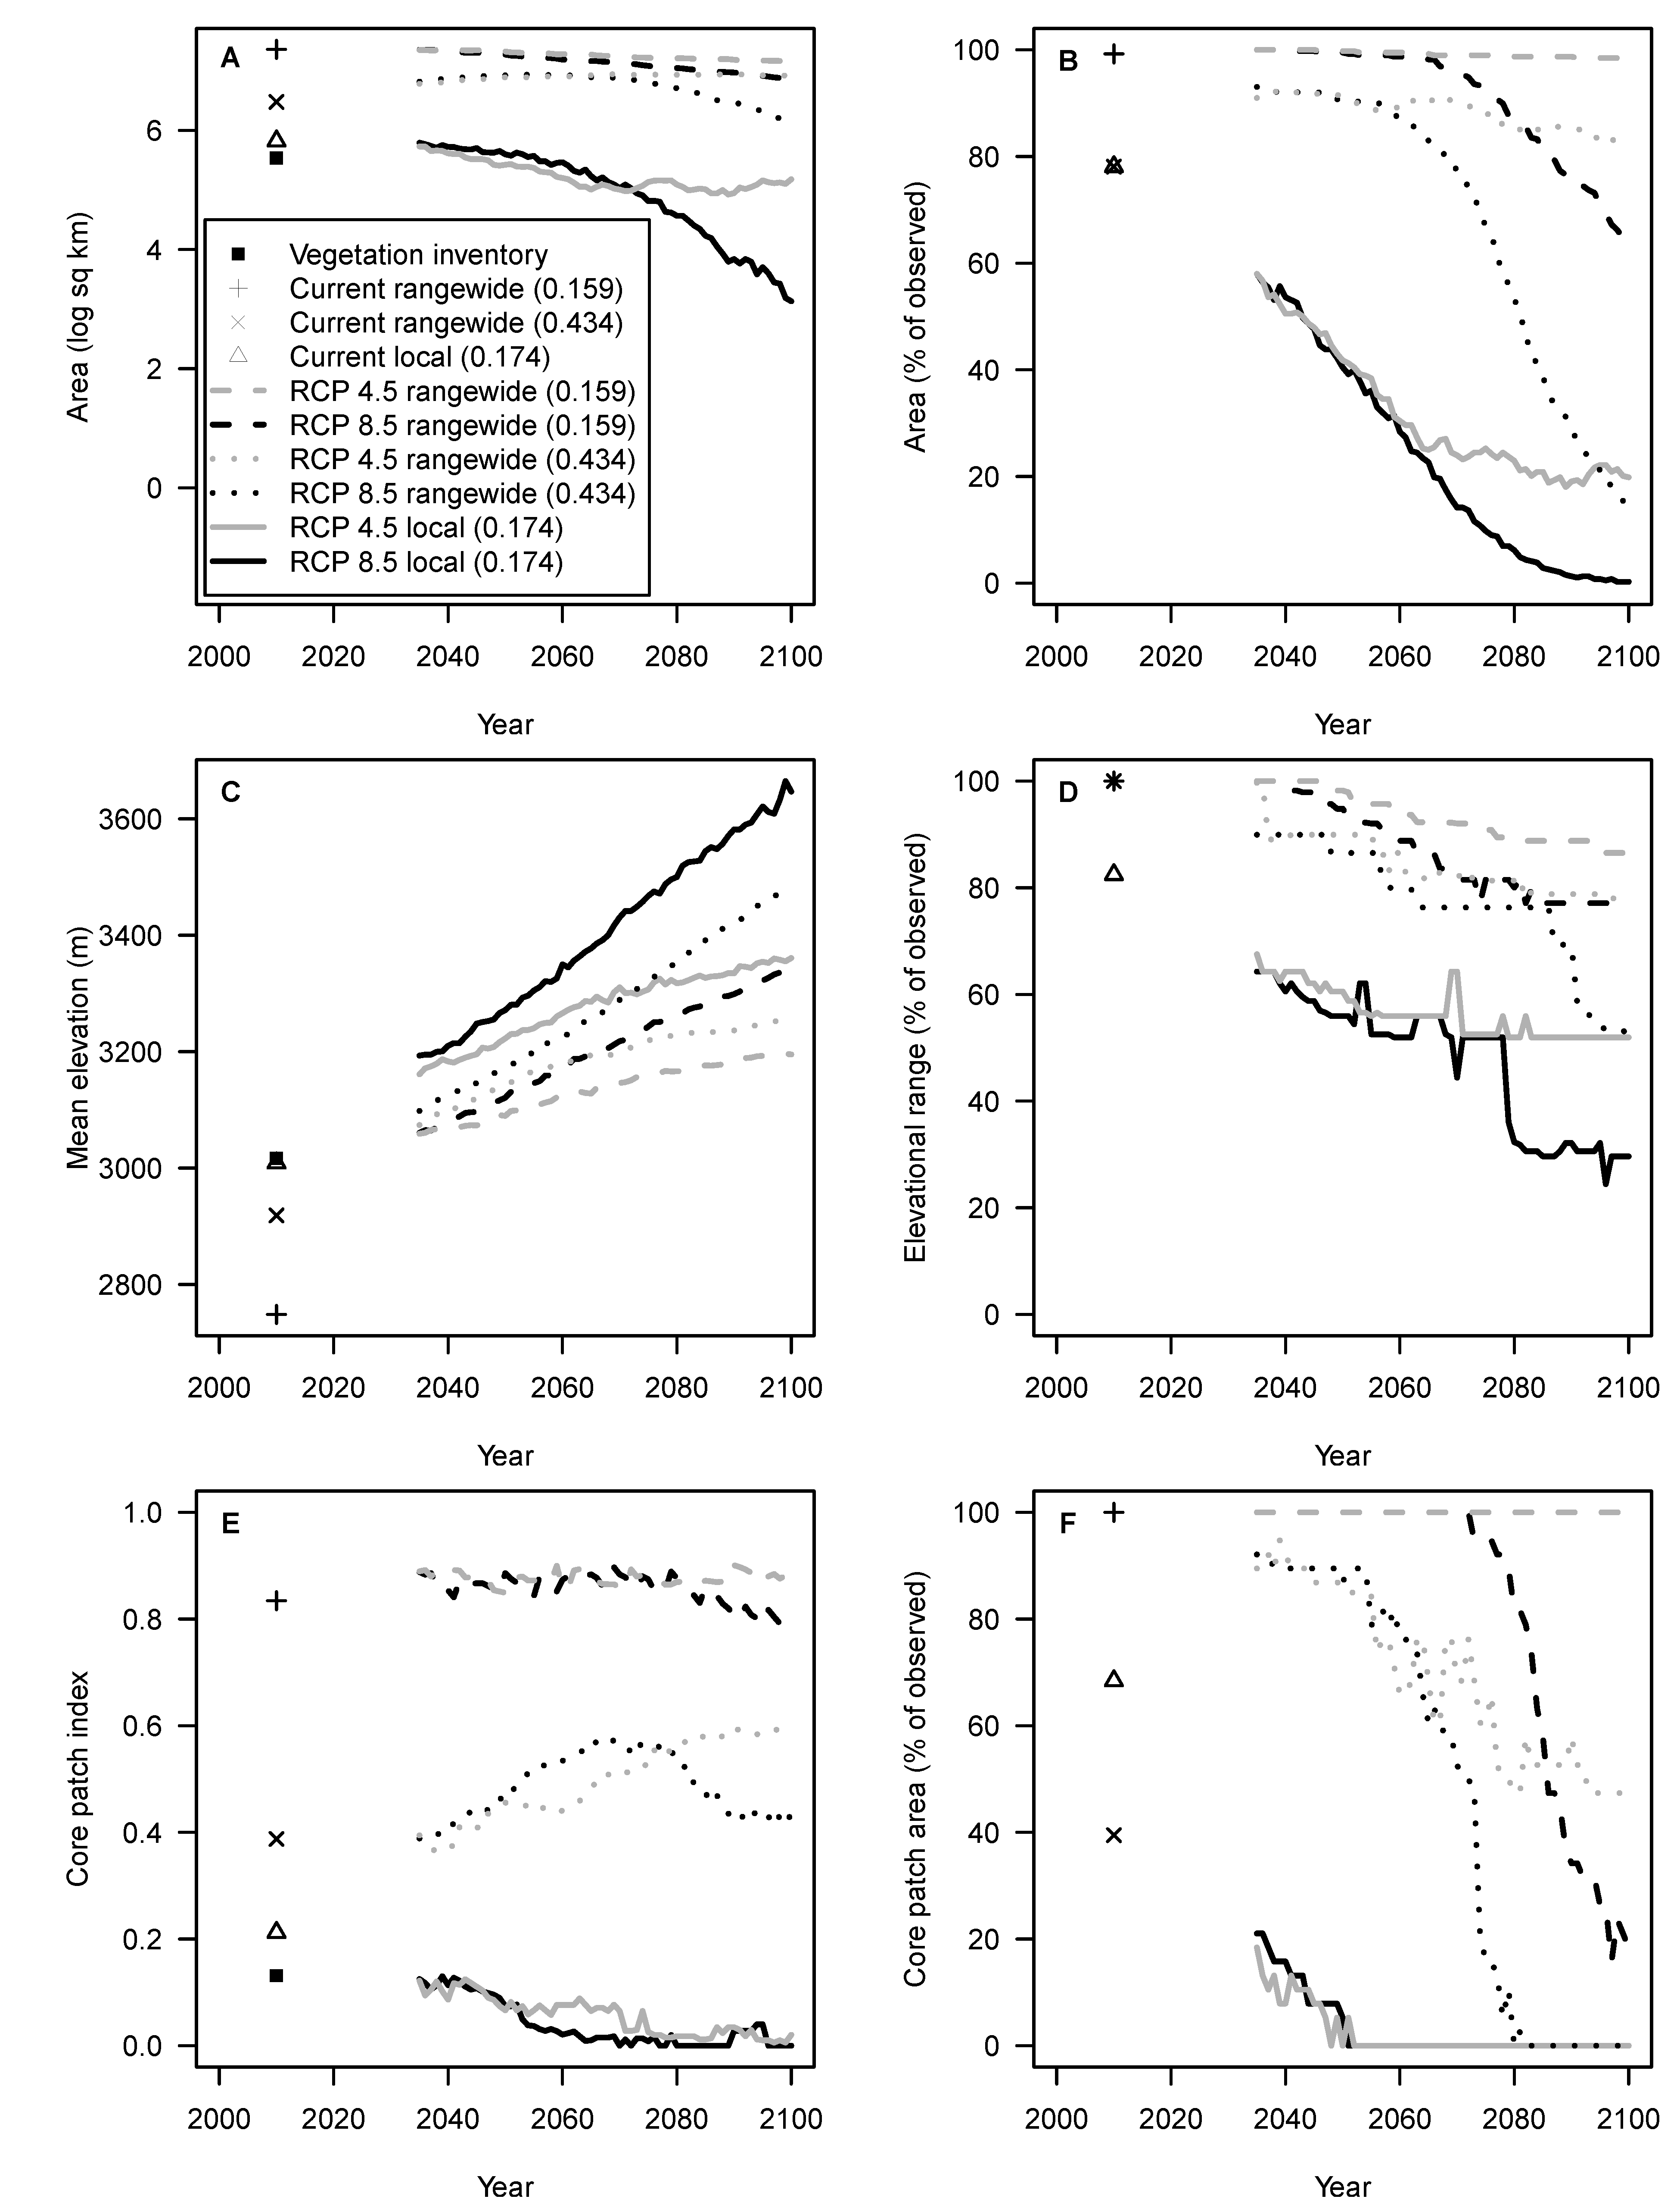
Results: Future Projections
Area response uncertain
Upslope movement beyond current elevational range consistent
Pattern (core patch) response uncertain

Slide 12
Key Management Questions
Abiotic:
How long will current distribution remain climatically suitable (manage for stasis)? Upslope movements may already be underway and looking to test in field with Scott Esser and Jason Sibold
When and where will areas outside the current distribution become more climatically suitable (manage for change)? If above = T, then likely need to be managing for change now in some areas

Slide 13
Other next steps
Extend WBP life history models to limber > evaluate opportunities to use niche conservatism to economize VAs (Tony, Nate, Andy)
Reevaluate land facets and possible micro-climate (Dave)
Look to collaborative modeling workshop with ROMO staff at RAM (maybe Scott Esser [other conifers] or Jim Cheatham [invasives])
Possible limber pine management plan

