Slide 1
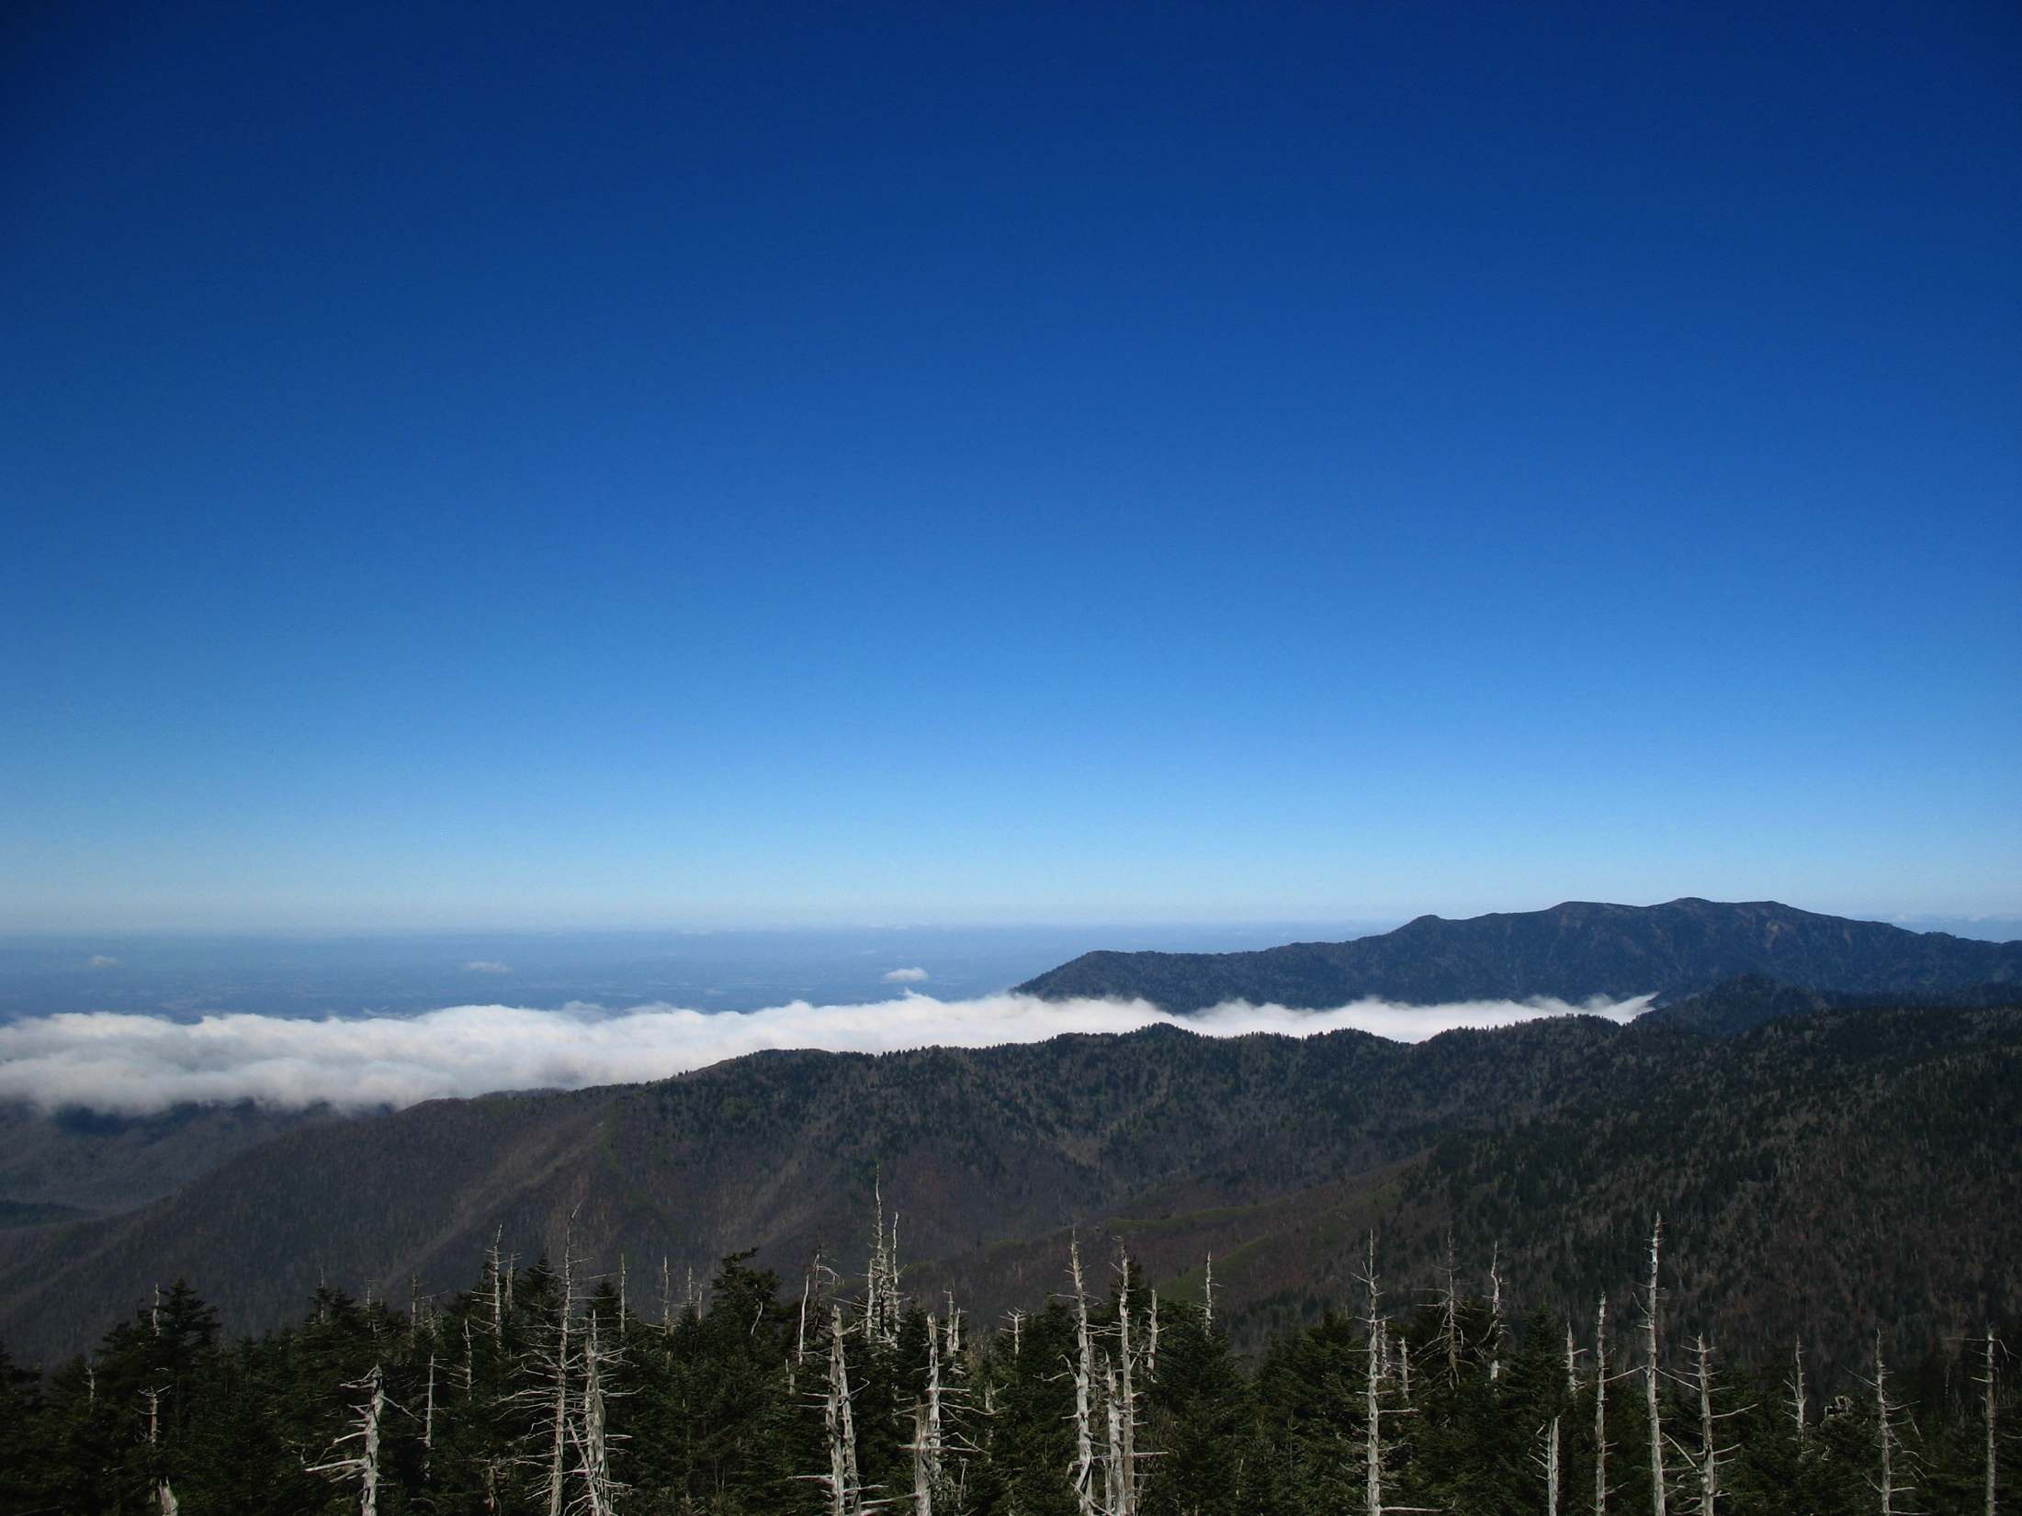

Synthesis of eastern tree species redistribution under climate change
LCC-VP meeting
May 2013
Jackson Hole, WY

Slide 2
Recap
Goal: Synthesize current understanding of eastern forests response to climate change to inform finer scale modeling efforts and vulnerability assessment
Last meeting:
  36 high priority tree spp. identified
  Relevant ecological systems identified during Nov. mtg
  Acquired data: 6 GCMs, 3 em. scenarios (A1fi, A2, B1)
What’s new:
  Bulk of data processing done
  Data requested from two additional groups
  Paper drafted, refine + submit (goal: June 2013)
Notes:
- Additional data requested from Gerald Rehfeldt (USFS) and Patrick Gonzalez (NPS)

Slide 3
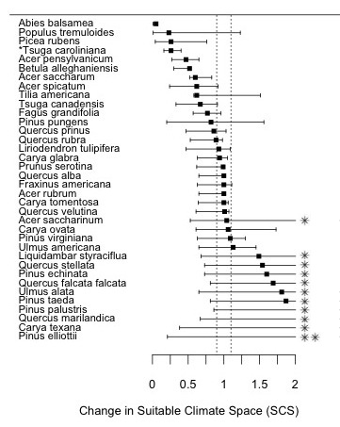
Change in amount of climate space
Iverson et al. (2008) and McKenney et al. (2011)
Notes:
- Note: ∆SCS = ratio of the future : current predicted abundance of climate space (ALCC here)
- Many spp. predicted to lose
- *max ∆SCS>2, **max ∆SCS>10

Slide 4
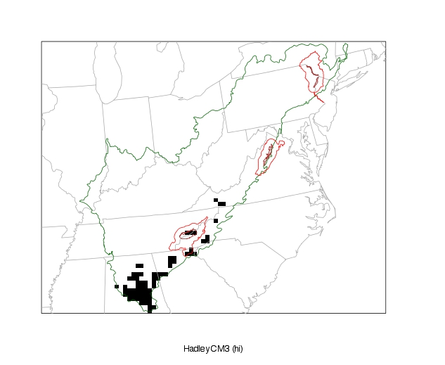
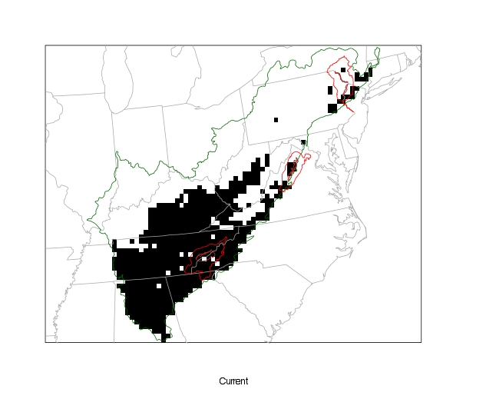
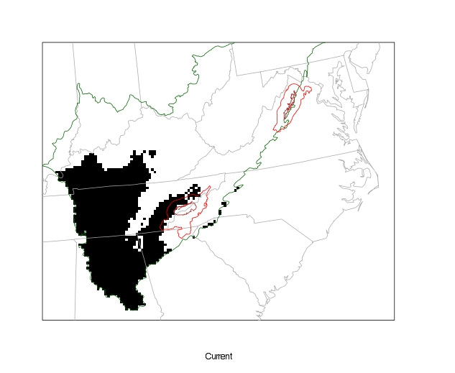
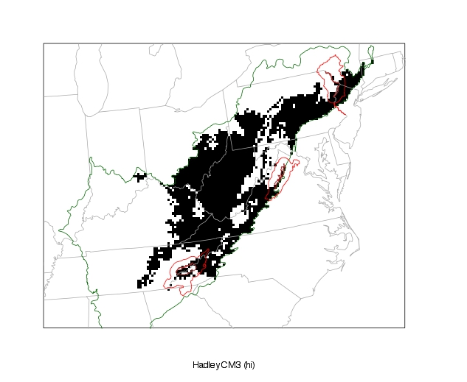
Longleaf pine
A1fi
Current
2100
A2
Top: Iverson et al. (2008)
Bottom: McKenney et al. (2011)

Slide 5
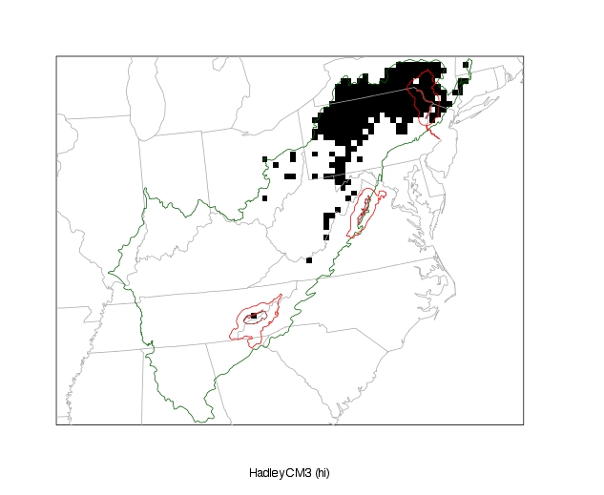
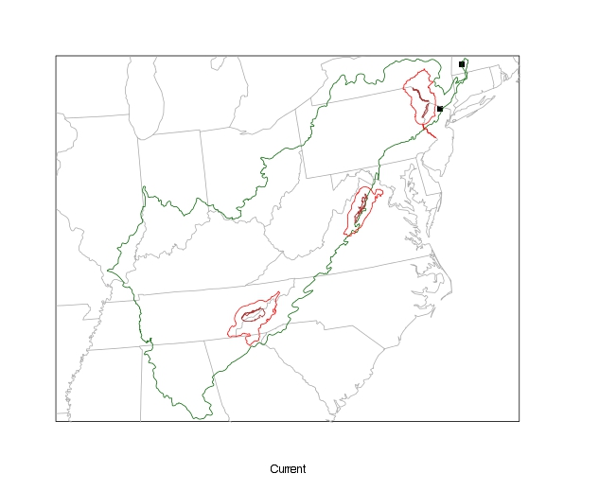
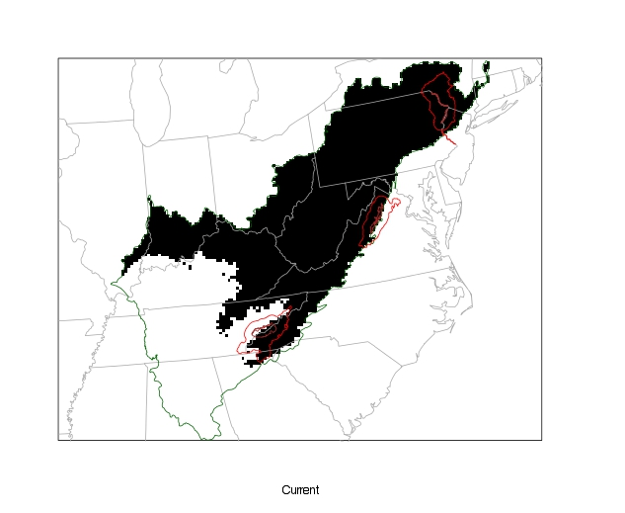
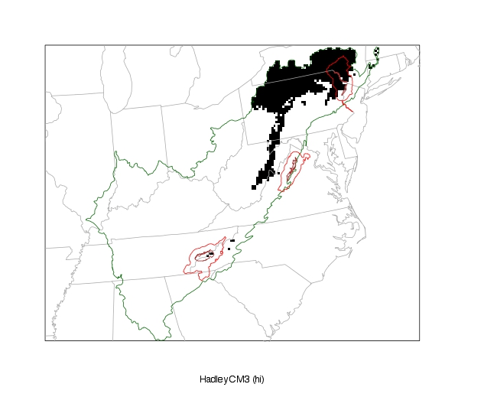
Quaking aspen
A1fi
Current
2100
A2
Top: Iverson et al. (2008)
Bottom: McKenney et al. (2011)

Slide 6
Ecological system change
McKenney et al. (2011)
Notes:
ALCC-scale
Decline for most- some faster than others
Largest loss for Spruce-Fir, Hemlock, Northern Hardwood
Gain for pine

Slide 7
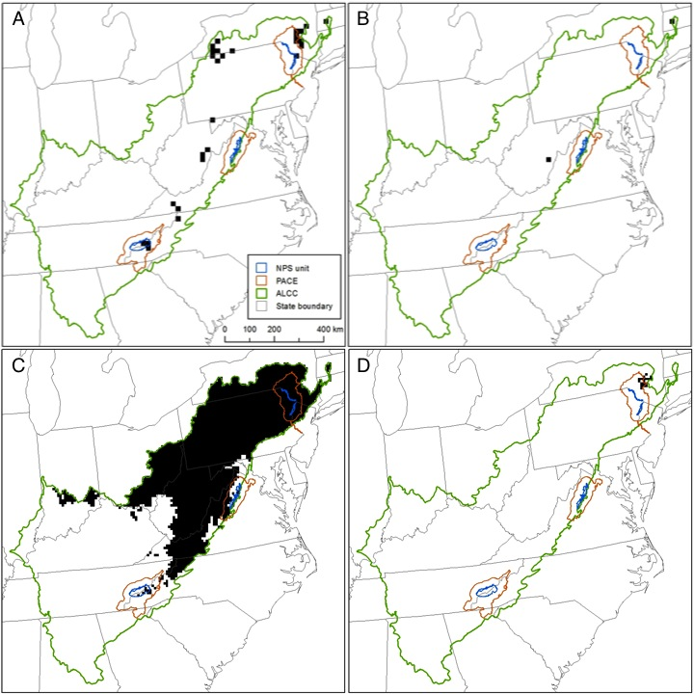
Spruce-Fir redistribution by 2100
SPRUCE-FIR
Tree spp.:
- *Balsam fir
- Red spruce
- 93%
A1fi
Current
2100
- 99%
A2
McKenney et al. (2011)
Notes:
- Both efforts predict considerable decline (>90%) in Spruce-Fir SCS in ALCC

Slide 8
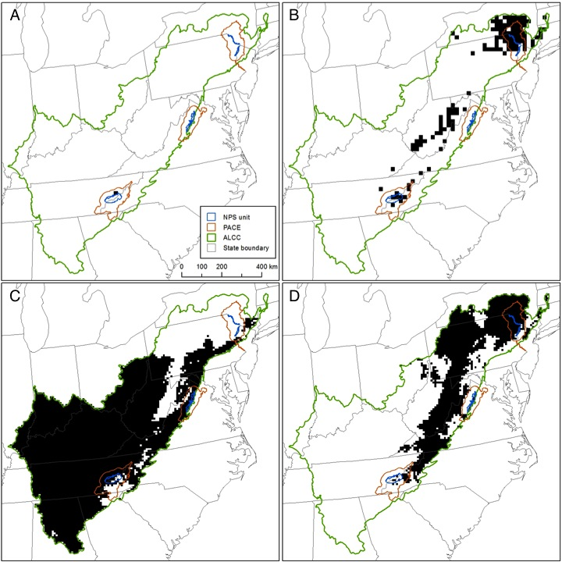
Oak-Hickory redistribution by 2100
OAK-HICKORY
Tree spp.:
- *Yellow birch
- Red maple
- Mockernut hickory
- Sweetgum
- White oak
- Southern red oak
- Chestnut oak
- Northern red oak
- American basswood
+ 12,800%
A1fi
Current
2100
?
- 63%
A2
McKenney et al. (2011)
Notes:
- Differences in amount predicted to change, largely b/c the current predicted models are so different (will triple-check this).
- Despite this, both efforts predict similar regions will be occupied by 2100 (i.e. northeastern ALCC)
- General consensus on future trends is good, important to know for conservation and mgmt strategies
- However, how likely is it that Oak-Hickory will gain ~13,000% SCS? Where would these shifts occur?

Slide 9
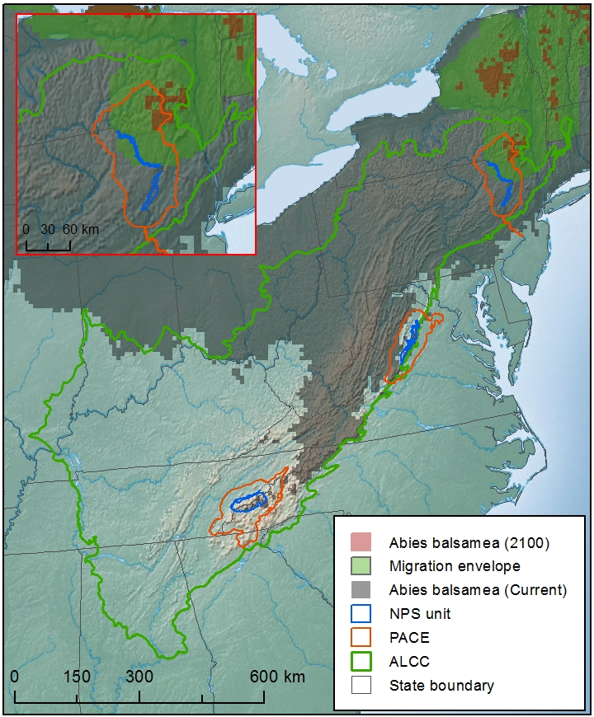
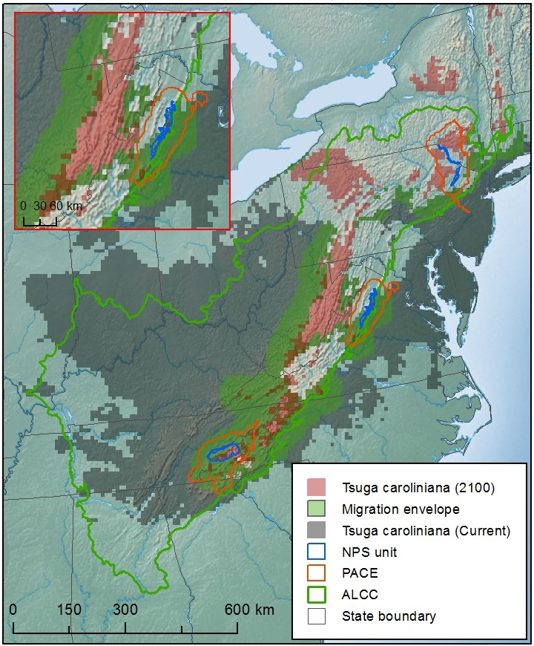
Redistribution and protected areas
Balsam fir
Carolina hemlock
- 100%
- 51%
McKenney et al. (2011)
Notes:
- For both SF and OH, let’s take a look at the limiting species, i.e. the species with the smallest range, thus controlling dist. of the ES
- SF = Balsam fir, OH = Yellow birch
- For these species, let’s consider their predicted shifts at the more mgmt-intensive scale of NPS units
- Trees will not necessarily perish in current regions that do not overlap future regions. However, the persistence of some trees in current CS (e.g. GRSM) is relatively more threatened by CC/disease/pest/etc.

Slide 10
Summary
Conclusions
1. Different studies = different methods
2. Most species (64%) predicted to lose climate space by 2100
3. Strong consensus on losers, weaker on gainers
4. McKenney et al. (2011) predict greater impact of climate change on individual species
5. The amount (and quality) of ecological system climate space predicted to decrease
6. NPS units in ALCC can support refugia and/or migration of some tree spp. into new climate space
What’s next?
Publish synthesis
Include results in vulnerability assessment
Finer scale modeling
  What does the future hold for tree species in NPS units?
Collaboration/iteration
Notes:
1. Controlling differences = beyond scope of analysis
2. … in ALCC under ensemble avg (i.e. avg for all GCMs and emissions scenarios at both spatial resolutions).
3. Strong consensus that many spp. will lose CS, weaker consensus on gainers/amt. gained (i.e. Forest Plot)
4. … in two ways:
i. They predict more spp. will lose climate space in ALCC + greater amount will be lost than Iverson et al. (20 km)
- Note: Avg ∆SCS inflated for both efforts because of the few species predicted to gain climate space in the ALCC are predicted to gain disproportionately more than the losers are predicted to lose
ii. They predict less overlap b/w current and future CS, suggesting migration to new CS maybe more challenging than previously considered
5. CS of all ecol. systems (except Pine) predicted to contract northward in ALCC; quality i.e. increasingly fragmented for most systems
- Note: tree spp. expected to respond to climate change on individual basis, hard to know whether ecol. systems will migrate as intact units.. results more indicative of ecol. system disintegration
6. The parks and their associated PACEs are important conduits for biodiversity persistence and propagation, thus the parks (continued) protection is essential

Slide 11
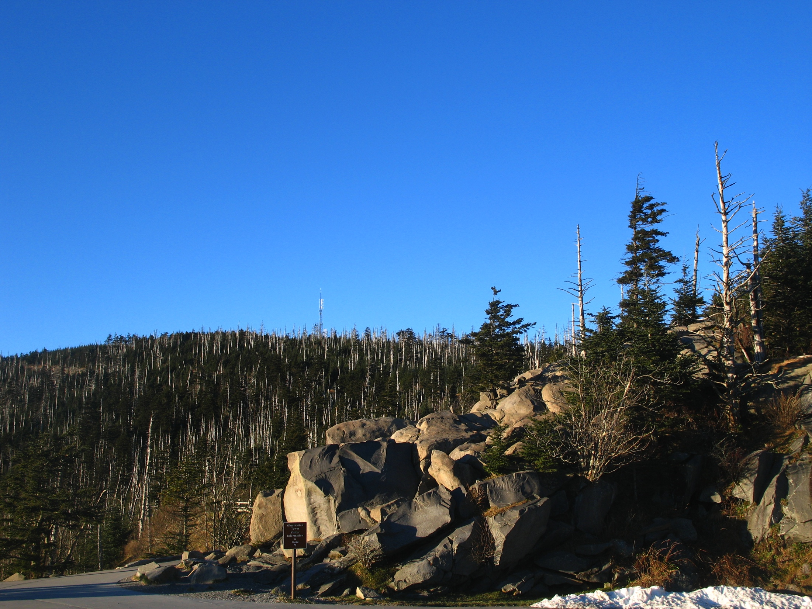
Thank you
References
Iverson, L. R., Prasad, A. M., Matthews, S. N., & Peters, M. (2008). Estimating potential habitat for 134 eastern US tree species under six climate scenarios. Forest Ecology and Management, 254, 390-406.
McKenney, D. W., Pedlar, J. H., Rood, R. B., and Price, D. (2011). Revisiting projected shifts in the climate envelopes of North American trees using updated general circulation models. Global Change Biology, 17, 2720-2730.

