Slide 1

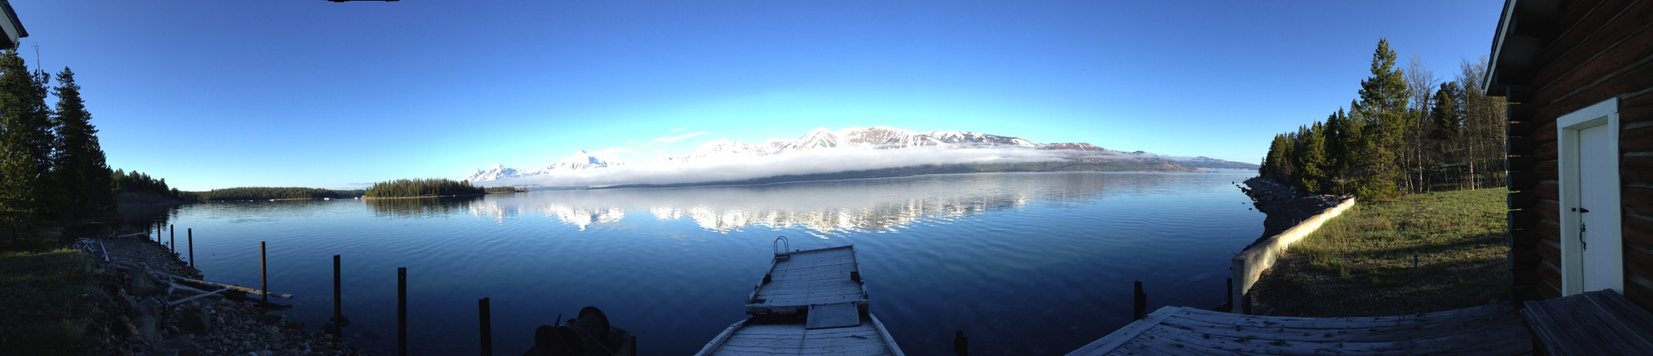


LCCVP Update & New Science Activities
David M. Theobald^{1,2} &
Sarah E. Reed^{2,3}
¹Conservation Science Partners, Inc.
²Department of Fish, Wildlife, and Conservation Biology, Warner College of Natural Resources, Colorado State University
³Wildlife Conservation Society
Notes:
May meeting:
Hone in on what analyses of vulnerability for two LCCs and PACEs
What kind of connectivity analysis would we do to response to vegetation
REYFELDT analysis

Slide 2
Updates & New science
Update on land use datasets
Incorporate ecological response to climate change – land facets, micro-topography, etc.
Include connectivity into vulnerability assessment
Management actions

Slide 3
1. Update on land use datasets
Land use classes:
  2000, 2010 completed
  2010 → 2100, in progress, end of summer?
  Relationships of housing density & transportation infrastructure
Historical housing density
  Consistent thru time (1900 – 2000, decadal)
Degree of human modification

Slide 4
SERGoM v2
Updates of data:
  2010 census, TIGER 2010, NLCD 2006, LEHD, PAD-US, groundwater wells
Modifications
  90 m, registered with NLCD 2006 extent (~30 m?)
  Transportation infrastructure replace travel time with capacity (lanes x speed limit)
  Beyond housing density → land use classes
  Expose empirical transition probabilities to allow scenario generation

Slide 5
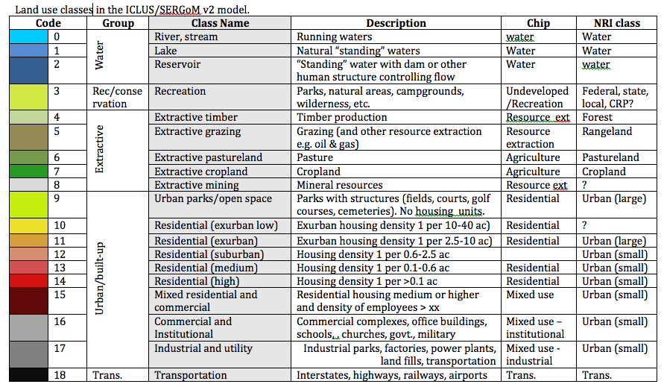
Land use classes

Slide 6
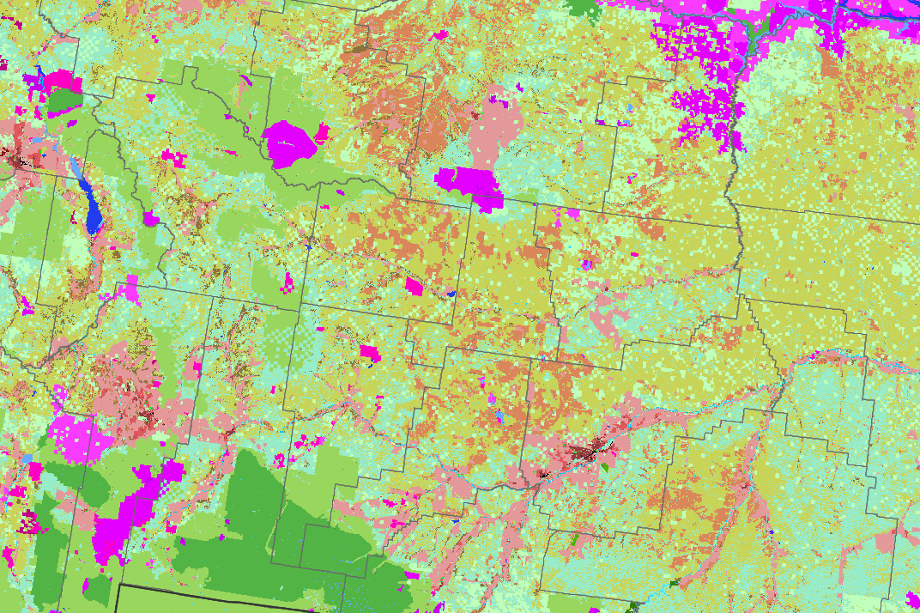
GNLCC

Slide 7
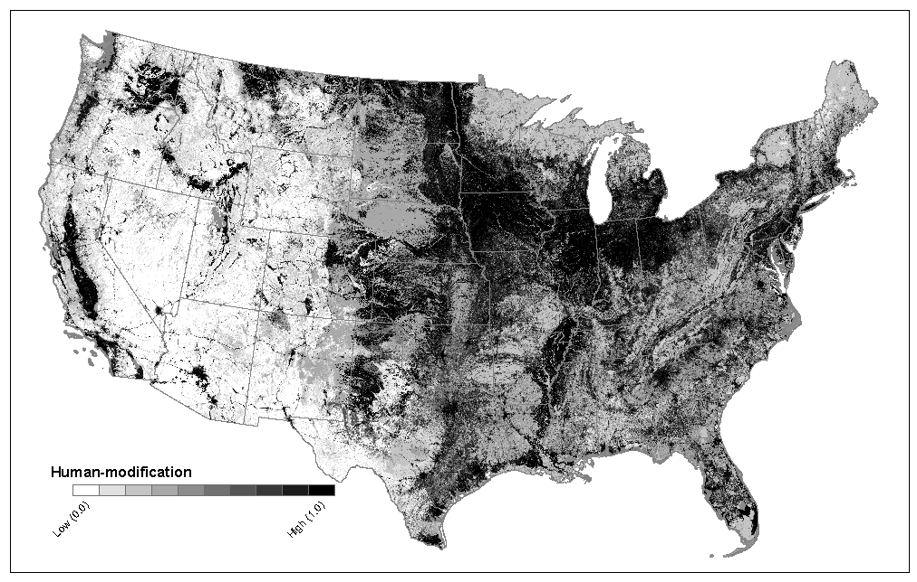
Landscape integrity
Pc fundamental
Metric (Gardner et al. 1987)
Theobald 2010; Theobald et al. 2012
Notes:
Proportion of cover (Pc) at a location is a fundamental metric (Gardner et al. 1987; Gardner and Urban 2007)
No other metric can be interpreted independently of Pc (Neel et al. 2004; Wickham et al. 2008)
Provides the basis for unambiguous interpretation to assess landscape change (Riitters et al. 2009)

Slide 8
1. Framework of human stressors
CONSERVATION MEASURES PARTNERSHIP Framework
Level 1 | Level 2*
Residential & commercial development | Commercial & industrial areas; Residential; Tourism and recreation areas
Agriculture | Annual & perennial non-timber crops; Wood & pulp plantations; Livestock farming & ranching
Energy production & mining | Oil & gas drilling; Mining & quarrying; Renewable energy
Transportation & service corridors | Roads & railroads; Utility & service lines; Shipping lanes; Flight paths
Biological resource use | Hunting & collecting terrestrial animals; Gathering terrestrial plants; Logging & wood harvesting; Fishing & harvesting aquatic resources
Human intrusions and disturbance | Recreational activities; War, civil unrest & military exercises; Work & other activities
Natural system modifications | Fire & fire suppression; Dams & water use
Invasives & disease | Invasive non-native species; Problemmatic native species; Introduced genetic material
Pollution | Household sewage & urban waste water; Industrial & military effluents; Agricultural & forestry effluents; Garbage & solid waste; Air-borne pollutants
*Bold=included in model, italics=empirical
(Salafsky et al. 2008)
Notes:
The Conservation Measures Partnership (CMP) framework catalogues and organizes multiple sources of stressors or threats associated with different human activities (Salafsky et al. 2008). Organizing the multiple stressors that can influence a landscape using this existing framework helps to minimize redundancy and potential overlap and results in a comprehensive but parsimonious list of roughly a dozen different threats (at level II) as variables for stressors (Table 1).

Slide 9
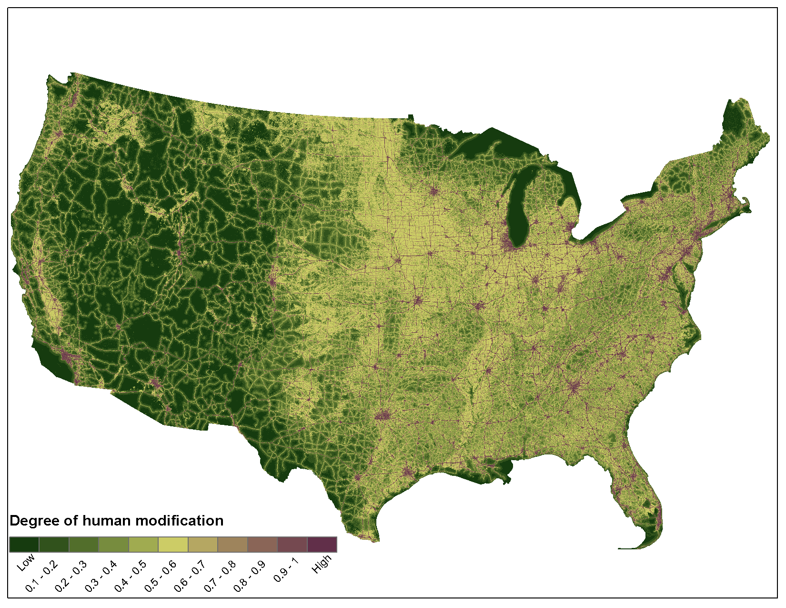
Mean = 0.375
SD = 0.243

Slide 10
2. Ecological response to climate change
Goal: to help interpret the ecological response of climate change at a management relevant scale (sub-pace to pace, landscape?)
Uses:
Apply a geomorphic filter, typically de-coupled from climate… or is it a geomorphic / filter/probablity surface in the interpretation of the data for the managers… keep the forecast models at … allow us to define micro-regufia. Take the difficult category of present today but predicted to be incompatible (loss) habitat
As an indicator of micro-refugia
Others…

Slide 11
Land facets/micro-topography
Variables
  Soils (SSURGO ~75%, filled-in by STATSGO)
    Available Water Capacity (best: general, integrative, data available)
  Topographic position index (TPI: landforms)
    Multi-scale (mTPI), 0.1, 1, 10, 100 km radius
    Use continuous variable rather than classes
  Insolation
    Variant of hillshade, possibly heat load index
  Slope
    Some correlation with mTPI
  Downstream gradient
    mostly for freshwater
Scale
  Grain – micro: 270 m poor, 90 OK, 30 good, 10 m best
  Extent –
Terrestrial AND freshwater
  Valley confinement
  River classifications (i.e. Montgomery & Buffington: <1, 1-2, 2-4, 4-8, 8-20, >20%)

Slide 12
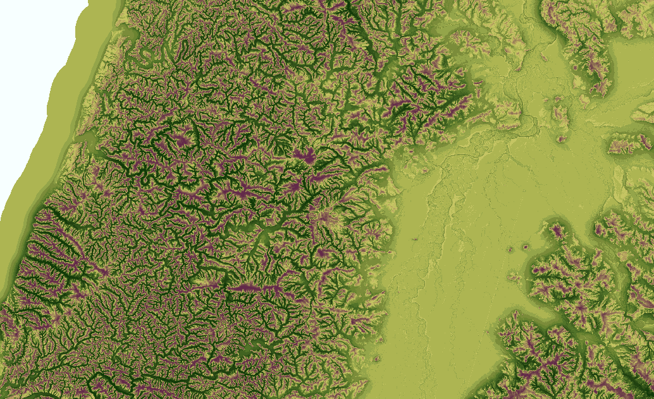
mTPI

Slide 13
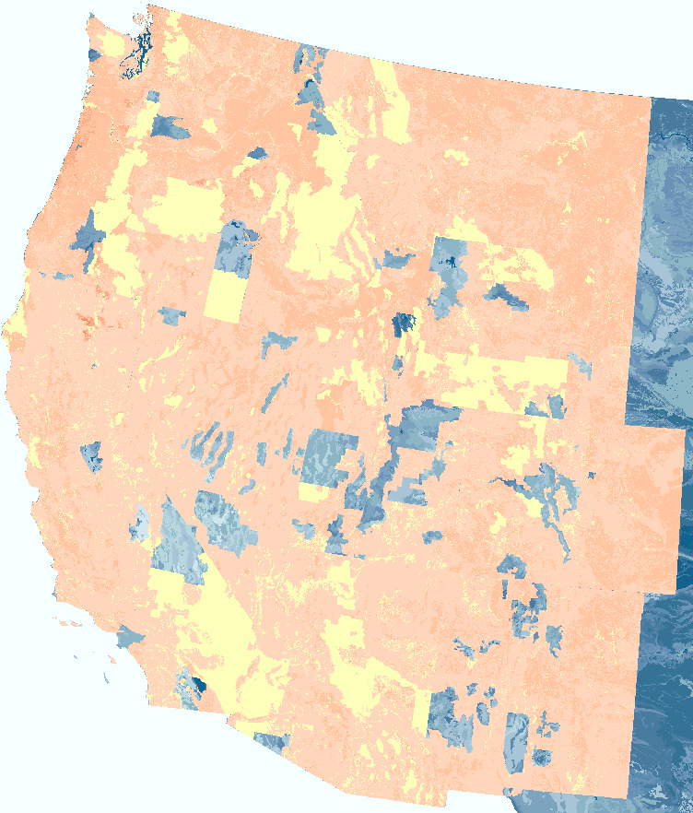
SSURGO for the west

Slide 14
3. How to more fully incorporate connectivity into vulnerability assessment

Slide 15
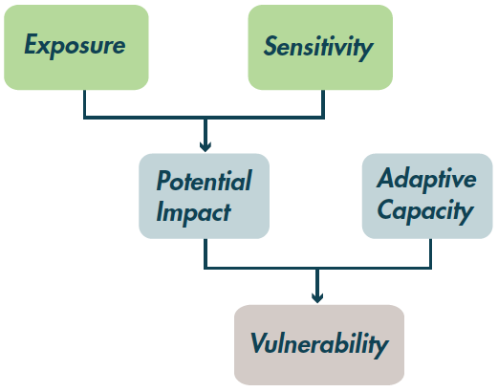
SRLCC Goal: identify areas that are important for maintaining connectivity in the face of land use and climate change
Calculate landscape permeability for current
human modification patterns
Convert permeability to sensitivity
S = f(1/C)
Et = mean annual T 2000-2100
Ep = annual total P, 2000-2100
Eh = LU change 2000-2100
It = Et * S
Ip = Ep * S
Ih = Eh * S
 | AC low | AC high
Impact low | medium | low
Impact high | Very high | Med/high

Slide 16
SRLCC Goal: identify areas that are important for maintaining connectivity in the face of land use and climate change
Calculate landscape permeability for current
human modification patterns
Convert permeability to sensitivity
S = f(1/C)
Et = mean annual T 2000-2100
Ep = annual total P, 2000-2100
Eh = LU change 2000-2100
Management unit | Mgmt Obj 1 | Mgmt Obj 2
Gap 1 | 0.0 | 0.2
Gap 3 | 0.6 | 0.8
Wilderness | 0.1 | 0.3
Front country | 0.7 | 0.9
Micro-responses
It = Et * S
Ip = Ep * S
Ih = Eh * S
 | AC low | AC high
Impact low | medium | low
Impact high | Very high | Med/high
Micro-responses

Slide 17
4. Fleshing out Adaptive capacity – management actions
Adaptive capacity
  What are main land management units?
  What tools/actions are possible/likely in a given land management unit
  At what scale (time and space) can these actions be applied?
  Is an action uniquely tied to climate change?
    E.g., upslope contraction of habitat, create mini-drift fences to establish snow drifts at higher elevatins to promote establishment
  Data gap? PAD-US, NLUD, others?

Slide 18
Management options: ways we can provide info
Forecasting ecological response:
  1. distribution
  2. performance
Qualitative interpretation based on ecological processes
  Evaluating consistency with ecological processes (e.g., Reyfeldt’s work consistent with knowledge of fire dynamics?)… get experts to weigh in and help
  E.g., distribution of rust

