Slide 1
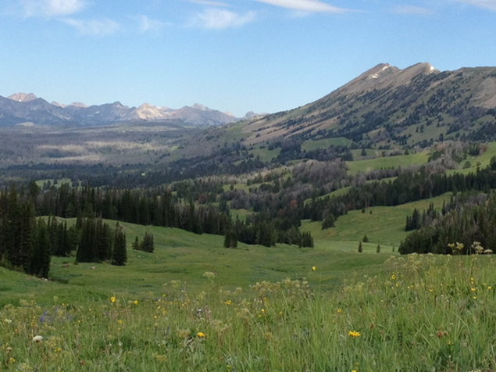
The Challenge

Slide 2
Discussion Questions
What are key topics on vegetation/climate relationships that are best approached with simulation modeling?
What types of models, spatial scales, time periods can best fill this need?
What data sets are available to parameterize these models?
How can these models be tested?
Should the Montana vegetation modeling community interact more frequently? What might be good ways to do this?

Slide 3
The Challenge
Vegetation response to climate change involves:

Slide 4
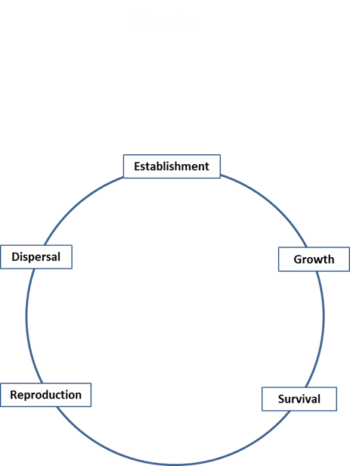
The Challenge
Vegetation response to climate change involves:
Climate effects on the demography of a plant species

Slide 5
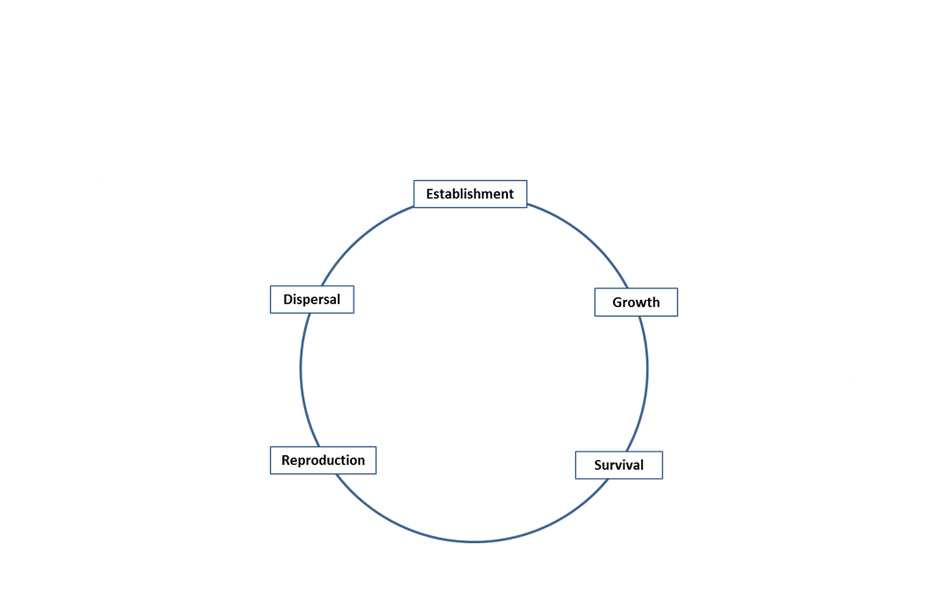
The Challenge
Vegetation response to climate change involves:
Climate effects on the demography of a plant species
Climate effects on other ecosystem components

Slide 6

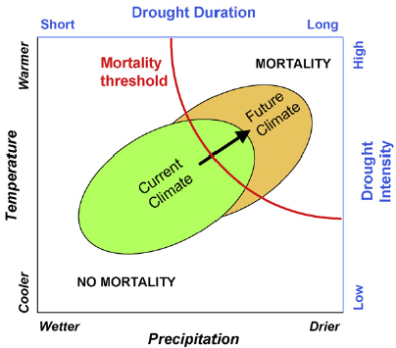
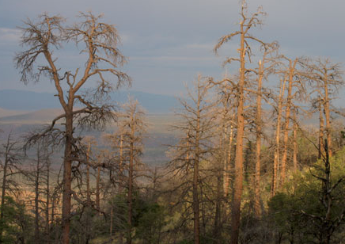
Approaches
Tree Mortality
Allen et al. 2010.

Slide 7


Approaches
Realism Certainty
Tree Mortality
Allen et al. 2010.

Slide 8
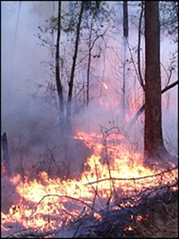
Approaches
Realism Certainty
Fire
Westerling et al. 2011.

Slide 9
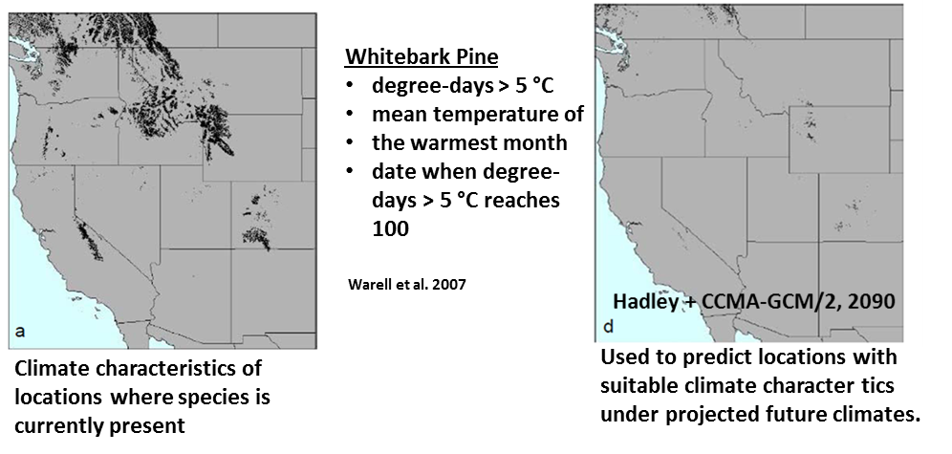
Approaches
Realism Certainty
Climate Suitability for Presence
Presence

Slide 10

Approaches
Realism Certainty
Coupling dynamic habitat models with stochastic population models
Presence
Keith et al. 2008.

Slide 11
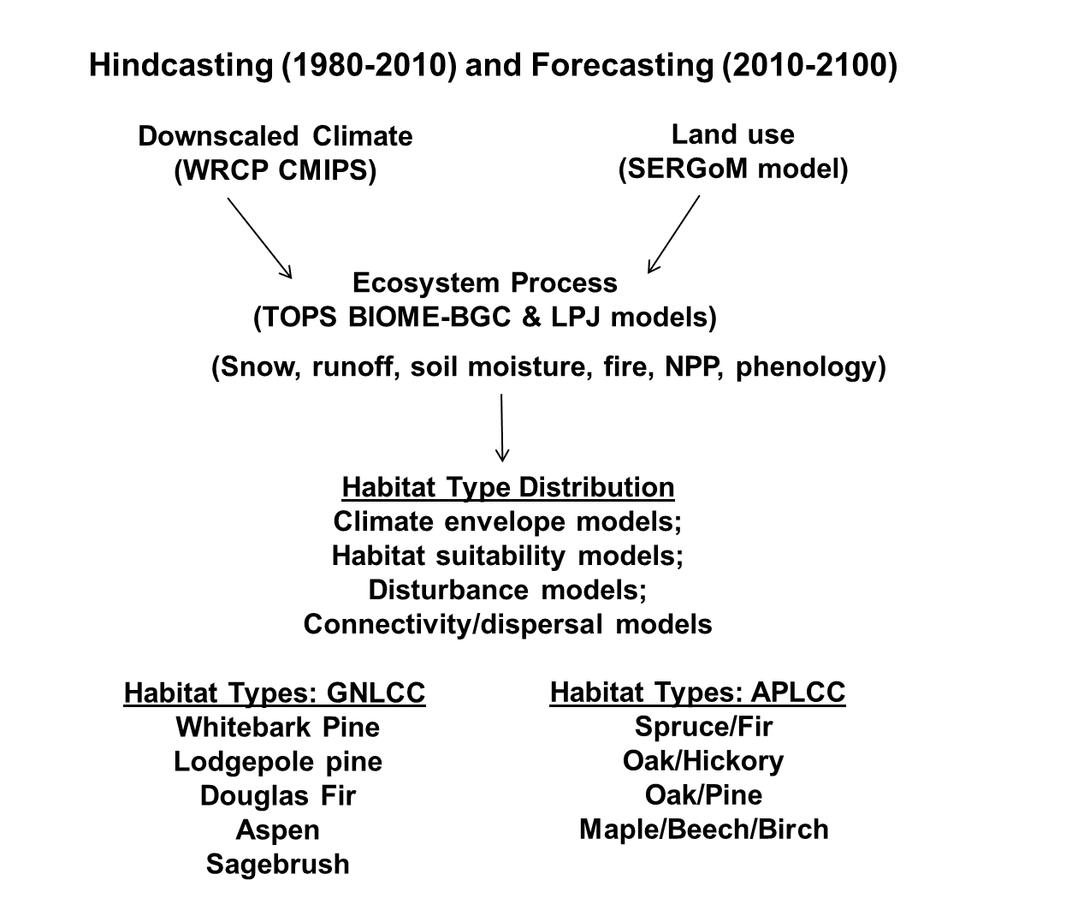
NASA LCCVP Approach

Slide 12
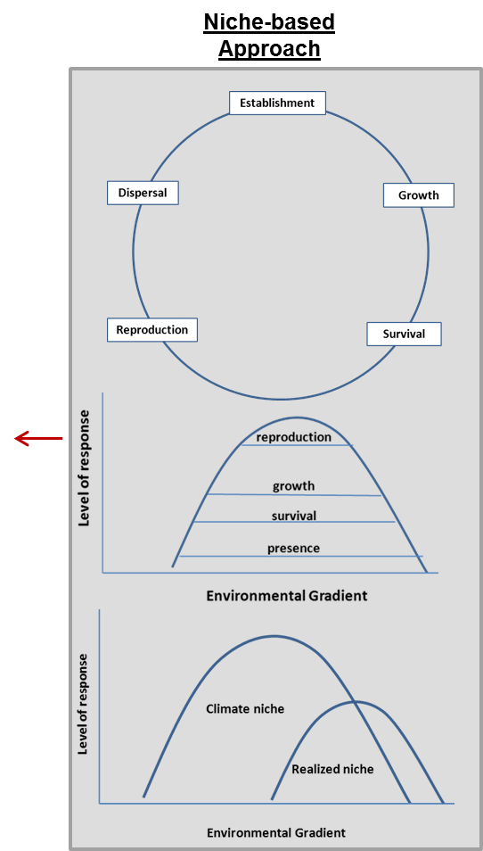
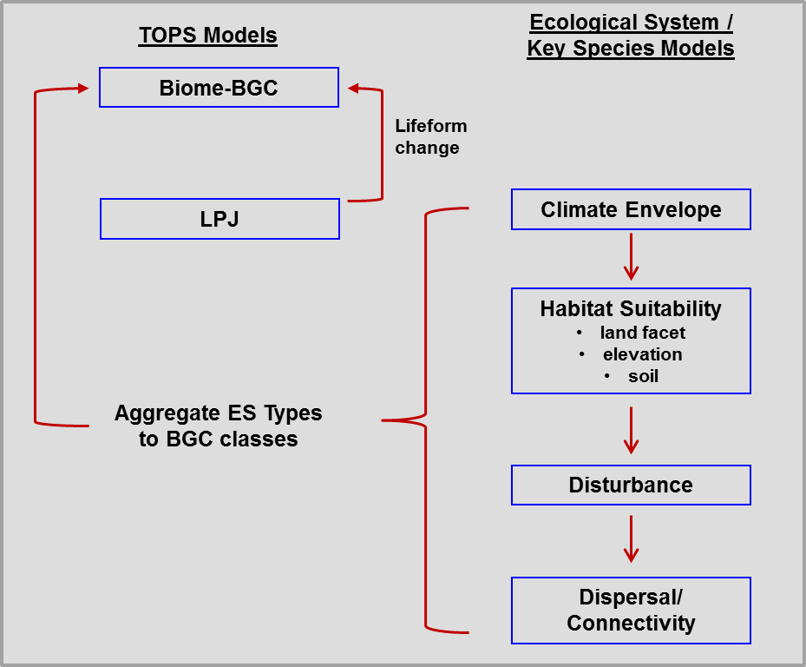
NASA LCCVP Approach

Slide 13
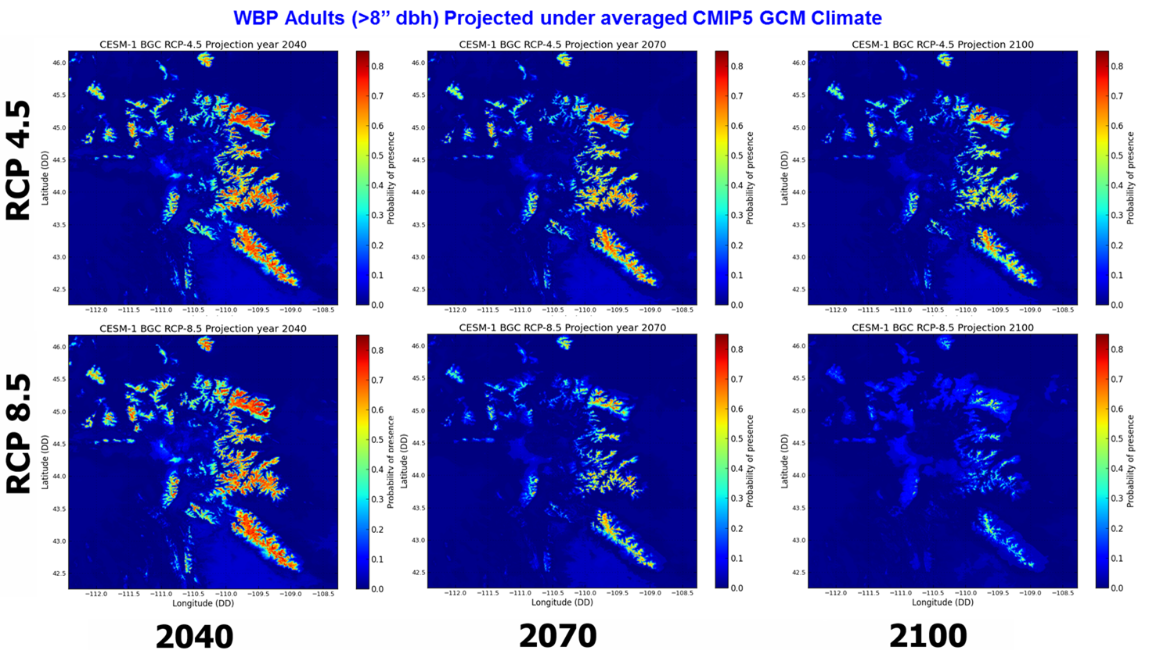
NASA LCCVP Approach

Slide 14
Needs for Science and Management
Realism Certainty
More realistic models with lower uncertainty at greater ecosystem scales
Presence

Slide 15
Needs for Science and Management
Realism Certainty
More realistic models with lower uncertainty at greater ecosystem scales
Presence
For Example:
Where are locations in GYE where controlling competing vegetation would allow recruitment to reproductive age classes under climate change?

Slide 16
Purpose of Workshop
1. Review the current approaches being used in the Northern Rockies
2. Evaluate utility, scope, limitations of each and needs for additional approaches
3. Increase communication and synergy among the community working on vegetation/climate issues.
4. Ultimately, improve our abilities to study, simulate, understand and manage RM ecosystems under climate change.

