Slide 1
Modeling Vegetation Dynamics with LPJ-GUESS
Katie Ireland, Andy Hansen, and Ben Poulter

Slide 2
Stand to Global Scale Modeling Approaches
Stand-scale models
Gap (i.e., ZELIG )
Growth-Yield (i.e. FVS)
Landscape models
Mechanistic - (FireBGCv2)
Deterministic – (SIMMPLE)
Global Models
DGVMS – (MAPSS)
Notes:
Various modeling approaches have been used to project forest/vegetation response to climate, disturbance.
At stand-scales, gap models, for example simulate individual tree establishment, growth and mortality at the scale of small forest gaps.
Landscape models, such as FireBGCv2 operate at scales of hundreds of thousands of ha.
At global scales, dynamic vegetation models are frequently used to simulate vegetation response to climate. Vegetation in these models is often represented by biomes or plant functional types, rather than individual species.
Biome-BGC has been applied from stand to global scales. But, it represents a single, static vegetation type at the level of a biome.

Slide 3
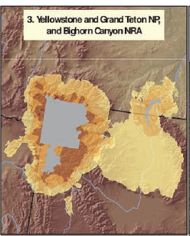
Need for Management at Large Spatial Scales
Fire
Insects
Disease
Climate change
Land-use change
Need ecosystem-scale science, management
Hansen et al. 2011. Bioscience 61:363-373
Notes:
Changing patterns of fire, insect outbreaks and disease are increasing the recognition of the need for science and management that crosses management boundaries and matches the scale of ecological processes. Additionally, the need to explore the implications of climate change and increasing human land-use emphasizes the need for management at the scale at which ecosystems function.

Slide 4
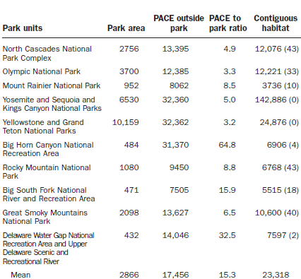
What do we mean by “ecosystem-scale”?
  Cross management boundaries
    Ecological flows
    Crucial habitat
    Effective size
    Human edge effects
  Range of sizes
    ~5500 – 143,000 km² contiguous habitat
Hansen et al. 2011. Bioscience 61:363-373
Notes:
Hansen & others developed a useful definition for ecosystems, centered on protected areas and their surrounding lands, which we can use to discuss what is meant by “ecosystem-scale”.
Ecosystems often cross public and private boundaries and include several different management jurisdictions.
They may be defined as the areas large enough to maintain:
-ecological flows – for example, spread of disturbance or water flow through watersheds
-crucial habitat – or the area required to maintain a self-sustaining population of species of interest
-effective size – the size of area needed to prevent isolation-induced loss of species of interest
-human edge effects – large enough to mitigate the effects of human activities in adjacent lands spreading into core protected areas
Using these definistions across 13 US parks, Hansen and others defined protected area centered ecosystems ranging in size (contiguous habitat) from 5500-143000 km2

Slide 5
Stand to Global Scale Modeling Approaches
Stand-scale models
Gap (i.e., ZELIG )
Growth-Yield (i.e. FVS)
Landscape models
Mechanistic - (FireBGCv2)
Deterministic – (SIMMPLE)
Ecosystem-scale models
LPJ-GUESS
Global Models
DGVMS – (MAPSS)
Notes:
Need an ecosystem-scale approach
LPJ-GUESS might be a good compromise

Slide 6
Desired Model Characteristics
For modeling vegetation dynamics at greater ecosystem scales:
Capable of simulating individual species/communities
Links climate with ecosystem processes
Simulates disturbance
Large spatial scale
  Ex. Yellowstone & Grand Teton Ecosystem ~42,500 km²

Slide 7
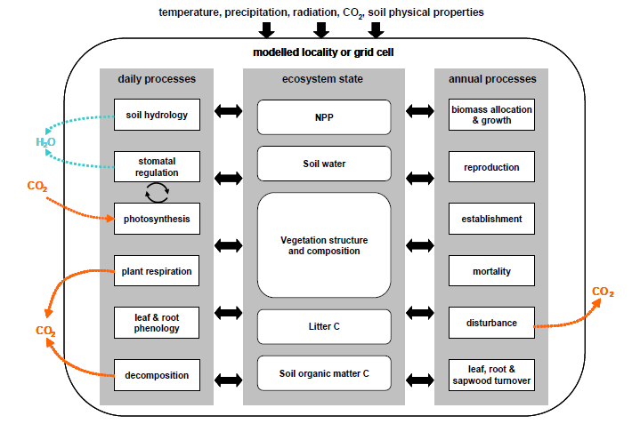
LPJ-GUESS Overview
Notes:
Regional to global model simulates dynamics and composition of vegetation in response to changes in climate, atmospheric CO2 concentration,
Physiological processes include photosynthesis, autotrophic and heterotrophic respiration, which are calculated at a daily time-step
Carbon allocation (to leaves, sapwood, and fine roots) is based on a set of rules that determine plant growth. Carbon allocation is determined at the end of the simulation year by dividing annual NPP into the 3 growth compartments.
Plant establishment, growth, mortality, and decomposition determine vegetation composition and successional dynamics and are respond to light, water availability.
Fire is the primary disturbance modeled in LPJ-GUESS.

Slide 8
Inputs
Climate data: monthly temp., precip., shortwave radiation, CO₂
Soil data: soil texture
Vegetation: PFT/species, bioclimatic limits, ecophysiological parameters
LPJ-GUESS
Photosynthesis
Respiration
Allocation
Establishment, growth, mortality, decomposition
Outputs
Vegetation types
Biomass
Carbon storage
C & H20 fluxes
NPP, NEE
Fire-induced mortality
CO₂, etc. emissions
Fuel consumption

Slide 9
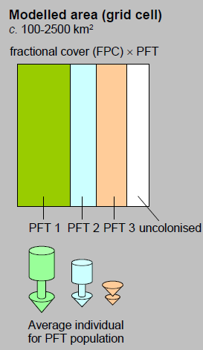
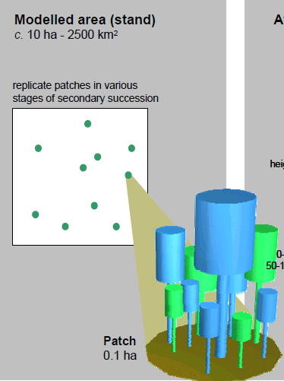
Vegetation Dynamics in LPJ-GUESS
LPJ-DVM:
“Population Mode”
GUESS:
“Individual/Cohort Mode”
PFTs
Simplistic veg. Dynamics
No cohorts
Coarse
PFTs or species
‘Gap’ veg dynamics
Cohorts
Fine
Notes:
LPJ-GUESS is essentially the combination of 2 different models, the physiological/biophysical processes from the Lund-Potsdam-Jena (LPJ) dynamic vegetation model and the vegetation dynamics (tree establishment, growth, mortality) of a forest gap model, the General Ecosystem Simulator (GUESS).
Can be run in 2 different “modes”.
Population mode is coarse-scale, computationally more efficient. Essentially, this is the DVGM, LPJ. Each modeled grid cell is large and vegetation is simplistically represented as a mixture of plant functional types, where each PFT takes up some proportion of the modeled area. No age cohorts are represented so succession and vertical stand structure are not modeled.
Cohort mode corresponds to the gap model, GUESS. Simulates growth of individuals within a cohort on replicate patches. Each individual represents the maximum area of influence of one adult individual on its neighbours. Individuals can represent PFTs or species. More detailed – allows for simulation of competition for resources (light, moisture), successional processes.

Slide 10
Bioclimatic Niche
Each PFT assigned bioclimatic limits
  Survive prevailing climatic conditions
  Variables
    Tcmin – min. coldest month temperature, survival
    Tcmax – max. coldest month temperature, establishment
    GDDmin – min. GDD sum (5ºC), establishment
    Tw-c,min – min. warmest – coldest month temperature range
Notes:
Where and when different vegetation types can establish and survive is dependent upon each PFT’s (or species’) bioclimatic niche. Bioclimatic limits are assigned which determine whether each PFT/species can survive under the climatic conditions in a particular grid cell at a particular year in the simulation.

Slide 11


Fire Dynamics – SPITFIRE model
Climate
Temp, precip, radiation, CO2
Emissions
CO2, CO, CH4, NOx
LPJ-GUESS
Vegetation pattern
Vegetation
(type, crown height, length, DBH)
Litter
(size, moisture, distribution)
Plant mortality/damage
Wind
(speed, direction)
Notes:
Fire is simulated in either population or cohort mode, using a process-based fire model, SPITFIRE.
Fire ignitions can be from lightning or humans, but fire spread only occurs if there is enough fuel and it is dry enough
Fire spread depends upon wind speed and direction and the amount, moisture content, and size of live/dead fuels
Simulated fire effects include plant mortality (fxn of tree height and bark thickness), fuel consumption, and CO2 and other trace gas emissions.

Slide 12
Comparisons: LPJ-GUESS, BIOME-BGC, FireBGCv2
 | BIOME-BGC | FireBGCv2 | LPJ-GUESS
Spatial Scale | Stand to global | Landscape | Stand to global
Vegetation Representation | Biomes (static) | Individual tree (dynamic) | PFTs or species cohorts (dynamic)
Input Variables | Daily climate, ecophysiological parameters | Daily climate, site variables, ecophysiological parameters | Monthly climate, soil texture, ecophysiological parameters
Output Variables | C, N, and H₂O fluxes | C, N, H₂O, vegetation, fire | C, H₂O fluxes, vegetation, fire
Disturbance | Fire | Fire, insects, disease | Fire
Spatially interactive | No | Yes | No

Slide 13
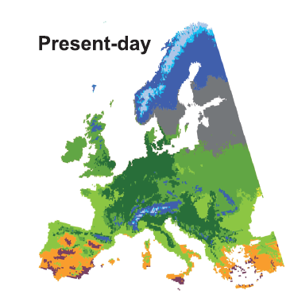
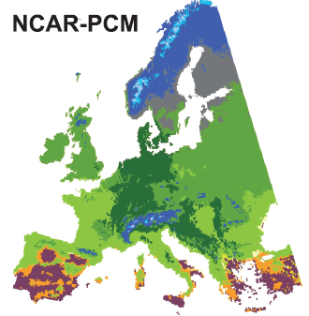
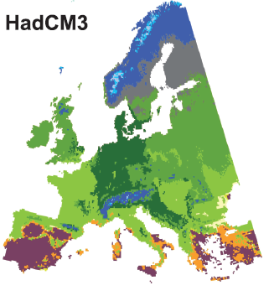
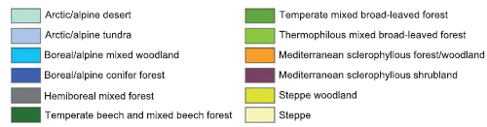
LPJ-GUESS & PNV Shifts in Europe
By 2085:
  NCAR-PCM: 31% in different PNV
  HadCM3: 42% in different PNV
  Forest replaces tundra
  Broad-leaved temperate forest expands northward
  Mediterranean forest shifts to shrubland
Hickler et al. 2012 Global Ecology & Biogeography 21: 50-63
Notes:
Thomas Hickler and others paramaterized LPJ-GUESS for 16 tree species and 4 shrub species to simulate changes in European potential natural vegetation. Ran under current climate and compared to current PNV map – aggregating spp into course veg types (tundra, boreal, etc), the two maps agreed for 86% of the area mapped. But, the LPJ-GUESS modeled vegetation doesn’t show the same fine-scale changes in veg type, partially because of details (i.e. understory veg) not captured in the parameterization of LPJ-GUESS.
Using two different GCMS and the A2 “business as usual” emissions scenarios, they projected 31-42% of the total area of Europe would experience a change in PNV by 2085. The largest shifts were in arctic/alpine ecosystems where trees replace tundra and in the expansion of temperate broad-leaved forests into boreal conifer forests. In southern Europe, forested areas shift to dominance by shrublands in response to increased drought.

Slide 14
LPJ-GUESS for Ecosystem-scale Modeling?
Pros
Cons
Capable of simulating individual species
Species dynamic
Large-scale applications
Links climate to vegetation change
Lack of spatial interactions
  Dispersal
  Disturbance
Parameters for North American tree species
Stochastic establishment/mortality
  Computationally intensive

