Slide 1

FireBGCv2:
A research simulation platform for exploring fire, vegetation, and climate dynamics
Robert Keane
Missoula Fire Sciences Laboratory
Rocky Mountain Research Station
USDA Forest Service
Notes:
1

Slide 2

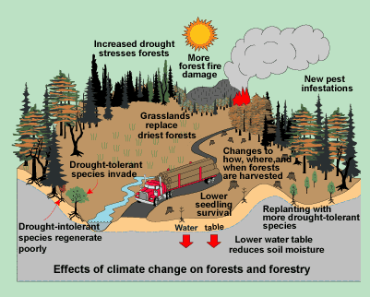
Natural Resources Canada

Slide 3
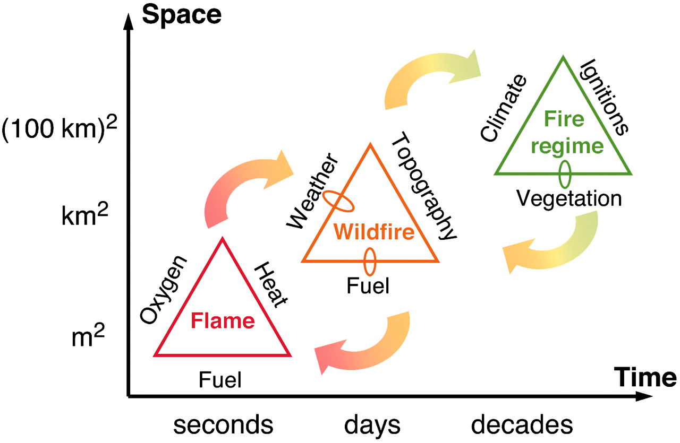
Multi-scale controls on fire
Field and empirical studies become more difficult →
Moritz M. A. et.al. 2005. PNAS;102:17912-17917
Notes:
Extension of traditional fire triangle concept - Climate/weather and fuels changing over time, multiple scales. Multiple interactions – climate/weather influence plant growth, fire dynamics: vegetation/landscapes are shaped by fire and succession, but also influence burning patterns.
Controls on fire at different scales. Dominant factors that influence fire at the scale of a flame, a single wildfire, and a fire regime. This is an extension of the traditional “fire triangle” concept (20, 21), here including broad scales of space and time, the feedbacks that fire has on the controls themselves (small loops), as well as feedbacks between processes at different scales (arrows).

Slide 4
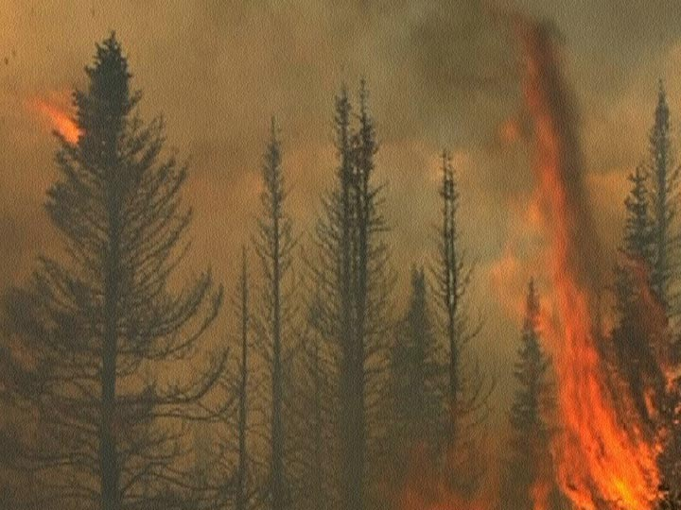
So much to simulate… What model?
The best models to explore climate change dynamics integrate complex ecological processes over spatial and temporal scales
  Complex interactions at fine scales eventually become manifest at coarse scales
  Models without these interactions have limited application
  Interactions should be across processes & scales

Slide 5
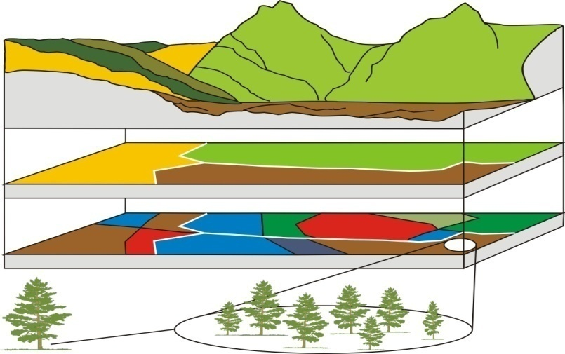
The FireBGCv2 model
Mechanistic, spatially explicit individual tree succession model
  Ecosystem process simulation
  Fire ignition and spread
  Multi-species / multi-age stand dynamics
  Operates at multiple spatial and temporal scales
  Captures climate-fire-vegetation interactions
Landscape
Site
Stand
Tree
Species
Simulation platform
Notes:
FireBGC = Fire BioGeoChemical succession model
500 year simulation period
Model complexity
Uncertainty – what do we learn?
How to use models in management?
Five hierarchical levels of organization are implemented into Fire-BGC. The coarsest level is the landscape. Nested under the landscape are static polygons called sites that have similar topography, soils, weather and potential vegetation. Each site is composed of a number of dynamic stands that differ in vegetation composition and structure reflecting past disturbance history. Fire-BGC simulates ecosystem processes on a small portion of the stand called the simulation plot for computational efficiency. Any number of species can inhabit a stand and species composition influences many processes such as canopy dynamics and tree regeneration. The finest level of organization is the tree. Each tree on a simulation plot is explicitly represented in the Fire-BGC architecture and described by a number of attributes including diameter, height and leaf carbon. Trees are not mapped on the simulation plot. Table 1 lists the ecosystem processes simulated at each hierarchical level.
Fire-BGC is the fusion of two ecosystem models, each developed from very different approaches. The process-based, gap-replacement model FIRESUM was merged with the mechanistic biogeochemical simulation model FOREST-BGC (Running and Coughlan 1988; Running and Gower 1991) to predict changes in species composition and landscape dynamics in response to changes in various ecosystem processes over long periods. The mechanistic approach of FOREST-BGC improved the level of detail needed to understand those ecosystem processes that govern tree growth and successional dynamics. Fire-BGC simulates the flow of carbon, nitrogen and water across many ecosystem components to calculate individual tree growth and changes in organic biomass on the forest floor. Carbon is fixed by tree needles via photosynthesis using solar radiation, temperature and precipitation as driving variables. The fixed carbon is then distributed to leaves, stems and roots of individual trees, with a portion lost from each tree component each year to accumulate on the forest floor in the litter, duff, and soil. These forest floor compartments lose carbon through decomposition. Nitrogen is cycled through the system from the available nitrogen pool. The carbon allocated to each tree’s stem at year’s end is used to calculate diameter and height growth. Daily weather described by temperature, precipitation, and radiation, influence the flux of carbon, nitrogen, and water to and from each component. The spatially explicit fire simulation model FAIRSITE is linked to Fire-BGC to predict the growth of fire across the landscape once it is started by the FIRESTART model which is also linked to Fire-BGC using the Loki system. FIRESTART stochastically simulates the occurrence or ignition of a fire on the landscape based on Weibull probability distributions stratified by climate and site fire regime. FARSITE uses the spatial data layers of topography, vegetation, weather and fuels to predict fire behavior characteristics such as fireline intensity and rate of spread.

Slide 6

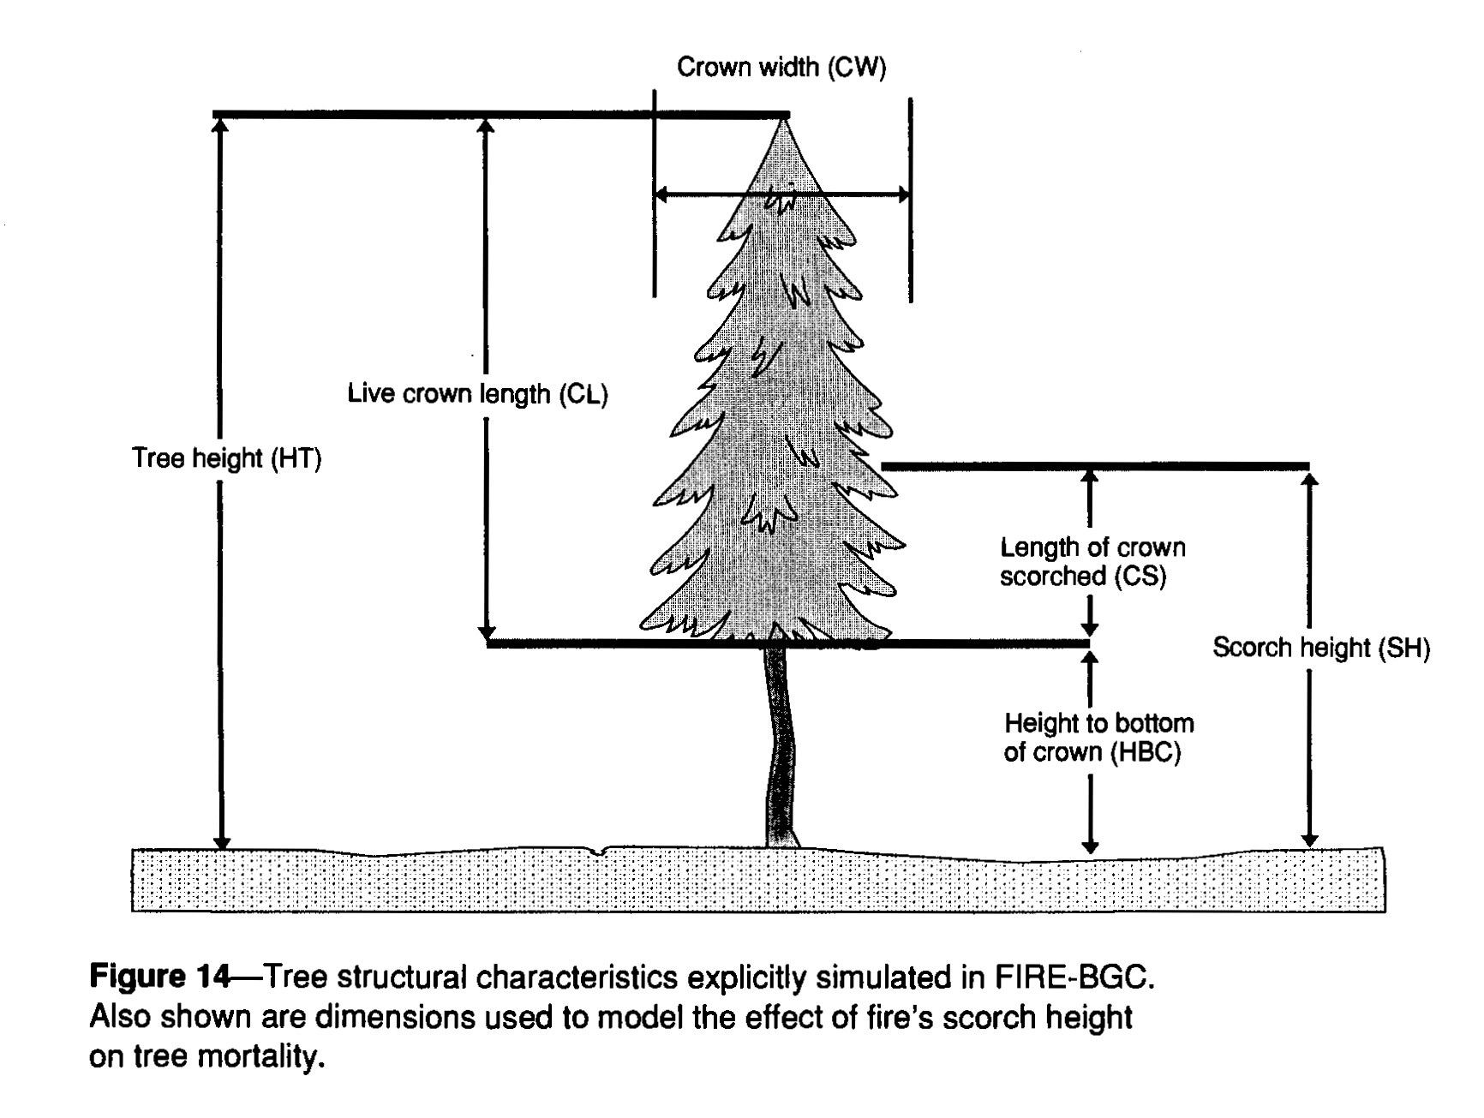
FireBGCv2 is NOT…
A prognostic, predictive model
  A model that predicts events
  A model that is used for short-term predictions
Accurate
  Complexity increases uncertainty
Stable
  Highly complex models are inherently unstable

Slide 7
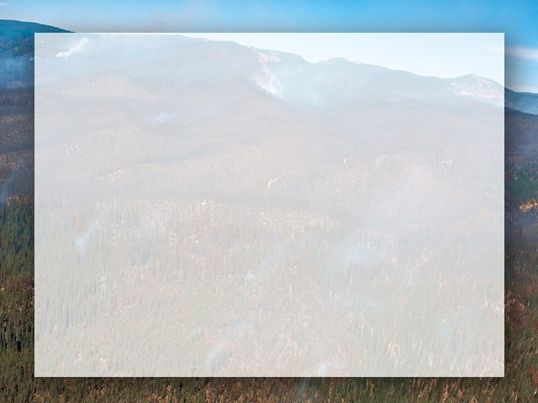
FireBGCv2 is…
A regime or cumulative effects model
  Simulates long-term ecological effects
  Simulates complex interactions across scales
  Simulates many disturbances
Robust
  Mechanistic architecture allows wide application
A research platform
  Explore new landscape behaviors
  Compare various modeling approaches

Slide 8
The Lineage or “Family Tree” of FireBGCv2
H2OTRANS
FOREST-BGC
BIOME-BGC
DAYTRANS
FIRE-BGC
“Big Leaf” BioGeoChemical Models
JABOWA
SILVA
FIRESUM
FireBGCv2
Stand level gap phase models

Slide 9

FIRE-BGC Simulation Design
Key Levels of Organization:
LANDSCAPE
SITE
STANDS (Plot)
SPECIES
TREES

Slide 10
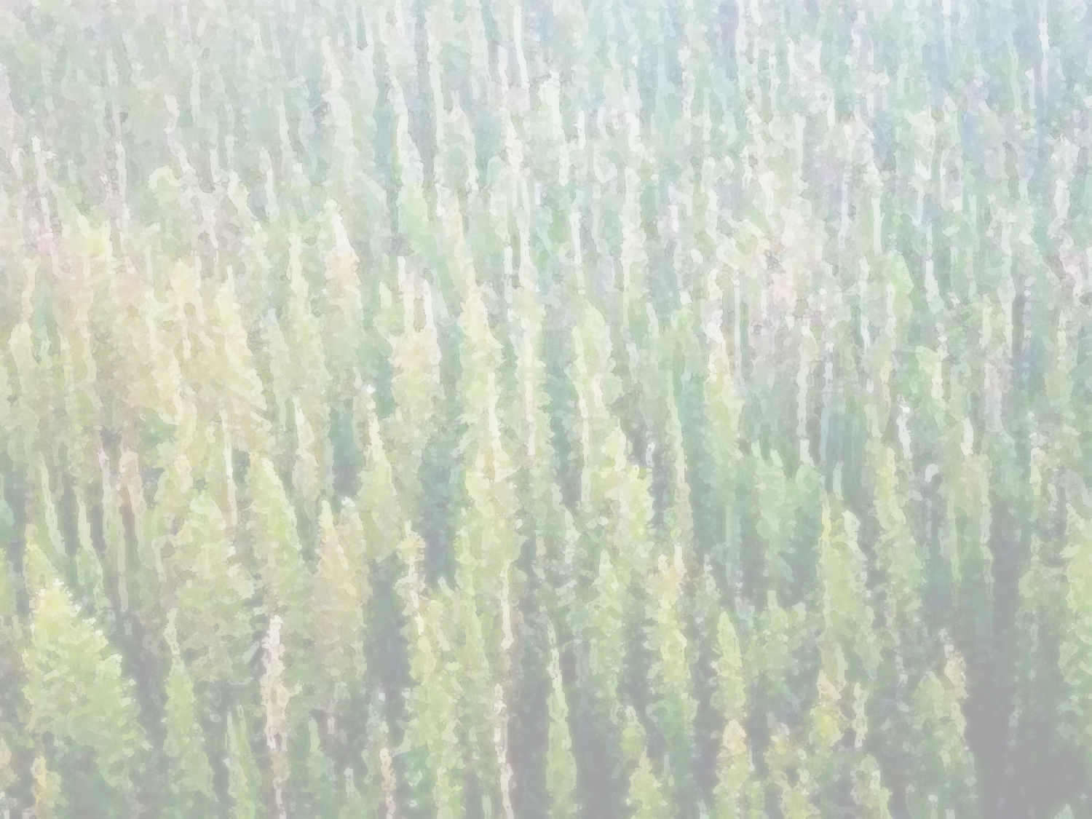

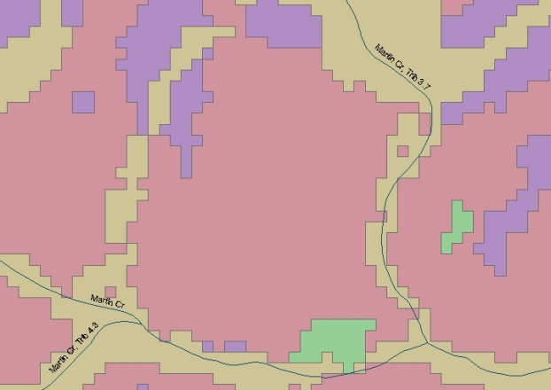
FIRE-BGC Simulation Modeling
Processes Simulated at Each Scale
Landscape
● Seed dispersal
● Cone crops
● Fire dynamics:
Ignition
Spread
● Insect and disease occurrence
White pine blister rust
Mountain pine beetle
● Management action planning
● Climate change
● Hydrology

Slide 11
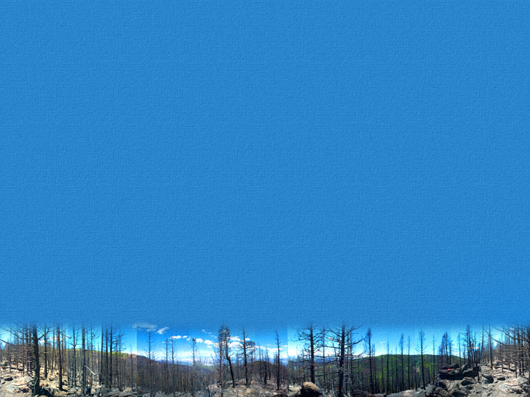
FIRE-BGC Simulation Modeling
Processes Simulated at Each Scale
Site
● Weather
● Phenology
● Soils

Slide 12
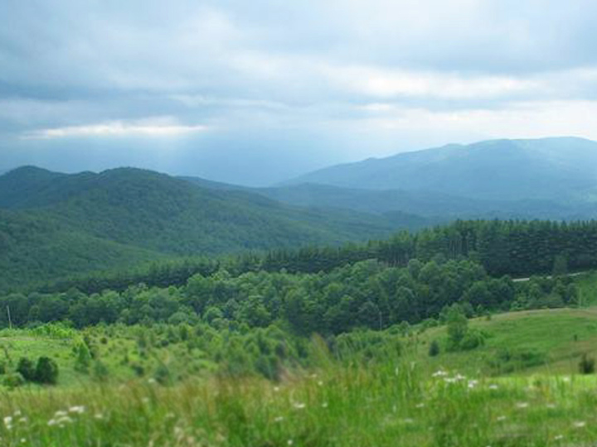
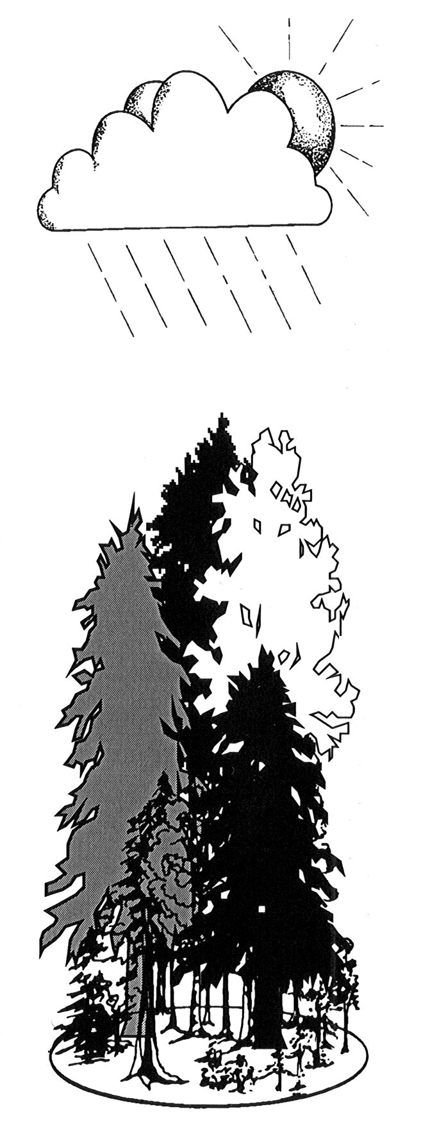
FIRE-BGC Simulation Modeling
Processes Simulated at Each Scale
Stand
Most important ecological
processes are simulated
at this scale

Slide 13
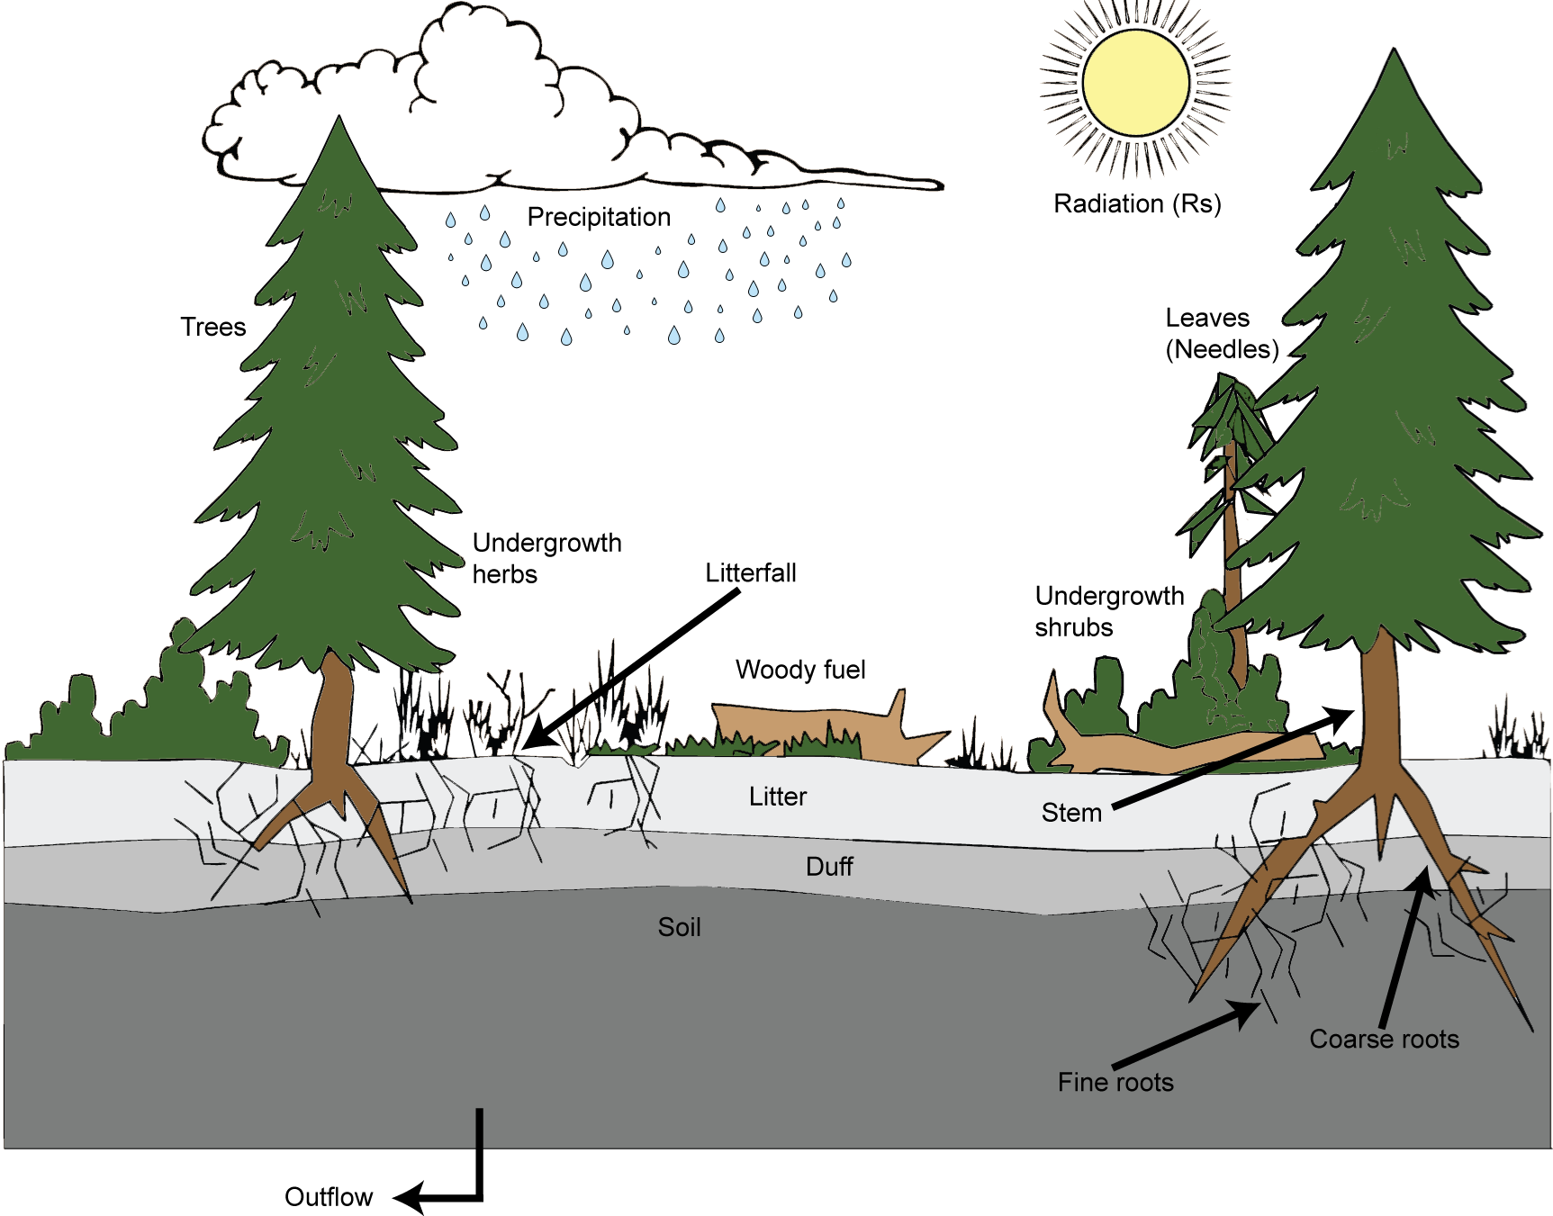
FireBGCv2 Stand Components

Slide 14
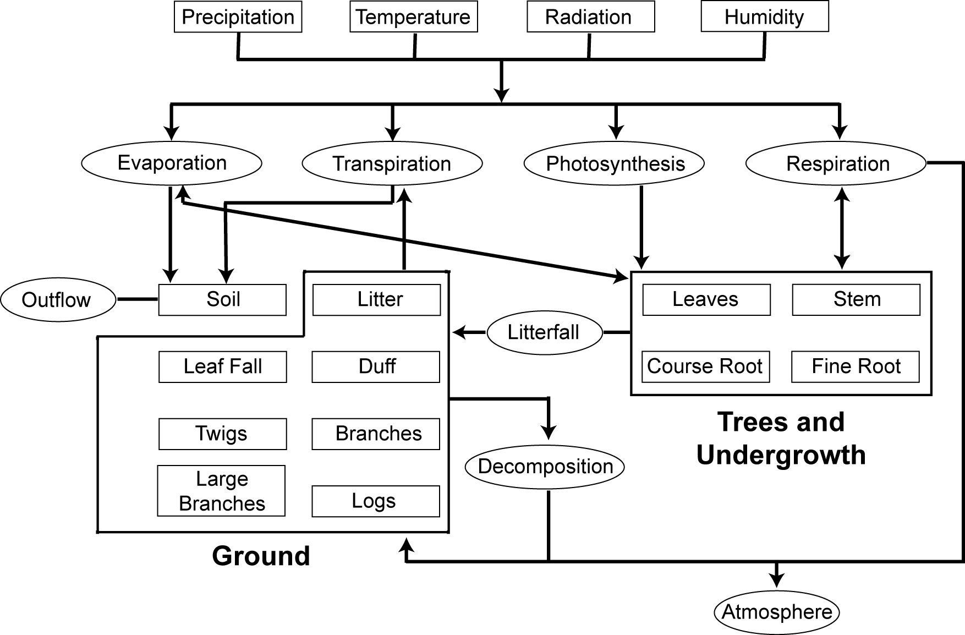
Stand Level Processes Flow Chart

Slide 15
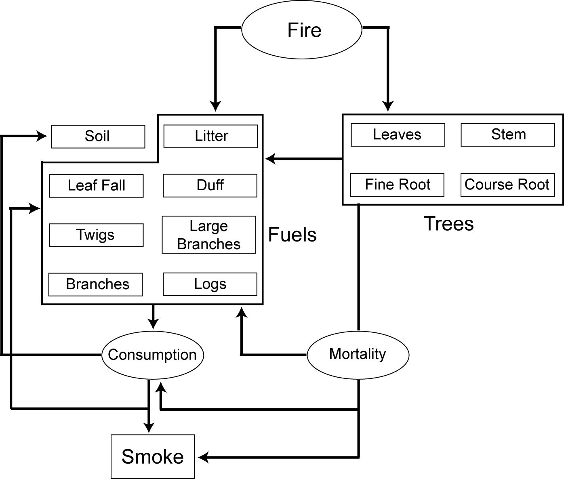
Fire Effects simulated in FireBGCv2
Stand level

Slide 16
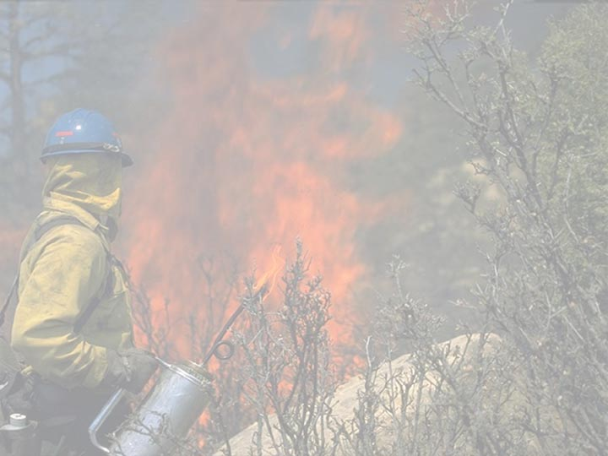
Management Actions
Stand Level
Various management actions
  Prescribed burn
  Timber harvesting (thinning→clearcut)
  Wildland fire use
Grazing
Wildlife habitat suitability
Hydrology
Stream temperature

Slide 17
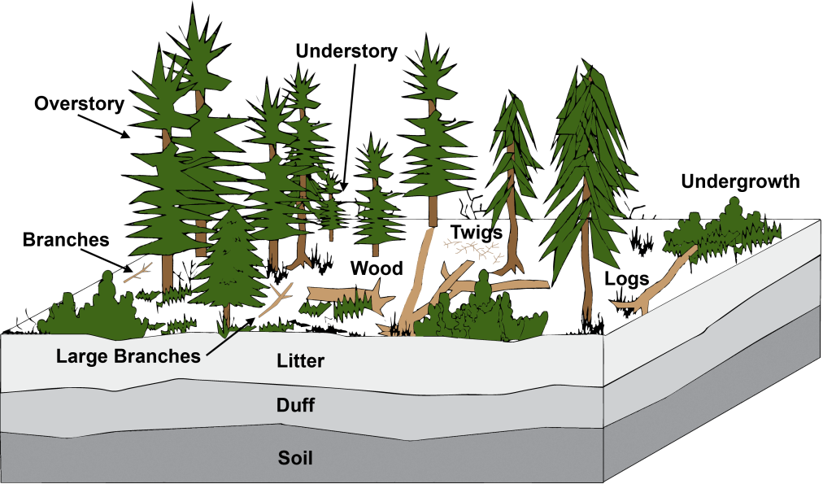
FIRE-BGC Simulation Modeling
Processes Simulated at Each Scale
Species
● Regeneration
● Phenology
● Fire effects

Slide 18
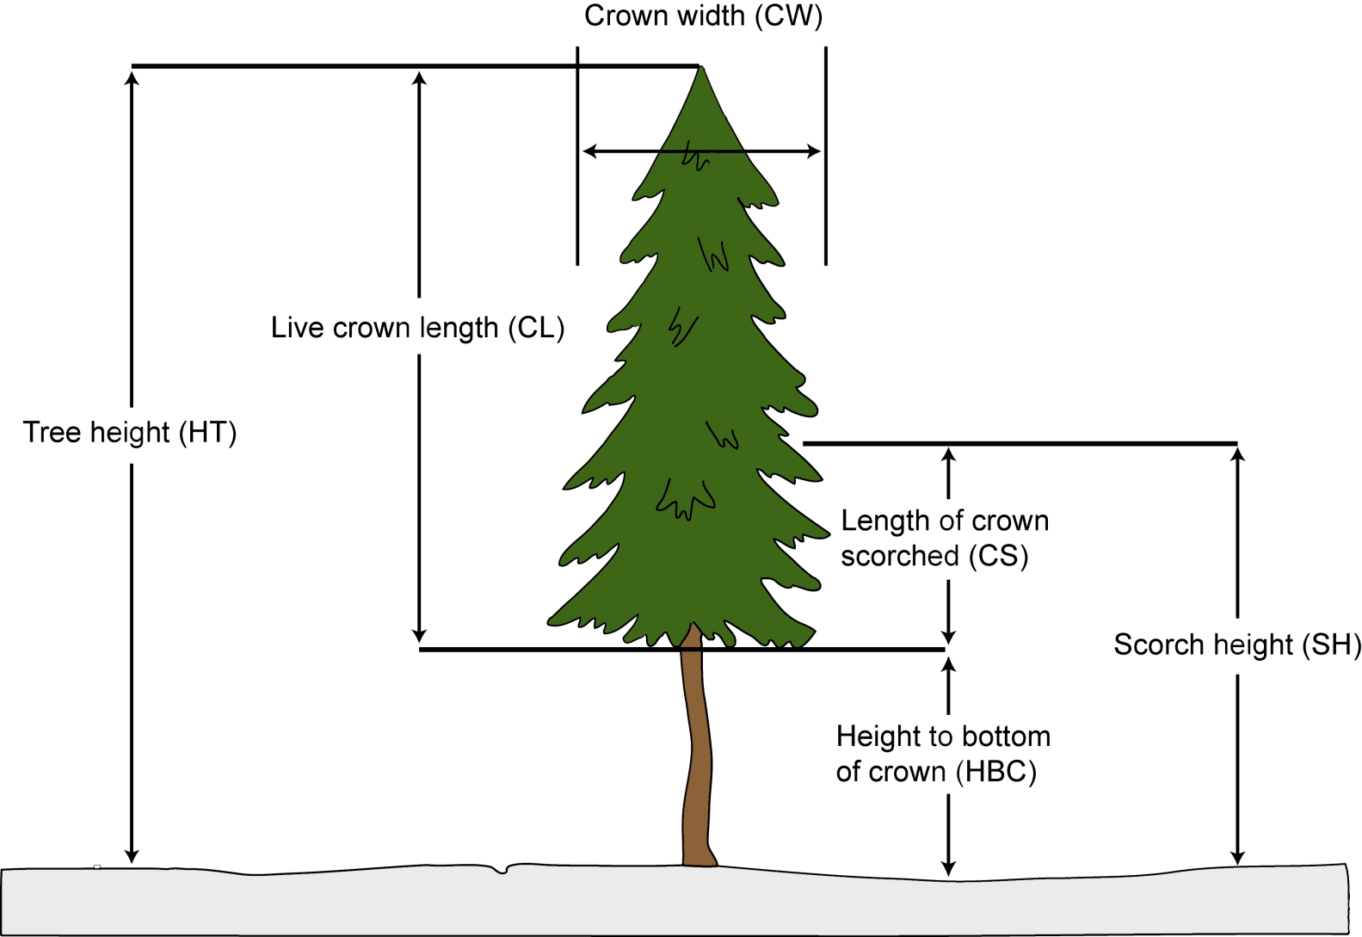
FIRE-BGC Simulation Modeling
Processes Simulated at Each Scale
Tree
● Growth
● Mortality
● Regeneration
● Litterfall
● Wildlife habitat
● Snag dynamics

Slide 19
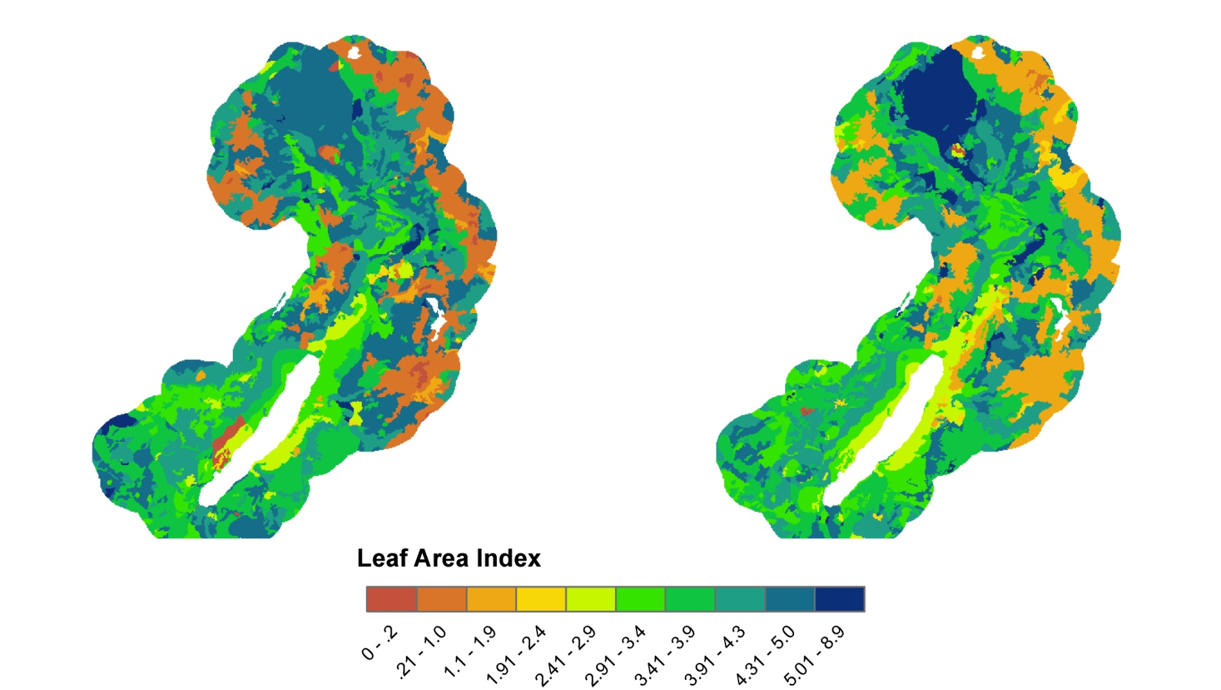
FIRE-BGC Simulation Modeling
Dynamic Output
● Tabular and map output available
● Over 890 possible output variables
for tabular summaries
● Only 25 map variables
● Output by landscape, site, stand, species, tree

Slide 20
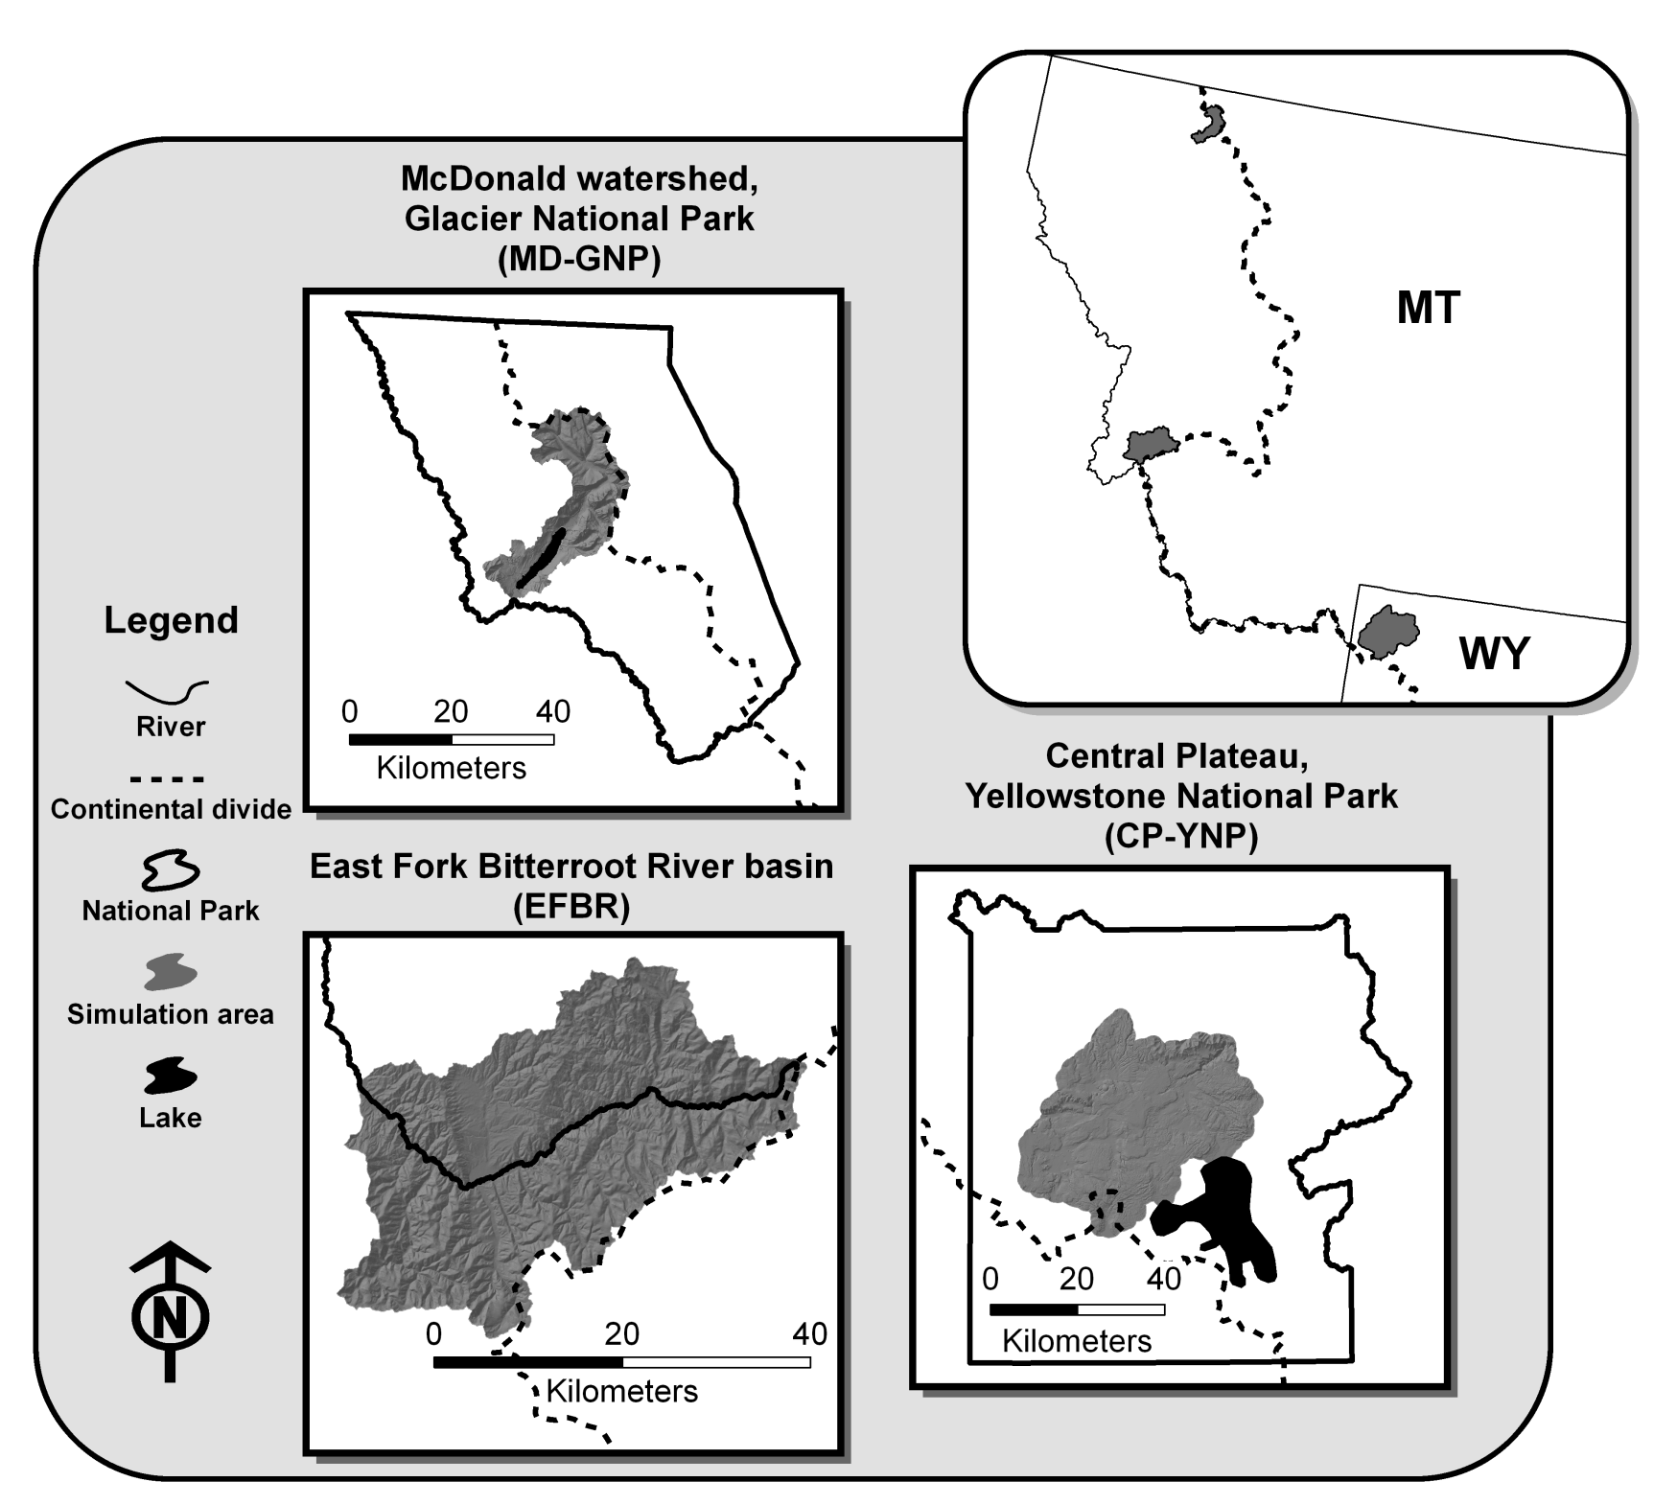
Notes:
Define resilience and resistance

Slide 21
Modeling tipping points
Six temperature factors: 1 °C - 6 °C
Seven precipitation factors: 70% - 130%
Ecosystem and fire effects
How much change is too much?
DRIER
WARMER
Notes:
Define resilience and resistance

Slide 22
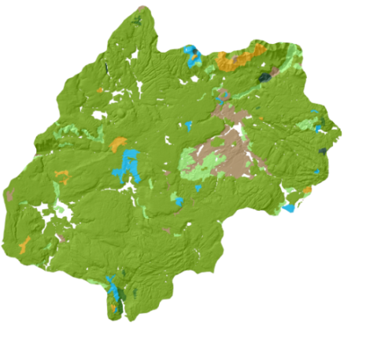
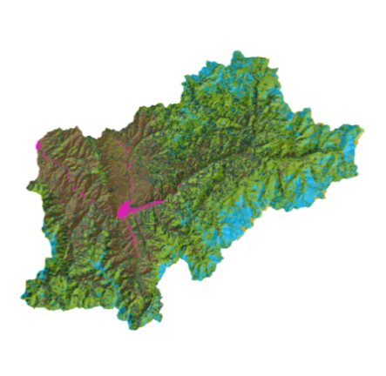
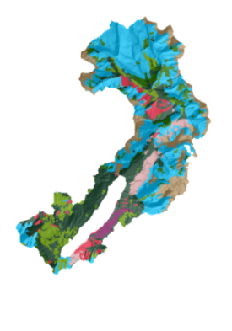
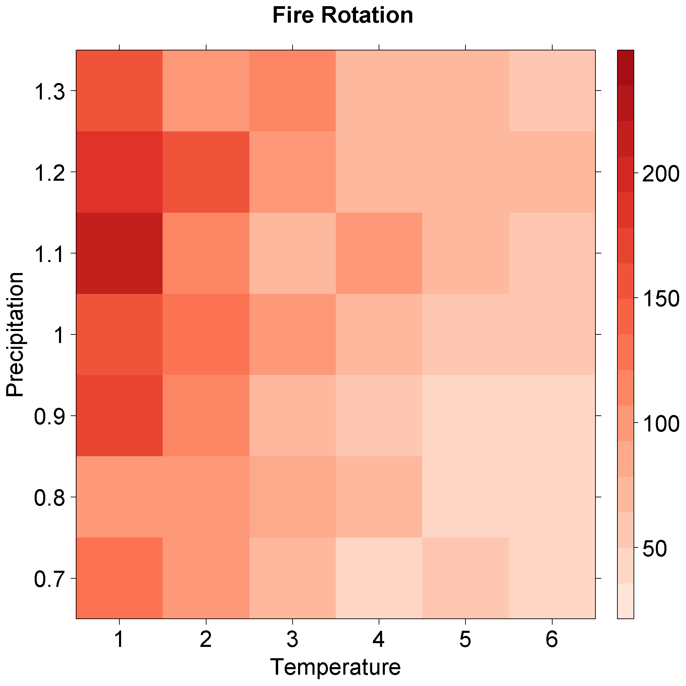
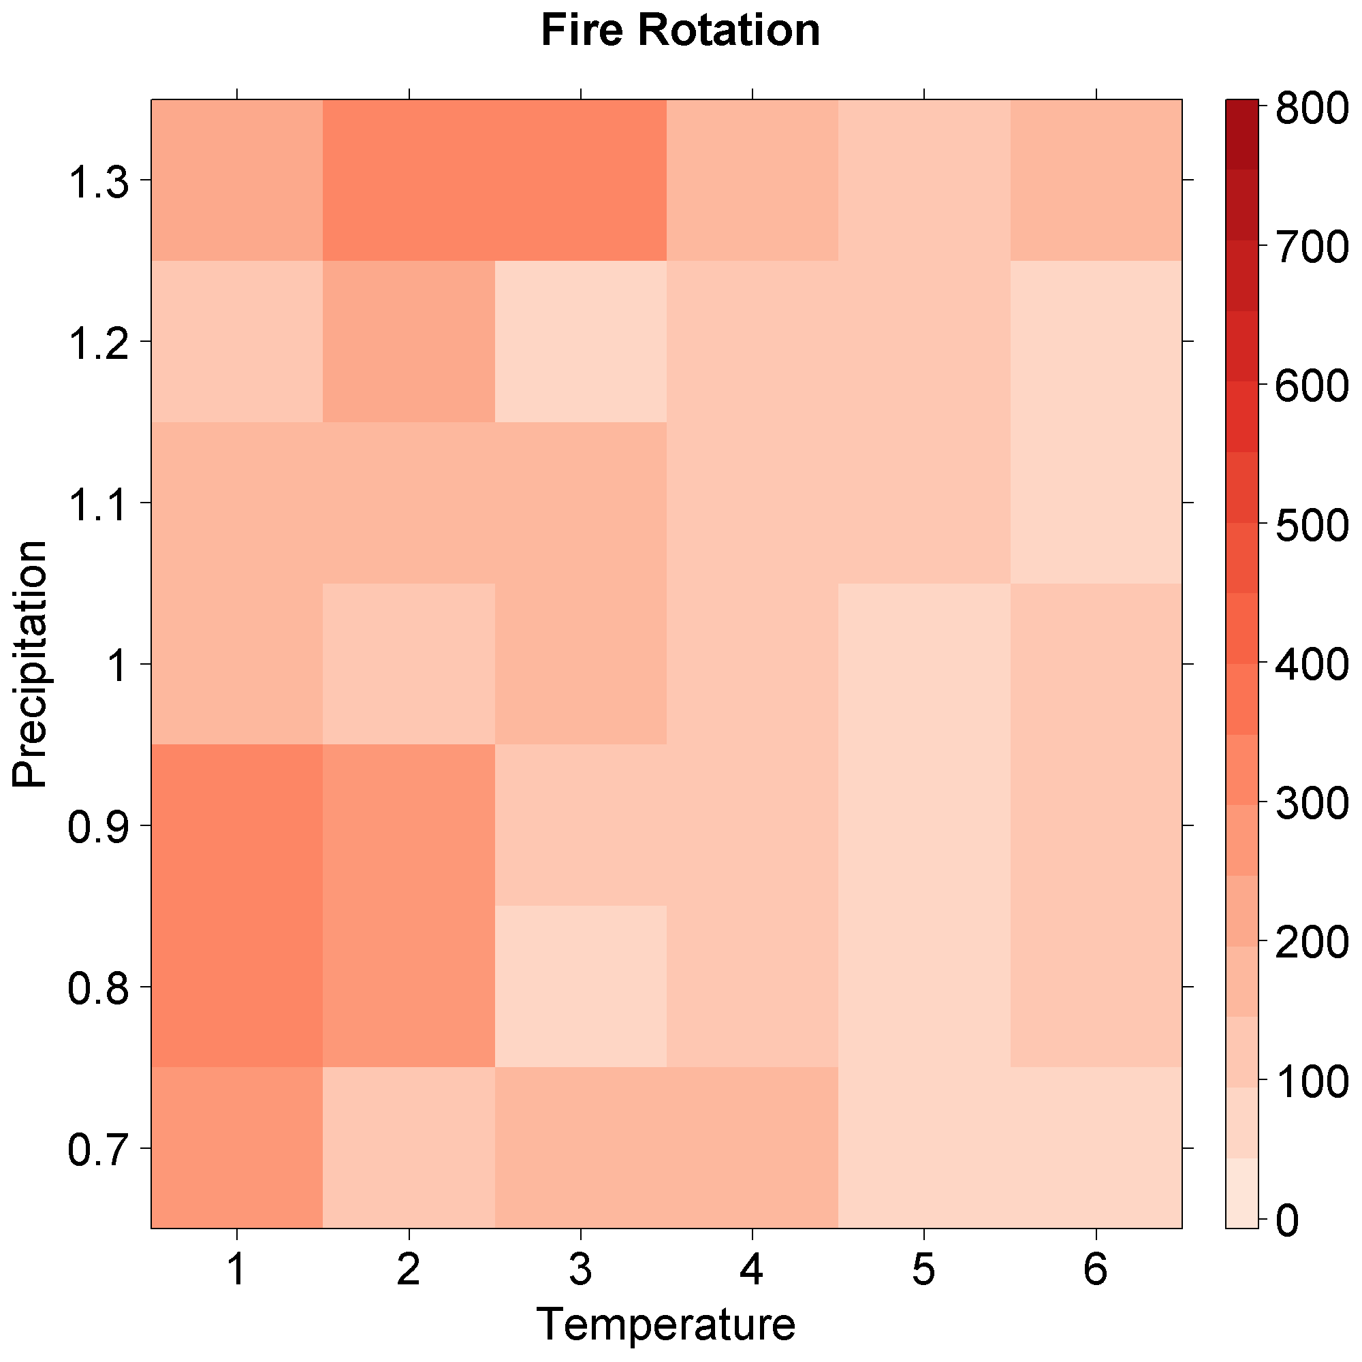
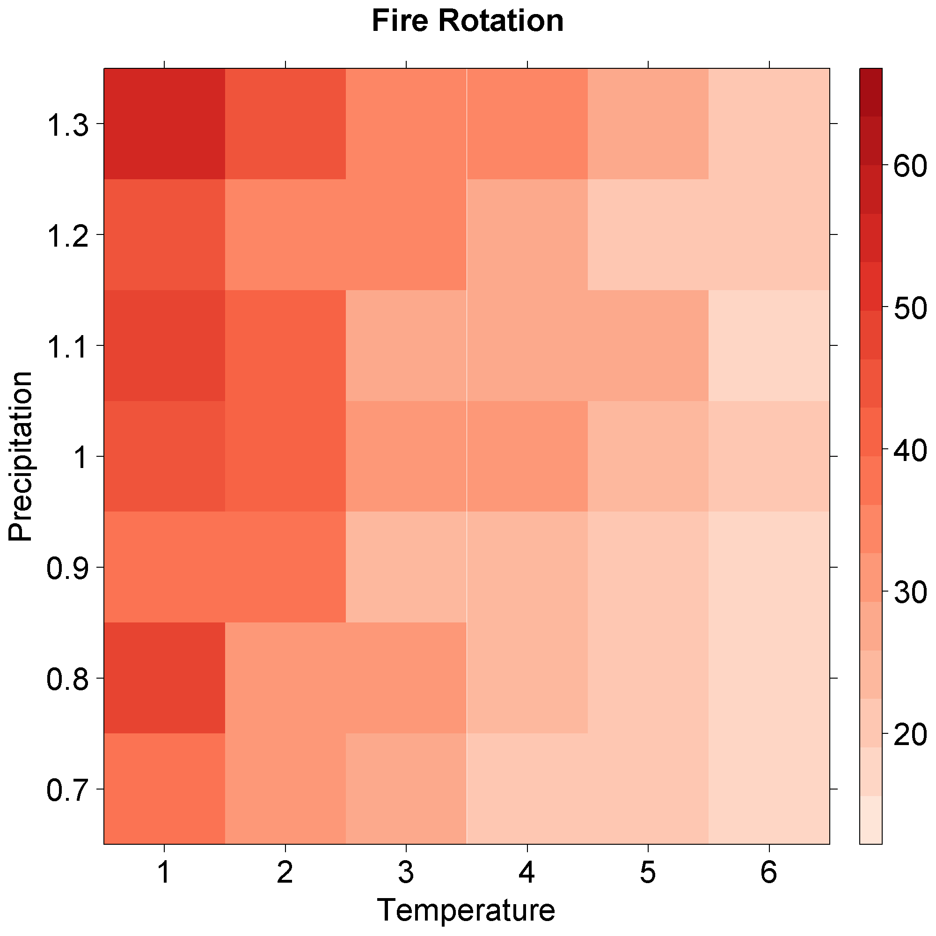
Fire rotation (yrs)
Glacier NP
Yellowstone NP
Bitterroot NF
DRIER
WARMER
169 yrs.
223 yrs.
56 yrs.

Slide 23
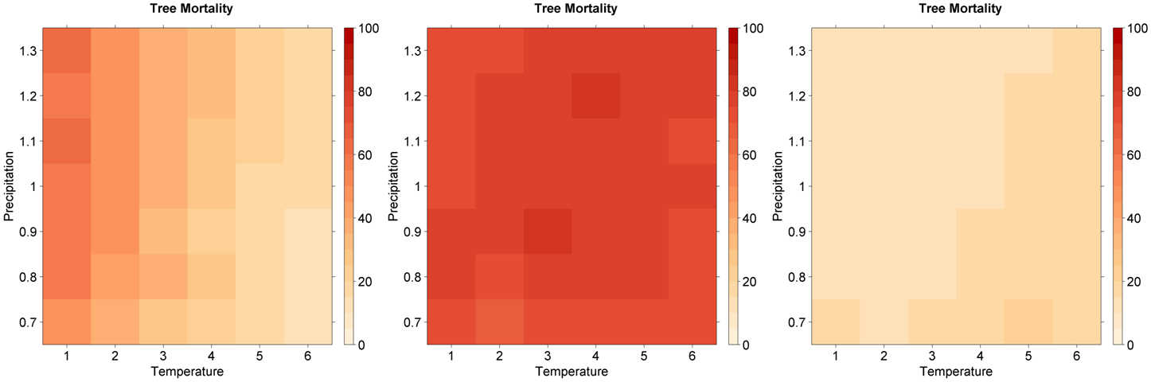
Tree mortality (%)
Glacier NP
Yellowstone NP
Bitterroot NF
DRIER
WARMER
59.7%
70.3%
17.0%

Slide 24
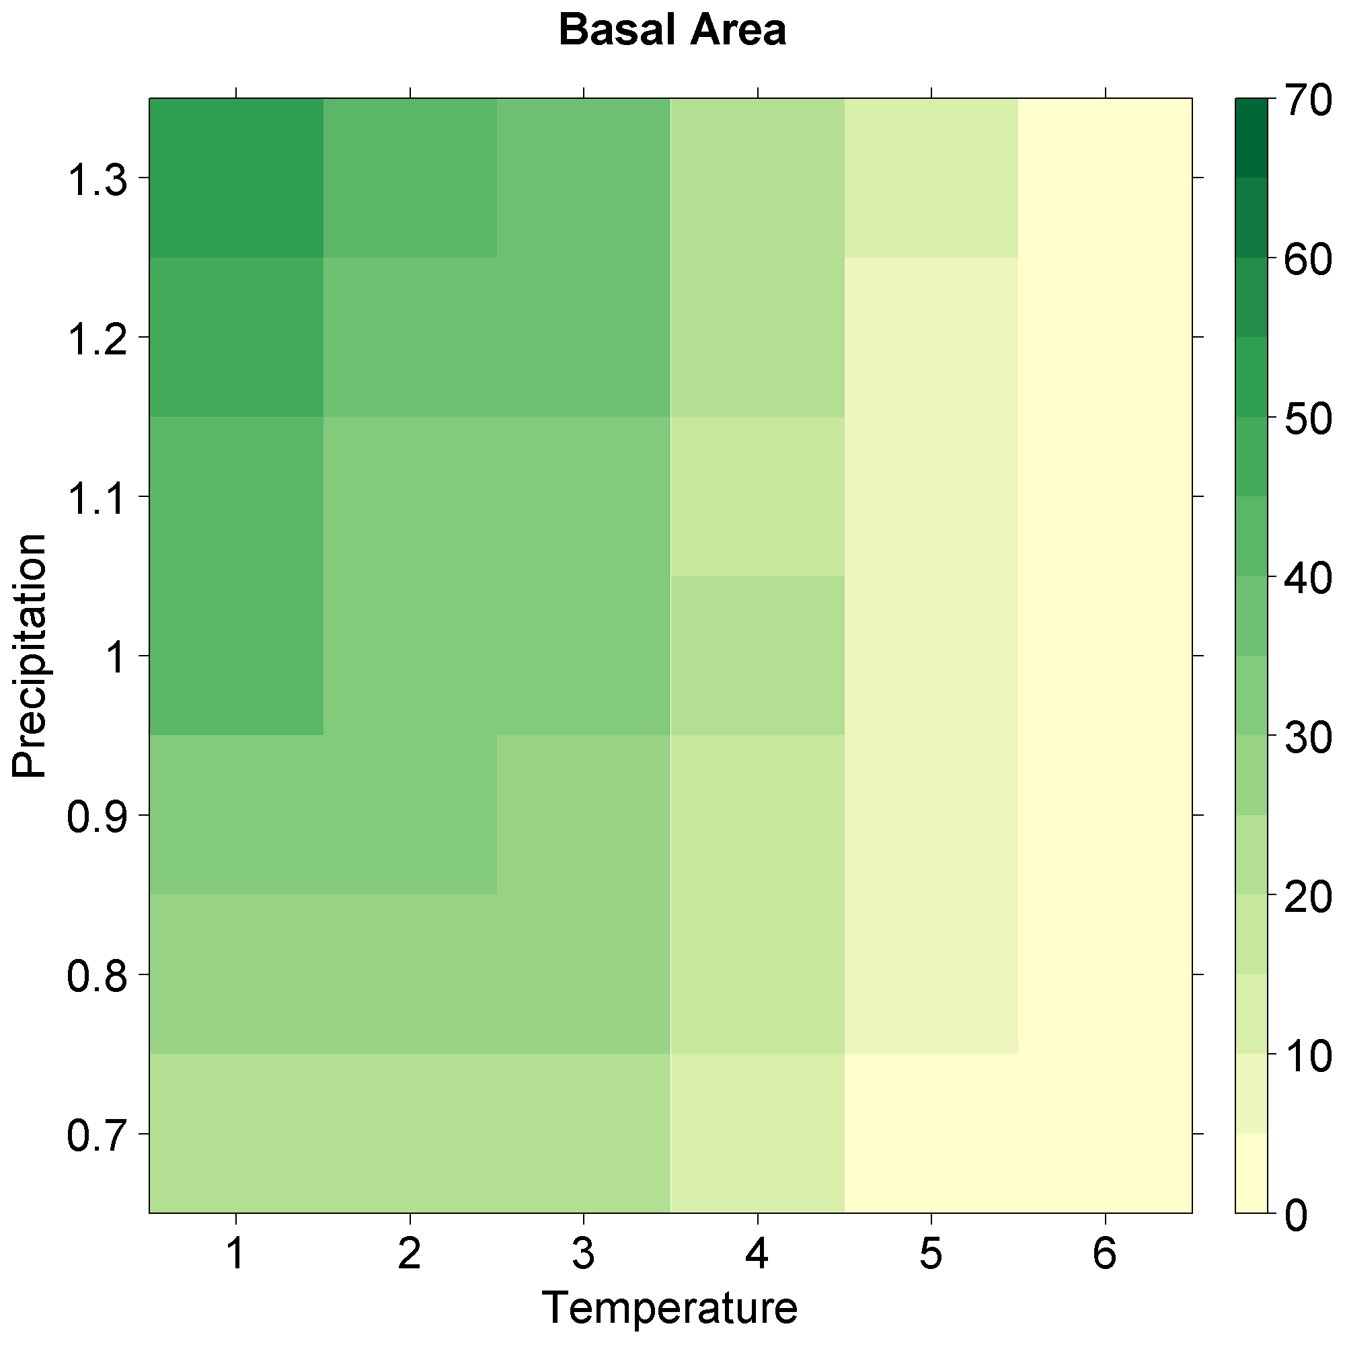
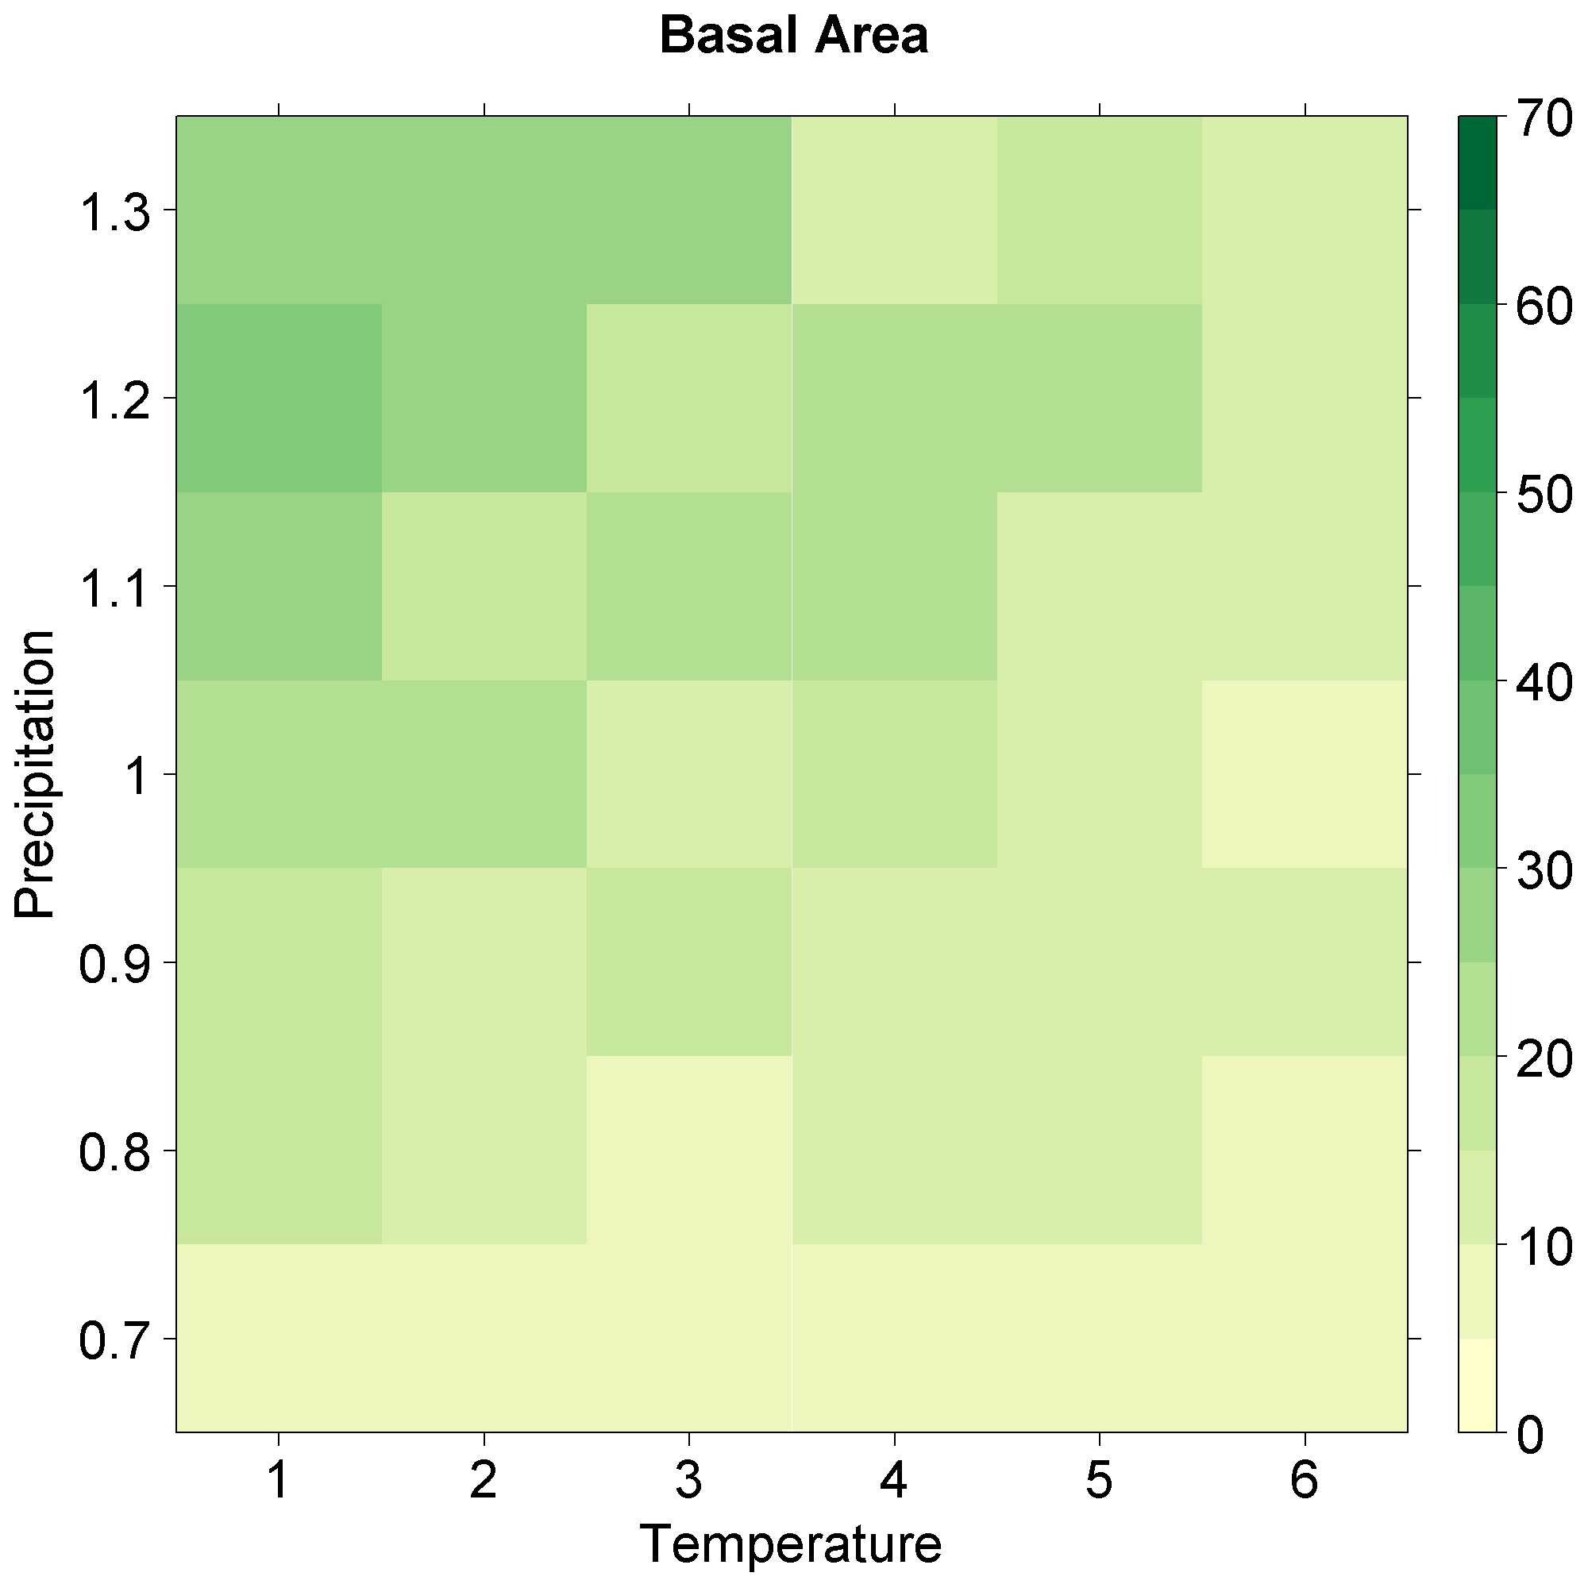
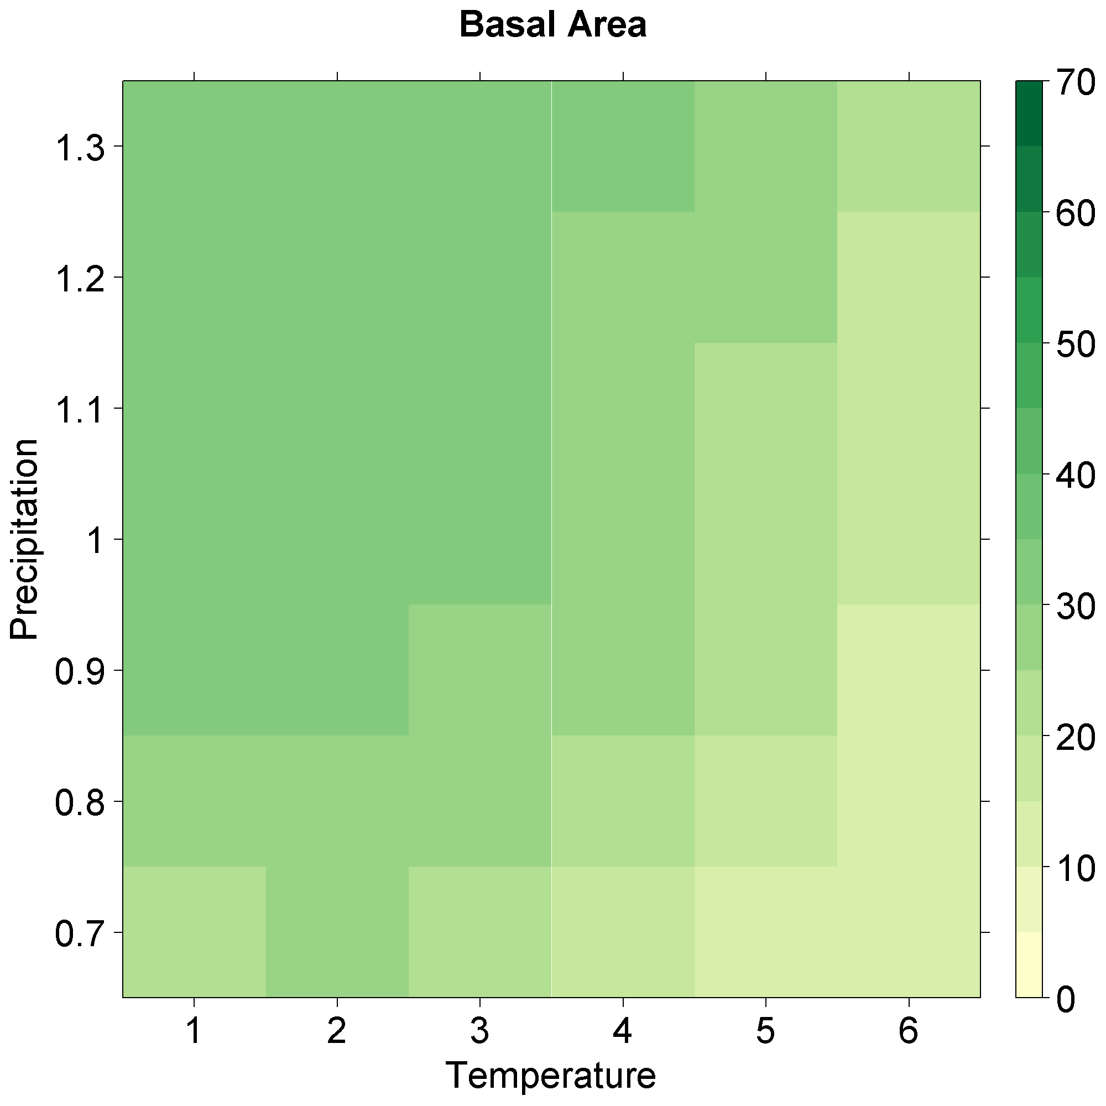
Basal area (m²/ha)
Glacier NP
Yellowstone NP
Bitterroot NF
DRIER
WARMER
38.8 m²/ha
26.5 m²/ha
29.6 m²/ha

Slide 25
Basal area thresholds
Significant (P < 0.5) changes in mean basal area for climate change scenarios for MD-GNP, CP-YNP, and EFBR. Solid fill indicates decreased basal area and hatched fill indicates increased basal area as compared with the no climate change scenario.
 | 1° |  |  | 2° |  |  | 3° |  |  | 4° |  |  | 5° |  |  | 6°
130%
120%
110%
100%
90%
80%
70%
Glacier NP
Yellowstone NP
Bitterroot NF
DRIER
WARMER

Slide 26
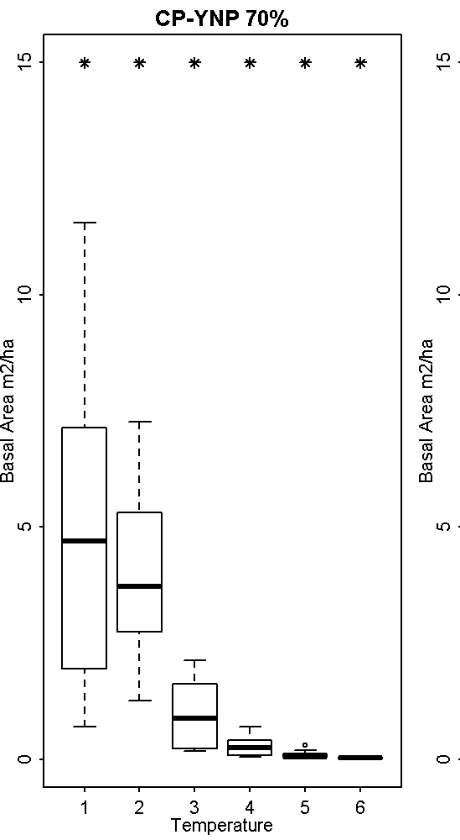
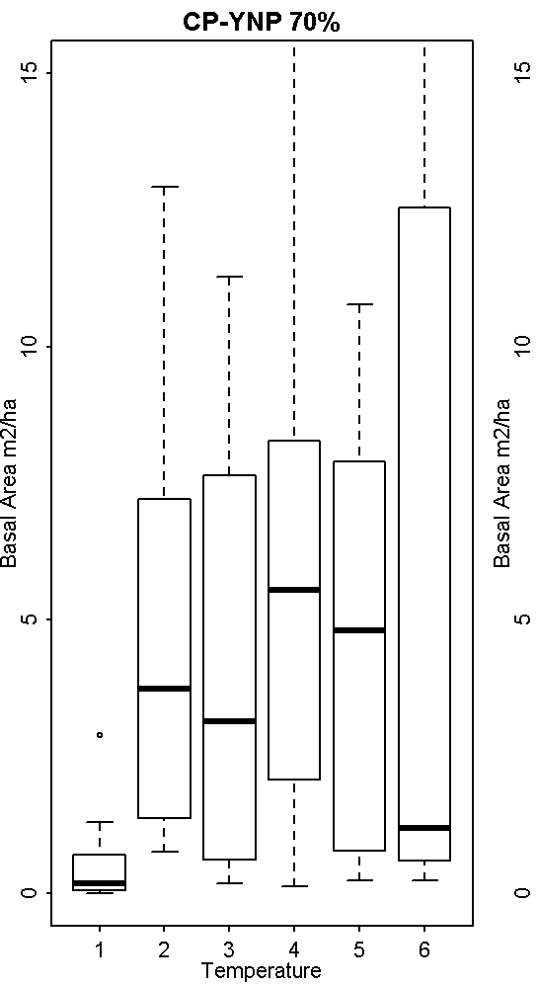


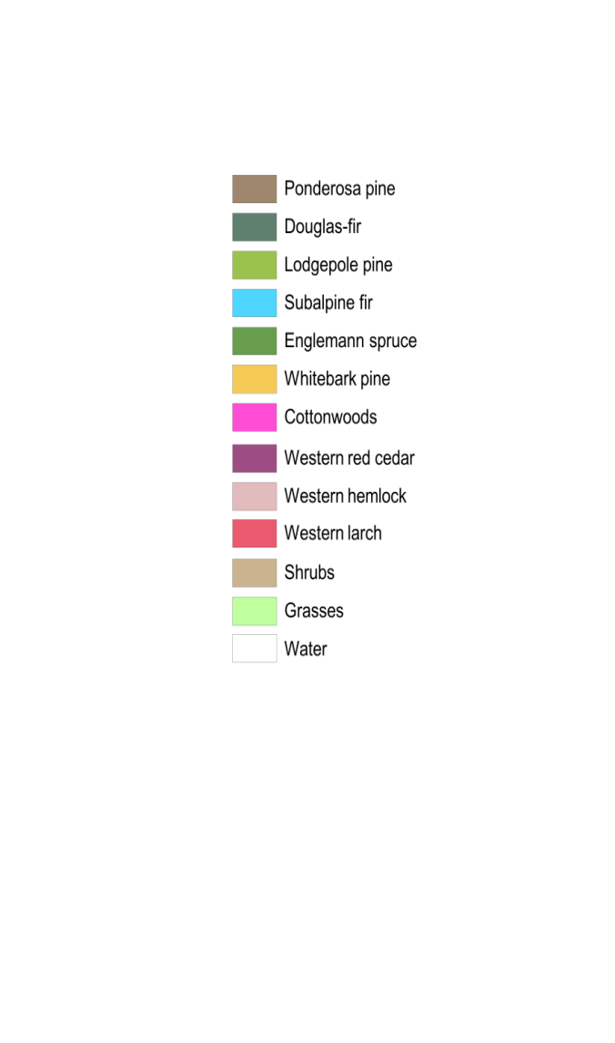
Dominant species changes
Yellowstone NP
Lodgepole pine
Douglas-fir

Slide 27
Hypothesized Change
Same Forest
Same Forest
Fire Adapted
 | Current | Climate | Climate & Fire
Climate does not affect forest
Climate creates new forest composition or structure
Climate creates vegetation transition
New Forest
Grass
Same Forest
Current Forest
New Forest
Same Forest
Fire Adapted
Sage
Fire Adapted New Forest
Grass
Grass
Sage
New Forest
Grassland
Same Forest
Current Forest
New Forest
Same Forest
Fire Adapted
Fire Adapted New Forest
Sage Steppe
New Forest
Grass
Current Forest
New Forest
Fire Adapted
Sage
Grassland
Grassland
Grass
Grass
Sage Steppe
Sage
Notes:
Present idea of fire and climate as drivers of forest composition and structure.

Slide 28
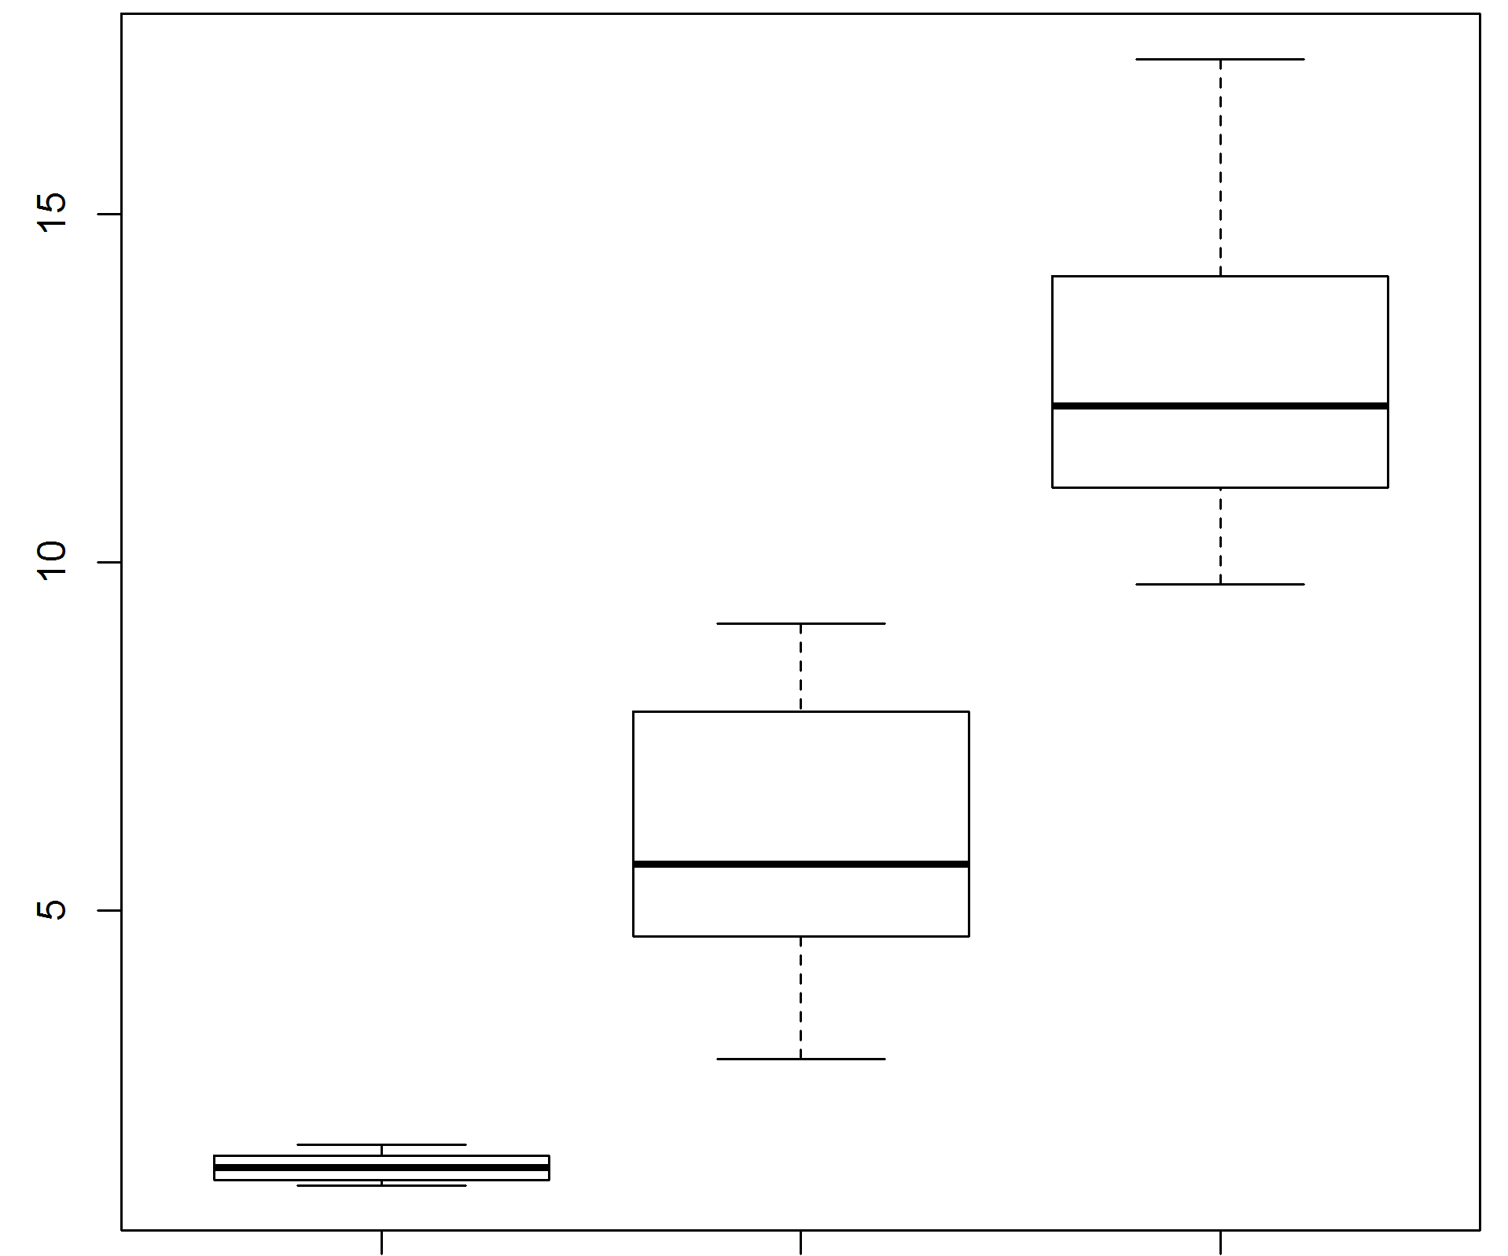
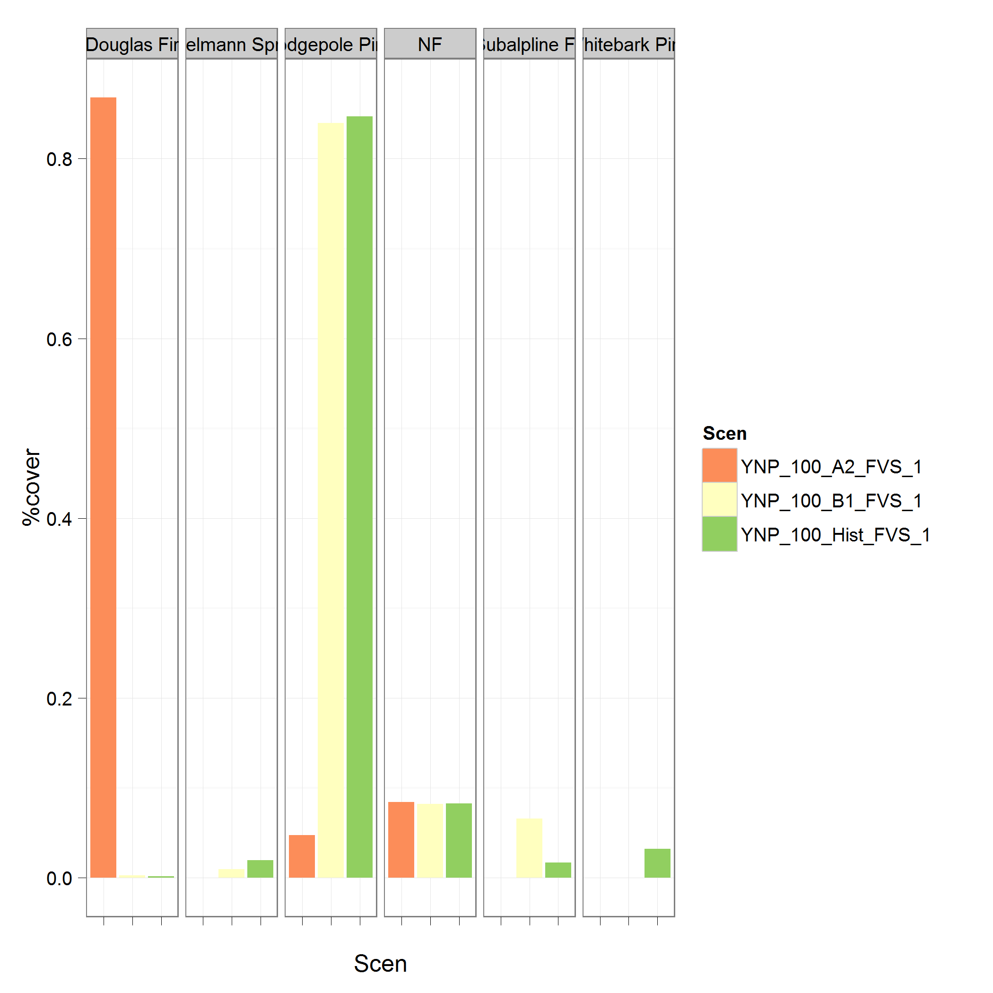
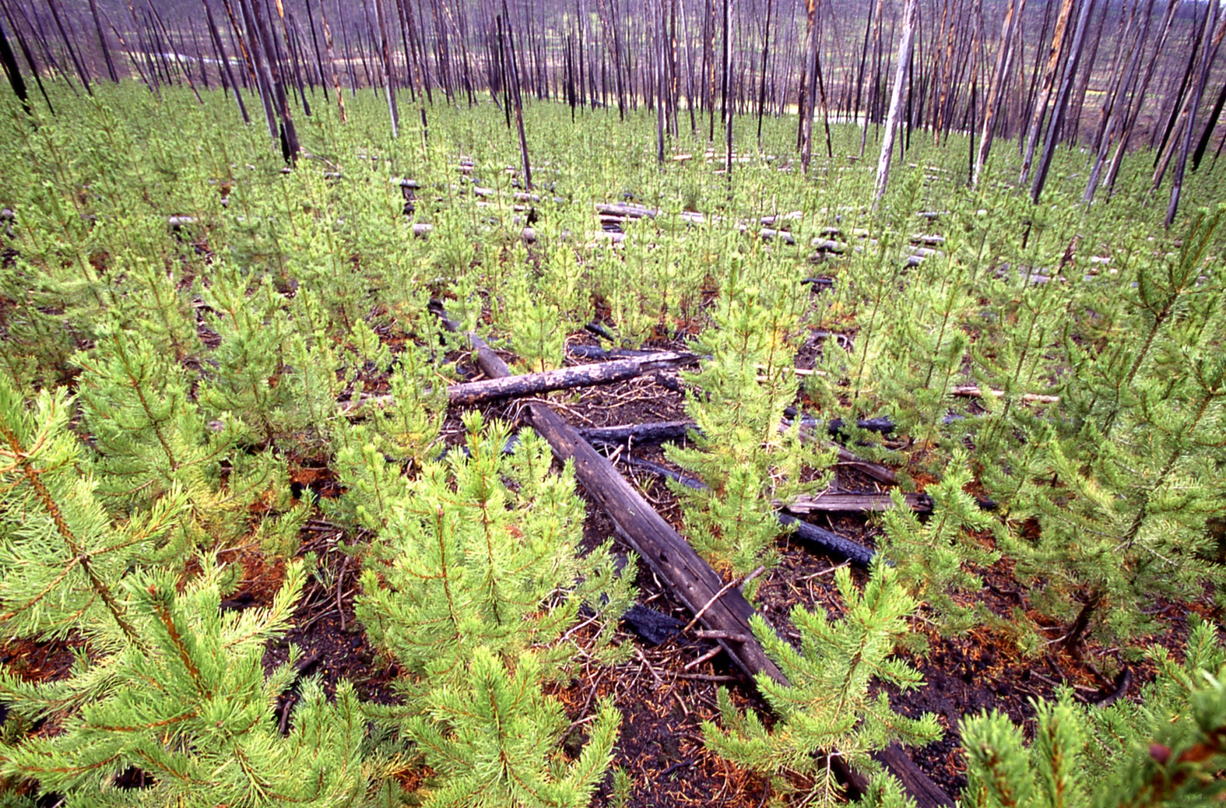
Climate
Same Forest
Same Forest
Basal Area
Fire Adapted
Same Forest
Percent Cover
Same Forest
Same Forest
New Forest
Grass
Fire Adapted
Current Forest
New Forest
A2
Fire Adapted
Sage
B1
New Forest
Grass
Current Forest
New Forest
New Forest
Grass
Historic
Fire Adapted
Sage
Grass
Sage
Grass
Grass
Sage
A2
B1
Historic
Douglas-fir
Non-Forest
Lodgepole Pine
Subalpine Fir
Engelmann Spruce
Whitebark Pine
Photo: US NPS
Notes:
Effect of vegetation, present 100 results

Slide 29
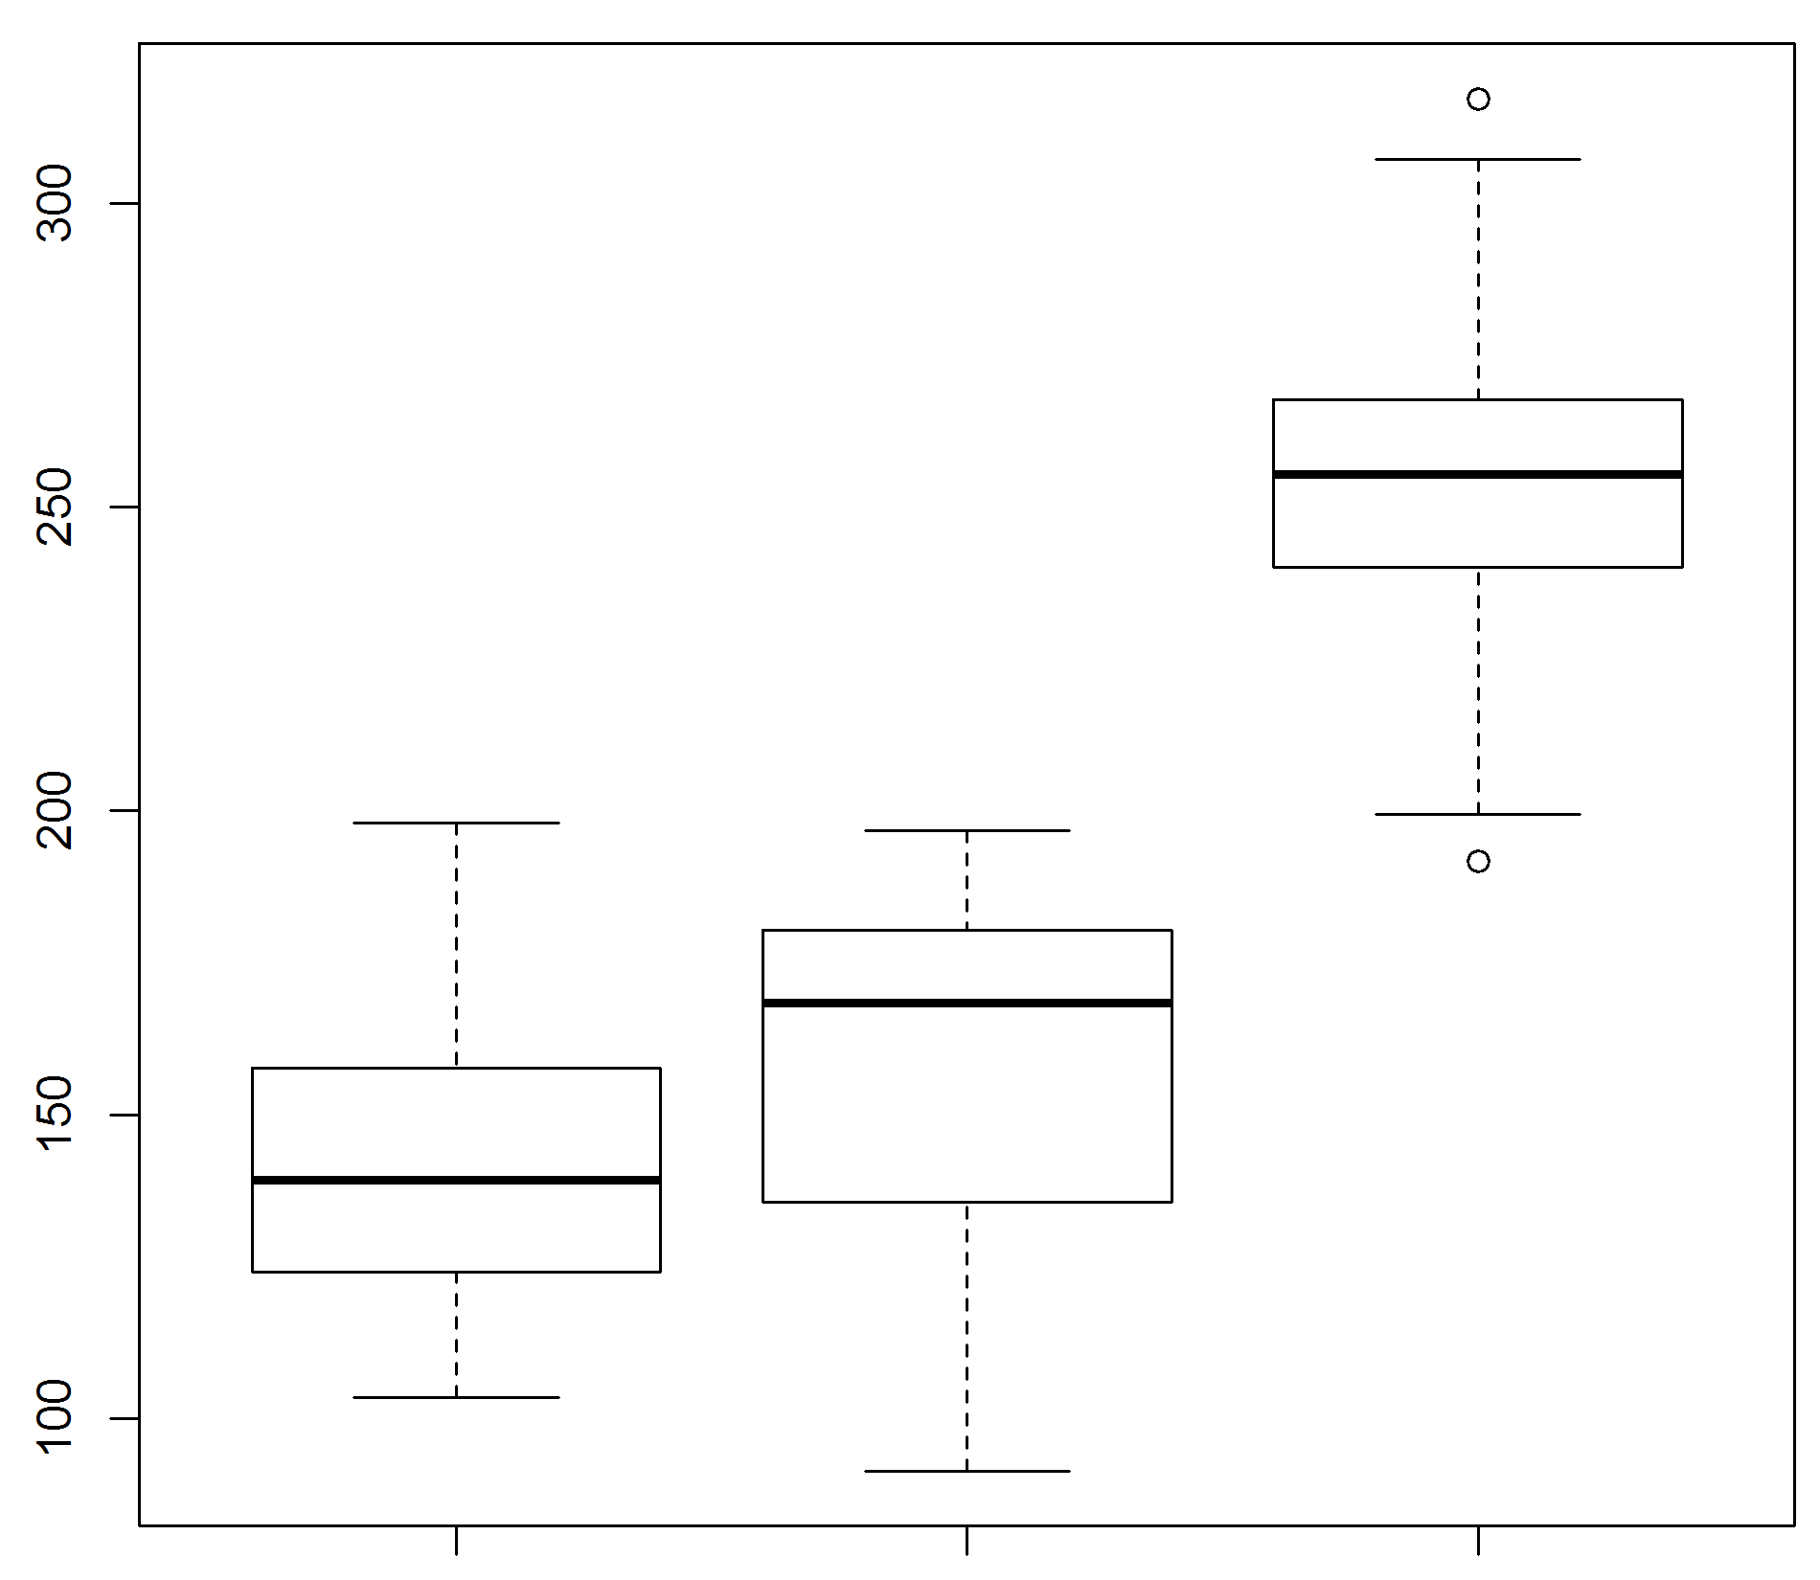
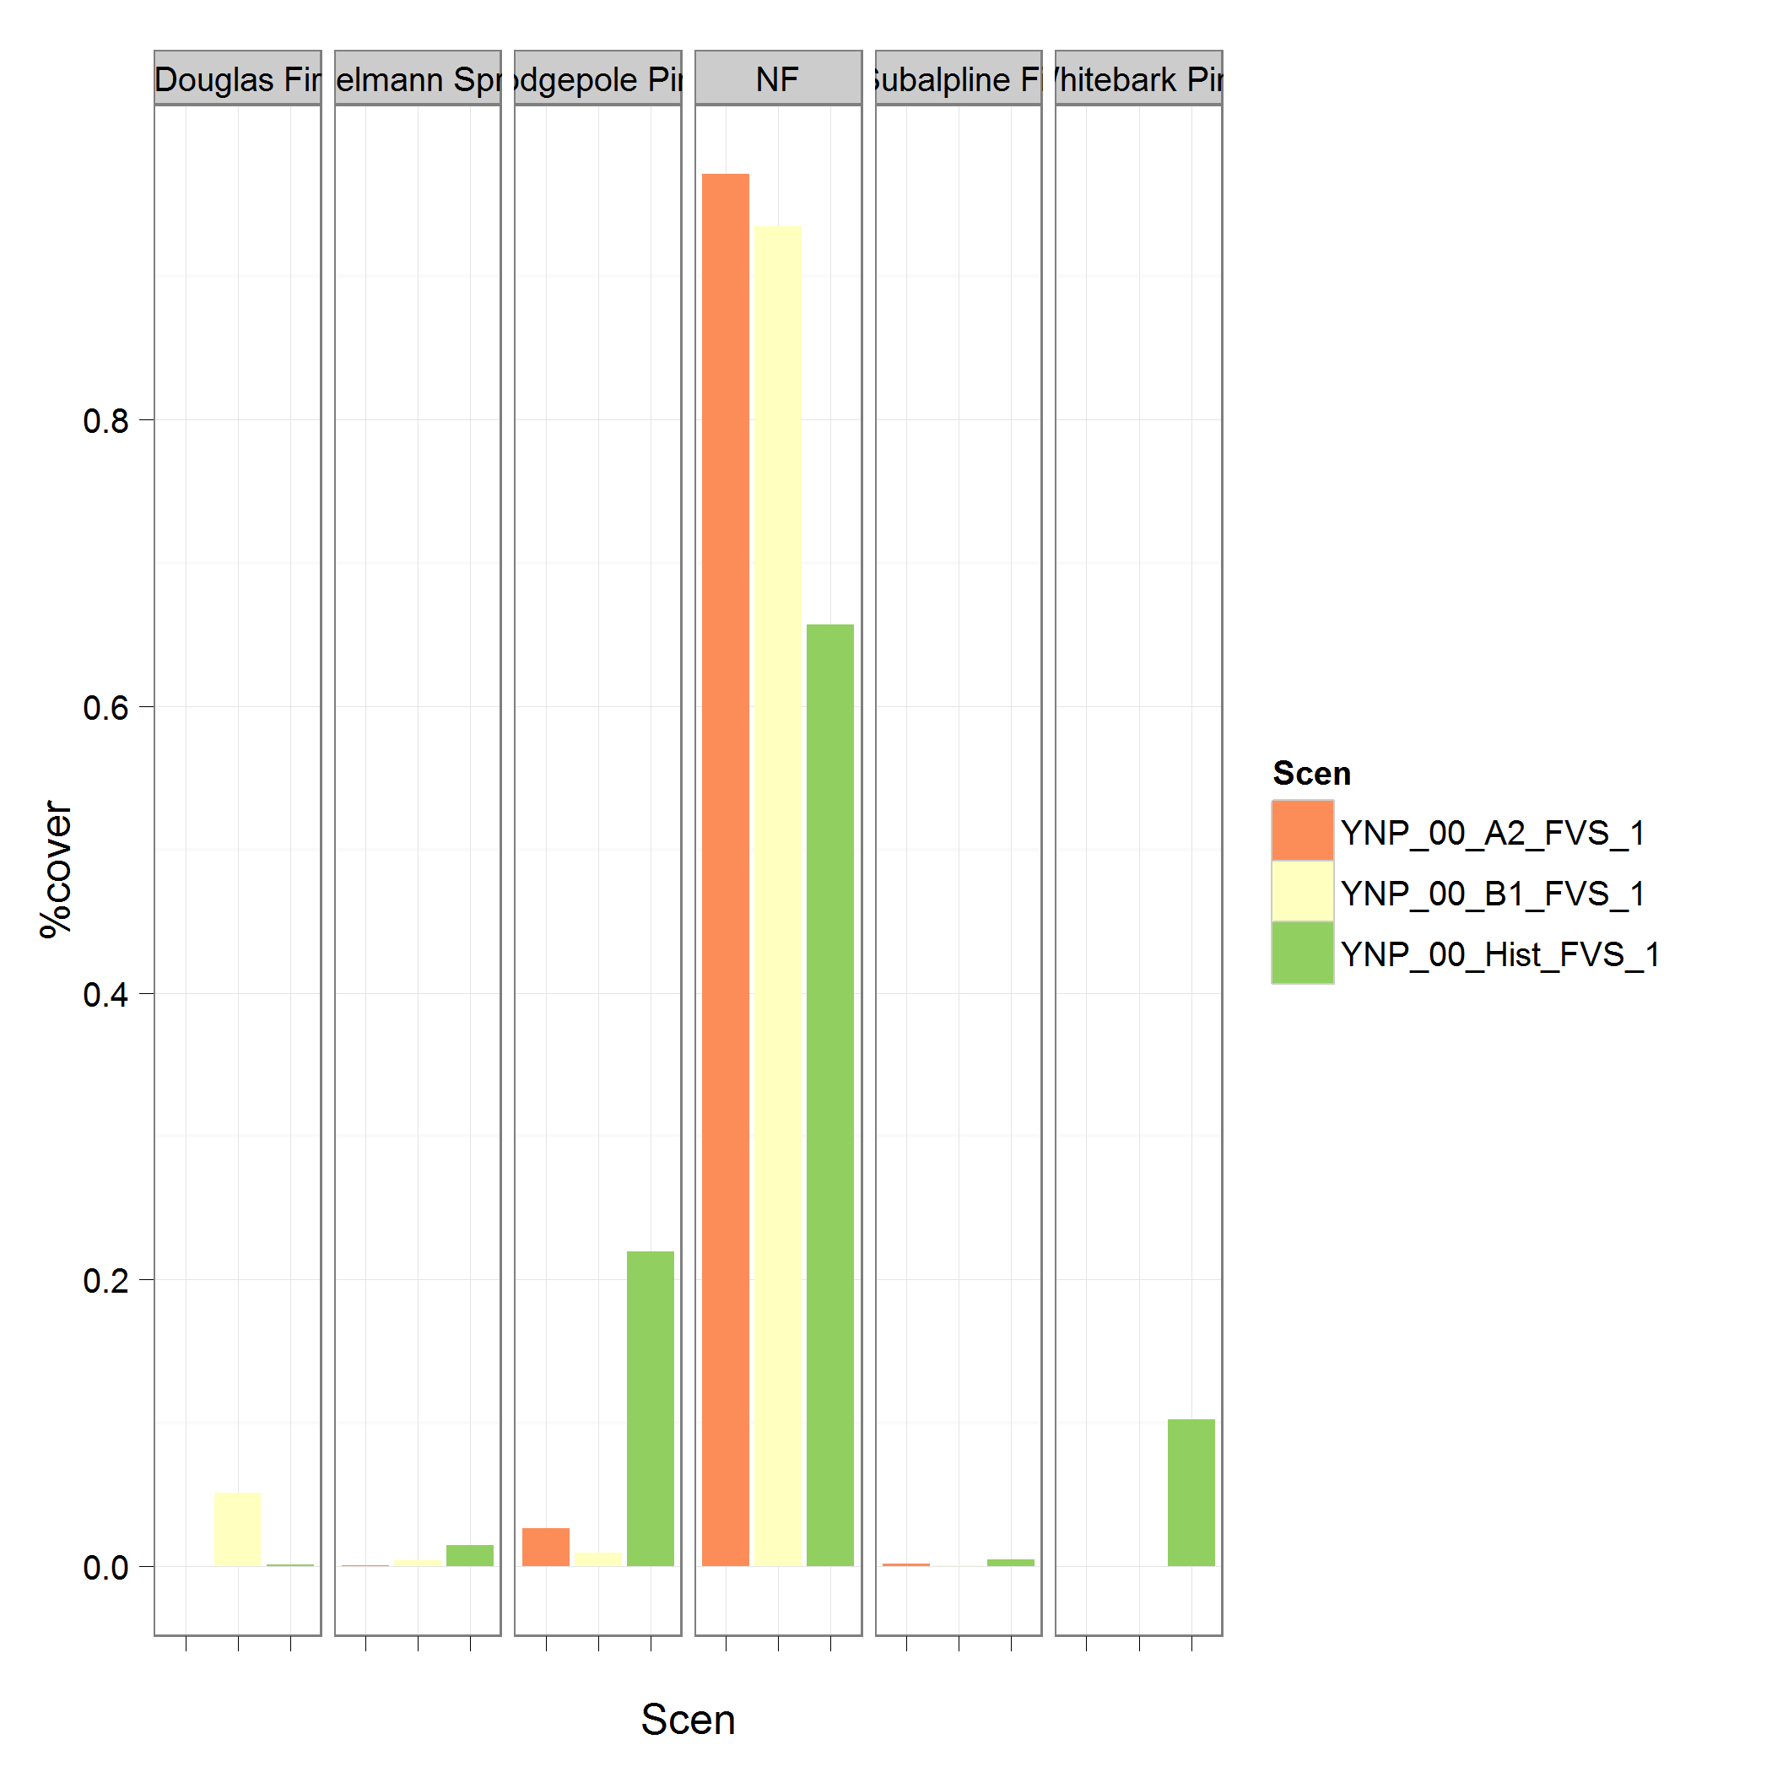
Climate + Fire
Same Forest
Same Forest
Fire Adapted
Same Forest
Same Forest
Stand Age
Same Forest
Percent Cover
Same Forest
New Forest
Grass
Fire Adapted
Current Forest
New Forest
A2
Fire Adapted
Sage
B1
New Forest
Grass
Current Forest
New Forest
Grass
Historic
Fire Adapted
Sage
Grass
Sage
Grass
Grass
Grass
Grass
Sage
Sage
A2
B1
Historic
All Fires | Historical | B1 | A2
Fire Rotation | 320 y | 150 y | 120 y
Mean Annual Area Burned | 483 ha | 853 ha | 1328 ha
Douglas-fir
Non-Forest
Lodgepole Pine
Subalpine Fir
Engelmann Spruce
Whitebark Pine
Notes:
Effect of climate on vegetation and fire, present 00 results, also present age distribution box plots.

Slide 30
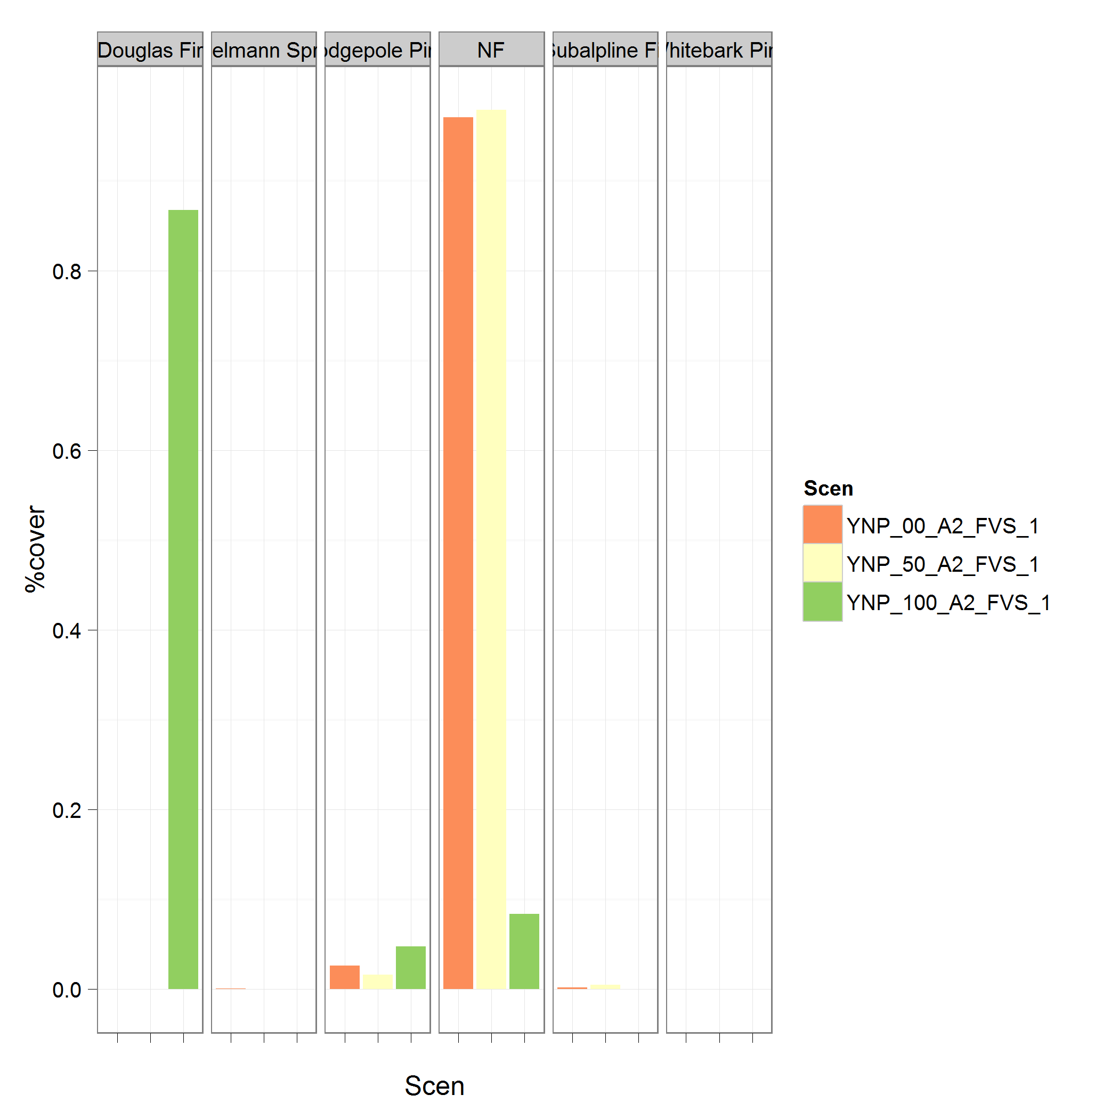
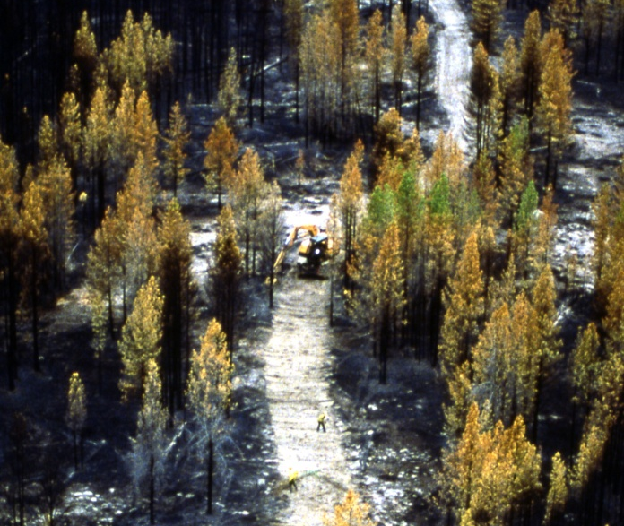
Management
Same Forest
Same Forest
Fire Adapted
Same Forest
Percent Cover
Same Forest
New Forest
Grass
Fire Adapted
Current Forest
New Forest
0% Suppression
Fire Adapted
Sage
New Forest
Grass
50%
Grass
Current Forest
New Forest
New Forest
Grass
100%
Fire Adapted
Sage
Fire Adapted
Sage
Grass
Sage
Grass
Grass
Sage
50% Suppress. | Historical | B1 | A2
Fire Rotation | 320 y | 170 y | 302 y
Mean Annual Area Burned | 483 ha | 955 ha | 491 ha
Douglas-fir
Non-Forest
Lodgepole Pine
Subalpine Fir
Engelmann Spruce
Whitebark Pine
Photo: US NPS
Notes:
Suppression on veg, present contrast of 50% or 98 with 00 results, just table.

Slide 31
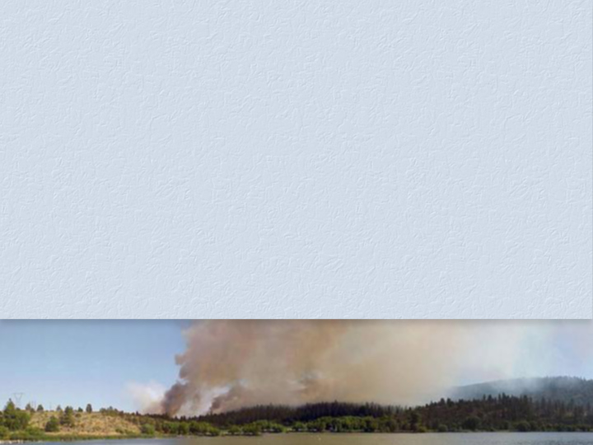
FireBGCv2 Limitations
Difficult to parameterize
Difficult to initialize
Long execution times (20-50 hours)
Extensive memory requirements (>7 GB)
Abundant output
Difficult to understand and use
Long training time
Not really a management model

Slide 32
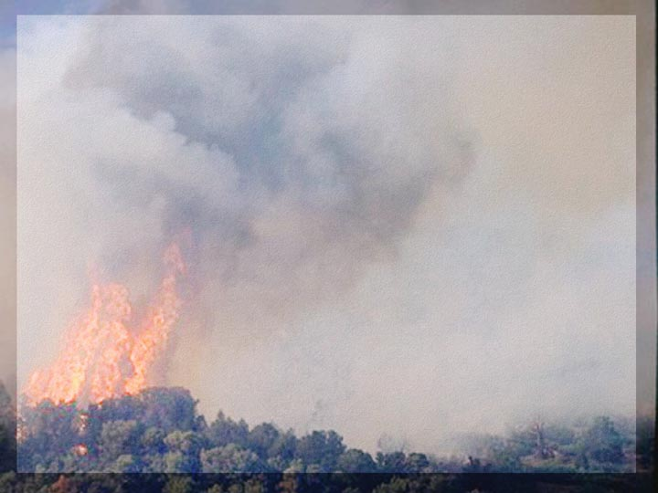
FireBGCv2 Advantages
One of the most comprehensive landscape models available
Highly complex, non-linear behaviors
Fire-climate-vegetation linkage
Runs on any computer
Extensive documentation
Code available
Flexible structure

Slide 33

Final FireBGCv2 Information
Coded in C programming language
Compiles on any platform
Web site:
http://www.firelab.org/research-projects/fire-ecology/139-firebgc
Implemented for 14 landscapes
Used in over 15 projects…

